Slide 1
High Altitude Aeronautical Platform Stations (HAAPS)
ANUKALP BHARDWAJ
Electronics and communication engineering
Madan Mohan Malaviya University of Technology Gorakhpur (UP State Govt. University)
Email: 2020041039@mmmut.ac.in
Notes:
1

Slide 2
Table of Content
What is HAAPS?.
History of HAAP.
Satellite Systems.
Altitude selection for HAAPS.
Why at Stratosphere?
Various HAAPS Projects
Applications.
Advantages.
HAAP Issues
Summary and Conclusion.
References.

Slide 3
What is HAAPS?
High Altitude Aeronautical Platform Stations (HAAPS) is new age technology for providing wireless narrowband and broadband telecommunication services
They also provide broadcasting services with airships or aircrafts.
HAAPS operate at altitudes between 17 to 22 km and area upto 1,000 km diameter.
The platforms may be airplanes, airships ,balloons and may be manned or un-manned running on fuel or solar power.

Slide 4
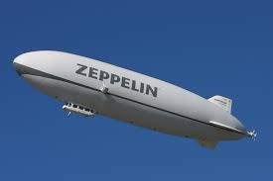
History of HAAP
The idea of airships dates back to the first world war.
Zeppelin , a rigid airship 128 metre long made with two external cars ,each of 16 horsepower engine geared to two external propellers.
Zeppelin was made by a retired German officer ,this airship could travel at 20 miles per hour , for 100 hours at higher altitude than the planes available at that time.
Fig.1 ZEPPELIN

Slide 5
Contd..
In 1990s and 2000s several projects were launched by USA and JAPAN to explore the potential application of high altitude platform for telecommunication and remote sensing.
Project Loon started the objective to create network of stratospheric balloons to provide Internet access in remote areas .
For example in 2016 following an agreement with the government
Google started internet services within Sri Lanka and Puerto Rico

Slide 6
Satellite Systems
Geostationary Orbits (GEO): These satellites are located at 35,000 km above the equator moving at a speed matched to the rotation of earth.
They appear to be fixed to the observer on the ground.
They are established to operate for both satellite television broadcast and fixed connectivity services.
They are not efficient compare to terrestrial systems and inappropriate for delay sensitive devices.
They can work with low cost receivers and do not depend on costly tracking devices.

Slide 7
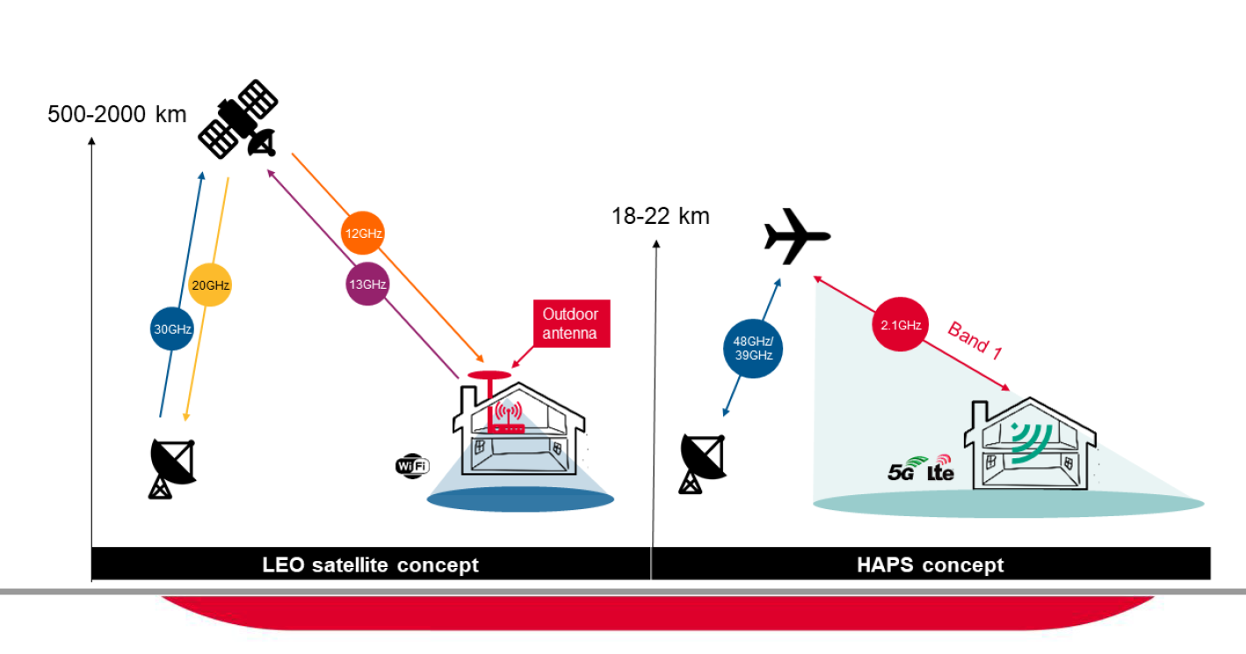
Low and Medium Earth Orbits (LEO and MEO)
These satellite systems move relative to a fixed point on earth at altitude of 2000 km range
Due to lower orbits the beams of low orbit satellites are more focused
Fig.2.a LEO Satellite concept
Fig.2.b HAPS concept

Slide 8
Comparison with satellites
It combines most of the advantages of satellite and terrestrial systems while avoiding many of the pitfalls.
Since HAPs operate at much lower altitudes than satellites, it is possible to cover a small region much more effectively.
Lower altitude also means smaller round trip delay compared to satellites.
HAPs, do not cost much and are rapidly deployable.
Another major difference is that a satellite, once launched, does not allow for full maintenance, while HAPs do.

Slide 9
Altitude selection for HAAPS
For an airship, a major challenge is the ability of the HAP to maintain station keeping in the face of winds.
An operating altitude between 17 and 22 km is chosen this purpose
This represents a layer of relatively mild wind and turbulence above the jet stream
This altitude (> 17 km) is also above commercial air-traffic heights, which would otherwise prove a potentially prohibitive constraint

Slide 10
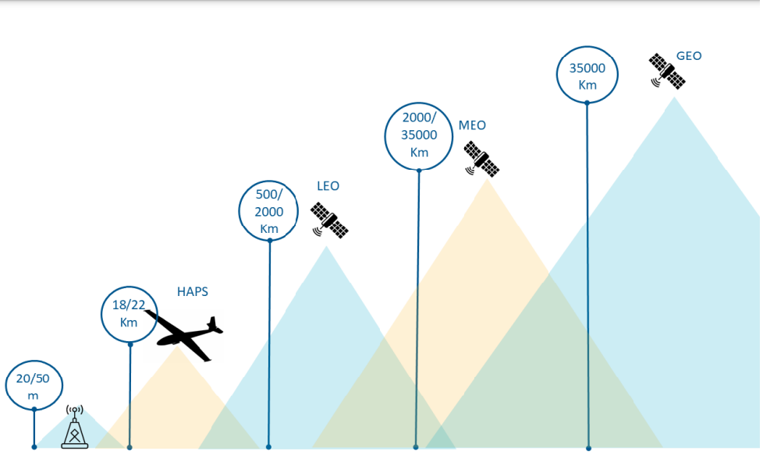
Why at Stratosphere?
Above Aircraft routes.
Winds are relatively mild here , depending on the location and season.

Slide 11
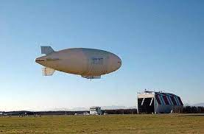
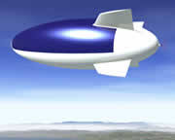
Various HAAPS Projects
Stratospheric Platform System from Japan
Rigid & ellipsoidal shape structure
Helium filled bag and air ballonets
Use solar cells to supply electricity
StratSat(developed by UK based ATG)
Solar array is the main energy source
Array extends over ¾ th of the airship
Fig.3.a Stratospheric Platform System
Fig.3.b StratSat

Slide 12
Applications
For high-speed wireless communications.
For surveillance and intelligence gathering.
For real-time monitoring of a region.
For weather/environmental monitoring .

Slide 13
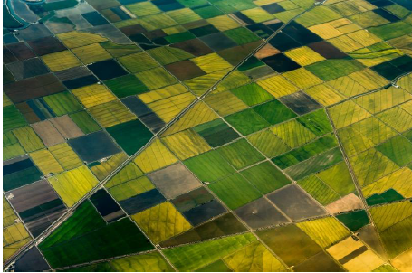
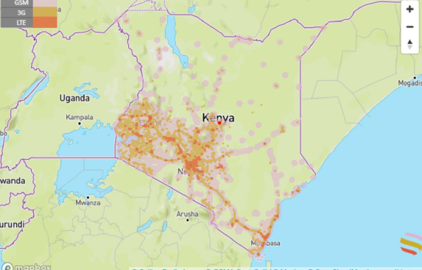
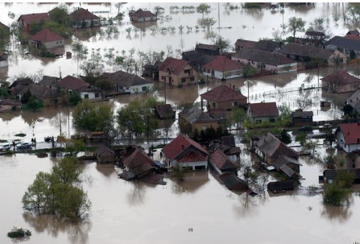
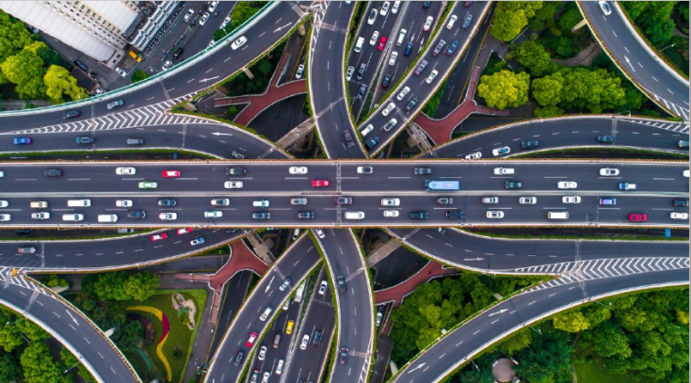
Fig.4.a Green field coverage
Fig.4.b White Spot
Fig.4.c Disaster recovery
Fig.4.d Internet of things

Slide 14
Advantages
No launch vehicle required, can move throughout the world or remain stationary .
Immediate service without the need to deploy a global infrastructure.
Low altitudes provide a higher frequency reuse and thus higher capacity than satellite.
The low launching costs and repair facility of platforms.
Each platform can be updated without services interruption.
Solar powered and non-polluting fuel cells.

Slide 15
HAAP Issues
Lightweight.
Strength of the ENGINE.
WIND Factor.
Thermal management.
Operation at low latitude.

Slide 16
Summary and Conclusion
HAAPS will play a complementary role in future mobile system infrastructure.
They would generally be more accessible for repairs and upgrades than satellites.
They have huge scope in telecommunication market.
Several projects have been initiated in past but got terminated.
From 2013 major companies have again shown their interest in this field and hopefully it will prosper in coming days.

Slide 17
References
High-altitude drones. Center for the Study of the Drone Arthur B, Michel H (published in December 2015) ,45(5), 245-251, page 248 .
Amos J (2010) ‘Eternal plane’ returns to Earth. BBC News; Androulakakis SP, Judy RA (2013), 35(5),181-189 ,page 186.
Status and plans of High Altitude Airship (HAA) Program. Proceedings of the AIAA Lighter-Than-Air Systems Technology (LTA) Conference; Dayton Beach, USA , 37(7),231-290, page 247.
Defense Advanced Research Projects Agency (2009) Vulture II Special Notice. DARPA-SN-09-41 published on 2015 Dec ,131-136, page 133 .
European Space Agency (2006) Stratospheric platforms — a definition study for an ESA system [accessed 2015 Dec 04] , 171-181, page 176.

Slide 18

THANK YOU

