Slide 1
UI &UX
Presentation by :
R.a. karthika
BSC.AIML/13

Slide 2
INTRODUCTION :
UIUX design is the building the visual look and the overall feel or functionality of a digital product like website or app.

Slide 3
What is UI?
1 . UI =User interfaces
2. The visual interactive part of a digital product.
INCLUDES:
* Colors
* Fonts
* Buttons
* Icons
* Layout
* Menus

Slide 4
Example for UI :
EXAMPLE :
"AMAZON APP"
* Search bar
* Product image
* Buttons
* Navigation menu
* colors, layout and page.

Slide 5
What is UX ?
1.UX = User Experience
2.Focuses on how easily and comfortably users can use a product.
INCLUDES :
*Usability
* Navigation
* Accessibility

Slide 6
Example for UX:
EXAMPLE:
"AMAZON"
*simple search
*product details
*checkout

Slide 7
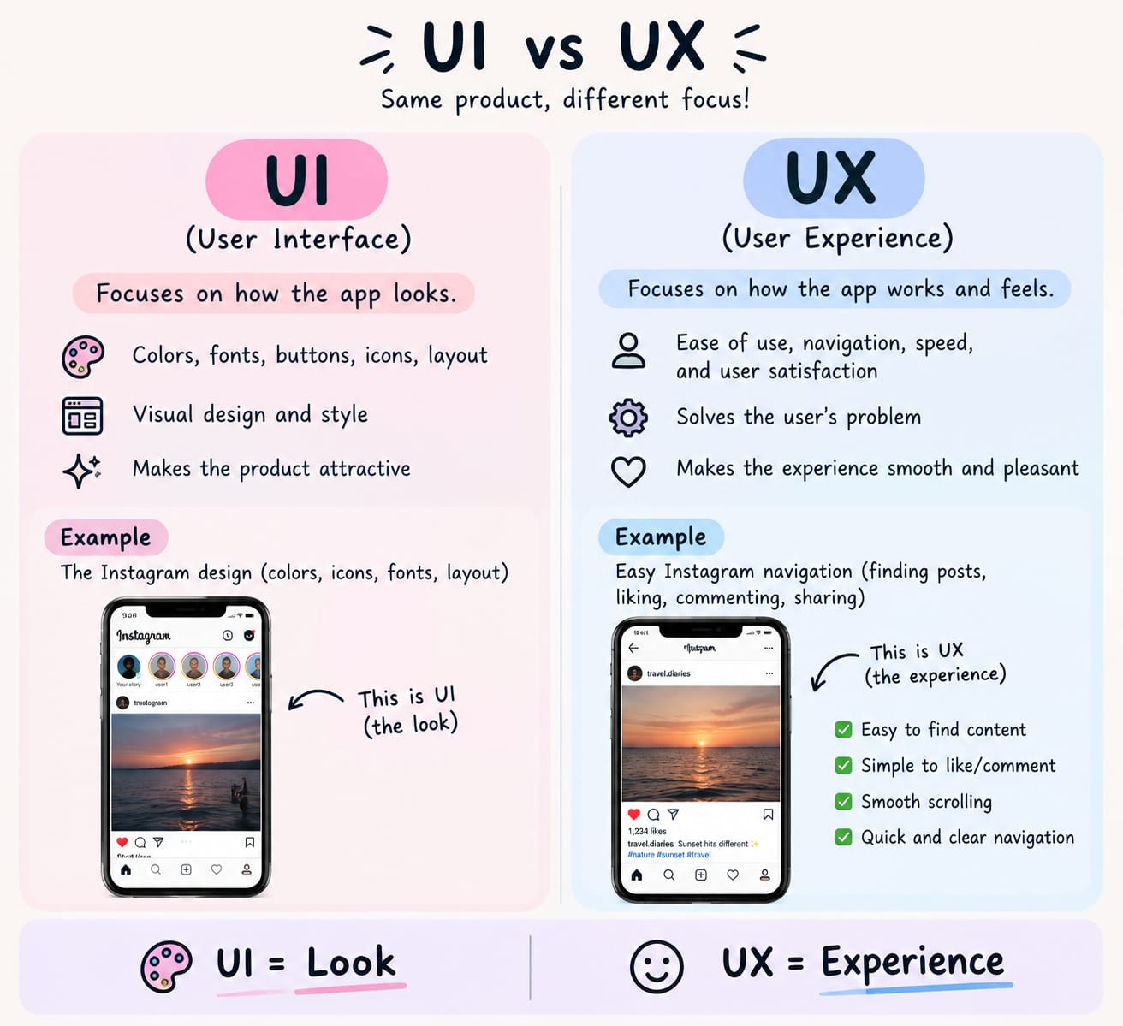
DIFFERENCE OF UI &UX:

Slide 8
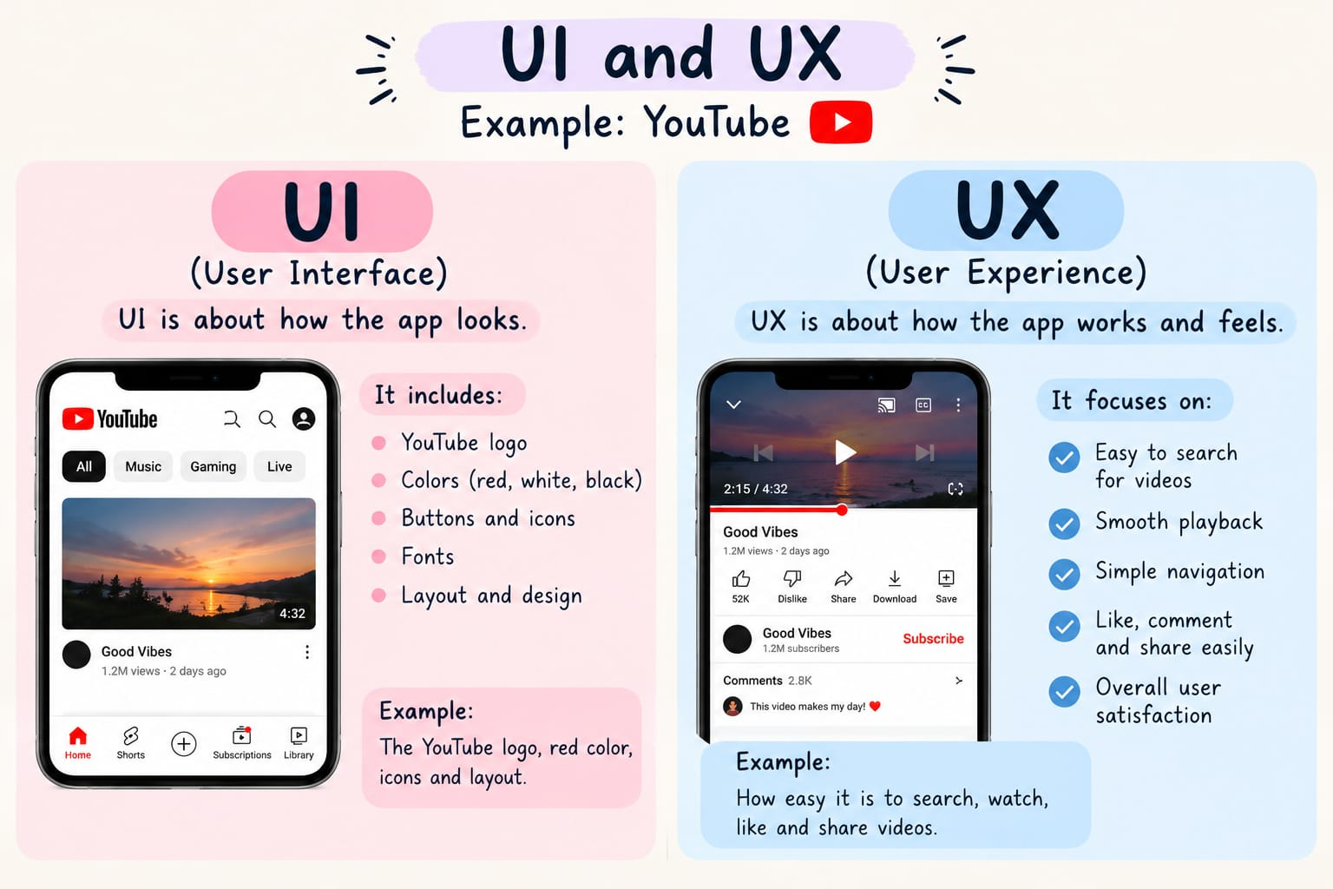
UI & UX EXAMPLE :

Slide 9


