Slide 1
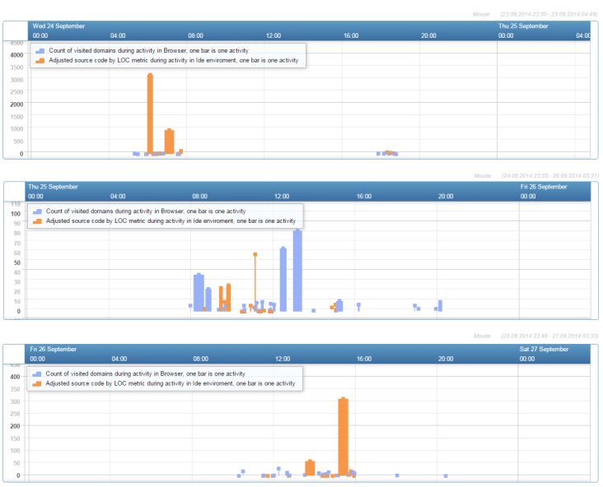







Interactive Visualization of Developer’s Actions
Lukáš Sekerák
IVDA
Supervisor:
Alena Kovárová
What is IVDA?
web-based tool to view the development process from the perspective of particular steps of a developer
visualization of developers’ actions and their behavior
What information is visualized?
it can show what developers did and what they are doing
duration of activities, custom metrics (per environment, context)
visited domains / edited files / source code adjustments
Who is IVDA user?
manager, scientists
How can it help the user?
the user can spot a bad behavior, can see visited domains, which are not relevant to a project.
the user can find answer on hypothesis related to software development.
How data was captured? What is main source of data?
Project PerConIK log developers’ work as set of actions
What are the main features?
simple and easy user environment
explorative analysis tool
10 interactive graphs, histograms, etc.
How did we evaluate our solution?
by Gutwin’s elements, usability testing, comparison of features
Where can you try this tool?
http://ivda.eu
Searching for relevant information (metadata)
Logging
Logged data
2. Verifi-cation
Reformulation
Accepted
1. Visuali-sation
Assumption
Important information
Success rate of tasks TC1-TC10 completion in IVDA and ManicTime (%)
Technologies used:
Data stream
3. Stream reasoning
Logged metadata
Exploratory analysis of logged data involving hypothesis formation based on visualisation
Number of visited domains vs. with number of edited lines (developer “Mouse”), cumulated per continuous activity; three subsequent days
This work was supported by the Research and Development Operational Programme for the project Research of methods for acquisition, analysis and personalized conveying of information and knowledge, ITMS 26240220039, co-funded by the ERDF. This work was also partially supported by the Scientific Grant Agency of Slovak Republic, grant No. VG 1/0752/14. Detailed results will be published in Acta Polytechnica Hungarica

