Slide 1
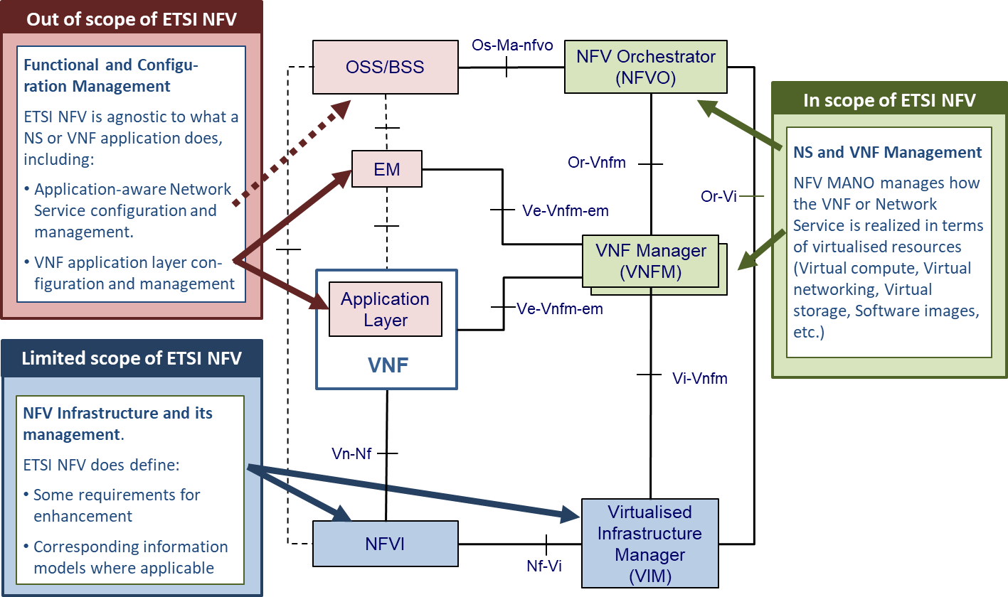
CNTT | Relation to ETSI
NFV Architectural Framework (NFV002) defines several building blocks, of which not all are described in NFV documents.
NFV documents focus on Mangement and Orchestration (NFV-MANO).
This creates some difficulty for operators who want to deploy networks using NFV.
Compatibility at reference points which are not standardized in NFV
High number of variants for functional blocks not defined by NFV, e.g. NFVI
CNTT is a community-driven activity try to address these painpoints.

