Slide 1
CNTT Technology WG
GitHub Contribution guidelines

Slide 2
CNTT Technology WG | GitHub – important links
GitHub CNTT repository: https://github.com/cntt-n/CNTT
GitHub CNTT Web: https://cntt-n.github.io/CNTT/
GitHub Guidelines: https://guides.github.com/
Mastering Markdown: https://guides.github.com/features/mastering-markdown/

Slide 3
CNTT Technology WG | GitHub
You can always use third party software tools to manage Github repository or to make a commit, pull request, or add a comment.
You can also use a dedicated Editor for Markdown
These slides are guidelines to use the GitHub web interface.

Slide 4


CNTT Technology WG | GitHub basics
For easier interaction with GitHub, it is important to understand the basics of Github and how we are planning to use it.
cntt-n/CNTT master
Diff
Pull Request
Fork
user
Local branch
Modified branch
Local branch
Edits & Commits

Slide 5
CNTT Technology WG | Contribution Modes
Any update to master will need Pull Request to push changes from local branch into master branch, this can be done by two ways:
Editing a file directly form cntt-n/CNTT repository’s master branch and commit changes will allow you to create Pull Request.
This will also create a local branch (forked form master) in your account
Master can be manually forked, changes can be made to your account local branch and a Pull Request can be created manually (by diffing local branch against cntt-n/cntt master).
This is needed to upload files (such as images) and easier for bulk changes.

Slide 6
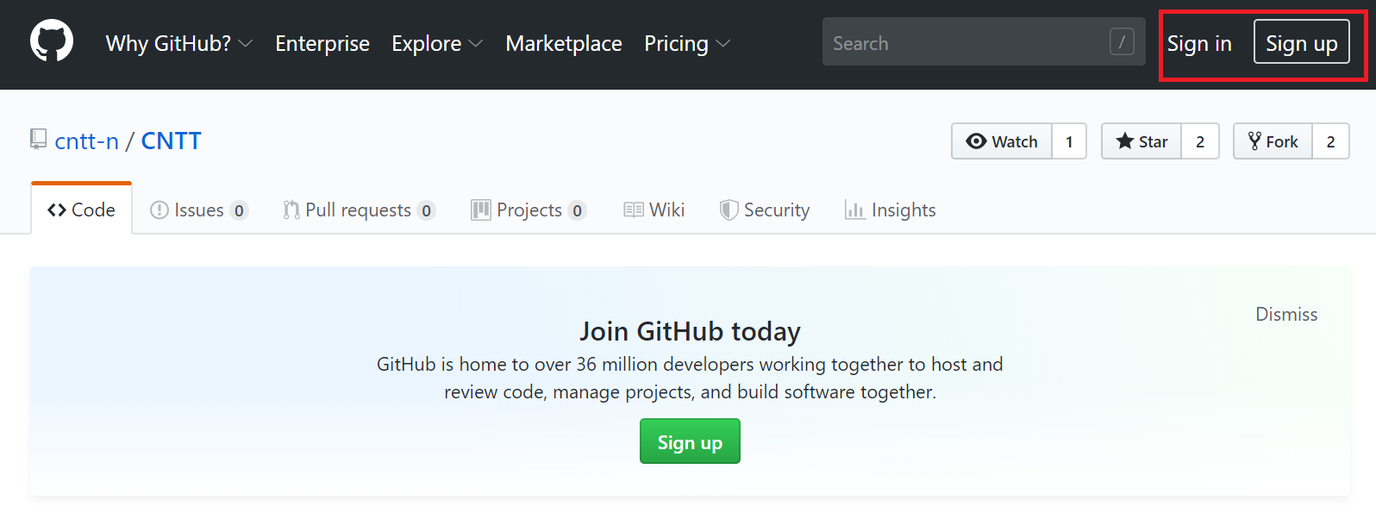
CNTT Technology WG | GitHub – Editing a file for a new commit.
1
Navigate to https://github.com/cntt-n/CNTT
2
Login (or signup if you don’t have an account (it will take 1 minute)

Slide 7
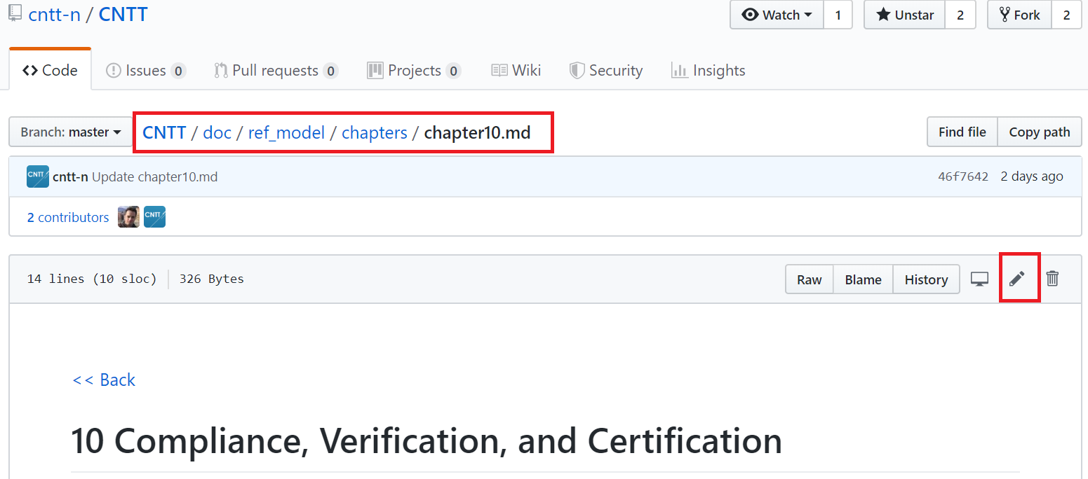
CNTT Technology WG | GitHub – Editing a file for a new commit.
3
Navigate to file of interest and click edit symbol

Slide 8
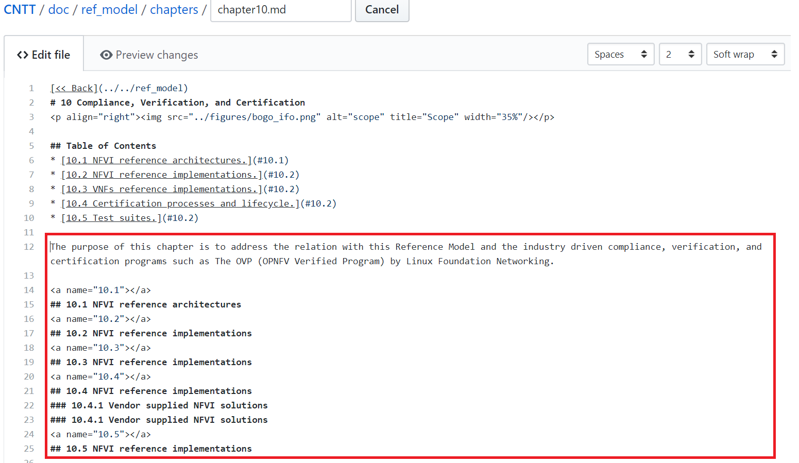
CNTT Technology WG | GitHub – Editing a file for a new commit.
4
Add your Changes in Markdown format.

Slide 9
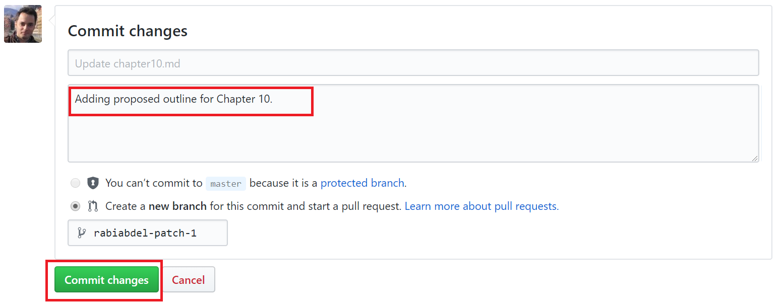
CNTT Technology WG | GitHub – Editing a file for a new commit.
5
Add your Commit message.
6
Click Commit Changes (or propose file change).

Slide 10
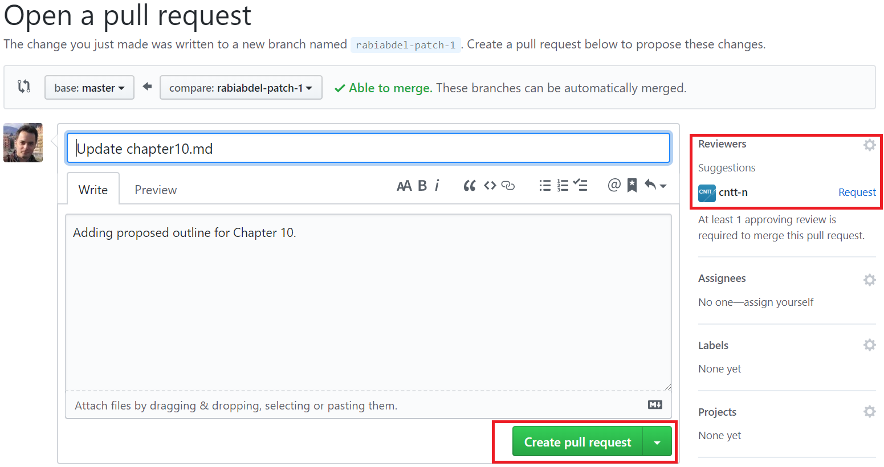
CNTT Technology WG | GitHub – Create Pull Request.
7
Create Pull Request for review.

Slide 11
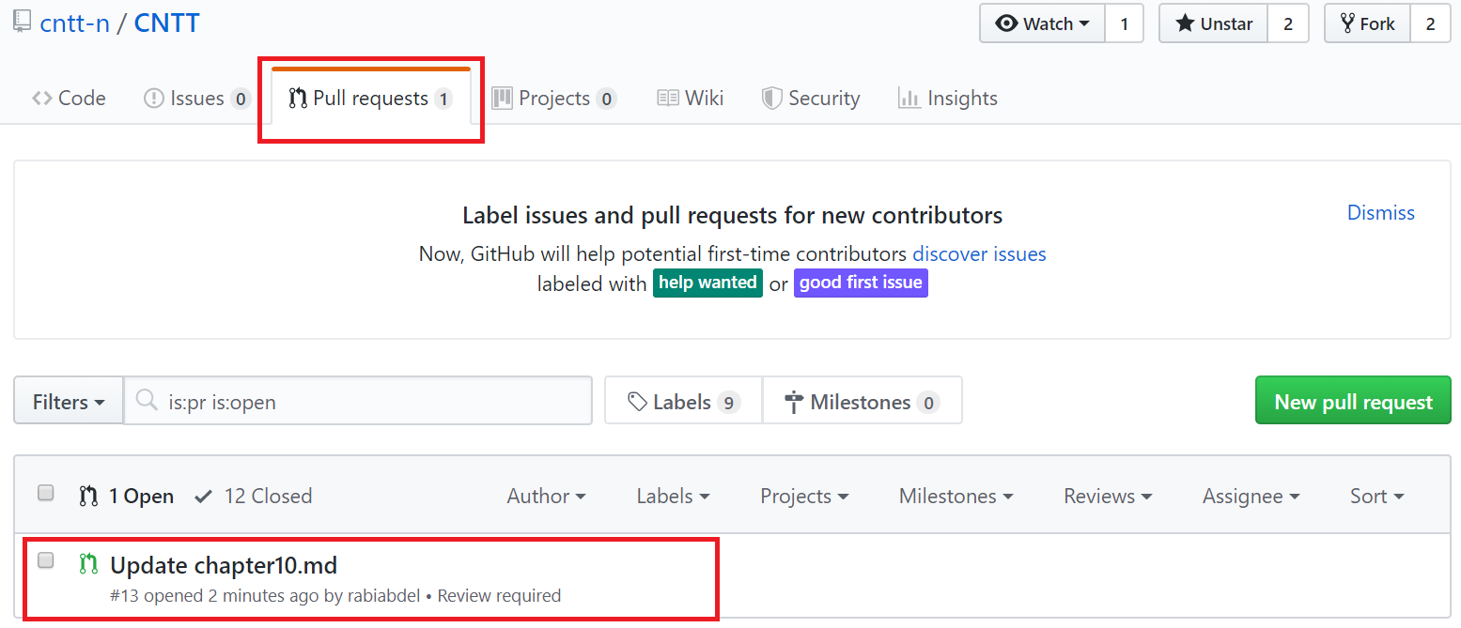
CNTT Technology WG | GitHub – Wait for Comments/Approvals
8
At any time, Check any open Pull Requests for comments and status.

Slide 12
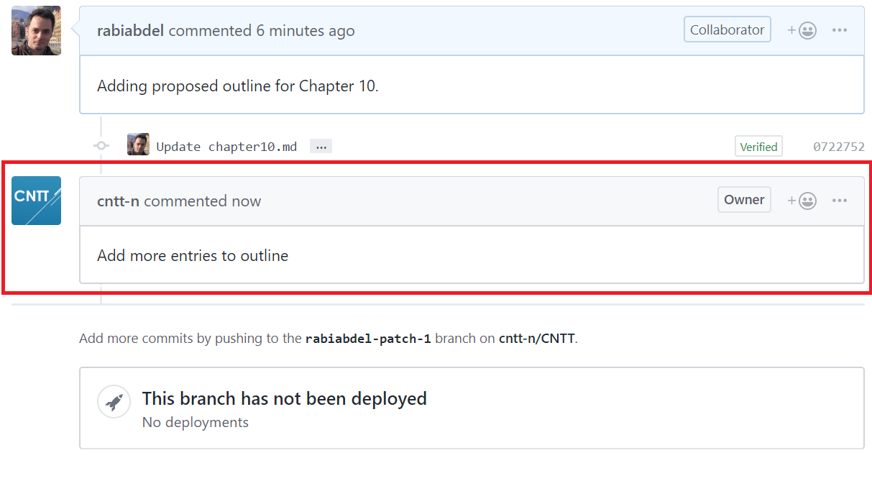
CNTT Technology WG | GitHub – Receive/Reply to Comments
9
Receive Comments from others.

Slide 13
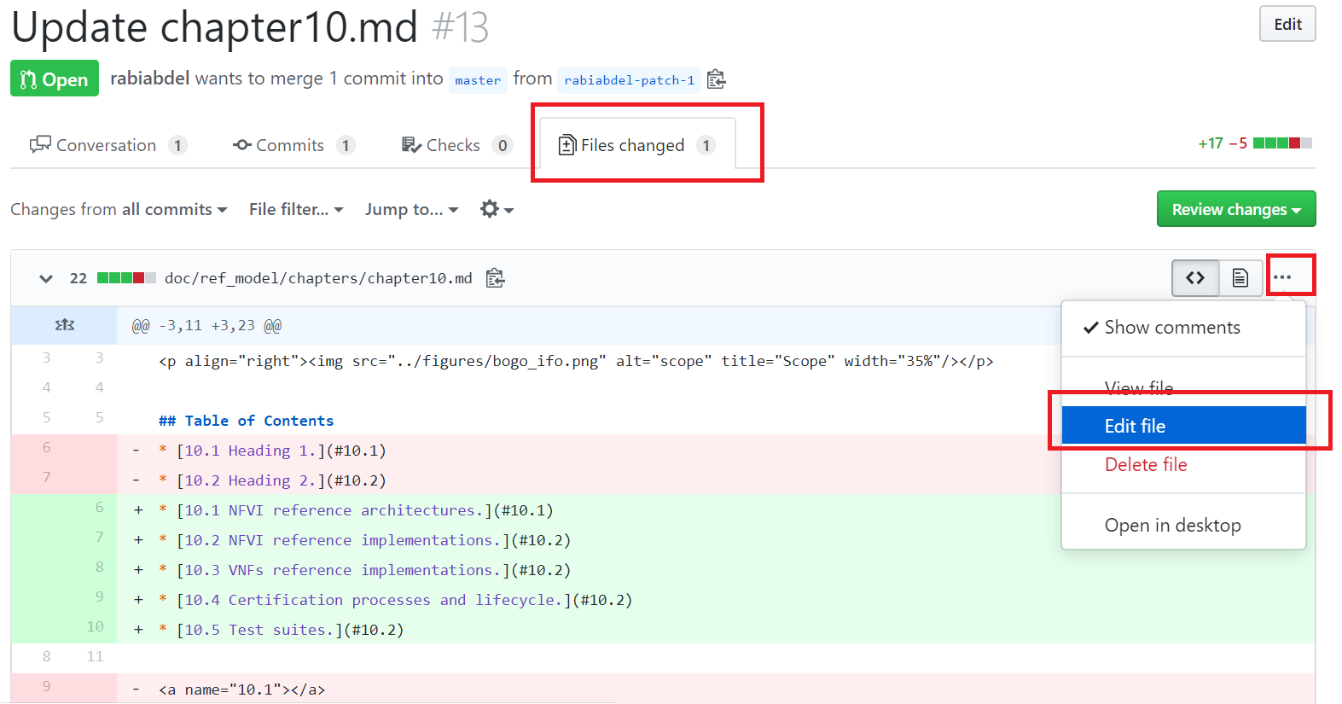
CNTT Technology WG | GitHub – Update Pull Request
10
Make necessary changes for Pull Request (as a new commit).

Slide 14
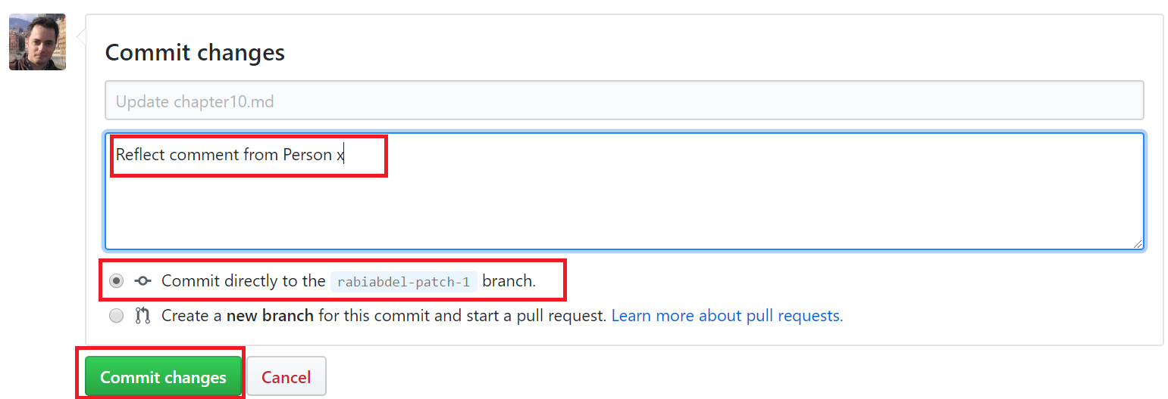
CNTT Technology WG | GitHub – commit new changes
11
Commit new Changes to same branch (associated with Pull Request).

Slide 15
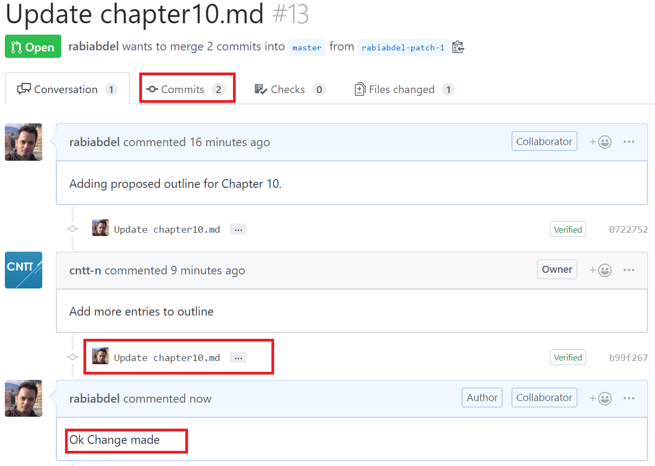
CNTT Technology WG | GitHub – Address All comments
12
You can add as many commits as needed (to reflect comments from team)

Slide 16
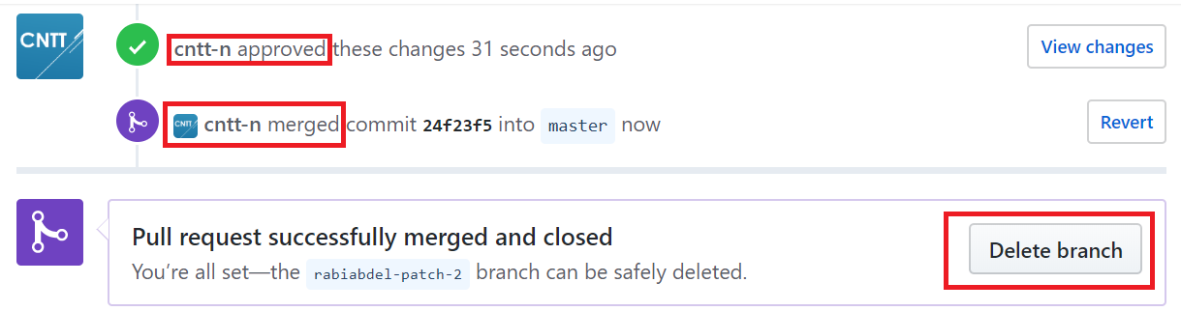
CNTT Technology WG | Merge & Clean-ups
13
Pull Request will be Approved and Merged into Master .
14
You can now delete your account local branch once approved & merged (optional).

Slide 17
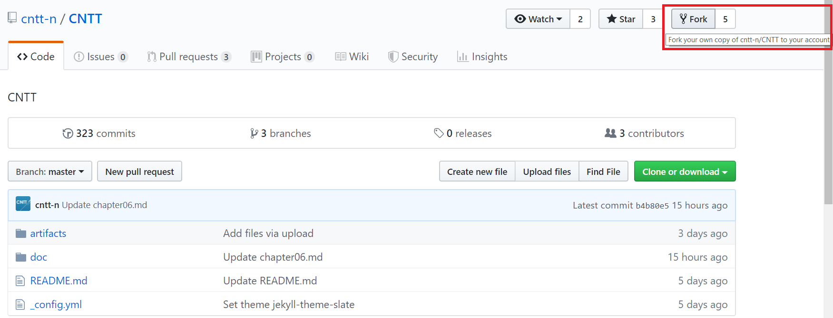
CNTT Technology WG | Upload an image file
15
Fork CNTT master into your own account, by clicking on fork (if you don’t already have a local branch).

Slide 18
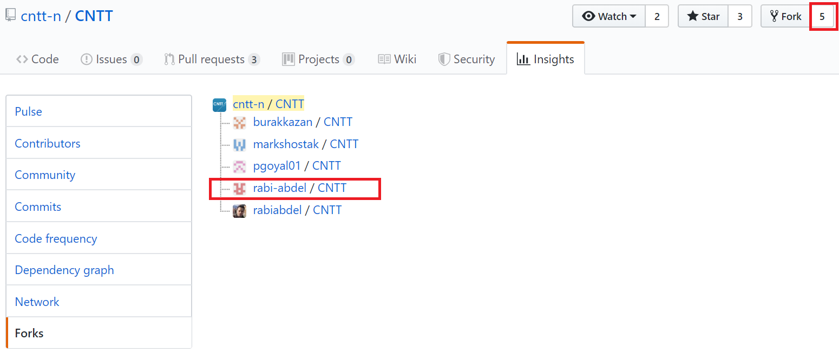
CNTT Technology WG | Upload an image file 2
16
Check if you already have a local branch into your account and navigate to your own branch.

Slide 19
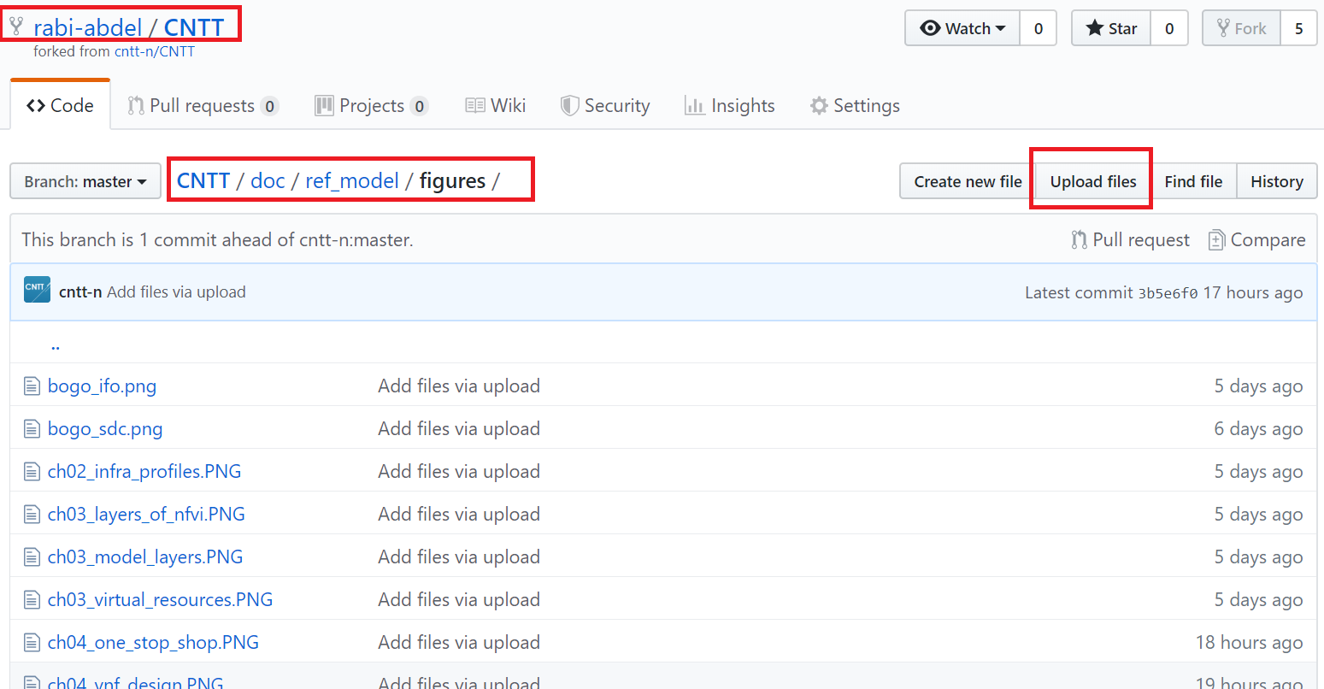
CNTT Technology WG | Upload an image file - 3
17
Navigate to figures directory within your own branch and upload your file in there.

Slide 20
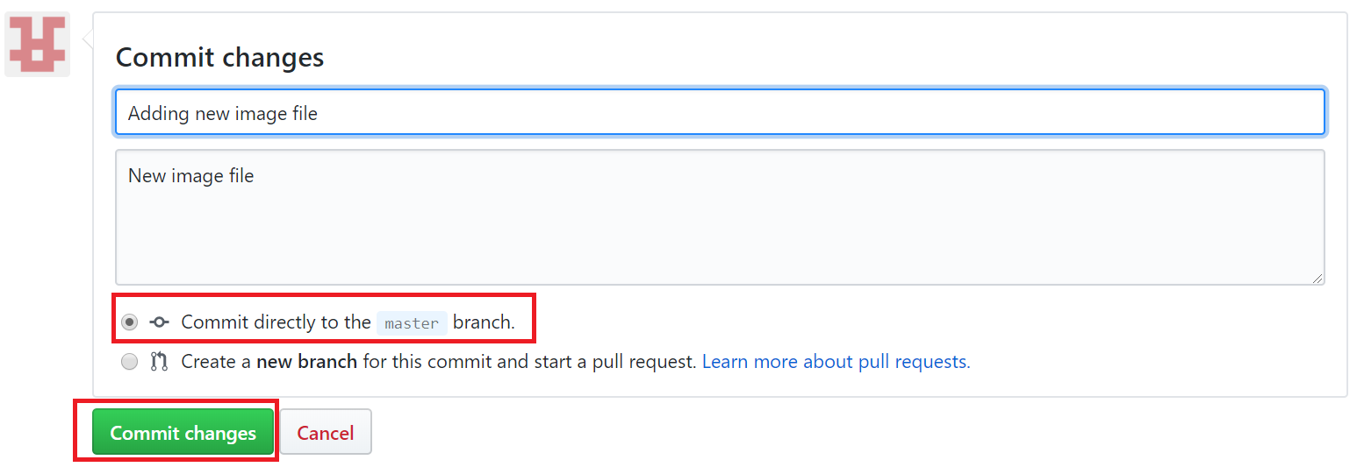
CNTT Technology WG | Upload an image file - 4
18
Commit file directly into master branch (within your own branch).

Slide 21
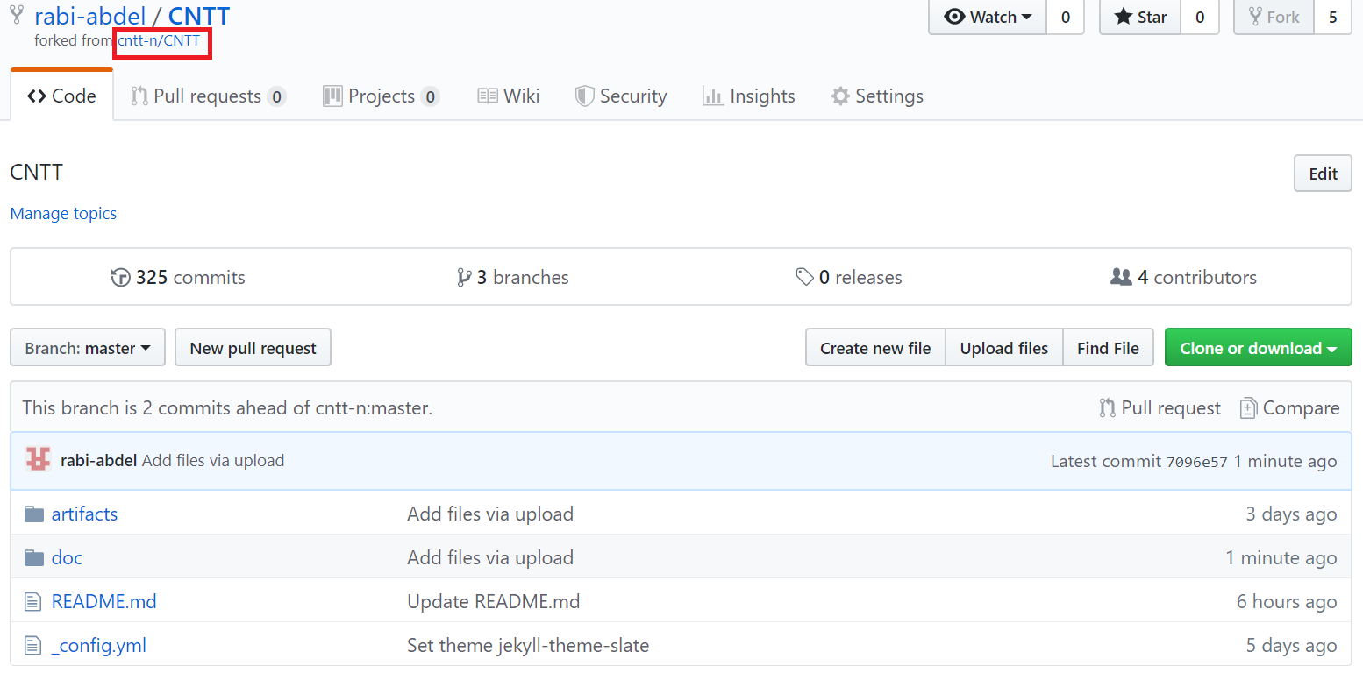
CNTT Technology WG | Upload an image file - 5
19
Navigate Back to cntt-n/CNTT repository. By clicking on cntt-n/cntt

Slide 22
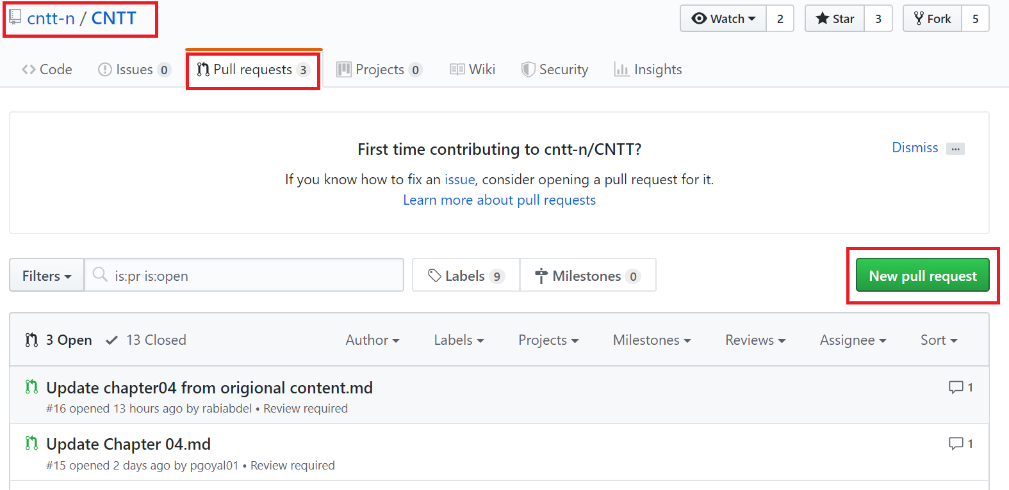
CNTT Technology WG | Upload an image file - 6
20
Manually Create a Pull Request

Slide 23
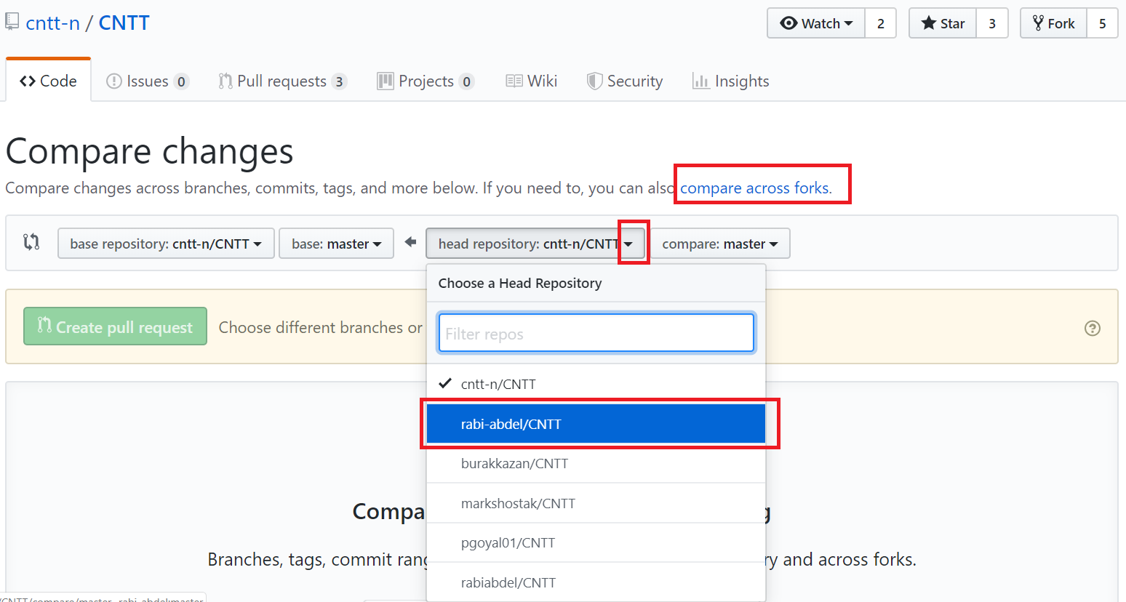
CNTT Technology WG | Upload an image file - 7
21
Compare Changes to create Pull Request (use “compare across forks” option)

Slide 24
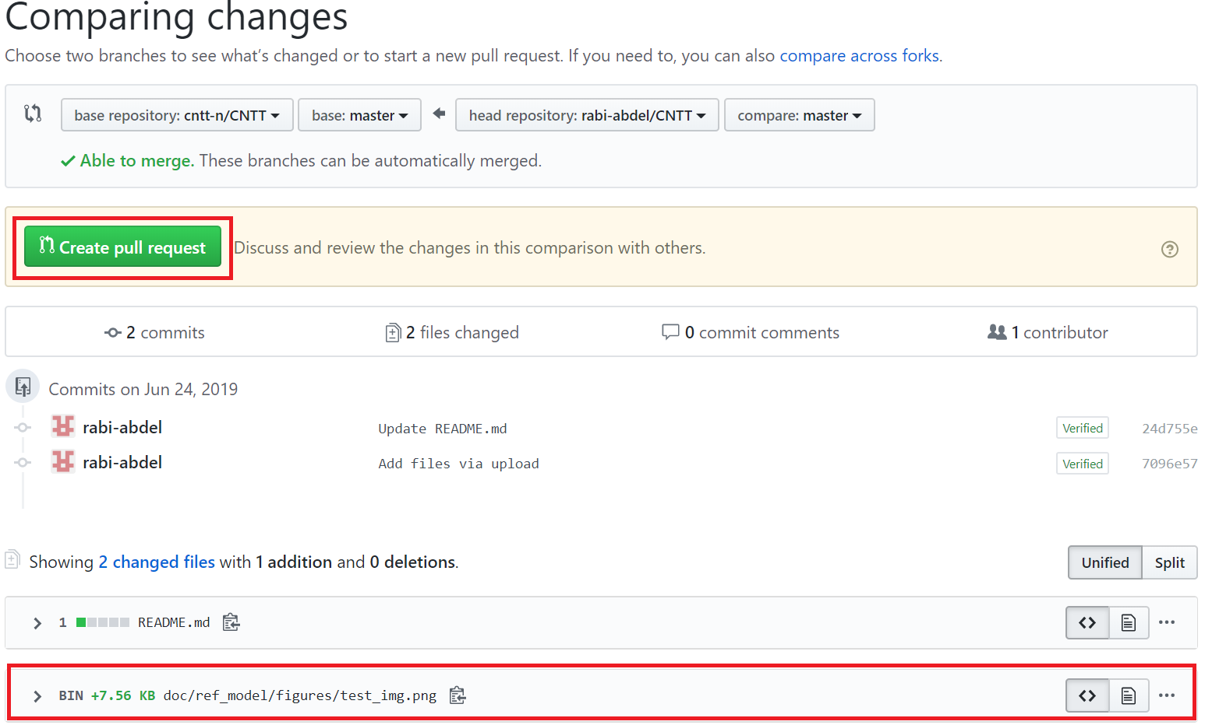
CNTT Technology WG | Upload an image file - 8
22
Crate pull request from all commits to your local branch (including file uploads, etc)

Slide 25
Thank you

