Slide 1
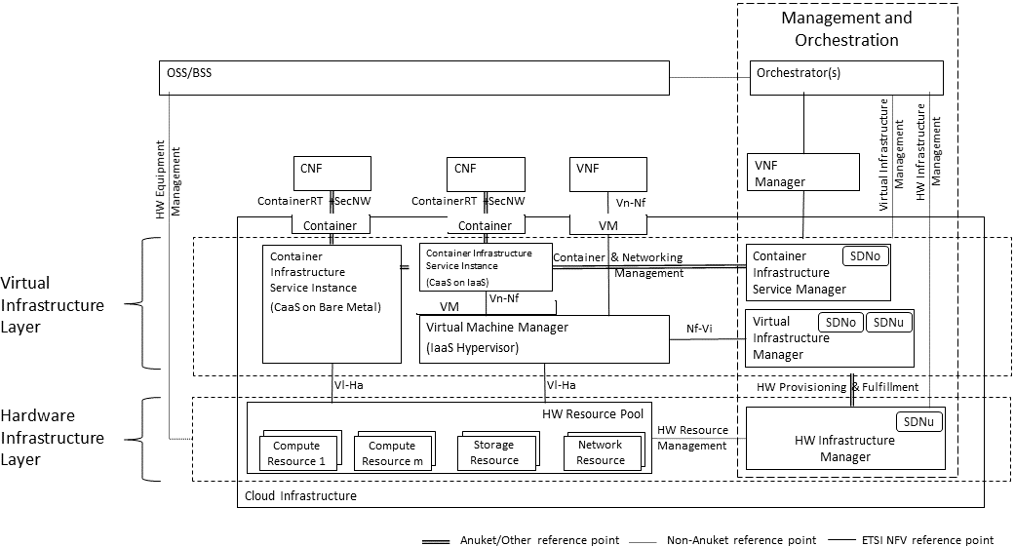
O-RAN Service Management & Orchestration
rApps
R1
O1
O-Cloud
Infra Mgmt
X
O2ims
O2dms
O-Cloud
WL Placement
Distributed O-Cloud
AAL
AAL
AAL
Deployment Management
Services
Infrastructure Management
Services
L1 Radio HW Acc

Slide 2
Anuket Multi-Cloud Management
O-RAN Service and Management Orchestration of Federated O-Clouds
Transport
Management
Cloud A
Using External Provided
Infrastructure
Anuket Cloud B Using & Managing Internal Infrastructure
O-Cloud A
O-Cloud B
O-Cloud C
Operator Telco or IT (Anuket) Cloud Infrastructure
AAL
AAL
L1 Radio HW Acc
L1 Radio HW Acc
L2-NW
L2-NW
Cloud Infrastructure Provider x

