Slide 1











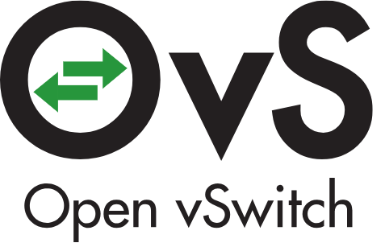


Dashboard
HORIZON
API endpoints
Orchestration
Tenant Services
OS Image
Repository
Placement
Key Management
Deployment node(s)
Cloud Deployment (Foundation)
Control nodes
HEAT
KEYSTONE
GLANCE
PLACEMENT
BARBICAN
Logging, monitoring and alerting node(s)
\
BMaaS
Accelerator
Management
Logging
Monitoring
Alerting
Compute
Networking
Block
Storage
Object
Storage
SWIFT or compatible
CYBORG
NOVA
NEUTRON
CINDER
Optional
Optional
Storage nodes
Shared Storage
Alerting
Monitoring
Common Services for OpenStack (databases, messaging, etc.)
Host OS + Hardware Drivers
vRouter
Virtual switch
Compute
Networking
Hypervisor
Accelerator
Management
Compute nodes
CYBORG
vR / DPDK
OvS / DPDK
NOVA
NEUTRON
Qemu/KVM
Optional
Alerting
Monitoring
Host OS + Hardware Drivers

