Slide 1
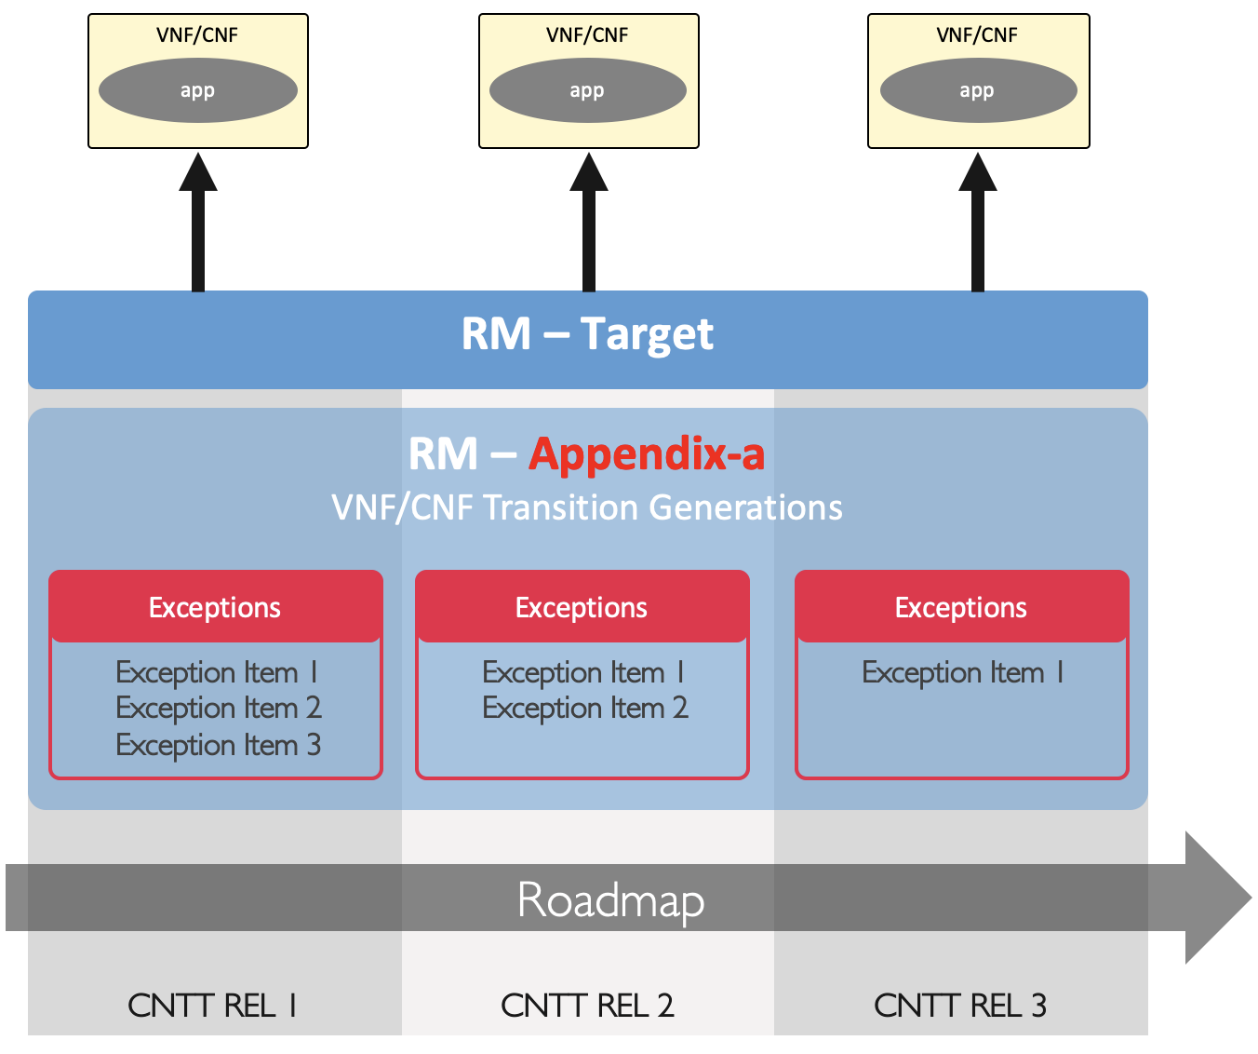

Slide 2
VNF/CNF
VNF/CNF
VNF/CNF
App
App
App
RM - Target
Anuket REL 1
Anuket REL 2
Anuket REL 3
RM – Appendix a
VNF/CNF Transition Generations
Exceptions
Exceptions
Exception Item 1
Exception Item 2
Exception Item 3
Exceptions
Exception Item 1
Exception Item 1
Exception Item 2
Roadmap

Slide 3
Anuket REL 1
Anuket REL 2
Anuket REL 3
Roadmap
RA – Appendix a
Exceptions
Exceptions
Exception Item 1
Exception Item 2
Exception Item 3
Exceptions
Exception Item 1
Exception Item 1
Exception Item 2
RA - Target

