Slide 1
RESOL
Arbitrage on the Solana Blockchain
Anu Khatri, Grant Tugwell, Robert Elizondo, Veronica Wisor

Slide 2
Contents
Problem Background
Challenges Faced
Requirements
Design Alternatives
System Description
Project Scheduling
Test Plan and Demonstration
Team Management
Project Concerns

Slide 3
Problem Background
Price differences in same cryptocurrencies on different decentralized exchanges (DEX)
Blockchain technology allows us to capitalize on this
Unlike stock exchanges, there is no geographical advantage
Atomicity
Flash loans
Cryptocurrency is a relatively new market that has potential for big returns

Slide 4
Needs Statement
Since there are so many Decentralized Exchanges (DEXs) on the Solana network, there are subtle price differences between the exchanges.
We want to take advantage of the difference to create an arbitrage on the Solana network
There currently isn’t a user-friendly interface for similar arbitrage programs

Slide 5
Goal
Create a profitable arbitrage program that gives the user useful insight into the performance of the program.

Slide 6
Challenges Faced
Lack of documentation
Not yet created or outdated
Starter examples that don’t work
Continuously changing code
Deprecated API calls
Solution:
Use different AMM’s
Reach out to developers

Slide 7
Requirements
Our system currently requires:
A Solana Node for private RPC connection ($9/month)
A wallet that supports Solana
Internet connection
Ability to use command line interface

Slide 8
Design Alternatives
Trading Bot
Focus application on possible profitable trades
Work with different AMM’s
Continue to look into different exchanges like Raydium
Trading Strategy - Buy and Hold
Could get lower return on investment

Slide 9
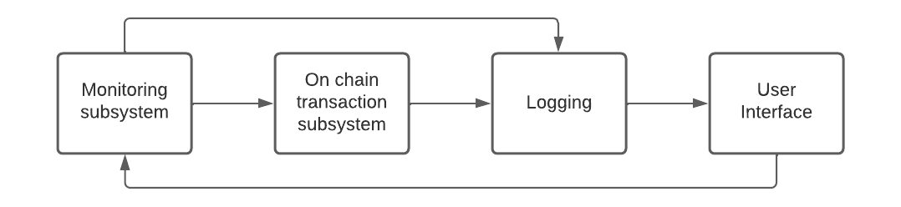
System Level Description

Slide 10
System Level Description
Price Monitoring Module
Uses client side AMM APIs to fetch the current exchange
Uses Jupiter to get profitable price routes
Transaction Module
Currently off chain with plans to move on chain
Using Orca API and Jupiter API to execute transactions on several different AMMs
Can currently make transactions on: Aldrin, Cropper, Raydium, Saber, Sencha, Serum, Orca, and more
Wallet Monitoring
Interacts with UI and Pricing/Transaction Modules
Currently fetches the SOL and OXY token balance from the wallet
User Interface

Slide 11
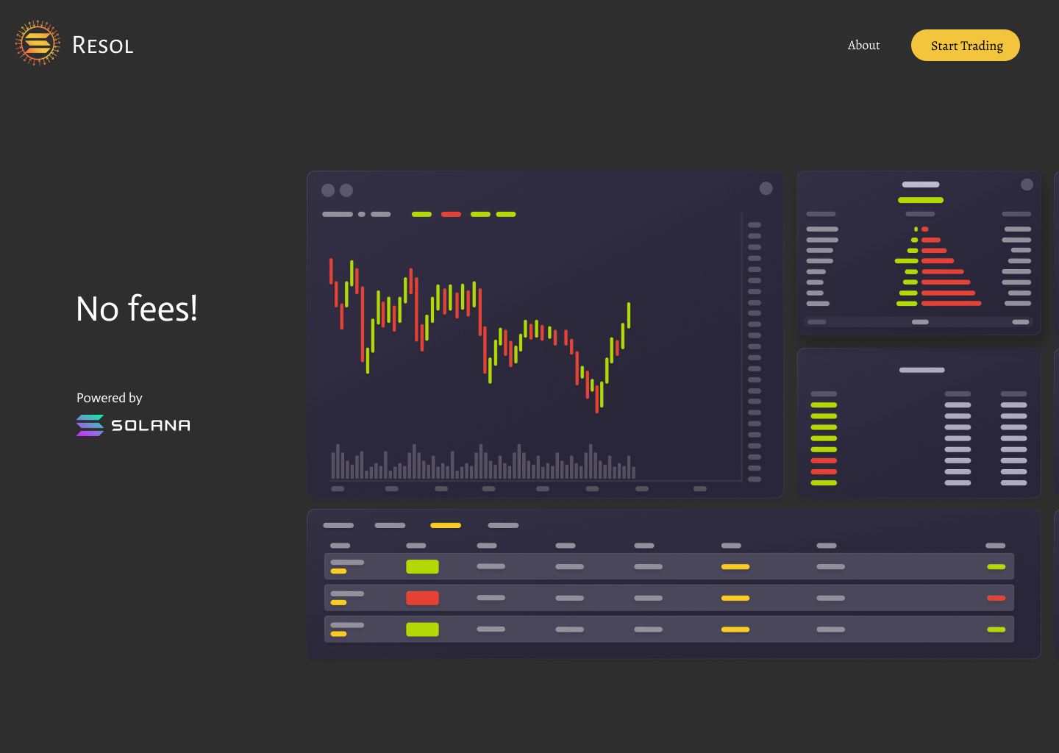

Slide 12
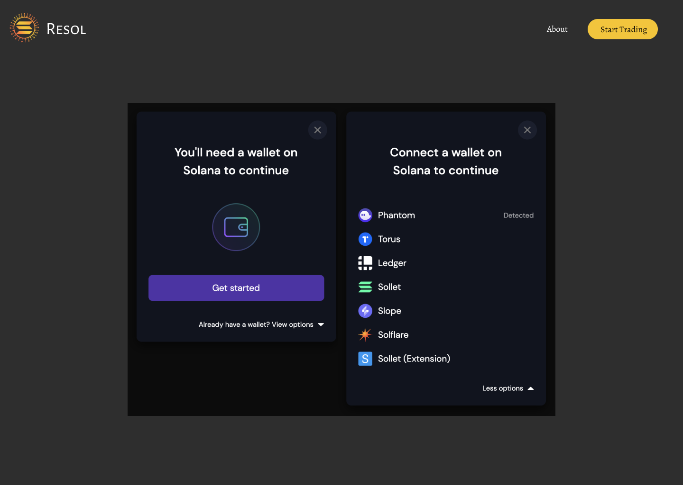

Slide 13
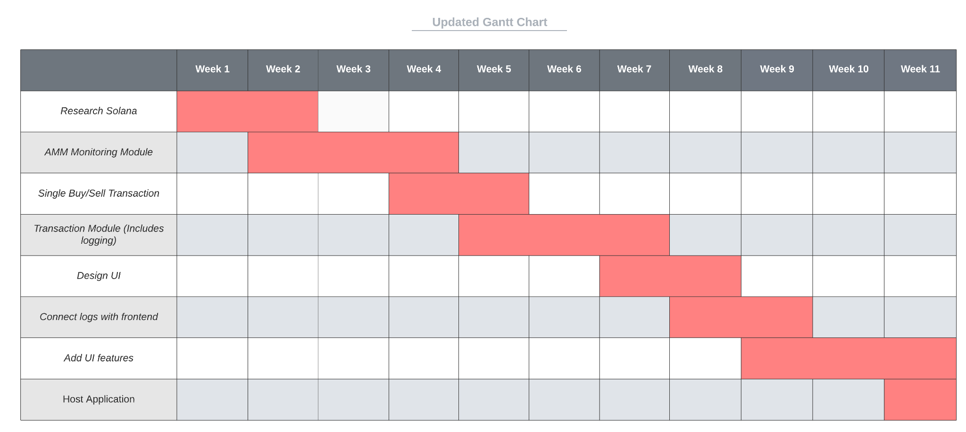
Project Scheduling

Slide 14
Project Deadlines
Week of 3/28
Move transaction module to on chain
Use Solana’s waller adaptor for React
Week of 4/4
Atomicity of transaction module
Front end work of visualizing price monitoring
Week of 4/11
Improving logic of modules
Testing/design validation
Week of 4/18
Integrate modules and UI

Slide 15
Design Validation Plan
Paper Wallet
Test different strategies
Prove that the arbitrage is profitable over time
Finalize financial plan for when real money is added
Logging system from on chain function
Returns metadata about each transaction
Can be stored in a DB to show profitability over time
Visual UI for analysis
Allows for quick analysis
More easily read than a command line tool

Slide 16
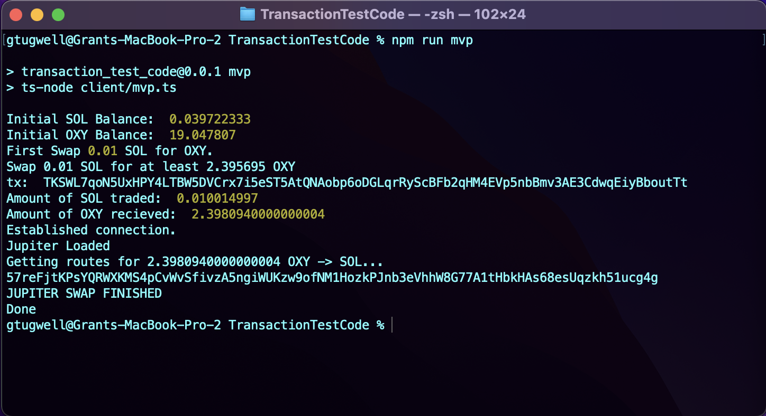
Design Demonstration
https://youtu.be/ZWq1n7FFtw0

Slide 17
Team Management
Anu
Project lead
Design/Develop UI
Grant
Transaction Module
Integration of Transaction and Pricing Module
Robert
Validation / Testing
Develop UI
Veronica
AMM Price Monitoring Module
Integration of Transaction and Pricing Module

Slide 18
Health & Safety Concerns
Project will not be released to the public until extensive testing has been completed
If the arbitrage is not profitable, could have economic repercussions on the user
Solana uses proof of stake and has a much lighter environmental footprint compared to proof of work
Potential to leak users secret key

Slide 19
Sustainability and Economics
Must maintain the product to stay up to date with the current market
The AMMs/DEXs are constantly changing
Hosting on AWS
Needed for higher traffic and multiple users

Slide 20
Overview
Problem Background
Challenges Faced
Requirements
Design Alternatives
System Description
Project Scheduling
Test Plan and Demonstration
Team Management
Project Concerns

Slide 21
Questions?

