Slide 1
Resol
Robert Elizondo, Anu Khatri, Grant Tugwell, Veronica Wisor

Slide 2
Problem Background
Price differences in same cryptocurrencies on different decentralized exchanges (DEX)
Blockchain technology allows us to capitalize on this
Unlike stock exchanges, there is no geographical advantage
Atomicity
Flash loans
Cryptocurrency is a relatively new market that has potential for big returns

Slide 3
Needs Statement
Since there are so many Decentralized Exchanges (DEXs) on the Solana network, there are subtle price differences between the exchanges.
We want to take advantage of the difference to create an arbitrage on the Solana network
There currently isn’t a user-friendly interface for similar arbitrage programs

Slide 4
Goal
Create a profitable arbitrage program that gives the user useful insight into the performance of the program

Slide 5
Objectives
Create a price monitoring system that keeps track of cryptocurrency prices from different DEXs to see where profits can be made
Create a function that will invoke the buy/sell transaction on the Solana blockchain
Log all successful/failed transactions and display the analytics to a frontend for the user to see

Slide 6
Research Findings
Bitsgap
User-friendly interface, but expensive and limited on usability depending on pricing tier
BlackbirdBot
Only works with bitcoin and has little documentation
Cryptohopper
Arbitrage and Auto-trading bots, but room for improvement with speed due to API usage
Bitcoin Arbitrage
Automatic trading only supported for a few exchanges and currency pairs
Pionex
Can deposit USD and bot will start making trades, no additional software needed

Slide 7
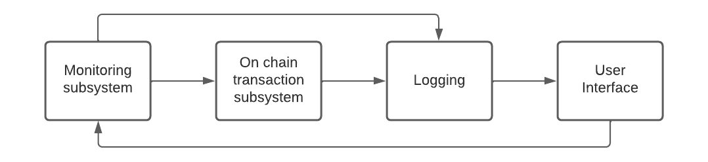
Proposed Design
AMM Monitoring Subsystem
On Chain Transaction System
Logging
User Interface

Slide 8
Design Validation
Paper Wallet
Test different strategies
Prove that the arbitrage is profitable over time
Finalize financial plan for when real money is added
Logging system from on chain function
Returns metadata about each transaction
Can be stored in a DB to show profitability over time
Visual UI for analysis
Allows for quick analysis
More easily read than a command line tool

Slide 9
Economic Analysis/Budget
$600 Budget
No development cost
No parts or manufacturing costs
Solana Transaction fee: $.00107 (100 transactions cost about a penny)
Hosting Costs
Free AWS t2.micro
$40 Raspberry Pi
$47 AWS a1.medium (remaining 11 weeks)
Plan to use the remainder for the arbitrage

Slide 10
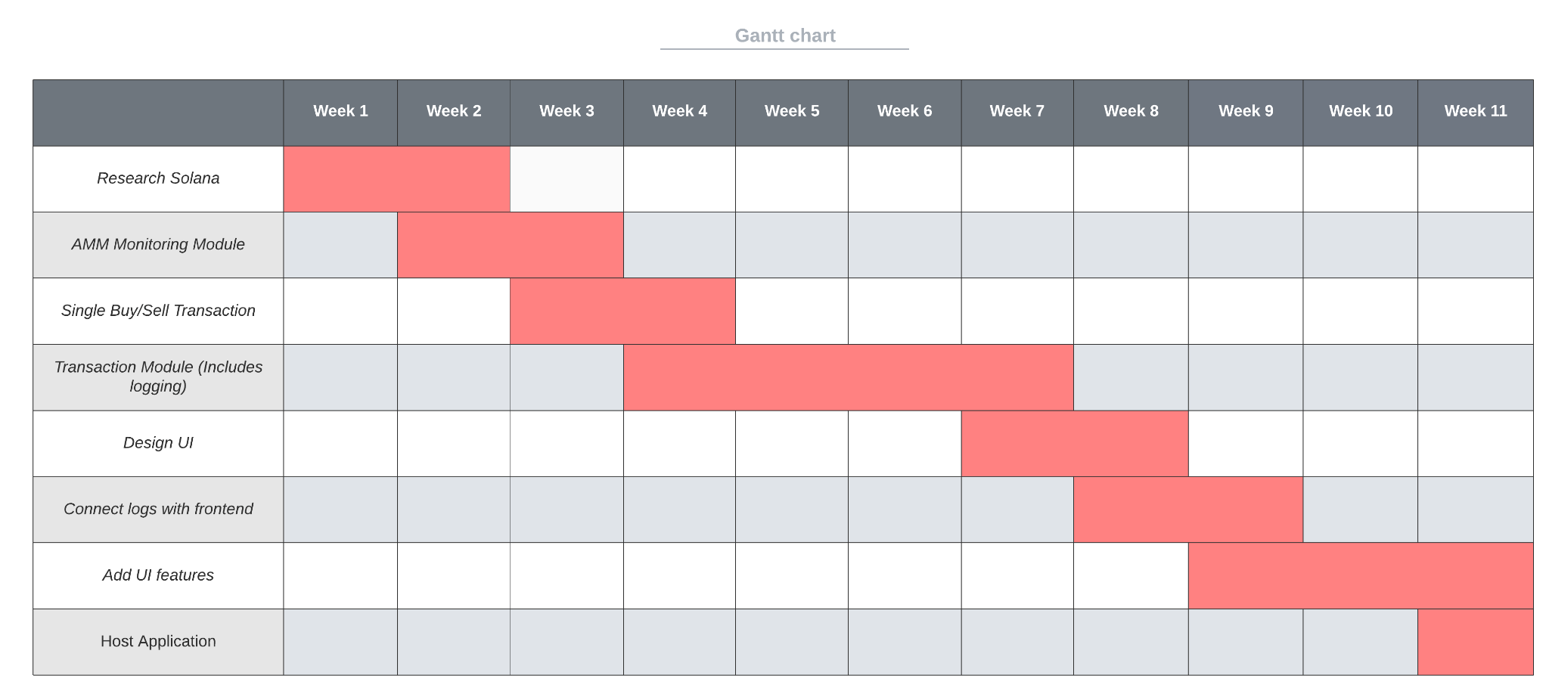
Task Schedule

Slide 11
Project Management
Members will break down large tasks into smaller, manageable tasks
Progress checks each Monday and Wednesday
JIRA/Trello to track task progress and have a backlog
Gantt charts and individual logs

Slide 12
Teamwork
Anu
Project lead
Design/Develop the UI
Grant
Testing using paper wallet
Robert
On chain transaction function
Veronica
AMM monitoring module

Slide 13
Societal, Safety, and Environmental Analysis
Project will not be released to the public until extensive testing has been completed
If the arbitrage is not profitable, could have economic repercussions on the user
Solana uses proof of stake and has a much lighter environmental footprint compared to proof of work
No safety concerns

