Slide 1

CREDIT CARD FRAUD DETECTION
GROUP 1:
Anukriti baijal
HARVENDRA SINGH
Theodore smith

Slide 2
Introduction
Credit Card Fraud
1.5 billion fraudulent transactions in US alone
Aim of project
Understand factors of credit card fraud
Considerations for analysis
Is customer age a factor?
Are certain credit card companies more prone?
Which predictive model performs best for fraud prediction?

Slide 3
DATASET
Dataset:
55,719 rows
23 Columns
The following information was included in the dataset:
Transaction date, time and number
Credit Card Number*
Merchant Information
Customer Information*
City Population
Transaction Amount
Fraudulent Transaction (yes/no)

Slide 4

Data Cleaning

Slide 5
Data cleaning and Pre-processing
Before proceeding with the exploratory analysis, it was important to clean the data:
The transaction date and column were separated and converted into correct formats along with ‘DOB’ column.
Columns containing the first and the last names of the customers were combined into one.
Removed extra special characters from the content of the columns ‘Merchant’ and ‘Category’.
Calculated age of the customers using their DOB and the last date for the year included in the dataset.
Identified the credit card provider using the first digit of the credit card number. (2 or 5: Mastercard, 3: American Express, 4: Visa, 6: Discover)

Slide 6
Exploratory data analysis

Slide 7
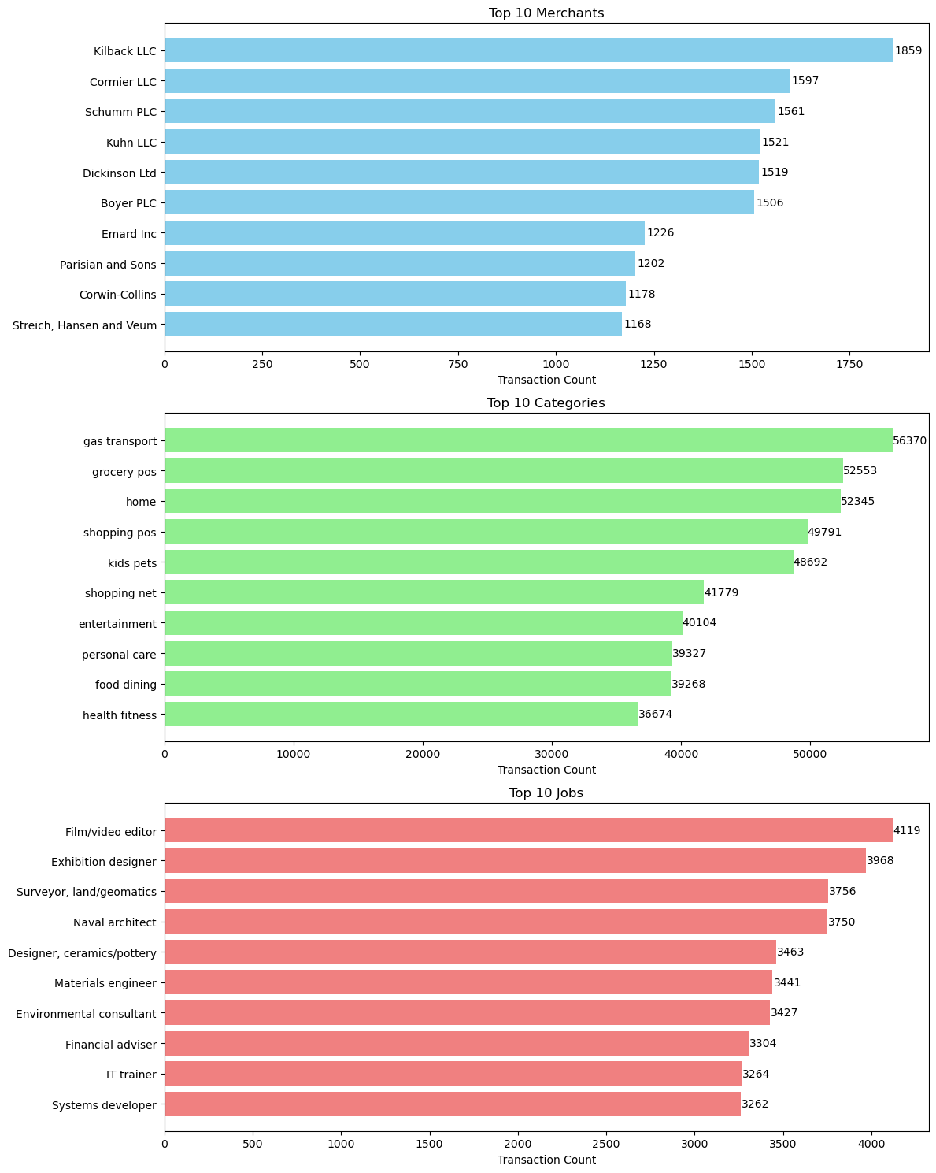
Eda
Total Transactions
Merchant Kilback LLC had the most transactions
Most transactions related to Gas Transport
Film/Video Editors spent the most

Slide 8
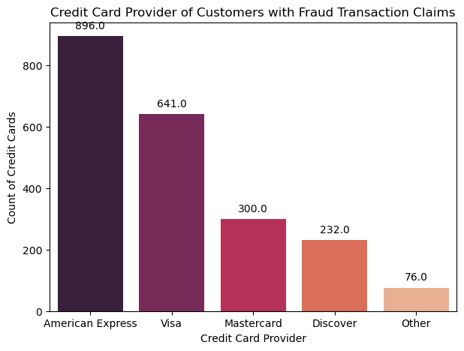
Eda
Credit Card Provider Claims
American Express tops the list at 45%
Visa double that of Mastercard

Slide 9
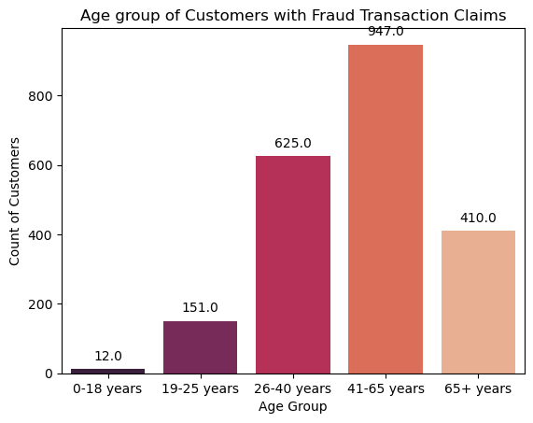
EDA
Claims by Age Group
41-65 most at risk
26-40 2nd
Those two groups make up 75% of fraud

Slide 10
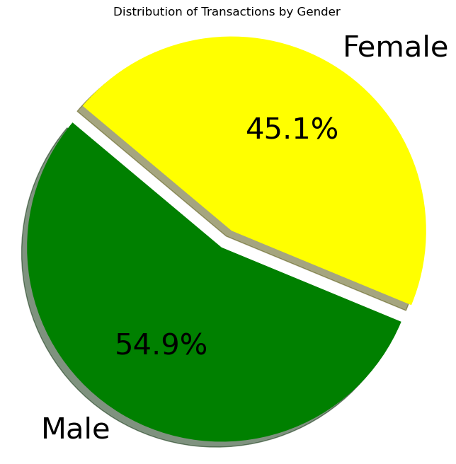
EDA
Fraud by Gender
Mean amount of all transactions was off by only 1 penny
Was this a factor of having a very large dataset?

Slide 11
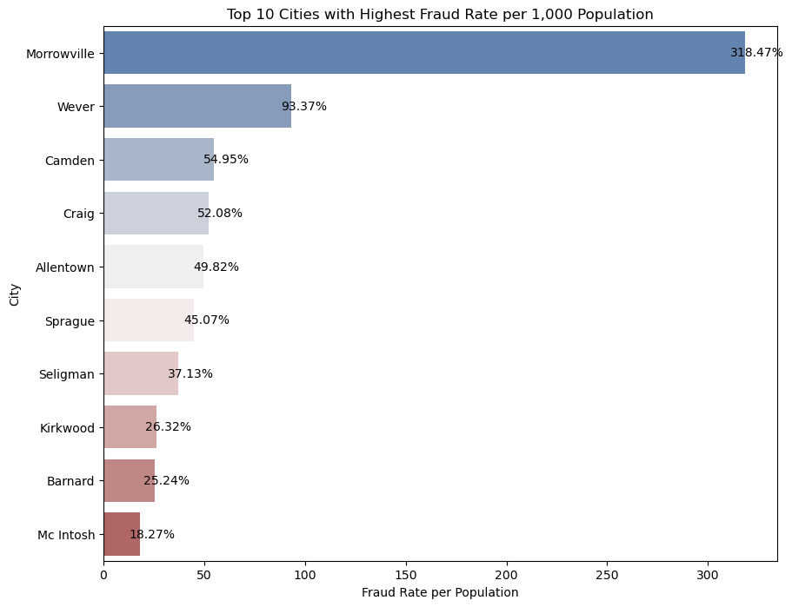
EDA
Fraud Rate by City
Note:
Population of Morrowville is less than 1000

Slide 12
PREDICTIVE MODEL

Slide 13
OVERVIEW
Categorical variables were encoded using different encoding methods such as label encoding
The dataset was imbalanced
Dealt with the imbalance using Random Under Sampling Technique
The dataset was split into 80-20 ratios (80% for training and 20% for testing)

Slide 14
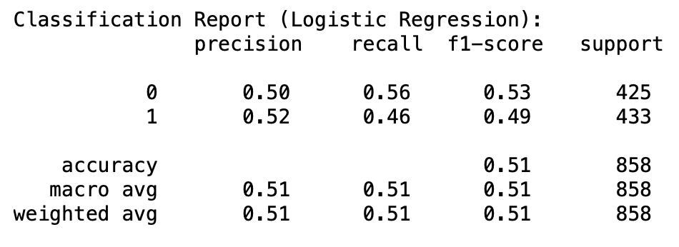
LOGISTIC REGRESSION
Predictors: Age
Target: Fraud
Accuracy for the model is approximately 50.93%
Mean accuracy after cross validation is 53.52%
The precision score is 0.52 indicating that out of all the transactions, only 52% of the predictions were correct.
The recall score is 0.46, which means that out of all predicted fraud transactions, only 46% of them were actually fraud.
the F1-score, 0.49, which is not close to 1.

Slide 15

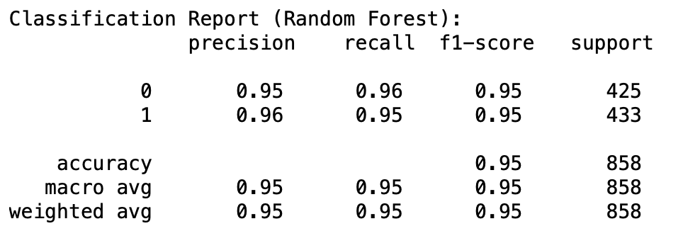
RANDOM FOREST CLASSIFIER
Predictors: Age, Category, Credit Card Provider, Amount, and Gender
Target: Fraud
Accuracy for the model is approximately 95.45%
The mean accuracy after cross validation is 94.41%
The precision score is 0.96 which indicates that out of all the transactions, 96% of our predictions were correct, similar to Logistic Regression Model.
The recall score is 0.95, which means that out of all predicted fraud transactions, 95% of them were actually fraud.
F1-score, 0.95, which is quite close to 1

Slide 16

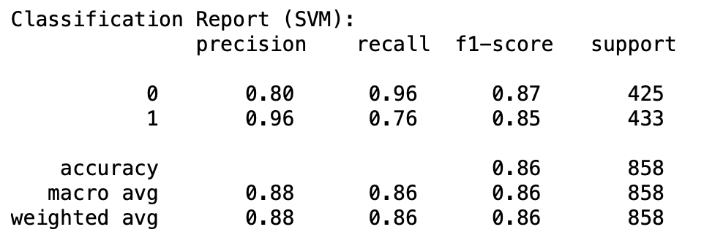
SUPPORT VECTOR MACHINE
Predictors: Age, Merchant, City, Credit Card Provider, Amount, and Gender
Target: Fraud
Accuracy for the model is approximately 86.13%
The mean accuracy after cross validation is 85.64%
The precision score is 0.96 which indicates that out of all the transactions, 96% of our predictions were correct, which is again similar to Logistic Regression and Random Forest Models.
The recall score is lower but similar to logistic regression at 0.76, which means that out of all predicted fraud transactions, 76% of them were actually fraud .
The F1-score, 0.85, which is quite close to 1

Slide 17

RESULTS AND CONCLUSION
Random Forest
Most accurate of the three
Credit card company could be an important factor
Challenges with big datasets
Many outliers
Equal means

Slide 18
THANK YOU

