Slide 1
solution

Slide 2
Features the app should have
Should be customizable with level of disorder and age
Should have attracting animations and sound effects
Easy language under reach of children
Should have changing patterns
Soothing background and continuous background voice
No easy back option, back only if someone calculate the problem
Should be of relating atmosphere to child
Less verbal sounds more activities
Reward giving like a funny video or animation

Slide 3
Divisions in the app:
A section should exist for guidance to an ASD adult as an adult needs more guidance for managing real world problems and earning as compared to a child who have a lot of time to invest in moral activities.
A section should exist to tell parents about the:
different fun activities to perform daily that the child might like with a reminder
Chat with other parents connected through this app
Have an expert advise(in updated versions)
A section for ASD kids which firstly asks parents some questions related to kid for creating related interface and games

Slide 4
4 Sections for kids having difficulty level set depending upon the answers from their parents:
Language basics, word formation, recognizing objects
Counting and basic arithmetic operations
Recognition of shape, color, size and type of an object
Relations, responsibilities and Respect
2 Section for adults that could be parents or self an autism grown up :
Learning different activities that can benefit mind growth and control their activities
Socializing, talking to experts and people.

Slide 5
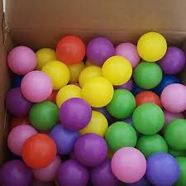

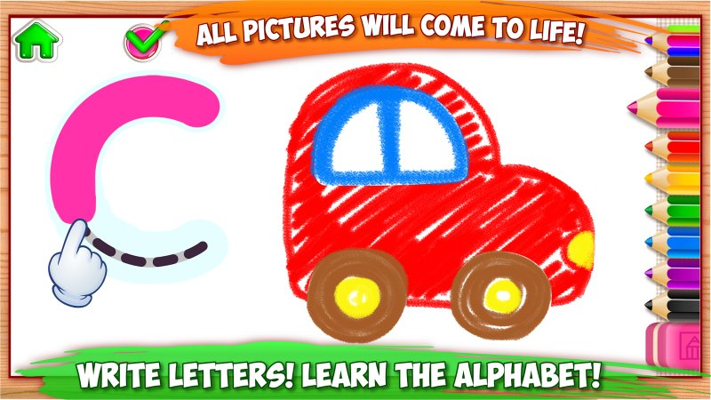
Language basics, word formation, recognizing objects
The app should not only contain learning activities but should be fun too, so first learning the child should have is of language( preferably English)
Learning language should be fun, so for learning letters, we will have a game: find the word hidden in balls and then draw it by chasing a bee moving on letters
Word formation, each word with pictures or clips attached so that child understand the meaning of word and then asking them to construct the sentence watching pictures
Object recognition by first telling about object and then hiding it in between other objects and asking them to find it

Slide 6
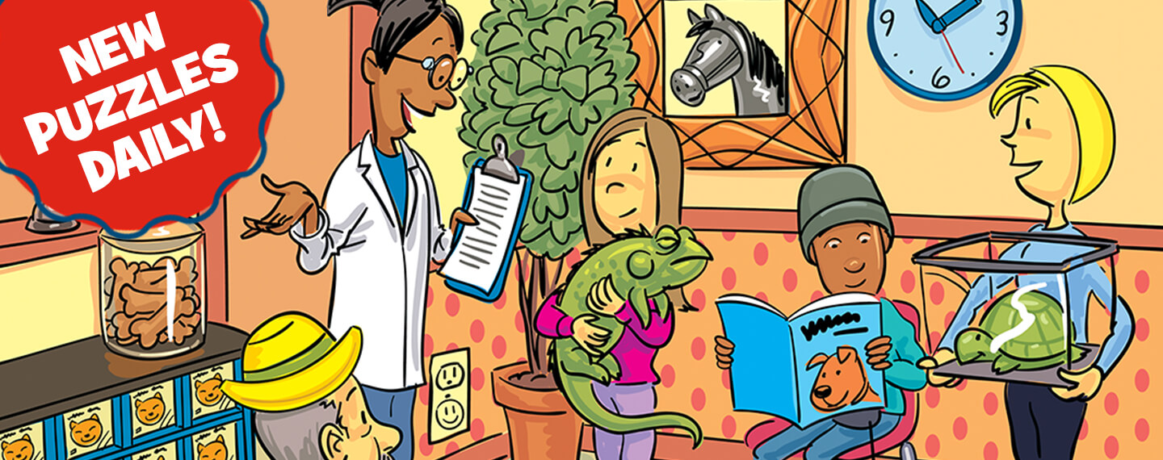
Counting and basic arithmetic operations:
It should be fun, asking child his favorite activity, or what he did previous day or anything and catching a word by voice and then displaying it’s picture to count hidden in a picture and displaying the number on screen when the object is found e.g. Count animals in picture, when counted put a cross on animal.
By using fingers and Hanoi’s tower, addition or substraction can be fun
Like I showed him 5 toffees kept on my hand. I asked him to keep 4 more toffees on my hand, I opened my second hand and as he kept toffees on my hand I will count till 4 and ask him total toffees and display ”5+4=”and recognize the number he will say by voice or can type

Slide 7
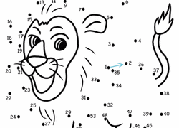
Recognition of shape, color, size and type of an object
Fit the right size in the given outline of shape, and a voice of praise after every completion
Cleaning the room, all things dispersed, keep the things on place like broom lying on ground keep it in dotted area
Fitting the pieces of blocks in dotted area
Claps voice and animated hands to appreciate

Slide 8
Relations, responsibilities and Respect
Managing hormonal imbalance, audio voices to narrate some social skills like good morning, story telling like
Ramesh is a kid, he likes to play games, when asked his name, he tells his name, he wishes good morning when sun rises, this is Ramesh’s mom, she cooks him food and Ramesh after eating always says thankyou for food to mom, mummy smiles
Animations to teach kid with responsibilities he have, why he need to learn, how should he communicate with other children

Slide 9
For Adults :
Managing emotions, understanding their family mates, understanding feelings
knowledge providing for opposite sex and not hurting anyone with their aggregation
Communicating with others having the same problem
Progress show for their kid or themselves if they are autistic

