Slide 1



Group 18 - Generative AI
ANUPREKSHA JAIN
PRASHANT KATARIA
ROHINI
SRIDHAR

Slide 2
Email Subject Generation

Slide 3




Objective
To explore the use of Generative AI Language Models (LLMs) for generating compelling email subject lines.
Generate a succinct subject line from the body of an email.
To evaluate the effectiveness of different LLMs in creating subject lines that improve open rates.
To discuss the deployment process and challenges faced during implementation.

Slide 4
Model Evaluated
LLM | Framework | Model Type | Training Steps | Evaluation Method
Mistral | unsloth | 4 bit quantized | 60 | ROUGE Score
Llama3 | unsloth | 4 bit quantized | 60 | ROUGE Score
T5 | Transformer | Base model | 200 | ROUGE Score
Bart | Transformer | Base model | 200 | ROUGE Score

Slide 5






Inference Results
Email Body
Please help summarize the provided email body and generate email subject The following reports have been waiting for your approval for more than 4 days. Please review. Owner: James W Reitmeyer Report Name: JReitmeyer 10/24/01 Days In Mgr. Queue: 5
Reference Ouptut:
Reports Awaiting Approval
Llama3 Model Output:
Reports Waiting For Approval
Mistral Model Output:
Approval Needed - Reports Waiting More Than Four Days
T5 Model Output:
Reports Waiting For Your Approval
Bart Model Output:
Expense Reports Awaiting Your Approval

Slide 6
Metrics
LLM | Rogue1 | Rogue2 | RougeL | RogueLSum
Mistral | 0.04 | 0.02 | 0.04 | 0.04
Llama3 | 0.04 | 0.02 | 0.04 | 0.04
T5 | 0.14 | 0.07 | 0.14 | 0.14
Bart | 0.27 | 0.13 | 0.25 | 0.25

Slide 7
Observations
Model Training:
Email Subject Generation:
Model Performance and Comparison:
To train on available limited hardware, used PEFT technique (LORA) on quantized versions of Llama 3 and Mistral models
Used Transformer framework to train the base versions of T5 and Bart models.
Both Generative and Seq2Seq models generated contextually correct email subjects.
Mistral and Llama 3 models generated synonyms of words, resulting in low Rouge scores.
Seq2Seq models picked up words directly from the email content, leading to high Rouge scores.
Bart and T5 models, both encoder-decoder types, outperformed Mistral and Llama 3 models.

Slide 8
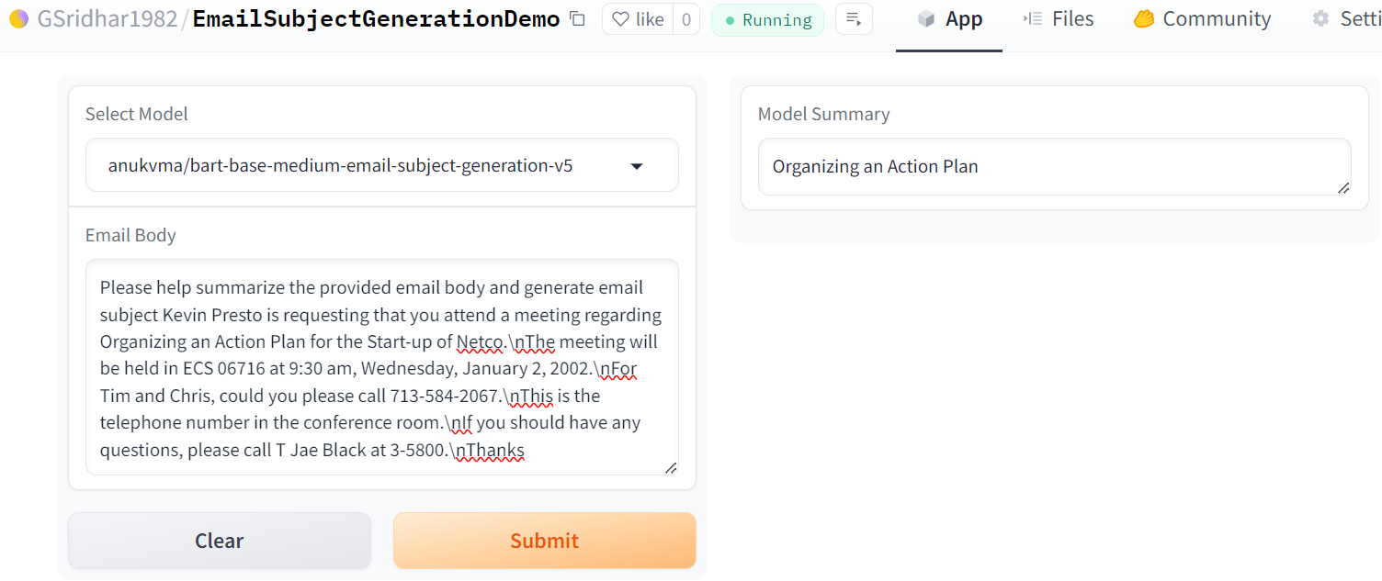
Demo
Gradio App:
https://huggingface.co/spaces/GSridhar1982/EmailSubjectGenerationDemo
FAST API:
https://anukvma-emailsubjectapi.hf.space/

Slide 9
Question and Answer

Slide 10
Objective
1
2
3
4
Model a system to generate appropriate answer to the question related to AIML
Compile a dataset of AIML-related questions and answers from the AIML course materials.
Explore the use of Generative AI Language Models (LLMs) for appropriate question answer generation.
To evaluate the effectiveness of different LLMs in generating answers to the given question.
To discuss the deployment process and challenges faced during implementation.

Slide 11
Data Collection and Preprocessing
Data Collection
Source: AIML course material
Format: Collected in CSV files
Content: Primarily Question and Answer pairs
Data size: ~3600
Preprocessing Steps
Punctuation Removal: Cleaned text by removing punctuation marks
Text Normalization: Converted all text to lowercase for consistency
Tools Used: Python libraries such as NLTK

Slide 12
Model Evaluated
LLM | Framework | Model Type | Training Steps | Evaluation Method
Mistral (7B) | unsloth | 4 bit quantized | 60 | ROUGE Score
Llama3 | unsloth | 4 bit quantized | 60 | ROUGE Score
GPT2 | Transformer (LORA) | Base model | 600 | ROUGE Score
Bart | Transformer | Base model | 600 | ROUGE Score
Qwen | Transformer | 4 bit quantized | 100 | ROUGE Score

Slide 13






Inference Results
Question
What is a linear classifier?
Target:
A linear classifier is a classification algorithm that makes its predictions based on a linear predictor function combining a set of weights with the feature vector.
GPT2 Model Output:
Linear classifiers are a way to represent a set of values in a linear way. They are used to represent a set of values in a linear way.
Bart Model Output:
A linear classifier is a model that makes predictions based on data points in a direction where the data points follow a linear equation.
Mistral Model Output:
'A linear classifier is a machine learning algorithm that predicts class labels by assigning weights to features. It uses the weighted sum of feature values as input for classification
['A linear classifier is a machine learning algorithm that predicts class labels by assigning weights to features. It uses the weighted sum of feature values as input for classification.', 'Linear classifiers are models used in machine learning to classify data points into different classes based on their feature values.']
Llama3.1 Model Output:
Qwen1.5 Model Output:
A linear classifier is a type of classifier that predicts the class of a given input based on the input's features.

Slide 14
Result Metrics
LLM | Rogue1 | Rogue2 | RougeL | RogueLSum
Bart | 0.38 | 0.17 | 0.31 | 0.40
GPT2 | 0.48 | 0.17 | 0.39 | 0.42
Llama31 | 0.20 | 0.10 | 0.22 | 0.23
Mistral | 0.26 | 0.08 | 0.21 | 0.20
Qwen1.5 | 0.58 | 0.28 | 0.51 | 0.54

Slide 15
Observations
Model Training
Question Answer
Model Performance and Comparision
To train on available limited hardware, used PEFT technique (LORA) on quantized versions of Llama 3, Mistral, Qwen models and base version of GPT2.
Used Transformer framework to train the base versions of Bart model.
Tried with multiple batch sizes and evaluation steps.
Used repetition penalty parameter for llms not to repeat the answer.
Both Generative and Seq2Seq models generated contextually correct response.
Mistral and Llama 3 models generated outputs are not consistent for each regeneration, resulting in varying Rouge scores.
GPT2 base version is trained using PEFT technique (LORA) giving better results compared to other picked models
Bart encoder-decoder type model, provides consistent response and decent ROUGE scores.

Slide 16
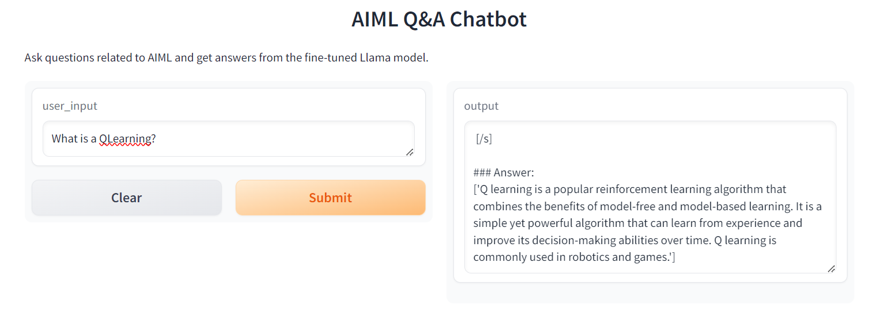
Demo
Gradio App:
https://huggingface.co/spaces/anukvma/AIML_Question_Answer
FAST API:
hugging face space

Slide 17
Thanks

