Slide 1
Advancements in Theft Detection and proposed solution
By: Abhijith Ajith, Harsha Srinivas, Gnyana Varshini, T. Lekhya

Slide 2
Introduction
Video or CCTV surveillance plays an important role in the security of any place whether it is residential areas, industries, public spaces like shopping malls, museums, railway stations, banks, airports etc.
It will help in preventing theft and damage to manufactured goods and products as well as prevention and analysis of any type of crime.
It has been proven that CCTV surveillance is one of the most important tools for security and one of the most effective method to prevent dangerous event that can cause damage.
Offline method evaluation: Most of the CCTV systems that exist work on this principle of recording and storing it in some central cloud, if any mishap happened they refer to it and evaluate the evidence to catch the culprit.
Another way is monitoring lively through camera feed and security personnel. The limitations here are mental or visual fatigue as they have to keep on monitoring the screen hence reduced the overall accuracy.
Regression analysis: Estimating relationship between a dependent and one or more independent variables.
One-way variance analysis: It is used to determine whether there are statistically significant difference between the means of 3 or more independent groups. It is also called as ANOVA.
Correlation evaluation: It is used to identify potential patterns or relationships between variables that may indicate fraud or theft.
Currently most of the CCTV or video surveillance is based on the offline evaluation after the occurrence of events like robbery, murder and other types of crime.

Slide 3
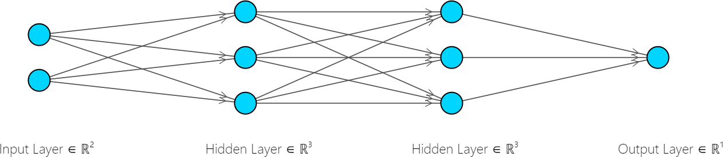
Existing Market Solutions
Researching upon current market solutions we come upon majorly two types of classifications of the organization services to theft detection. The services of higher quality cover higher number of cases while training the machine learning models such as:
Neural Networks : It is a type of machine learning algorithm that is inspired by the human brain. It is made up of a network of interconnected nodes, or neurons, that are able to learn and adapt to new data. They are expensive to develop and train often requiring high amount of good training data and are harder to interpret on why they made a particular decision.
Decision Trees and Random Forests : It is a supervised machine learning algorithm that can be used to make predictions or decisions based on a set of data. Decision trees are made up of a series of nodes, each of which represents a decision or question. The branches of the tree represent the possible answers to the question, and the leaves of the tree represent the possible outcomes. Random forests is a collection of decision trees whose output depends on the collective average or decision of the trees within the forest. They both are easy to interpret but decision trees usually can be biased based on the training dataset whereas random forests are not which comes with a tradeoff that decision trees are quicker to train compared to random forests.

Slide 4
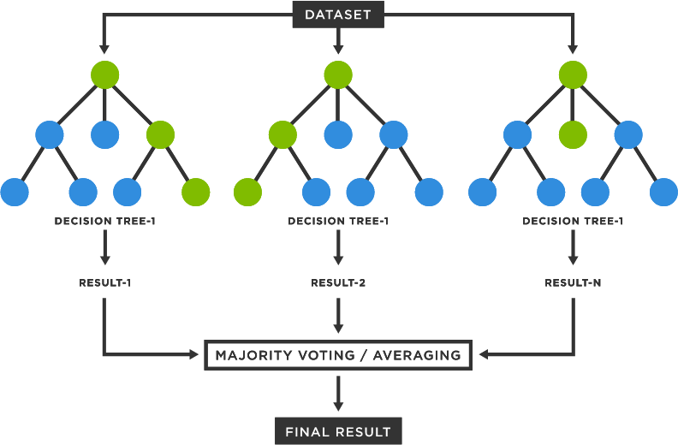
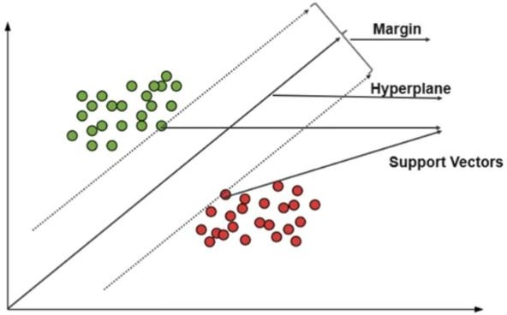
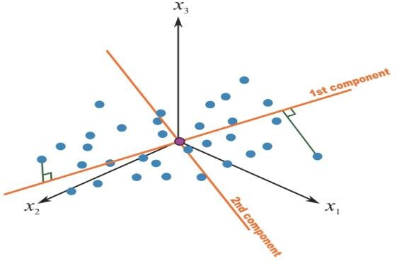
Support Vector Machine (SVM) and Principal Component Analysis (PCA) : SVMs are a type of supervised machine learning algorithm that can be used for classification and regression tasks. SVMs work by finding a hyperplane that separates the data into two classes. The hyperplane is chosen such that it maximizes the margin between the two classes. PCA on the other hand is a dimensionality reduction technique that can be used to reduce the number of features in a dataset. PCA works by finding a set of orthogonal axes that capture the most variance in the data. PCA can be used to remove noise in the dataset but can also lose a lot of features which may be necessary whereas SVMs are useful to split the dataset into different classes but can be hard to interpret and train.

Slide 5
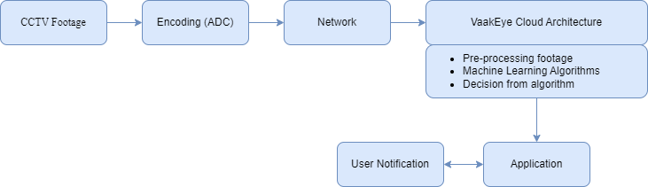
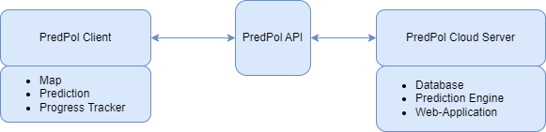
Here are two examples of the organizations architecture in the theft detection sector using real time CCTV Footage:
VaakEye : This organization provides services in the security sector and the major reason for the success of their theft detection service is training the model with a wide amount of events (120 event cases) giving high levels of accuracy in finding suspicious individuals who would commit a crime. They also leverage cloud services to give higher computing power to use the models and provide their service to larger number of clients.
PredPol : This organization provides software services in the police security sector for crime detection and the major reason for the downfall was the fact that their predictions were nothing more than a random chance. Their models are trained on historic crime data and the crime sector is a landscape that keeps changing throughout time so their models weren’t able to keep track of various kinds of new events in crime. Their model gave lots of false positives indicating wrong predictions due to poor parameter tuning. Their model was not validated on larger crime datasets which is also a reason for their model to be inaccurate.

Slide 6
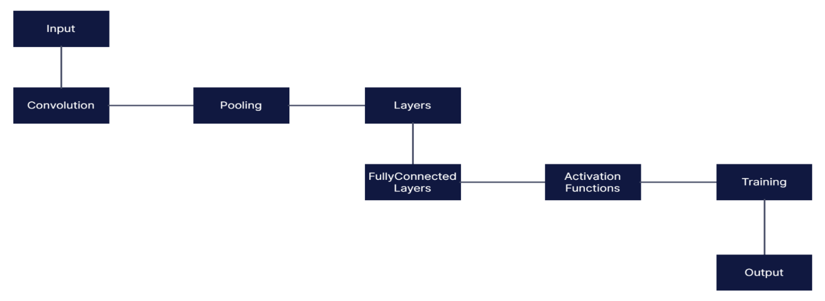
Most Popularly Used Solution
The most popularly used solution is convolutional neural networks which is a deep learning algorithm which is commonly used for image recognition and computer vision.
They are designed to mimic the visual processing of the human brain which is used for threat and intruders detection and also for locating the intruder.
Convolution: It is the core part of CNN which applies filters (kernels) to the input image which helps in capturing patterns and features like edges , corners , textures by sliding the filters over the images.
Pooling: Pooling is done to reduce the spatial dimensions of the features. Max pooling selects maximum value from each local region of the feature map.
Layers: CNN’s have many convolutional and pooling layers where convolutional layers learn about the complex features and pooling layers reduces the spatial dimensions.
Fully Connected Layers: These help in making the predictions based on the extracted features.
Activation Functions: Here the functions such as ReLU(Rectified Linear Unit) are incorporated by the CNN’s.
Training: CNN’s are trained using large labeled datasets.During the training the network learns to adjust the weights of the filters and connection through process called backpropagation. Backpropagation calculates the gradients of the network predictions and adjusts the weights to minimize the error between the predicted and actual outputs.
We can use faster R-CNN algorithm that is modified for fast learning and feature detection.

Slide 7
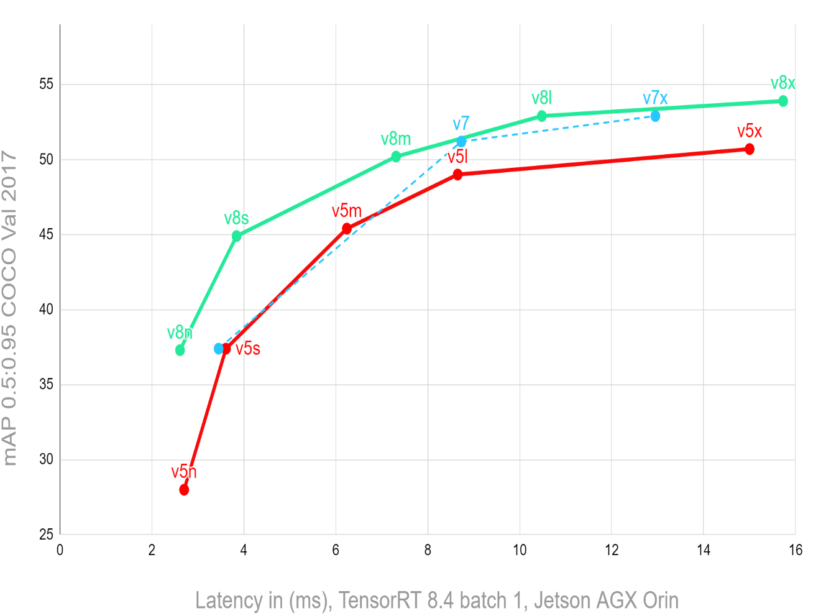
Proposed Solution
YOLOv8 is a popular computer vision framework used for object detection, classification and segmentation which uses a mixture of CNN models.
Our solution comprises of using the YOLOv8 model for detection of humans for the real time CCTV footage as YOLOv8 has higher mAP (mean average precision) values on the COCO (common objects in context) dataset compared to the previous YOLO version models.
YOLOv8 can be used for identifying the objects in interest for the event detection and then we can transfer the given bounded images in interest to a neural network.
The neural network has to be trained with a huge dataset as the successful solutions in todays market are the models trained with most of the cases in which a theft or crime can occur leading to higher positive predictions from the model.
On failed predictions we can retrain the model with the newly appended data to continuously improve it as a feedback system.

Slide 8
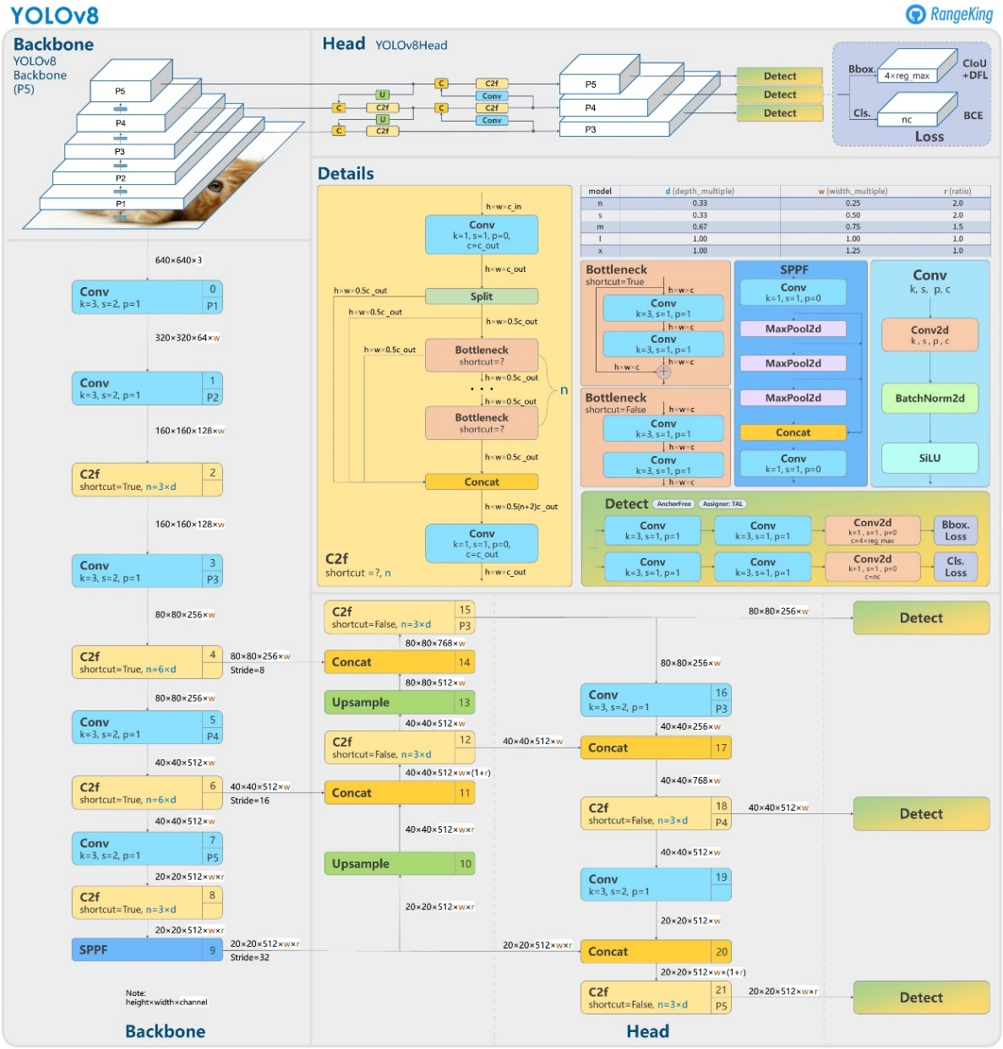
YOLOv8 Architecture
In the given neural network we see Conv which includes steps such as conv2D which performs elementwise multiplication on 2D input data along with BatchNorm2D which normalizes the given 4D data with a SiLU (Sigmoid Linear Unit) Activation function.
The SPPF (Spatial Pyramid Pooling Fast) is a faster variant of SPP layer which is essential for capturing context information at multiple scales by pooling features with different window sizes.
Bottleneck layer is a layer with fewer nodes/neurons than the layer above or below it which optimizes the network in space, time and calculation by reducing cost function and weight updates.
The loss function uses Binary Cross Entropy (BCE) for measuring error in reconstruction by calculating log losses greater than or equal to -100. Distribution Focal Loss is for checking losses of noisy images and miscalculated classes along with Complete IOU loss for overlap area, distance and aspect ratio between ground truth box and centre point of the predicted box.

Slide 9
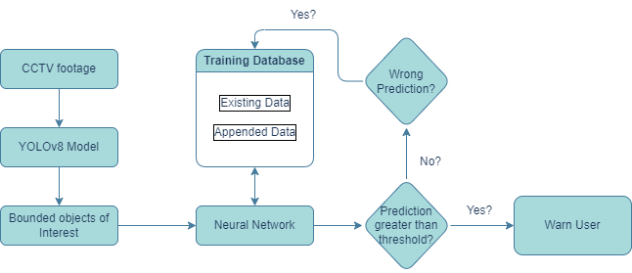
High level Architecture of the Solution

Slide 10
References
J. Bahri and R. Garg, "Suspicious Behavior Detection Using Man Machine Model with Integration of Virtual Reality," 2021 5th International Conference on Information Systems and Computer Networks (ISCON), Mathura, India, 2021, pp. 1-7, doi: 10.1109/ISCON52037.2021.9702309.
G. Savitha, S. Aashish Ramana and K. Jain, "Advanced Security Systems for Home Surveillance," 2022 Fourth International Conference on Cognitive Computing and Information Processing (CCIP), Bengaluru, India, 2022, pp. 1-5, doi: 10.1109/CCIP57447.2022.10058683.
https://vaak.co/
https://www.predpol.com/
Hoi-Ming Chi & Okan K. Ersoy (2002) Support Vector Machine Decision Trees with Rare Event Detection, International Journal of Smart Engineering System Design, 4:4, 225-242, DOI: 10.1080/10255810215022.
Bao, Tianlong, Saleem Karmoshi, Chunhui Ding, and Ming Zhu. "Abnormal event detection and localization in crowded scenes based on PCANet." Multimedia Tools and Applications 76 (2017): 23213-23224.
Fang, Z., Fei, F., Fang, Y., Lee, C., Xiong, N., Shu, L. and Chen, S., 2016. Abnormal event detection in crowded scenes based on deep learning. Multimedia Tools and Applications, 75, pp.14617-14639.
https://www.stereolabs.com/blog/performance-of-yolo-v5-v7-and-v8/
https://github.com/ultralytics/ultralytics/issues/189

Slide 11
THANK YOU

