Slide 1
Zomato Dataset Analysis

Slide 2
TABLE OF CONTENTS
LOADING & OBSERVING THE DATASET
DATA CLEANING & MANIPULATION
DATA ANALYSIS & VISUALIZATION
IDENTYING RELATIONS
PREDICT &
EVALUATE

Slide 3
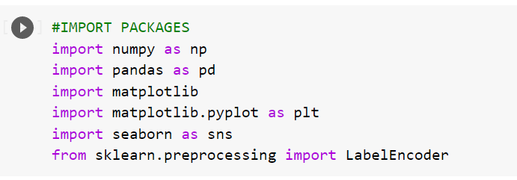
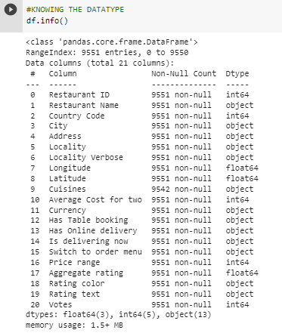
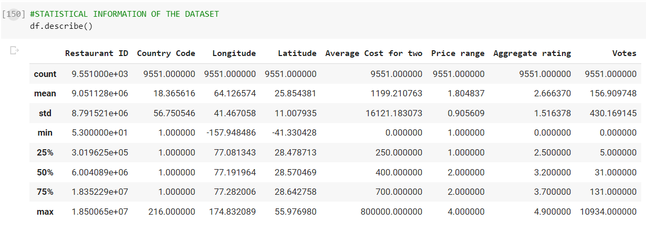
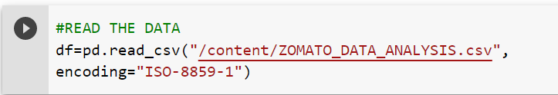
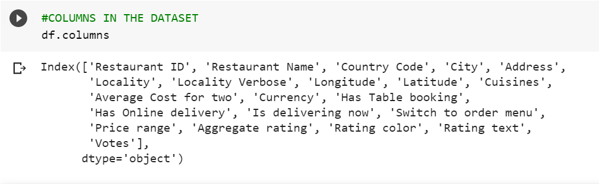
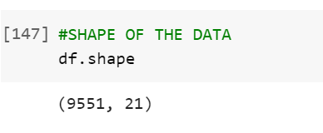
LOADING & OBSERVING THE DATASET

Slide 4
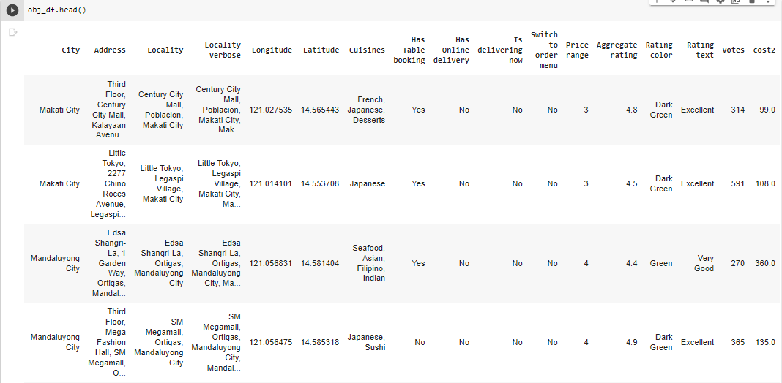
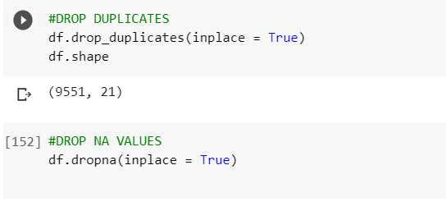
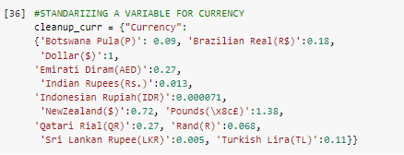
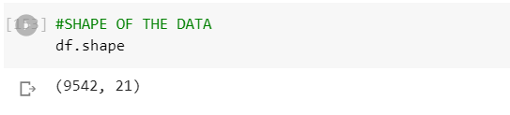
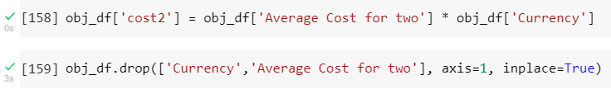
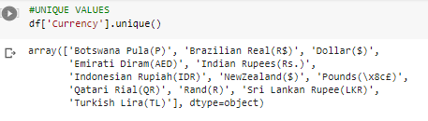
DATA CLEANING AND MANIPULATION

Slide 5
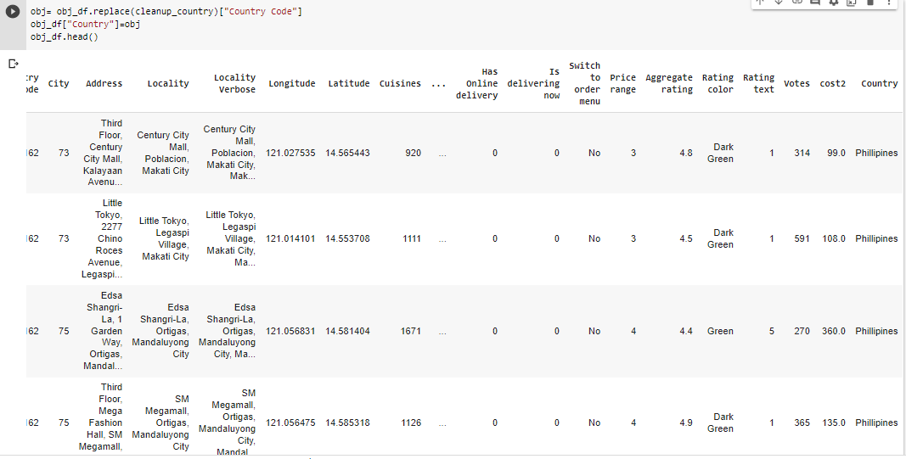
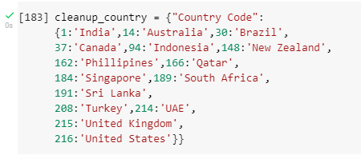
DATA CLEANING AND MANIPULATION

Slide 6
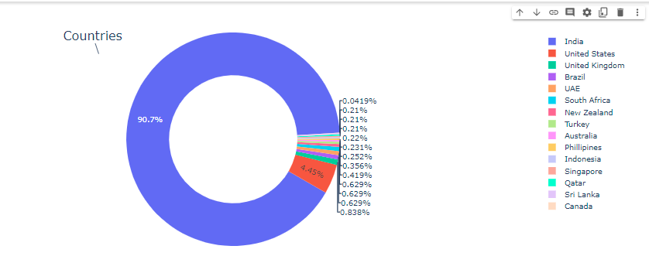
DATA ANALYSIS AND VISUALIZATION
UNIVARIATE ANALYSIS

Slide 7
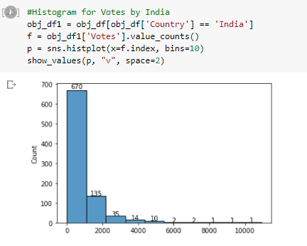
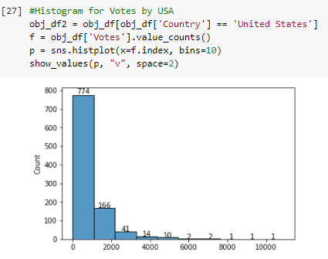
DATA ANALYSIS AND VISUALIZATION
UNIVARIATE ANALYSIS

Slide 8
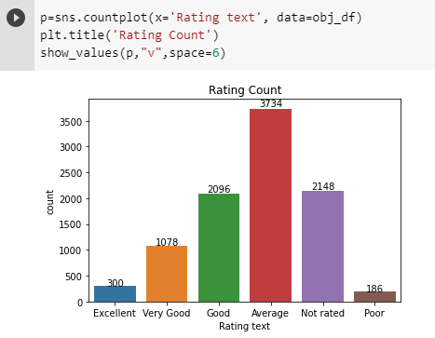
DATA ANALYSIS AND VISUALIZATION
UNIVARIATE ANALYSIS

Slide 9
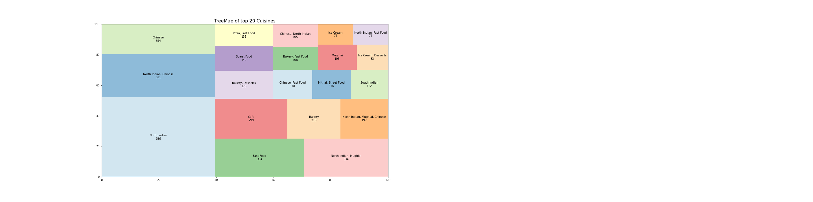
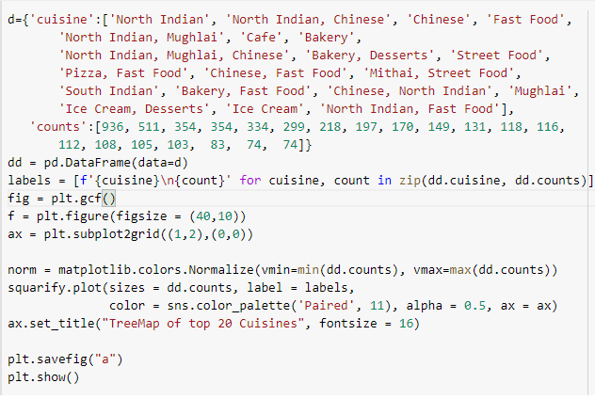
DATA ANALYSIS AND VISUALIZATION
UNIVARIATE ANALYSIS

Slide 10
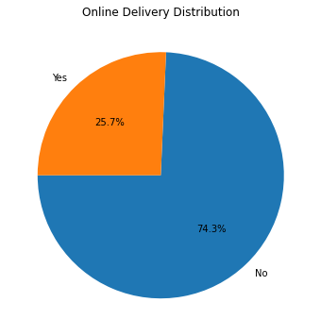
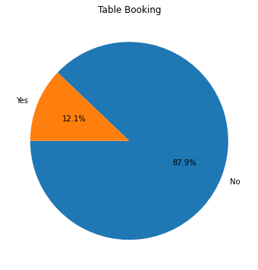
DATA ANALYSIS AND VISUALIZATION
UNIVARIATE ANALYSIS

Slide 11
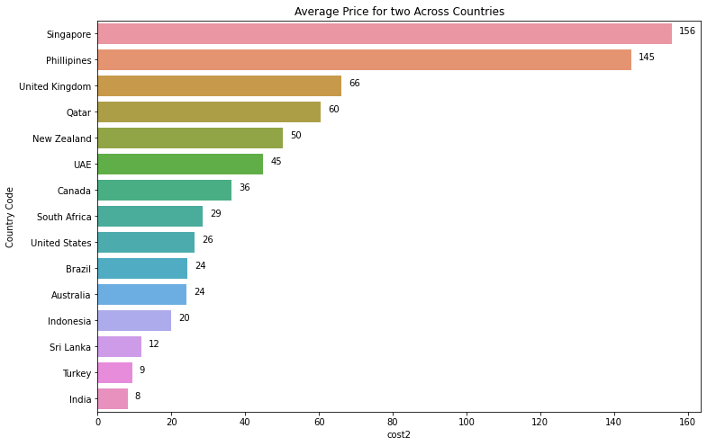
DATA ANALYSIS AND VISUALIZATION
BIVARIATE ANALYSIS

Slide 12
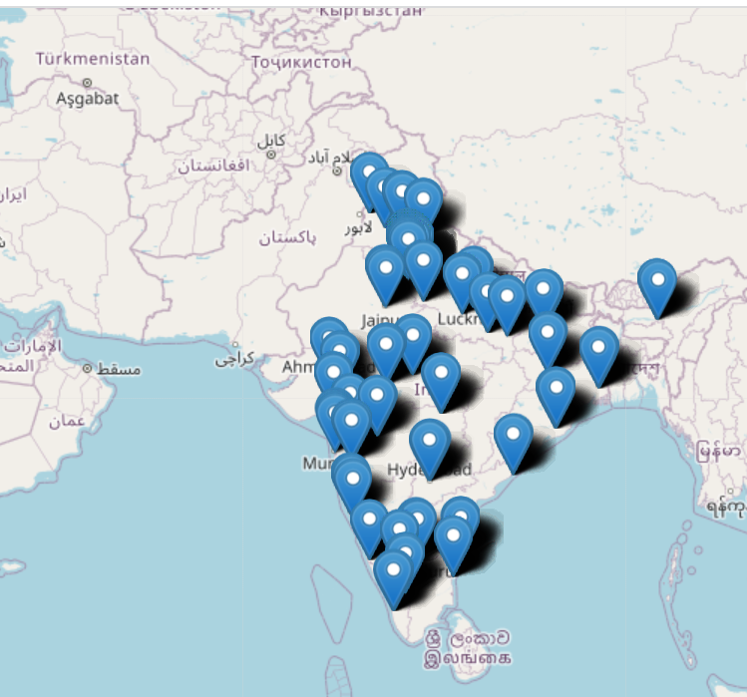

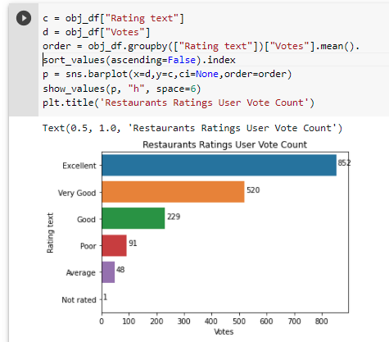
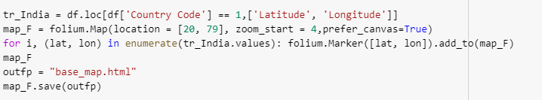
DATA ANALYSIS AND VISUALIZATION
BIVARIATE ANALYSIS

Slide 13
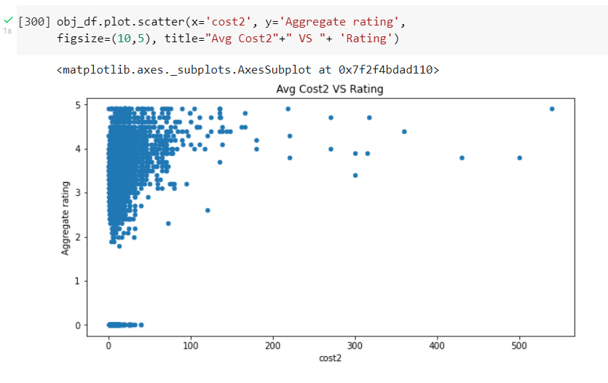
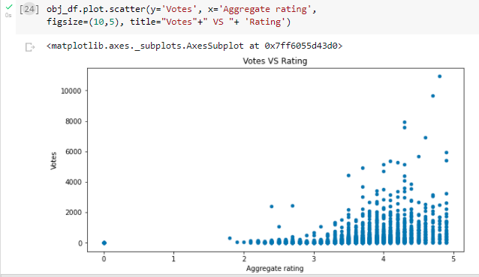
DATA ANALYSIS AND VISUALIZATION
BIVARIATE ANALYSIS

Slide 14
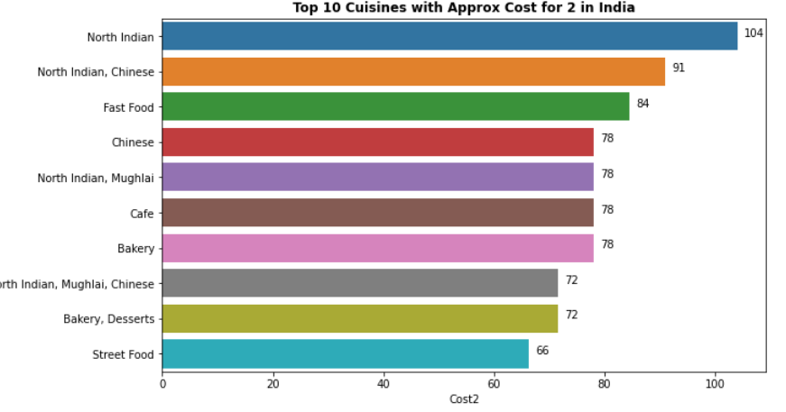
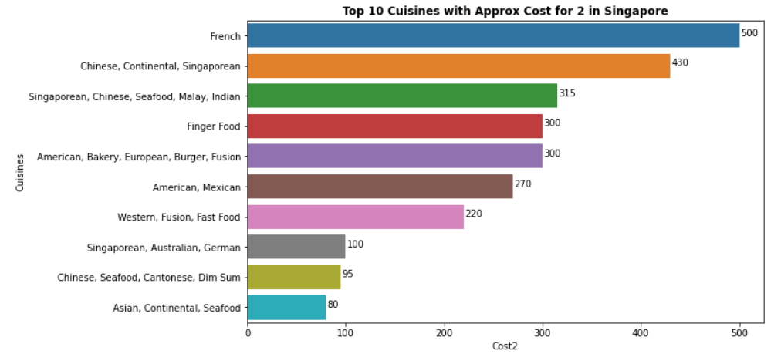
DATA ANALYSIS AND VISUALIZATION
BIVARIATE ANALYSIS

Slide 15

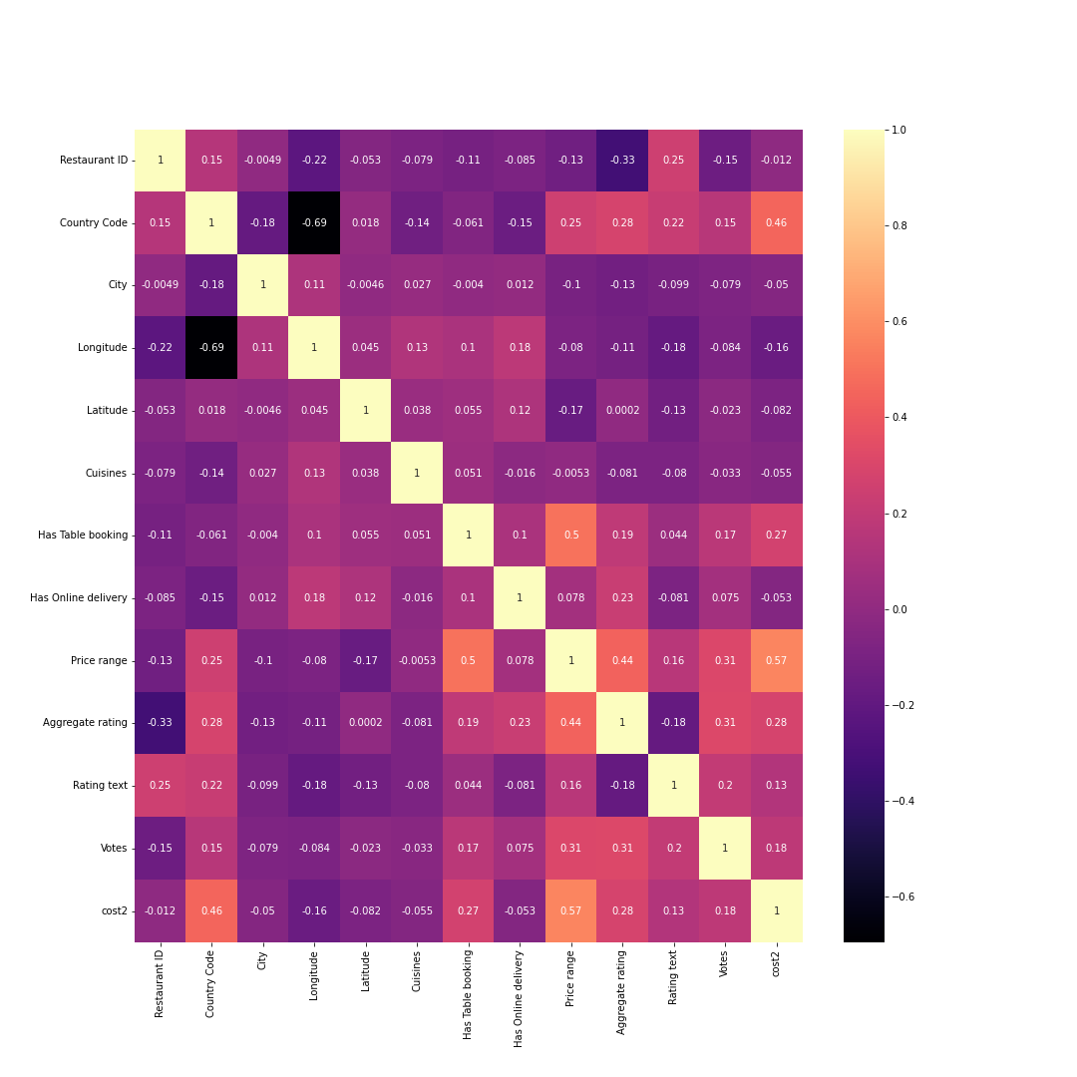
IDENTIFYING RELATIONS
1. Postive Correlation
2. Negative Correlation

Slide 16
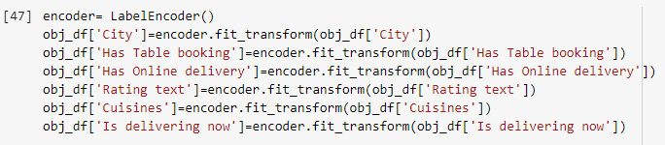
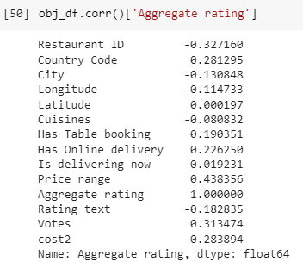
PREDICT AND EVALUATE

Slide 17
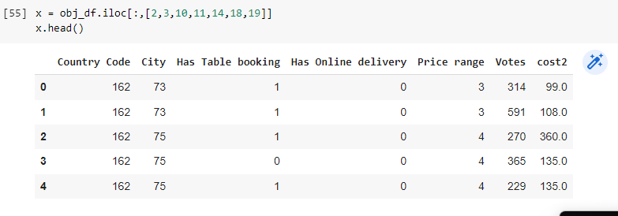
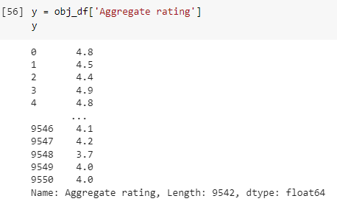
PREDICT AND EVALUATE

Slide 18
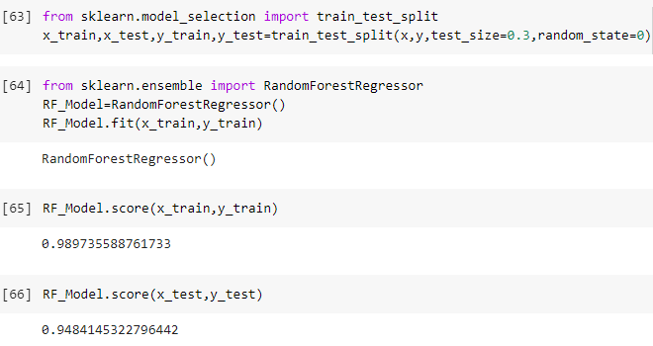
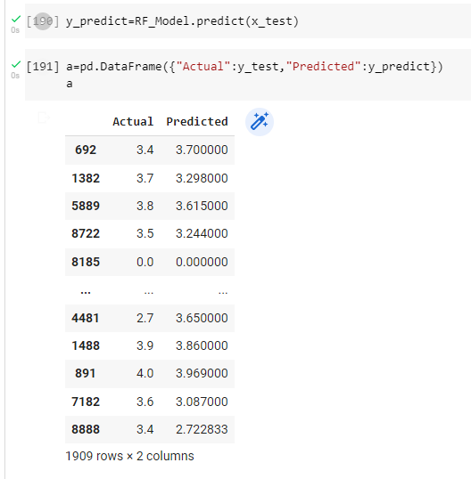
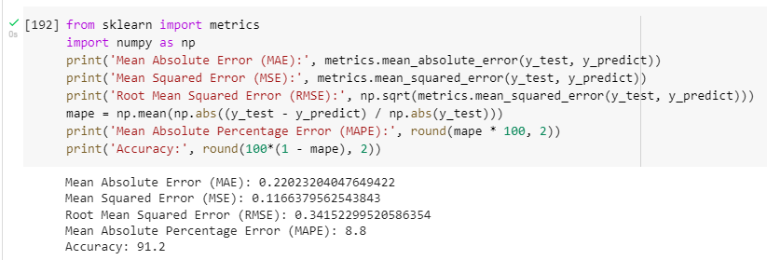
PREDICT AND EVALUATE

Slide 19
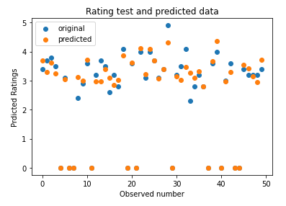
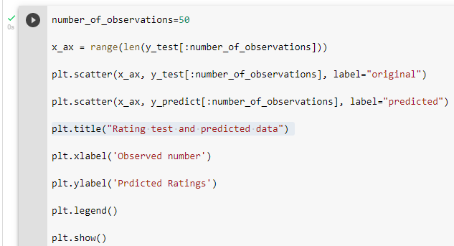
PREDICT AND EVALUATE

Slide 20




MADE BY
Anuli
Shinde
Vignesh
Suresh
Hanovar
Ravi
Sreejith
Menon

