Slide 1
PROJECT PRESENTATION
N100
N100 Financial Intelligence Platform
FINANCIAL INTELLIGENCE
From 12 raw workbooks to an auditable, production-grade analytical product
92 companies
30+ computed KPIs
6 sprints
01
Verified build · July 2026
A single source of truth for analysis, screening, reporting and serving.

Slide 2
EXECUTIVE OUTCOME
The platform is built, tested and review-ready
Concrete output—not a prototype: data foundation, analytics, reporting, dashboard, API and ML.
92
1,073
111
94.38%
companies fully covered
computed company-year ratios
automated tests passing
source-code coverage
Approval case
Messy, inconsistent workbook data now lands in an idempotent SQLite model, becomes independently tested financial intelligence, and is delivered through files, PDFs, Streamlit and FastAPI.
0 foreign-key violations
0 duplicate primary keys
Idempotent end-to-end rerun
N100 FINANCIAL INTELLIGENCE PLATFORM
02

Slide 3
PRODUCT VALUE
One platform answers four high-value questions
The design joins financial statements, market context and analytical evidence without mixing their semantics.
01
Can we trust the data?
02
Which companies stand out?
Registry-driven ingestion, explicit year/ticker rules, quarantines and complete validation evidence.
30+ ratios, six screeners, health scoring, sector medians and peer percentiles.
03
Why does a company stand out?
04
How is intelligence consumed?
Cash-flow intelligence, capital-allocation labels and confidence-scored pros/cons.
Excel, two-page PDFs, portfolio reports, a five-screen dashboard and 13 API routes.
N100 FINANCIAL INTELLIGENCE PLATFORM
03

Slide 4
DELIVERY ROADMAP
Six sprints move from data trust to product delivery
A 45-day roadmap organized around measurable exit gates.
SPRINT 5 · 70 STORY POINTS
1
2
3
4
5
6
Foundation & ETL
Ratio engine
Scores & peers
Valuation & UI
Intelligence & reports
API, ML & QA
Days 1–7
Days 8–14
Days 15–21
Days 22–28
Days 29–35
Days 36–45
12 datasets · SQLite · DQ
30+ KPIs · cross-validation
screeners · health · sector
valuation · Streamlit
cash flow · NLP · PDFs
FastAPI · clusters · tests
N100 FINANCIAL INTELLIGENCE PLATFORM
04

Slide 5
ARCHITECTURE
A registry-driven pipeline keeps every layer testable
TableSpec configuration controls loading, normalization, validation, deduplication and persistence.
12 Excel sources
TableSpec registry
Normalize + validate
Deduplicate + persist
Analytics + intelligence
Serve + report
Pure functions
normalizers · formulae · scoring
I/O adapters
Excel · SQLite · CSV/XLSX/PDF
Framework layer
Streamlit views · FastAPI routes
N100 FINANCIAL INTELLIGENCE PLATFORM
05

Slide 6
SPRINT 1 · DATA FOUNDATION
The data foundation makes known source defects explicit
Bad rows are explained and quarantined; retained rows preserve warning-level evidence.
12,892
12,108
784
0
source rows read
rows loaded
rows rejected
post-load FK violations
438 orphan rows
100 TTM rows
Mixed year formats
Quarantined by default because financial tickers were absent from the companies master.
Rejected from fiscal-year keyed P&L tables and logged as trailing-twelve-month observations.
Parsed into canonical YYYY-MM with flags for partial periods and assumed-March bare years.
Design contract
CRITICAL rejects · WARNING retains + flags · INFO counts only · positivity remains a warning, not a schema invariant
N100 FINANCIAL INTELLIGENCE PLATFORM
06

Slide 7
SPRINT 2 · FINANCIAL RATIOS
30+ KPIs computed directly from raw statements
The supplied ratios workbook is a cross-check reference—not the source of computed KPIs.
1,073
ROE
non-positive equity → None
company-year ratio rows
ICR
zero interest → Debt Free
30+
profitability · leverage · cash quality · growth · efficiency · valuation
P/E
non-positive PAT → None
Margins
zero sales → None
Cross-check result
Combined mean absolute divergence
CAGR
turnaround / decline / zero-base flags
0.002515
N100 FINANCIAL INTELLIGENCE PLATFORM
07

Slide 8
SPRINT 3 · HEALTH SCORE
Health scoring is robust to outliers and transparent by design
Latest-year features are winsorised P10–P90, scaled 0–100 and combined into fixed weighted components.
Score composition
Profitability
35%
Cash quality
30%
Growth
20%
Leverage
15%
ALL 92 COMPANIES SCORED
N100 FINANCIAL INTELLIGENCE PLATFORM
08

Slide 9
SPRINT 3 · DECISION LAYERS
Screeners and benchmarks turn ratios into decisions
Six configurable presets are complemented by real-sector medians and direction-aware peer ranks.
10 broad sectors
Derived from the source data. No hard-coded claim of 11 sectors.
11 peer groups
Percentile rank is calculated within peer group for every covered company.
Correct directionality
Higher-is-better metrics rank high; debt-to-equity is explicitly inverted.
N100 FINANCIAL INTELLIGENCE PLATFORM
09

Slide 10
SPRINT 5 · PLAN
Sprint 5 productionises intelligence and reporting in seven days
Days 29–35 · 70 story points · Epics 07, 08 and 09
29
30
31
32
33
34
35
Parse analysis text
Generate pros & cons
Cash-flow intelligence
Capital allocation
Tearsheet template
Batch reporting
Portfolio summary
regex · failures · divergence
24 rules · confidence >60
CFO quality · CapEx · distress
8 patterns · year-over-year change
2 pages · charts · word wrap
companies · sectors · visual QA
92 pages · sprint review
Definition of done
Every company gets evidence-backed narratives and cash-flow classification; every report renders cleanly.
N100 FINANCIAL INTELLIGENCE PLATFORM
10

Slide 11
SPRINT 5 · ACTUAL RESULTS
Sprint 5 meets the company-level intelligence goal
All 92 companies receive cash-flow classifications plus at least one pro and one con.
545
390 / 155
13
18
generated narratives
pros / cons
distress alerts
deleveraging flags
Analysis parser
Cash quality
Capital allocation
51 structured values parsed · 13 failures logged · 1 divergence flagged for manual review.
Five-year CFO/PAT classifies High Quality, Moderate or Accrual Risk.
Eight CFO/CFI/CFF patterns are assigned; 36 year-over-year pattern changes identified.
COVERAGE CHECK PASSED
92 / 92 companies have ≥1 pro and ≥1 con with confidence scores between 61% and 99%.
N100 FINANCIAL INTELLIGENCE PLATFORM
11

Slide 12
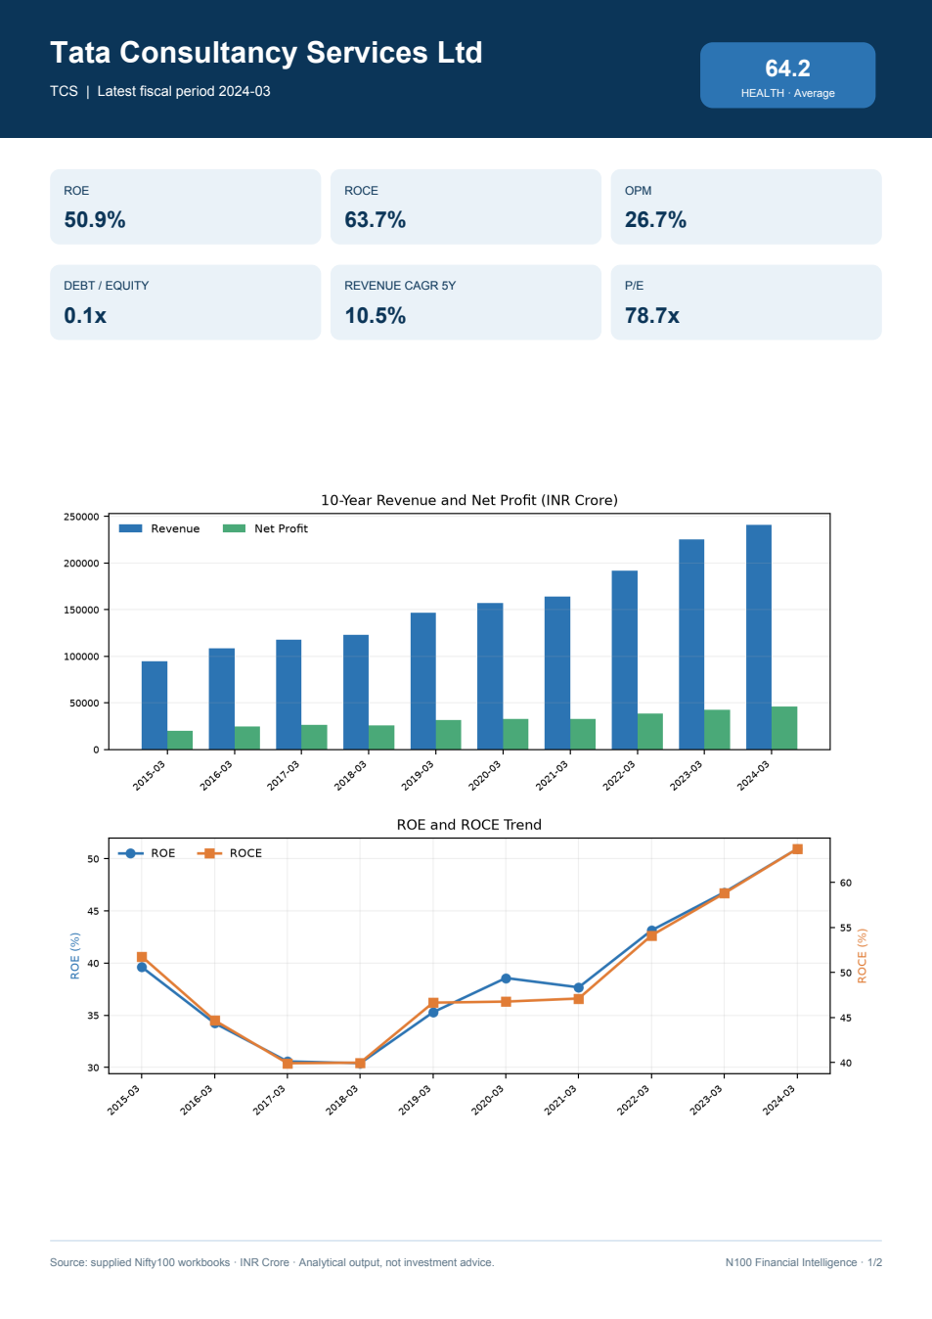
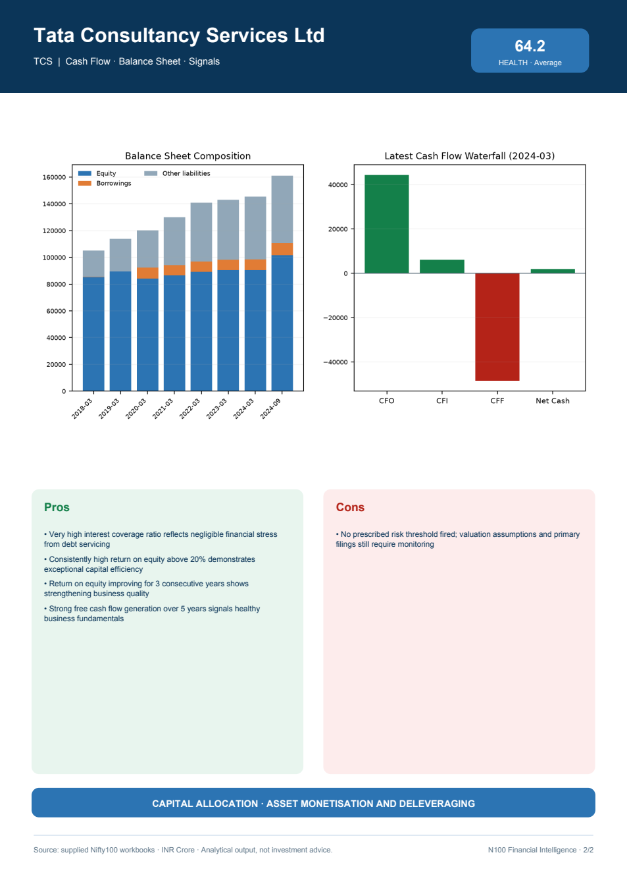
SPRINT 5 · REPORTING
Reporting at scale: PDFs, portfolio and Excel
Company, sector, portfolio and Excel outputs are generated from the same tested analytical layer.
Actual two-page company tearsheet · TCS
92
two-page tearsheets
10
sector PDFs
92
portfolio pages
23
Excel sheets verified
Plan said 11 sectors; source data has 10.
N100 FINANCIAL INTELLIGENCE PLATFORM
12

Slide 13
SPRINT 4 + 6 · SERVING
Interactive and programmatic access share one query layer
Framework wrappers stay thin; business logic remains independently unit-testable.
STREAMLIT
FASTAPI
5 screens
13 routes
01
Overview
/health /companies/{ticker} /pl · /bs · /cashflow · /ratios /documents · /screener /sectors · /peers/{group} /portfolio/stats
02
Company Profile
03
Screener
04
Sector
05
Peer
AUTO OPENAPI DOCUMENTATION AT /DOCS
N100 FINANCIAL INTELLIGENCE PLATFORM
13

Slide 14
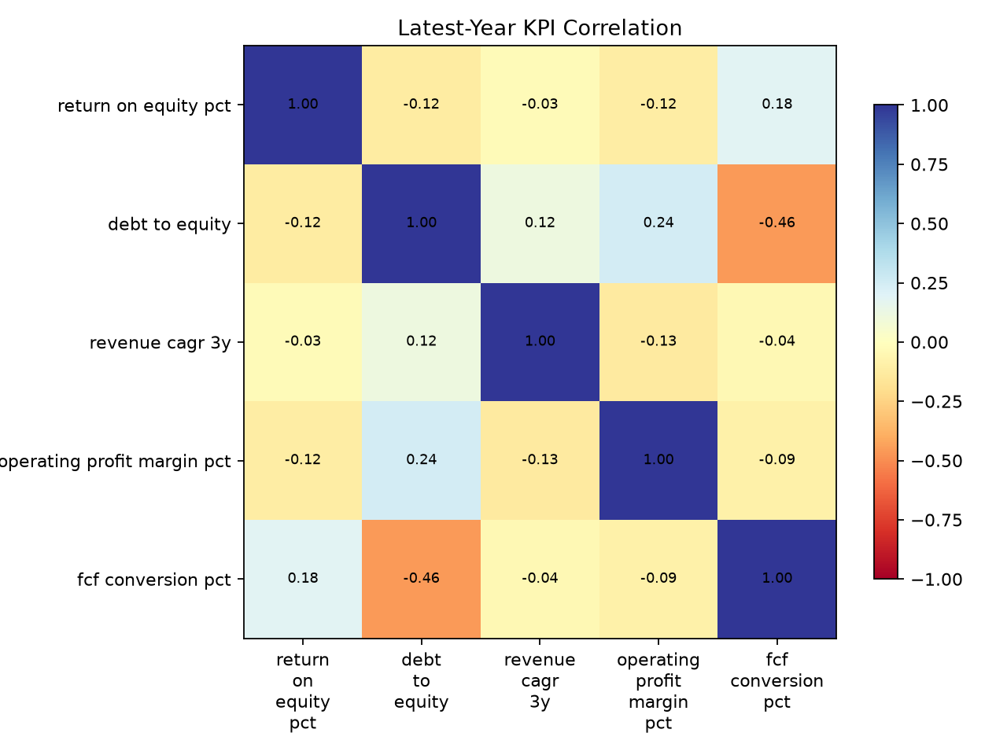
SPRINT 6 · MACHINE LEARNING
Clustering adds a portfolio-level view of financial archetypes
Five latest-year features are winsorised, standardised and grouped with KMeans.
Feature correlation
ROE
D/E
Revenue CAGR
OPM
FCF conversion
Cluster assignment
C0
23
C1
24
C2
17
C3
12
C4
16
N100 FINANCIAL INTELLIGENCE PLATFORM
14

Slide 15
QA EVIDENCE
Verification evidence supports production handoff
The exit gates cover data integrity, analytical correctness, artifact rendering and code quality.
111
94.38%
0
tests pass
coverage
FK violations
ETL · analytics · API · integration
above the 80% target
PRAGMA foreign_key_check
155 KB
0
0
minimum PDF
blank pages
text overflow
above the 30 KB Sprint 5 gate
all reports rendered and inspected
five-company visual review + batch QA
N100 FINANCIAL INTELLIGENCE PLATFORM
15

Slide 16
RISKS + DECISIONS
Data realities are treated as design inputs—not surprises
Transparent assumptions protect analytical meaning and prevent false completeness.
Reality
Platform decision
Why it matters
10 sectors, not 11
Generate 10 source-derived sector PDFs
Avoid inventing an empty sector
Simulated market multiples
Keep valuation separate from raw-derived ratios
Preserve lineage and semantics
Orphan tickers
Quarantine by default; policy is configurable
Protect referential integrity
Extreme COVID-era ROE
Winsorise before scores and clusters
Reduce tiny-equity distortion
Limited history
Flag coverage; do not fabricate trends
Keep comparisons honest
N100 FINANCIAL INTELLIGENCE PLATFORM
16

Slide 17
DEMO FLOW
The demo follows the same path as a production user
A short, evidence-led walkthrough proves reproducibility, usefulness and delivery quality.
01
02
03
04
05
Reproduce
Explore
Inspect
Query
Decide
make all make test
Streamlit 5 screens
TCS tearsheet Excel exports
FastAPI /docs 13 routes
screeners · scores clusters · alerts
Fresh setup: python -m venv .venv → pip install -r requirements.txt → make all → make test
N100 FINANCIAL INTELLIGENCE PLATFORM
17

Slide 18
PRODUCTION HANDOFF
The platform is ready for technical review and operational use.
N100
READY
Auditable data · tested analytics · complete Sprint 5 intelligence · multi-channel delivery
Decision requested
Approve production handoff
92 companies
111 tests
0 FK violations
N100 FINANCIAL INTELLIGENCE PLATFORM
18

