Slide 1
BLUESTOCK FINTECH
Mutual Fund
Analytics
A 7-Day Data Analytics Capstone
40 schemes · 46,000 daily NAVs · ~32,800 transactions · 2022–2026
Prepared by Anumana Bhattacharya

Slide 2
01 · CONTEXT
Problem & Objective
The challenge
The objective
The outcome
Mutual-fund data is fragmented across NAV feeds, AUM reports, transactions and holdings — hard to analyse holistically.
Build one reproducible pipeline that ingests, cleans, warehouses and analyses it end-to-end.
A SQL warehouse, dashboard, performance scorecard and risk analytics — portfolio-grade.

Slide 3
02 · DATA
Data Sources & Scope
10
46,000
32,778
7
source datasets
daily NAVs
transactions
benchmark indices
Provided: fund master, NAV history, scheme performance, investor transactions, portfolio holdings, AUM by house, SIP inflows, category inflows, folio counts, benchmark indices.
Live: daily NAV pulled from the AMFI-backed mfapi.in REST API (GET /mf/<scheme_code>) for six schemes.
Coverage: 40 schemes across 10 AMCs, January 2022 – May 2026.

Slide 4
03 · PIPELINE
Architecture
Ingest
→
Clean
→
SQLite
warehouse
→
EDA
→
Performance
→
Dashboard
→
Advanced
analytics
Seven standalone, documented Python scripts orchestrated by run_pipeline.py. Data flows from raw CSVs + live API → cleaned tables → a 10-table SQLite star schema (dim_fund hub + 9 fact tables) → analytics, dashboard and reporting layers.

Slide 5
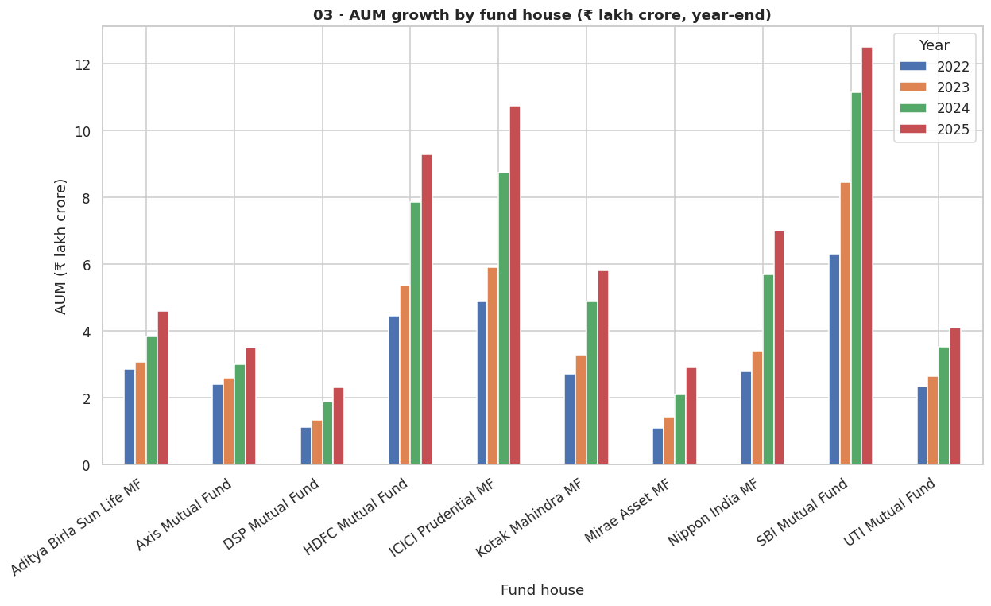
04 · EDA
Industry Growth
AUM by fund house
• SBI leads at ₹12.5L cr (2025)
• All 10 AMCs ~doubled AUM since 2022
• Top 3 (SBI, ICICI, HDFC) hold the bulk of assets
Industry AUM in the 10-AMC sample grew from ₹30L cr to ₹62.7L cr.

Slide 6
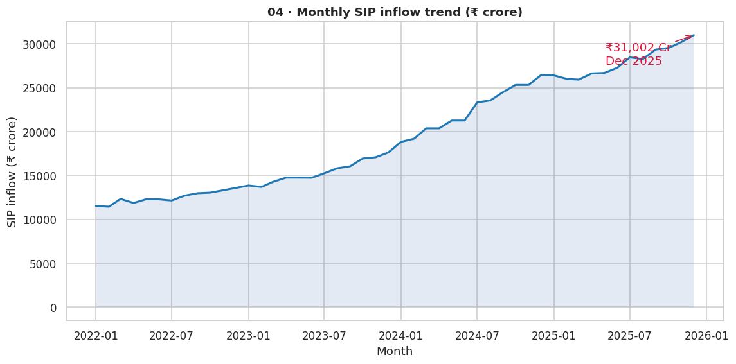
04 · EDA
SIP & Retail Momentum
Monthly SIP inflows
• Record ₹31,002 cr in Dec 2025
• ~31% average YoY growth
• Folios nearly doubled: 13.26 → 26.12 cr
Systematic investing is the dominant, structurally growing channel.

Slide 7
05 · PERFORMANCE
Fund Scorecard
Composite 0–100: 30% 3-yr return · 25% Sharpe · 20% alpha · 15% expense · 10% max-DD
# | Fund | Category | Score
1 | Mirae Asset Large Cap | Large Cap | 85.9
2 | ICICI Pru Midcap | Mid Cap | 82.5
3 | Kotak Flexicap | Flexi Cap | 81.6
4 | HDFC Mid-Cap Opportunities | Mid Cap | 80.4
5 | ICICI Pru Bluechip | Large Cap | 79.6
Top performer
Mirae Asset
Large Cap
85.9 / 100

Slide 8
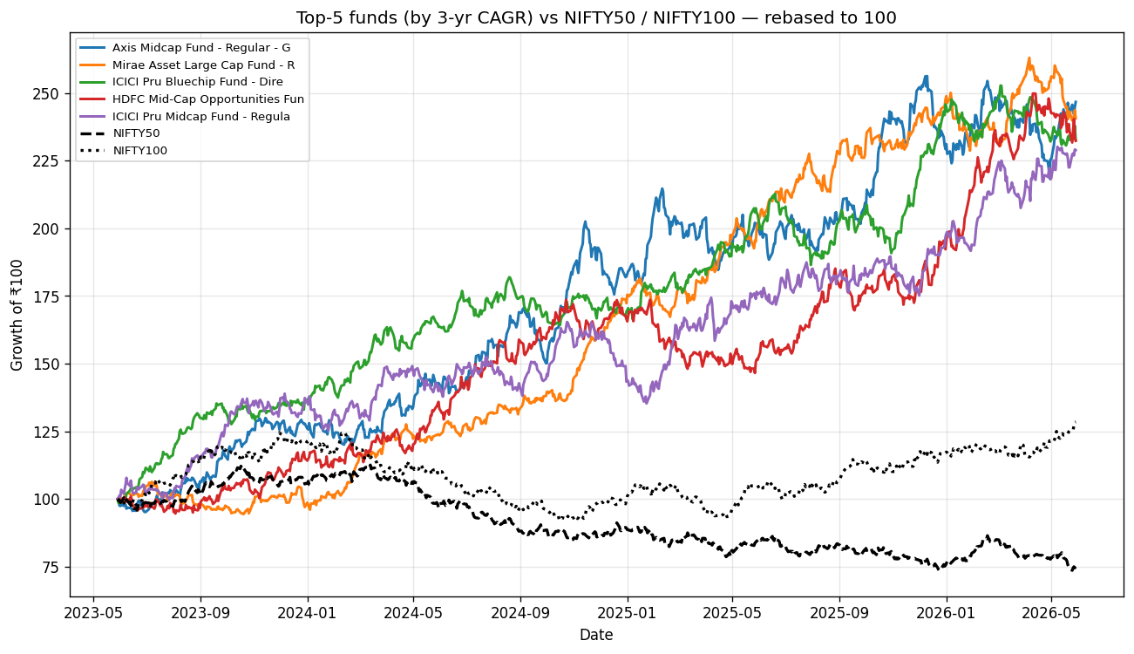
05 · PERFORMANCE
Returns vs Benchmark
Top-5 funds vs NIFTY50/100
(rebased to 100)
• Mid/large-cap leaders outpace the indices
• Metrics: CAGR, Sharpe, Sortino, max-DD
Note: synthetic NAVs are independent of the market, so alpha/beta are illustrative (β≈0).

Slide 9
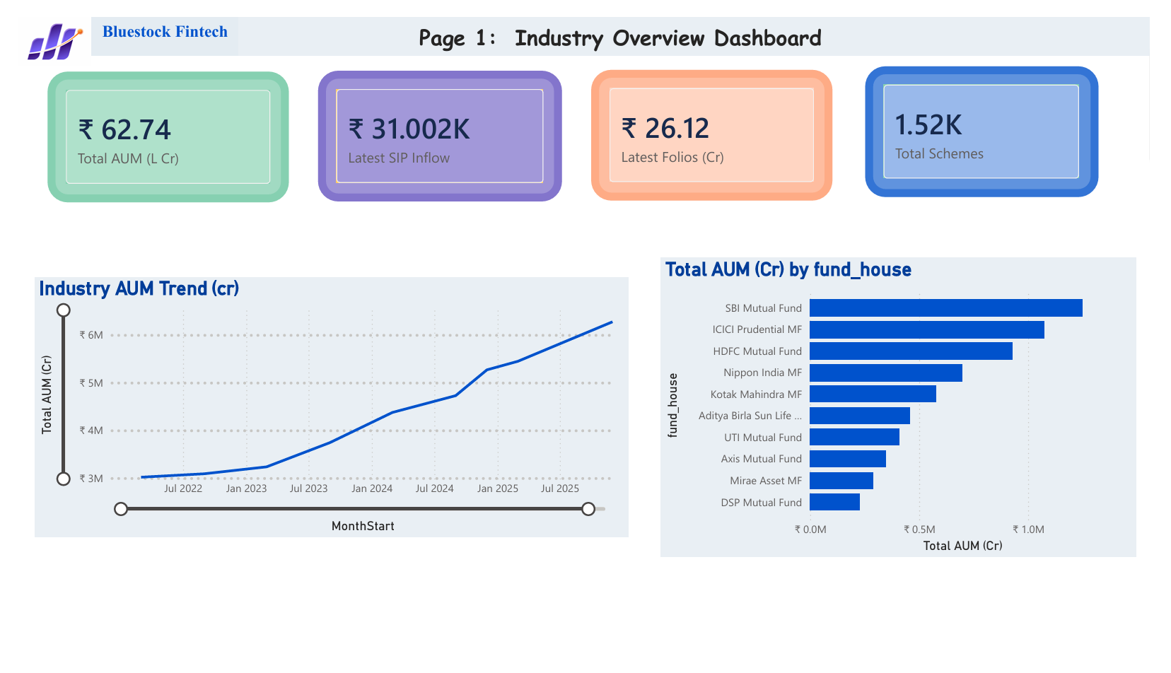
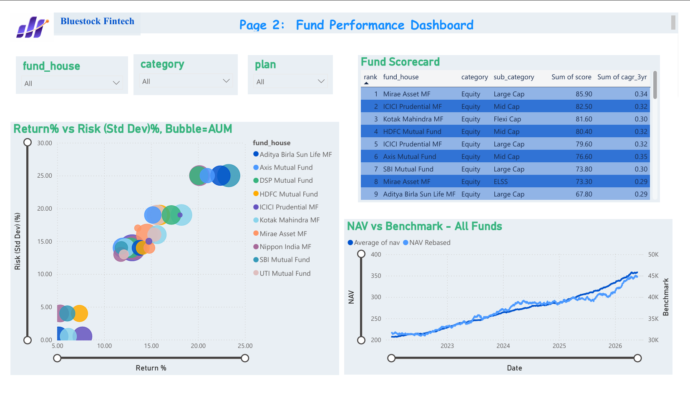
06 · DASHBOARD
Power BI — Industry & Performance
Page 1 — Industry Overview Page 2 — Fund Performance

Slide 10
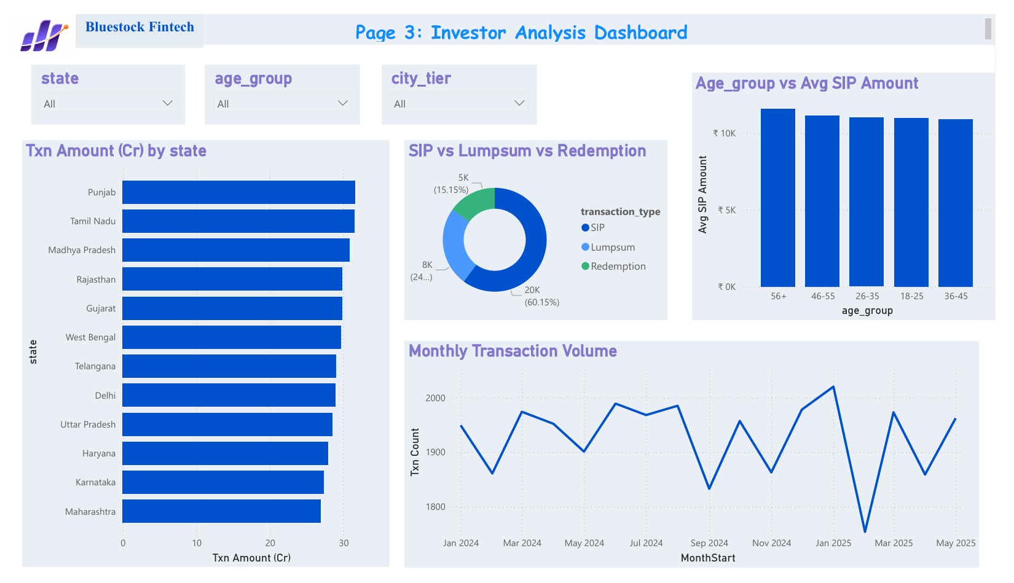
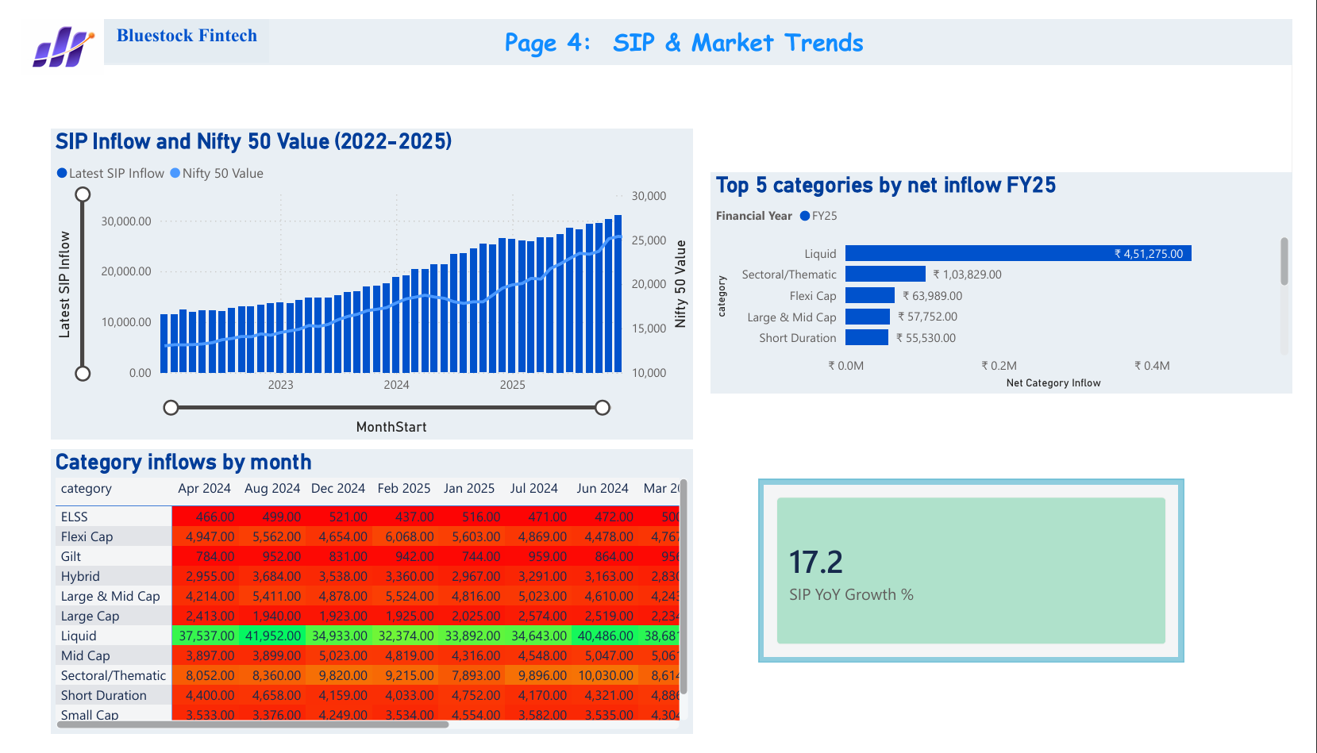
06 · DASHBOARD
Power BI — Investors & Trends
Page 3 — Investor Analytics Page 4 — SIP & Market Trends

Slide 11
07 · INSIGHTS
Key Findings
1
SBI dominates AUM
₹12.5L cr at end-2025, ahead of ICICI & HDFC
2
SIP at record highs
₹31,002 cr/month, ~31% YoY growth
3
Small-caps = tail risk
Daily VaR₉₅ ≈ −2.7%, deepest of all funds
4
Sector concentration
Most equity funds exceed HHI 0.18
5
Young, T30-led base
26–35 cohort core; T30 drives ~66% of flows

Slide 12
Thank You
Bluestock Fintech — Mutual Fund Analytics Capstone
Deliverables: ETL pipeline · SQLite warehouse · 4-page Power BI dashboard · performance scorecard · advanced risk analytics · final report.

