Slide 1
30-Day Readmission Analysis Among Diabetic Patients
Capstone Project 1 | S.M. Anusuya
Tools: Python | MySQL | Power BI | GitHub
Notes:
Say: Hello, I'm S.M. Anusuya. My project analyses about 100,000 hospital records of diabetic patients to find which factors are linked to readmission within 30 days.

Slide 2
Business problem and objective
Readmissions are costly
8.98%
Patients return to hospital within 30 days of leaving.
It can mean follow-up care was not enough.
of patients came back within 30 days
Managers need to know who returns
6,283 of 69,979 patients.
About 1 patient in 11.
Staff and time are limited.
Knowing high-risk patients helps plan follow-up.
Goal: find factors linked to readmission
I compare readmission rates across patient groups.
A higher rate is a warning sign, not proof of a cause.
Capstone Project 1 | 30-Day Readmission Analysis | 2

Slide 3
Dataset and workflow
Item | Detail | What it means
Source | UCI repository, CC BY 4.0 | A public research dataset anyone can download and cite.
Size | 101,766 rows x 50 columns | 130 hospitals over 10 years, enough to see clear patterns.
One row | One hospital encounter | One stay of one patient. A patient can appear many times.
Key fields | Age, days in hospital, diagnosis, A1C, readmitted | The first four are possible factors. Readmitted is the result.
Python: clean
→
MySQL: ask
→
Power BI: show
Fix repeats and missing values.
Group patients, check the numbers.
Clickable dashboard for managers.
Data link: archive.ics.uci.edu/dataset/296
Capstone Project 1 | 30-Day Readmission Analysis | 3
Notes:
Say: I used the Diabetes 130-US Hospitals dataset from the UCI repository. It has 101,766 rows and 50 columns, and each row is one hospital encounter. I used three tools, each for one job: Python cleaned the data, MySQL stored it and answered nine business questions, and Power BI told the story in a dashboard. The same numbers matched in all three.

Slide 4
Data cleaning: before and after
Before
Rule | Rows removed | Why
Invalid gender | 3 | Cannot be used in gender analysis.
Died or hospice | 2,423 | They cannot be readmitted, so they would lower the rate.
No primary diagnosis | 20 | I group patients by diagnosis.
Repeat visits (first kept) | 29,341 | Each patient counts once, so frequent patients do not dominate.
101,766
After (patients)
69,979
Weight column dropped (96.9% missing). 0 missing values left.
Capstone Project 1 | 30-Day Readmission Analysis | 4
Notes:
Say: I removed 31,787 rows. 29,341 were repeat visits by the same patient, 2,423 were patients who died or went to hospice and cannot be readmitted, and 23 had an invalid gender or no diagnosis. One challenge: 81.65 percent of patients had no A1C test. I kept 'Not tested' as its own group instead of guessing. The result is 69,979 patients and no missing values.

Slide 5
SQL analysis: 3 of 9 questions
Do prior visits matter?
Who is high risk?
Which diagnosis?
0 visits | 7.94%
6+ visits | 18.00%
High | 17.42%
Medium | 12.13%
Lower | 8.14%
Injury | 10.80%
Respiratory | 7.30%
Patients who visited often last year return more often.
Prior visits are known on day one, so they are an early warning.
The rate changes with the main diagnosis.
Injury is above the 8.98% average, Respiratory is well below.
High = 3+ prior visits and 8+ days stay.
Only 683 patients (1%), but about twice the average rate.
Capstone Project 1 | 30-Day Readmission Analysis | 5
Notes:
Say: In MySQL I wrote nine queries. Here are three. Patients with no prior visits had a 7.94 percent rate, and with six or more it was 18.00 percent. My risk groups give 17.42 percent for high risk against 8.14 percent for lower risk. Injury is the highest diagnosis at 10.80 percent. These numbers matched Python and Power BI.

Slide 6
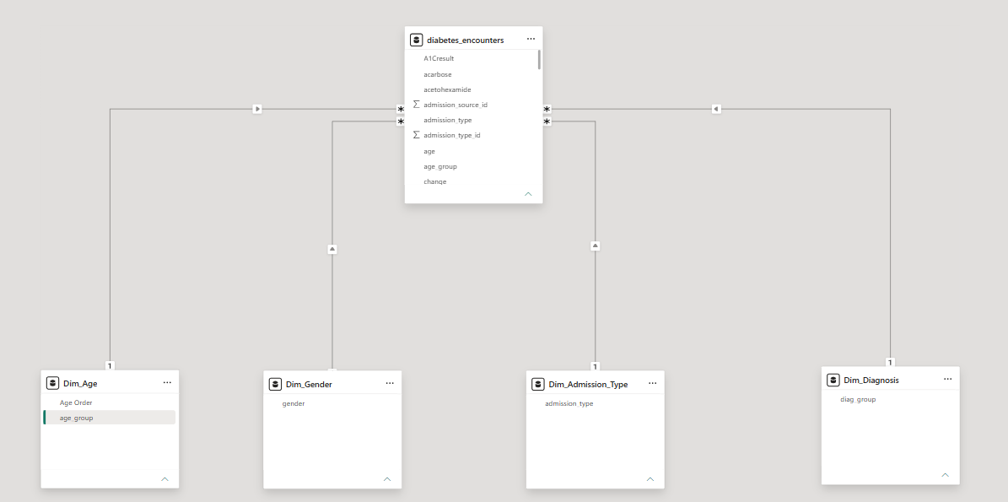
Data model: star schema
1 fact table: patients
One row per patient; holds all the measurements.
4 lookup tables
Age, gender, admission type, diagnosis. They give clean slicer lists.
Relationships feed 4 slicers
Picking a value filters every chart at once.
3 DAX measures
Total Patients, Readmitted Patients, and Rate = readmitted / total.
Capstone Project 1 | 30-Day Readmission Analysis | 6
Notes:
Say: In Power BI I built a star schema. The middle table has one row per patient, and four lookup tables for age, gender, admission type and diagnosis connect to it and feed the slicers. I wrote three DAX measures: Total Patients, Readmitted Patients, and Readmission Rate, which divides the second by the first.

Slide 7
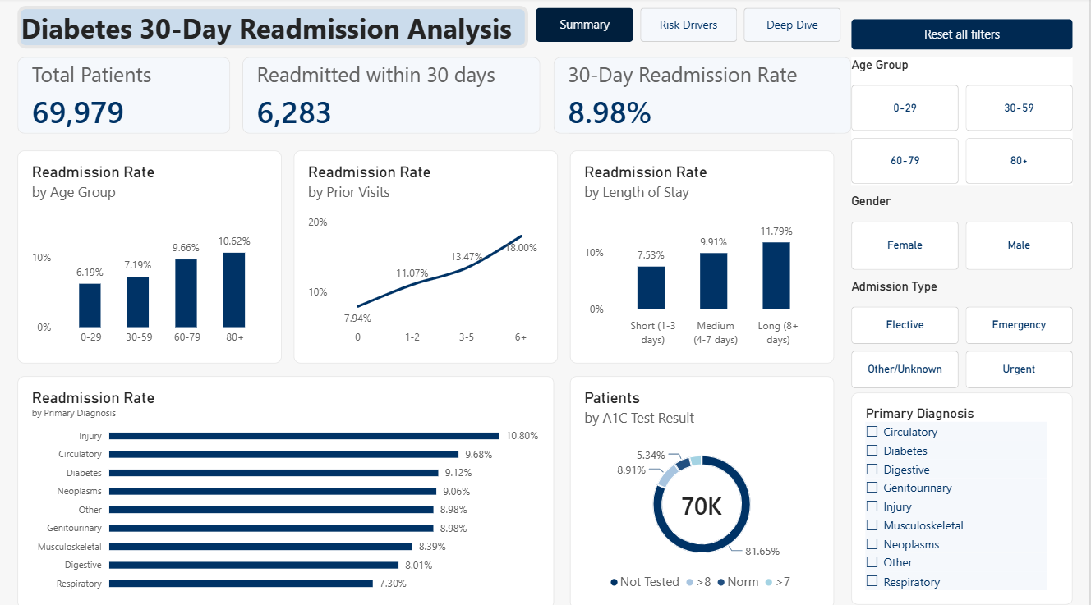
Dashboard 1: Summary
3 KPI cards
69,979 patients, 6,283 readmitted, 8.98% rate. They answer: how big is the problem?
Rate rises with age
6.19% for ages 0-29 up to 10.62% for 80+. Older patients return more often.
Rate rises with prior visits
7.94% with none up to 18.00% with 6+. Past visits warn about a return.
Capstone Project 1 | 30-Day Readmission Analysis | 7
Notes:
Say: This is the Summary page. The cards show 69,979 patients, 6,283 readmitted and a rate of 8.98 percent. Notice that the rate rises with age and with the number of prior visits.

Slide 8
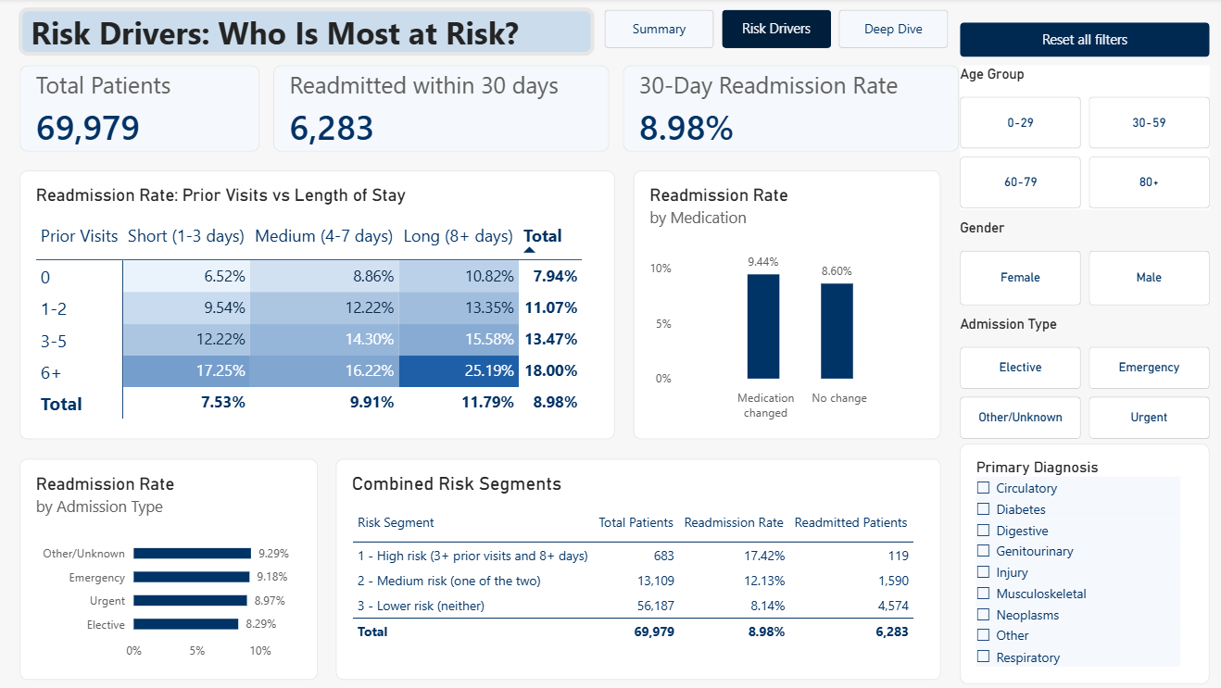
Dashboard 2: Risk Drivers
Matrix: prior visits by stay
Shows both factors in one table. A darker cell means a higher rate.
Highest cell: 25.19%
6+ prior visits and 8+ days. Almost 3 times the 8.98% average.
Risk segments table
High 17.42%, Medium 12.13%, Lower 8.14%. A simple way to spot who needs follow-up.
Capstone Project 1 | 30-Day Readmission Analysis | 8
Notes:
Say: On the Risk Drivers page the matrix shows the rate by prior visits and length of stay. The darkest cell is 25.19 percent, for six or more prior visits and a stay of eight days or more. In a live demo, click Age 80 plus and the rate changes to 10.62 percent, then press Reset all filters.

Slide 9
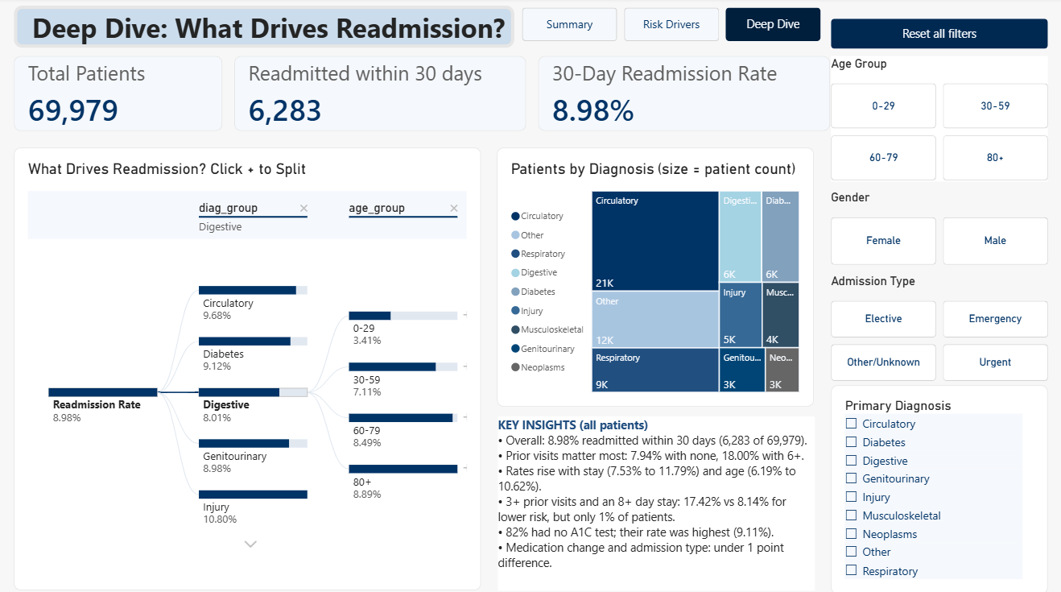
Dashboard 3: Deep Dive
Decomposition tree
Click + to split the rate by diagnosis, then by age. It shows where the rate is highest.
Example path
Injury is 10.80%. Digestive, then age 80+, is 8.89%.
Treemap
Box size = number of patients. Circulatory is the biggest group (about 21K).
Key insights box
A short summary of the findings for the viewer.
Capstone Project 1 | 30-Day Readmission Analysis | 9
Notes:
Say: The third page is Deep Dive. The decomposition tree lets me click plus and split the readmission rate by diagnosis and then by age group, so I can find where the rate is highest. For example, Injury is 10.80 percent, while the Digestive diagnosis for patients aged 80 plus is 8.89 percent. The treemap shows how many patients are in each diagnosis, and the text box repeats the key insights.

Slide 10
Key insights: what the numbers mean
8.98%
18.00%
11.79%
17.42%
readmitted in 30 days
with 6+ prior visits
after stays of 8+ days
in the high-risk group
More than double the 7.94% with none.
The strongest factor I found.
6,283 of 69,979 patients came back.
About 1 patient in 11.
Against 7.53% for 1-3 days.
Long stays may be more complex cases.
3+ prior visits and 8+ days, 683 patients.
The lower-risk group is only 8.14%.
Also: 81.65% had no A1C test, and their rate was highest (9.11%). These are associations, not causes.
Capstone Project 1 | 30-Day Readmission Analysis | 10
Notes:
Say: Four findings. One, 8.98 percent of patients were readmitted. Two, prior visits is the strongest factor, 18.00 percent with six or more. Three, stays of eight days or more reach 11.79 percent. Four, the high-risk group is at 17.42 percent against 8.14 percent for lower risk. These are associations, not causes.

Slide 11
Recommendations: what to do
1 Follow up high-risk patients
2 Flag prior visits at admission
3 Review discharge after long stays
683 patients at 17.42%
7.94% up to 18.00%
11.79% vs 7.53%
A small group with almost twice the average rate.
A call or visit after discharge is low-cost.
Prior visits are known on the first day.
Staff can plan discharge early.
Long stays return more often.
Check home care before the patient leaves.
These are ideas to test with a small pilot, not proven actions.
Capstone Project 1 | 30-Day Readmission Analysis | 11
Notes:
Say: So I recommend three actions. Follow up the 683 high-risk patients. Flag patients with many prior visits when they are admitted. Review discharge planning after long stays. These are ideas to test, for example with a small pilot, not proven actions.

Slide 12
Learnings and next steps
Learned: clean first, then ask questions
Dirty data gives wrong numbers. I checked the same numbers in 3 tools.
Next: build and test a prediction model
My risk groups are simple rules, not a validated model.
Next: pilot follow-up for high-risk patients
Test the ideas on a small group before changing care.
Thank you
GitHub: github.com/anumasi-analytics/diabetes-readmission-analysis
Notes:
Say: I learned to clean the data first and to check the same numbers in three tools. The limits are that results show associations, not causes, the risk groups are simple rules and not a model, and I kept only each patient's first encounter. Next I would build and test a prediction model. Thank you, the code is on GitHub, and I'm happy to take questions.

