Slide 1
Quadtrees
IT204 project
Anumeha Agrawal
Aditi Rao
Praneeta D
Spandana B

Slide 2
Quadtrees implementation
Image Processing using Quadtrees
Surface Mapping using Quadtrees

Slide 3
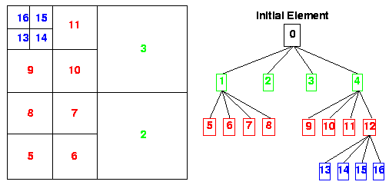
Quadtrees implementation
A quadtree is a tree data structure in which each internal node has at most four children
Quadtrees are trees used to efficiently store data of points on a two-dimensional space.

Slide 4
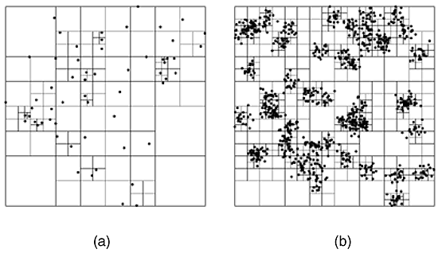

Slide 5
Image Processing using
Quadtrees
We create a complete quadtree with the leaf nodes consisting of individual pixels of the image.
The input image can be compressed to our
required level.

Slide 6

Original Image

Slide 7
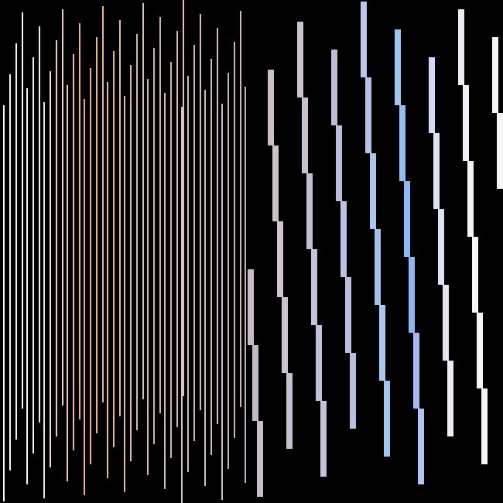
Compression at level 4

Slide 8
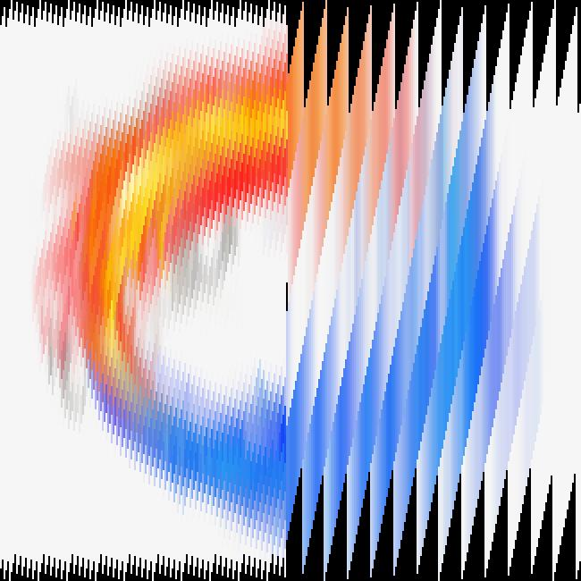
Compression at level 6

Slide 9

Compression at level 9

Slide 10
Surface Mapping using
Quadtrees
A 3-D graph is given whose z-coordinates are taken as the input data for the tree
The data is converted into pixels.
The pixels are pooled up to generate the image.

Slide 11
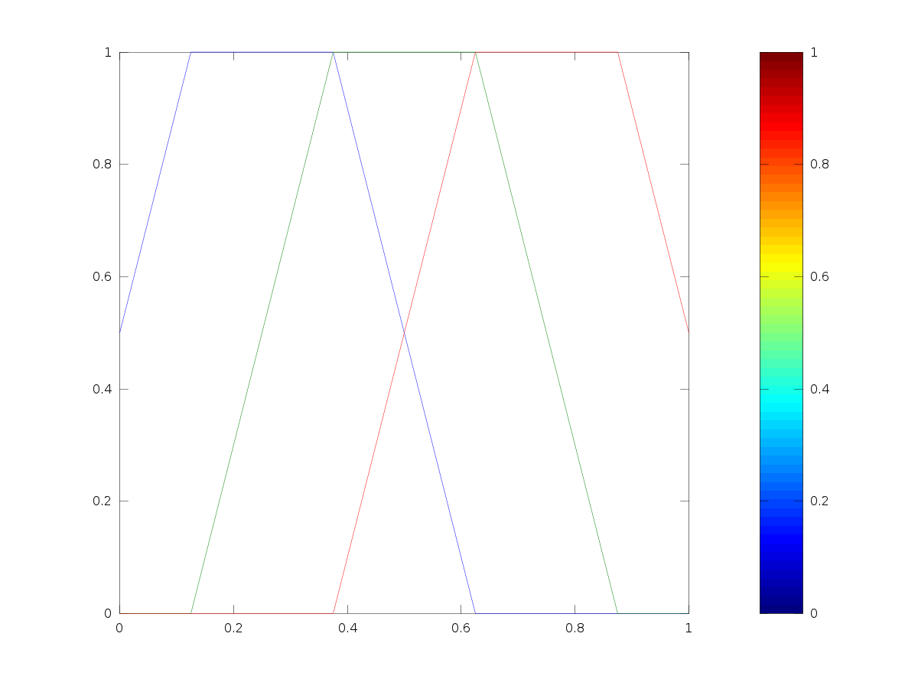
Color Plot

Slide 12
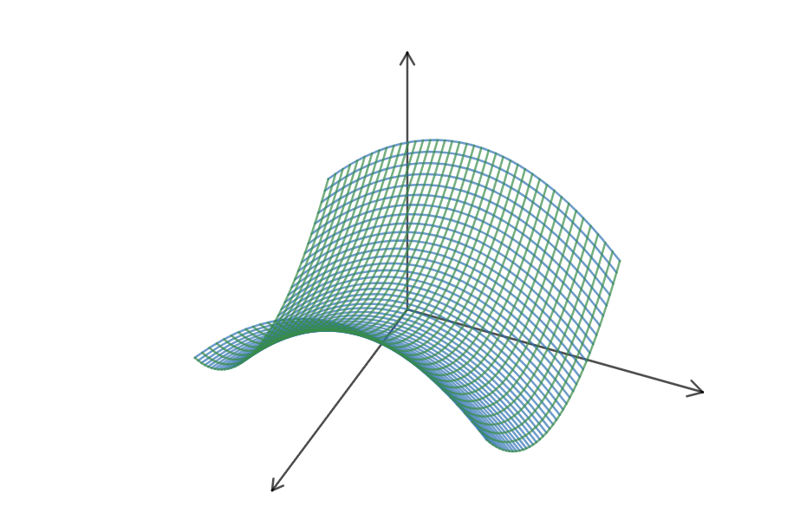
(X^2 – Y^2)/6

Slide 13
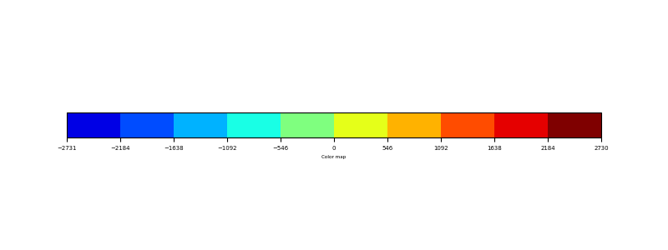
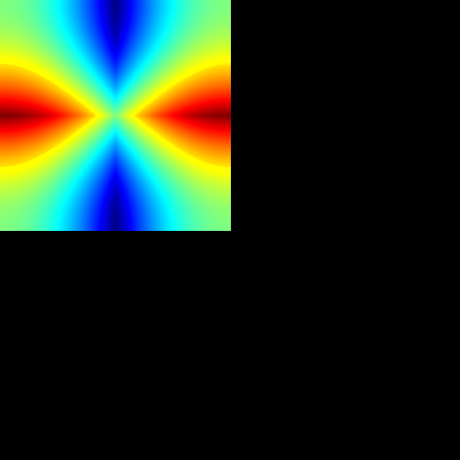
Color map
Color graph

Slide 14
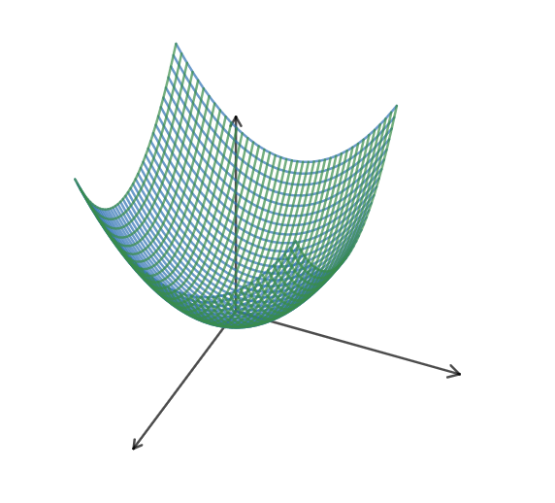
(X^2 + Y^2 )/4

Slide 15
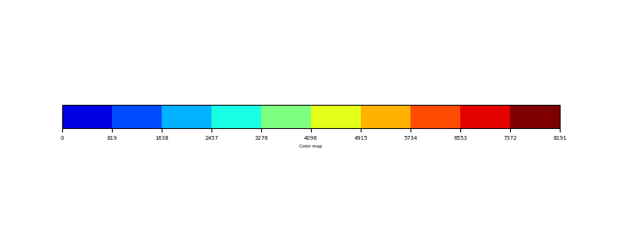
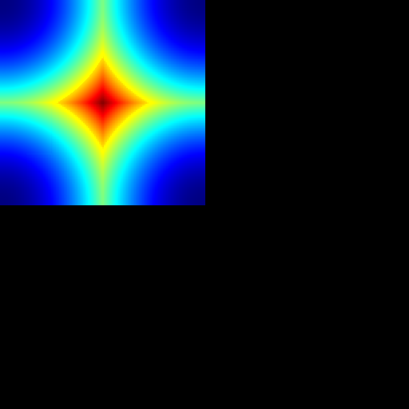
Color map
Color graph

Slide 16
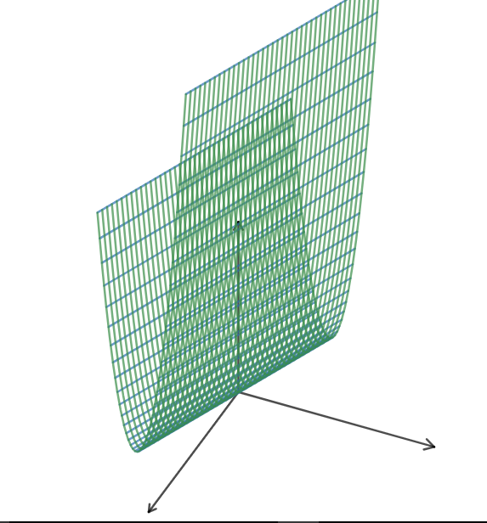
X^2+Y

Slide 17
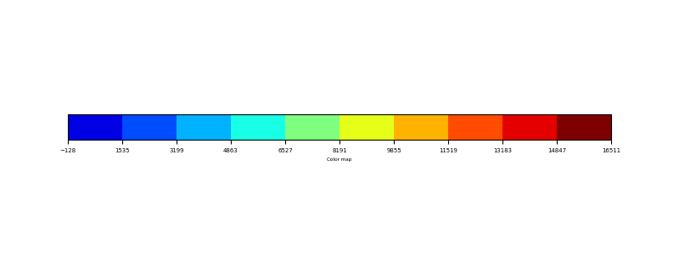
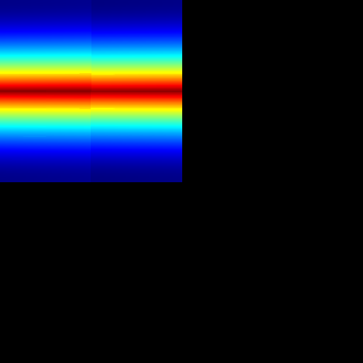
Color map
Color graph

