Slide 1
Applying Symbolic Execution to Test Implementations of a Network Protocol Against its Specification
Hooman Asadian, Paul Fiterau-Brostean, Bengt Jonsson, Konstantinos Sagonas
Notes:
Hello and Welcome to this talk.
My name is Hooman Asadian and In the following minutes, I present our work on applying symbolic execution to test the implementations of network protocols against the protocol’s specification.

Slide 2
Introduction
Testing correctness of network protocol implementations is essential
A successful software testing technique is symbolic execution
However, it is not so effective at testing stateful systems
This work:
Presents a methodology that makes symbolic execution effective in
Testing network protocol implementations, and
Exposing requirement violations using assumptions and assertions
Applies this methodology to implementations of the DTLS protocol
Revealing numerous new security vulnerabilities and bugs in them
Notes:
Our world has become reliant on network protocols.
Therefore, It is essential that the implementations of these protocols are thoroughly tested.
One proven testing technique is symbolic execution. However, when applied to implementations of network protocols, symbolic execution is less effective since these implementations are typically stateful.
In this work: (advance)
We introduce a methodology that makes symbolic execution effective in testing network protocol implementations. and exposing requirement violations using assumptions and assertions. (advance)
We applied our methodology to implementations of the DTLS protocol.
Our application uncovered numerous new security vulnerabilities and bugs.

Slide 3
Methodology
Extract Specification Requirements
Represent the requirements by logical formulas
Augment the SUT with assumptions and assertions
Assume inputs under which a requirement can be violated
Assert that no forbidden action is performed
Symbolic Execution
Explores the paths in the augmented SUT
Test Case Construction and Validation
Confirm the bug on the unmodified SUT
Notes:
Here I will give an overview of our methodology. Our methodology consists of 4 steps of which the first two are manual. (advance)
When we are planning to test the implementations of a specific protocol:
In the first step, we extract the requirements from the protocol's specification. These requirements are then represented by logical formulas.
In the next step, we add assumptions and assertions to the system under test. More specifically, we add assumptions over inputs, under which a requirement can be violated and assert that no forbidden action is performed. (advance)
Later, a symbolic execution tool automatically explores the paths in the augmented SUT looking for assertion violations, crashes, memory errors, etc, and produces concrete inputs for each individual path(advance)
For inputs exposing bugs, we construct test cases which we run on the unmodified SUT in order to validate the bugs.

Slide 4
1- Extract Specification Requirements
Requirements from the protocol RFC are identified by particular keywords:
MUST, MUST NOT, SHOULD, SHOULD NOT, …
Two types of requirements are extracted:
Input validity requirements
Input-output requirements
Represent the requirements by logical formulas
Notes:
Now, Let us explain each step in more detail by giving some examples.
If we want to check the implementations of a specific protocol, we start with the protocol’s RFC.
We can identify the requirements existing in the RFC by keywords such as MUST, MUST Not, should, should not, and so on.
We extract two types of requirements:
Input validity requirements: are concerned with the well-formedness of (a sequence of) inputs.
Input-output requirements: are concerned with the output generated in response to (a sequence of) inputs.
We represent these requirements by logical formulas.

Slide 5
Input Validity Requirements
E.g., the DTLS 1.2 RFC states:
“For each received record, the receiver MUST verify that the record contains a sequence number that does not duplicate the sequence number of any other record received during the life of this session.’’
For a set of Records $R$, received during a DTLS session:
$$∀ r, r′∈R: r≠r′⟹r.sequence_number ≠ r′.sequence_number$$
Notes:
Here I will give an example of an input validity requirement and how we formulate it.
The DTLS 1.2 RFC in a nutshell requires that:
Received records have unique sequence numbers during the life of a session.
We can express this requirement for a set of received records using the following formula. (advance)
Notice that our formula specifies that for every two records that are not the same, the sequence numbers should be different.

Slide 6
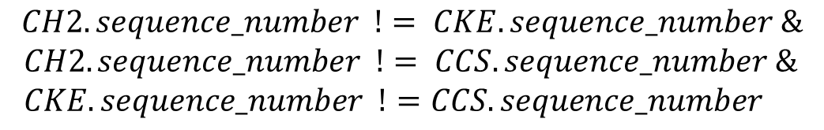



2- Augment the SUT with Assumptions
$$∀ r, r′∈R: r≠r′⟹r.sequence_number ≠ r′.sequence_number$$
$$R= \{ CH2, CKE, CCS\}$$
Pair-wise conjunction
Negation
$$assume (!($$
$$CH2.sequence_number != CKE.sequence_number \&$$
$CH2.sequence_number != CCS.sequence_number \&$
$CKE.sequence_number !=CCS.sequence_number$
$$))$$
Notes:
Now that we have the formula, It is time to add the assumption to the SUT's code.
Let us suppose that DTLS records that have field called sequence number in a session are the following three (advance)
We can then specialize our formula for this set of records resulting in the following expression. (advance)
After specializing the formula, We assume the negation of the constraint expressed by the formula. (advance)
This is the constraint under which the requirement can be violated.
This negation is there to limit the input space only to inputs that violate our uniqueness requirement.

Slide 7
2- Augment the SUT with Assertions
Add an assert statement to check if the implementation of the protocol uses invalid input in some forbidden way
E.g., the DTLS 1.2 RFC:
Check whether progress occurs after reception of invalid records
Approximate this by successful completion of protocol interaction
Add failing assertion
“Invalid records SHOULD be silently discarded …”
Notes:
The next step is adding assertions to the system under Test.
This allows us to check if the implementation processes invalid input in forbidden ways.
For example, In the case of DTLS, the RFC states that “Invalid records SHOULD be silently discarded, …”
This requires a DTLS server or client to discard invalid records and not to progress the state.
Therefore, one should make sure that a DTLS server or client will not progress its state upon receiving invalid inputs.
A coarse-grained approach that we also employed in checking DTLS implementations is checking if the protocol interaction can be successfully completed in the presence of invalid inputs.
This is achieved by adding a failing assertion in the code where the handshake is about to be complete.

Slide 8
3- Symbolic Execution
Exploring the paths in the augmented SUT looking for assertion violation, crashes, memory errors, etc
To achieve scalability:
Only make symbolic the relevant fields in a requirement
Other fields are given concrete values from a pre-captured session
Check one requirement at a time
To ensure deterministic execution of the SUT:
De-randomize the SUT
Notes:
After augmenting the SUT with assumptions and assertions:
A symbolic execution tool explores the paths in the augmented SUT looking for possible assertion violations, crashes, etc.
There are two challenges associated with this step. (advance)
The first challenge is scalability.
Symbolic execution is known to suffer from path explosion. Therefore, we only make symbolic the relevant fields in a requirement.
For other fields, we use concrete values from a pre-captured session. In addition, we only check one requirement at a time. (advance)
Our reliance on a pre-captured session results in another challenge, which is, having to ensure that the SUT executes deterministically.
As a result, we remove any existing randomization in the SUT.

Slide 9
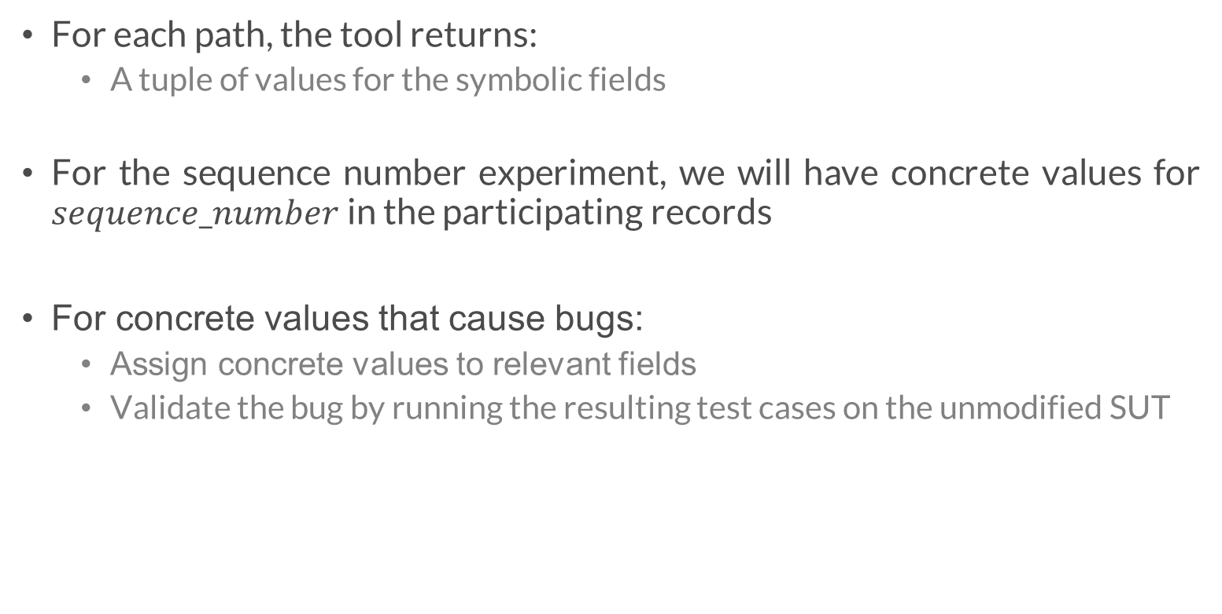
4- Test Case Construction and Validation
For each path, the tool returns:
A tuple of values for the symbolic fields
For the sequence number experiment, we will have concrete values for $sequence_number$ in the participating records
For concrete values that cause bugs:
Assign concrete values to relevant fields
Validate the bug by running the resulting test cases on the unmodified SUT
Notes:
Once symbolic execution is finished, the symbolic execution engine returns for each path a tuple of concrete values for every symbolic field.
In our uniqueness example, we will have concrete values for the sequence number field for every participating record.
For the concrete values that cause an assertion violation or any other type of bug, we construct test cases.
This is done by assigning the concrete values to the relevant fields in the pre-captured records.
we can confirm the bug's existence by running those test cases on the unmodified SUT. So, we can make sure the modifications to the SUT did not create the bug.

Slide 10
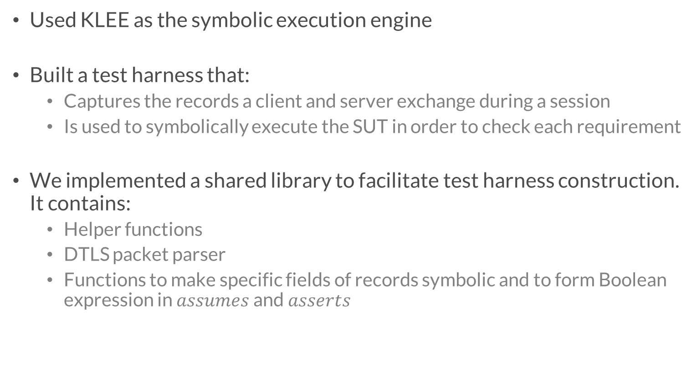
Implementation and Application to DTLS
Used KLEE as the symbolic execution engine
Built a test harness that:
Captures the records a client and server exchange during a session
Is used to symbolically execute the SUT in order to check each requirement
We implemented a shared library to facilitate test harness construction. It contains:
Helper functions
DTLS packet parser
Functions to make specific fields of records symbolic and to form Boolean expression in $assumes$ and $asserts$
Notes:
To implement our methodology, we utilized the symbolic execution engine, KLEE. And we tested the libraries of the DTLS protocol.
For each of these libraries, a test harness is built. This harness is responsible for :
Instantiating the client and server to capture the records they exchange during a DTLS handshake.
It is then used to symbolically execute the SUT to check each requirement (advance)
Building test harnesses is time consuming.
To facilitate this process, We developed a library which can be shared between different DTLS implementations. It provides:
Helper functions (e.g., for loading the records from files).
Functions to parse DTLS records into pre-defined DTLS data structures.
Functions to make specific fields of records symbolic and for forming Boolean expression in assumes and asserts.

Slide 11

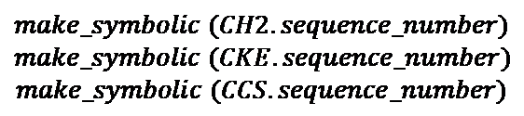
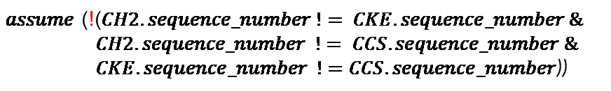
1 – Load the records from files to DTLS structured variable
4 - Feed the records to the side we are testing
DTLS Test Harness
CH2
CH0
CKE
Server
2- Make the relevant fields in the records symbolic
CCS
FIN
CH0
CH2
Shared library
CKE
$$make_symbolic (CH2.sequence_number)$$
$$make_symbolic (CKE.sequence_number)$$
$$make_symbolic (CCS.sequence_number)$$
3 - Assume the negation of the requirement
CCS
FIN
assert(0)
$assume$ (!($CH2.sequence_number != CKE.sequence_number \&$
$CH2.sequence_number != CCS.sequence_number \&$
$CKE.sequence_number !=CCS.sequence_number$))
Notes:
Now that we have introduced different steps of the methodology and how they are implemented, let’s put all the pieces together.
Suppose we want to check whether a DTLS server correctly satisfies the sequence number uniqueness requirement that we discussed earlier.
In preparation for symbolic execution, we build a test harness for the implementation and capture the records sent to the server.
We also augment the server (advance) with the failing assertion where the handshake finishes.
We then perform the following steps: (advance)
The symbolic execution starts with the harness loading the captured records from files to DTLS structured variables. (advance)
In the next step, only the relevant fields in the participating records are made symbolic. (advance)
Later, the negation of the requirement we check for is assumed. In this example, it is like assuming that at least two records have non-unique sequence numbers. (advance)
Next, we feed the records required to complete the interaction on the server-side to the server instance. You can see that among these records, in bold are the ones for which the sequence number is symbolic and assumed to be non-unique.
In the end, symbolic execution exercises available paths based on the symbolic fields and the assumption. And we check if any assertion violation or other types of bugs are discovered.

Slide 12
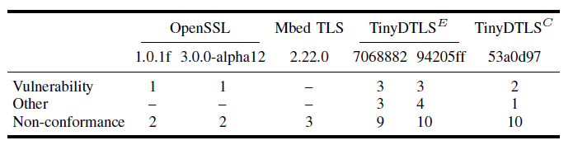
Evaluation
We tested 4 DTLS libraries against 16 requirements:
36 unique bugs
7 vulnerabilities of which 6 are new
Notes:
Now, Let’s review the results from testing 4 different DTLS libraries.
During our experiments, We tested two versions of OpenSSL. One stable and one from the development branch.
We also tested MbedTLS and three versions from two variants of TinyDTLS.
These 6 versions are tested against 16 requirements we extracted from the DTLS 1.2 RFC.
In total we have found 36 unique bugs in the libraries we tested of which 6 were new security vulnerabilities. One of these vulnerabilities is found in OpenSSL development branch at the time.
You can read in our paper the description and cause of the most serious bugs we have found, But let me present you here one subtle memory error we were able to uncover in TinyDTLS.

Slide 13
TinyDTLS Reassembly Bug
The DTLS 1.2 RFC specifies:
Memory over-read when client/server reassemble a fragmented message
Occurs if the fragment length field is greater than the size of the actual fragment
Three pull request attempts before the bug was fixed
“When a DTLS implementation receives a handshake message fragment, it MUST buffer it until it has the entire message”
Notes:
Once more, we started from a requirement that specifies that When a DTLS implementation receives a handshake message fragment, it MUST buffer it until it has the entire message.
By formulating this requirement and performing symbolic execution, We found a memory over-read bug due to insufficient checks where the client and server are reassembling a fragmented message.
This bug occurs for specific values of fragment length that are greater than the size of the actual fragment.
It is worth mentioning that Each time a pull request was submitted to fix the bug, we were able to trigger the bug in another way, and it took three times before the root cause of the bug was identified and fixed.

Slide 14
KLEE Experiences
Protocol implementations define incoming/outgoing buffers sizes with respect to the Maximum Transmission Unit (MTU)
Memory over-read/over-write bugs can be missed by KLEE
Our solution: Allocate memory dynamically with respect to the size of the actual packets
Significant interpretation slowdown when functions in cryptographic libraries are executed
Even in the absence of symbolic variables
Provided a benchmark in issue #1255 (700% slowdown)
(Partial) solution: Execute the functions as an external call
Notes:
Here, We present some experiences we gained from using KLEE as the symbolic execution tool.
Therefore, although there might be memory over-read/over-write when a packet is being processed, the KLEE can miss the bug.

Slide 15
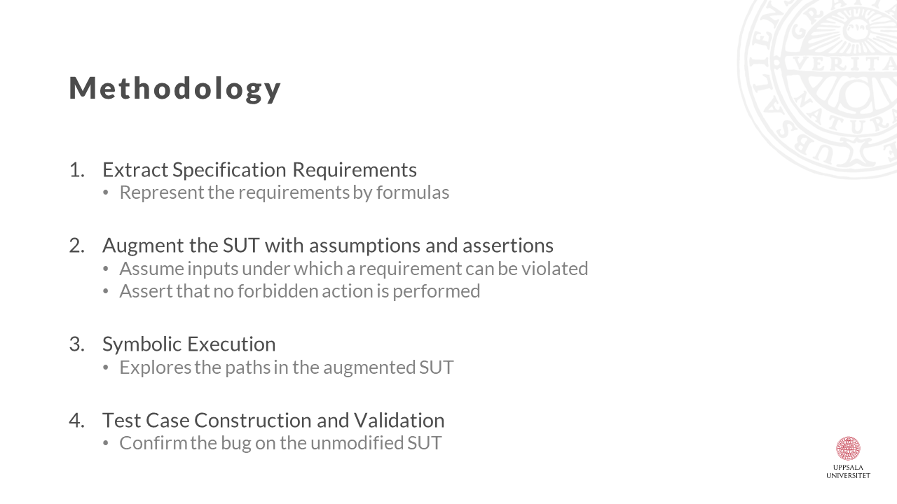
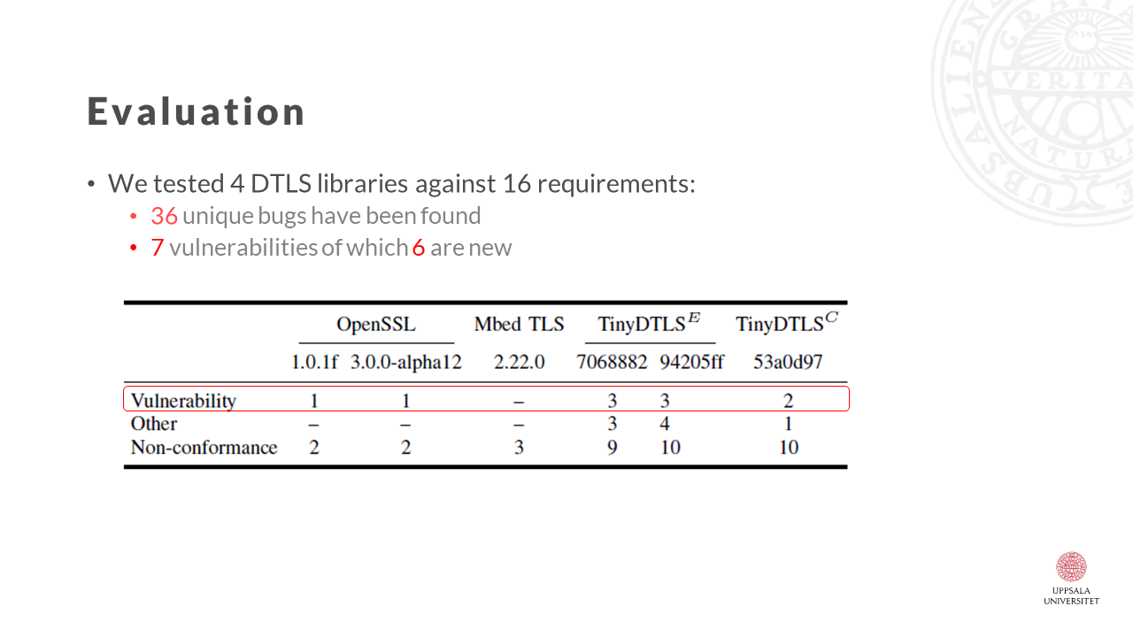
Conclusion
Thank You for Listening
Replication materials available at:
https://zenodo.org/record/5929867#.YkS3HSjMJaT
Notes:
In our paper, you can find the formulated requirements, the detailed description of the bugs discovered as well as a comparison to related approaches.
To summarize, We introduced a methodology that makes symbolic execution effective in testing network protocol implementations and exposing requirement violations using assumptions and assertions.
We applied our methodology to implementations of the DTLS protocol using KLEE as the symbolic execution engine.
Our application uncovered numerous new security vulnerabilities and bugs.
The replications materials necessary to reproduce our experiments are available online. (advance)
With that, I conclude this talk and thank you for listening. ☺

