Slide 1
CS-250-Data Structures & Algorithms
Lecture 3
ADT and Linked lists
(Dec 2020)
Instructor: Lt Col Muhammad Imran Javaid
Email: imranjavaid@mcs.edu.pk
Military College of Signals , NUST

Slide 2
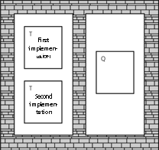
Few Software design Principles
Modularity (divide a program into manageable parts)
Keeps the complexity of a large program manageable
Isolates errors
Eliminates redundancies
Encourages reuse (write libraries)
A modular program is easier to write / Easier to read / Easier to modify
Information Hiding
Hides certain implementation details within a module
Makes these details inaccessible from outside the module
Isolate the implementation details of a module from other modules
Isolated tasks: the implementation of task T does not affect task O

Slide 3
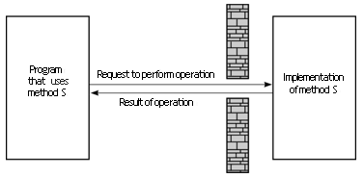
Few Software design Principles
Isolation of Modules
Methods’ specifications, or contracts, govern how they interact with each other
Similar to having a wall hiding details, but being able to access through “hole in the wall“
Abstraction
From Latin: to ‘pull out’—the essentials
To defer or hide the details
Abstraction emphasizes essentials and defers the details. It separates the purpose and use of a module from its implementation

Slide 4
Few Software design Principles
Abstraction Example
I don’t need a mechanic’s understanding of what’s under a car’s hood in order to drive it
What’s the car’s interface?
What’s the implementation
Abstraction
The principle of ignoring those aspects of a subject that are not relevant to the current purpose in order to concentrate solely on those aspects which are relevant
How do we achieve:
Modularity
Information hiding
Isolation of modules

Slide 5
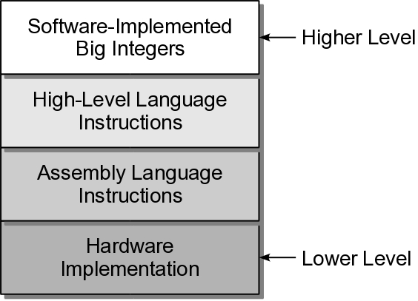
Abstract Data Type (ADT)
Mathematical description of a “thing” with set of operations.
Abstract Data Type(ADT) is a data type, where only behavior is defined but not implementation
A mechanism for separating the properties of an object, and restricting the focus to those relevant in the current context.
Focus on the “what” not the “how”.
Common types in computer science:
Procedural abstraction
Use of a function/method knowing what it does but not how it's done.
ex: y = sqrt( x )
Data abstraction
Separate the values/operations from the implementation of a data type.
ex: big integers in Python
For complex problems, there may be multiple layers of abstraction.
Multi Layer Abstractions

Slide 6
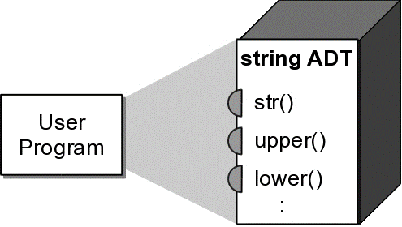
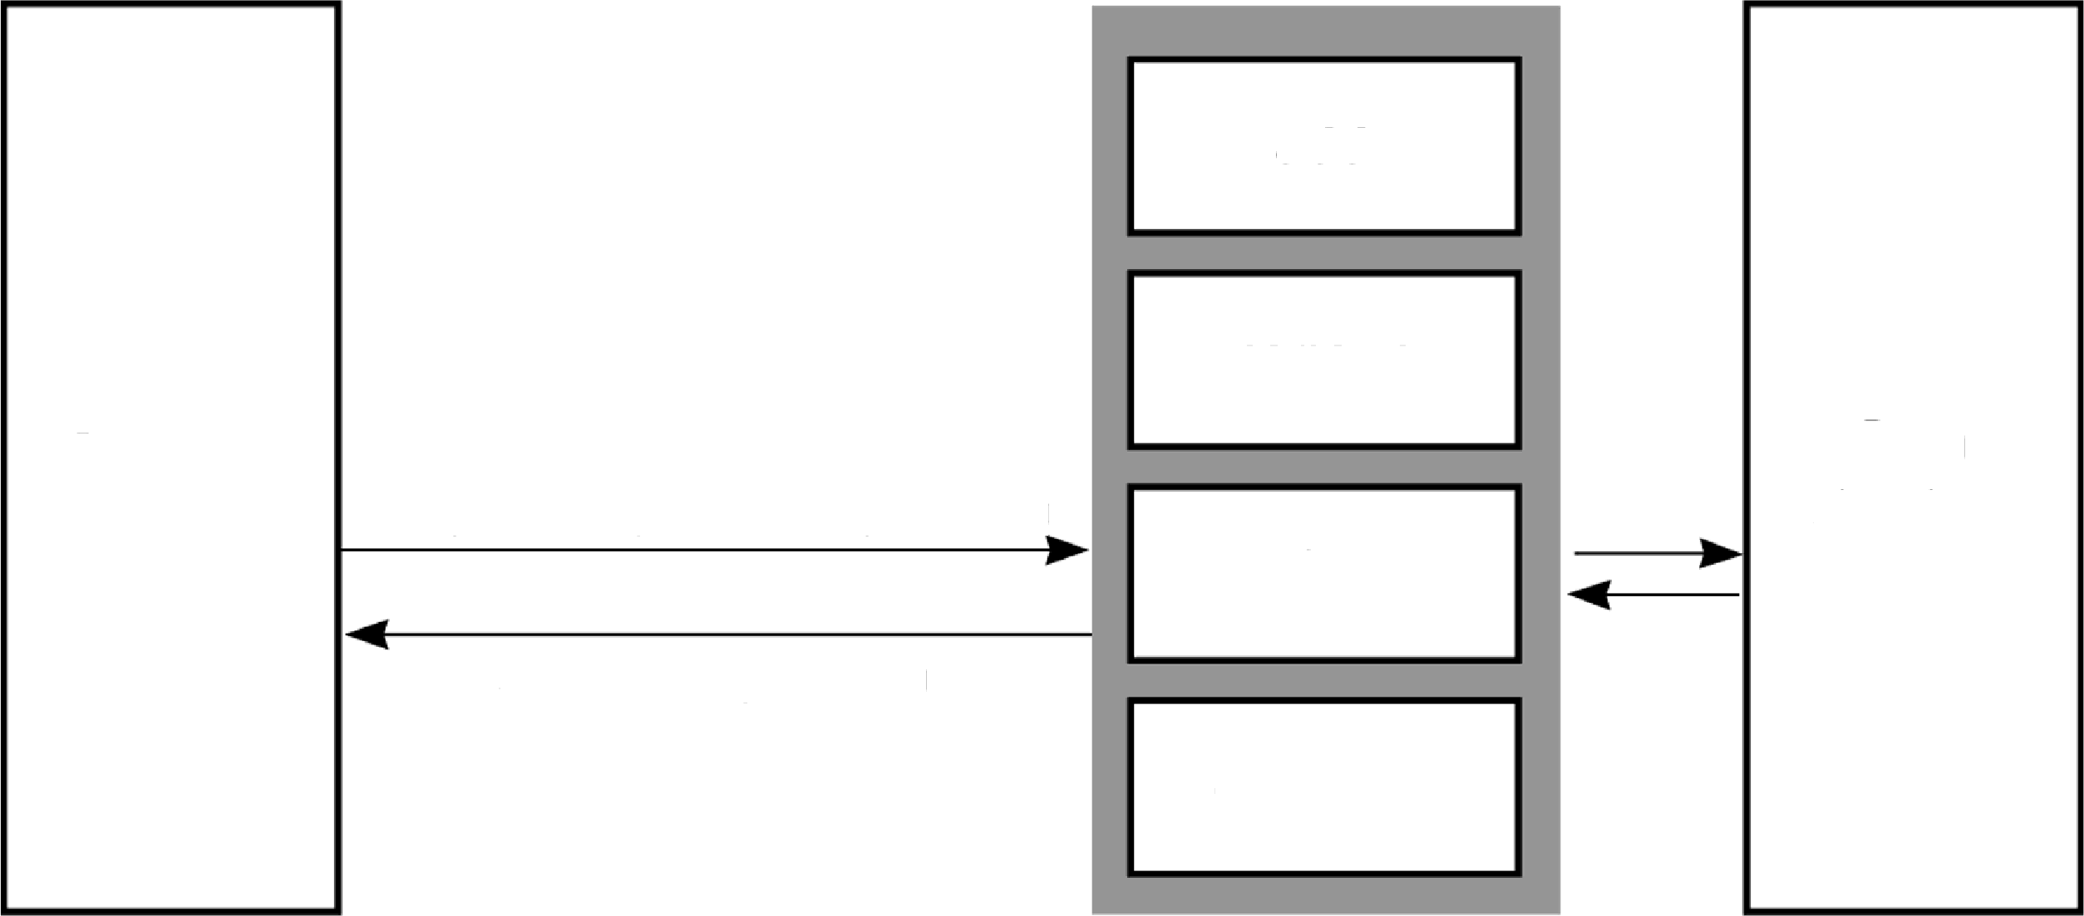

Abstract Data Type (ADT)
ADTs can be viewed as black boxes:
Functionality is provided through an interface.
Implementation details are hidden inside the box.
A wall of ADT operations isolates a data structure from program that uses it
Interface
add
Program
Data structure
Request to perform operation
find
Result of operation
display
Wall of ADT operations

Slide 7
Abstract Data Type (ADT)
Disadvantages of Using ADTs
Design issues
Code to write and maintain
Overhead of calling a method to access ADT
Greater initial time investment
Advantages of Using ADTs
A client (the application using the ADT) doesn't need to know about the implementation
Maintenance of the application is easier
The programmer can focus on problem solving and not worry about the implementation
ADTs can be categorized based on their implementation
Simple ADT. Composed of simple individual parts E.g: Integers, floating point, dates, rational numbers.
Complex ADT. Composed of a collection or group of values.E.g: list, dictionary, set
Complex abstract data types are implemented using a data structure.

Slide 8
Abstract Data Type (ADT) Examples
Integers
Data:
Containing the positive and negative whole numbers and 0
Operations which manipulate the data:
Such as addition, subtraction, multiplication, equality comparison, and order comparison
Methods for data conversion, output etc.
Floating-point
Data:
Containing the whole possible positive and negative values
Precision is limited by number of digits
Operations which manipulate the data:
Such as addition, subtraction, multiplication, equality comparison, and order comparison
Complex mathematical functions such as exponential, logarithm, triangular functions etc.
Roundings
Methods for data conversion, output etc.

Slide 9
Abstract Data Type (ADT)
The ADT definition should specify:
Required inputs and resulting outputs.
State of the ADT instance before and after the operation is performed.
Precondition. Condition or state of the ADT instance and data inputs before the operation is performed.
Assumed to be true and error occurs if the condition is not satisfied. e.g index out of range
Postcondition. Result or state of the ADT instance after the operation is performed.
Will be true if the preconditions are met. E.g
given: x.pop(i)
the i^{th} item will be removed if i is a valid index.
The specific postcondition depends on the type of operation.

Slide 10
Linear Structures
Linear structures are data collections whose items are ordered depending on how they are added or removed from the structure
Once an item is added, it stays in that position relative to the other elements that came before and came after it
Linear structures can be thought of as having two ends, top and bottom, (or front and end or front and back)
Examples: Stack, Queue, Linked-list, etc.
Add a new element
Remove top element
Remove top element
12
57 34
103
12
57 34
57
34
12
57
34

Slide 11
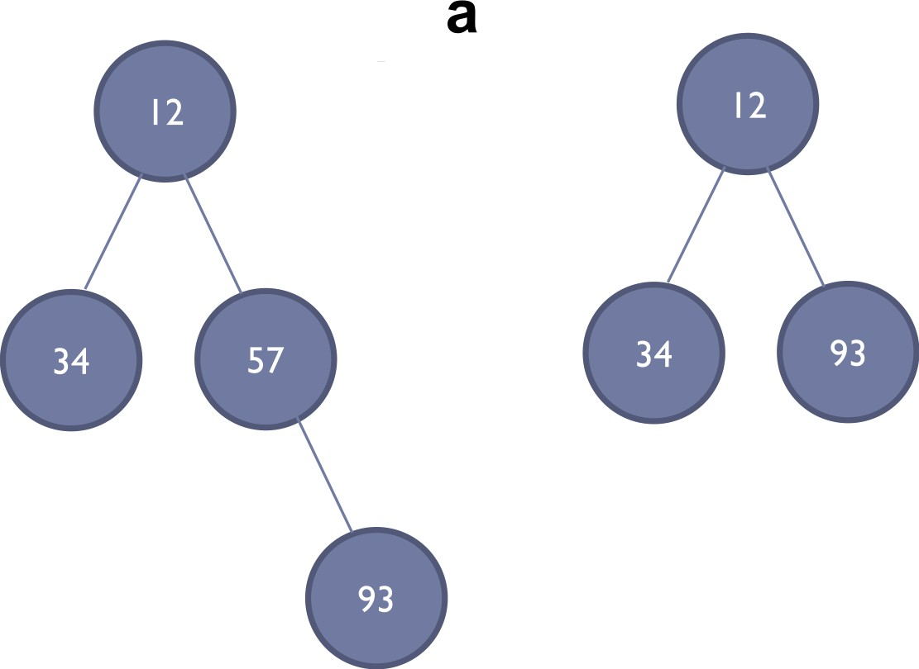
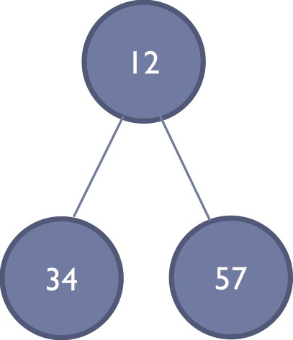
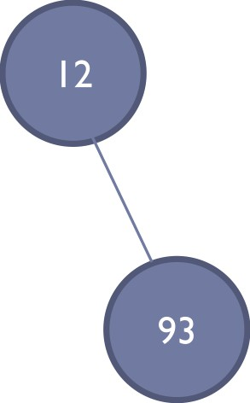
Non-Linear Structures
Every data item is attached to several other data items in a way that is specific for reflecting relationships
The data items are not arranged in a sequential structure
Examples: Tree, Graph, Heap, etc.
Add a new element
Remove
Remove a element
element

Slide 12

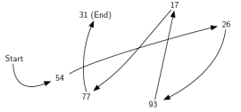
Linked List Data Structure
The linked list data structure
Can be used to store a collection in linear order.
Each item holds a relative position with respect to the others we can consider the list as having a first item, a second item, a third item ….
Improves on the construction and management of an array and list.
Requires smaller memory allocations.
No element shifts for insertions and deletions.
Constructed using a collection of objects called nodes.
Each node contains data and at least one reference or link to another node.

Slide 13
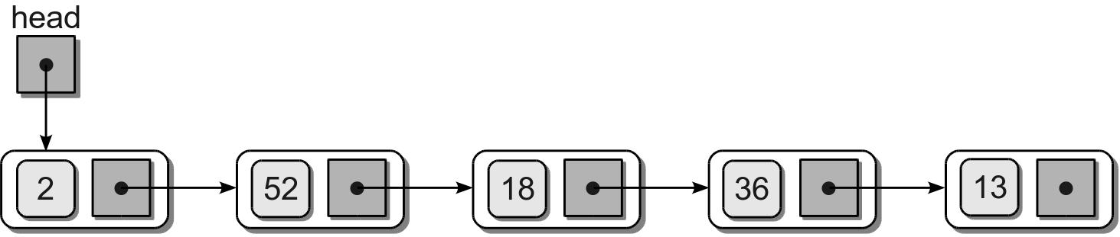
Linked List
Linked list – a linked structure in which the nodes are linked together in linear order.
Terms:
head – first node in the list.
tail – last node in the list; link field has a null reference.

Slide 14
Linked List
Most nodes have no name; they are referenced via the link of the preceding node.
head reference – the first node must be named or referenced by an external variable.
Provides an entry point into the linked list.
An empty list is indicated by a null head reference.

Slide 15
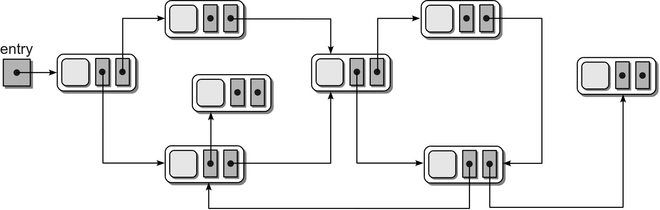
Linked List
Linked list are built using fundamental components provided by the language:
reference variables
objects
Many different configurations are possible:

Slide 16
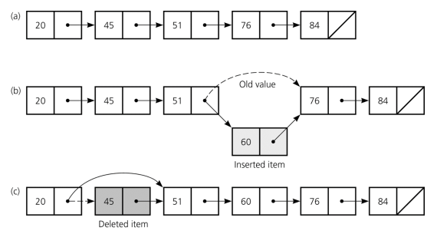
Linked List
Items can be inserted into and deleted from the linked list without shifting data

Slide 17
Singly Linked List
A linked list in which
each node contains a single link field or consists of nodes linked in a single direction.
access and traversals begin with the first node or allows for a complete linear order traversal from front to back.
Several common operations can be performed.

Slide 18
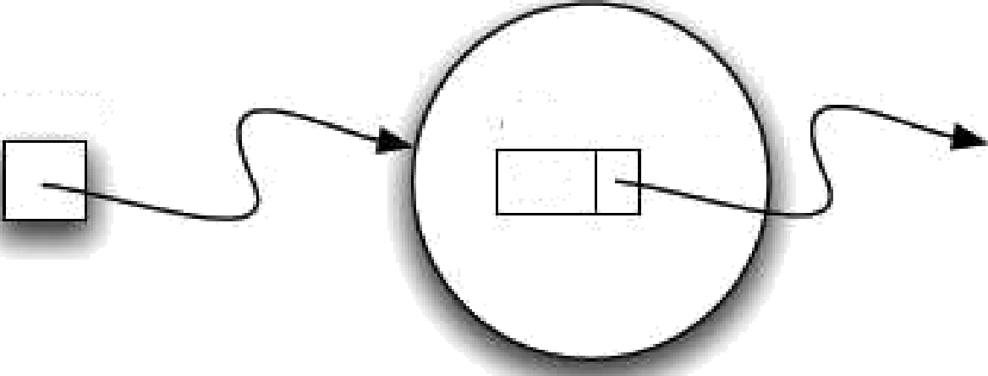









Node Definition
A node is the basic building block of a linked list
It contains the data as well as a link to the next node in the list
The nodes are constructed from a simple storage class:
temp
93
data next
93
Temp
93
class ListNode:
def __init__( self, data ):
self.data = data
self.next = None
a_node—+
p = Node(93) temp = Node(93)
data
Another node

Slide 19
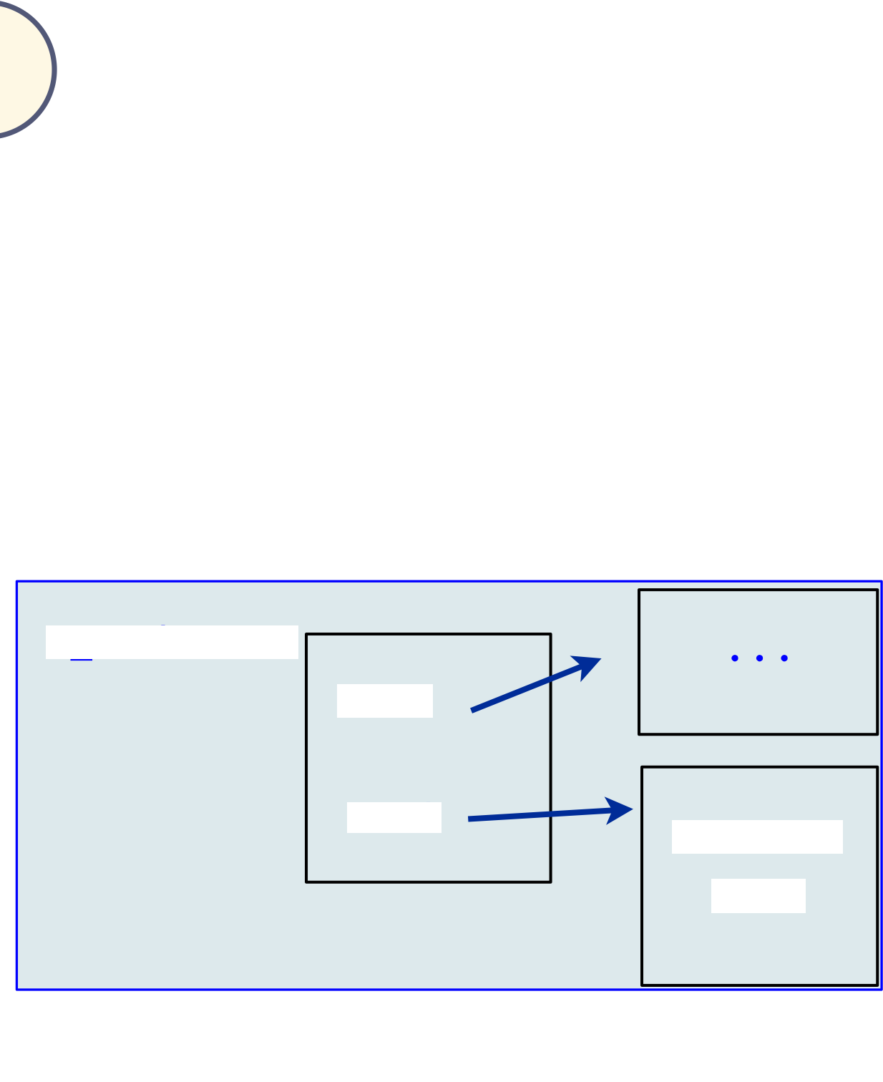


Node Class
class Node:
def __init__(self, init_data):
self.data = init_data
self.next = None
def get_data(self):
return self.data
def get_next(self):
return self.next
def set_data(self, new_data):
self.data = new_data
def set_next(self, new_next):
self.next = new_next
a node —•-•->
Another node

Slide 20
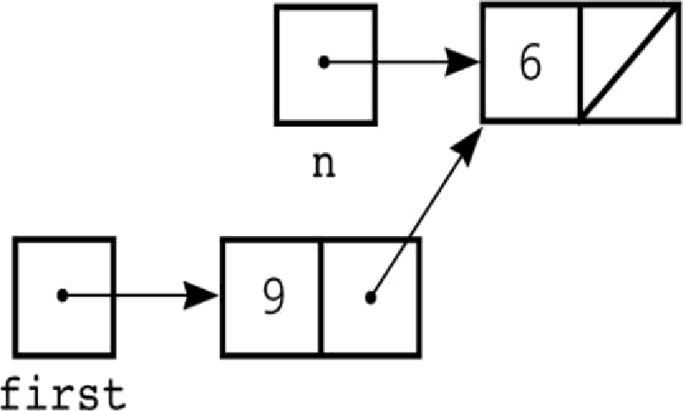
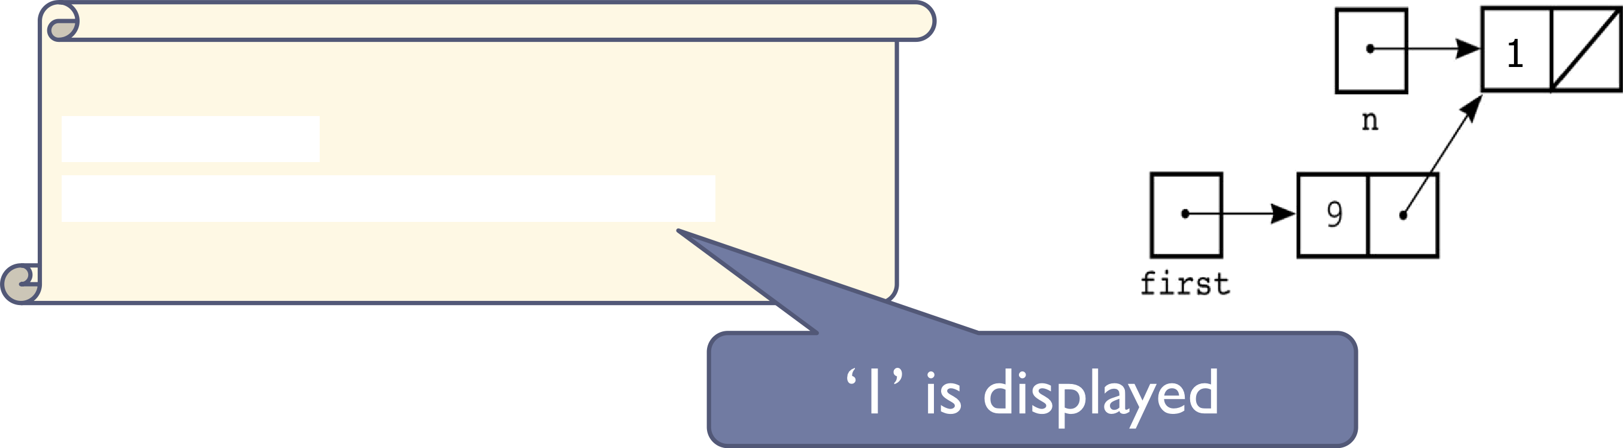
Chain of Nodes
n = Node(6)
first = Node(9)
first.set_next(n)
n.set_data(1)
print(first.get_next().get_data()))

Slide 21
Exercise
What is output of the following code? (previous slides node class hold true here)
def print_chain(n):
while not n == None:
print(n.get_data(), end = " ")
n = n.get_next()
n5 = Node(15)
n6 = Node(34)
n7 = Node(12)
n8 = Node(84)
n6.set_next(n5)
n7.set_next(n8)
n8.set_next(n6)
n5.set_next(None)
print_chain(n5)
print()
print_chain(n6)
print()
print_chain(n7)
print()
print_chain(n8)
print()
15
34 15
12 84 34 15
84 34 15

Slide 22
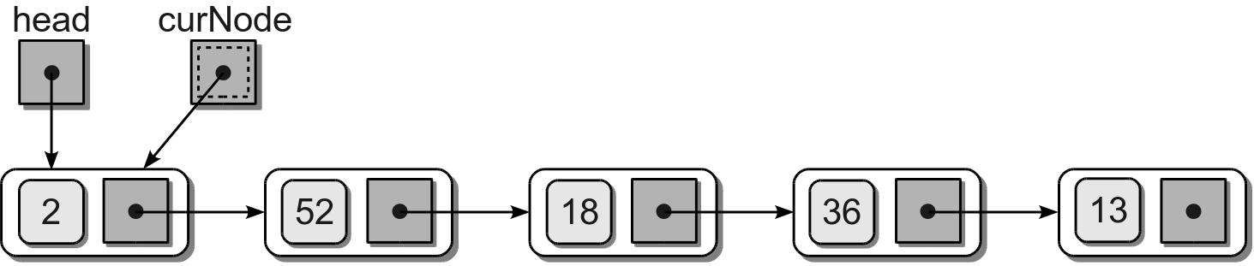
Traversing the Nodes
We can traverse the nodes using a temporary external reference variable.
Initialize a temporary reference to the head node.
Visit the node.

Slide 23
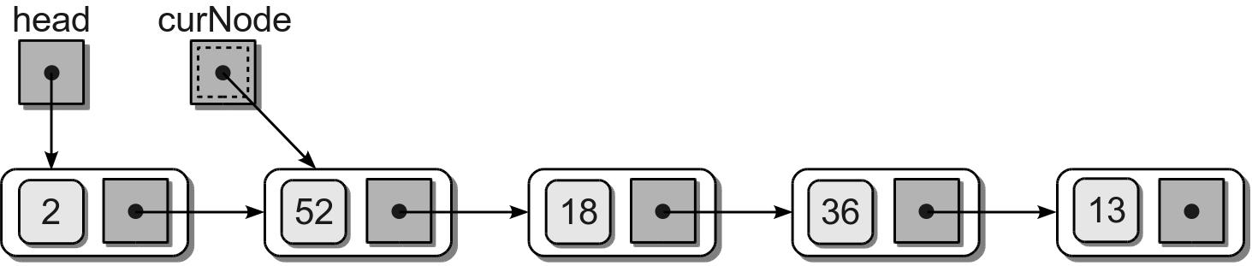
Traversing the Nodes
Advance the temporary reference to the next node using the link field and visit that node.

Slide 24
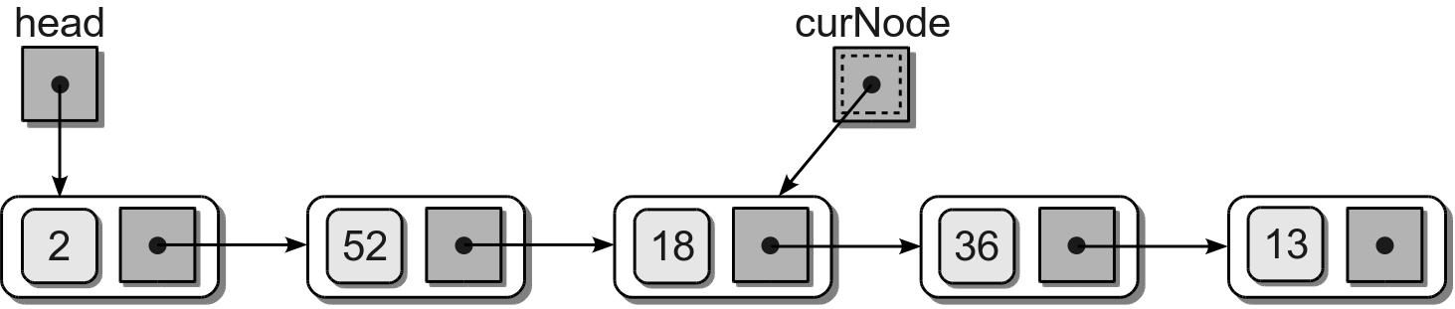
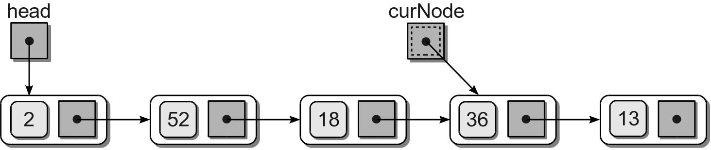
Traversing the Nodes
Repeat the process until the reference falls off the end of the list.

Slide 25
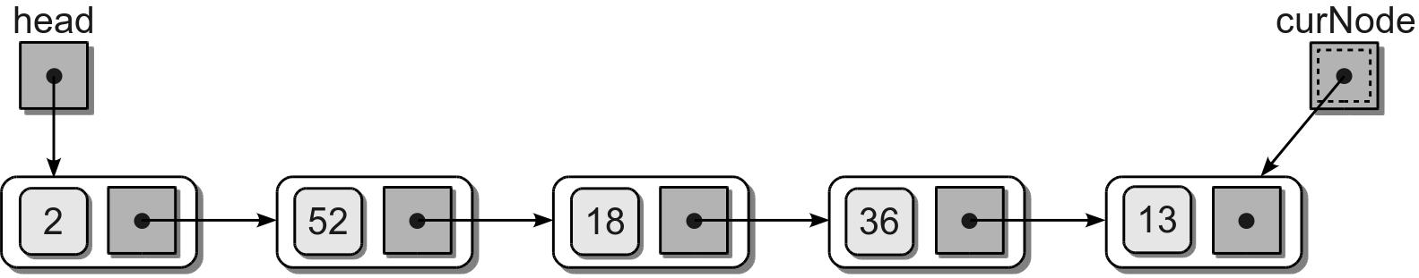
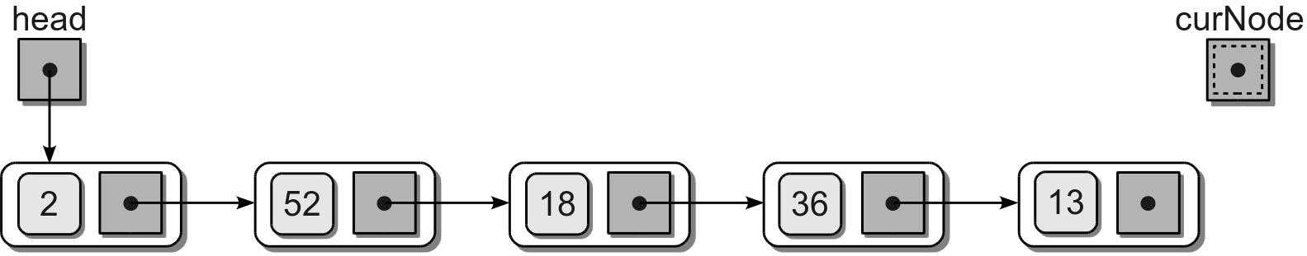
Traversing the Nodes
Repeat the process until the reference falls off the end of the list.

Slide 26
Traversal Code
Given the head reference, we can traverse the nodes.
def traversal( head ):
curNode = head
while curNode is not None :
print( curNode.data )
curNode = curNode.next

Slide 27
Searching
We can perform a linear search to determine if the list contains a specific data item.
def unorderedSearch( head, target ):
curNode = head
while curNode is not None and
curNode.data != target :
curNode= curNode.next
return curNode is not None

Slide 28
Prepending Nodes
When working with an unsorted linked list, new values can be inserted at any point.
We can prepend new items with little effort.
Example: add value 96 to the sample list.

Slide 29
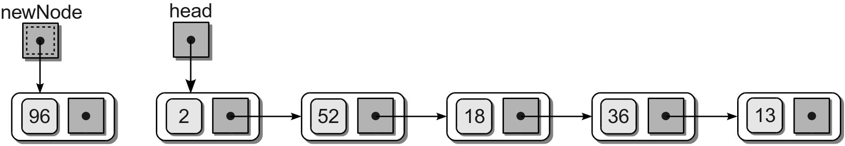
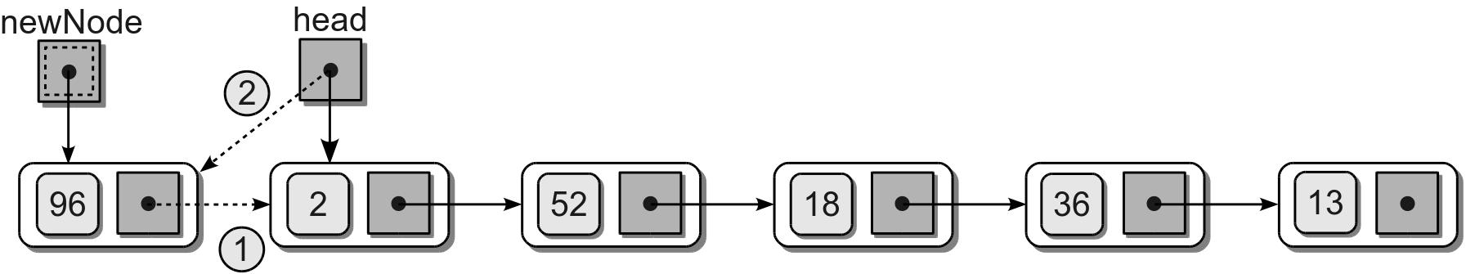
Prepending Nodes
Create a new node for the new item.
Connect the new node to the list.

Slide 30
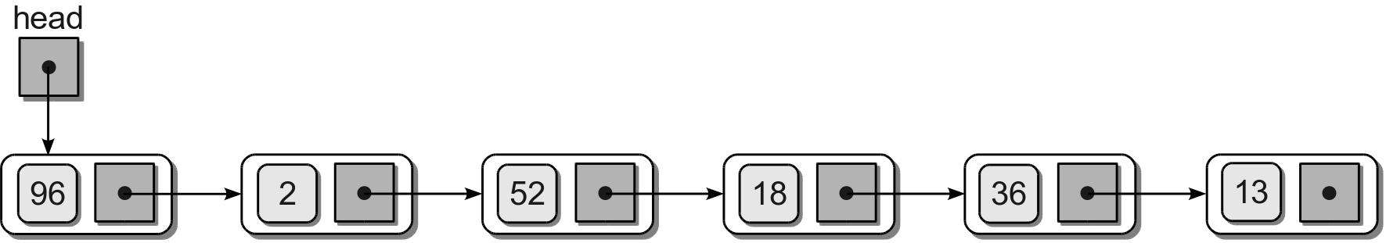
Prepending Nodes
The resulting list.
Python code
# Given the head reference and the new item.
newNode = ListNode( newItem )
newNode.next = head
head = newNode

Slide 31
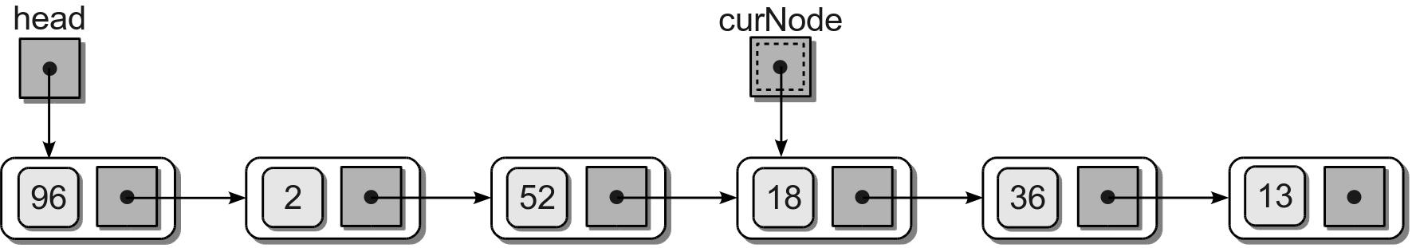
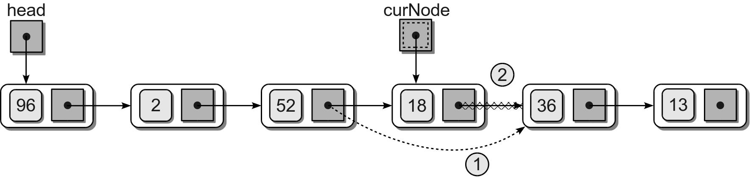
Removing Nodes
An item can be removed from a linked list by removing or unlinking the node containing the item.
Find the node containing the item.
Unlink it from the list.

Slide 32
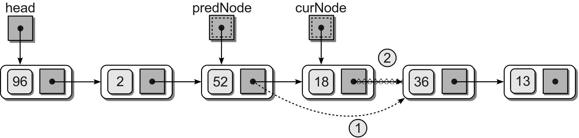

Removing Nodes
Removing a node from the middle of the list requires a second external reference.
Resulting list.

Slide 33
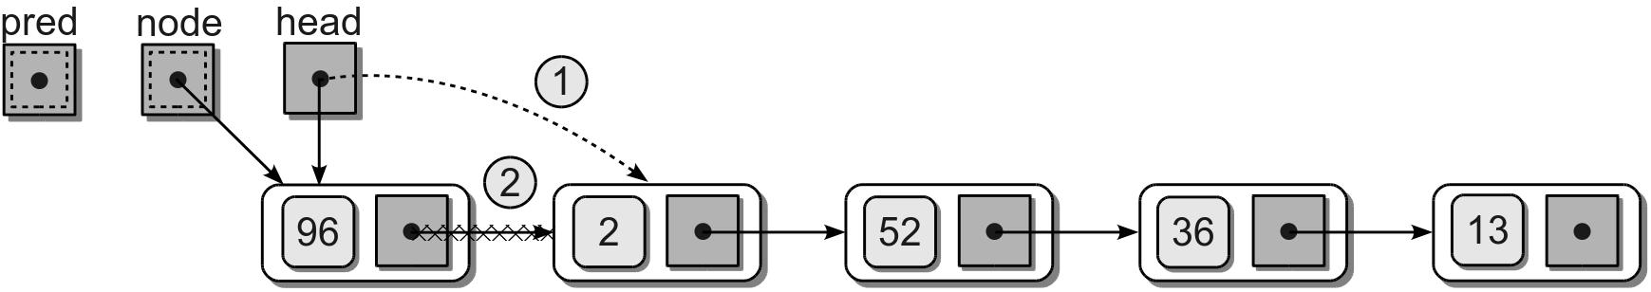
Removing Nodes
Removing the first node is a special case.
The head reference must be reposition to reference the next node in the list.

Slide 34
Removing Nodes
Given the head reference, we can remove a target from a linked list.
predNode = None
curNode = head
while curNode is not None and curNode.data != target :
predNode = curNode
curNode = curNode.next
if curNode is not None :
if curNode is head :
head = curNode.next
else :
predNode.next = curNode.next

Slide 35
Building Linked Lists
There are more ways to build a linked list than simply prepending nodes to the front.
Appending nodes
Sorted linked lists

Slide 36
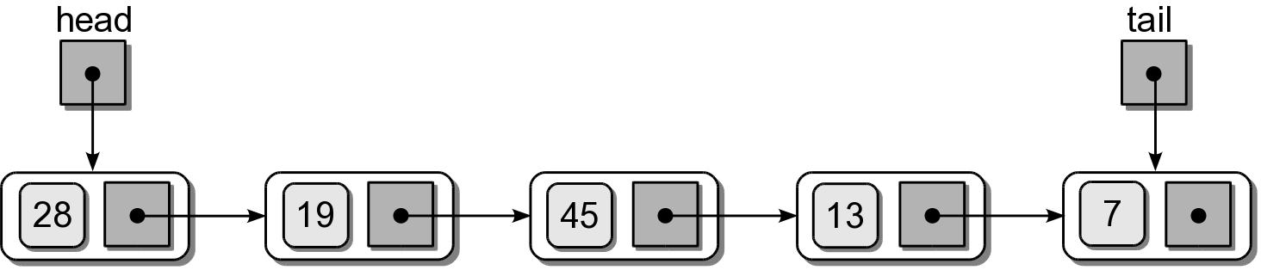
Using a Tail Reference
Some applications require items be appended to the end of the linked list.
tail reference – a second external reference indicating the tail or last node in the list.

Slide 37
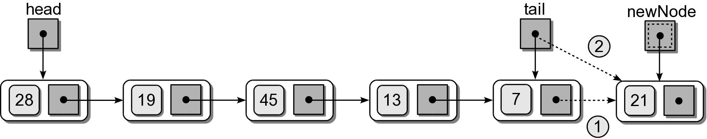
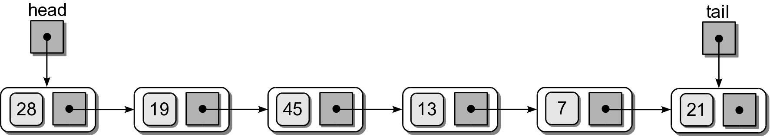
Appending Nodes
Must manage the tail reference as nodes are added/removed.
Example: append 21 to the list.

Slide 38
Appending Nodes
Given the head and tail reference, we can add an item to a linked list.
newNode = ListNode( item )
if head is None :
head = newNode
else :
tail.next = newNode
tail = newNode

Slide 39
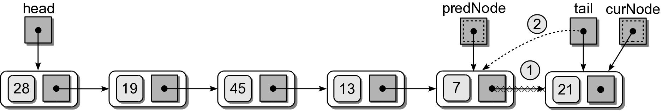
Removing Nodes
If the tail node is removed, the tail reference has to be adjusted.

Slide 40
Removing Nodes
Given the head and tail reference, we can remove a node from a linked list.
predNode = None
curNode = head
while curNode is not None and curNode.data != target :
predNode = curNode
curNode = curNode.next
if curNode is not None :
if curNode is head :
head = curNode.next
else :
predNode.next = curNode.next
if curNode is tail :
tail = predNode

Slide 41

The Sorted Linked List
The items in a linked list can be maintained in sorted order.

Slide 42
Sorted List: Searching
Searching a sorted list is similar to that of an unsorted list.
def sortedSearch( head, target ):
curNode = head
# Stop early when a larger value is encountered.
while curNode is not None and \
curNode.data < target :
if curNode.data == target :
return True
else :
curNode = node.next
return False

Slide 43
Sorted List: Insert
Adding a new node to a sorted list requires locating the correct position within the list.
Locating the position is similar to the removal operation.
Use a second temporary reference for the predecessor.
There are 3 possible cases.
front
middle
back

Slide 44
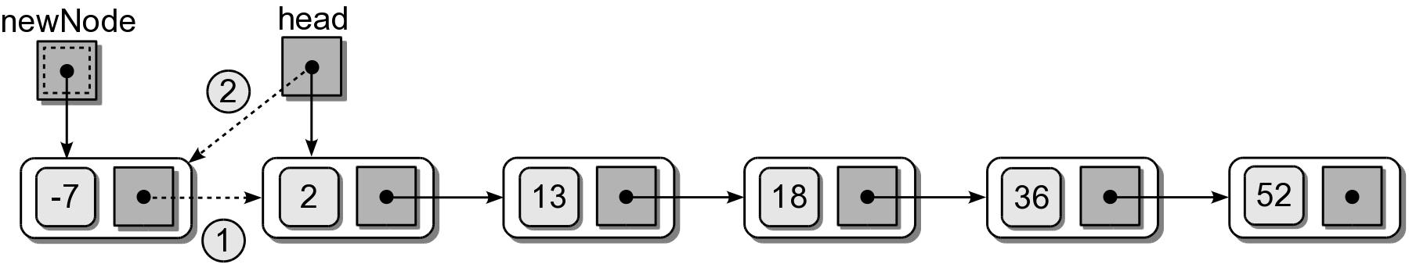
Sorted List: Insert
(1) Insert at the front.

Slide 45
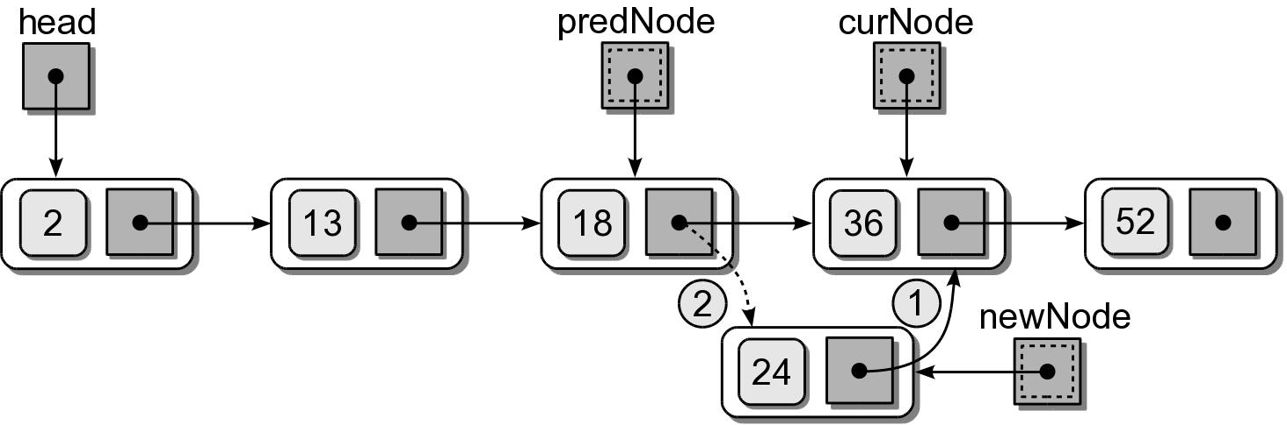
Sorted List: Insert
(2) Insert in the middle.

Slide 46
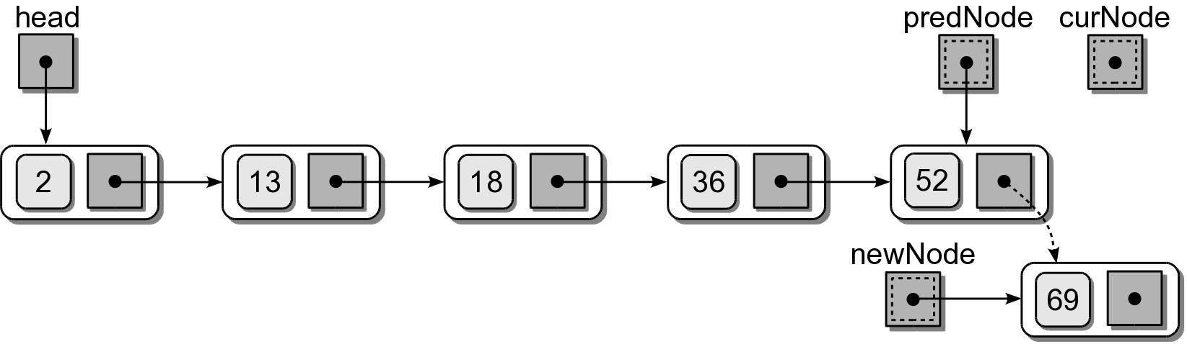
Sorted List: Insert
(3) Insert at the end.

Slide 47
Array of Linked Lists
The array contains one element for each row of the matrix.
Each element contains a sorted linked list.
The nodes correspond to the non-zero elements for that row.
The nodes are sorted by column index.

Slide 48

Polynomials
Expressions specified in terms of variables and constants
term – a_{i}x^{i}
coefficient – a_{i} (can be zero).
degree – the exponent part of x^{i}
Example

Slide 49
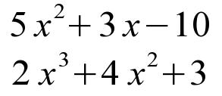
Polynomials: Addition
Two polynomials of the same variable can be summed by adding the coefficients of corresponding terms of equal degree.
Example
Result is a third polynomial

Slide 50

Polynomials: Multiplication
The product of two polynomials is a third polynomial.
Obtained by summing the result from multiplying each term of the first polynomial by each term of the second.

Slide 51
Polynomial: Evaluation
The easiest operation is the evaluation of a polynomial.
Specify a value for the variable and compute the real value.
Example: let x = 3

Slide 52
The Polynomial ADT
A polynomial is a mathematical expression of a variable constructed of one or more terms.
Each term is of the form a_{i}x^{i}
where a_{i} is a scalar and x^{i} is the unknown variable of degree i.
Polynomial() Polynomial( degree, coefficient ) degree() getitem( degree ) | evaluate( scalar ) add( rhsPoly ) subtract( rhsPoly ) multiply( rhsPoly )

Slide 53

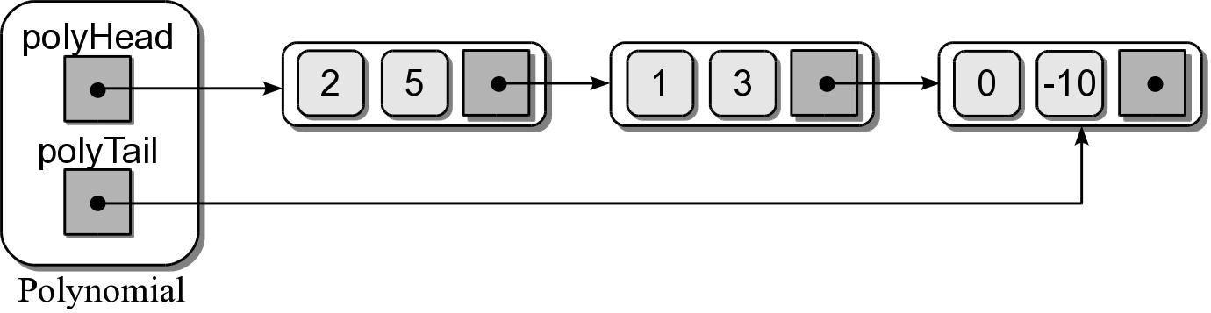
Polynomial ADT – Linked List
We can use a singly linked list to represent a one-variable polynomial.
Use a tail reference for easy append operations.
Store the individual non-zero terms in each node.
Order the terms by degree in descending order.

Slide 54
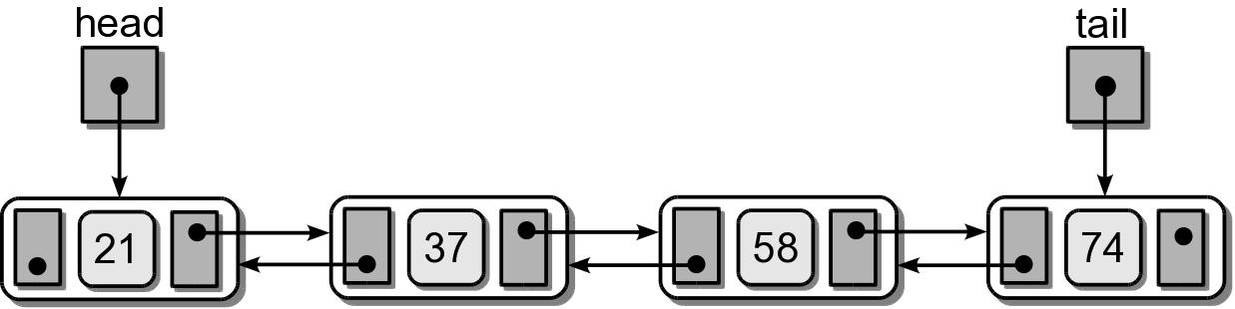
Doubly Linked List
A linked list in which each node contains a data component(s) and two links:
one pointing the next node and
one pointing to the preceding node.

Slide 55
Doubly Linked List
Doubly Linked Order : Can be unsorted or sorted based on a key value.
Operations on the unsorted version are very similar to those of a singly linked list.
We limit our discussion to the sorted doubly linked list.
Doubly Linked Nodes. The node storage class is similar to that of a singly linked list.
class DListNode :
def __init__( self, data ):
self.data = data
self.next = None
self.prev = None

Slide 56
Doubly Linked: Traversing
Traversals can be in either order.
Forward is the same as with a singly linked list.
Reverse order is similar but the prev link is followed.
def revTraversal( tail ):
curNode = tail
while curNode is not None :
print( curNode.data )
curNode = curNode.prev

Slide 57
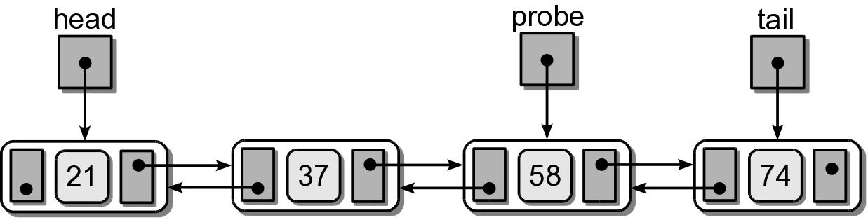
Doubly Linked: Search
Normal searching based on key value is the same as searching a singly linked list.
Doubly linked lists provide an additional advantage.
We can search both forwards and backwards.
Use and maintain a probe reference.

Slide 58
Doubly Linked: Probing
Use the probe reference for searching.
After a search, keep the reference where it left off.
On the next search, we can search either forwards or backwards based on the target value.

Slide 59
Doubly Linked: Probing
# Make sure the list is not empty.
if head is None :
return False
# If probe is null, initialize it to the first node.
elif probe is None :
probe = head
# If the target comes before the probe node, we traverse backward
if target < probe.data :
while probe is not None and target <= probe.data :
if target == probe.data :
return True
else :
probe = probe.prev
else : # otherwise traverse forward.
while probe is not None and target >= probe.data :
if target == probe.data :
return True
else :
probe = probe.next
# If the target is not found in the list, return False.
return False

Slide 60
Doubly Linked: Insert
Locate the position for the new node, then connect the links.
There are three possible cases.
No need for a second temporary reference.
Connections must be made in a specific order.

Slide 61
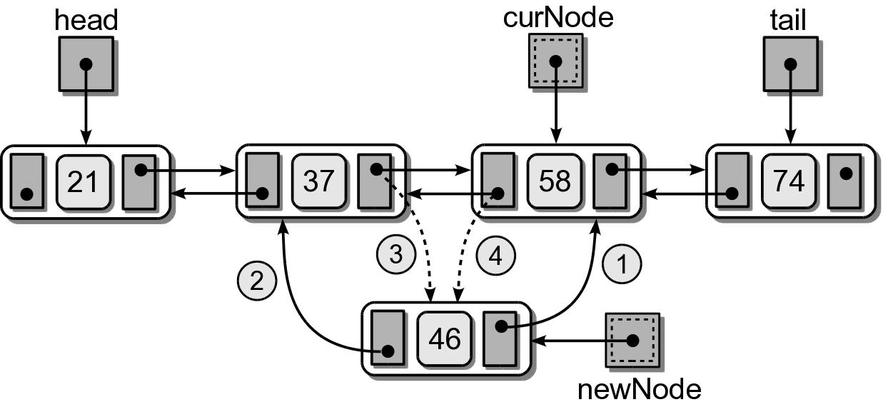
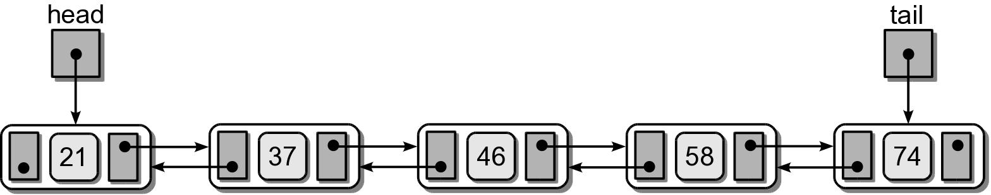
Doubly Linked: Insert
(1) Insert in the middle.
Result after the insertion.

Slide 62
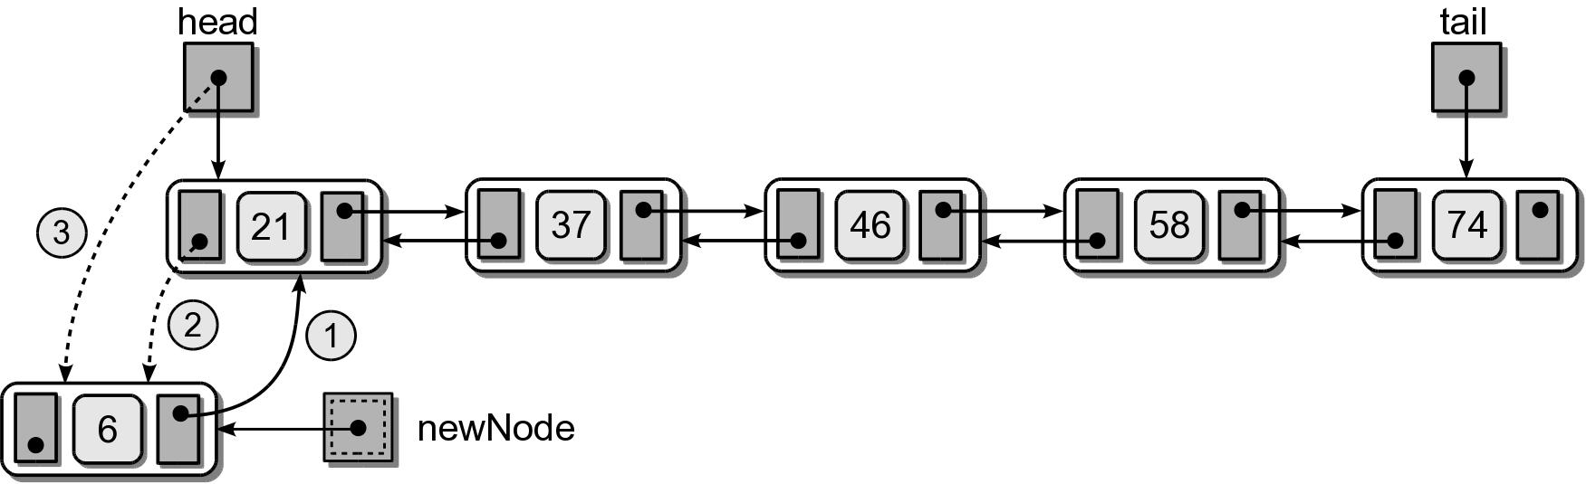
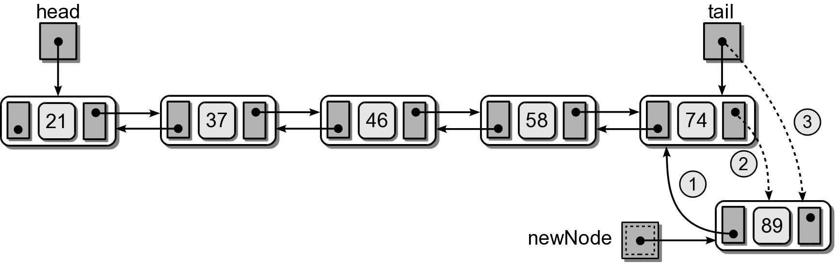
Doubly Linked: Insert
(2) Insert at the front.
(3) Insert at the end.

Slide 63
Doubly Linked: Insert
# Add a new value given a head and tail reference
newnode = DListNode( value )
if head is None : # empty list
head = newnode
tail = head
elif value < head.data : # insert before head
newnode.next = head
head.prev = newnode
head = newnode
elif value > tail.data : # insert after tail
newnode.prev = tail
tail.next = newnode
tail = newnode
else : # insert in the middle
node = head
while node is not None and node.data < value :
node = node.next
newnode.next = node
newnode.prev = node.prev
node.prev.next = newnode
node.prev = newnode

Slide 64
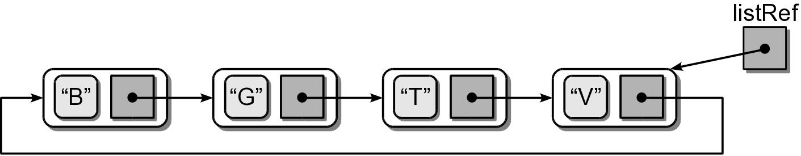
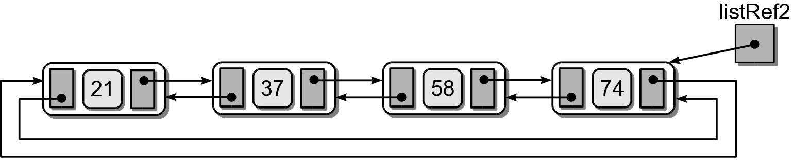
Circular Linked List
Another variation of the linked list in which the nodes form a continuous circle.
Allows for a complete traversal from any initial node.
Used with round-robin type applications.
The external reference can point to any node in the list. Common to reference “end” of the list.
A circular linked list can also be doubly linked.

Slide 65
Circular Linked: Traverse
A traversal can start from any node, but it must visit every node.
def traverse( listRef ):
curNode = listRef
done = listRef is None
while not done :
curNode = curNode.next
print( curNode.data
done = curNode is listRef

Slide 66
Circular Linked: Searching
Searching a circular linked list is similar to the traversal operation.
def searchCircularList( listRef, target ):
curNode = listRef
done = listRef is None
while not done :
curNode = curNode.next
if curNode.data == target :
return True
else :
done = curNode is listRef or\
curNode.data > target
return False :

Slide 67
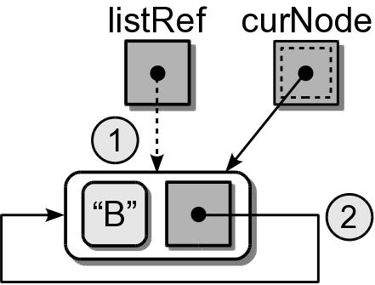
Circular Linked: Inserting
Adding nodes is very similar to that of the sorted singly linked list.
Unsorted list – common to add the node following the listRef.
Sorted list – new node is placed in proper position.
Can be divided into four cases.
(1) Insert into an empty list.
...
if listRef is None :
listRef = newNode
newNode.next = newNode

Slide 68
Circular Linked: Inserting

Slide 69
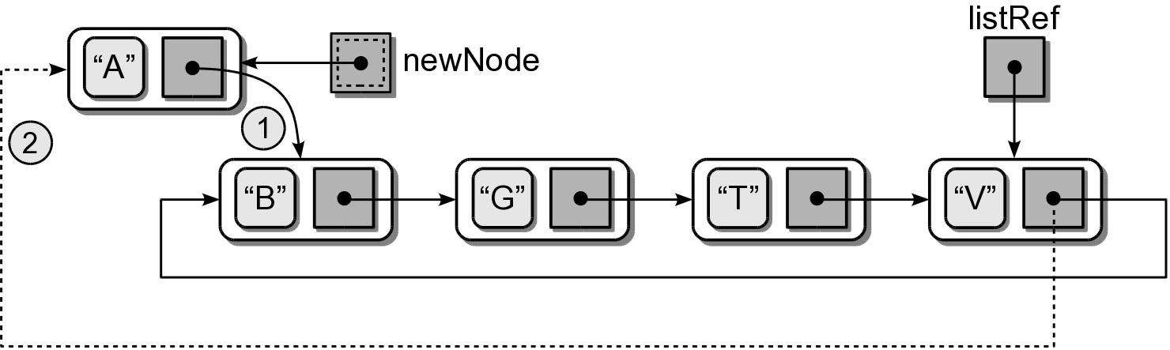
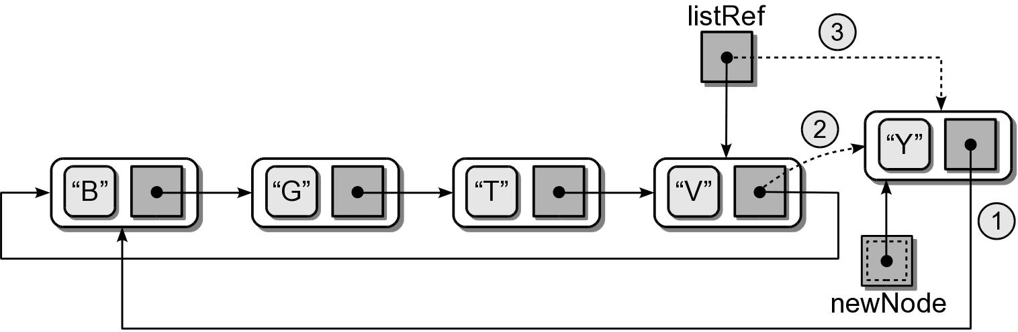
Circular Linked: Inserting
(2) Insert at the “front” (one node past listRef)
(3) Insert at the “end” (adjust listRef)
...
if value < listRef.next.data :
newNode.next = listRef.next
listRef.next = newNode
...
if value > listRef.next.data :
newNode.next = listRef.next
listRef.next = newNode
listRef = newNode

Slide 70
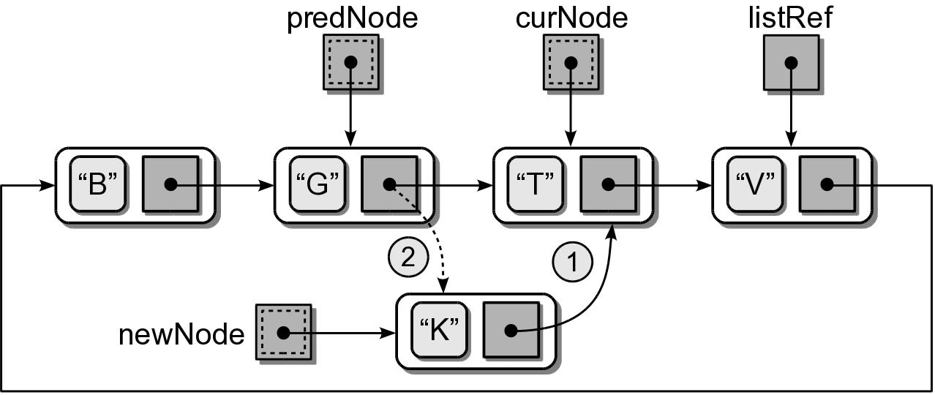
Circular Linked: Inserting
(4) Insert in the middle.

Slide 71
Circular Linked: Inserting
newnode = ListNode( value )
if listRef is None : # empty list
listRef = newNode
newNode.next = newNode
elif value < listRef.next.data : # insert in front
newNode.next = listRef.next
listRef.next = newNode
elif value > listRef.data : # insert in back
newNode.next = listRef.next
listRef.next = newNode
listRef = newNode
else : # insert in the middle
# Position the two pointers.
predNode= None
curNode = listRef
done = listRef is None
while not done :
predNode = curNode
predNode = curNode.next
done = curNode is listRef or curNode.data > target
# Adjust links to insert the node.
newNode.next = curNode
predNode.next = newNode

Slide 72
Multi-Linked Lists
A linked list in which each node contains multiple link fields.
Used to create multiple chains within the same collection of nodes.
Each chain has its own head reference.
The doubly linked list is a special case of the multi-linked list.

Slide 73
Multi-Linked Lists
Multi-linked Nodes. The storage class contains the data and one link field for each chain.
Multi-Linked Operations
Traversal and search
Can be performed on any chain.
Depends on the application.
Adding nodes:
Create an initialize a single node.
Add the node to each chain.
class StudentMListNode :
def __init__( self, data ):
self.data = data
self.nextById = None
self.nextByName = None

Slide 74

Multiple Chains
Multiple keys and multiple lines are used to create chains through one set of nodes.

Slide 75

Multi-Linked Example
The chains do not all have to form complete lists.
Common for at least one chain to contain all nodes in the list.

Slide 76
Application: Text Editor
Text editors are very common.
Can be a complete editor or for a simple input box.
Must maintain and manage text as user enters, deletes, and manipulates characters.
We define an a simple Edit Buffer ADT.
Defined independent of the editor.
Contains operations for storing and manipulating plain text.

Slide 77

Text Editor: Layout
Text editors typically work with an abstract view of the text document.

Slide 78
Text Editor: Layout
Physical storage of the text document depends on the underlying data structure.
When stored on disk, it is a sequential stream of characters.
Each line of text ends with a \n
Rows can be of varying sizes.

Slide 79
Text Editor: Cursor
A cursor is used to mark the current position within the document.
Identified by row and a char offset within the row.
Insertions and deletions are performed relative to the cursor.
The cursor can be moved anywhere within the document, but only to a spot containing a character.
We only consider a
keyboard text cursor.

Slide 80
Cursor Movement
Minimum cursor movements:
Vertical: up or down one or more lines.
maintains the same horizontal cursor position.
if the new line is shorter, the cursor is positioned at the end of the line.
Horizontal: forwards or backwards one or more chars.
wraps to the end of the previous line or the beginning of the next line.
Extremes:
moved to the front or back of the current line or to the beginning or end of the document.
end of document: moved to front of the last row.

Slide 81
Text Editor: Insert
Use an entry mode of either insert or overwrite.
insert mode
new characters are inserted into the text.
chars on the same line are shifted down following the cursor.
overwrite mode
new characters replace existing chars at the cursor position.

Slide 82
Text Editor: Insert
Chars are inserted at the cursor position.
The cursor is moved forward one position after the insertion.
The newline chars used to indicate the end of a line are treated like any other character.
If new chars are inserted:
before a \n, the current row is extended.
after a \n, they are inserted at the front of the next row.
If a \n is inserted, the current row is split into two.

Slide 83
Text Editor: Delete
Provide both a delete and rub-out operation.
delete
the char at cursor position is removed.
cursor remains at the same position.
rub-out (backspace)
removes the char preceding the cursor.
cursor moves one position to the left.
Both delete a char and shift all following chars on the same line forward one position.

Slide 84
Text Editor: Delete
Deleting newline chars
When a \n is deleted the current line and the one immediately following are merged.
The \n at the end of the last row can not be deleted.
Truncating a line
Remove all chars from he cursor position to the end of the line.
Does not remove the \n.
Delete a line
Remove all chars on the current line including \n.

Slide 85
The Edit Buffer ADT
An edit buffer is a text buffer that be used with a text editor for storing and manipulating the text.
Stores plain text with no special formatting codes.
Uses \t and \n characters.
Individual lines are terminated with a \n.
All operations are performed relative to the current cursor position.
The cursor can only be positioned where a char currently exists.
The cursor can never be moved outside the bounds of the document.

Slide 86
The Edit Buffer ADT
EditBuffer() numLines() numChars() lineIndex() columnIndex() setEntryMode( insert ) toggleEntryMode() inInsertMode() getChar() getLine() moveUp( num ) moveDown( num ) moveDocHome() | moveDocEnd() moveLeft() moveRight() moveLineHome() moveLineEnd() breakLine() deleteLine() truncateLine() addChar( char ) deleteChar() ruboutChar() deleteAll()

Slide 87
Edit Buffer Implementation
There are many ways to implement an edit buffer.
We choose a doubly linked list of Python lists.
Each row will be stored in a node.
Chars of a line will be in a Python list.
Advantages
Allows the buffer to dynamically grow or shrink.
Provides quick line insertions and deletions.

Slide 88

Edit Buffer Object

