Slide 1
CS-250-Data Structures & Algorithms
Lecture 5
Queus
(Dec 2020)
Instructor: Lt Col Muhammad Imran Javaid
Email: imranjavaid@mcs.edu.pk
Military College of Signals , NUST

Slide 2

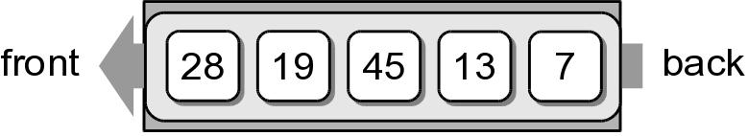
What is a Queue?
Queues are appropriate for many real-world situations. Example:
A line to buy a movie ticket
Computer applications, e.g. a request to
print a document
A restricted access container that stores a linear collection
A Queue is an ordered collection of items where :-
Addition of new items happens at one end (the rear or back of the queue)
Removal of existing items always takes place at the other end (the front of the queue)
First-in, first-out (FIFO) property i.e the first item inserted into a queue is the first item to leave

Slide 3
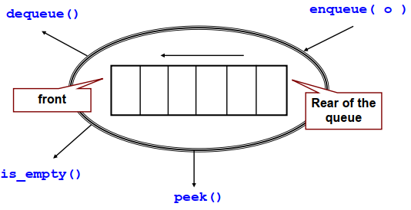
What is a Queue? : ADT
Operations:
Create an empty queue e.g Queue()
Is_empty: Determine whether a queue is empty:
Enqueu: Add a new item to the queue
Dequeue:Remove from the queue the item that was added earliest
Peek: Retrieve from the queue the item that was added earliest
Queue(), enqueue(item) and dequeue() are critical operations in order to manipulate the elements of the queue
peek(), is_empty() and size() are useful to allow the users to retrieve the properties of the queue but they are not necessary

Slide 4
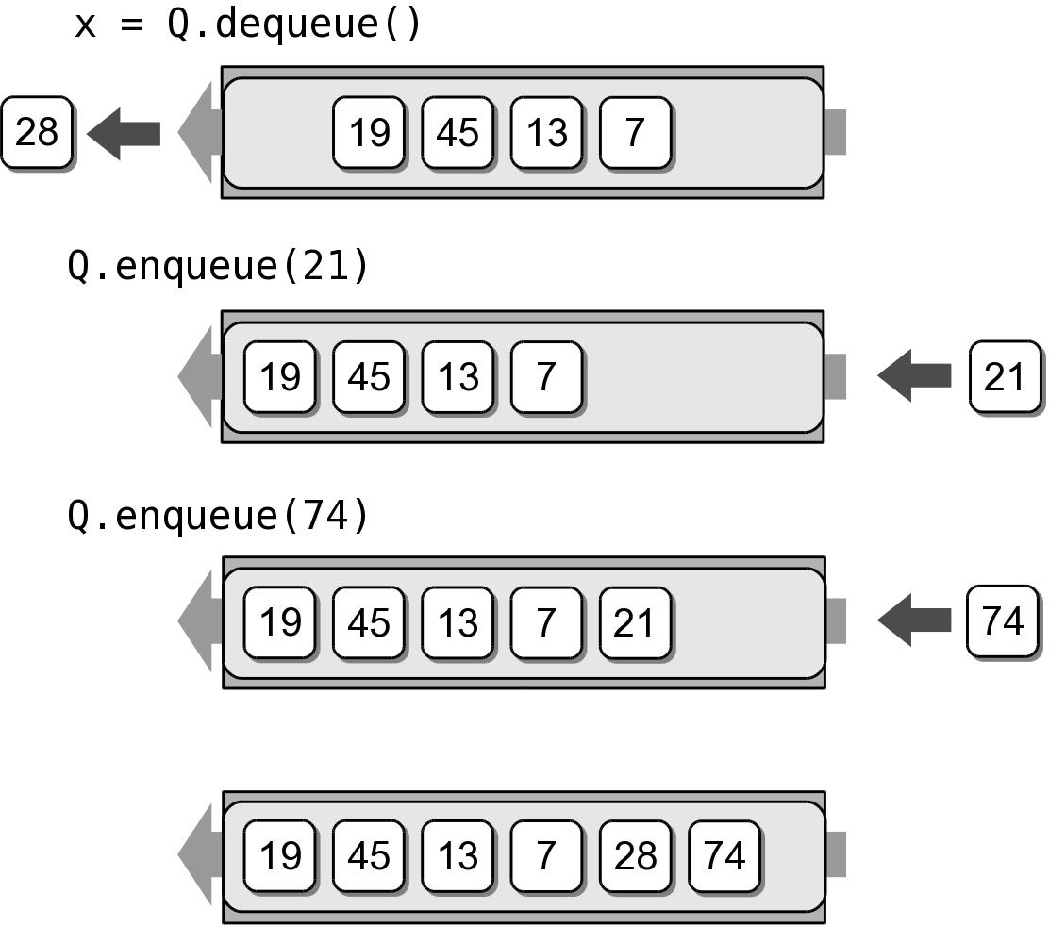
What is a Queue? : ADT
The following code creates the queue from earlier
We can remove items from the queue and
add more items.
Q = Queue()
Q.enqueue( 28 )
Q.enqueue( 19 )
Q.enqueue( 45 )
Q.enqueue( 13 )
Q.enqueue( 7 )
x = Q.dequeue()
Q.enqueue( 21 )
Q.enqueue( 74 )

Slide 5
Queue Implementation
Several common ways to implement a stack:
Python list
Easiest to implement
Circular array
Fast operations with a fixed size queue.
Linked list
Reduces memory wastes by eliminating the extra capacity created with a vector.

Slide 6
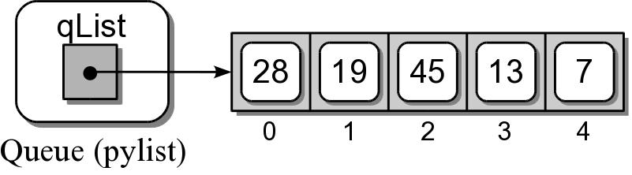
Queue: Python List (1)
Queues Visualization
How is the data organized within the Python list?
Add new items to the end of the list.
Remove items from the front of the list.
# Implementation of the Queue ADT using a Python list.
class Queue :
def __init__( self ):
self._qList = list()
def isEmpty( self ):
return len( self ) == 0
def __len__( self ):
return len( self._qList )
def enqueue( self, item ):
self._qList.append( item )
def dequeue( self ):
assert not self.isEmpty(),"Cant dequeue from empty."
return self._qList.pop( 0 )
def peek( self ):
return self._qList[0]
s = Queue()
print(s.isEmpty())
s.enqueue(56)
s.enqueue('EE')
print(s.peek())
s.enqueue(True)
print(s.isEmpty())
s.enqueue(8.4)
s.dequeue()
print(s.peek())
True
56
False
EE

Slide 7
Comparisons between Queue & Stack
Behaviour:
The behaviour of a stack is like a Last-In-First-Out (LIFO) system
The behaviour of a queue is like a First-In-First-Out (FIFO) system
Implementation with Python list:
The list methods make it very easy to use a list as a stack
To add an item to the top of the stack, using append()
To retrieve an item from the top of the stack, using pop() without an explicit index
It is not efficient to use a list as a queue
To add or remove an item from the end of list are fast, using append() and pop()
To add or remove an item at the beginning of list are slow (because all of the other elements have to be shifted by one)

Slide 8
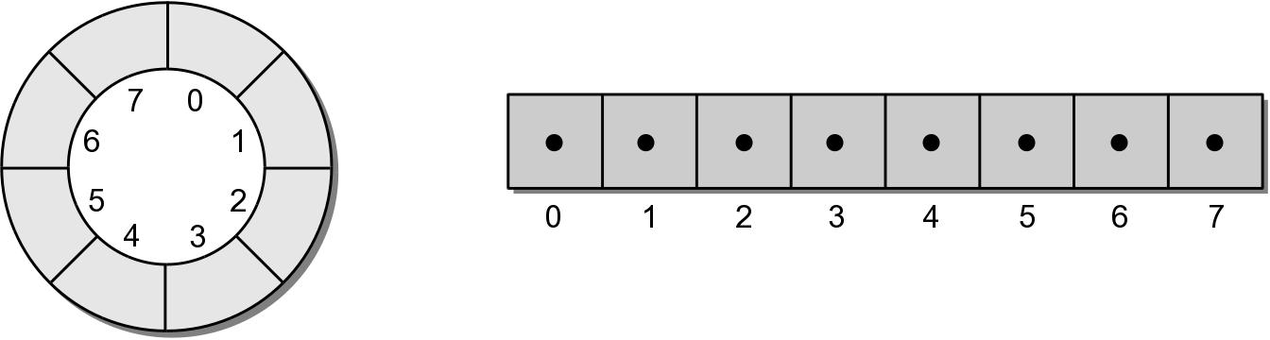
Queue: Circular Array (2)
Circular array – an array viewed as a circle instead of a line.
Items can be added/ removed without having to shift the remaining items in the process.
Introduces the concept of a maximum-capacity queue that can become full.

Slide 9
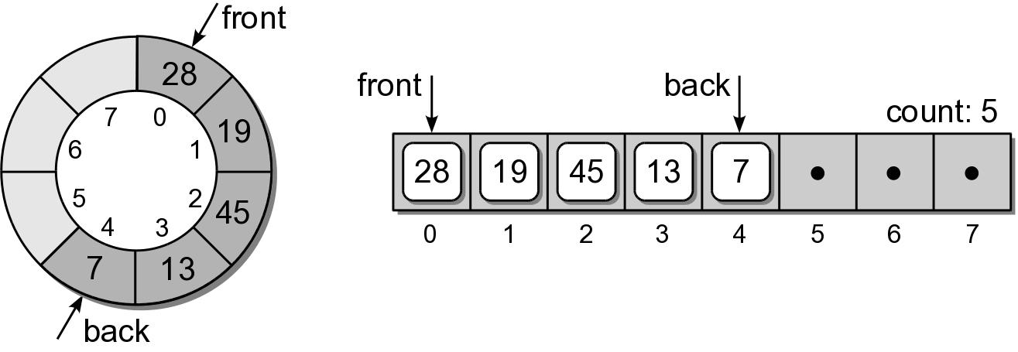
Queue: Circular Array
How should the data be organized within the array?
count field – number of items in the queue.
front and back markers – indicate the array elements containing the queue items.

Slide 10
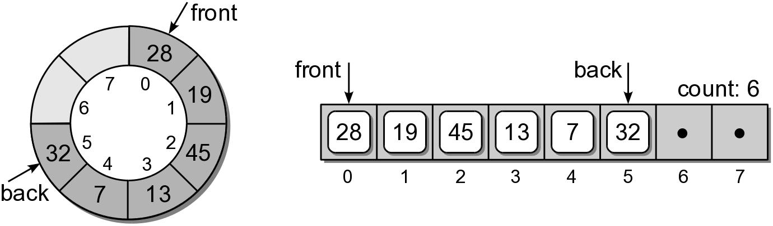
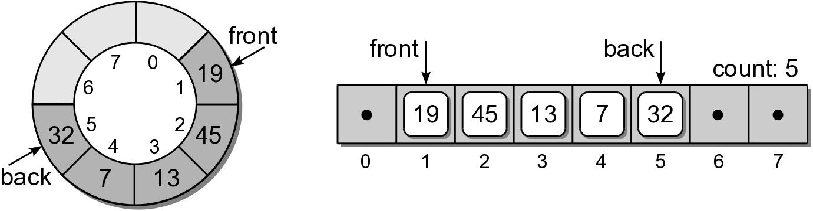
Queue: Circular Array
To enqueue an item:
new item is inserted at the position following back
back is advanced by one position
count is incremented by one.
Suppose we enqueue 32:
To dequeue an item:
the value in the front position is saved
front is advanced by one position.
count is decremented by one.
Suppose we dequeue an item:

Slide 11
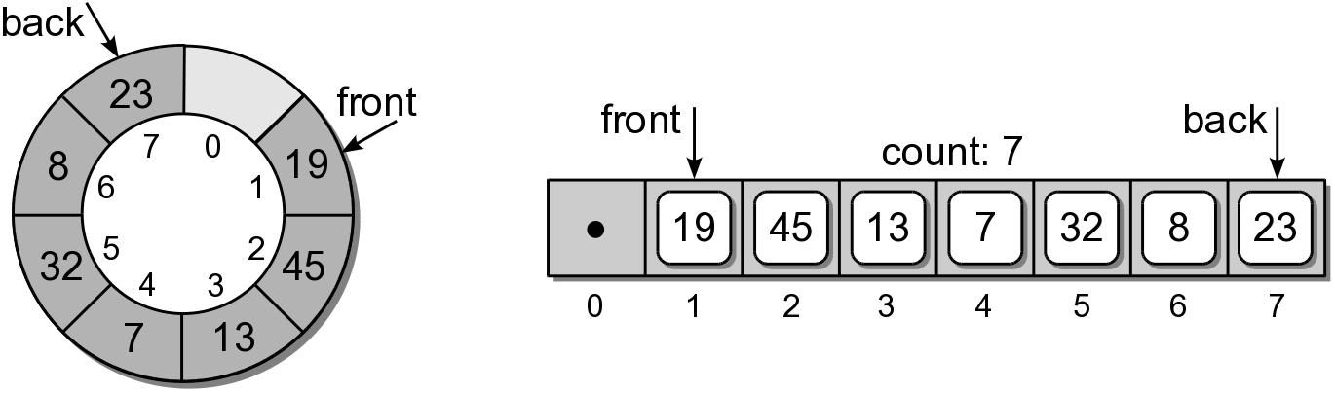
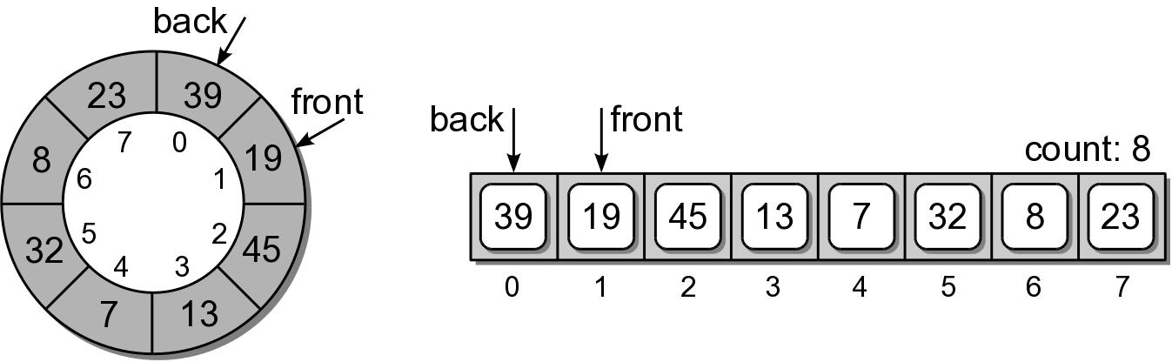
Queue: Circular Array
Suppose we enqueue items 8 and 23:
What happens if we enqueue 39?
Since we are using a circular array, the same steps are followed.
But since back is at the end of the array, it wraps around to the front.

Slide 12
Queue: Circular Array - Implementation
class Queue :
def __init__( self, maxSize ) :
self._count = 0
self._front = 0
self._back = maxSize - 1
self._qArray = Array( maxSize )
def isEmpty( self ) :
return self._count == 0
# A new operation specifically for the circular array.
def isFull( self ) :
return self._count==len(self._qArray)
def __len__( self ) :
return self._count
def enqueue( self, item ):
assert not self.isFull(), "Cannot enqueue to a full queue."
maxSize=len(self._qArray)
self._back=(self._back+1)% maxSize
self._qArray[self._back] = item
self._count += 1
def dequeue( self ):
assert not self.isEmpty(), "Cannot dequeue from an empty queue."
item = self._qArray[ self._front ]
maxSize = len(self._qArray)
self._front = (self._front + 1) % maxSize
self._count -= 1
return item

Slide 13
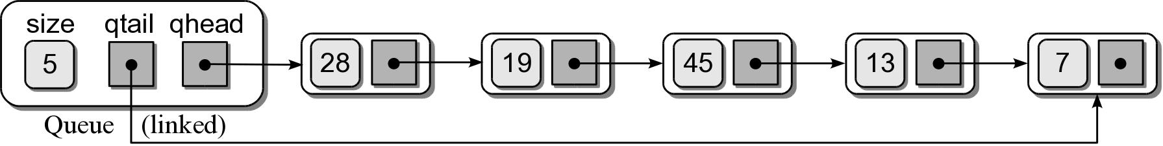
Queue: Linked List (3)
How should the data be organized?
Use both head and tail references.
Let the head of the list represent the front of the queue and the tail the back.
Queues Visualization (using linked lists)

Slide 14
Queue: Link List - Implementation
# Implementation of the Queue ADT using a linked list.
class Queue :
def __init__( self ):
self._qhead = None
self._qtail = None
self._count = 0
def isEmpty( self ):
return self._qhead is None
def __len__( self ):
return self._count
# ...
# Private storage class for creating the linked list nodes.
class _QueueNode:
def __init__( self, item ):
self.item = item
self.next = None
class Queue :
# ...
def enqueue( self, item ):
node = _QueueNode( item )
if self.isEmpty() :
self._qhead = node
else :
self._qtail.next = node
self._qtail = node
self._count += 1
def dequeue( self ):
assert not self.isEmpty(), "Cannot dequeue from an empty queue."
node = self._qhead
if self._qhead is self._qtail :
self._qtail = None
self._qhead = self._qhead.next
self._count -= 1
return node.item

Slide 15
Priority Queues
Some applications require the use of a queue in which items are assigned a priority.
higher priority items are dequeued first.
items with equal priority still follow FIFO.
Two types:
bounded – limited range of priorities.
unbounded – unlimited range.

Slide 16
Priority Queues - ADT
A priority queue is a queue in which each item is assigned a priority and items with a higher priority are removed before those with lower priority.
Integer values are used for the priorities.
Smaller integers have a higher priority.
Example: Consider the following code segment:
PriorityQueue()
BpriorityQueue( numLevels )
isEmpty()
length()
enqueue( item, priority )
dequeue()
Q = BpriorityQueue( 6 )
Q.enqueue( “purple”, 5 )
Q.enqueue( “black”, 1 )
Q.enqueue( “orange”, 3 )
Q.enqueue( “white”, 0 )
Q.enqueue( “green”, 1 )
Q.enqueue( “yellow”, 5 )

Slide 17
Priority Queues - Implementation
How should the ADT be implemented. We must consider:
A priority must be associated with each item in the queue.
The next item dequeued is the item with the highest priority.
If multiple items have the same priority, those must be dequeued in a FIFO order.

Slide 18
Unbounded Priority Queues (1) - Implementation
We explore two approaches:
Python list
Linked list

Slide 19
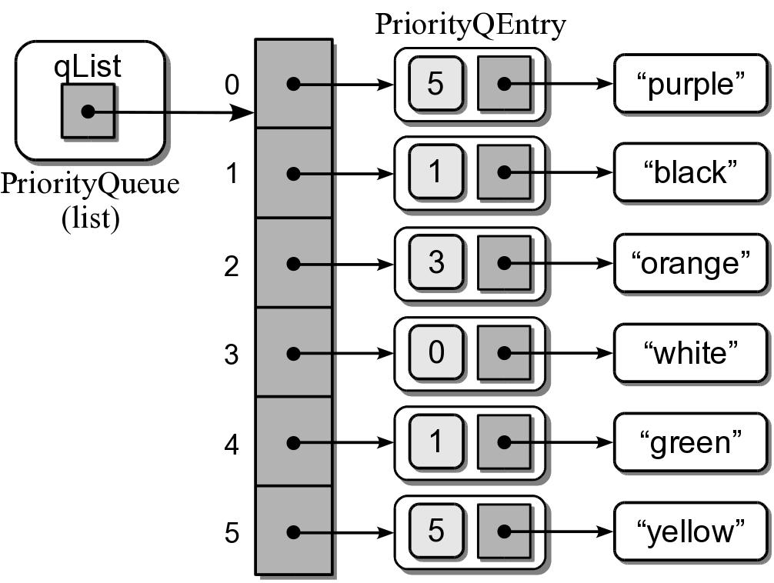
Unbounded Priority Queues (1A) - Python list
Python list to implement the unbounded Priority Queue ADT.
How do we associate a priority with each item?
How should the entries be organized?
append new items to the end, or
keep the items in sorted order based on priority.
Sample instance for the earlier priority queue.
class PriorityQEntry :
def __init__( self, item, priority ):
self.item = item
self.priority = priority

Slide 20
Unbounded Priority Queues - Python list
class PriorityQueue :
def __init__( self ):
self._qList = list()
def isEmpty( self ):
return len( self ) == 0
def __len__( self ):
return len( self._qList )
def enqueue( self, item, priority ):
entry = _PriorityQEntry( item, priority )
self._qList.append( entry )
def dequeue( self ) :
assert not self.isEmpty(), "Cannot dequeue from an empty queue."
# Find the entry with the highest priority.
highest = self._qList[i].priority
for i in range( self.len() ) :
if self._qList[i].priority < highest :
highest = self._qList[i].priority
# Remove the entry with the highest priority and return the item.
entry = self._qList.pop( highest )
return entry.item

Slide 21
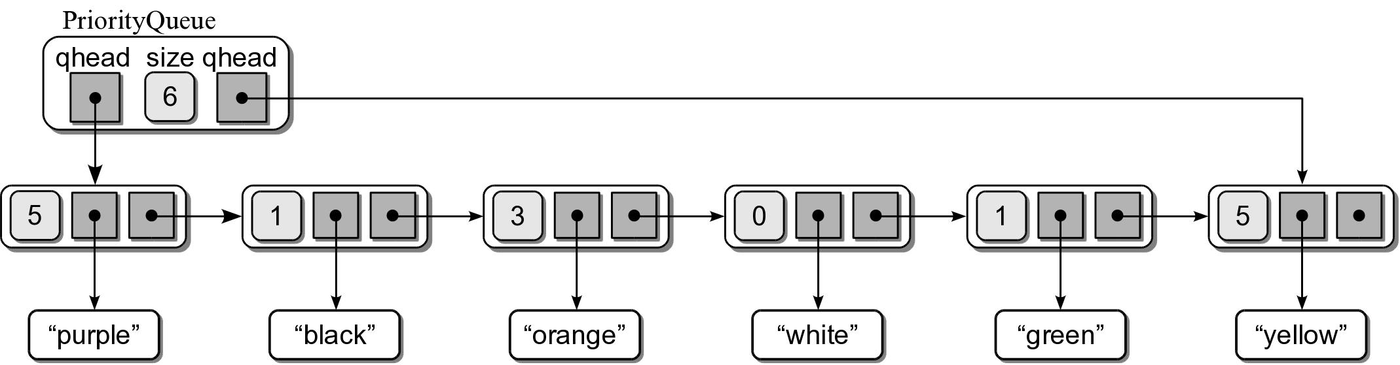
Unbounded Priority Queues (1B) - Linked List
We can use a singly linked list:
Head and tail references.
Append new entries to the end.

Slide 22
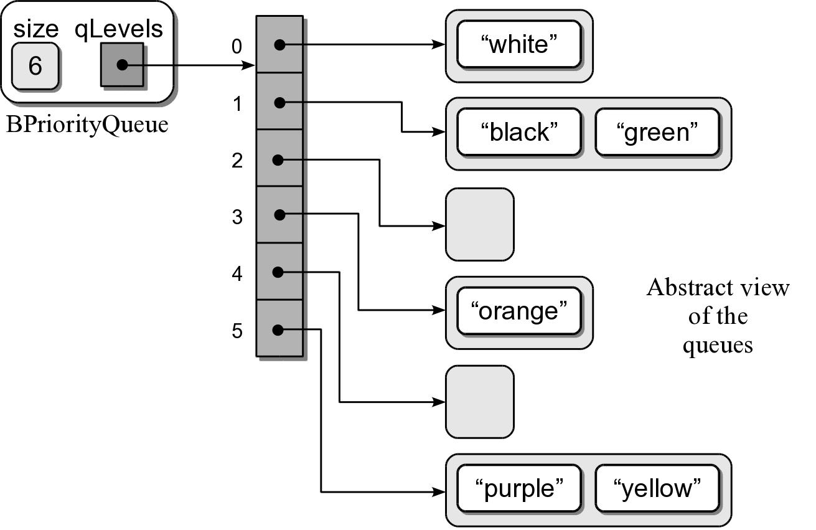
Bounded Priority Queues (2)
We can use the Python list or linked list to implement the bounded Priority Queue.
Both require linear time to dequeue an item.
We can improve this time using an array of queues.

Slide 23
Bounded Priority Queues - Implementation
from array import Array
from llistqueue import Queue
class BPriorityQueue :
def __init__( self, numLevels ):
self._qSize = 0
self._qLevels = Array( numLevels )
for i in range( numLevels ) :
self._qLevels[i] = Queue()
def isEmpty( self ):
return len( self ) == 0
def __len__( self ):
return len( self._qSize )
def enqueue( self, item, priority ):
assert priority >= 0 and priority < len(self._qLevels), \
"Invalid priority level."
self._qLevels[priority].enqueue( item )
def dequeue( self ) :
# Make sure the queue is not empty.
assert not self.isEmpty(), "Cannot dequeue from an empty queue."
# Find the first non-empty queue.
i = 0
p = len(self._qLevels)
while i < p and not self._qLevels[i].isEmpty() :
i += 1
# We know the queue is not empty, so dequeue from the ith queue.
return self._qLevels[i].dequeue()

Slide 24
Practical Applications
Computers can be used to model and simulate real-world systems and phenomena.
Computer applications.
Games.
Hot Potato game
Applications.
Palindrome Checker
Printing Queues
Simulations. Designed to represent and react to significant events in the system.
Examples:
Weather forecasting
Flight simulators
Business activities

Slide 25
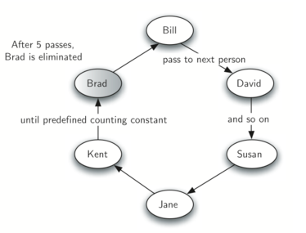
Practical Application (1): Hot Potato
Children form a circle and pass an item from neighbour to neighbour as fast as they can
At a certain point in the game, the action is stopped and the child who has the item (the potato) is removed from the circle
Play continues until only one child is left

Slide 26
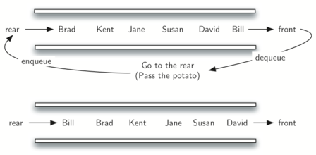
Hot Potato – Algo with a Queue
Assume that the child holding the potato will be at the front of the queue.
Upon passing the potato, the simulation will simply dequeue and then immediately enqueue that child, putting her at the end of the line.
She will then wait until all others have been at front, before her turn again.
After num dequeue/enqueue operations, the child at the front will be removed permanently and another cycle will begin.
This process will continue until only 1 name remains (size of the queue is 1).

Slide 27
Hot Potato – Implementation
from random import randrange
def hot_potato(namelist):
simqueue = Queue()
for name in namelist:
simqueue.enqueue(name)
while simqueue.size() > 1:
num = randrange(1, 13) # randomly "stopping the music"
for i in range(num):
simqueue.enqueue(simqueue.dequeue())
simqueue.dequeue()
return simqueue.dequeue()
players = ["David", "Susan", "Jane", "Kent", "Brad", "Bill"]
print(hot_potato(players))
Move element from the front of the queue to the end
Return the name when there is only ONE name remains in the queue

Slide 28
Practical Application (2): Palindrome Checker
A string which reads the same either left to right, or right to left is known as a palindrome
Radar
Deed
A dog, a plan, a canal: pagoda

Slide 29
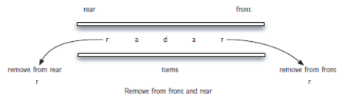
Palindrome Checker – Algorithm
Create a deque to store the characters of the string
The front of the deque will hold the first character of the string and the rear of the deque will hold the last character
Remove both of them directly, we can compare them and continue only if they match
If we can keep matching first and the last items, we will eventually either run out of characters or be left with a deque of size 1
In either case, the string must be a palindrome

Slide 30
Palindrome Checker – Algorithm
print(pal_checker("lsdkjfskf"))
Queue: f, k, s, f, j, k, d, s, l
1st round: compare f and l => FALSE, STOP
print(pal_checker("radar"))
Queue: r, a, d, a, r
1st round: compare r (front) and r (back)
2nd round: compare a (front) and a (back)
3rd round: size() = 1, STOP, return TRUE

Slide 31
Palindrome Checker– Implementation
Check:
The front of the deque (the first character of the string)
The rear of the deque (the last character of the string)
still_equal = True
while char_deque.size() > 1 and still_equal:
first = char_deque.remove_front()
last = char_deque.remove_rear()
if first != last:
still_equal = False
return still_equal

Slide 32
Practical Application (3): Airline Ticket Counter
How many ticket agents are needed at certain times of the day in order to provide timely service?
Too many agents will cost the airline money.
Too few will result in angry customers.
A computer simulation can be developed to model this real system.

Slide 33
Airline Ticket Counter : Queuing System
A system where customers must stand in line awaiting service.
A queue structure is used to model the system.
Simple systems only require a single queue.
Goal: The goal is to study certain behaviors or outcomes.
average wait time
average queue length
average service time

Slide 34
Airline Ticket Counter : Discrete Event Simulation
Consists of a sequence of significant events that cause a change in the system.
Time driven and performed over a preset time period.
Passing of time is represented by a loop, one iteration per clock tick.
Events can only occur at discrete time intervals.
Time units must be small enough to accommodate the events.
Sample Events. Some sample events include:
Customer arrival
Start or end of a transaction (service)
Customer departure

Slide 35
Airline Ticket Counter : System Parameters
A simulation is commonly designed to allow user supplied parameters to define conditions:
Length of the simulation (begins at time 0).
Number of servers.
Expected time to complete a transaction.
Distribution of arrival times.
By adjusting these, the conditions can be changed under which the simulation is performed.

Slide 36
Airline Ticket Counter : Event Rules
A set of rules are defined for handling the events during each tick of clock.
The specific rules depend on what is being studied.
Sample event Rules.To determine the average wait time:
If a customer arrives, he is added to the queue.
at most one customer can arrive per time step.
If there are free servers and customers waiting, the next customer in line begins her transaction.
we begin a transaction for each free server.
If a transaction ends, the customer departs and the server becomes free.
multiple transactions can complete in one time step.

Slide 37
Airline Ticket Counter : Random Events
To correctly model a queuing system, some events must occur at random. (i.e. customer arrival)
We need to model this action as close as possible.
Specify the odds of a customer arriving at each time step as the average time between arrivals.
Use a random number generator to produce a value.
Compare the value to the average arrival time.

Slide 38
Airline Ticket Counter : Sample Simulation
Analyze the average time passengers have to wait for service at an airport ticket counter.
Multiple ticket agents.
Multiple customers that must wait in a single line.

Slide 39
Airline Ticket Counter : System Inputs
The program will prompt the user for the queuing system parameters.
For simplicity, we use minutes as the discrete time units.
Number of minutes to simulate: 25
Number of ticket agents: 2
Average service time per passenger: 3
Average time between passenger arrival: 2

Slide 40
Airline Ticket Counter : System Outputs
After performing the simulation, the program will produce the following output:
Number of passengers served = 12
Number of passengers remaining in line = 1
The average wait time was 1.17 minutes.

Slide 41
Airline Ticket Counter : Debug Info
We also display event information that can help verify the validity of the program.
Time 2: Passenger 1 arrived.
Time 2: Agent 1 started serving passenger 1.
Time 3: Passenger 2 arrived.
Time 3: Agent 2 started serving passenger 2.
Time 5: Passenger 3 arrived.
Time 5: Agent 1 stopped serving passenger 1.
Time 6: Agent 1 started serving passenger 3.
Time 6: Agent 2 stopped serving passenger 2.
Time 8: Passenger 4 arrived.
Time 8: Agent 2 started serving passenger 4.
Time 9: Agent 1 stopped serving passenger 3.
Time 10: Passenger 5 arrived.
Time 10: Agent 1 started serving passenger 5.
Time 11: Passenger 6 arrived.
Time 11: Agent 2 stopped serving passenger 4.
Time 12: Agent 2 started serving passenger 6.
Time 13: Passenger 7 arrived.

Slide 42
Airline Ticket Counter : Class Organization
Our design will be an object-oriented solution with multiple classes.
Passenger – store info related to a passenger.
TicketAgent – store info related to an agent.
TicketCounterSimulation – manages the actual simulation.

Slide 43
Airline Ticket Counter : Passenger Class
class Passenger :
# Creates a passenger object.
def __init__( self, idNum, arrivalTime ):
self._idNum = idNum
self._arrivalTime = arrivalTime
# Gets the passenger's id number.
def idNum( self ) :
return self._idNum
# Gets the passenger's arrival time.
def timeArrived( self ) :
return self._arrivalTime

Slide 44
Airline Ticket Counter : TicketAgent Class
class TicketAgent :
def __init__( self, idNum ):
self._idNum = idNum
self._passenger = None
self._stopTime = -1
def idNum( self ):
return self._idNum
def isFree( self ):
return self._passenger is None
def isFinished( self, curTime ):
return self._passenger is not None and self._stopTime == curTime
def startService( self, passenger, stopTime ):
self._passenger = passenger
self._stopTime = stopTime
def stopService( self ):
thePassenger = self._passenger
self._passenger = None
return thePassenger

Slide 45
Airline Ticket Counter : The Simulation Class
from array import Array
from llistqueue import Queue
from people import TicketAgent, Passenger
class TicketCounterSimulation :
def __init__( self, numAgents, numMinutes,
betweenTime, serviceTime ):
# Parameters supplied by the user.
self._arriveProb = 1.0 / betweenTime
self._serviceTime = serviceTime
self._numMinutes = numMinutes
# Simulation components.
self._passengerQ = Queue()
self._theAgents = Array( numAgents )
for i in range( numAgents ) :
self._theAgents[i] = TicketAgent(i+1)
# Computed during the simulation.
self._totalWaitTime = 0
self._numPassengers = 0
# ...

Slide 46
Airline Ticket Counter : The Simulation Class
class TicketCounterSimulation :
# ...
# Run the simulation using the parameters supplied earlier.
def run( self ):
for curTime in range(self._numMinutes + 1) :
self._handleArrival( curTime )
self._handleBeginService( curTime )
self._handleEndService( curTime )
# Print the simulation results.
def printResults( self ):
numServed = self._numPassengers - len(self._passengerQ)
avgWait = float( self._totalWaitTime ) / numServed
print( "" )
print( "Number of passengers served = ", numServed )
print( "Number of passengers remaining in line = %d" %
len(self._passengerQ) )
print( "The average wait time was %4.2f minutes." % avgWait )
# The remaining methods that have yet to be implemented.
# def _handleArrive( curTime ): # Handles simulation rule #1.
# def _handleBeginService( curTime ): # Handles simulation rule #2.
# def _handleEndService( curTime ): # Handles simulation rule #3.

Slide 47
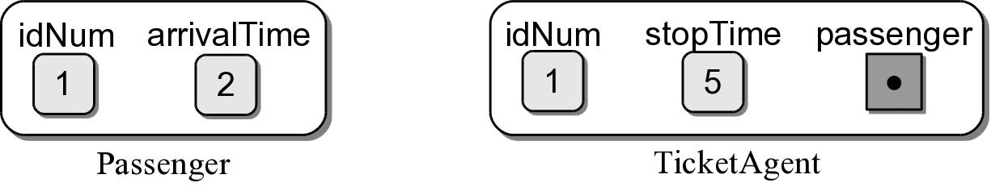
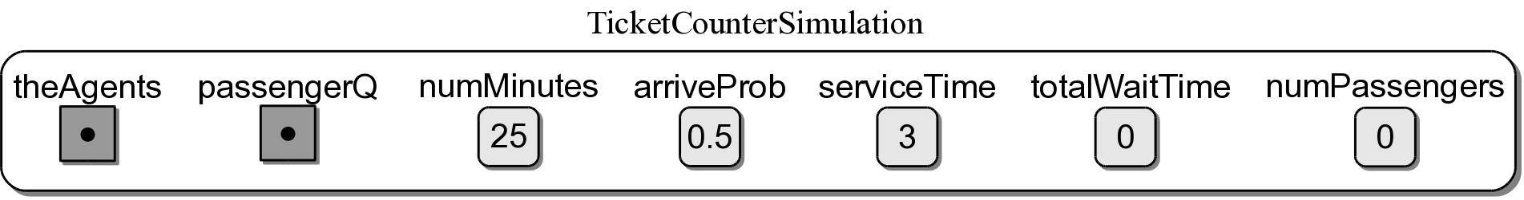
Airline Ticket Counter : Simulation Objects
Sample instances of each class.

Slide 48
Airline Ticket Counter : Sample Results
Num Minutes | Num Agents | Avg Service | Time Between | Avg Wait | Passengers Served | Passengers Remaining
100 | 2 | 3 | 2 | 2.49 | 49 | 2
500 | 2 | 3 | 2 | 3.91 | 240 | 0
1000 | 2 | 3 | 2 | 10.93 | 490 | 14
5000 | 2 | 3 | 2 | 15.75 | 2459 | 6
10000 | 2 | 3 | 2 | 21.17 | 4930 | 18
100 | 2 | 4 | 2 | 10.60 | 40 | 11
500 | 2 | 4 | 2 | 49.99 | 200 | 40
1000 | 2 | 4 | 2 | 95.72 | 400 | 104
5000 | 2 | 4 | 2 | 475.91 | 2000 | 465
10000 | 2 | 4 | 2 | 949.61 | 4000 | 948
100 | 3 | 4 | 2 | 0.51 | 51 | 0
500 | 3 | 4 | 2 | 0.50 | 240 | 0
1000 | 3 | 4 | 2 | 1.06 | 501 | 3
5000 | 3 | 4 | 2 | 1.14 | 2465 | 0
10000 | 3 | 4 | 2 | 1.21 | 4948 | 0

Slide 49
Copyright Notice
The material in this presentation has been taken from text books, reference books, research literature and various sources on Internet; and compiled/edited for class room teaching at MCS-NUST without any infringement into the copyrights of the author(s). The original authors retain their respective copyrights as per their stated claims. Commercial use of the material contained herein in full or in part through copying, publication and reproducing in any form is strictly prohibited

