Slide 1
CS-250-Data Structures & Algorithms
Lecture 4
Stack
(Dec 2020)
Instructor: Lt Col Muhammad Imran Javaid
Email: imranjavaid@mcs.edu.pk
Military College of Signals , NUST

Slide 2
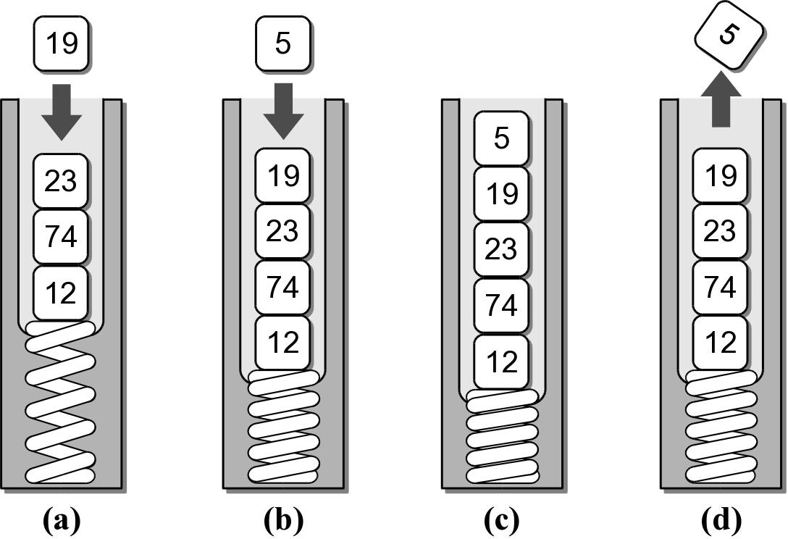
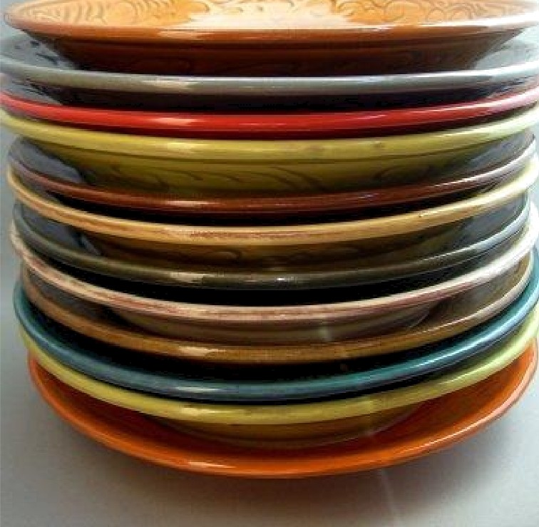
What is a Stack?
A stack is an ordered collection of items where the addition of new items and the removal of existing items always takes place at the same end, referred to as the top of the stack i.e. add at top, remove from top
A restricted access container that stores a linear collection.
Very common for solving problems in computer science.
Provides a last-in first-out (LIFO) protocol.
The last item placed on the stack will be the first item removed
Example: A stack of dishes in a cafeteria

Slide 3
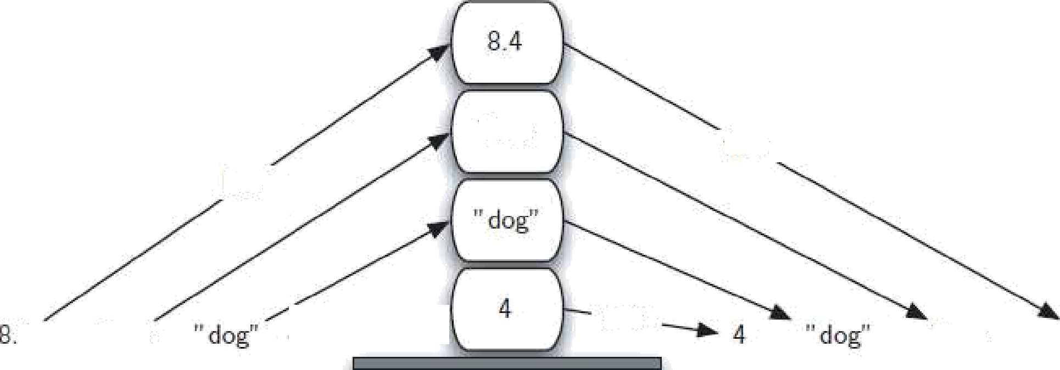

Orders
The base of the stack contains the oldest item, the one which has been there the longest
For a stack the order in which items are removed is exactly the reverse of the order that they were placed
Original Order
Reversed Order

Slide 4
The Stack ADT
Operations
Stack() creates a new stack that is empty
is_empty() tests to see whether the stack is empty
size() returns the number of items on the stack
push(item) adds a new item to the top of the stack
pop() removes the top item from the stack
peek() returns the top item from the stack but does not remove it
Stack() isEmpty() length() or size() pop() push( item ) peek()

Slide 5
The Stack Example
# Extracts a collection of int values from the user & prints them in reverse order. PROMPT = "Enter an int value (<0 to end):" myStack = Stack() # Extract the values and push them onto a stack. value = int(input( PROMPT )) while value >= 0 : myStack.push( value ) value = int(input( PROMPT )) # Pop the values from the stack and print each. while not myStack.isEmpty() : value = myStack.pop() print( value )
s=Stack()
print(s.isEmpty())
s.push('EE')
s.push('MCS')
print(s.peek())
s.push(True)
print(s.size())
print(s.isEmpty())
s.push(99)
print(s.peek())
s.pop()
s.pop()
print(s.size())
True
MCS
3
False
99
2

Slide 6
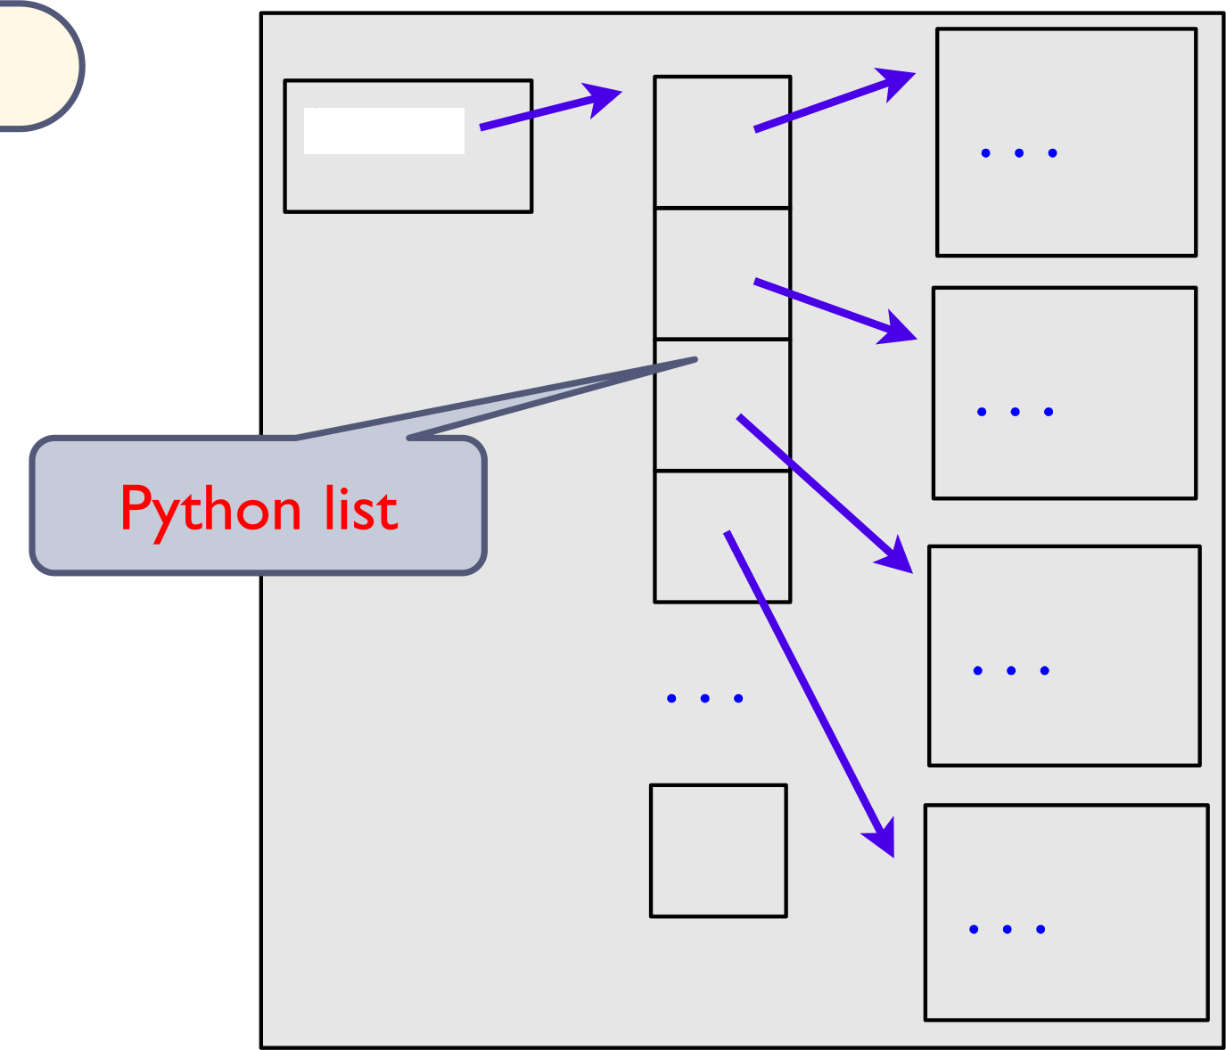
Stack Implementation
Remember: The addition of new items and the removal of existing items always takes place at the same end, referred to as the top of the stack
Several common ways to implement a stack:
Python list - easiest to implement (Stack Visualization)
Linked list - better choice when a large number of push and pop operations are performed. (Stack Visualization using link list)
Items

Slide 7
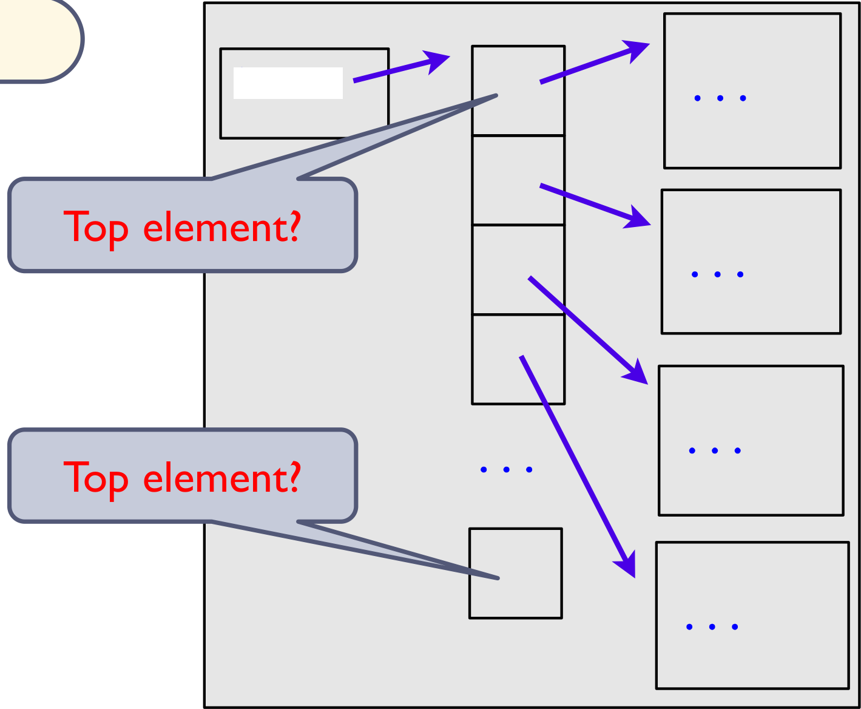
Stack – Python list
How is the data organized within the Python list?
Let the end of the list represent the top of the stack
Let the head of the list represent the top of the stack
Items

Slide 8
Stack – Python list (Tail Top)
# Implementation of the Stack ADT using a Python list.
class Stack :
def __init__( self ):
self._theItems = list()
def isEmpty( self ):
return len( self ) == 0
def __len__ ( self ):
return len( self._theItems )
def peek( self ):
assert not self.isEmpty(), "Cannot peek at an empty stack"
return self._theItems[-1]
def pop( self ):
assert not self.isEmpty(), "Cannot pop from an empty stack"
return self._theItems.pop()
def push( self, item ):
self._theItems.append( item )
# The private storage class for creating stack nodes.
class _StackNode :
def __init__( self, item, link ) :
self.item = item
self.next = link

Slide 9
Stack – Python list (Head Top)
# Implementation of the Stack ADT using a Python list.
class Stack :
def __init__( self ):
self._top = None
self._size = 0
def isEmpty( self ):
return self._top is None
def __len__( self ):
return self._size
def peek( self ):
assert not self.isEmpty(), “Cant peek at empty stack"
return self._top.item
def pop( self ):
assert not self.isEmpty(), "Cant pop from an empty stack"
node = self._top
self.top = self._top.next
self._size -= 1
return node.item
def push( self, item ) :
self._top = _StackNode( item, self._top )
self._size += 1
# The private storage class for creating stack nodes.
class _StackNode :
def __init__( self, item, link ) :
self.item = item
self.next = link

Slide 10
Stack Applications
Many applications in computer science requires the use of a stack. E.g
Balanced delimiters. Applications use delimiters to group strings of text or simple data into subparts.
Checking for Balanced Braces
Bracket Matching
Mathematical expressions
programming languages
HTML markup
Postfix expressions
Postfix Calculation
Conversion from Infix to Postfix

Slide 11
Checking for Balanced Braces
Using a stack to verify whether braces are balanced
An example of balanced braces
{ { } { { } } }
An example of unbalanced braces
{ } { { }
Requirements for balanced braces
Each time you encounter a “}”, it matches an already encountered “{"
When you reach the end of the string, you have matched each “{"

Slide 12
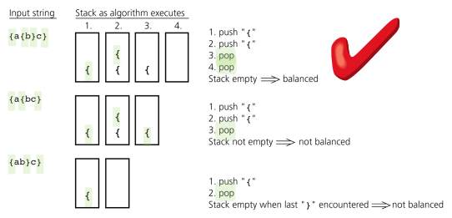
Checking for Balanced Braces - Algorithm
EXAMPLE
Initialize the stack to empty
For every char read • If it is an open bracket then push onto stack • If it is a close bracket, • If the stack is empty, return ERROR • Else, pop an element out from the stack • if it is a non-bracket character, skip it
If the stack is NON-EMPTY, ERROR

Slide 13
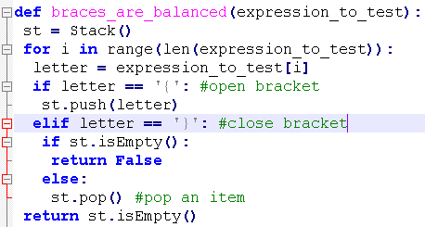
Checking for Balanced Braces – Code
def braces_are_balanced(expression_to_test):
st = Stack()
for i in range(len(expression_to_test)):
letter = expression_to_test[i]
if letter == '{': #open bracket
st.push(letter)
elif letter == '}': #close bracket
if st.isEmpty():
return False
else:
st.pop() #pop an item
return st.isEmpty()
a='{a{b}c}'
print(braces_are_balanced(a))
a='{ab}c}'
print(braces_are_balanced(a))
a='{a{bc}'
print(braces_are_balanced(a))
Initialize the stack to empty
For every char read • If it is an open bracket then push onto stack • If it is a close bracket, • If the stack is empty, return ERROR • Else, pop an element out from the stack • if it is a non-bracket character, skip it
If the stack is NON-EMPTY, ERROR
True
False
False

Slide 14


Bracket Matching
Ensure that pairs of brackets are properly matched
Examples:
{a,(b+f[4])*3,d+f[5]}
// too many closing brackets
// too many open brackets
// mismatched brackets
[..(..]..)

Slide 15
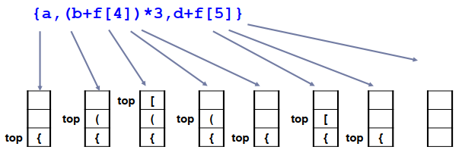
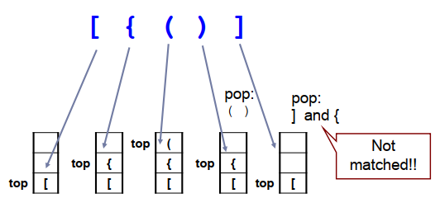
Bracket Matching- Algorithm
Initialize the stack to empty
For every char read • If it is an open bracket then push onto stack • If it is a close bracket, • If the stack is empty, return ERROR
Pop from the stack
If they don’t match return ERROR
If the stack is NON-EMPTY, ERROR
EXAMPLE 1
EXAMPLE 2

Slide 16
Bracket Matching- Code
def brackets_checker(symbol_string):
st = Stack()
balanced = True
index = 0
while index < len(symbol_string) and balanced:
symbol = symbol_string[index]
if symbol in "([{":
st.push(symbol)
elif symbol in ")}]":
if st.isEmpty():
balanced = False
else:
top = st.pop()
if not matches(top, symbol):
balanced = False
index = index + 1
if balanced and st.isEmpty():
return True
else:
return False
# make the function to check match
Example: a = ‘(‘; b = ‘)’ returnTrue

Slide 17
Bracket Matching- Code
def brackets_checker(symbol_string):
st = Stack()
balanced = True
index = 0
while index < len(symbol_string) and balanced:
symbol = symbol_string[index]
if symbol in "([{":
st.push(symbol)
elif symbol in ")}]":
if st.isEmpty():
balanced = False
else:
top = st.pop()
if not matches(top, symbol):
balanced = False
index = index + 1
if balanced and st.isEmpty():
return True
else:
return False
#function matches(a, b)
def matches(a, b):
if (a == '(' and b == ')'):
return True
elif (a == '[' and b == ']'):
return True
elif (a == '{' and b == '}'):
return True
else:
return False
a='[{()]'
print(brackets_checker(a))
a='[{()}]'
print(brackets_checker(a))
a='[{()}]}'
print(brackets_checker(a))
False
True
False

Slide 18
Example: Balanced Delimiters
Consider the following C++ source code:
The delimiters must be paired and balanced.
We can design and implement an algorithm to:
scan a C++ source file, and
determine if the delimiters are properly paired.
int sumList( int theList[], int size )
{
int sum = 0;
int i = 0;
while( i < size ) {
sum += theList[ i ];
i += 1;
}
return sum;
}

Slide 19
Example: Balanced Delimiters
Check the C++ source code:
from lliststack import Stack
def isValidSource( srcfile ):
s = Stack()
for line in srcfile :
for token in line :
if token in "{[(" :
s.push( token )
elif token in "}])" :
if s.isEmpty() :
return False
else :
left = s.pop()
if (token == "}" and left != "{") or \
(token == "]" and left != "[") or \
(token == ")" and left != "(") :
return False
return s.isEmpty()

Slide 20
Mathematical Expressions
We work with mathematical expressions on a regular basis.
Easy to determine the order of evaluation.E.g A + B * C , (A + B) * C
Easy to calculate.
But the task is more difficult in computer programs.
A program can not visualize the expression to determine the order of evaluation.
Must examine one token at a time.
Three different notations can be used:
infix: arg1 op arg2 E.g A + B , A + B * C
prefix: op argl arg2 E.g + A B , + A * B C
postfix: argl arg2 op E.g A B + , A B C * +

Slide 21
Infix to Postfix
Infix expressions can be easily converted by hand to postfix notation.
Fully parenthesize the expression.
For each set of (), move operator to the end of the closing parenthesis.
Remove all of the parentheses.
Examples:
2 * 3 + 4 => 2 3 * 4+
2 + 3 * 4 => 2 3 4* +
1 * 3 + 2 * 4 => 1 3 * 2 4 * +
A * B + C / D
((A * B) + (C / D))
((A B *) (C D /) +)
A B * C D / +
(Post Fix )

Slide 22
Infix to Postfix Algorithm
Operands always stay in the same order with respect to one another
An operator will move only “to the right” with respect to the operands
All parentheses are removed
Operand – append it to the output string postfixExp
“(“ – push onto the stack
Operator
If the stack is empty, push the operator onto the stack
If the stack is non-empty
Pop the operators of greater or equal precedence from the stack and append them to postfixExp
Stop when encounter either a “(“ or an operator of lower precedence or when the stack is empty
Push the new operator onto the stack
“)” – pop the operators off the stack and append them to the end of postfixExp until encounter the match “(“
End of the string – append the remaining contents of the stack to postfixExp

Slide 23
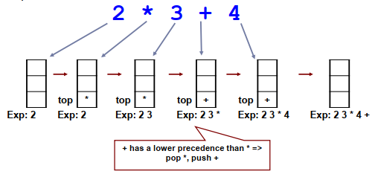
Infix to Postfix – Example 1

Slide 24
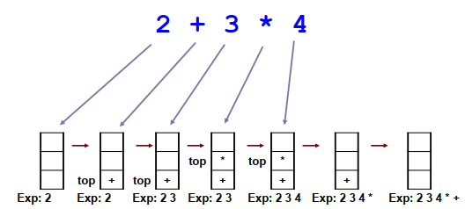
Infix to Postfix – Example 2

Slide 25
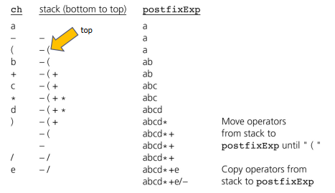
Infix to Postfix – Example 3

Slide 26
Postfix Evaluation Algorithm
We can evaluate a valid postfix expression using a stack structure.
For each token:
If the current token is an operand, push its value onto the stack.
If the current token is an operator:
Pop the top two operands off the stack.
Perform the operation (top value is RHS operand).
Push the result of the operation back on the stack.
Final result will be last value on the stack.

Slide 27
Postfix Evaluation Algorithm – Example 1
Assume an empty stack, and variable as A = 8, B = 2, C = 3, D = 4
Evaluate the valid expression : A B C + * D /
Token | Alg Step | Stack | Description
ABC+*D/ | 1 | 8 | push value of A
ABC+*D/ | 1 | 8 2 | push value of B
ABC+*D/ | 1 | 8 2 3 | push value of C
ABC+*D/ | 2(a) | 8 | pop top two values: y = 3, x = 2
 | 2(b) | 8 | compute z = x + y or z = 2 + 3
 | 2(c) | 8 5 | push result (5) of the addition
ABC+*D/ | 2(a) |  | pop top two values: y = 5, x = 8
 | 2(b) |  | compute z = x * y or z = 8 * 5
 | 2(c) | 40 | push result (40) of the multiplication
ABC+*D/ | 1 | 40 4 | push value of D
ABC+*D/ | 2(a) |  | pop top two values: y = 4, x = 40
 | 2(b) |  | compute z = x / y or z = 40 / 4
 | 2(c) | 10 | push result (10) of the division

Slide 28
Postfix Evaluation Algorithm – Example 2
What happens if the expression is invalid?
A B * C D +
Token | Alg Step | Stack | Description
AB*CD+ | 1 | 8 | push value of A
AB*CD+ | 1 | 8 2 | push value of B
AB*CD+ | 2(a) |  | pop top two values: y = 2, x = 8
 | 2(b) |  | compute z = x * y or z = 8 * 2
 | 2(c) | 16 | push result (16) of the multiplication
AB*CD+ | 1 | 16 3 | push value of C
AB*CD+ | 1 | 16 3 4 | push value of D
AB*CD+ | 2(a) | 16 | pop top two values: y = 4, x = 3
 | 2(b) | 16 | compute z = x + y or z = 3 + 4
 | 2(c) | 16 7 | push result (7) of the addition
Error | xxxxxx | xxxxxx | Too many values left on the stack.

Slide 29
Postfix Evaluation Algorithm – Example 3
What happens if there are too many operators for the given number of operands?
A B * + C /
Token | Alg Step | Stack | Description
AB*+C/ | 1 | 8 | push value of A
AB*+C/ | 1 | 8 2 | push value of B
AB*+C/ | 2(a) |  | pop top two values: y = 2, x = 8
 | 2(b) |  | compute z = x * y or z = 8 * 2
 | 2(c) | 16 | push result (16) of the multiplication
AB*+C/ | 2(a) |  | pop top two values: y = 16, x = ?
Error | xxxxxx | xxxxxx | Only one value on stack, two needed.

Slide 30
Summary
Stacks are used in applications that manage data items in LIFO manner, such as:
Checking for Balanced Braces
Matching bracket symbols in expressions
Evaluating postfix expressions
Conversion from Infix to Postfix

Slide 31
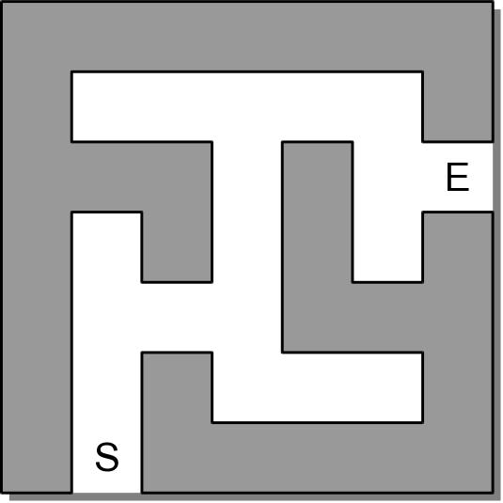
Practical Application: Solving a Maze
How can we find a path through a maze?
Possible Solutions:
Brute Force
Backtracking

Slide 32
Brute-Force
The most basic problem-solving technique.
Find a solution by systematically examining all possible candidates.
Is time-consuming and generally chosen as a last resort.
When applied to solving a maze:
Start at the beginning and follow a path.
If we find a blocked passage, start over from the beginning and follow a different path.

Slide 33
Backtracking
The process of eliminating possible contenders from the solution and partially backing up to try others.
backtracking algorithms – broad class of algorithms that employ this technique.
Attempt to find a solution by extending a partial solution one step at a time.
When applied to solving a maze:
Start from the beginning and move forward.
If we encounter a blocked passage, backup one step and try a different path.
Follow the new path until we find the exit or encounter another blocked passage.
Repeat until we find the exit or return to the starting position.

Slide 34
Designing a Solution
Backtracking can be applied to the problem maze problem.
Step 1: Problem details
Step 2: Algorithm description
Step 3: Implementation details

Slide 35
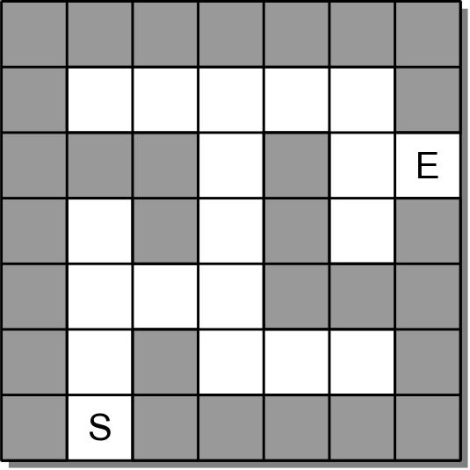
Step 1: Problem Description
Given a maze with starting and exit positions:
determine if there is a path from the starting position to the exit.
specify the path with no circles or loopbacks.
Maze Structure: The maze is a collection of equal-sized cells laid out in rows and columns. Each cell is either
filled to represent a wall, or
empty to represent an open space.

Slide 36
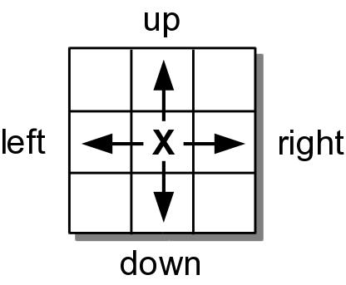
Step 1: Problem Description
Movement: Movement within the maze is restricted:
can only move one cell at a time and can only move to open positions:
those not blocked by a wall, and
those not previously used in the current search.
can only move horizontally and vertically.

Slide 37
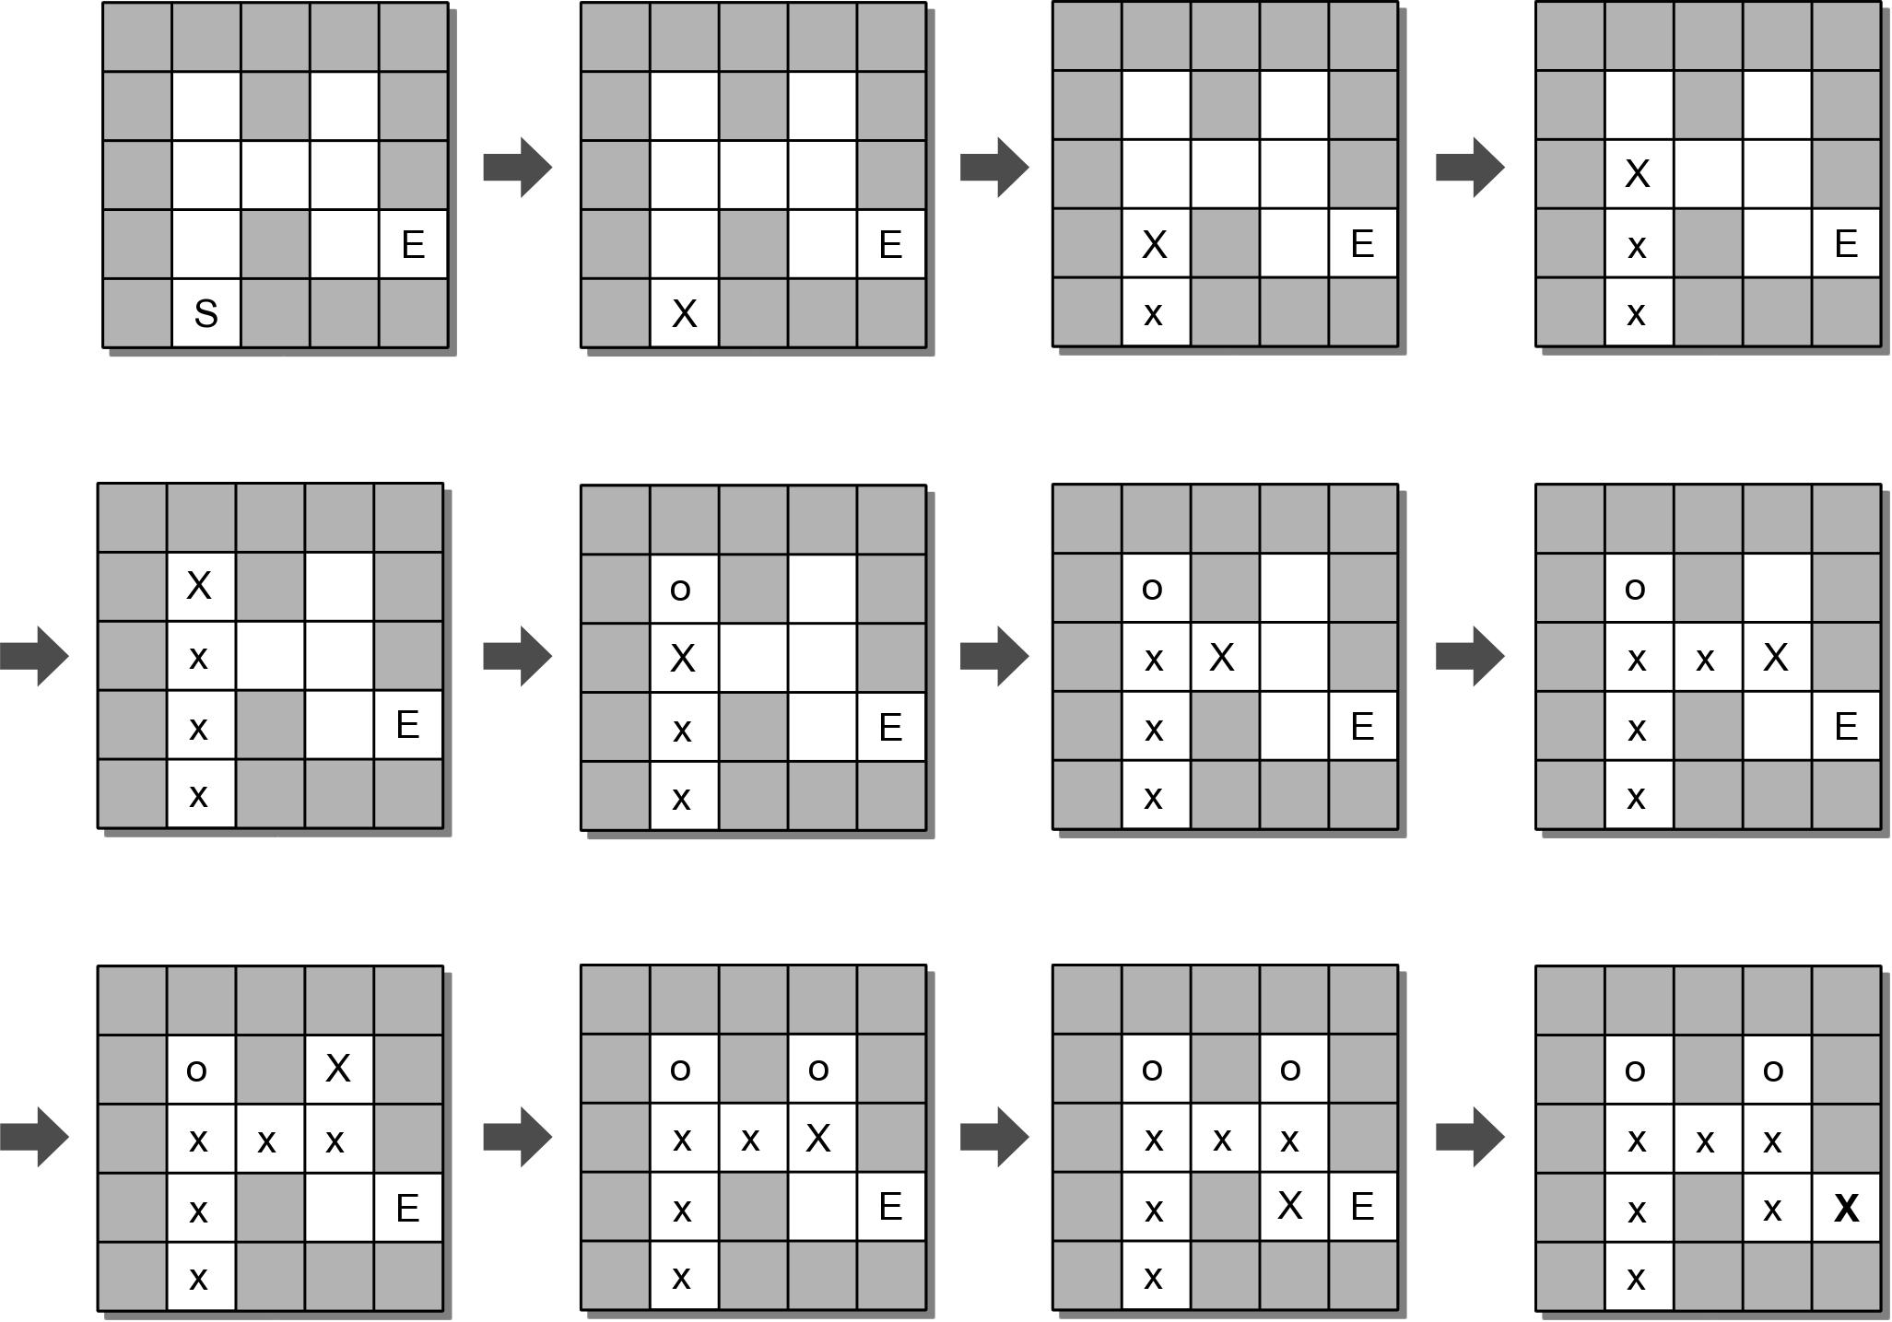
Step 2: Algorithm - Finding the Exit

Slide 38
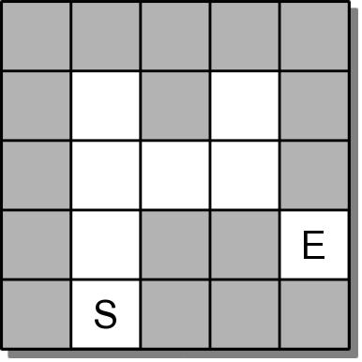
Step 2: Algorithm - No Path to the Exit
What if there is no path to the exit?

Slide 39
Step 2: The Maze ADT
A maze is a two-dimensional structure divided into rows and columns of equal-sized cells.
Individual cells can be filled (wall) or empty (open)
One cell is marked as the start and another as the exit.
Maze( nrows, ncols ) numRows() numCols() setWall( row, col ) setStart( row, col ) | setExit( row, col ) findPath() reset() draw()

Slide 40
Step 2: Using the Maze ADT
# Program for building and solving a maze.
from maze import Maze
def main():
maze = buildMaze( "mazefile.txt" )
if maze.findPath() :
print( "Path found...." )
maze.draw()
else :
print( "Path not found...." )
def buildMaze( filename ):
......
def readValuePair( infile ):
line = infile.readline()
valA, valB = line.split()
return int(valA), int(valB)
# Call the main routine to execute the program.
main()

Slide 41
Step 2: Maze Text File
The maze will be constructed from a maze specification stored in a text file.
line 1: size of the maze – rows and cols
line 2: starting position
line 3: ending position
5 5
4 1
3 4
01234
0 BBBBB
1 B.B.B
2 B...B
3 B.B..
4 B.BBB

Slide 42
Step 2: Building the Maze
def buildMaze( filename ):
infile = open( filename, "r" )
# Read the size of the maze.
nrows, ncols = readValuePair( infile )
maze = Maze( nrows, ncols )
# Read the starting and exit positions.
row, col = readValuePair( infile )
maze.setStart( row, col )
row, col = readValuePair( infile )
maze.setExit( row, col )
# Read the maze itself.
for row in range( nrows ) :
line = infile.readline()
for col in range( len(line) ) :
if line[col] == “B" :
maze.setWall( row, col )
# Close the maze file and return the newly constructed maze.
infile.close()
return maze

Slide 43
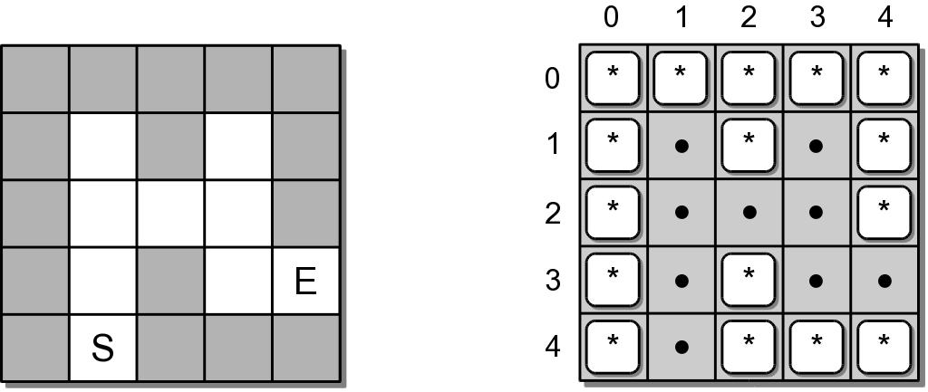
Step 3: Maze Implementation
What data structure should be used?
Obvious choice is a 2-D array
Array elements represent the cells of the maze.
Open cells can be represented as null references.
Walls and tokens can be individual characters.

Slide 44
Step 3: Maze Implementation
from array import Array2D
from lliststack import Stack
class Maze :
# Define constants to represent contents of the maze cells.
MAZE_WALL = "*"
PATH_TOKEN = "x"
TRIED_TOKEN = "o"
# Creates a maze object with all cells marked as open.
def __init__( self, numRows, numCols ):
self._mazeCells = Array2D( numRows, numCols )
self._startCell = None
self._exitCell = None
# ...
# Private storage class for holding a cell position.
class _CellPosition( object ):
def __init__( self, row, col ):
self.row = row
self.col = col

Slide 45
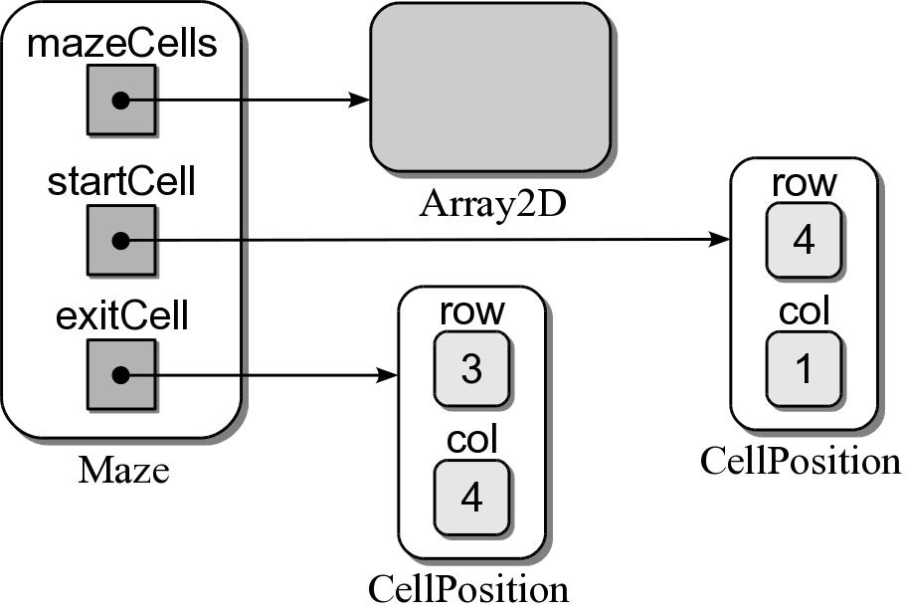
Step 3: Sample Maze Object
A maze object contains three data fields.

Slide 46
Step 3: Maze Implementation
class Maze :
# ...
# Returns the number of rows in the maze.
def numRows( self ):
return self._mazeCells.numRows()
# Returns the number of columns in the maze.
def numCols( self ):
return self._mazeCells.numCols()

Slide 47
Step 3: Maze Implementation
class Maze :
# ...
# Fills the indicated cell with a "wall" marker.
def setWall( self, row, col ):
assert row >= 0 and row < self.numRows() and \
col >= 0 and col < self.numCols(),
"Cell index out of range."
self._mazeCells.set( row, col, self.MAZE_WALL )
# Sets the starting cell position.
def setStart( self, row, col ):
assert row >= 0 and row < self.numRows() and \
col >= 0 and col < self.numCols(),
"Cell index out of range."
self._startCell = _CellPosition( row, col )
# Sets the exit cell position.
def setExit( self, row, col ):
assert row >= 0 and row < self.numRows() and \
col >= 0 and col < self.numCols(), \
"Cell index out of range."
self._exitCell = _CellPosition( row, col )

Slide 48
Step 3: Maze Implementation
class Maze :
# ...
# Returns True if the given cell position is a valid move.
def _validMove( self, row, col ):
return row >= 0 and row < self.numRows() and \
col >= 0 and col < self.numCols() and \
self._mazeCells[row, col] is None
# Helper method to determine if the exit was found.
def _exitFound( self, row, col ):
return row == self._exitCell.row and \
col == self._exitCell.col
# Drops a "tried" token at the given cell.
def _markTried( self, row, col ):
self._mazeCells.set( row, col, self.TRIED_TOKEN )
# Drops a "path" token at the given cell.
def _markPath( self, row, col ):
self._mazeCells.set( row, col, self.PATH_TOKEN )

Slide 49
Copyright Notice
The material in this presentation has been taken from text books, reference books, research literature and various sources on Internet; and compiled/edited for class room teaching at MCS-NUST without any infringement into the copyrights of the author(s). The original authors retain their respective copyrights as per their stated claims. Commercial use of the material contained herein in full or in part through copying, publication and reproducing in any form is strictly prohibited

