Slide 1


Slide 2

CHECKSUM
Group Members
Capt Muhammad Hamza
Capt Usama Bashir
Capt Syed Shujaat Ali

Slide 3
CHECKSUM
SEQUENCE
Introduction
Working
Equipment Requirement
Error Detection
Mechanism
Applications

Slide 4
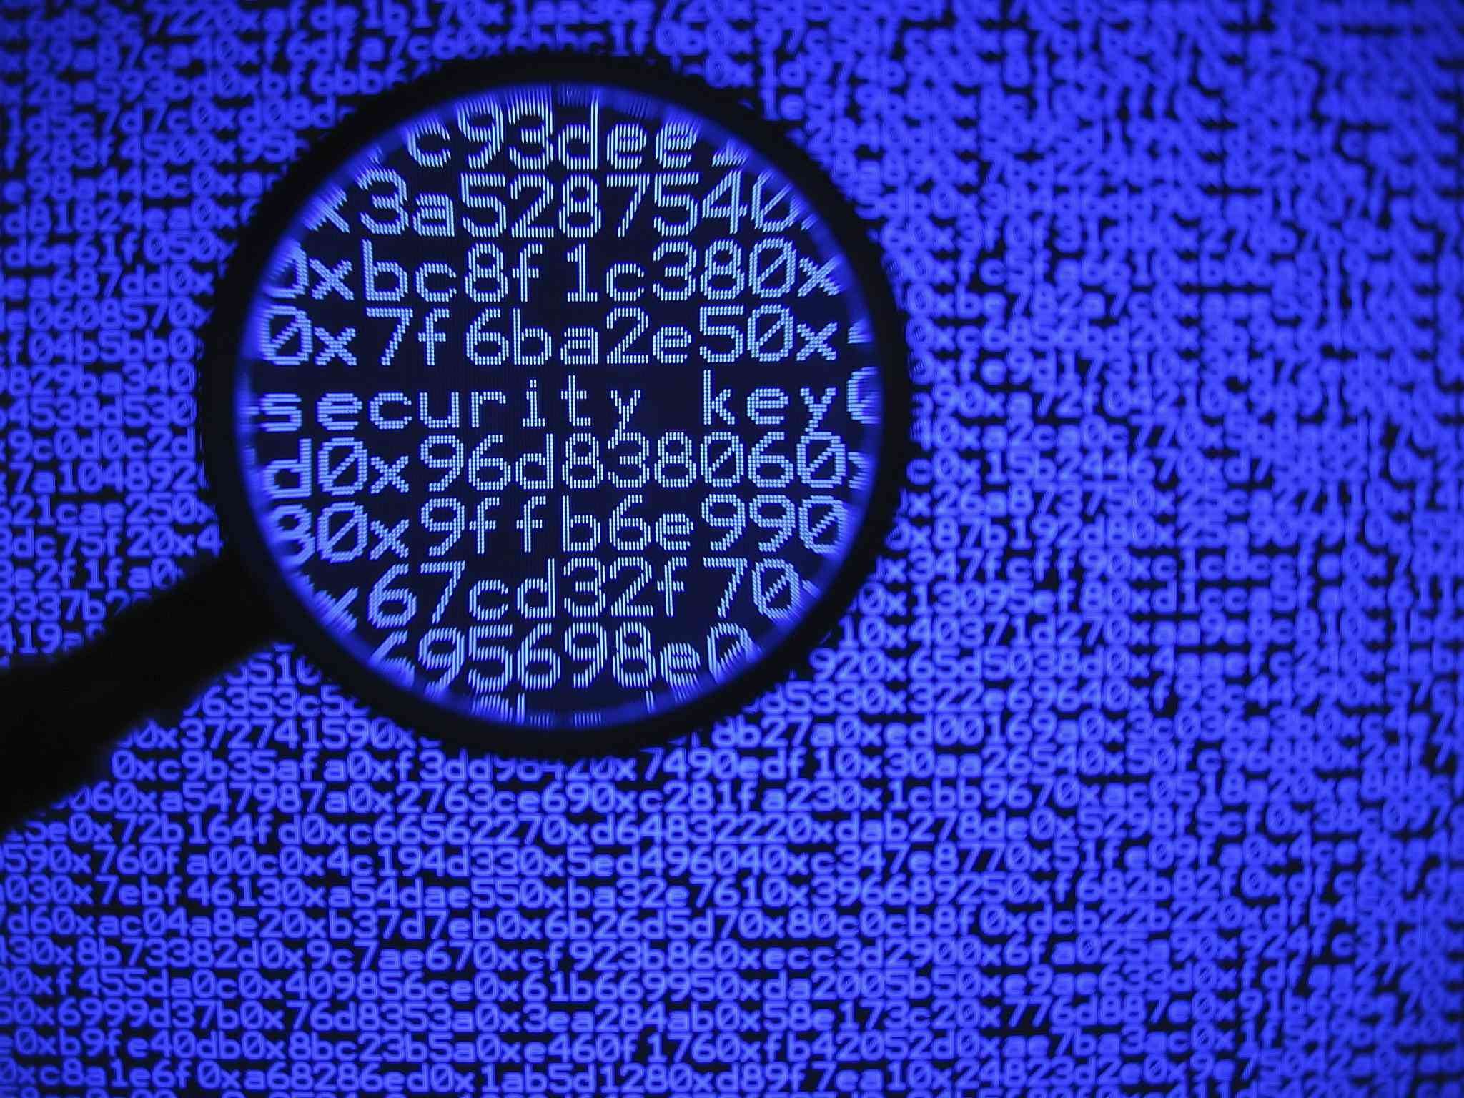
CHECKSUM
4

Slide 5
CHECKSUM
Introduction to Checksum
A checksum is a string of numbers and letters used to uniquely identify a file
Checksum is most commonly used to verify if a copy of a file is identical to an original, such as downloaded copies of ArcGIS product installation or patch files

Slide 6

CHECKSUM
Working of Checksum
A file is pushed through an algorithm, which outputs a unique alphanumeric string called a checksum, also known as a "hash". Different files, even those with minute differences, produce different checksum values
Files may be changed during download, transmission, or storage. For example, if there is an issue with network connectivity at the time of download, the file may not download correctly. Issues with hard drive storage could also lead to file alteration

Slide 7
CHECKSUM
Question
Design a digital system to calculate checksum of the input data. You need to study in detail what is checksum technique and its role in data communication. Your circuit should take some input bytes, then calculate the checksum from the input bytes and display its every bit on output. Students are required to demonstrate the complete working of design and submit a detailed lab report

Slide 8
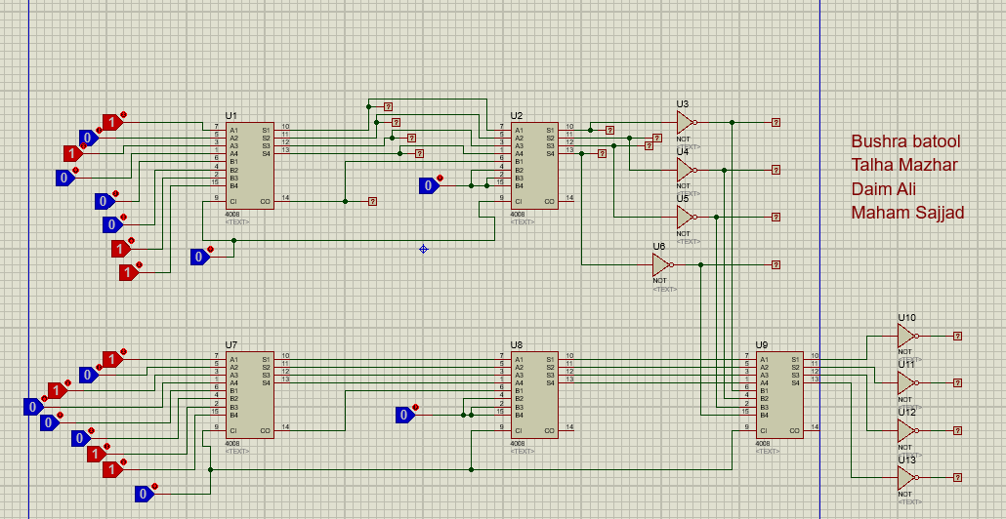
CHECKSUM
Proteus

Slide 9
CHECKSUM
Ellaboration
The sender is used for checksum creation
Operation:
1. Breaks the original message of 8 bits into 2 blocks of 4 bits each
2. Sums the 2 data blocks
3. Add the carry to sum, if any
4. Perform 1's complement to obtain checksum
5.The receiver is used for checksum validation

Slide 10
CHECKSUM
Ellaboration
Operation:
Collects all data blocks including the checksum.
2. Sums all data blocks and checksum.

Slide 11
CHECKSUM
Equipment Required
Full bit binary adder with fast carry
Logic toggle
Logic probe
Not gates

Slide 12
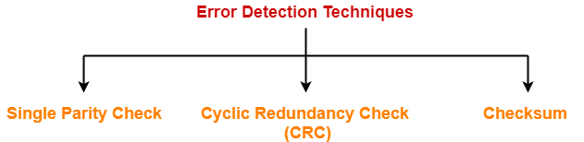
CHECKSUM
Error Detection
There are three main techniques for detecting errors in frames:
Single parity check
Cyclic redundancy check
Checksum

Slide 13
CHECKSUM
Mechanism
Step 1 :At senders end
If our data unit consists of m bits the data unit is divides into segments of m bits
These segments are then added together
The value so obtained is then inverted using 1’s complement
The result obtained is called the checksum

Slide 14
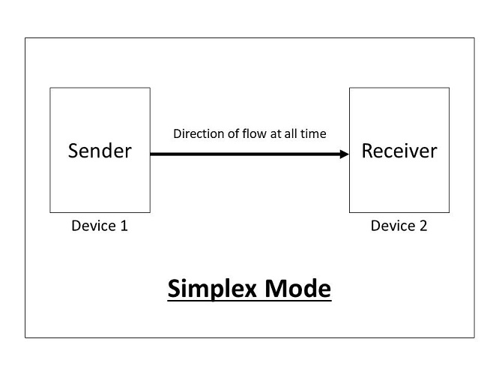
CHECKSUM
Mechanism
Step2:Data transmission
The data unit along with the checksum value is transmitted to the receiver

Slide 15
CHECKSUM
Mechanism
Step3:At the receivers end
If the checksum consists of m bits then it is again broken down into segments of m bits .
It is added with the checksum value and the obtained value is inverted
If the result is 0 ,receiver accepts data considering it error free .if it is not equal to 1 then it is considered as an error

Slide 16
CHECKSUM
Applications in Military
Computer Systems used in Military and other challenging applications, are often exposed to increased levels of electromagnetic radiation. Embedded systems falling in this category often suffer from this exposure due to the operation of the device to which they belong. Consequently data communications within such devices need to be protected against transmission errors

Slide 17
CHECKSUM
Applications in Military
The modified checksum is hence shown to be an algorithmic tool that can significantly contribute to the design of reliable and fault tolerant computing systems, such as the ones used for military systems or other applications that operate in adverse environments

Slide 18
CHECKSUM
Applications in Data Integrity
Data integrity is a rising concern for general masses these days .every type of data ranging from bank account number to online payments, consumer data and record to a company’s documents require security. Checksum method is a technique which can be used to verify that the file has not been tampered by an external source or a third party member. In this way validity of a document is proven.

Slide 19
CHECKSUM
THANK YOU

