Slide 1
CS-250-Data Structures & Algorithms
Lecture 2
Python Language Fundamentals
(Nov 2020)
Instructor: Lt Col Muhammad Imran Javaid
Email: imranjavaid@mcs.edu.pk
Military College of Signals , NUST

Slide 2
List comprehensions
A powerful feature of the Python language.
A list can be created using instructions that appear within the square brackets
Generate a new list by applying a function to every member of an original list.
The syntax of a “list comprehension” is tricky.
If you’re not careful, you might think it is a for-loop, an ‘in’ operation, or an ‘if’ statement since all three of these keywords (‘for’, ‘in’, and ‘if’) can also be used in the syntax of a list comprehension.
It’s something special at its own.
my_list = [x for x in range(0, 10)]
[0, 1, 2, 3, 4, 5, 6, 7, 8, 9]

Slide 3

List comprehensions : Syntax 1
The general format is as follows:
[expression for variable in sequence]
Where expression is some calculation or operation acting upon variable.
For each member of the sequence, calculate a new value using expression, and then we collect these new values into a new list which becomes the return value of the list comprehension.
Examples:
my_list = [c for c in 'Ann']
['A', 'n', 'n']
freshfruit = [' banana', ' loganberry ']
li = [weapon.strip() for weapon in freshfruit]
['banana', 'loganberry']
vec = [2, 4, 6]
li = [3*x for x in vec]
[6, 12, 18]
li = [n * 2 for n in range(1, 5)]
[2, 4, 6, 8]

Slide 4
Exercise
Write a list comprehension that generates all the odd numbers between 1 and 50

Slide 5
Exercise
Write a list comprehension that generates all the odd numbers between 1 and 50
my_list = [n * 2 + 1 for n in range(0, 25)]
my_list = [n * 2 + 1 for n in range(0, 25)]
[1, 3, 5, 7, 9, 11, 13, 15, 17, 19, 21, 23, 25, 27, 29, 31, 33, 35, 37, 39, 41, 43, 45, 47, 49]

Slide 6







List Comprehension Syntax 2
If the original list contains a variety of different types of values, then the calculations contained in the expression should be able to operate correctly on all of the types of list members.
values = ['hello', [1,2], (3,5)] li = [len(n) for n in values]
[5, 2, 2]
If the members of list are other containers, then the name can consist of a container of names that match the type and “shape” of the list members.
values = [('a', 1), ('b', 2), ('c', 7)]
li = [ n * 3 for (x, n) in values]
[3, 6, 21]

Slide 7







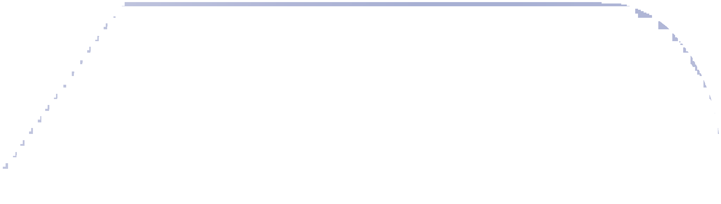


List Comprehension Syntax 3
The expression of a list comprehension could also contain user-defined functions.
def foo(a): return a * a
oplist = [(6, 3), (1, 7), (5, 5)] [36, 1, 25]
li = [foo(x) for (x, y) in oplist]
def subtract(a, b): return a - b
[-3, 6, 0]
oplist = [(6, 3), (1, 7), (5, 5)]
li = [subtract(y, x) for (x, y) in oplist]

Slide 8






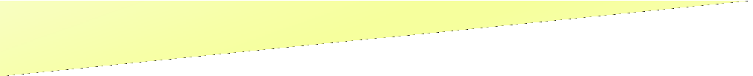

List Comprehension Syntax 4
We can also create …
A list of dictionaries
A list of list
vec = [2, 4, 6]
li = [{x: x**2} for x in vec]
[{2: 4}, {4: 16},{6: 36}]]
vec = [2, 4, 6]
li = [[x, x**2] for x in vec]
[[2, 4], [4, 16], [6, 36]]

Slide 9
List Comprehension Syntax 5
With Two sequences…
vec1 = [2, 4, 6]
vec2 = [4, 3, -9]
li = [x*y for x in vec1 for y in vec2]
2*4, 2*3, 2*(-9)
4*4, 4*3, 4*(-9)
6*4, 6*3, 6*(-9)
[8, 6, -18, 16, 12, -36, 24, 18, -54]
li = [x+y for x in vec1 for y in vec2]
[6, 5, -7, 8, 7, -5, 10, 9, -3]
9
9

Slide 10



List Comprehension Syntax 5
With Two sequences…
vec1 = [2, 4, 6]
vec2 = [4, 3, -9]
li = [vec1[i]*vec2[i] for i in range(len(vec1))]
i=0, i=1, i=2 (execute three times)
2*4, 4*3, 6*(-9)
[8, 12, -54]

Slide 11


List comprehensions that use conditions (Filtered List)
We can extend the syntax for a list comprehension to include a condition:
The general format is as follows:
Similar, to regular list comprehensions, except now we might not perform the expression on every member of the list.
We first check each member of the list to see if it satisfies a filter condition.
Those list members that return False for the filter condition will be omitted from the list before the list comprehension is evaluated.
my_list = [x for x in range(0, 10) if x % 2 == 0]
[0, 2, 4, 6, 8]
[expression for variable in sequence if condition]

Slide 12










Examples
Examples:
vec = [2, 4, 6]
my_list = [3*x for x in vec if x > 3]
[12, 18]
Only 4 and 6 satisfy the filter condition.
3*4, 3*6
So, only 12 and18 are produced.
Get all the factors of a number:
vec = [2, 4, 6]
my_list = [3*x for x in vec if x < 2]
[]
n = 6
my_list = [x for x in range(1,n+1) if n%x == 0]
[1, 2, 3, 6]

Slide 13
Filtered List
Example:
name = "Andrew Luxton-Reilly“
vowels = "aeiouAEIOU“
my_list = [c for c in name if c not in vowels]
['n', 'd', 'r', 'w', ' ', 'L', 'x', 't', 'n', '-', 'R', 'l', 'l', 'y']

Slide 14


Exercise
Create a list of all the vowels in the string:
Example: “solidarity”
word = 'solidarity' vowels = 'aeiou‘
li = [v for v in word if v in vowels]
print(li)
['o', 'i', 'a', 'i']

Slide 15
Summary: Features of lists
Information in a list is stored contiguously in memory
location of the information can be calculated
location = start of the list + index * size of each element
Efficiency issues
It takes the same time to access any of the elements
Slow to move elements around (i.e. add and delete elements from within the list)

Slide 16
Exercise
Write a list comprehension that generates a list of tuples.
The tuple contains the number (even number between 0 to 9), the square of the number, and the cube of the number.

Slide 17
Exercise
Write a list comprehension that generates a list of tuples.
The tuple contains the number (even number between 0 to 9), the square of the number, and the cube of the number.
li = [(i, i**2, i**3) for i in range(10) if i % 2 == 0]
[(0, 0, 0), (2, 4, 8), (4, 16, 64),(6, 36, 216), (8, 64, 512)]

Slide 18

Exercise
What is the output of the following code fragments?
li = [(x,y) for x in range(3) for y in range(2)] print(li)
names = ['Angela', 'Ann','Adriana'] my_list = [len(x) for x in names] print (my_list)
def double(x):
return x*2
my_list1 = [double(x) for x in range(5)] print(my_list1)
my_list2 = [double(x) for x in range(10) if x%2==0]
print(my_list2)

Slide 19
Exercise
What is the output of the following code fragments?
li = [(x,y) for x in range(3) for y in range(2)] print(li)
[(0, 0), (0, 1), (1, 0), (1, 1), (2, 0), (2, 1)]
names = ['Angela', 'Ann','Adriana'] my_list = [len(x) for x in names] print (my_list)
[6, 3, 7]
def double(x):
return x*2
my_list1 = [double(x) for x in range(5)] print(my_list1)
my_list2 = [double(x) for x in range(10) if x%2==0]
print(my_list2)
[0, 2, 4, 6, 8]
[0, 4, 8, 12, 16]

Slide 20
Objects
An object represents an entity in the real world that can be distinctly identified, e.g., students, dogs, cars, cats, books
Every real-world object has:
State – information that the object stores.
Behavior – functionality of the object, i.e., what the object can do.
Example:
Consider a system managing university students.
A student object has:
State – id, name, age, contact number, completed courses, current courses
Behavior – enroll in course, change contact no, change enrolment degree
A software object’s state is represented by its variables, called data fields
A software object implements its behavior with methods.
Every object is a bundle of variables and related methods.
Two objects of the same kind would have the same set of behaviors, but independent state information
20

Slide 21
Classes
The definition of a particular kind of objects is called a class. Once created, an object is an instance of a class
Python has a number of classes built-in e.g lists, dictionaries, sets, int, float
Almost everything in Python is an object, with its properties and methods.
To create a class, use the keyword class
Use class name to create objects,
Class definitions cannot be empty, but if you for some reason have a class definition with no content, put in the pass statement to avoid getting an error.
class MyClass:
x = 5
print(MyClass)
p1 = MyClass()
print(p1.x)
class Person:
pass

Slide 22
Classes
Access Specifier
All members in a Python class are public by default
Python's convention to make an instance variable protected is to add a signle prefix _ (single underscore) to it.
A double underscore __ prefixed to a variable makes it private.
Private members of a class are denied access from the environment outside the class
Public members are accessible from outside the class
Protected members of a class are accessible from within the class and are also available to its sub-classes
class employee:
def __init__(self, name, sal):
self._name=name # protected attribute
self._salary=sal # protected attribute
class employee:
def __init__(self, name, sal):
self.__name=name # private attribute
self.__salary=sal # private attribute

Slide 23

Classes
The __init__() Function
All classes have a function called __init__(), which is always executed when the class is being initiated.
the __init__() function to assign values to object properties, or other operations that are necessary to do when the object is being created
The self Parameter
Note that the first parameter is special. The self parameter is a reference to the current instance of the class, and is used to access variables that belongs to the class.
class Person:
def __init__(self, name, age):
self.name = name
self.age = age
p1 = Person(“Ahmad", 11)
print(p1.name)
print(p1.age)

Slide 24

Classes
It does not have to be named self , you can call it whatever you like, but it has to be the first parameter of any function in the class
Class Functions/ Methods
Modify Object Properties:
Delete Object Properties:
Delete Objects:
def __init__(self, name, age):
self.name = name
self.age = age
def myfunc(self):
print("Hello my name is " + self.name)
p1 = Person(“Ahmad", 11)
p1.myfunc()
p1.age = 40
del p1.age
del p1

Slide 25
Importing Class
Date time class
from datetime import datetime
d = datetime.now()
print("Current year is " + str(d.year))
print("Current month is " + str(d.month))
print("Current day of month is " + str(d.day))
print("Current hour is " + str(d.hour))
print("Current minute is " + str(d.minute))
print("Current second is " + str(d.second))
Current year is 2020
Current month is 11
Current day of month is 13
Current hour is 14
Current minute is 49
Current second is 56

Slide 26
Inheritance
Inheritance allows us to define a class that inherits all the methods and properties from another class.
Parent class is the class being inherited from, also called base class.
Any class can be a parent class, so the syntax is the same as creating any other class
Child class is the class that inherits from another class, also called derived class.
To create a class that inherits the functionality from another class, send the parent class as a parameter when creating the child class
Parent class
Child class
class Person:
def __init__(self, fname, lname):
self.firstname = fname
self.lastname = lname
def printname(self):
print(self.firstname, self.lastname)
x = Person(“Ahmad", “Imran")
x.printname()
class Student(Person):
pass
x = Student("Aariz", "Imran")
x.printname()

Slide 27
Inheritance
When you add the __init__() function, the child class will no longer inherit the parent's __init__() function.
The child's __init__() function overrides the inheritance of the parent's __init__() function.
To keep the inheritance of the parent's __init__() function, add a call to the parent's __init__() function
class Student(Person):
def __init__(self, fname, lname):
#add properties etc.
class Student(Person):
def __init__(self, fname, lname):
Person.__init__(self, fname, lname)

Slide 28
Inheritance
Python also has a super() function that will make the child class inherit all the methods and properties from its parent.
Add Properties
class Student(Person):
def __init__(self, fname, lname):
super().__init__(fname, lname)
class Student(Person):
def __init__(self, fname, lname):
super().__init__(fname, lname)
self.graduationyear = 2022

Slide 29
Exception Handling
Errors occur in software programs. However, if you handle errors properly, you'll greatly improve your program’s readability, reliability and maintainability.
Python uses exceptions for error handling
Common Exception examples:
Attempt to divide by ZERO
Couldn’t find the specific file to read
Invalid Input values
The run-time system will attempt to handle the exception (default exception handler), usually by displaying an error message and terminating the program

Slide 30
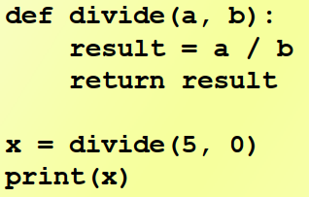
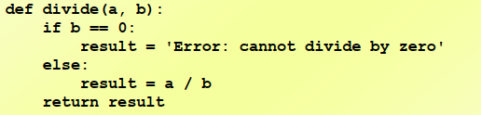
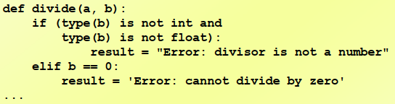
Example
Divide by 0
Check for valid input first
What if “b” is not a number?

Slide 31
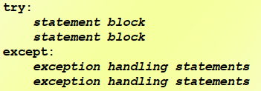
Exception Handling
An exception is an event that occurs during the execution of a program that disrupts the normal flow of instructions during the execution of a program.
When an error occurs within a method, the method creates an exception object and hands it off to the runtime system.
The exception object contains information about the error, including its type and the state of the program when the error occurred.
Creating an exception object and handing it to the runtime system is called throwing an exception.
Statements are executed sequentially as normal
If an error occurs then the remainder of the code is skipped
The code starts executing again at the except clause. It is termed as exception is "caught“

Slide 32
Exception Handling
An exception is an event that occurs during the execution of a program that disrupts the normal flow of instructions during the execution of a program.
When an error occurs within a method, the method creates an exception object and hands it off to the runtime system.
The exception object contains information about the error, including its type and the state of the program when the error occurred.
Creating an exception object and handing it to the runtime system is called throwing an exception.
Statements are executed sequentially as normal
If an error occurs then the remainder of the code is skipped
The code starts executing again at the except clause. It is termed as exception is "caught“

Slide 33
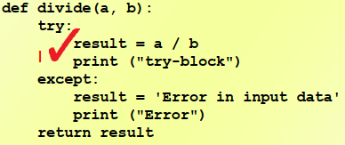
Exception Handling
General Error Handling
You can put two or more except clauses, each except block is an exception handler and handles the type of exception indicated by its argument in a program.
The runtime system invokes the exception handler when the handler is the FIRST ONE matches the type of the exception thrown.
def divide(a, b):
try:
result = a / b
except IndexError:
result = 'Type of operands is incorrect'
except ZeroDivisionError:
result = 'Divided by zero'
except:
result = 'Some other Error'
return result
x = divide(7, 7)
print(x)

Slide 34
Exception Handling
Any kind of built-in error can be caught
Check the Python documentation for the complete list at https://docs.python.org/3/library/exceptions.html
Some popular errors:
ArithmeticError: various arithmetic errors
ZeroDivisionError
IndexError: a sequence subscript is out of range
TypeError: inappropriate type
ValueError: has the right type but an inappropriate value
IOError: Raised when an I/O operation
EOFError: hits an end-of-file condition (EOF) without reading any data

Slide 35
Practice
What is the output of the following program when x is 1, 0 and '0'?
def testing(x):
try:
print('Trying some code’)
2 / x
except ZeroDivisionError:
print('ZeroDivisionError raised here')
except:
print('Error raised here')
else:
print('Else clause')
finally:
print('Finally')
1
Trying some code
Else clause
Finally
0
Trying some code
ZeroDivisionError raised here
Finally
‘0’
Trying some code
Error raised here
Finally

