Slide 1
Delivery Experience
Intelligence Platform
Spot delivery trouble early. Check the photo evidence.
Decide what to do next, before the customer complains.
Anum Sagheer | End-to-end data science on Google Cloud
Real data. Real cloud. Every number measured.

Slide 2
What is inside
The problem
Why late deliveries cost double
How it works
Six steps from order to decision
Risk models
Predicting lateness and bad reviews
Computer vision
99.6% package detection
Streaming + agent
6,235 events/sec, 500 verified decisions
A/B testing
A properly designed experiment
Tech stack
GCP, ML, and engineering
Honest limits
What is real and what is not
Click any card to jump to that section.

Slide 3
The problem
Late deliveries cost twice: the redelivery, then the customer's trust.
  Most companies learn about failures from angry reviews. That is the most expensive feedback loop possible.
This platform moves detection earlier.
  Predict risk at purchase time. Watch events stream in. Check the delivery photo. Draft the right response, before the customer has to complain.
Built on 100% real public data, deployed on real Google Cloud.
  Olist orders, Amazon routes, OpenStreetMap, Open Images. Nothing invented.
Home

Slide 4
How it works: six steps
1
2
3
4
5
6
Orders stream in
Risk is scored
Photos are checked
The agent decides
Everything is audited
Experiments done right
Real order events flow through Pub/Sub into BigQuery.
Two classifiers predict lateness and low reviews from purchase-time data only.
Blur check (free), then AI classifier, then Gemini for hard cases.
A written policy weighs every signal. Drafts a message or escalates. Never auto-sends.
All 500 cloud decisions independently re-verified: 500/500 matched.
A/B test designed with real power analysis before anyone claims an uplift.
Home

Slide 5
Risk models: which orders are in trouble?
Two classifiers using only purchase-time features. Strict temporal splits, no peeking at the future.
Model | Where | ROC-AUC | What it means
Late delivery (HGB) | Local | 0.649 | Ranks late orders above on-time ones 65% of the time
Late delivery (BQML) | BigQuery | 0.616 | Same task, trained where the data lives
Low review (HGB) | Local | 0.601 | Predicts 1 to 2 star reviews
Low review (BQML) | BigQuery | 0.575 | Cloud twin of the local model
Honest context: these are modest scores. Delivery lateness is hard to predict from purchase data alone. The value is the methodology: temporal splits, leakage controls, calibrated thresholds.
Home

Slide 6
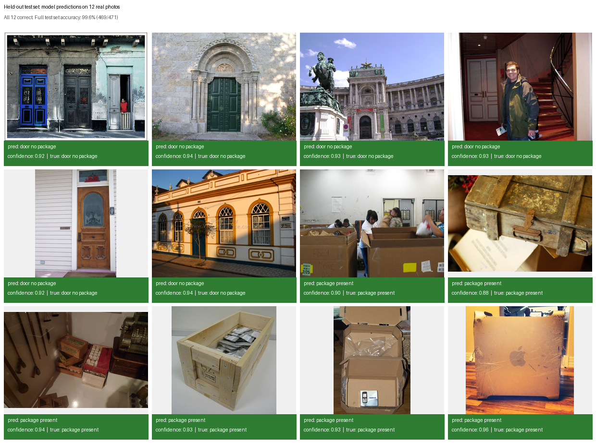
Computer vision: is the package in the photo?
Trained on 4,712 real photos with human-drawn annotations.
• Test accuracy: 99.6% (469 of 471 held-out photos)
• Package precision: 1.0000, never cried wolf
• Package recall: 0.9910, missed 2 of 221
• Cost-ordered cascade: free blur check, then AI, then Gemini
• Batch prediction only, no expensive always-on endpoint
Real test photos with the model's actual predictions and confidence scores.
Home

Slide 7
Streaming + intervention agent
Pub/Sub streaming: 6,235 events per second, zero message loss.
  19,770 real order events published to the cloud topic and consumed into BigQuery.
500 real cloud decisions, every one independently verified.
  A separate script recomputed each decision from warehouse facts. 500 out of 500 matched. 496 no action, 4 customer outreach drafts.
Nothing is ever sent automatically.
  The agent drafts messages for human approval. Dry-run only, by design.
Evidence: evals/streaming/pubsub_cloud.json, evals/agent/verify_audit_500.json, gcp/verify_agent_audit.py
Home

Slide 8
A/B testing: the outreach experiment
Designed like a real experiment, because it might become one.
  Customer-level randomization (not order-level), sticky assignment, 50/50 split.
Sample size calibrated on the real data: about 750 per arm.
  Simulation on the actual score distribution showed the naive textbook number was too small.
Sequential monitoring done correctly.
  O'Brien-Fleming boundaries hold the false positive rate at 5%. Naive repeated testing would hit 13%.
Status: designed and validated. Never run live. No uplift claimed.
  The module exists to prove experimental rigor, not to invent business impact.
Home

Slide 9
Technology stack
Cloud
Machine learning
Computer vision
• BigQuery
• Pub/Sub
• Cloud Storage
• Vertex AI
• scikit-learn
• BigQuery ML
• HistGradientBoosting
• OpenCV
• Vertex AI AutoML
• Gemini 2.5 Flash
Agentic AI
Experimentation
Engineering
• Policy engine
• Dry-run eval
• Audit logging
• Power analysis
• Permutation tests
• Sequential monitoring
• Python 3.10+
• pytest (31 tests)
• Docker
• GitHub Actions
Home

Slide 10
Honest limits
Historical data, not live operations.
  Olist 2016 to 2018, Amazon 2018 routes. The platform replays history; it has never touched a live delivery.
The agent never contacted anyone.
  All decisions were dry runs. Auto-send needs human-in-the-loop tooling this project does not claim.
Some treatment effects are simulated.
  The A/B power analysis simulates the uplift on real data. The design is real; the business impact is not claimed.
Modest risk models, clearly labeled as triage signals.
  ROC-AUC around 0.6. The methodology is the point, not the score.
Datasets are never falsely joined.
  Four datasets, four companies, four contexts. Cross-module demos are labeled as controlled scenarios.
Every number in this deck traces to a script in the repo or a resource in GCP project delivery-experience-511901.
Home

Slide 11
Thank you
Real data. Real cloud. Real measurements.
Every claim verified, every limit stated.
Anum Sagheer | github.com/anumsagheer01
Home

