Slide 1
Introduction to CSS
From: Lynda.com

Slide 2
What is CSS
Stands for cascading style sheets.
It is style language used to control the appearance of markup languages.
Think of HTML as controlling the structure of the web while CSS controls the presentation of it.
CSS is what makes the web pretty.

Slide 3
How to apply CSS to HTML
Inline styles
<p style=“color:#0000;”>
Style blocks
/* p { color:#0000; } /*
External Style Sheets
style.css

Slide 4
Benefits of CSS
Separate style from structure
Control styles for entire website in one place
Tailor styles to the viewing device

Slide 5
CSS Syntax
p
{
font-family:Arial;
font:size:10px;
}
Where p is selector and declaration blocks in the curly braces.

Slide 6
CSS Selectors
Selectors are used to target HTML elements.
Types of selectors:
Elements Selector
Class Selector
ID Selector
Descendant Selector

Slide 7
Element Selector
Element selector is global in nature.
They are going to effect every element of that type
You simply need to know what the tag is for a given element in order to style it.
For example: to style paragraph, you will use the P. For heading ones, you will use H1.
p { font-size:14px; }
h1 { font-size:12px; }

Slide 8
Class Selector
Classes are HTML attributes that can be set on any HTML element.
You can name the class anything you want and you can use it on as many elements and as many times on a page as you need. This makes CSS classes pretty popular.
Example:
HTML : <p class=“error”>oOps </p>
CSS : .error { color:red ; }

Slide 9
ID Selector
They are similar to class selectors in that they represent an HTML attribute.
They differ from classes in one very important aspect
They must be unique to a page.
If you assign an ID to a page element, no other element on that page may have that specific ID
ID are identified as pound symbol.
Example:
HTML: <div id=“content”> Lopem Ipsum </div>
CSS : #content { color:green; }

Slide 10
Class and ID Selector
One of the strengths of CSS that we have talked about is its ability to cascade, to combine CSS from multiple sources, enable inheritance of styles from parent to child theme.
IDs can only be used once on a page, their scope is more specific and they can override class based styles.
Example:
HTML: <div id=“content” class=“main”> Lopem ipsum </div>
CSS: #content { color:green }
CSS: .main { color: red}

Slide 11
Descendant Selector
It allows you to target an element based on where it’s found within another element.
You simply string the selector together , separating them with white space.
The parent selectors are added first, followed by each successive nested selector.
Example:
CSS : div p a { color:green; }
The browser would find any anchor elements inside of a paragraph element , which is also inside div element.
Descendant Selectors can apply to any nested element, no matter how deep it’s found within the page structure.

Slide 12
Group selectors
This will make writing styles more efficient.
Instead of writing 3 separate selectors, you could simply write one group selector.
Example:
h1, p , .content
{
font-family:Arial;
}

Slide 13
Tips for working with CSS and HTML
Use meaningful Class and ID names.
1
Use a consistent HTML structure
2
Structure First and Design Second
3

Slide 14
CSS Resources to practice
https://www.w3.org/Style/CSS/
https://www.w3schools.com/css/default.asp
https://tympanus.net/codrops/css_reference/
http://htmldog.com/guides/css/

Slide 15
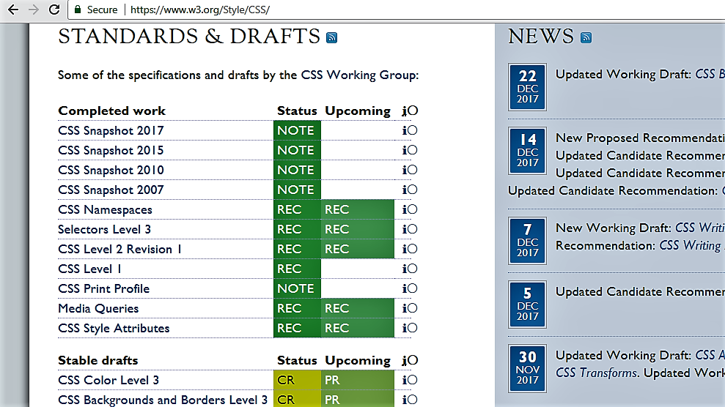



Checking Browser Support – W3C
Here, we will see how you can know whether a particular bit of CSS is both currently recommended by the W3C and what browser support looks like for it.
So first one is w3c.org website.
You can find out the most current state of CSS.

Slide 16
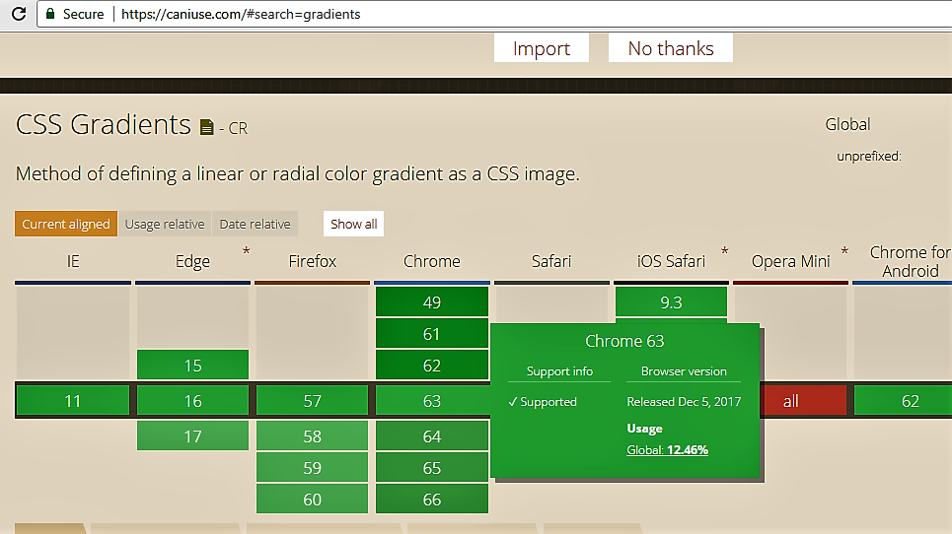
caniuse
It’s basically a tool that visually shows browser support for front-end web technologies such as CSS, HTML and JavaScript on both desktop and mobile web browsers.

Slide 17
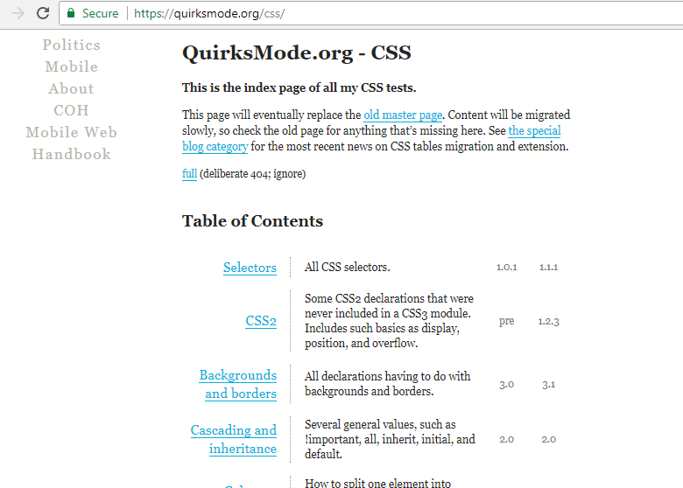


QuirksMode
You can click on anything from the table of contents and get a quick glance of whether or not support is common.

Slide 18

Browser Stack
It is really a cool service that will take a screenshot of your homepage or any page from your site from various browser simulations and let you see visually see the differences.

Slide 19
CSS Concepts

Slide 20
CSS Concept 1 - CSS Normalization and Resets
Every browser have its own built-in stylesheet that helps makes a more readable document if there are no styles applied.
Each browser will render these default styles just a little bit differently.
To get rid of consistencies across browsers, you can create a clean slate by getting rid of all browser styles.
You could do this yourself, writing your own CSS for every single HTML element but imagine doing that for every project.
There some better alternatives- called CSS Normalize and CSS Reset.
They are both small stylesheets that can add to your project.
The goal of both of these is to provide consistent base styling across browsers, but each take a little bit of a different approach.

Slide 21
CSS Reset & CSS Normalize
CSS Reset stylesheets is meant to completely wipe out all built-In styling for HTML elements.
The Normalize stylesheet also removes browser inconsistencies for HTML elements but instead of removing everything like CSS Reset, Normalize CSS will keep some of the useful defaults.
Normalize was created to make built in browser styling more consistent across all browsers.

Slide 22
CSS Concept 2- Working With Fonts
Basic Font Properties:
Font Family (font-family)
Font weight (font-weight)
Font Style (font-style)
Font Size (font-size)
Font Family:
Specifies the font for an element.
Is a prioritized list of elements
Includes fallback font
Example:
p { font-family: “Times New Roman”, “Times”, “ serif” }

Slide 23
Font Weight:
It specifies the weight of the font.
p { font-weight :bold; }
Check out the font weight property option from this link :
https://www.w3.org/TR/css-fonts-3/#font-weight-prop .
Font Style:
It specifies the style of the font.
Check the font style properties options from this link :
https://www.w3.org/TR/css-fonts-3/#propdef-font-style .
Font Size:
It specifies the size of the font.
Check out the examples and option from this link:
https://www.w3.org/TR/css-fonts-3/#propdef-font-size .

Slide 24
System Fonts and Web Fonts
System fonts are limited set of small fonts that come pre-installed on almost every machine.
CSS also gives ability to display fonts that are not in client machine.
These are called web fonts(https://www.w3schools.com/cssref/css_websafe_fonts.asp)
They are external style sheets that you need to bring that you need to bring into the project.
Ways to incorporate the web fonts:
@font-face
@import
Link to stylesheet
Load via JavaScript

Slide 25
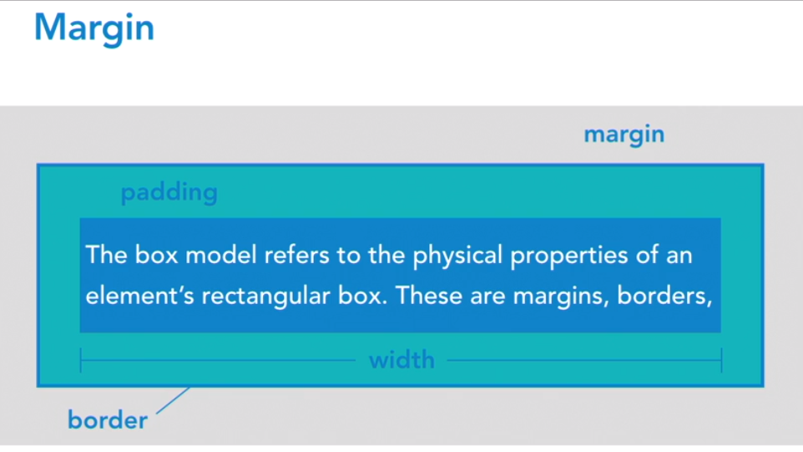
CSS Concept 3 – Box Model
Box Model refers to the physical properties of an element’s rectangular box.
These are margins, borders, padding and content width and height.

Slide 26
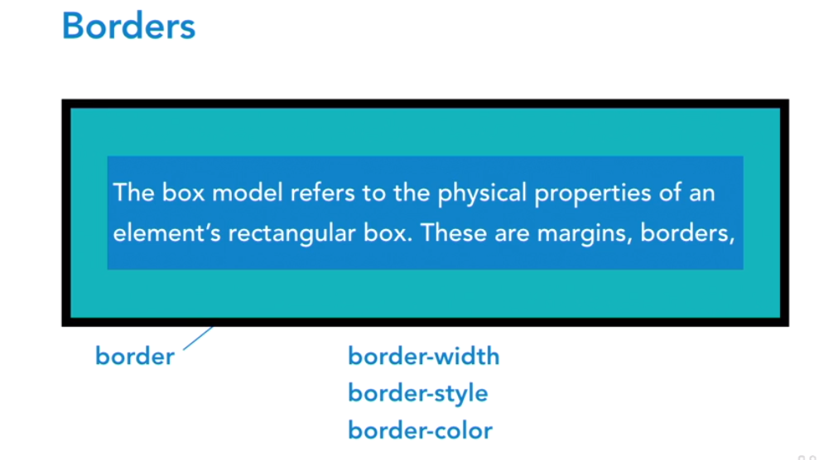
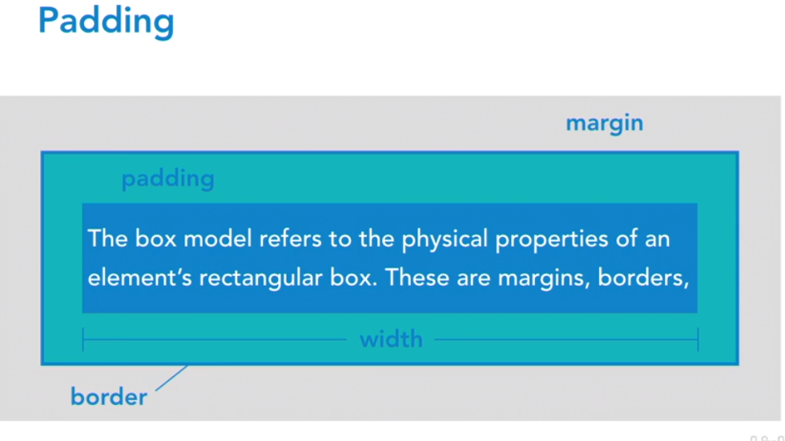

Slide 27
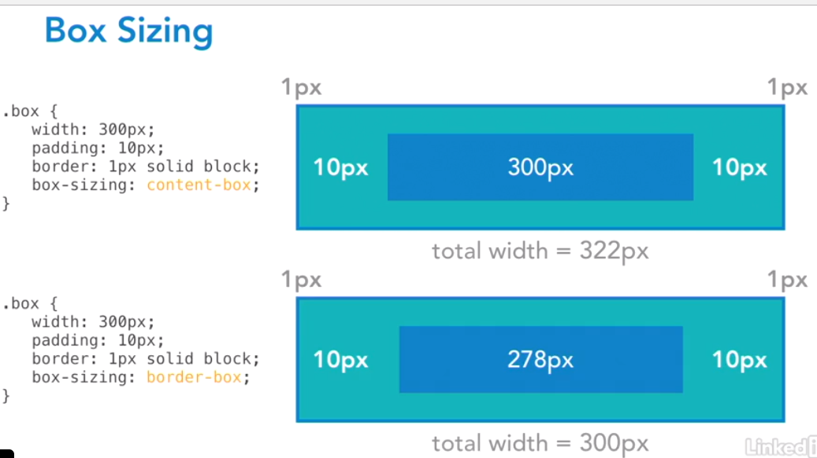

Slide 28
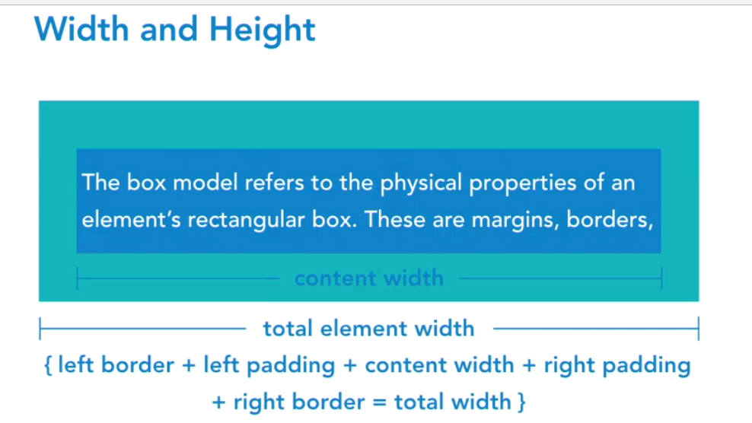

Slide 29
CSS Concept 4 –Padding and Margins
Padding is that space inside the elements that hold the contents of an element away from its edge.
Padding Syntax:
Individual Properties:
padding-top: //values;
padding-right://values;
padding –bottom://values;
padding-left://values;
The sequence should be – top right bottom left
Short Notation:
padding: 10px(top) 20px(right) 15px(bottom) 10px(left)
padding: 10px(top) 20px(right and left) 10px(bottom)
padding: 10px(top and bottom) 20px (right and left side)
padding: 10px (apply to all sides)

Slide 30
Margins
It represent the space between elements.
Values are not calculated as part of an element’s total width.
Most elements have default margin you must account for when structuring your layout.
Margin Syntax is same as padding:
Individual Properties:
margin-top: //values;
margin-right://values;
margin–bottom://values;
margin-left://values;
The sequence should be – top right bottom left
Short Notation:
margin: 10px(top) 20px(right) 15px(bottom) 10px(left)
margin: 10px(top) 20px(right and left) 10px(bottom)
margin: 10px(top and bottom) 20px (right and left side)
margin: 10px (apply to all sides)

Slide 31
CSS Concept 5 – Borders and Background
Borders defines the outside edge of elements.
Border Syntax:
Name: border
Value: <border-style> || <border-width> || <border-color>
Shorthand Notation:
border-top: 1px solid black
border-right: 1px solid black
border-bottom: 1px solid black
border-left: 1px solid black
Border-Width Calculation:
p {
padding: 20px;
border: 1px solid black;
width: 200px;
}
Total Width = 1px + 20px + 200px + 20px +1px

Slide 32
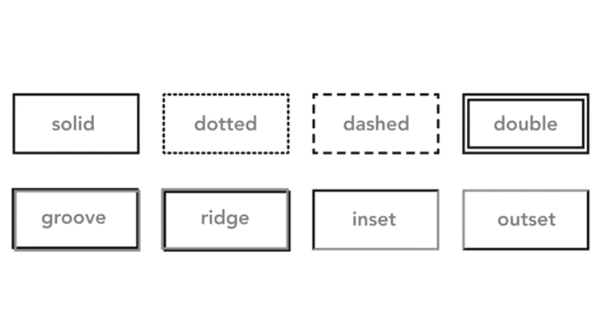
Border Styles:
Solid
Dotted
Dashed
Double
Groove
Ridge
Inset
Outset

Slide 33
Border-Color
This property can be specified independently of foreground and background color.
Syntax :
border-color: black;
Outliners:
It always goes around all sides.
It’s not a part of box model, so it won’t effect the position of elements
It is often used for accessibility reasons, to emphasize a link or form field for keyboard users tabbing through a screen.
The outline doesn’t affect the positioning in the way the border would.

Slide 34
Backgrounds
It add visual sophistication and style to basic content.
It extends all the way to the outside edge of an element border.
It is typically transparent by default.
Background Options:
It can contain solid color, image and gradient
Background-clip
Background-position
Background-repeat
Background-size

Slide 35
CSS Concept 6 - Working with Colors
You can define colors on borders, backgrounds or an element by following options:
RGB values: rgb(255,0,0)
Hexadecimal Notation: #000000 or #000
#ff6600 or #f60
#ff34as
HSL(Hue(0-360), Saturation(0-100%) and lightness(0-100%) for example: border: { hsl(0,100%,0%); }
Opacity- to define transparency for example: div { opacity:0.5; }

Slide 36
CSS Concept 7 - Unit of Measurement
px(Pixel)
Absolute(fixed) value
Used to define the height and width values
Example: p { font-size:17px; }
em
Relative value(relative to font size of another element)
Value of text as its default size. If someone has their browser ‘s default size is 16 pixels, so if set the body font size to 100%, then that would equals 16 pixel.
Example: h1 { font-size:3em; } here 3em = 300% of 16 pixels
If you set the paragraph tag to be one em which equals 16 pixels

Slide 37
Unit of Measurement
rem or root em
Relative value(relative to font-size of root element)
Offers more predictable control then ems
% (Percentage)
Used in responsive layouts
Not typically used for font sizing

Slide 38
CSS Concept 8 - Vendor Prefixes
-webkit-
WebKit(Chrome, Safari, iOS and Android)
-moz-
Mozilla(Firefox)
-ms-
Microsoft(Internet Explorer)
-o-
Opera(Opera)
Which vendor prefix - https://ireade.github.io/which-vendor-prefix/

Slide 39
Challenge for this lesson
Add your styles below this :
1. set the .wrapper to a width of 70%.
2. for both the header and footer :
set the background color to purple
set the text color to white
add a padding to all four sides of 30px
3. For the .content:
add a 1px solid border colored black
add a padding to all the four sides of 30px
add a top and bottom margin of 10px

Slide 40
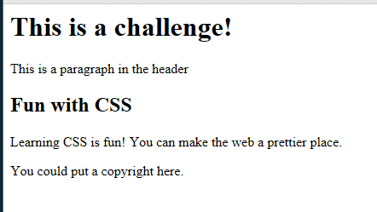
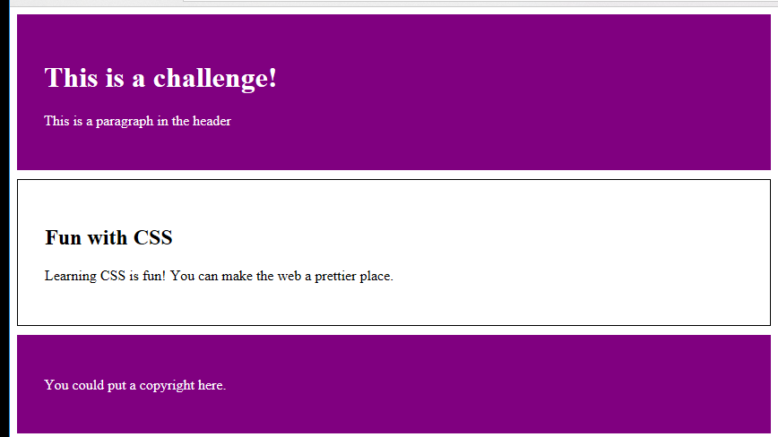
Challenge Solved

Slide 41
CSS Layouts

Slide 42
Structuring a Page
HTML page layouts options for structing a page:
Tables
Floats and clears
CSS frameworks and Grid
Flexbox
CSS Grid (New)

Slide 43
Element Positioning
Normal Document Flow (Browser Default):
Block-level elements:
Inline elements
Images
Links
Spans
Headings
Paragraphs
divs
Articles
Asides and more….
Element Floating
Absolute positioning

Slide 44
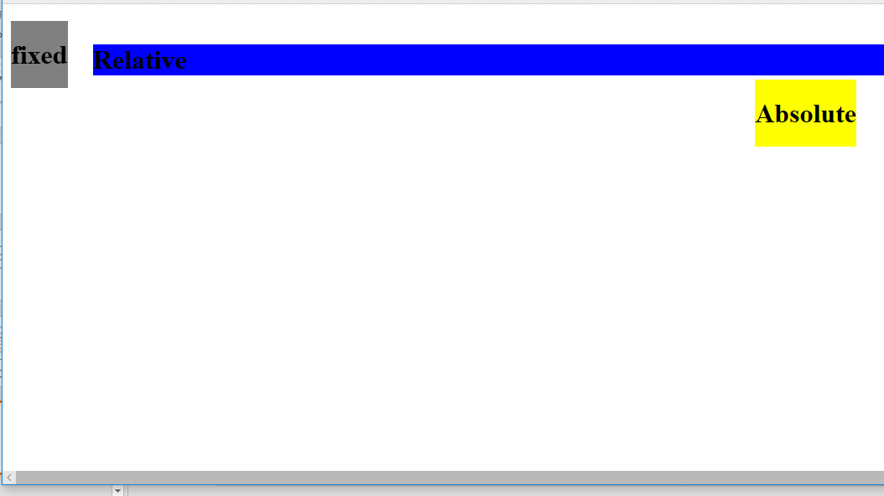
Position:
Name: position
Value:
static
relative
absolute
inherit
fixed

Slide 45
