Slide 1
Learning Git and GitHub
From → Lynda.com

Slide 2
Installing GIT
Go to the git website which is git-scm.com
Click on downloads to download according to which OS (ios,linux,windows)
Open the terminal and type : git –version to see what version of git we are using.

Slide 3
Git Initialization
It is version Control Sytem that keep track of the files in a project.
In order to use git we start by identifying a folder as a git repository
You do that by issuing a Git init command within a folder.
On desktop – create project folder
Open the terminal
In project folder, create new file index.html.
Make one more file about.html.
Make sure your terminal you are inside this project folder.
So first we need to travel to desktop/project folder using cd command in your terminal.

Slide 4
Git Initialization and Staging
Issue a Git init command.
This will initialize this folder as a Git repository.
If you issue an ls command or ls -la command, you will see that there is another folder called .git.
Git has couple of different places where you can store the state of files. One of then is staging environment.
We can add anything to the staging environment using the command Git add.
You can do git status command and take a look of the status of the files.

Slide 5
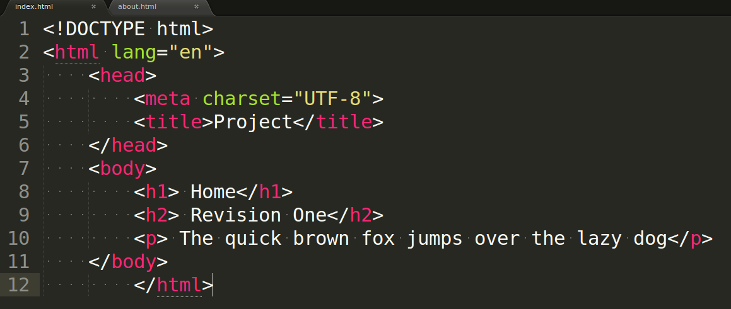
Index.html Document

Slide 6
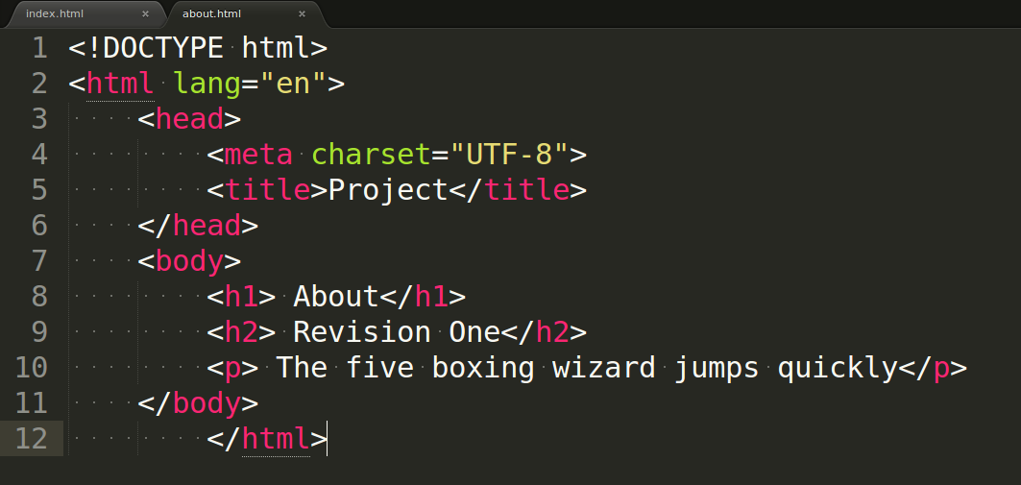
About.html Document

Slide 7
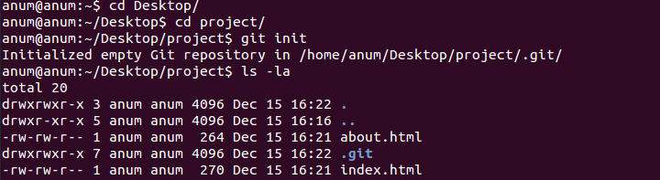
Git init

Slide 8
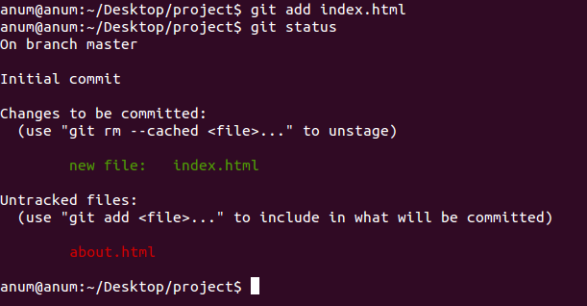
Git add and git status

Slide 9
Git add and Git status
One of them is our new file index.html that we have added to git staging environment and therefore it's ready for something commiting wher it's ready to be commited.
There is another file about.html which is being listed as an untracked document.
That means git doesn't anything about it
Most of the time you want to work on a number of files or just add all the files that you have made changes to. That command is called Git add and then period. Git add .

Slide 10
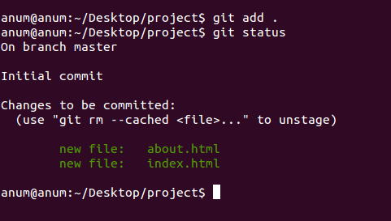
Git add .

Slide 11
Git Status, staging and commiting
Git status command is always going to show you what is going with git at any particular moment.
It shows the what is in staging queue or any files that are untracked by git at the moment.
The difference between staging and commiting is sort of saving a file versus printing it . When you save a file you sort of save the current state of the document. When print something it becomes a more permanent record.

Slide 12
Commiting a files
Git commit -m “revision one”.
-m allows you to create a message for this commit.
When you commit things for the first time you might get a message that yo will ask for your name and email id.
Now git is used to tracking projects for multiple users so it important to let it know your personal information
Go ahead and run these commands with your name and email address.
git config –global “you@example.com”
git config –global “you name”
Git log command – you can see the commit that we did is right here.

Slide 13
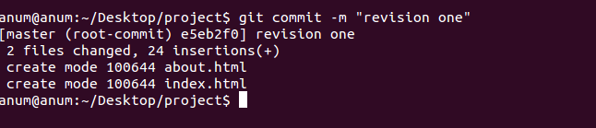
Commit a file

Slide 14
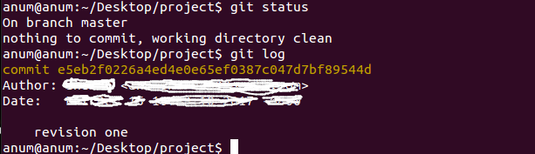
Now check git status and Git log

Slide 15
Things we have learned till now
What is Git
Creating folder – project and making 2 files
Git init command
Git status command
Git add command
Git commit command
Git config –global command
Git log command

Slide 16
Managing In and Out of the staging Environment
Now, let's take a look how to get things in and out in statging queue.
First, make a changes to our index.html document and save it .
Go back to terminal and do git status command.
You can see that Git is telling us a couple of things about index.html document. First, it is not staging for commiting.
It means it is not on staging environment, yet it needs to be added there.
You can do that with git add command, so type git add index.html or git add .
It adds all the files .

Slide 17
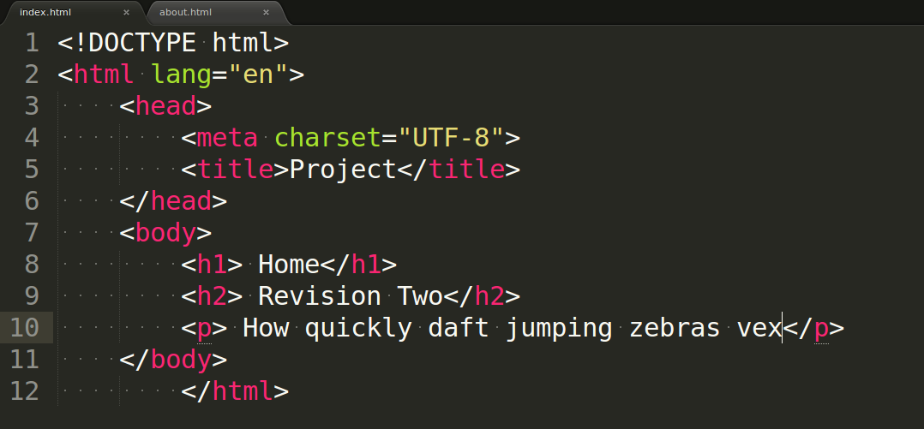
Change the index.html file

Slide 18
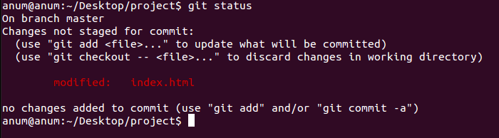
Checking the status after changing the index.html document

Slide 19
Git checkout
We can discard the changes in the working directory by using git checkout command and checking out this file right there.
Type in terminal: git checkout index.html
Hit return and go back to index.html file. It switches back to being at “Revision One” .
What we did is we grabbed the file out of our staging environment which grabs the previous version of the file and it overwrote the changes that we had just made.
That means we are ignoring the changes that we just saved and pulled whatever was in staging area into work environment.

Slide 20
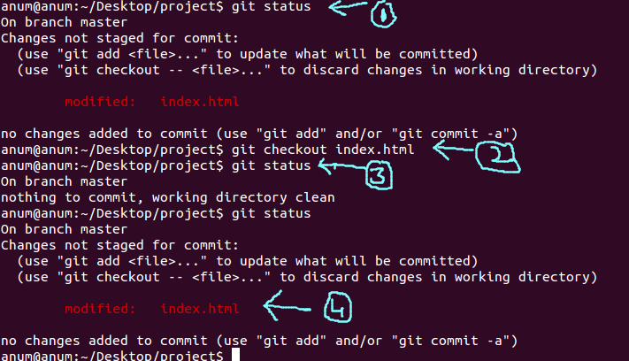
Git checkout command

Slide 21
Steps
1. first, you change the index.html document.Then you check the status using git status command that some changes has done on index.html file
2. But you want to discard the changes in index.html document, so you type- git checkout index.html.
3. If you return to the index.html document, you will see the original content”revision one” so if you again check the status – it give give you a message – nothing to commit.
4. Now change the index.html file with “Revision Two” and save it. Check the status now . You will see document is modify and ready for staging .

Slide 22
Unstaging the file
So next step is to do – git add .
Then git status to check the status of file. So now this shows up a green color It is telling us that the changes are in staging environment and thet are ready to be commited.
Notice that git status is not suggesting that you check things out from the staging area any more.
If something is already in staging, we can take it out using git reset HEAD index.html.
This is called unstaging It taking whatever was in our staging environment and replacing what in our working environment with whatever is in staging.

Slide 23
How to unstage the file
First change the index.html document with “Revision Three” and save that.
Do – git status to check the status of document.
It showing you that now we have things that been saved and are in our working environment, they are not in staging.
And we still have something in staging environment that would be “Revision Two”. We can take the things that are in staging and then overwrite whatever we have in this environment.
Do – git reset HEAD index.html

Slide 24
How to unstage the document
If we git status again, now it looks like I have something in my working environment that is not in staging.
We just grabbed whatever was in staging and we replaced our working environment.
You will notice that it's sort of ignored “Revision Two” although, it just sort of deleted it out of staging.

Slide 25
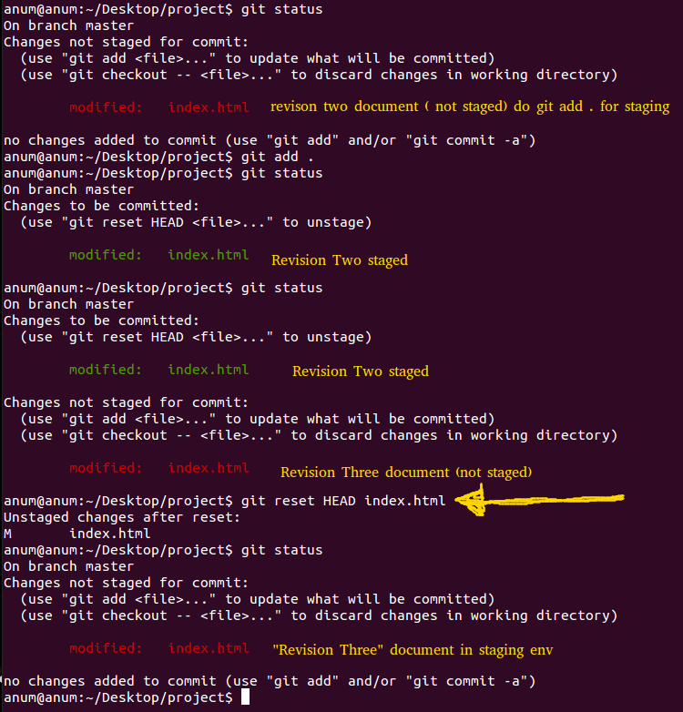

Slide 26
Couple of commits to all the files.
Undo to get back to “Revision Two” index.html file and save it
Do git add.
Do – git status
You can see “Revision Two has been placed into out staging environment.
Do git commit -m “Revision Two”.
Do – git status to check the status and right now there is nothing to commit.

Slide 27
Couple of commits to all the files.
Now make the changes for “Revision Three” and save it .
Do – git add index.html .
Do – git commit -m “Revision Three”
Do – git status to check the status.
Now check the logs typing – git log and you can see that all of the revisions that we have done.

Slide 28
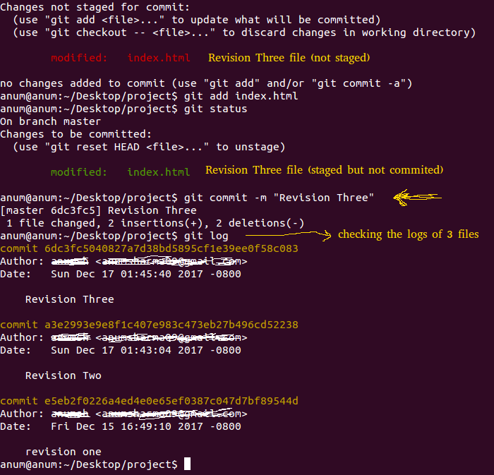
Git log

Slide 29
Deleting a file
Suppose you delete about.html from project folder.
Do - git status now, it noticed that a file has been deleted, so it's expecting that file to be there.
If you want to just get the file from staging environment, I can just checkout – git checkout about.html . So file appear in project folder.
Again , delete the about.html file and I want to get rid of that file , I do git rm about.html.
Check git status, notice that file is gone, it deleted the file and it's no longer here either.

Slide 30
Git add --all command
It is sort of super push everything into staging.
It is kind of grabbing everything(add files and folders + deleted files and folders too) and move it to staging environment.

Slide 31
Managing log
Every time you make a commit, it creates a logged entry and you can look at it by using git log command.
You can see there is three different commits and they are identified in two ways:
1. by this commit message “revision one”.
2. one of these really log hash(bunch of hexadecimal numbers)
commit e5eb2f0226a4ed4e0e65ef0387c047d7bf89544d
Author: -
Date: -
  revision one

Slide 32
Managing logs
You can actually use these different hashes to pull the commit from the log into the working environment.
We do that by using git checkout commit ID
git checkout e5eb2f0226a4ed4e0e65ef0387c047d7bf89544d
This is sort of playground where you can mess around with your project and do whatever you want and then you can go back into the original set of commits without messing anything up.
Think of it as an alternate reality that starts at the commit that you checked out.

Slide 33
Managing logs
You can retain what you are doing in this area as another branch.
Do – git log in this new branch.
You look at the log right now it only has one entry.
It doesn't know anything about other 2 entries.That's in original timeline.
Remember this is our alternate reality.
So from here we can do any sort of work just like before.
Modify index.html document and save it.
Do – git status command and you will index.html document is modify int his new commitID.

Slide 34
Managing Log
It's in working environment and we can if we want to stage this.
Do – git add .
Do – git commit -m “alternate one”.
Do – git log . Now you can see two commits in this new branch.
So we keep on going in here, make whatever changes we want, keep on editing files, and then whenever we are done fooling around and we want to go back to our normal universe where all those other commits existed, we can do that by going back to our different branch.

Slide 35
Git branch
The main branch is called master branch(the original universe)
You can look at other branches by issuing git branch command.
Let's say that we don't really care about any of these changes, we just want to go back into our normal branch.
Do- git checkout master.
If you wanted to keep all the stuff that you did in a separate branch, you can do that by using git branch <branch-name> piece of hashtag(bc34353)
Example: git branch alternate e5eb2f0226a4ed4e0e65ef0387

Slide 36
git checkout, git branch and git log
If you want to lok the list all the branches, then do – git branch.
If you currently on master branch and you want to switch to other branch for example- alternate branch, then do – git checkout alternate.
If you want to check the logs of alternate branch, do – git log
If you want to go back to master branch , do – git checkout master.

