Slide 1
Learning Git and GitHub
From → Lynda.com

Slide 2
Installing GIT
Go to the git website which is git-scm.com
Click on downloads to download according to which OS (ios,linux,windows)
Open the terminal and type : git –version to see what version of git we are using.

Slide 3
Git Initialization
Git is a version Control System that keep track of the files in a project.
In order to use git we start by identifying a folder as a git repository
You do that by issuing a git init command within a folder.
On desktop – create project folder
Open the terminal
In project folder, create new file index.html.
Make one more file about.html.
Make sure your terminal you are inside this project folder.
So first we need to travel to desktop/project folder using cd command in your terminal.

Slide 4
Git Initialization and Staging
Issue a git init command.
This will initialize this folder as a Git repository.
If you issue an ls command or ls -la command, you will see that there is another folder called .git.
Git has couple of different places where you can store the state of files. One of then is staging environment.
We can add anything to the staging environment using the command git add.
You can do git status command and take a look of the status of the files.

Slide 5
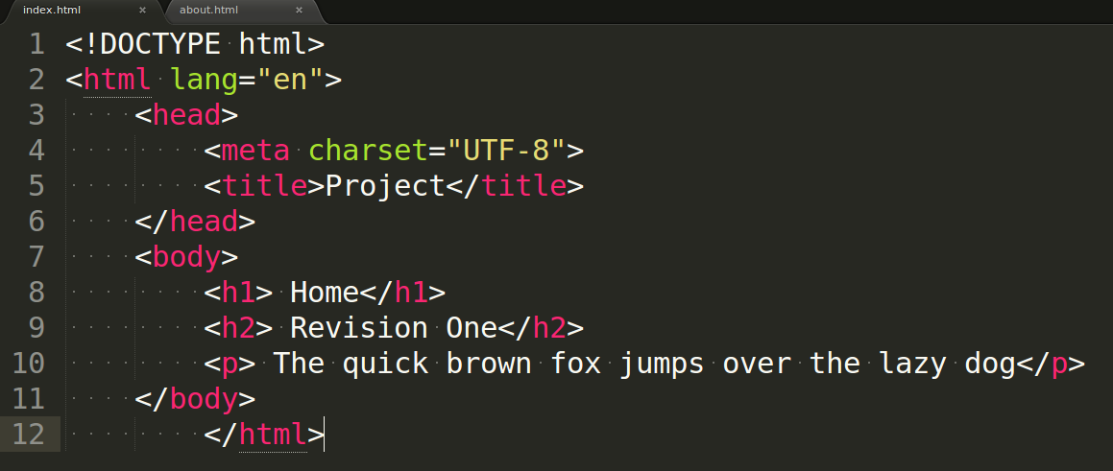
Index.html Document

Slide 6
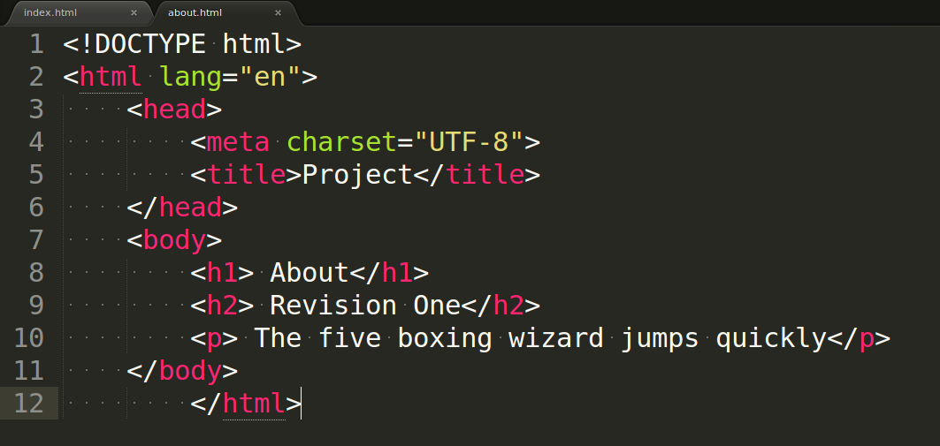
About.html Document

Slide 7
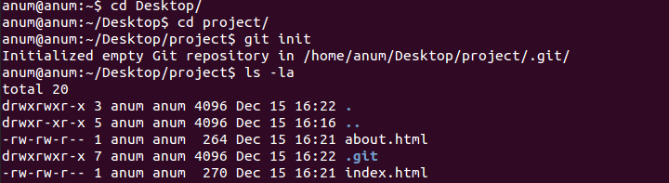
Git init

Slide 8
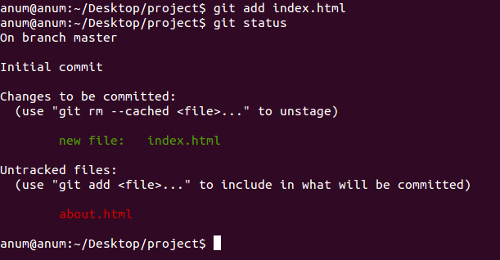
Git add and git status

Slide 9
Git add and Git status
One of them is our new file index.html that we have added to git staging environment and therefore it's ready for something commiting where it's ready to be committed.
There is another file about.html which is being listed as an untracked document.That means git doesn't know anything about it.
Most of the time you want to work on a number of files or just add all the files that you have made changes to. That command is called Git add and then period. git add .

Slide 10
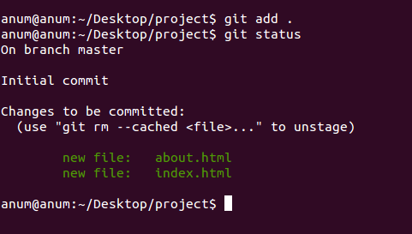
Git add .

Slide 11
Git Status, staging and commiting
Git status command is always going to show you what is going with git at any particular moment.
It shows the what is in staging queue or any files that are untracked by git at the moment.
The difference between staging and commiting is sort of saving a file versus printing it . When you save a file you sort of save the current state of the document. When print something it becomes a more permanent record.

Slide 12
Configuration and Commiting files
Do git commit -m “revision one” for commiting a file.
-m allows you to create a message for this commit.
When you commit things for the first time you might get a message that it will ask for your name and email id.
Now git is used to tracking projects for multiple users so it important to let it know your personal information
Go ahead and run these commands with your name and email address.
git config –global “you@example.com”
git config –global “you name”
git log command – you can see the commit that we did is right here.

Slide 13
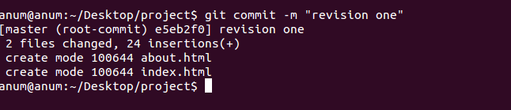
Commit a file

Slide 14
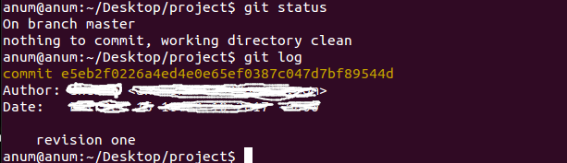
Now check git status and Git log

Slide 15
Git commands that we have learned till now:
What is Git
Creating folder – project and making 2 files
Git init command
Git status command
Git add command
Git commit command
Git config –global command
Git log command

Slide 16
Managing In and Out of the staging Environment
Now, let's take a look how to get things in and out in staging queue.
First, make a changes to our index.html document and save it .
Go back to terminal and do git status command.
You can see that Git is telling us a couple of things about index.html document. First, it is not staging for commiting.
It means it is not on staging environment, yet it needs to be added there.
You can do that with git add command, so type git add index.html or git add .
It adds all the files .

Slide 17
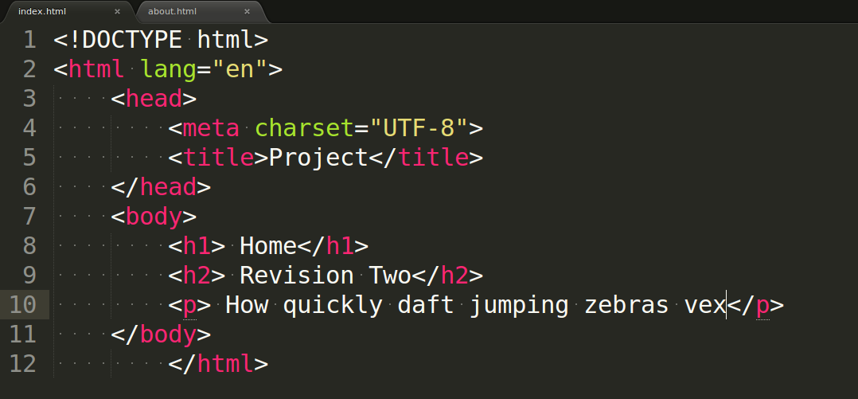
Change the index.html file

Slide 18
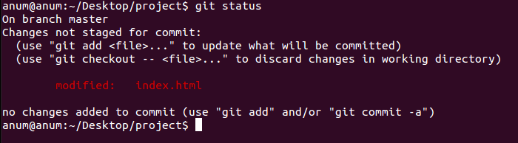
Checking the status after changing the index.html document

Slide 19
Git checkout
We can discard the changes in the working directory by using git checkout command and checking out this file right there.
Type in terminal: git checkout index.html
Hit return and go back to index.html file. It switches back to being at “Revision One” .
What we did is we grabbed the file out of our staging environment which grabs the previous version of the file and it overwrote the changes that we had just made.
That means we are ignoring the changes that we just saved and pulled whatever was in staging area into work environment.

Slide 20
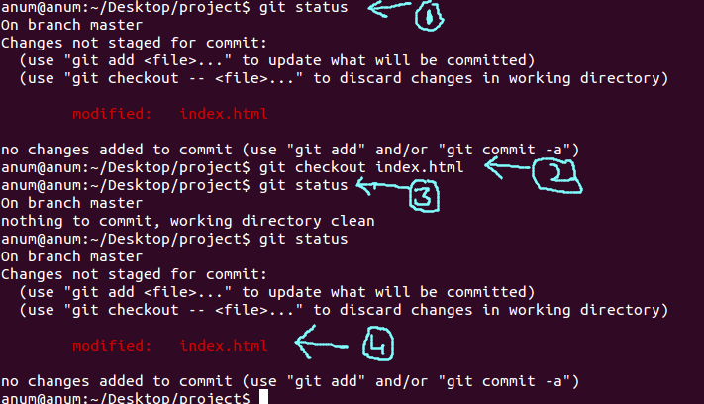
Git checkout command – all 4 steps explained in next slide

Slide 21
Steps
1. first, you change the index.html document.Then you check the status using git status command that some changes has done on index.html file
2. But you want to discard the changes in index.html document, so you type- git checkout index.html.
3. If you return to the index.html document, you will see the original content”revision one” so if you again check the status – it give give you a message – nothing to commit.
4. Now change the index.html file with “Revision Two” and save it. Check the status now . You will see document is modify and ready for staging .

Slide 22
Unstaging the document
So next step is to do – git add .
Then git status to check the status of file. So now this shows up a green color It is telling us that the changes are in staging environment and thet are ready to be commited.
Notice that git status is not suggesting that you check things out from the staging area any more.
If something is already in staging, we can take it out using git reset HEAD index.html.
This is called unstaging It taking whatever was in our staging environment and replacing what in our working environment with whatever is in staging.

Slide 23
How to unstage the document
First change the index.html document with “Revision Three” and save that.
Do – git status to check the status of document.
It showing you that now we have things that been saved and are in our working environment, they are not in staging.
And we still have something in staging environment that would be “Revision Two”. We can take the things that are in staging and then overwrite whatever we have in this environment.
Do – git reset HEAD index.html

Slide 24
How to unstage the document
If we git status again, now it looks like I have something in my working environment that is not in staging.
We just grabbed whatever was in staging and we replaced our working environment.
You will notice that it's sort of ignored “Revision Two” although, it just sort of deleted it out of staging.

Slide 25
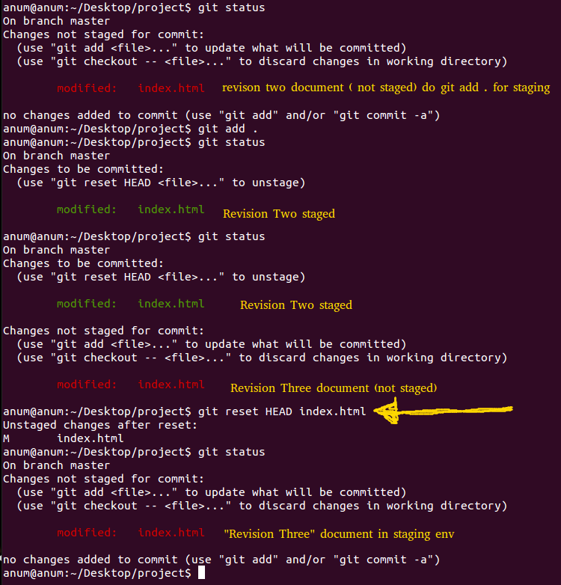

Slide 26
Couple of commits to all the files.
Undo to get back to “Revision Two” index.html file and save it
Do git add.
Do – git status
You can see “Revision Two has been placed into out staging environment.
Do git commit -m “Revision Two”.
Do – git status to check the status and right now there is nothing to commit.

Slide 27
Couple of commits to all the files.
Now make the changes for “Revision Three” and save it .
Do – git add index.html .
Do – git commit -m “Revision Three”
Do – git status to check the status.
Now check the logs typing – git log and you can see that all of the revisions that we have done.

Slide 28
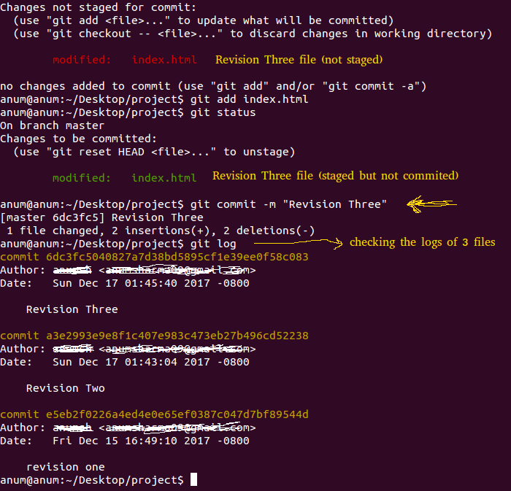
Git log

Slide 29
Deleting a file
Suppose, you delete about.html from project folder.
Do - git status now, it noticed that a file has been deleted, so it's expecting that file to be there.
If you want to just get the file from staging environment, I can just checkout – git checkout about.html . So file appear in project folder.
You can directly delete the file using – git rm about.html without going to folder and delete about.html file.

Slide 30
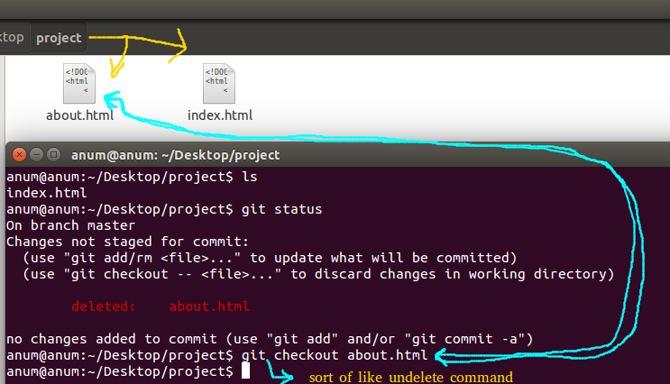
1.delete a file, git status, git checkout index.html

Slide 31
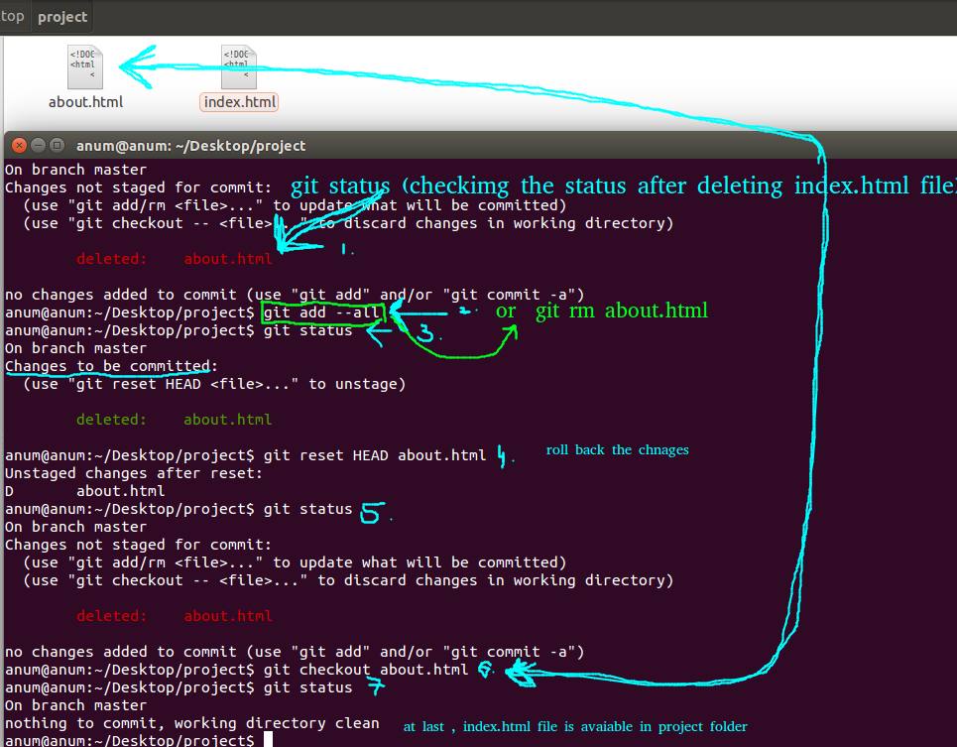
2. delete file, git add about.html, git reset HEAD about.html, git checkout about.html

Slide 32
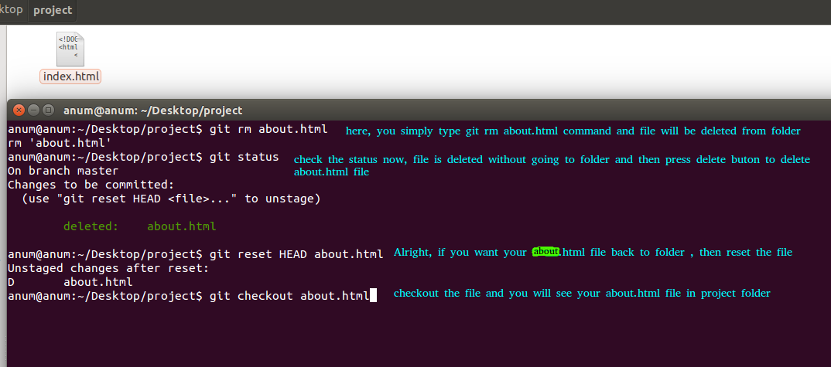
Directly delete the file using git rm command

Slide 33
Git add --all command
It is sort of super push everything into staging.
It is kind of grabbing everything(add files and folders + deleted files and folders too) and move it to staging environment.

Slide 34
Managing log
Every time you make a commit, it creates a logged entry and you can look at it by using git log command.
You can see there is three different commits and they are identified in two ways:
1. by this commit message “revision one”.
2. one of these really log hash(bunch of hexadecimal numbers)
commit e5eb2f0226a4ed4e0e65ef0387c047d7bf89544d
Author: -
Date: -
revision one

Slide 35
git checkout e5eb2f0
You can actually use these different hashes to pull the commit from the log into the working environment.
We do that by using git checkout commit ID
git checkout e5eb2f0226a4ed4e0e65ef0387c047d7bf89544d
This is sort of playground where you can mess around with your project and do whatever you want and then you can go back into the original set of commits without messing anything up.
Think of it as an alternate reality that starts at the commit that you checked out.

Slide 36
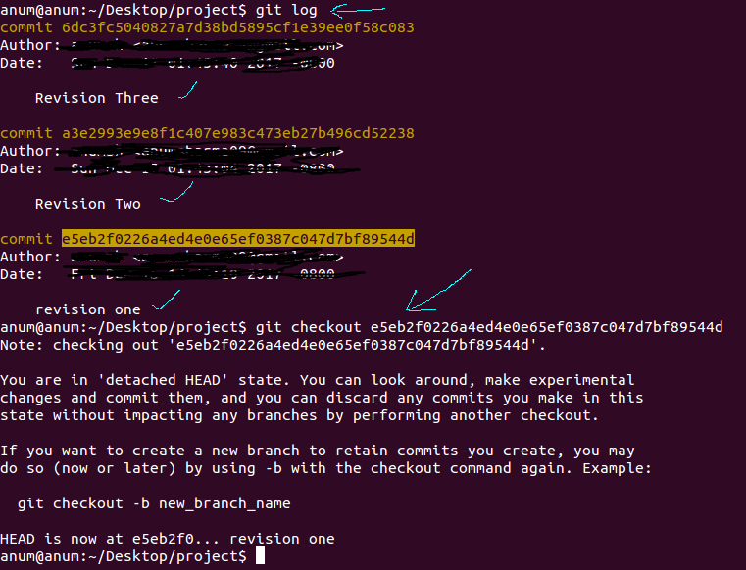
Git checkout e5eb2f0226

Slide 37
git checkout e5eb2f0
You can retain what you are doing in this area as another branch.
Do – git log in this new branch.
You look at the log right now it only has one entry.
It doesn't know anything about other 2 entries.That's in original timeline.
Remember this is our alternate reality.
So from here we can do any sort of work just like before.
Modify index.html document and save it.
Do – git status command and you will see that index.html document is modify in this new commitID/ hash lines.

Slide 38
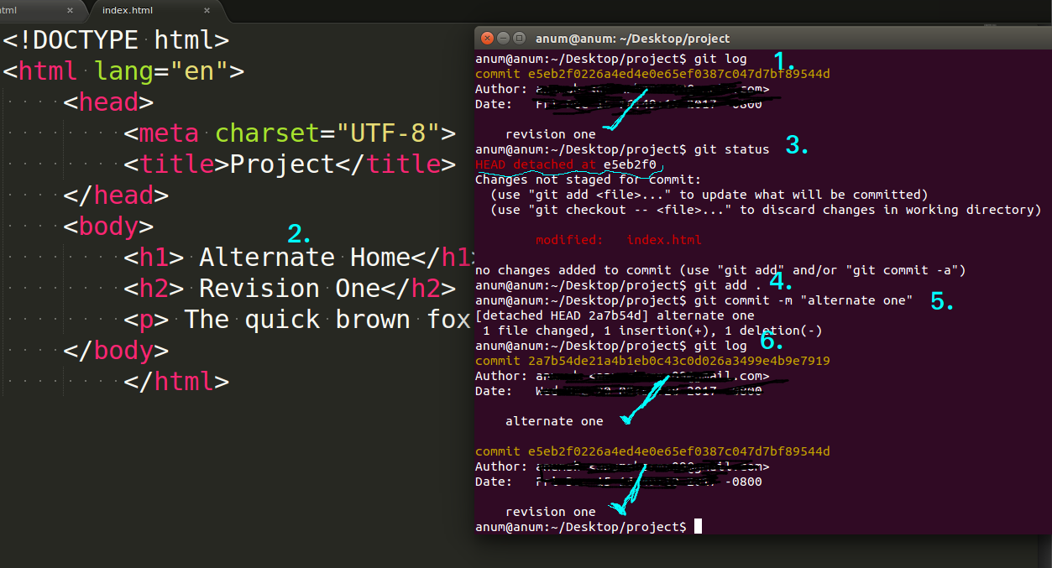
git checkout e5eb2f0

Slide 39
git checkout e5eb2f0
Right now you are in detached HEAD state- e5eb2f0 , means not in master branch.
The edited index.html file is in working environment of e5eb2f0 and we can add if we want to stage this.
Do – git add .
Do – git commit -m “alternate one”.
Do – git log . Now you can see two commits in this new branch.
So we keep on going in here, make whatever changes we want, keep on editing files, and then whenever we are done fooling around and we want to go back to our normal universe where all those other commits existed, we can do that by going back to our different branch using – git checkout master , if you go back to master branch. You can check all branches using – git branch

Slide 40
Git branch
The main branch is called master branch(the original universe)
You can look at other branches by issuing git branch command.
Let's say that we don't really care about any of these changes, we just want to go back into our normal branch.
Do- git checkout master.
If you wanted to keep all the stuff that you did in a separate branch, you can do that by using :
git branch <branch-name> piece of hashtag(e5eb2f0)
Example: git branch alternate e5eb2f0226a4ed4e0e65ef0387

Slide 41
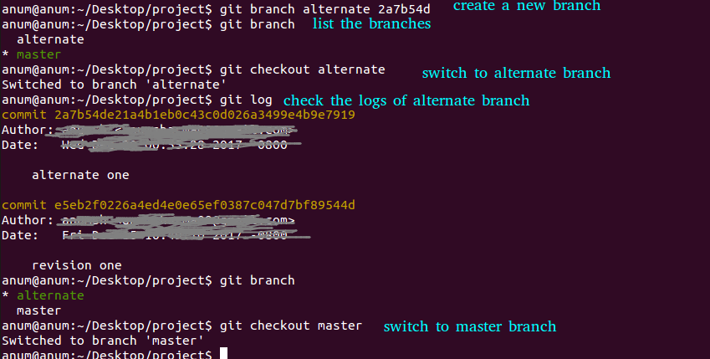
Git branch

Slide 42
git checkout, git branch and git log
If you want to look the list all the branches, then do – git branch.
If you currently on master branch and you want to switch to other branch for example- alternate branch, then do – git checkout alternate.
If you want to check the logs of alternate branch, do – git log
If you want to go back to master branch , do – git checkout master.

Slide 43
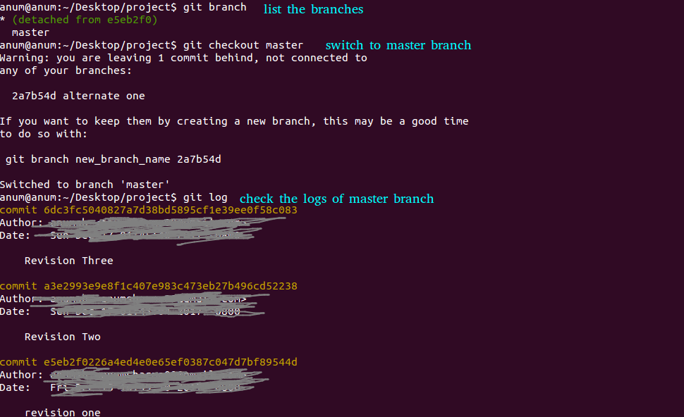
Switching to different branches

Slide 44
Controlling state with branches
Branches in git are like having the ability to create alternate universes.
You can create a branch whenever you want.
There are a lot of really useful branch commands that you should be comfortable with:
1. git branch command – show the list of branches.
2. create a new branch- git branch <branch-name>
3. name it as – git branch app01
4. Now if you do – git branch command, we will notice we have 3 branches.

Slide 45
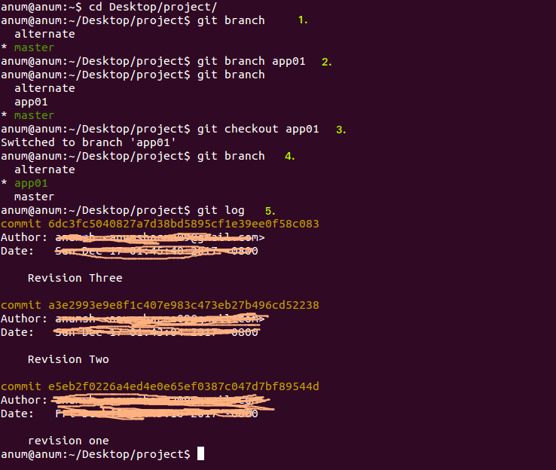
Git branch app01

Slide 46
Git branch
When you create a branch, you actually stay in the current branch so anything we do from now on will continue to be in master branch, not the one that we just made and that really important.
Think of branch as a sort of save point.
You want to save the state of all the files. Whenever you wanna create a branch that saves a state of everything, you have done so far, you use branch command.
Suppose you are working on a project and you want to test out a new feature, but you want to leave the current branch as is, you may wanna leave like, the master untouched and you wanna go play around.

Slide 47
Git branch app01
We can do it a git checkout branch(app01). You switch to app01 branch.
Do – git branch and you will see you are in app01 branch.
Let go ahead and make changes in index.html – “revision four”.
Do – git add .
Do – git commit -m “Revision Four”.
Check the logs – git log . You can see that we have 4 different commits that we have done with revision four commit that we just did at the very top.

Slide 48
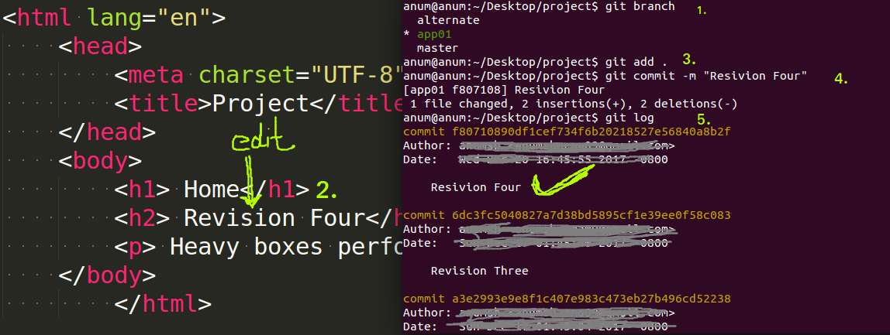
Edit the index.html and commit in app01 branch

Slide 49
Merge command
So if we switch to master branch using git checkout master and issue git log, we will see 3 commits, we don't have number four and so now we have sort of two versions of out project.
One that is in app01 that has some changes and new commit that we have made and the branch master that has everything we had done up to that point.
Let say that you are working on that project, you have created that app01 branch and you really like what you have done.
You want to bring those changes back into master.

Slide 50
Merge Command
So what we want to do there is do a command – merge. Merge will take everything from one branch and attempt to pull it into the current branch.
Do – git branch first. So that we can see the two branches that we have.
We want to bring everything from app01 into master branch.
We are noticing that we are already in master branch. All we need to do is say git merge app01.
That means that we want take changes from app01 and merger into master.
You are bringing changes from some other branch into current branch.

Slide 51
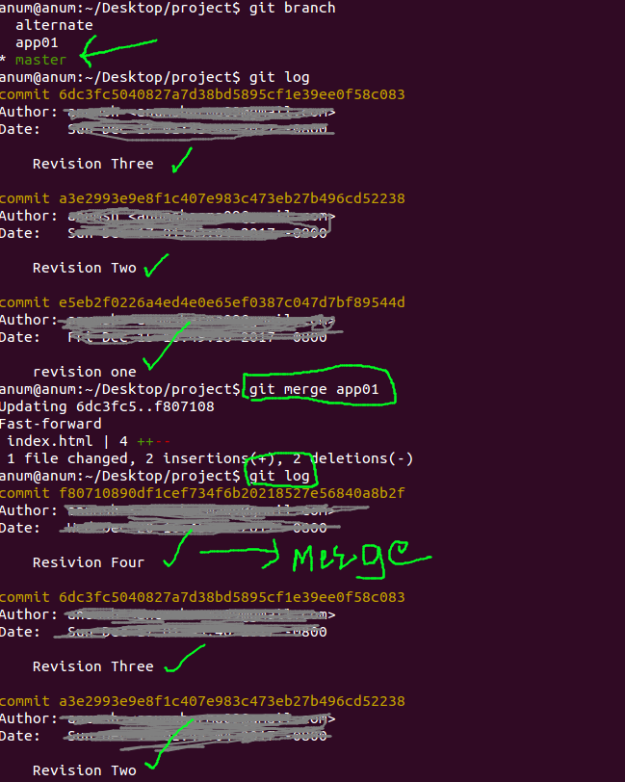
Git merge app01

Slide 52
Rename and delete the branch
You can change the branch name with -m command.here -m means move from one name to another
Do – git branch first and see list of all the branches.
You want to change of name of app01, so do- git branch -m app01 app1
Do – git branch, you will see that the app branch is now called app1.
Sometimes you don't need that branch any more so to do that , you use -D command.
Do – git branch and look at the branches. Let's get rid of alternate branch here . Do – git branch -D alternate.
Once we do that, it deletes that branch, now that branch is gone.

Slide 53
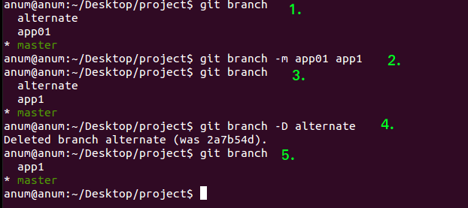
Rename and delete the branch

Slide 54
Git commands that we have learned till now:
git checkout <file-name>
git reset HEAD <file-name>
git rm <file-name>
git branch <branch-name>
git branch
git branch -m <current-branch-name> <new-branch-name>
git branch -D <branch-name>
git merge <branch-name>

Slide 55
Working with Github projects
Analyzing a Github project structure
Cloning a Github repo
Cloning individual branches
Using a Github branch as a template

Slide 56
Analyzing a Github project structure
Here you will see how to take an existing project like those you might find in somebody's github page and download that project into your local folder so that you can work with it and understand the files that you are going to get when you download a repository.
You can find all of the projects under URL github.com/<github-username>
For example: https://github.com/anumsh
You will list of all repositories on the homepage.
If you want to get a complete list of all of my repositories, you can click on this Repositories Tab.

Slide 57
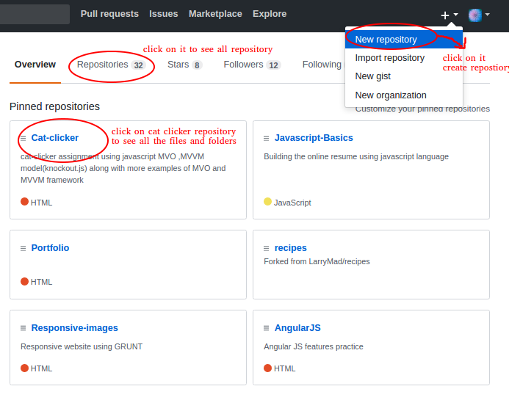
Github Home Page

Slide 58
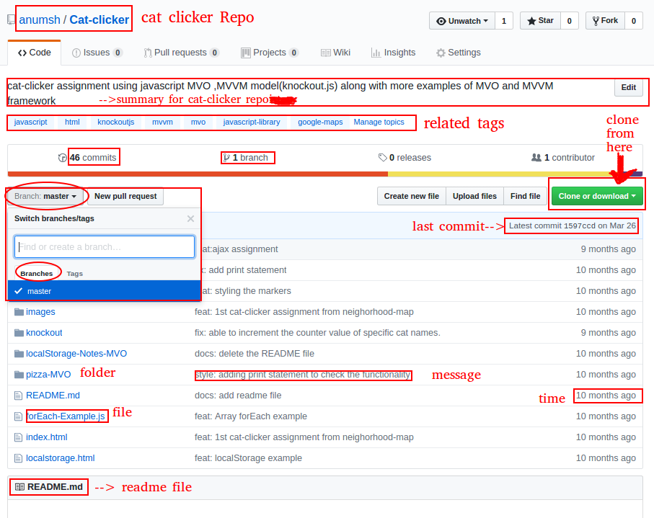

Slide 59
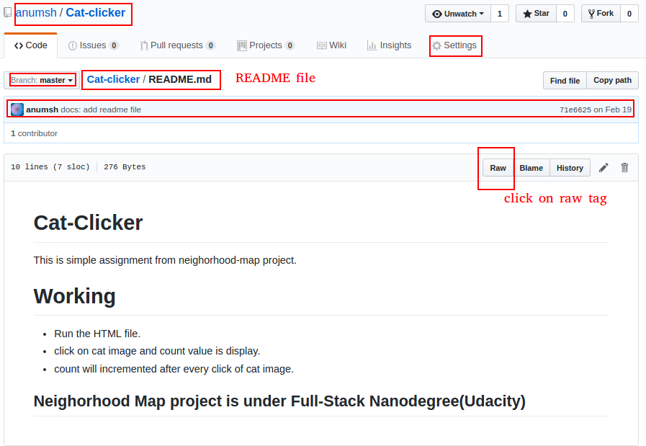

Slide 60
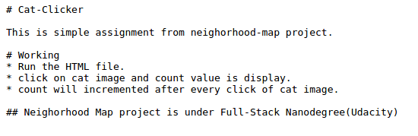
README file – raw data

Slide 61
Number of invisible files in repository
.gitignore – when you download this project into your loacl directory, you are not going to see this file inless you use the terminal to list your directory or you open this up in a text editor that has invisible files turned on.
This file is super important.
It is list of the files you don't want to upload into Github.
So if we look at that file, you can see that we have something called ds_store.
This is a file that the Mac operation system creates all the time in just about every folder to keep track of what is in the folder.

Slide 62
Number of invisible files in repository
Another folder that is never uploaded to github is node_modules. It is set of project dependencies if the project happens to use Node.js.
Now this isn't just a Github file ,but something that you can use whenever you are working with Git. If you create a gitignore file in your folder, Git will never track of anything inside these folders.
You will notice that in this gitignore file, I alos asked git not to track any images. Now , including images in github would make the project a lot bigger than it needs to be.
You are making open source, you may not always have right to distribute the images in the license that you include in the project.

Slide 63
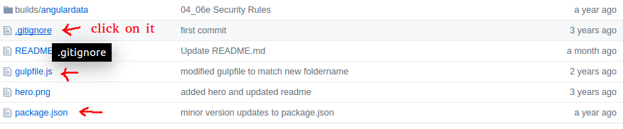
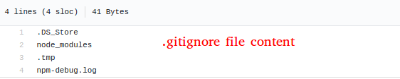
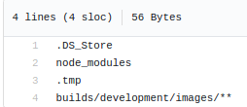
.gitignore file and contents

Slide 64
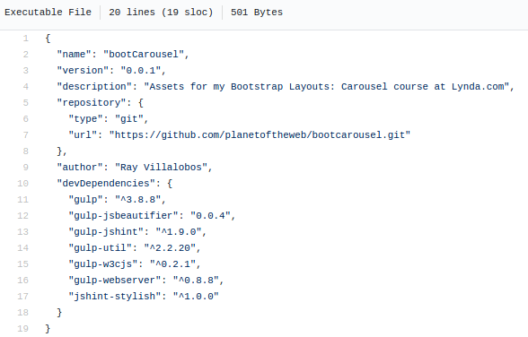
Package.json
package.json help you keep track of any dependencies that the project needs in order to run.
Things like version number, a short description, and then maybe a list of where this repository is in your project.

Slide 65
Package.json
Package.json file is really important is because you will always notice that in the gitignore folder.
we are asking Node not to keep track of node_modules folder.
So the job of this package.json file is to recreate the node_modules folder when you download this project.

Slide 66
Cloning a Github repo on your local directory
If you want to copy the repository on your local hard drive, you can use the git clone command to do that.
Step 1 : clone the repository: https://github.com/anumsh/Cat-clicker.git
Step2: open the terminal, navigate to Desktop folder, do – git clone https://github.com/anumsh/Cat-clicker.git.
Then navigate to cat-clicker folder , you can see all the files and folders of this repository.
Images on the next slide.

Slide 67
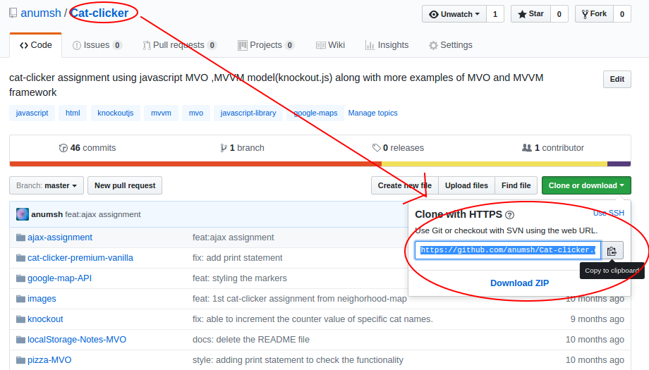

Slide 68
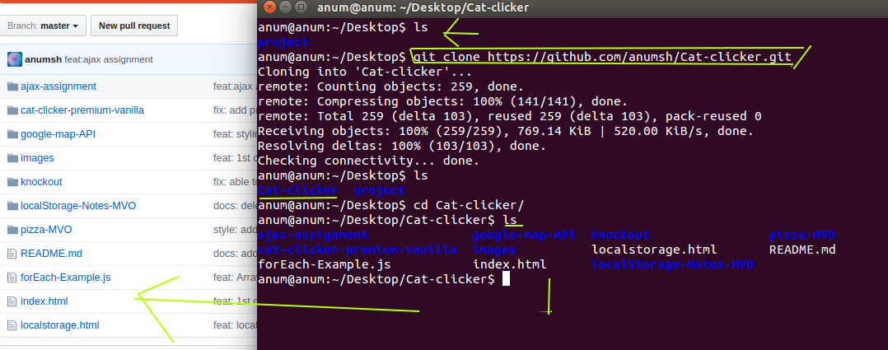

Slide 69
Cloning individual branches
When you clone a repo, you can only see the master branch of the project. The other branches are hidden.
Let's take a look at how you can get specific branches or download a project with all of the branches.
Step 1: clone the repository first in desktop folder.
Step 2: do – git branch -a command to see all the branches that you would normally see in Github. They are in red color. It means that it didn't pull any of those files.
The only one that it grabbed was master. That means that it actually created a local copy of that branch and it's the thing that you are accessing right now.

Slide 70
Cloning individual branches
If you wanted to pull a different branch what you would do is execute a git checkout -b for branch, and then pull the branch that you want to check out. And what we want to do is type in location of the origin of this branch.
Example: git checkout -b 02_01 origin/02_01
You are going to switch to this branch so that you should see the project.
Do – git branch, you can see that now we have 2 branches and the star is on the branch that we just pulled.
It checkout a branch from our remote server from Github and right this branch called 02_01, it made a new branch in our local project called 02_01 and it downloaded everything in github and then automatically switch to that branch.

Slide 71
Cloning individual branches
We could do – git checkout master and continue to work with our project.
Now we have to run serious of commands that is going to download everything, all the branches that you see over here in github.
Step1: create a directory(suppose- html) for this project.
Step 2 :switch to that directory(html) and clone the repository but in slightly different way. So what I want to do here is make a mirror of the repository. And then paste the git URL, add a space and do .git, This is very important. We are copying the invisible git folder that keeps track of everything in our project from Github.
command:
git clone – mirror https://github.com/anumsh/Cat-clicker.git .git

Slide 72
Cloning individual branches
Execute the command:
git clone – mirror https://github.com/anumsh/Cat-clicker.git .git
It is saying that it's cloning this into a bare git repository.
You can see that inside that folder, we are not really seeing anything in there. There's nothing in there quite yet.
do- ls and you will notice that there is actually an invisible git folder
Make sure that you are inside that folders (Desktop/html).
Do – git config –bool(boolean value that we are modifying to take this from being a bare repository which is just a repository in it except for that invisible git folder. We can say core.bare so we are switching it from bare repository into a regular repository. So, core.base false.

Slide 73
Cloning individual branches
git config –bool core.base false command
git reset –hard command
We need to do one more command this will be git rest –hard command. This is a hard reset. What it is going to do is essentially grab everything that is inside this folder and create all of the branches and make it look like a normal repository.
So now if we go into project you can see that we have everything that we used to have before the gitignore file, everything.
Do – git branch and you will see that all the branches were pulled down from the Github repository and work with my entire structure for the project.

Slide 74
Using a Github branch as a template
When we begin a new project, we really don't want to start from scratch.
We like to begin with previous project and use that as sort of template.
So if you want to use any repository/project as a starter template, don't get the final branch of the project.
Create a special branch like 00_start in your repo that is copy of project at the beginning.
So if you want to copy the specific branch from Github project, copy the URL from clipboard and then go to terminal and issue a clone command like this:

Slide 75
Using a Github branch as a template
git clone 00_start https://github.com/anumsh/Cat-clicker.git
Specific branch
repository

Slide 76
Using a Github branch as a template
You will see all files and folders of repo in your html folder.
Then Do – cd html
Do – git log
This is going to show you that even though this version of the project pretty new, you have still logged lot of different things.
And so, what I want to do sort of get rid of everything to do with git so that I can use this project as it's own starter.
Do – ls
We will notice that there is a git folder.This is actually what allows us to look at all the logs, look at different barnches.

Slide 77
Using a Github branch as a template
Do – rm -dfr .git ( dfr means delete, then recursively delete any sub folders within folder that is asking for.
This is a dangerous command so make sure that you are typing the right thing here because this is going to delete that folder and not ask anything about it.
Now, do – git log. It says that this is not a git repository at all. It doesn't understand any git command any more.
Next is go to your html folder(repository that you clone) and get rid of anything that you don't want to include(like may be in style.css file, so clear out any script), modify index.html file so that it was pretty much empty.
It would may be get rid of JavaScript libraries that we are not using here.

Slide 78
Using a Github branch as a template
Then we are ready to make this brand new git project.
Do – git init command. It's going to initialize this as a new repository with absolute nothing in log.
So you could add everything – git add .
You could commit – git commit -m “first commit”.
Now it's added everything into git as if it were new project.
Once you downloaded a branch to use a template, you can go in and remove the git folder. That means that it's just a normal folder. You can kind of mess around with the template. Get it just how you want it and then use it as a great starter of your projects.

Slide 79
Learning Git and Github
Thank You

