Slide 1
Tree-crown detection vs the BBMP census
Is a municipal point census usable as ground truth for detectree2 crown detection? · 2026-07-30
What we compared
Model output: crown polygons from detectree2 on drone orthomosaics.
Reference: BBMP July-2026 tree census — 701,016 GPS points, city-wide. Points, not outlines.
Three orthos: JP Nagar (nominal 5 cm), the full drone_imagery block (3 cm), Lalbagh (3 cm).
Every number here is produced by scripts in code/scripts/ — no manual measurement, no eyeballing a basemap.

Slide 2
Step 1 · Clipping the census to the image footprint
The census is city-wide; each ortho sees 0.07–1.24 km². Only points inside the image can be compared.
index_census.py — one-time preparation
The raw census is a 228 MB GeoJSON with 702,109 features and no spatial index, so every query would re-parse the entire file.
Converted once to a GeoPackage (93 MB) carrying an R-tree index; 1,093 loadtesting* rows dropped → 701,016 real trees.
consensus_gt.load_census_in_bbox() — per ortho
Read the ortho's bounds in its own CRS (EPSG:3857), then rasterio.warp.transform_bounds → EPSG:4326, the census CRS.
Query the GeoPackage with that bbox: the R-tree returns only points falling inside the image — O(bbox), not O(701k).
Reproject the selected points to EPSG:32643 (UTM 43N) before any distance or area maths.
Why reproject: the orthos are Web Mercator, whose "metres" are inflated ~2.6% in length and ~5.8% in area at Bangalore's latitude. A 4 m GPS tolerance in EPSG:3857 is not 4 m on the ground.
Verified: the R-tree bbox query and a strict point-in-bounds test return the identical count (958 for JP Nagar).

Slide 3
Step 1 · What the clip produced
701,016 city-wide points → only those inside each image
ortho | true extent | GSD (nominal / true) | census pts inside | consensus trees
jp_nagar…5cm_sample.tif | 493 × 490 m | 5.0 / 4.87 cm | 958 | 594
drone_imagery.tif | 1108 × 1118 m | 3.0 / 2.92 cm | 1,369 | 841
test_lalbagh_3cm.tif | 274 × 257 m | 3.0 / 2.92 cm | 0 | —
Lalbagh returned zero points — the census stops at the garden boundary (0 inside, 369 within ~0.6 km, 42,711 within ~2.2 km). It is Horticulture Department land, not BBMP ward trees, so no census comparison is possible there.
The clip is also what makes the coverage gap visible: the census footprint is a bounded ward blob, not the whole image.

Slide 4
Step 2 · How every model crown is categorised
compare_gt.CROWN_CATS — these are the exact RGB values drawn on the tiles
validated “validated by census” ← exactly 1 consensus tree inside the crown + 4 m buffer
merged “merged (>=2 census trees)” ← 2 or more consensus trees in one crown → under-count
green_nopt “green, no census point” ← 0 census trees but crown ExG > 15 → real, unsurveyed
likely_fp “not green, no point (FP?)” ← 0 census trees and ExG ≤ 15 → not on vegetation
The rule, in order (compare_gt.classify)
n_clusters >= 2 -> merged; == 1 -> validated; == 0 -> green_nopt if ExG > 15 else likely_fp
Two independent signals do the work: proximity (is a surveyed tree here?) and greenness (is this vegetation at all?). Greenness is what separates "the survey missed it" from "the detector was wrong".

Slide 5
Step 2 · How every census tree is categorised
compare_gt.POINT_CATS — same colours as the right-hand panel
confirmed “confirmed by a crown” ← a crown claims it AND it is on canopy → usable GT
matched_offcanopy “matched but not green” ← a crown claims it but ExG ≤ 15 → suspect location
missed_by_model “on canopy, no crown” ← on canopy, no crown → detector false negative
bad_census “off canopy, no crown” ← off canopy, no crown → GPS error / felled / sapling
The rule (compare_gt.classify)
matched -> confirmed if on_canopy else matched_offcanopy; unmatched -> missed_by_model if on_canopy else bad_census
matched = the point lies inside a crown buffered by 4 m. on_canopy = ExG sampled at the point > 15.
ExG = 2G − R − B, read straight off the ortho. It detects vegetation, so ~14–21% of the mask is mown grass, not tree crown.

Slide 6
Step 2 · Duplicates and multi-point crowns
The census surveys the same tree repeatedly — raw counts are meaningless without collapsing them
Duplicate survey points → one consensus tree
DBSCAN(eps = 4 m, min_samples = 1) on the UTM coordinates. Each cluster becomes one consensus tree at the centroid, carrying n_pts as an agreement weight. JP Nagar: 958 raw points → 594 consensus trees.
Dot size on every tile grows with n_pts and counts ≥ 5 are labelled, so heavily-surveyed trees stay visible.
Several consensus trees inside one crown → merged
Each crown is buffered by 4 m (GPS error) and spatially joined against the consensus points; n_clusters counts DISTINCT clusters inside. n_clusters ≥ 2 means the detector fused neighbouring trees into one polygon — an under-count, not a false positive.
Collapsing first is what makes this readable: without it, 18 raw points on one crown would look like 18 separate trees.
Overlapping crowns
Crowns may overlap, so a point inside two buffered crowns counts for both. Verified against an independent brute-force STRtree recomputation: 672/672 crowns agree, matched sets identical, maximum matched distance 3.979 m ≤ the 4 m tolerance.
Known limit: min_samples=1 is single-linkage, so clusters chain. The largest spans 15.3 m — several trees merged, not one re-surveyed. Cluster count is eps-sensitive: 594 / 702 / 808 at 4 / 3 / 2 m.

Slide 7
Model crowns vs census trees — the numbers
JP Nagar run C and drone_imagery run E (tile 40 / buffer 5 / conf 0.35)
 | JP Nagar (C) | drone_imagery (E)
model crowns | 672 | 2,381
census consensus trees | 594 | 841
confirmed by a crown | 165 | 218
matched but not green | 131 | 178
on canopy, no crown | 132 | 167
off canopy, no crown | 166 | 278
merged crowns | 113 | 150
on-canopy census found | 56% | 57%
census points on canopy | 50% | 46%
canopy enclosed (by area) | 15.1% | 11.9%
Only half the census points sit on canopy at all — the ceiling on usable ground truth. Of those that do, the model now finds ~56%.

Slide 8
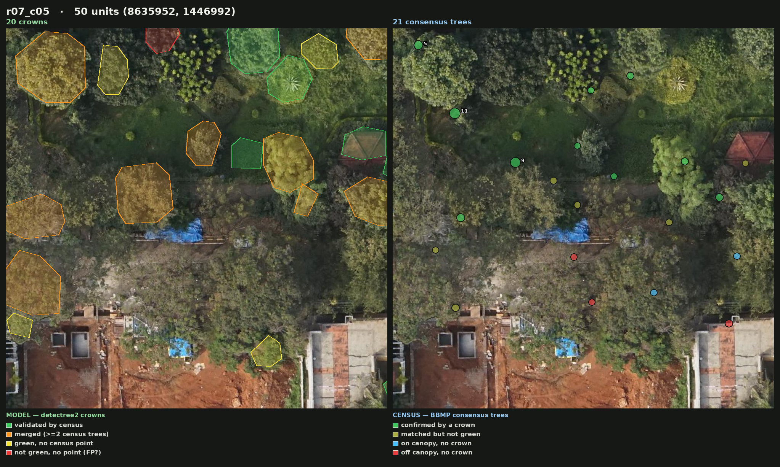
Where the two agree
MODEL crowns (left) vs CENSUS trees (right) · identical imagery · JP Nagar run C · tile r07_c05 · 50 m across
Crowns (left): 6 validated · 9 merged · 4 green-no-point · 1 likely-FP. Census trees (right): 10 confirmed · 6 matched-but-not-green · 2 missed · 3 off-canopy. Most polygons here are ORANGE — one crown covering several surveyed trees — so the detector under-counts even where it agrees.

Slide 9
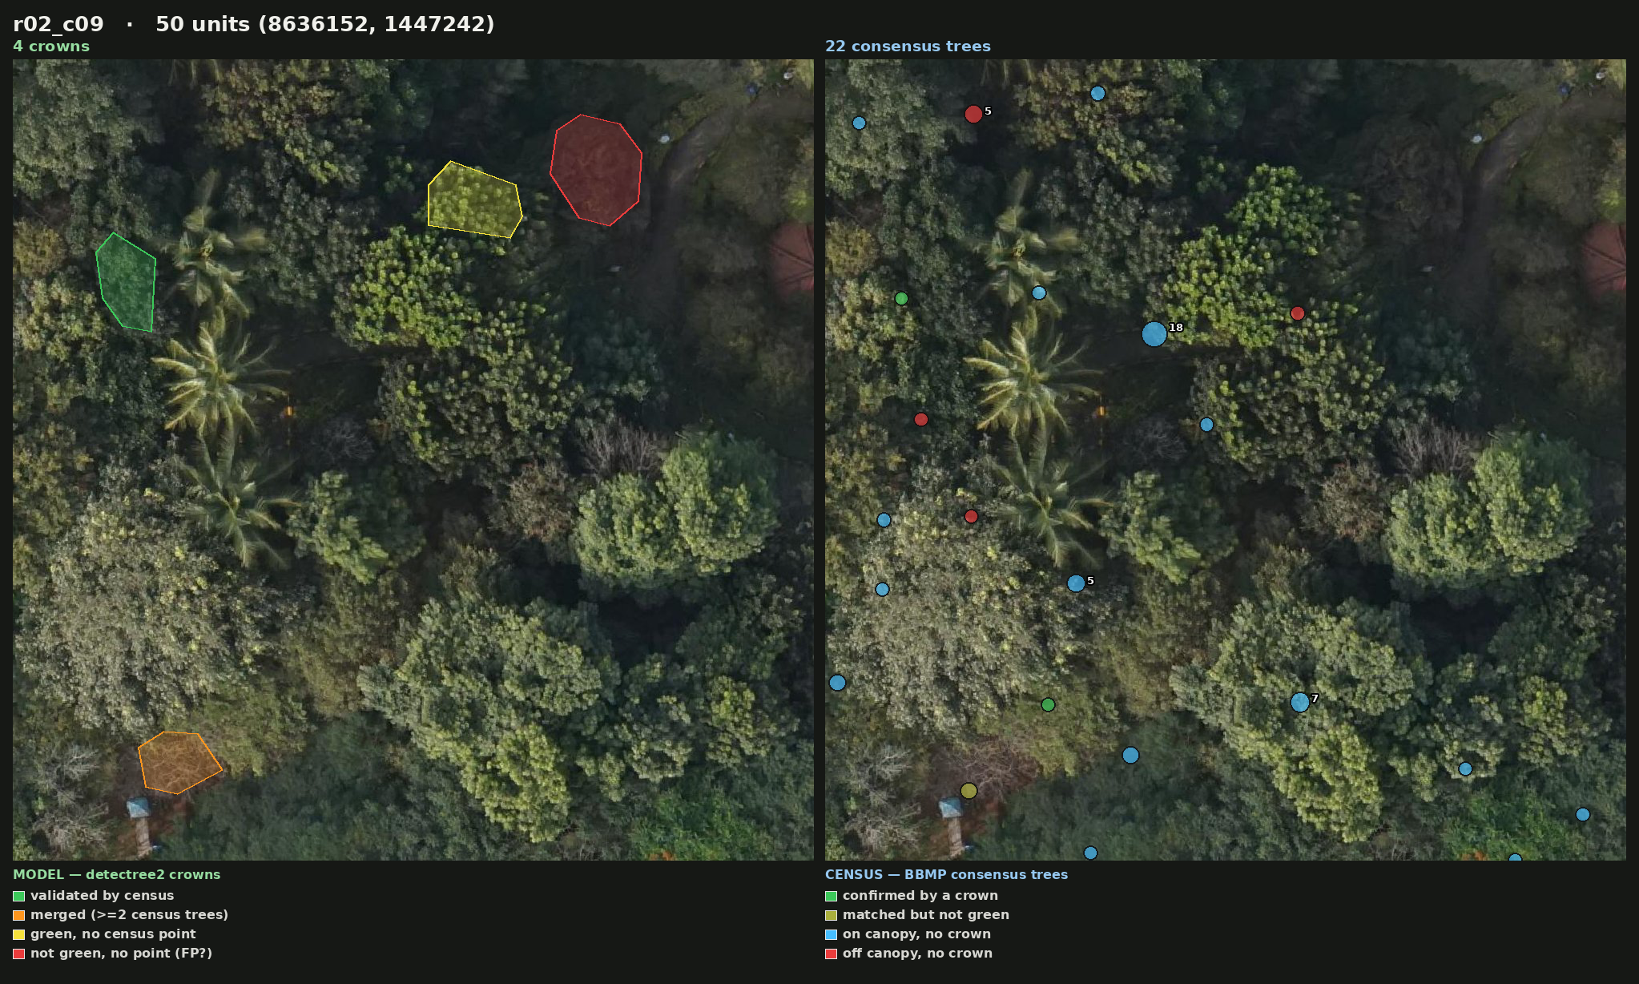
Census trees the model missed
MODEL crowns (left) vs CENSUS trees (right) · identical imagery · JP Nagar run C · tile r02_c09 · 50 m across
4 crowns vs 22 census trees. 15 cyan points sit on obvious canopy with no polygon drawn — detector false negatives. The tile is not one-sided though: 4 red points are off-canopy census error and 1 is matched but not green.

Slide 10
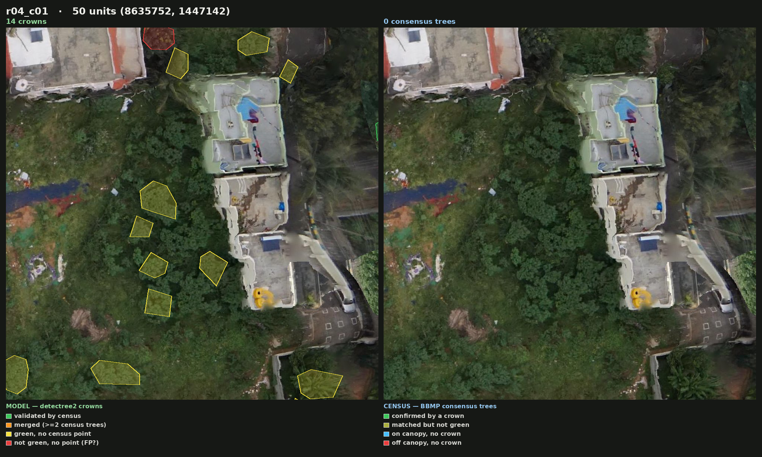
Crowns the census never surveyed
MODEL crowns (left) vs CENSUS trees (right) · identical imagery · JP Nagar run C · tile r04_c01 · 50 m across
14 crowns, 0 census points in the tile — 12 of the 14 are YELLOW (green crown, no census tree). A survey coverage gap, and why raw precision understates the model. (1 crown still counts as validated: its 4 m buffer reaches a consensus point in the neighbouring tile.)

Slide 11
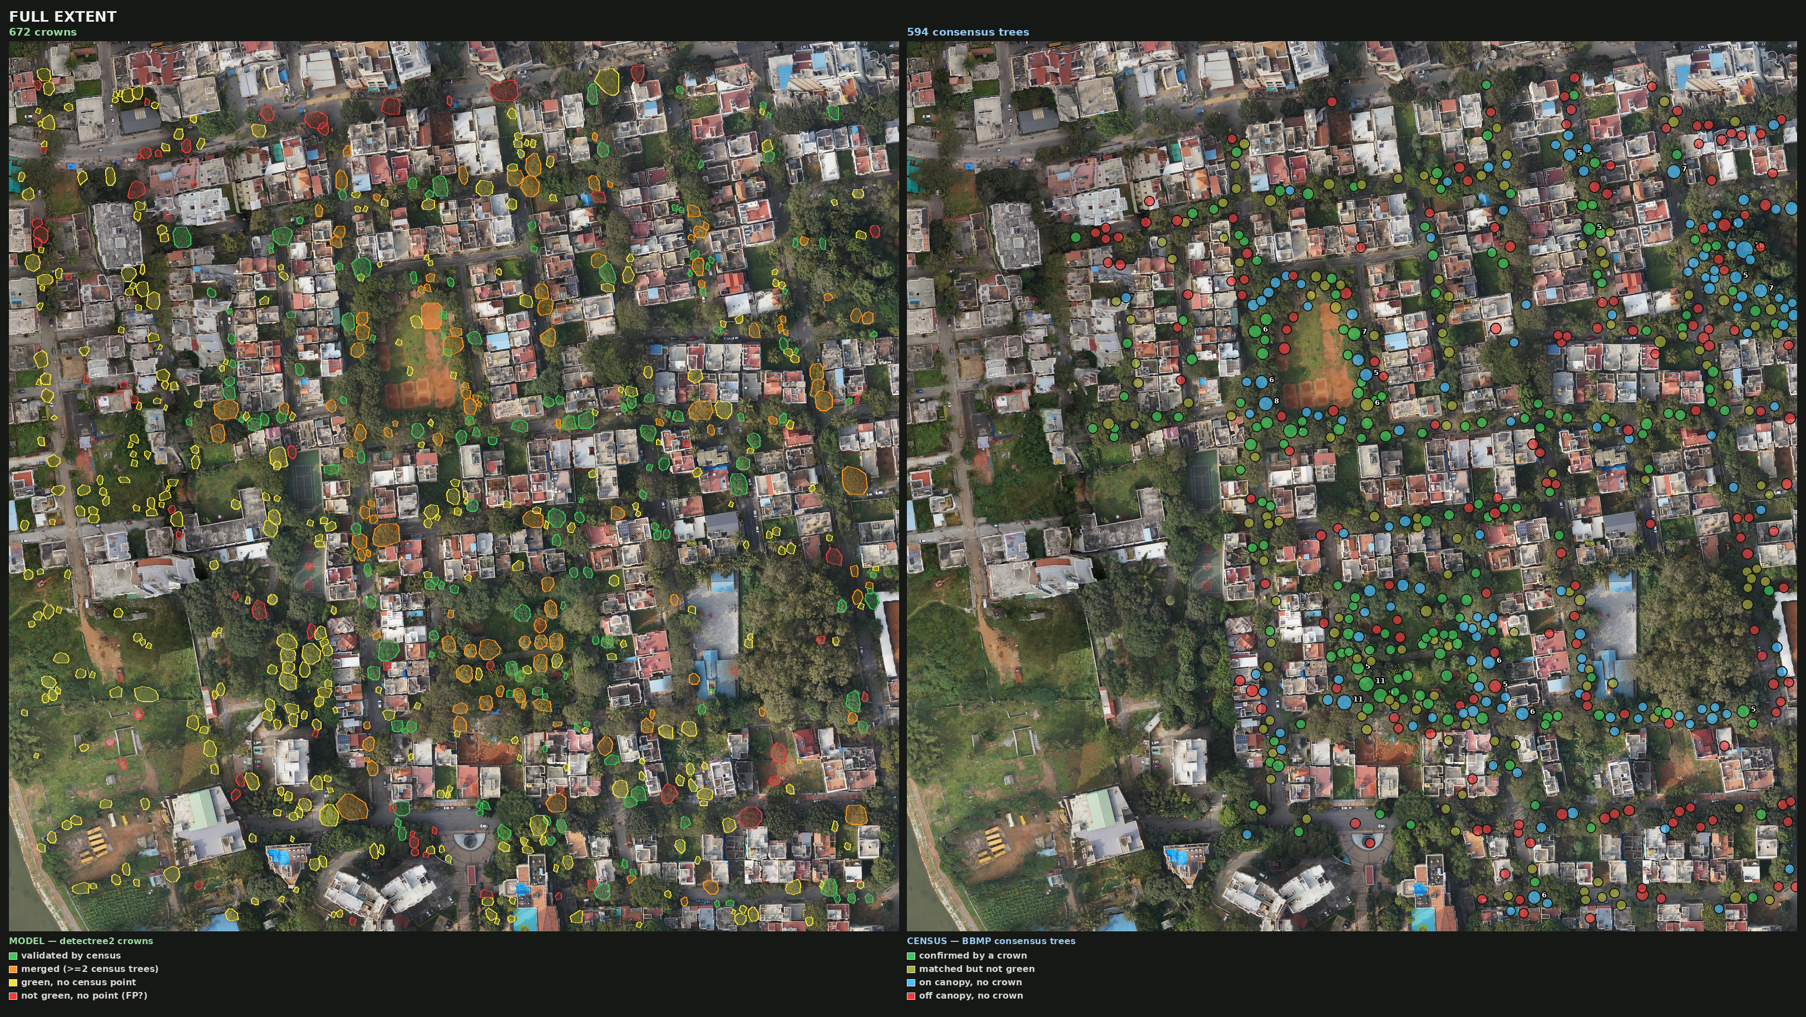
Full extent — all crowns, all census trees
JP Nagar run C · left: 672 model crowns · right: 594 census consensus trees
The census footprint stops well short of the image's western edge — 126 of 672 crowns fall outside it entirely.

Slide 12
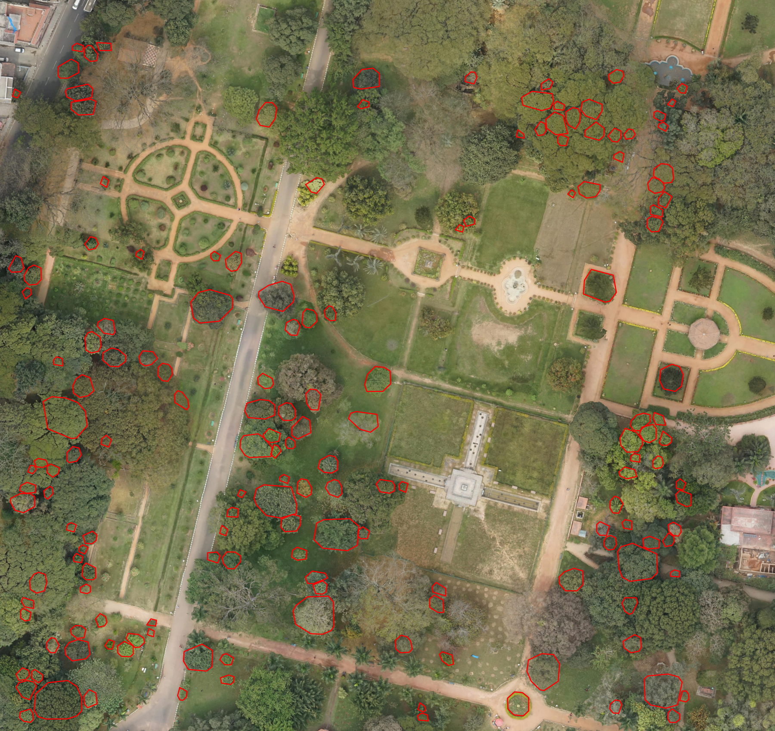
Lalbagh — detection only, no census
163 crowns · the census contains zero points inside this ortho
8.1% of the canopy enclosed; 93.7% of crown area on vegetation (a sanity check, not a precision score). It fires on isolated specimens, stays silent on closed canopy — 97% of which sits in blobs above predict.py's 200 m² cap.

Slide 13
What this means for the census as ground truth
Usable — but only as a clipped, filtered subset
Clip to the surveyed footprint; keep only on-canopy consensus points (~half of them); collapse duplicates before training.
It supervises detection and counting, not segmentation — the census gives points, not crown outlines.
Two detector faults found on the way, both mechanical
buffer > tile_size made the core tile smaller than a crown; conf_threshold 0.75 (applied three times in predict.py) discarded many ambiguous closed-canopy crowns. Fixing both took canopy coverage 3.1% → 15.1% and recall 16% → 56%, with the census unchanged.
Next: raise the hard crown-area cap
predict.py drops any crown outside 4–200 m², yet 80% of JP Nagar's and 97% of Lalbagh's canopy sits in connected blobs larger than that. Test this before swapping detector models.

