Slide 1
Presentation
on
interfacing of
stepper motor
and
Traffic light
controller
using
FPGA

Slide 2
By
M.V.Shivaditya
Shruti Singh
Anunay kumar
Nikhil Raj

Slide 3
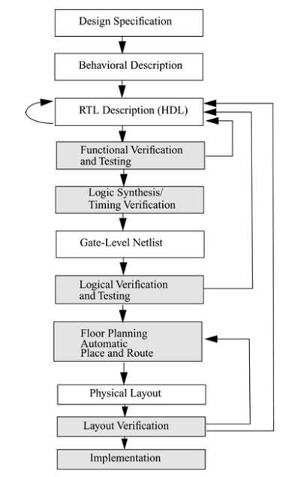
Flowchart explaining the sequential process of
the hardware design

Slide 4
Familiarization of Verilog
A hardware description language or HDL is a specialized computer language used to program digital logic circuits. Verilog HDL is one of the most used HDLs Behavioral or Algorithmic level is the highest level of abstraction provided by Verilog HDL . Designing at this level is very similar to C programming. Once a design block is completed, it must be tested. The functionality of the design block can be tested by applying testbench and checking results. One important difference between most programming languages and HDLs is that HDLs explicitly include the notion of time.

Slide 5
HDL are used for simulation of system boards, interconnect buses, FPGAs (Field Programmable Gate Array) and PALs (Programmable Array Logic).There are many design methods possible with which can either implement behavioral model or structural model. This also provides a concise representation of the design, compared to gate-level schematics are almost incomprehensible for very complex designs. FPGA offers densities ranging from 50,000 to five million–system gates.

Slide 6
Familiarization of FPGA (Spartan-3)
A field-programmable gate array (FPGA) is an integrated circuit designed to be configured by a customer or a designer after manufacturing – hence "field-programmable" .FPGA contains an array of programmable logic blocks, and a hierarchy of re configurable interconnects that allow the blocks to be "wired together", like many logic gates that can be inter-wired in different configurations. Logic blocks can be configured to perform complex combinational functions.

Slide 7
Base board
32/16 TOGGLE/DIP switch for I/P selection.
32/16 OPLEDs connected to the output of the FPGA.
16*2 Alpha-numeric LCD display with the backlight.
Four-digit 7-segment display.
4*4 Key matrix.
One PUSH BUTTON switch.
On board 10MHz oscillator.
10MHz clock & one of four different frequency clocks (5MHz,1MHz,500KHz & 100KHz).

Slide 8
User I/O’s available for pattern generator and Logic Analyzer.
On-Board differently supply voltage generation to match the multi Volt with O/P LED indication.
Standard VGA interface through 15-pin D type connector.
PS/2 standard external keyboards/mouse interface.
RS232 serial interface through 9-pin D type connector.
All the voltages 1.2V,1.5V,2.5V,3.3V & VCC are indicated through LEDs.
26-PIN FRC cable for connecting to ALS standard interface board like Stepper motor, ADC, DAC, Traffic light controller, elevator, printer interface etc.
Four sets of 20*2 female berg connector to plug the DAUGHTER BOARD.

Slide 9
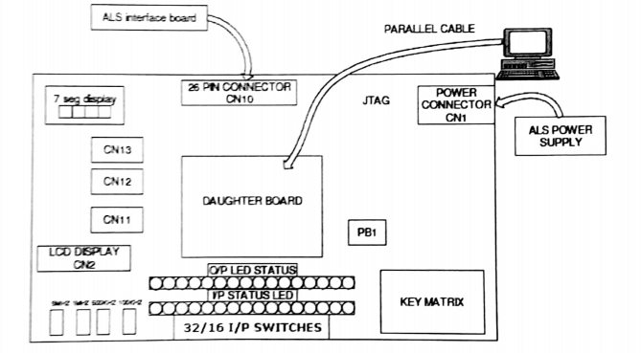

Slide 10
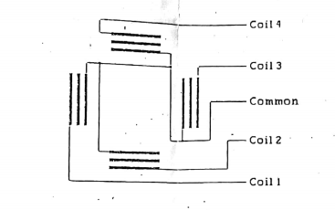
Implementation Of Stepper Motor Driver in FPGA
A stepper motor or step motor or stepping motor is a brushless DC electric motor that divides a full rotation into a number of equal steps. The motor's position can then be commanded to move and hold at one of these steps without any position sensor feedback. A stepper motor with 6 wires in 4-phase unipolar, but with two common wires

Slide 11
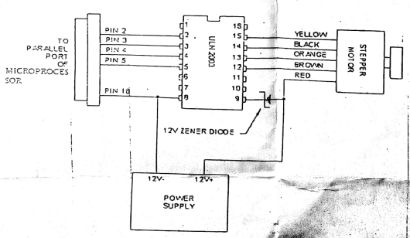

Slide 12
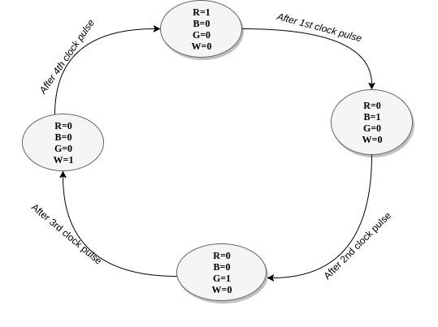
STATE DIAGRAM OF STEPPER MOTOR

Slide 13
Simulation traffic light control system
In this project, a simple traffic light system for a 4 way intersection is implemented using an FPGA The aim of the project is to implement a simple traffic light controller using FPGA the traffic is controlled in a pre-defined timing system .Traffic signals are integral part of modern life. Proper operations entails precise timing, scanning through the states correctly and responding to outside inputs.

Slide 14
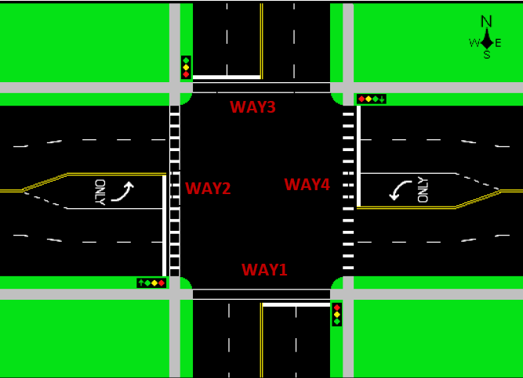

Slide 15
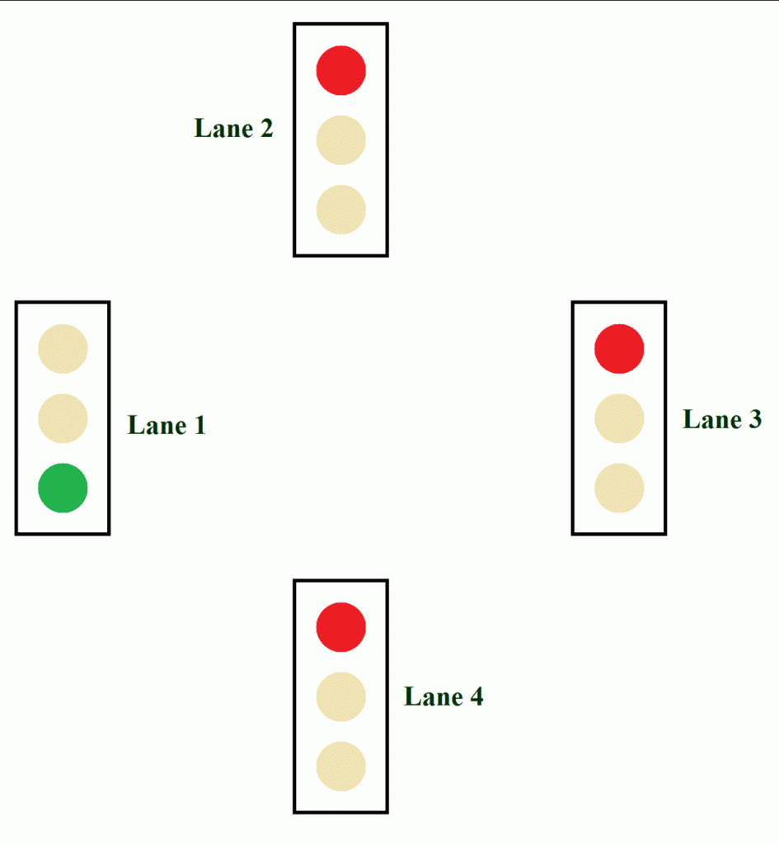

Slide 16
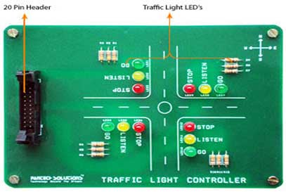

Slide 17
Algorithm for traffic light controller
In that, first the Lane 1 gets its Green light turned. Hence, in all the other Lanes, their corresponding Red lights are turned on. After a time delay of predefined time say 5 seconds, the Green light in the Lane 3 must be turned on and the Green light in the Lane 1 must be turned off.
As a warning indicator, the Yellow light in Lane 1 is tuned on indicating that the red light is about to light up. Similarly, the yellow light in the Lane 3 is also turned as an indication that the green light about to be turned on.
The yellow lights in Lanes 1 and 3 are turned for a small duration say 2 seconds after with the red light in the Lane 1 is turned on and green light in Lane 3 is also turned on.
The green light in Lane 3 is also turned on for a predefined time and the process moves forward to Lane 4 and finally Lane 2. The system then loops back to Lane 1 where the process mentioned above will be repeated all over again.

Slide 18
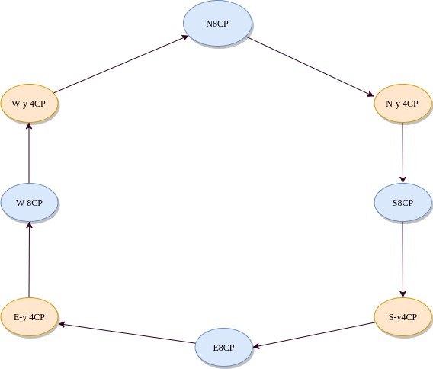
State diagram explaining the operation of traffic controller

Slide 19
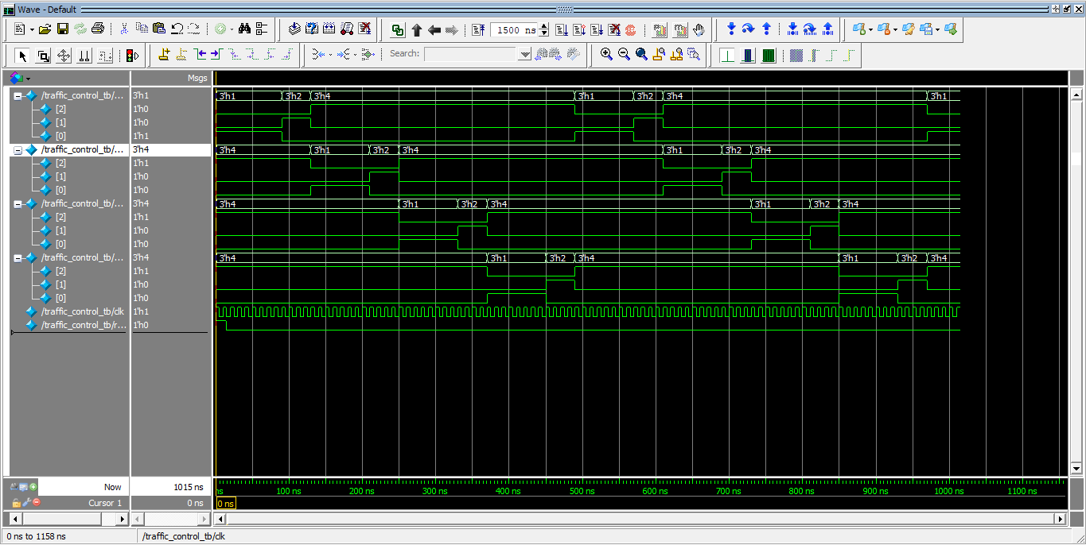
Simulation of traffic controller using Modelsim

Slide 20
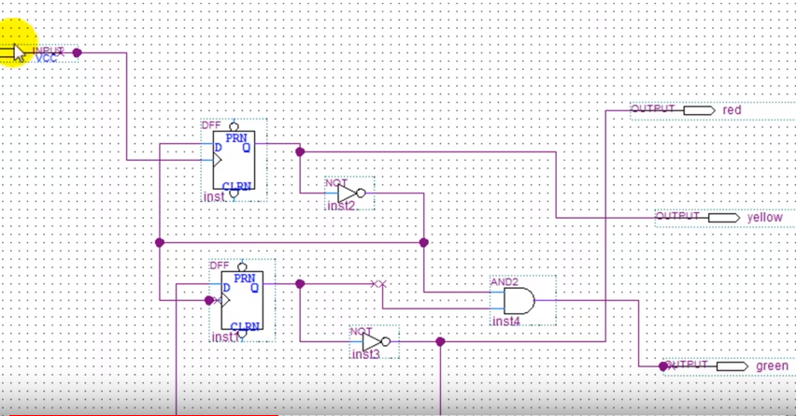
Structural model of a single traffic signal

Slide 21
Conclusion
There are huge number of applications of FPGA as we can create complex circuits in the form of code so that we can organize and find the fault without any confusion

