Slide 1


Conversation Timeline
Submitted by -
Anunaya Srivastava, 13535010
Under guidance of
Dr. Dhaval Patel

Slide 2
Outline
The Complex Social Structure
Need to Capture Conversations
What we propose
How we did it
Experiments & Analysis

Slide 3
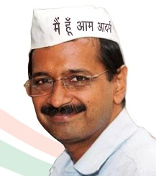
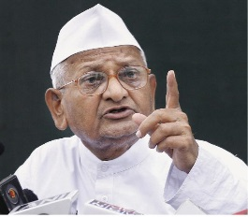
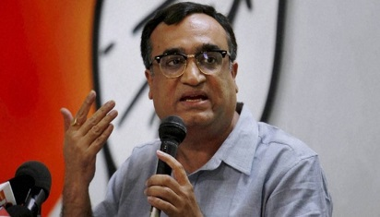
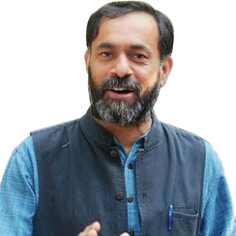
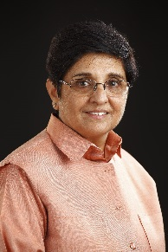
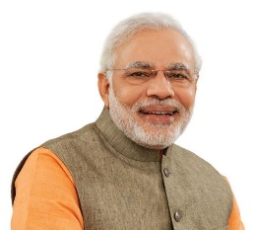
The Complex Social Structure
Aam Aadmi Party chief Arvind Kejriwal wins
Anna Hazare will share stage with Arvind Kejriwal
Delhi Vidhan Sabha 2015
Bedi, Kejriwal are opportunists, says Ajay Maken
We are not against Narendra Modi
Kiran Bedi shields Narendra Modi

Slide 4
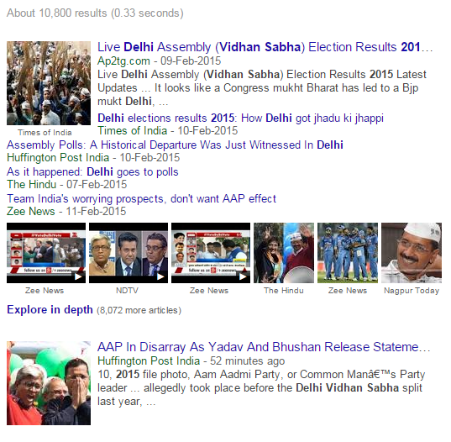

Can we capture this structure ?
?
?
Whom does Arvind Kejriwal interact with ?
What does he say about other people or vice-versa ?

Slide 5
Capture Conversations
We came up with a solution …
Conversation Timeline
To efficiently extract and display the conversations of a given entity(eg. Arvind Kejriwal) has with other entities

Slide 6
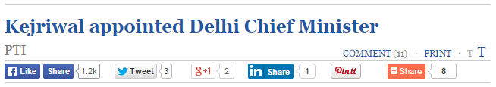
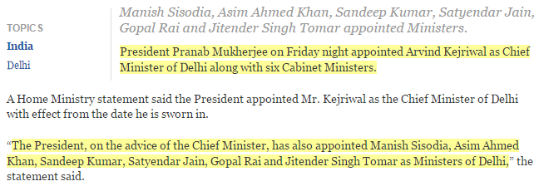
Do we really need conversational timeline ?
Previous systems -
1) Summarization
2) Topic Detection & Tracking
Women Security
Assault Nirbhaya Courts Criminal Self-defense Police
Corruption
Courts Politician Criminal Commonwealth Reliance Congress
Social reforms
Water Electricity Women Security Corruption CCTV

Slide 7
Do we really need conversational timeline ?
3) Storyline: A storyline is a chain of inter-related events describing the underlying structure of events related to the topic.
Election dates announced
None of these systems talked about conversations between entities !
We propose a new system …
Kiran Bedi joins BJP
President’s rule in Delhi
Kejriwal apologies to people
Kiran Bedi BJP’s CM candidate
Election results announced
AAP gets 67 seats
Kejriwal becomes CM
Fig.: A storyline for Delhi Vidhan Sabha Election 2015

Slide 8





What we propose …
Given a real-world entity, our system efficiently extracts and represents conversations with other unknown entities along with their chronological order, so as to give holistic view of the underlying interactions for better user understanding.
Input:
A real-world entity (e₀)
Eg.: Arvind Kejriwal
Proposed System –
Conversation Timeline
News Media
Fig.: Conversations with Arvind Kejriwal

Slide 9
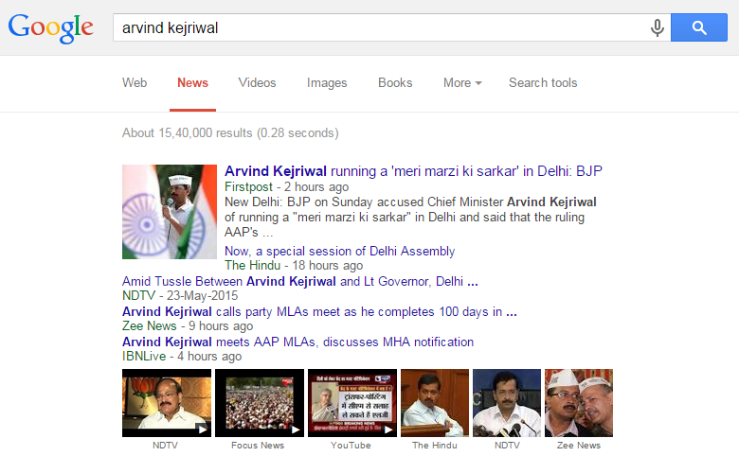
Extracting Conversations Efficiently
Parse the news articles for the input entity ‘Arvind Kejriwal’ on Google News gives 15,40,000 results
Applying NLP techniques to extract and filter the conversations on such a huge document corpus is inefficient.
News headlines:
Short , human-audited text representing the key idea in the article.

Slide 10
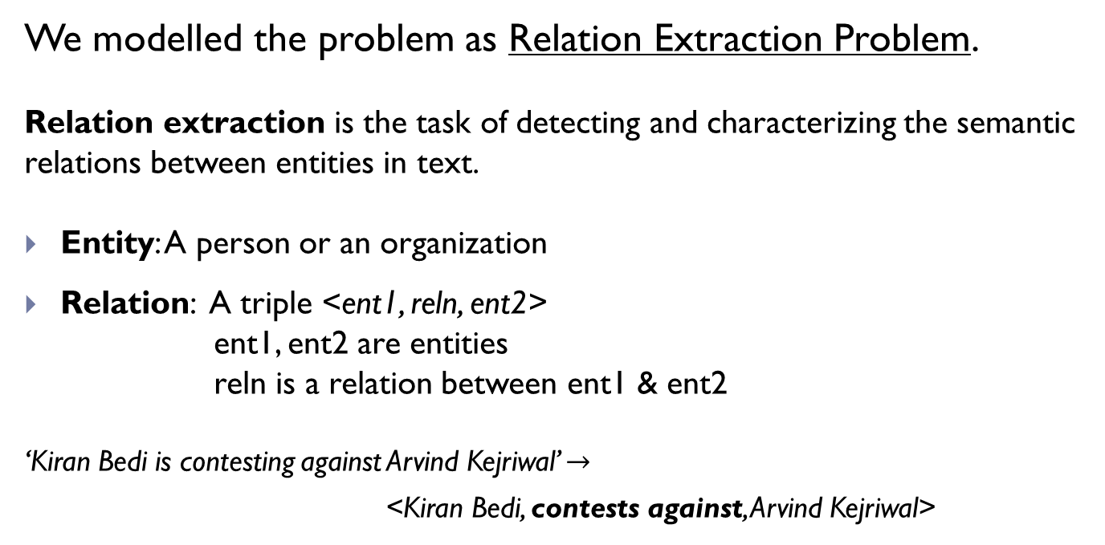
Extracting Conversations
We modelled the problem as Relation Extraction Problem.
Relation extraction is the task of detecting and characterizing the semantic relations between entities in text.
Entity: A person or an organization
Relation: A triple <ent1, reln, ent2>
ent1, ent2 are entities
reln is a relation between ent1 & ent2
‘Kiran Bedi is contesting against Arvind Kejriwal’ $→$
<Kiran Bedi, contests against, Arvind Kejriwal>
The proposed system pre-processes the headlines such that more meaningful relations triplets can be extracted from the news headlines.

Slide 11
What we contribute …
Reduced Computational Cost Used news headlines so as to save the cost of parsing the entire article.
New Document Understanding Technique Extracting chronologically ordered conversations of a given entity with other unknown entities.
Features Provide new features for classifying conversation related headlines.
Efficient Relation Extraction from Headline Steps to pre-process the headlines for better relation extraction.

Slide 12
A Naive Approach
Directly apply the Reln. Ext. Algo on the headlines.
But it doesn’t preform well…
Headlines | Relations before pre-processing
Court to Arvind Kejriwal: Appear on May 24 or face action | No relations extracted
Is it right to use such foul language: Arvind Kejriwal to Narendra Modi | No relations extracted
BJP on power crisis: Arvind Kejriwal should quit | No relations extracted
BJP: Arvind Kejriwal unable to govern, looking for escape route | No relations extracted
Anna Hazare: I will protest against Arvind Kejriwal if he indulges in wrongdoing | <I, will protest against, Arvind Kejriwal>
Can we pre-process the headlines such that Reln. Ext. Algo. can extract more meaningful relations ?
Why ? Headlines do not follow the grammatical rules of English. This is a pre-requisite for Reln. Ext. Algo.

Slide 13
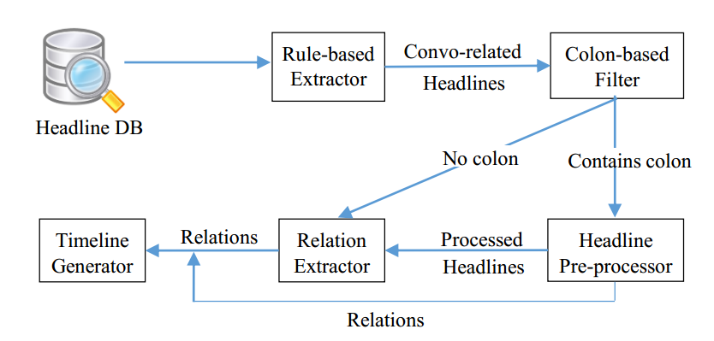
System Overview
Fig. Conversation Timeline Architecture

Slide 14
Rule-based Headline Extractor
To filter conversation related headlines
Headline is conversation related
It contains input entity, and
(R1 OR R2) is TRUE
R1: Headline contains ‘:’
eg. Arvind : AAP is an honest political party.
R2: Verb in headline is a verb of attribution (present in Vlist)
eg. ‘says’, ‘calls’, ‘retorts’, ‘tweets’, ‘suggests’, ‘slams’ etc.
Parameters | Value
Input entity | Arvind Kejriwal
No. of records in database | 37,73,677
No. of records related to input entity | 3238
No. of records after rule-based headline extractor | 1411
Table: Results of Rule-based Headline Extractor

Slide 15
Headline Pre-processor
Headlines don’t follow English grammatical rules, which degrades the performance of Reln. Ext. Algo.
We observed certain patterns which can help us to improve Reln. Ext. Algo. performance.
Colon ‘:’ is extensively used in headlines to state the statement made by a person or organization.
Headline pre-processor exclusively processes headlines containing a colon.
Discom creating ugly situations, govt. may step in: Kejriwal to Jung
body
header
Kejriwal to Jung : Discom creating ugly situations, govt. may step in
header
body

Slide 16
Headline Pre-processor
Steps | Type of Headline | Template | Transformation
Step 1 | Header contains ‘to’: An entity makes statement about another entity. Eg. Discom creating ugly situations, govt. may step in: Kejriwal to Jung | <ent1> to <ent2> : <statement> | Relation extracted < ent1, statement, ent2 >
Step 2 | Header contains ‘on’: An entity is speaking about a topic. Eg. Ex-CM Kejriwal on Elections: We will apologize to Delhi. | NNP on NNP : <statement> | <entity> : <statement> To be processed further
Step 3 | Body starts with a pronoun. Eg. Arvind Kejriwal: I can sacrifice CM seat 100 times | NNP: PRP <rest of body> | NNP <rest of body> To be processed further
Step 4 | The body starts with a proper noun. Eg. Arvind Kejriwal: Reliance is accused to looting public | <ent1>: <ent2>statement | Relation extracted < ent1, statement, ent2 >
To Reln Ext. Algo

Slide 17
Relation Extractor
Entity Extraction
Eg. ‘Delhi CM Arvind Kejriwal accuses Relaince.’ should give ‘Delhi CM Arvind Kejriwal’
Used Apache’s NP-chunker to extract the noun phrase.
Relation Extraction
To extract the relation triple <ent1, reln, ent2> we have used WOE algorithm
WOE, proposed by Fei & Weld, uses dependency parsing to extract the relation.
Parameters | Value
Input entity | Arvind Kejriwal
No. of records after rule-based headline extractor | 1411
No. of relations extracted | 281
Table: Results of Relation Extractor

Slide 18
Timeline Generator
Timeline Generator module cleans and arranges the relations chronologically.
Sample output:
2014-01-28 20:47:47.0 | Vinod Kumar Binny | accuses | Arvind Kejriwal
2014-02-01 05:47:15.0 | Arvind Kejriwal | accuses | Rahul Gandhi
2014-02-13 09:47:01.0 | Arvind Kejriwal | attacks | Mukesh Ambani
2014-03-01 09:47:01.0 | Arvind Kejriwal | accusation fobbed off by | Mukesh Ambani
…
…

Slide 19
Experiments and Evaluation
We analyse the relations quantitatively and qualitatively to judge the performance of the system.
We ran the system for entities –
Arvind Kejriwal
Barack Obama
Congress
Narendra Modi
Jayalalithaa

Slide 20
Quantitative Analysis
Direct Relations
Large % of colon related headlines
Headline Pre-processor
Input Entity | Related headlines in DB | Conv. related headlines | % hdl with colon (in complete DB) | Step 1 (A) | Step 2 (B) | Step 3 (C) | Step 4 (D) | % Impv. in Reln. Ext.
Arvind Kejriwal | 3238 | 1424 | 969 | 37 | 135 | 29 | 445 | 31.5 %
 |  |  | 30 % | 3.8 % | 14 % | 3 % | 45.9 %
Barack Obama | 1463 | 560 | 350 | 20 | 17 | 8 | 201 | 14.6 %
 |  |  | 23.9 % | 5.7 % | 4.9 % | 2.3 % | 57.4 %
Congress | 18418 | 7943 | 5693 | 232 | 1727 | 74 | 3170 | 15.9 %
 |  |  | 31 % | 4.1 % | 30.3 % | 1.3 % | 55.7 %
Narendra Modi | 14885 | 6692 | 4606 | 235 | 544 | 101 | 2222 | 22 %
 |  |  | 30.94 % | 5.1 % | 11.8 % | 2.3 % | 48.2 %

Slide 21
Qualitative Analysis
Headlines | Relations before pre-processing | Relations after pre-processing
Court to Arvind Kejriwal: Appear on May 24 or face action | No relations extracted | <Court , Appear on May 24 or face action, Arvind Kejriwal>
Is it right to use such foul language: Arvind Kejriwal to Narendra Modi | No relations extracted | <Arvind Kejriwal, Is it right to use such foul language, Narendra Modi>
BJP on power crisis: Arvind Kejriwal should quit | No relations extracted | <BJP, should quit, Arvind Kejriwal>
BJP: Arvind Kejriwal unable to govern, looking for escape route | No relations extracted | <BJP, unable to govern looking for escape route, Arvind Kejriwal>
Anna Hazare: I will protest against Arvind Kejriwal if he indulges in wrongdoing | <I, will protest against, Arvind Kejriwal> | <Anna Hazare, will protest against, Arvind Kejriwal>
Table: Examples of relations extracted after pre-processing

Slide 22
Case Studies
Parameters | Case 1 | Case 2
Input entity | Arvind Kejriwal | Jayalalithaa
Date Range (DD/MM/YYYY) | 28/01/2014 – 04/01/2015 | 28/01/2014 - 14/05/2015
No. of records in database | 37,73,677 | 4579530
No. of records related to input entity | 3238 | 3413
No. of records after rule-based headline extractor | 1411 | 1255
No. of relations extracted | 281 | 315

Slide 23
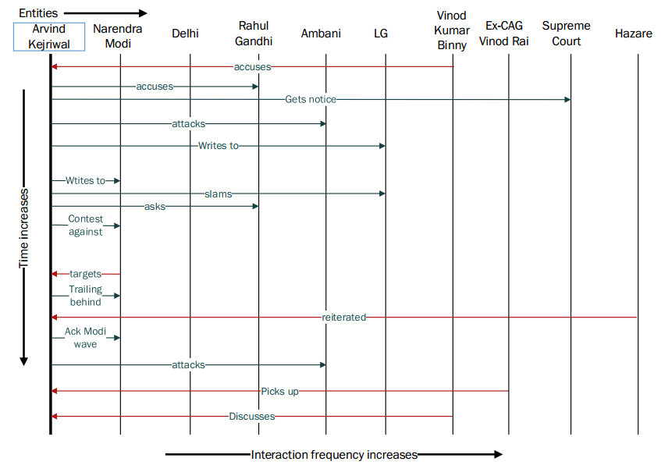
Visualizing Relations Extracted
Extracted entities
Extracted Relations
Fig.: Conversation Timeline of Arvind Kejriwal

Slide 24
Conversations about Jayalalithaa
Jayalalithaa was acquitted on May 11, 2015. Our system can extract what people have said about Jayalalithaa’s case.
Date(YYYY-MM-DD) | Event
2014-09-27 | Jayalalithaa was convicted and sentenced to prison
2014-10-07 | Bail plea rejected by Karnataka High Court
2014-10-17 | Supreme Court grants bail to Jayalalithaa
2015-05-11 | Jayalalithaa gets acquitted
Fig. Major Events in Jayalalithaa’s case (Source: Wikipedia)
Fig. frequency plot of mentions of ‘Jayalalithaa’ per day in Headline DB

Slide 25
Relations for query Jayalalithaa
Events on | Date of pub. | From | Conversation | To
2014-09-27 | 2014-09-28 | Subramanian Swamy | Jayalalithaa Can’t Recover From This Loss of Credibility | Jayalalithaa
 | 2014-09-28 | Arun Ram | Jayalalithaa – a woman of convictions | Jayalalithaa
2014-10-07 | 2014-10-08 | Jethmalani | Jayalalithaa must be granted bail | Jayalalithaa
2014-10-17 | 2014-10-18 | Venkaiah Naidu | Jayalalithaa will not misuse interim bail granted by SC | Jayalalithaa
 | 2015-03-25 | Panneerselvam | Jayalalithaa will be CM again | Jayalalithaa
2015-05-11 | 2015-05-12 | PM Modi | calls | Jayalalithaa
 | 2015-05-12 | Neerja Chowdhury | set to become India’s most powerful chief minister | Jayalalithaa

Slide 26
Conclusion
Proposed a new document understanding system – Conversational Timeline.
It captures conversations between entities along with their temporal info, thus giving a better understanding.
Used news headlines for reduced computational cost.
Modelled the problem as Relation Extraction Problem. Proposed pre-processing steps for headlines for more meaningful relation extraction.

Slide 27
Thank You !

Slide 28
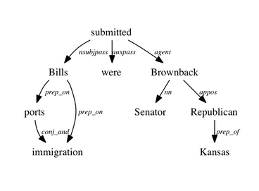
Dependency Parse Tree
‘Bills on ports and immigration were submitted by Senator Brownback, Republican of Kansas’
Fig.: Example of Dependency Parse Tree

Slide 29
WOE
Given: ‘Dan was not born in Berkeley’
Build dependency parse tree using StanfordNLP package.
For each pair of tokens such as ‘Dan’ & ‘Berkeley’
Build corePath
Build expandPath
Build generalized-corePath
Negation is missing !
(Extraction Pattern)

Slide 30
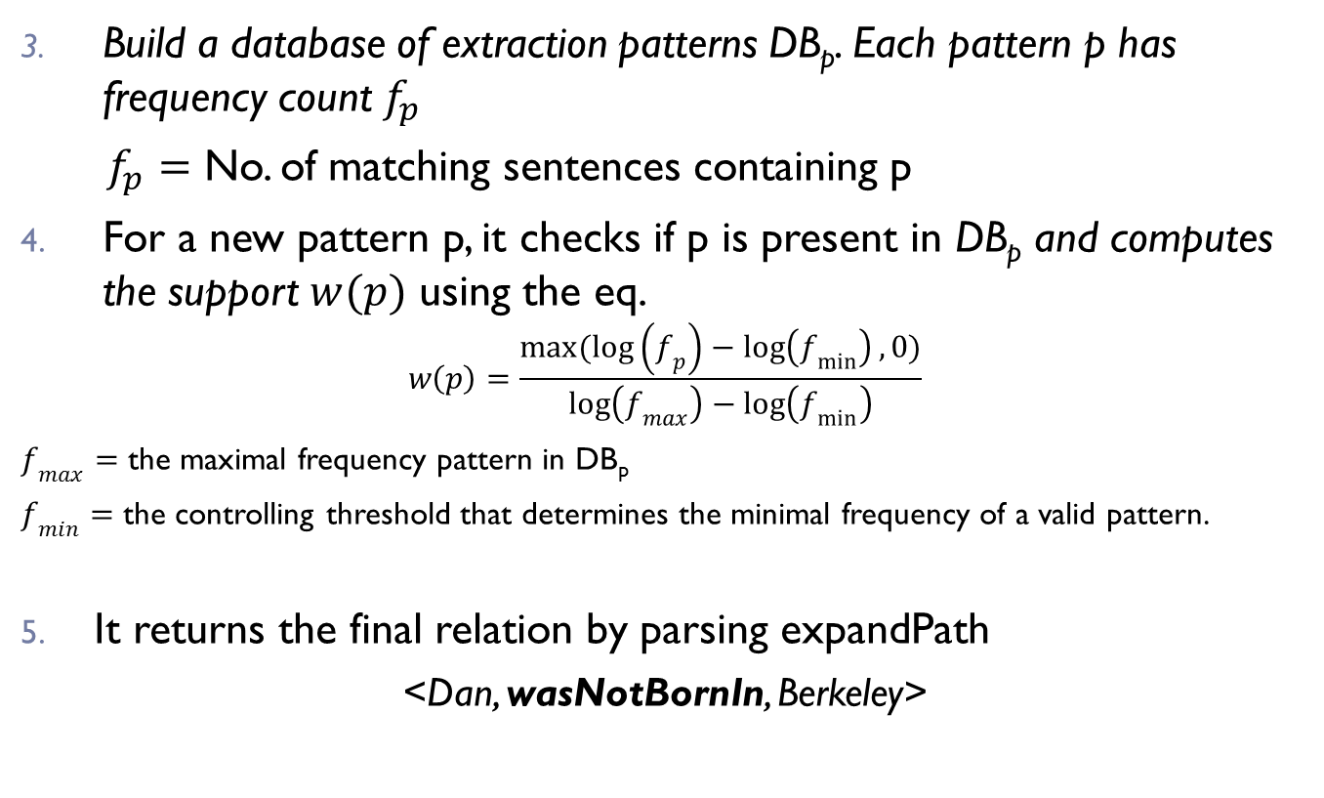
WOE
Build a database of extraction patterns DB_{p}. Each pattern p has frequency count $f_{p}$
$f_{p}=$ No. of matching sentences containing p
For a new pattern p, it checks if p is present in DB_{p} and computes the support $w(p)$ using the eq.
$$w\left(p\right)=\frac{max(\log\left(f_{p}\right)−\log\left(f_{min}\right), 0)}{\log\left(f_{max}\right)−\log\left(f_{min}\right)}$$
$f_{max}=$ the maximal frequency pattern in DB_{p}
$f_{min}=$ the controlling threshold that determines the minimal frequency of a valid pattern.
It returns the final relation by parsing expandPath
<Dan, wasNotBornIn, Berkeley>

Slide 31
Visualizing the Relations Extracted
Extracted Entities
Input Entity
Relations
Fig.: Sample Relations for ‘Arvind Kejriwal’

