Slide 1
Generating Storylines
Submitted by -
Anunaya Srivastava, 13535010
Under guidance of
Dr. Dhaval Patel

Slide 2
Outline
Motivation
Solutions offered
Understanding Storyline
Storyline Generation

Slide 3
Outline
Motivation
Solutions offered
Understanding Storyline
Storyline Generation

Slide 4
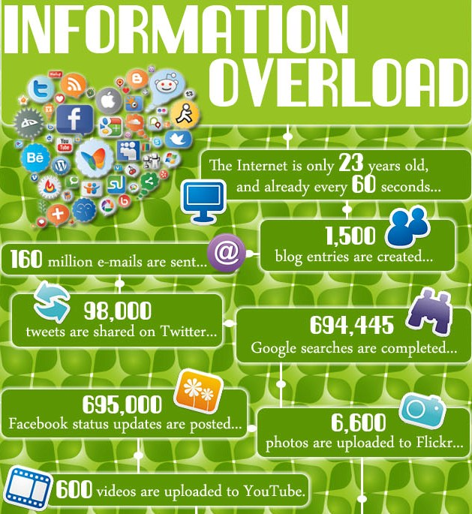

Motivation
“The abundance of information people are exposed to through e-mail and other technology-based sources could be having an impact on the thought process, obstructing deep thinking, understanding, impedes the formation of memories and makes learning more difficult.”
- Harvard Business Review
“Between the dawn of civilization through 2003 about 5 exabytes of information was created. Now, that much information created every 2 days.”
- Eric Schmidt, former Google CEO
A better way to represent information !

Slide 5
Outline
Motivation
Solutions offered
Understanding Storyline
Storyline Generation

Slide 6
Solutions offered
Document Summarization
Topic Detection and Tracking (TDT)
Storyline generation

Slide 7
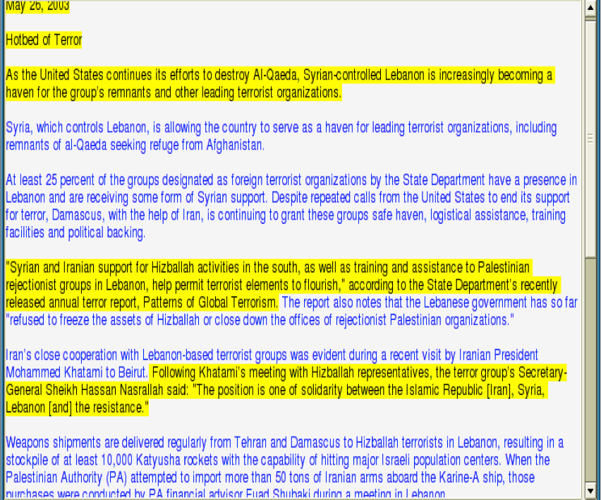

Document Summarization
Selecting representative sentences from one or more documents such that they convey the crux of the entire text.
Representative sentence
Topic representation
Score sentences
Select summary sentences
Basic summarization process flow
Representative Sentences selected from the text
But…..How many topics are present in the document(s) ?

Slide 8
Topic Detection and Tracking (TDT)
Preliminaries
An event is something that happens at a specific time and location.
Eg: Malaysian airline MH370 went missing
A story is a topically cohesive segment of news discussing inter-related events.
Eg: Missing MH370 leads to despatch of search parties, rescue attempts etc.
A topic is a set of news stories that are strongly related by some seminal real-world event.
Eg: Airline disasters
Topic
Story
Event

Slide 9
Topic Detection and Tracking (TDT)
Disease | Computers | Genetics | Evolution
bacteria infectious parasites control tuberculosis united disease parasite new strains bacterial resistance diseases host malaria | computers system computer information methods parallel model simulations systems data new software network models networks | human sequencing genetics genetic genes sequences genome dna gene sequence information molecular map project mapping | common life evolution organisms species group biology groups living evolutionary diversity new phylogenetic origin two
But…..How to are different events related to (dependent on) each other ?
Most frequent topics found after processing 17,000 articles from the journal Science
(David M. Blei, Probabilistic Topic Models.: Communications of the ACM, 2012)

Slide 10
Outline
Motivation
Solutions offered
Storyline
Storyline Generation

Slide 11

Storyline
One of the shortcomings of TDT is its view of news topics as a flat collection of stories.
However, a topic is more than a mere collection of stories. It is characterized by a definite structure of inter-related events.
Event
A storyline is a chain of inter-related events forming a story such that it gives a better understanding to the user about the underlying structure of events related to the topic.

Slide 12
Storyline – An example
protesters clash with police
no statement from Mubarak
curfew announced
revolution followed by Eritrea
Museum on fire
hope antiquities ok
people are invited to support revolution
human shields
protect Museum
looters destroy mummies
A sample storyline for query 'Egypt Revolution'
Source: Chen Lin et. al., "Generating Event Storylines from Microblogs"

Slide 13
What’s a good storyline ?
Good Storyline
Coherence
Relevance
Low redundancy
Coverage
Connectivity
Transition between different events on the storyline should be smooth.
Events must be relevant to the user query.
No duplicates. One representative article for every event.
(Metro Maps)Measures how different aspects of a story interact with each other
Cover every important event of the story

Slide 14
Coherence
A1: Talks Over Ex-Intern's Testimony On Clinton Appear to Bog Down
B1: Talks Over Ex-Intern's Testimony On Clinton Appear to Bog Down
A2: Judge Sides with the Government in Microsoft Antitrust Trial
B2: Clinton Admits Lewinsky Liaison to Jury; Tells Nation 'It was wrong.'
Shahaf et.al. in ‘Connecting the dots between News Articles’ suggested the idea of storyline coherence.
The story (a) is erratic and passes through unrelated events i.e. Microsoft trial, Palestinians, and European markets
A3: Who will be the Next Microsoft?
B3: GOP Vote Counter in House Predicts Impeachment of Clinton
A4: Palestinians Planning to Offer Bonds on Euro, Markets
B4: Clinton Impeached; He faces Senate Trial
A5: Clinton Watches as Palestinians Vote to Rescind 1964 Provision
B5: Clinton's Acquittal; Excerpts: Senators Talk About Their Votes
A6: Contesting the Vote: The Overview; Gore asks Public for Patience
B6: Aides say Clinton is Angered As Gore Tries to Break Away
(a)
B7: As Election Draws Near, the election Turns Mean
Coherent vs Non-coherent Storyline
B8: Contesting the Vote: The Overview; Gore asks Public for Patience
Source: Shahaf et.al. in ‘Connecting the dots between News Articles’
(b)

Slide 15
Storyline Configurations
3 kinds of storyline configurations -
User Query
Start Event
Start Event
v
v
v
v
v
v
v
End Event
Connecting Dots
Evolution Storyline
Metro Map

Slide 16
Storyline Configurations
3 kinds of storyline configurations -
(3/1/07) Home Prices Fall Just a Bit
Start Event
Start Event
(4/3/07) Keeping Borrowers Afloat
(5/3/07) A Mortgage Crisis Begins to Spiral
10/8/07 Investors Grow Wary of Bank’s Reliance on Debt
26/9/08 Markets Can’t Wait for Congress to Act
End Event
(4/10/08) Bailout Plan Wins Approval
Connecting Dots
(20/1/09) Obama’s Bailout Plan Moving Forward
(1/9/09) Do Bank Bailouts Hurt Obama on Health?
(22/9/09) Yes to Health-Care Reform, but Is This the Right Plan
End Event
Notes:
The user vaguely recalls that the financial crisis is related to the decline of home prices in 2007. The user would then choose representative articles for those two topics and feed them to our system. An output chain may look like this

Slide 17
Storyline Configurations
3 kinds of storyline configurations -
Start Event
protesters clash with police
no statement from Mubarak
curfew announced
revolution followed by Eritrea
Museum on fire
hope antiquities ok
people are invited to support revolution
human shields
protect Museum
looters destroy mummies
Evolution Storyline
A sample storyline for query 'Egypt Revolution'

Slide 18
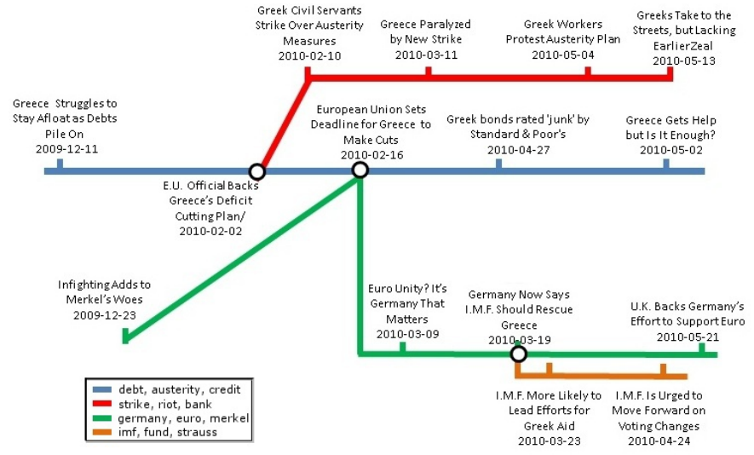
Storyline Configurations
3 kinds of storyline configurations -
User Query
v
v
v
v
v
v
v
Metro Map
An illustration of Metro Map showing stories related to 'Greek debt crisis‘ Source: Dafna Shahaf et.al., "Trains of Thought: Generating Information Maps"

Slide 19
Storyline Configurations
Storyline generation parameters –
Dataset: News articles, blogs, tweets, pictures, entities etc.
Input:
User Query
One of the following:
Start Event Only
Start Event & End Event

Slide 20
Outline
Motivation
Solutions offered
Storyline
Storyline Generation

Slide 21
Storyline Generation
Storyline generating process can be broadly divided into 3 stages -
Extract relevant documents
Document
Selected
Document
Summarization to find event-wise representative sentences
Connecting events to generate storyline

Slide 22
Storyline Generation
Storyline generating process can be broadly divided into 3 stages -
Extract relevant documents
Document
Selected
Document
Summarization to find event-wise representative sentences
Connecting events to generate storyline

Slide 23
1) Extract relevant documents
To form a storyline based on the user query, first of all the system has to extract relevant documents from the dataset.
We need to extract relevant tweets from the Twitter datastream.
An effective method to do so is Dynamic Pseudo Relevance Feedback (DPRF) which is used by Chen Lin et al., "Generating Event Storylines from Microblogs"

Slide 24

1.1) Dynamic Pseudo Relevance Feedback (DPRF)
Relevance Feedback (RF):
Pseudo Relevance Feedback (PRF):
Query
System
Qutput
User Feedback
Query
System
Qutput
Top k documents
Automated Feedback

Slide 25
1.1) Dynamic Pseudo Relevance Feedback (DPRF)
Dynamic Pseudo Relevance Feedback (DPRF):
In traditional PRF, the prior probability p_{k} of finding top is usually set to be uniform. DPRF is dynamic i.e. prior probability of relevant document is given by a probability distribution.
However, this assumption doesn’t hold in an instant broadcast medium like Twitter. For event query of “Egypt Revolution”, a top tweet published on 2011-01-25 is more likely to be a truly relevant tweet than a tweet published on 2011-01-01 on a near position in the ranking list.

Slide 26
Storyline Generation
Storyline generating process can be broadly divided into 3 stages -
Extract relevant documents
Document
Selected
Document
Summarization to find event-wise representative sentences
Connecting events to generate storyline

Slide 27
2) Summarization
Multi-document summarization techniques commonly use clustering algorithms to generate a summary.
A set of documents is treated as a set of sentences.
Clustering algorithms are used to cluster these sentences where each cluster consists of sentences pertaining to a single event.
We discuss 3 algorithms :
Latent Semantic Analysis (LSA) + k-means clustering
Non-negative matrix factorization(NMF)
Minimum Weight Dominant Set (MWDS)

Slide 28
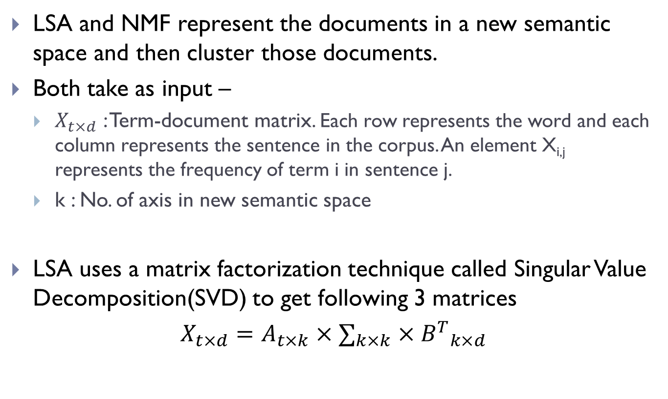
2.1) LSA + k-means clustering
LSA and NMF represent the documents in a new semantic space and then cluster those documents.
Both take as input –
$X_{t×d}$ : Term-document matrix. Each row represents the word and each column represents the sentence in the corpus. An element X_{i,j} represents the frequency of term i in sentence j.
k : No. of axis in new semantic space
LSA uses a matrix factorization technique called Singular Value Decomposition(SVD) to get following 3 matrices
$$X_{t×d}=A_{t×k}×∑_{k×k}×{B^{T}}_{k×d}$$

Slide 29
2.1) LSA + k-means clustering
Input:
D: Document Set
k: No. of axis
d1: Shipment of gold damaged in a fire.
d2: Delivery of silver arrived in a silver truck.
d3: Shipment of gold arrived in a truck.
Terms↓\ Sentences → | d₁ | d₂ | d₃
a | 1 | 1 | 1
arrived | 0 | 1 | 1
damaged | 1 | 0 | 0
delivery | 0 | 1 | 0
fire | 1 | 0 | 0
gold | 1 | 0 | 1
in | 1 | 1 | 1
of | 1 | 1 | 1
shipment | 1 | 0 | 1
silver | 0 | 2 | 0
truck | 0 | 1 | 1
Term- Sentence Matrix

Slide 30
2.1) LSA + k-means clustering
Document
y
New axis
O
x
Semantic space derived using SVD
After applying LSA, k-means clustering is applied to get document clusters.

Slide 31
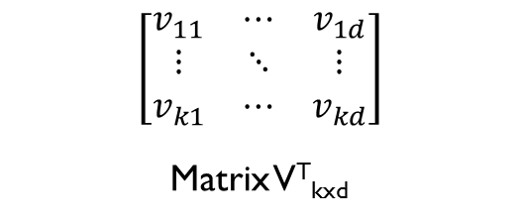
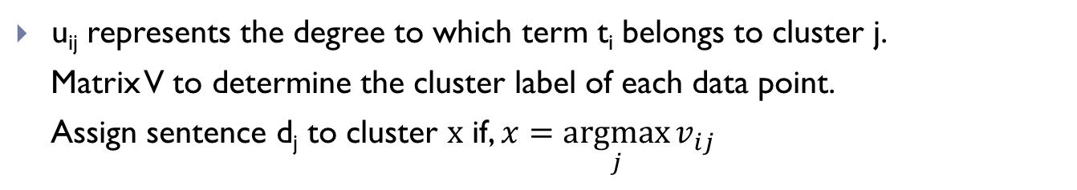
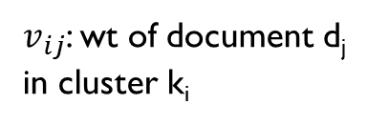
2.2) Non-Negative Matrix Factorization (NMF)
Input –
D: Document Corpus
k : Number of clusters to be formed
NMF factorizes matrix X into 2 matrices U and V s.t. all 3 matrices have no negative elements.
X_{txd} = U_{txk} x V^{T}_{kxd}
Where X_{txd} is term-sentence matrix
y
O
x
Semantic space derived using SVD
u_{ij} represents the degree to which term t_{i} belongs to cluster j.
Matrix V to determine the cluster label of each data point.
Assign sentence d_{j} to cluster x if, $x=\underset{j}{argmax}{v_{ij}}$
$$\left[\begin{matrix}v_{11} & ⋯ & v_{1d} \\ ⋮ & ⋱ & ⋮ \\ v_{k1} & ⋯ & v_{kd}\end{matrix}\right]$$
Matrix V^{T}_{kxd}
$v_{ij}$: wt of document d_{j} in cluster k_{i}

Slide 32
2.2) Non-Negative Matrix Factorization (NMF)
Cluster membership of each sentence can be determined by finding the axis on which it has the maximum projection value.
NMF automatically clusters the documents, thus unlike in SVD there is no need for another clustering technique.
Latent semantic space derived by NMF –
Need not be orthogonal
Each sentence will necessarily have only non-negative values in all the latent semantic directions
Each axis captures the base topic of a particular sentence cluster

Slide 33
2.3) Minimum Weight Dominant Set (MWDS)
A multi-document summarization technique that uses a graph based approach.
Preliminaries : Sentence Graph, Multi-view Tweet Graph
A sentence graph G = (V,E,W) is created where
V = Set of sentences in the document corpus
E = Set of edges representing similarity between the sentences
W = Set of weights for each vertex
Sentences : TF-IDF vectors.
v_{i}→v_{j} : cos-sim(v_{i},v_{j}) > Threshold(α)
w(vi) = distance(vi,q) = 1 – cos-sim(vi,q)
Problem reduced to –
Finding the Min. Dominant Set/Min. Weight Dominant Set of this graph

Slide 34
Minimum Weight Dominant Set (MWDS)
Chen Lin et. al. in “Generating Event Storylines from Microblogs” has used MWDS on multi-view tweet graph to generate a query-focused summary.
Multi-View Tweet Graph : G = (V,W,E,A) where
V = Set of tweets
W = Set of weights of vertices
E = Undirected edges representing similarity between tweets
A = Directed edges representing time continuity of tweets
Parameters: α, τ1,τ2 s.t. τ1 < τ2
(v_{i}→v_{j}) ∈ E : cos-sim(v_{i},v_{j}) > α and
τ1≤ t_{j} – t_{i}≤ τ2 where t_{i} and t_{j} are the timestamps of v_{i} and v_{j}
Vertex weight, w(v_{i}) = 1 – score(v_{i})
score(v_{i}) = cos-sim(q, v_{i})

Slide 35
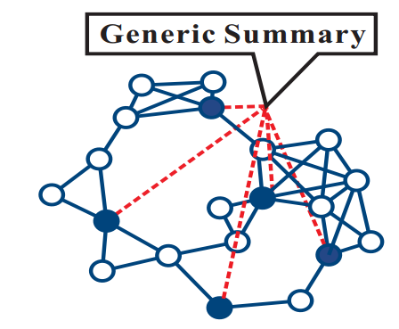
Minimum Weight Dominant Set (MWDS)
What is MWDS ?
A dominant set (DS) of a graph G is a set of vertices such that every vertex either belongs to DS or is adjacent to a vertex in DS.
A minimum dominating set (MDS) is a dominating set with the minimum size.
MDS can be naturally as a summary of the document corpus, since each sentence is either in MDS or connected to vertex in MDS.
v ∈ DS
v ∉ DS
Identifying DS in graph G

Slide 36
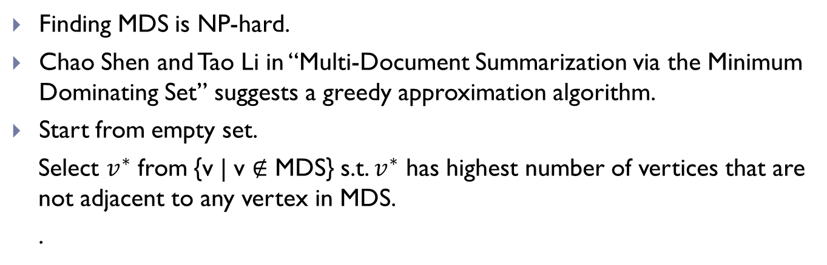
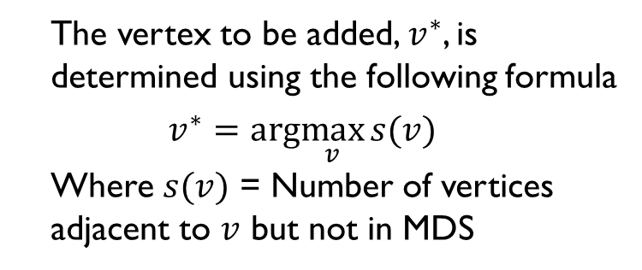
2.3) Minimum Weight Dominant Set (MWDS)
Finding MDS is NP-hard.
Chao Shen and Tao Li in “Multi-Document Summarization via the Minimum Dominating Set” suggests a greedy approximation algorithm.
Start from empty set.
Select $v^{∗}$ from {v | v ∉ MDS} s.t. $v^{∗}$ has highest number of vertices that are not adjacent to any vertex in MDS.
.
The vertex to be added, $v^{∗}$, is determined using the following formula
$$v^{∗}=arg\max_{v}{s(v)}$$
Where $s(v)$ = Number of vertices adjacent to $v$ but not in MDS
v ∈ DS
v ∉ DS
Identifying DS in graph G

Slide 37
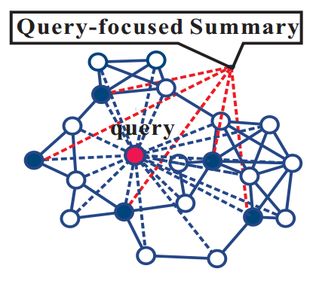
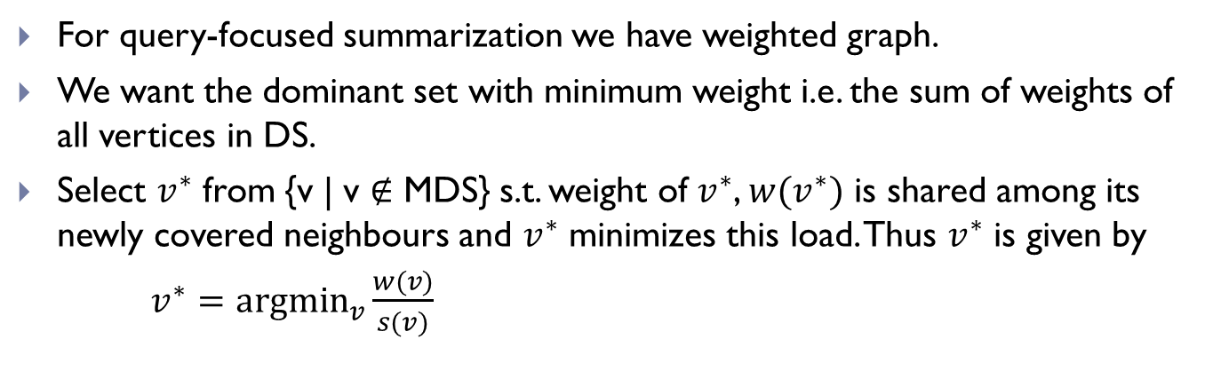
2.3) Minimum Weight Dominant Set (MWDS)
For query-focused summarization we have weighted graph.
We want the dominant set with minimum weight i.e. the sum of weights of all vertices in DS.
Select $v^{∗}$ from {v | v ∉ MDS} s.t. weight of $v^{∗}$, $w(v^{∗})$ is shared among its newly covered neighbours and $v^{∗}$ minimizes this load. Thus $v^{∗}$ is given by
$v^{∗}=\underset{v}{argmin}{\frac{w(v)}{s(v)}}$
v ∈ DS
v ∉ DS
Identifying MWDS in graph G

Slide 38
Storyline Generation
Storyline generating process can be broadly divided into 3 stages -
Extract relevant documents
Document
Selected
Document
Summarization to find event-wise representative sentences
Connecting events to generate storyline

Slide 39
3) Connecting Events to Generate Storyline
We have the representative documents.
Next, connect appropriate documents capturing the temporal and structural information of the documents.
Effective methods of connecting the dots –
Linear Programming (Carlos Guestrin, Dafna Shahaf, “Connecting the dots between news articles”)
Steiner Tree Algorithm (Chen Lin et al., “Generating Event Storylines from Microblogs,”)
Probabilistic Approach (Xianshu Zhu and Tim Oates, “Finding Story Chains in Newswire Articles”)

Slide 40
3.1) Linear Programming
Carlos Guestrin, Dafna Shahaf in “Connecting the dots between news articles” suggested novel idea of coherence of a storyline.
The author defines coherence which is used to develop the objective function. The objective function is used to score a possible chain.
Coherence
D : Set of documents.
W : Set of features (typically words or phrases)
Each article is a subset of W.
Given a chain (d₁, ...,d_{n}) of documents from D, the author has tried different approaches to define coherence.

Slide 41
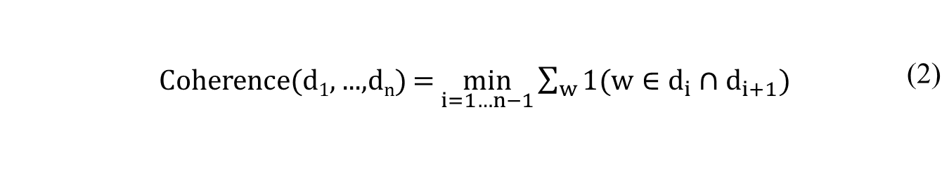
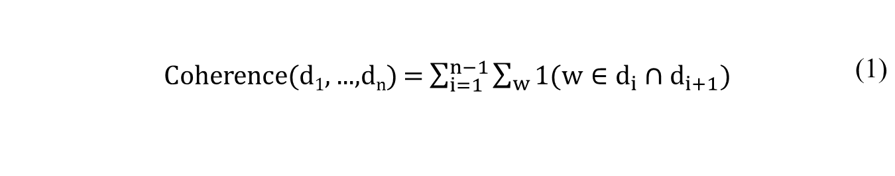
Coherence
An intuitive way to form a coherent chain is that every time a word appears in two consecutive documents we score a point.
Similar documents are placed next to each other.
But it has 4 drawbacks –
Weak links: High coherent chain having strong links and weak links. More reasonable to define chain strength based on weakest link.
 | Coherence(d₁, ...,d_{n}) = $\sum_{i=1}^{n−1}{\sum_{w}{1(w∈d_{i}∩d_{i+1})}}$ | (1)
 | Coherence(d₁, ...,d_{n}) = $\min_{i=1…n−1}{\sum_{w}{1(w∈d_{i}∩d_{i+1})}}$ | (2)

Slide 42
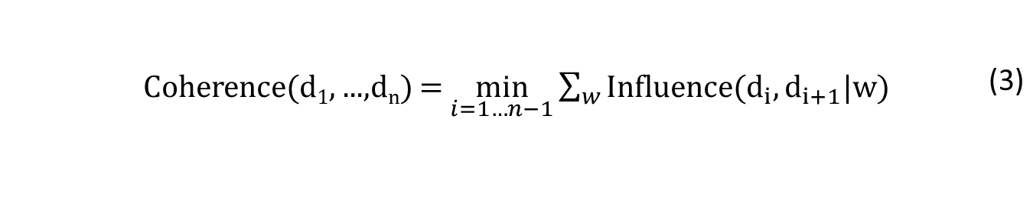
Coherence
Missing Words: Some words do not appear in an article, although they should have.
For example, if a document contains ‘lawyer’ and ‘court’ but not ‘prosecution’, which is highly relevant word.
Considering only words from the article can be misleading in such cases.
Importance: Some words are more important than others. More important words should have more influence on the transition between the two documents.
To address these issues author introduces variable Influence(d_{i},d_{i+1}|w). Influence(d_{i},d_{j}|w) is high if
The two documents are highly connected, and
w is important for the connectivity.
 | Coherence(d₁, ...,d_{n}) = $\min_{i=1…n−1}{\sum_{w}{Influence(d_{i},d_{i+1}|w)}}$ | (3)

Slide 43
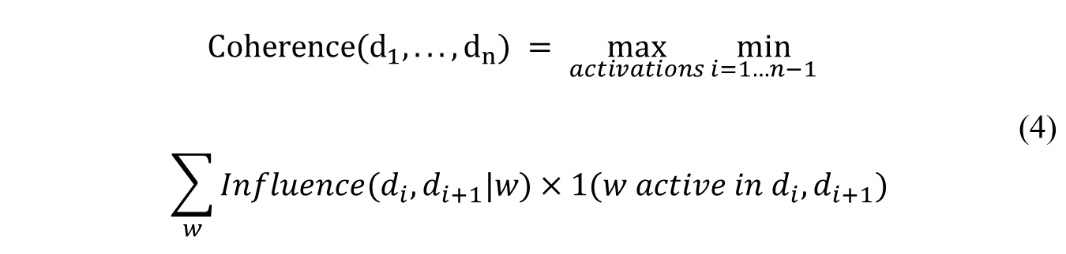
Coherence
Jitteriness: Jitteriness is appearance and disappearance of topics throughout the chain.
One way to avoid jitteriness is to consider the longest continuous stretch of each word. But words can have high influence on a transition even if they do not appear in the documents.
The author defines an activation pattern arbitrarily for each word and compute the objective based on it.
 | $$Coherence(d_{1},...,d_{n}) = \max_{activations}{\min_{i=1…n−1}{}}$$ $$\sum_{w}{Influence(d_{i},d_{i+1}|w)×1(w active in d_{i},d_{i+1})}$$ | (4)
?
Objective Function

Slide 44
Influence
How to calculate influence ?
Consider a bipartite graph G = (V,E), where
V = V_{D} U V_{W}, V_{D} is set of documents, V_{W} is set of words.
w(d_{i}—w_{j}): TF-IDF weights for word-document edge
d_{i} & d_{j} are connected ⇒ A random walk from d_{i} reaches d_{j} frequently.
Documents
Words
d1
w1
d1
w2
d2
w3
d3
d3
w4
A bipartite graph to model word-document relationship

Slide 45
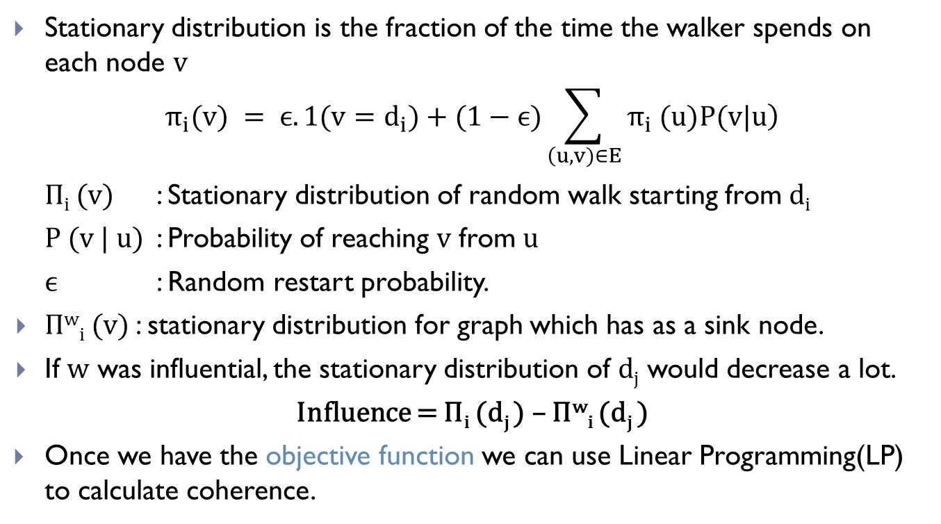
Influence
Stationary distribution is the fraction of the time the walker spends on each node $v$
$$π_{i}(v) = ϵ. 1(v=d_{i})+(1−ϵ)\sum_{\left(u,v)∈E\right.}{\left. π_{i} (u)P(v|u\right)}$$
Π_{i} (v) : Stationary distribution of random walk starting from d_{i}
P (v | u) : Probability of reaching v from u
ϵ : Random restart probability.
Π^{w}_{i} (v) : stationary distribution for graph which has as a sink node.
If w was influential, the stationary distribution of d_{j} would decrease a lot.
Influence = Π_{i} (d_{j} ) – Π^{w}_{i} (d_{j} )
Once we have the objective function we can use Linear Programming(LP) to calculate coherence.

Slide 46
3.2) Steiner Tree Algorithm(ST)
Chen Lin et al. in “Generating Event Storylines from Microblogs” have used Steiner Tree Algorithm to generate storylines from tweets.
Input: Set of relevant tweets/sentences
Multi-View Tweet Graph G = (V,W,E,A)
ST Algorithm
Steiner Tree
(Storyline)
Relevant Tweets/Sentences
Generating Storyline from tweets/sentences
Steiner Tree
Steiner tree of a graph G with respect to a vertex subset S(terminals), is the edge-induced subtree of G that contains all the vertices of S having the minimum total cost i.e. the minimum total weight of the vertices.
In our problem, as input we also given a root q ∈ S, from which every vertex of S is reachable in G.

Slide 47
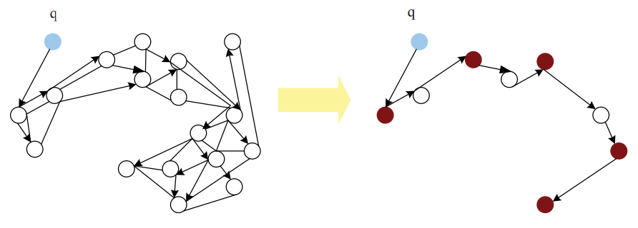
3.2) Steiner Tree Algorithm(ST)
q
q
Terminal Node
Non-terminal Node
Forming a Steiner Tree
Finding Steiner Tree is an NP-hard problem.
Charikar and Chekuri in “Approximation Algorithms for Directed Steiner Problems” proposed an approximation algorithm for generating a Steiner Tree.

Slide 48
3.2) Steiner Tree Algorithm(ST)
Input:
Vertex-weighted directed graph G = (V,W,A)
Level parameter i ≥ 1
The required number of nodes to cover in S, k
Terminal set, S
Root, q
i=1 : selects k vertices in S that are closest to root and returns the union of the shortest paths
A_{i}(k, v₀,S)
T ← ϕ
while k >0 do
T_{best} ← ϕ
cost(T_{best}) ← ∞
for v ∈ V, (v₀, v) ∈ A, 1 ≤ k' ≤ k do
T’ ← A_{i-1}(k',v,S) ∪ {(v₀, v)}
if cost(T_{best}) > cost(T') then
T_{best} ← T'
T ← T ∪ T_{best}
k ← k - || S ∩ T_{best} ||
S ← S \ V(T_{best})
Initialize
For each adjacent vertex of v₀
Recursively call Ai
T_{best} stores min cost tree root at v₀

Slide 49
3.3) Probabilistic Approach
Xianshu Zhu and Tim Oates in “Finding Story Chains in Newswire Articles” models the storyline generating problem as a divide and conquer bisecting search problem.
Input-
Set of documents with their timestamps
s : Start document
t : End document
Initial storyline contains only one link: s-t
Insert an optimum node (A). Now there are 2 sub-links: s-A and t-A
Recursively add new nodes to the new sub-links.
How to find the optimum node (A) ?

Slide 50
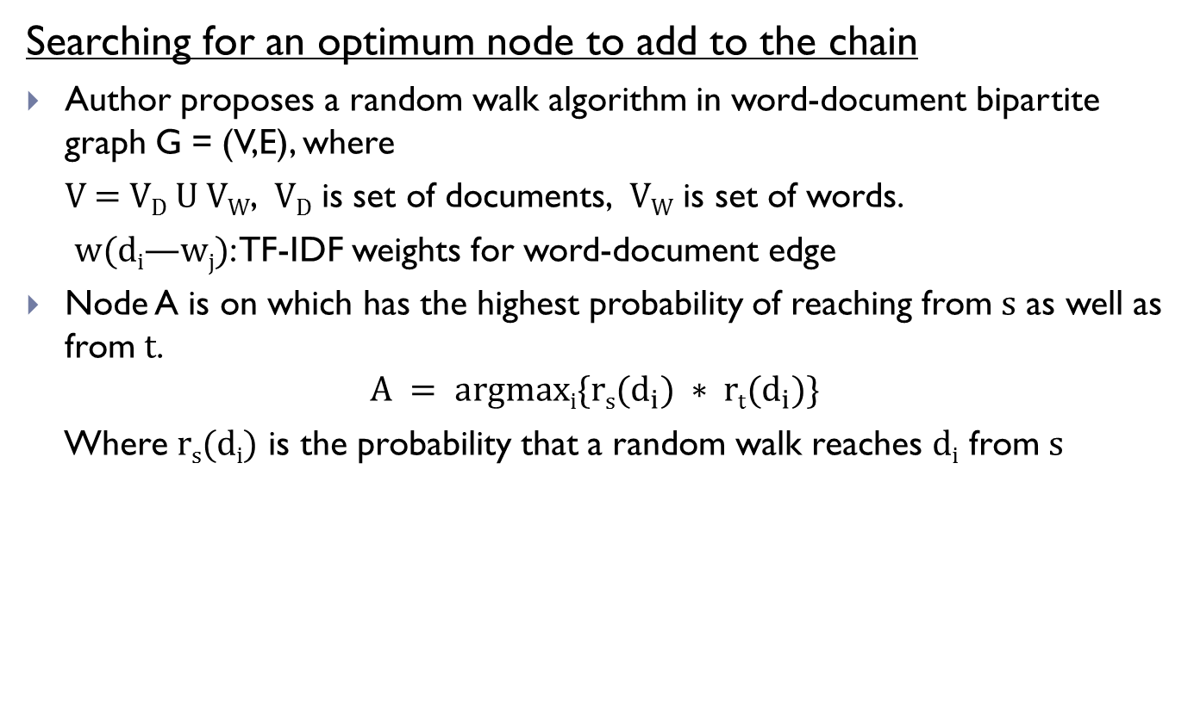
3.3) Probabilistic Approach
Searching for an optimum node to add to the chain
Author proposes a random walk algorithm in word-document bipartite graph G = (V,E), where
V = V_{D} U V_{W}, V_{D} is set of documents, V_{W} is set of words.
w(d_{i}—w_{j}): TF-IDF weights for word-document edge
Node A is on which has the highest probability of reaching from s as well as from t.
$$A = argmaxi\{rs(d_{i}) ∗ rt(d_{i})\}$$
Where r_{s}(d_{i}) is the probability that a random walk reaches d_{i} from s
A
A
s
t
s
A''
t
A'
Adding Optimum Node ‘A’ to the Storyline

Slide 51
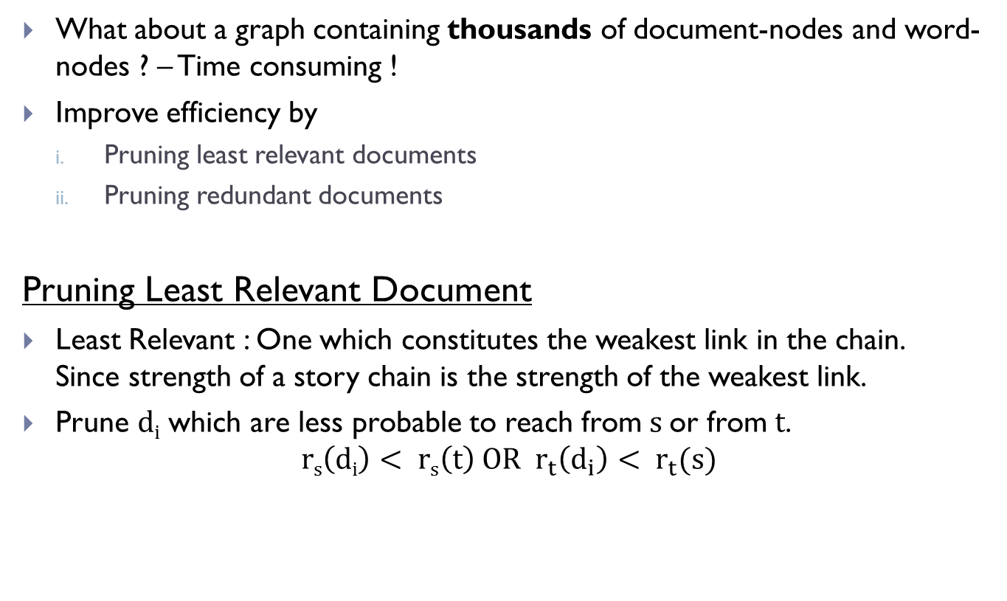
3.3) Probabilistic Approach
What about a graph containing thousands of document-nodes and word-nodes ? – Time consuming !
Improve efficiency by
Pruning least relevant documents
Pruning redundant documents
Pruning Least Relevant Document
Least Relevant : One which constitutes the weakest link in the chain. Since strength of a story chain is the strength of the weakest link.
Prune d_{i} which are less probable to reach from s or from t.
$$rs\left(di\right)< rs\left(t\right) OR r_{t}\left(d_{i}\right)< r_{t}(s)$$

Slide 52
3.3) Probabilistic Approach
Prune Redundant Article
Remove redundant articles but don’t remove similar articles with different timestamps. Eg. News about 2 different Cricket World Cups are not redundant..
Add time nodes to word-document bipartite graph.
Influence of time nodes
Time
α
Documents
1 - α
Words
t1
d1
w1
More likely to reach articles that are in the same bin and close in content
w2
t2
d2
w3
t3
d3
w4
A tripartite graph to solve redundancy problem

Slide 53
Conclusion
Information Overload
Summarization
Better representation technique
Reveals latent relationships
Topic Detection & Tracking
Storyline Generation
Better understanding of underlying structure
Portrays causal dependencies

Slide 54
Generating Storylines
Thank You !!
Q & A

