Slide 1
SuperMart Ecommerce Application use Case

Slide 2
Use Case:
SuperMart Ecommerce Application incurs cost whenever Customer places an order and cancels it
later point of time. In order to find the reason for this Customer behavior, SuperMart conducted
the Survey. Based on the Survey results, it is identified that there are two major issues while
placing an order on SuperMart's Website.

Slide 3
Use Case:........
Customer adds item to the Cart and logs off from the Session. After 2 days when customer remembers about the order and adds the item to the cart forgetting that same item is ordered before.
Customer places a order successfully with a list of items and order is in processing state. After few days Customer accidentally places the same order

Slide 4
Requirment:
In order to resolve this issue, SuperMart requires an application feature to identify the possible duplicate order from Customer's existing shopping cart or from purchase history and provide warning.
If there was exact match of the item from the cart or from purchase history, then application need to provide sufficient information like Order Date, Quantity to confirm their order details are valid.

Slide 5
Requirment........
Design High Level Real-time Big Data Analytics to implement the Order Duplication Identification and issue alerts. Please mention the list of technologies, tools which will be used for this application and significance of why this tool is selected over other frameworks/tools. Also design the data model to store the Order History of the Customer. Write code to store the Order details and read the Order History details for each new order when there is duplicate order is placed by the Customer

Slide 6
Requirment........
Assume each add/change event to the cart is sent as a message to the Application Backend.
Write code to receive these messages and persist it if needed as per your design. Lookup Order
History or Cart History to identify any duplicate item in the cart. This action should happen if the time difference between 2 events is greater than 4 hours for cart add/change event.
In case of new order event, it should compared with the last 5 Order History and alert if duplicate item found. Also choose appropriate topic name for each event in the Customer Order Journey in alignment to the Design.

Slide 7
Expected Solution Artifacts
High Level Design how data ingestion implemented
Choice of technologies and tools
Data Model Design to store and retrieve Purchase History or active Cart Details
Topic Names
Sample code to consume the events from Topic and persist in No-SQL Database
Sample Code to retrieve the Purchase History or Active Cart Details to validate with Current Order
Details

Slide 8
Assumption:
GUI Application – Out of Scope
Producer API to write into Kafka Topic
Assuming the alert message is part of response from API

Slide 9
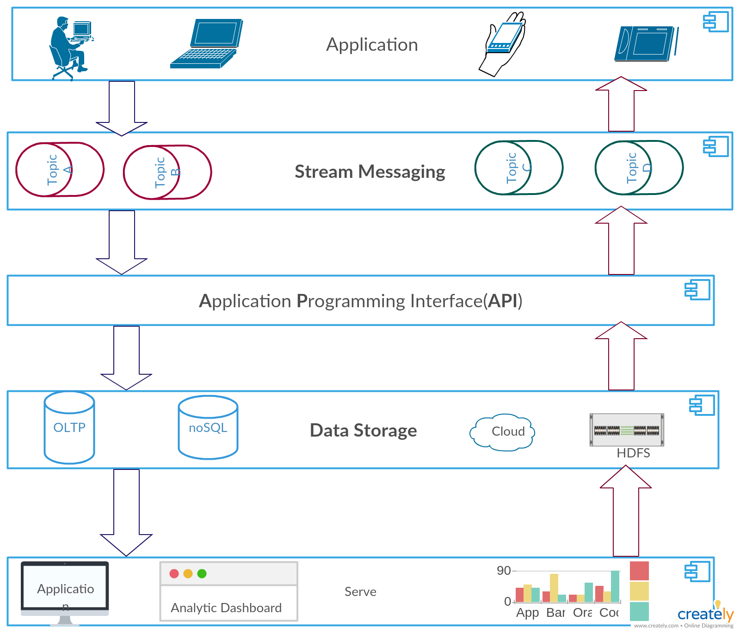
Design Diagram

Slide 10
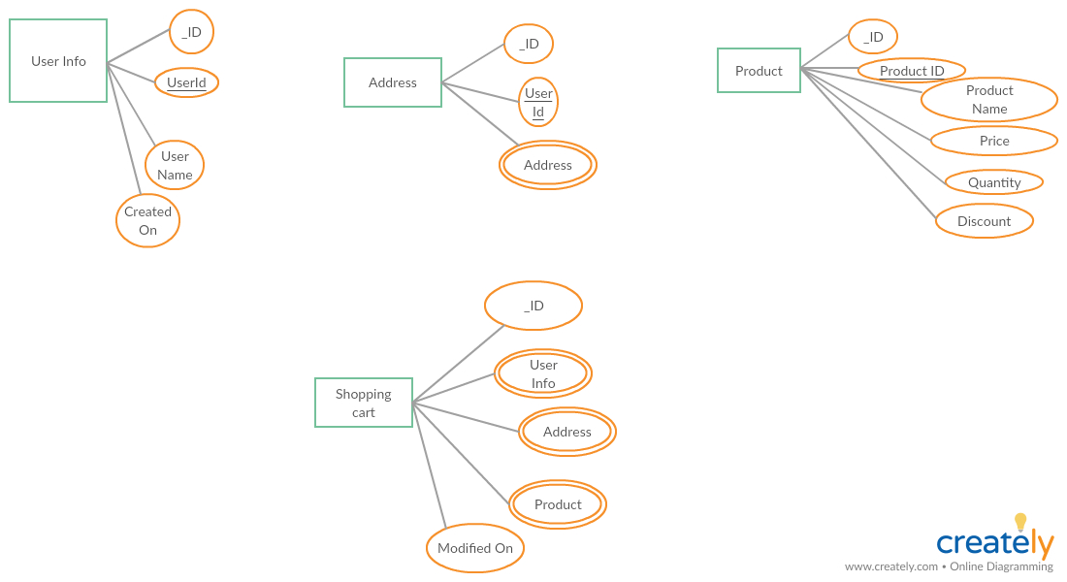
Data Model : Shopping Cart

Slide 11
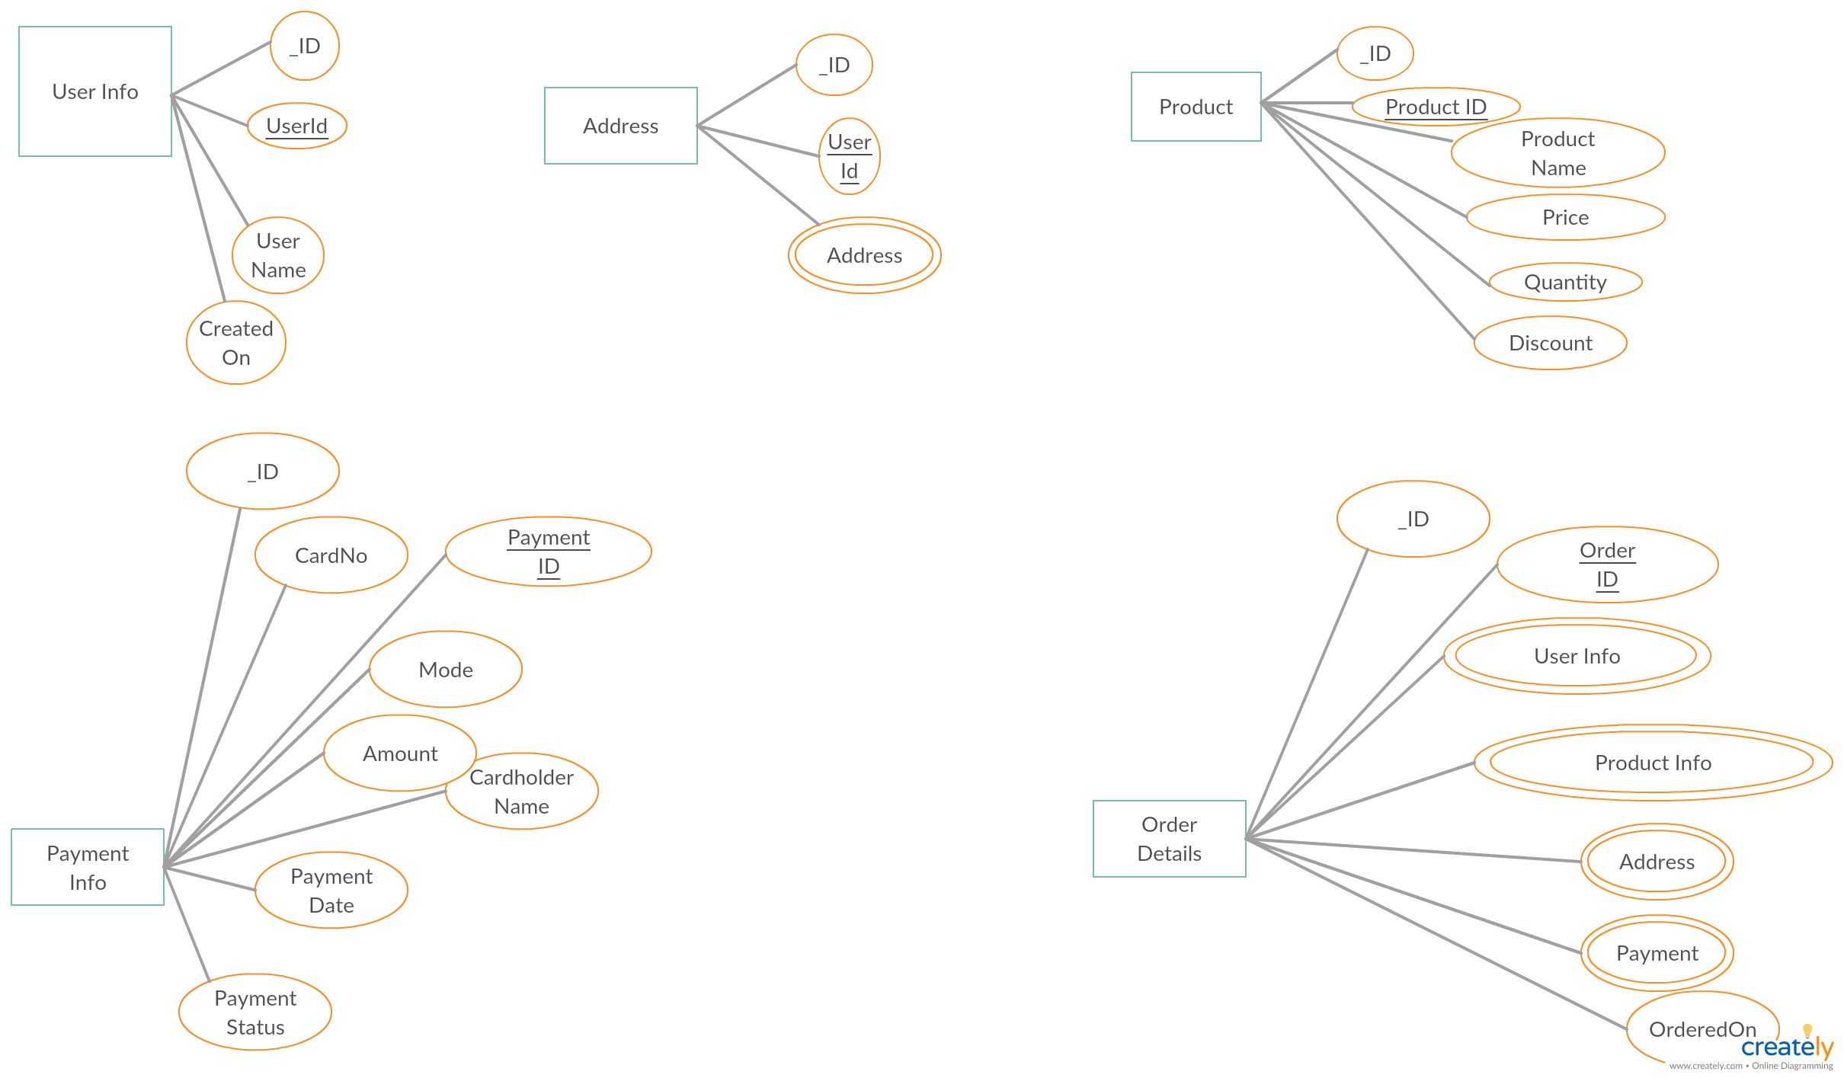
Data Model : Order Info

Slide 12
Technology Used
Stream Messaging:
  Apache kafka_2.12-1.1.0
Programming Language
  Python 3.6
NoSQL DB
  MongoDB 3.6.7
Python Packages
  Flask
  Pymongo
  Kafka
  Json
Postman

Slide 13
Git Repository:
https://github.com/anunaykr/supermart

