Slide 1
Develop a Strategic Plan for Intelligent Application Security
Plan for an intelligent SSDLC to build smarter, faster, and more resilient solutions.

Slide 2

Analyst perspective
With the rise of emerging technologies and increased attacks on applications, traditional secure software development lifecycles (SSDLCs) are no longer sufficient to safeguard applications. Conventional approaches are often rigid, heavily manual, and misaligned with the pace of digital innovation, leading to inconsistent controls and security debt across the software supply chain.
The solution is to rethink application security through a capabilities-driven lens that aligns to real-world business priorities and emerging threat realities.
By conducting a structured capabilities assessment, organizations can identify maturity gaps, align security to key SDLC phases, and prioritize improvements based on the highest business value and risk mitigation. The introduction of an intelligent, risk-aligned maturity model — backed by metrics and executive-level insights — enables security leaders to evolve AppSec practices without hindering innovation.
Building a scalable and adaptive application security program through an intelligent approach positions security as a business enabler. It strengthens foundational practices, increases development velocity, and ensures resilience across modern development pipelines — empowering organizations to deliver securely, at scale.
Confidently deliver your solutions through intelligent secure software.
Ahmad Jowhar Research Analyst, Security & Privacy Practice Info-Tech Research Group

Slide 3
Executive summary
Your Challenge
Common Obstacles
Info-Tech’s Approach
Emerging trends in application development pose new challenges for cybersecurity:
Generative AI coding accelerates development, stressing manual security reviews.
The need for new agentic AI applications creates a need for new security oversight.
Attack surfaces are increasingly shifting to applications and APIs, creating new threats and evolving attack vectors.
Conventional secure software development lifecycles fail to deliver on their promises. Rooted in waterfall bureaucracy, their inflexibility inevitably leads to decay.
Lack of a prioritization process exacerbates the challenges of effectively addressing and mitigating application-based vulnerabilities.
Integrating security, application, and operations teams remains a significant challenge for many organizations.
Autonomous code development requires autonomous security capabilities, delivered as part of an intelligent secure software development lifecycle (iSSDLC).
Leverage a best-of-breed capabilities assessment to evaluate the maturity of your application security practices.
Develop a structured roadmap with defined roles and responsibilities for achieving your desired application security maturity state.
Info-Tech Insight
Shift security from a roadblock to a growth accelerant. Intelligent, adaptive security capabilities — aligned to enable top business opportunities and mitigate the most critical threats — unlock the full speed and value of modern application delivery.

Slide 4
Challenge
80%
Poor application security practices expand an organization’s threat landscape.
80% of top breaches were related to application attack surfaces.
The rise of emerging technologies is driving the need to develop applications more efficiently and at greater scale, straining traditional development processes.
As applications and APIs become fundamental to digital services, they represent a growing portion of the threat landscape, making them key targets for attackers.
Traditional security practices struggle to keep up with modern application development and its associated threats, highlighting the need for more adaptive and application-focused security strategies.
As the urgency to leverage emerging technologies increases, unresolved vulnerabilities and ad hoc security practices accumulate, creating a growing backlog that threatens long-term resilience for organizations.
Source: “2024 State of Application Security Report”, CrowdStrike, 2024
92%
92% of organizations had a breach due to an application they developed.
49%
Source: “The Future of Application Security 2024,” Checkmarx, 2024
There was a 49% year-over-year increase in web application attacks from 2023 to 2024.
Source: “Application Security Report 2024,” Akamai, 2025

Slide 5
Common obstacles
Organizations lack guidance to mature their application security program.
30%
Current application security guidelines often fail to offer a clear, phased approach for evaluating and maturing secure coding practices across the development lifecycle.
Without a risk-based prioritization model that encompasses business opportunities and security threats, teams struggle to focus on vulnerabilities that pose the greatest threat, leading to inefficient mitigation efforts.
Security, development, and delivery teams frequently operate in silos, making it difficult to embed secure coding practices consistently across workflows.
Organizations may adopt security tools without aligning them to existing pipelines or developer workflows, resulting in poor adoption and inconsistent coverage.
Only 30% of organizations have a mature DevSecOps program.
Source: “DevSecOps Evolution,” Checkmarx, 2025
54%
Only 54% of major code changes go through full security reviews.
Source: “2024 State of Application Security Report”, CrowdStrike, 2024

Slide 6
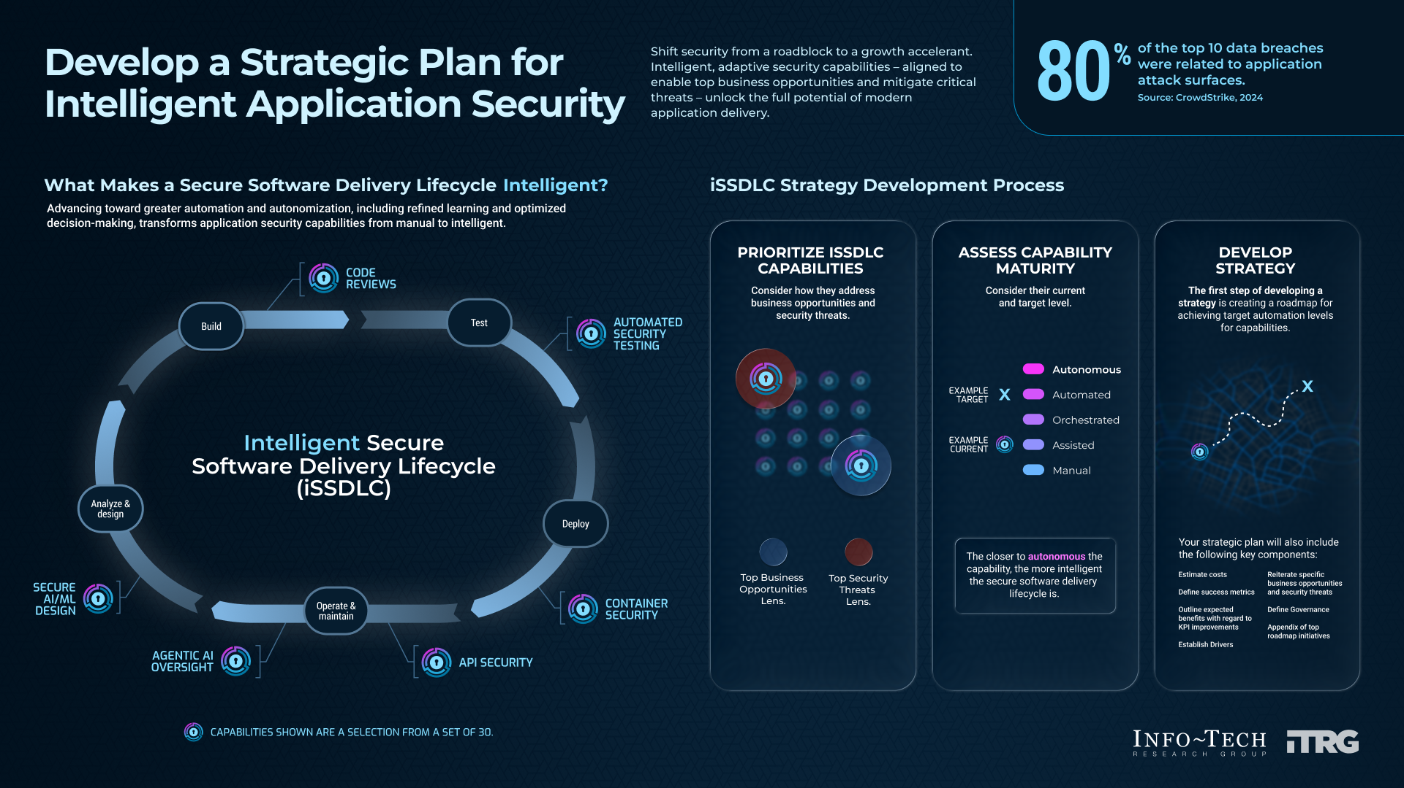

Slide 7
Info-Tech’s methodology for modernizing your application security services
 | 1. Prioritize iSSDLC capabilities. | 2. Assess maturity. | 3. Develop a strategic plan​.
Phase steps | Identify business and security requirements. Identify goals. Establish metrics. Assign roles and responsibilities. | Assess current application security state. Determine target state. | Develop and prioritize initiatives. Develop roadmap. Develop strategy deck.
Phase outcomes | Security requirements defined Business opportunities defined Security threats identified Metrics established Governance established | Current state assessed Target state determined | Initiatives developed and prioritized Roadmap developed

Slide 8
Insight summary
Remove the security roadblocks.
Shift security from a roadblock to a growth accelerant. Intelligent, adaptive security capabilities — aligned to enable top business opportunities and mitigate the most critical threats — unlock the full speed and value of modern application delivery.
Cross-functional collaboration drives security success.
Effective application security demands more than tools — it requires a shared ownership that aligns security, development, and operations teams to ensure secure practices are embedded early, which will enable faster delivery and reduce risks.
High-impact investments derive from capability gaps.
Assessment of your security capabilities exposes gaps in critical areas such as CI/CD security and software supply chain integrity, which enables organizations to prioritize efforts.
Secure development is not only a technical function.
Security must be integrated into an SDLC from architecture to operations. It must contain a structured process that supports governance, accountability, and culture.
Balance automation with expertise.
Although automation accelerates scale, other capabilities thrive on human expertise and context, which promotes a balanced approach to combine intelligence tooling with strategic human oversight.
Empower developers to build securely from the start.
Security shouldn’t slow down development but rather streamline it with clear guidelines and embedded controls.

Slide 9

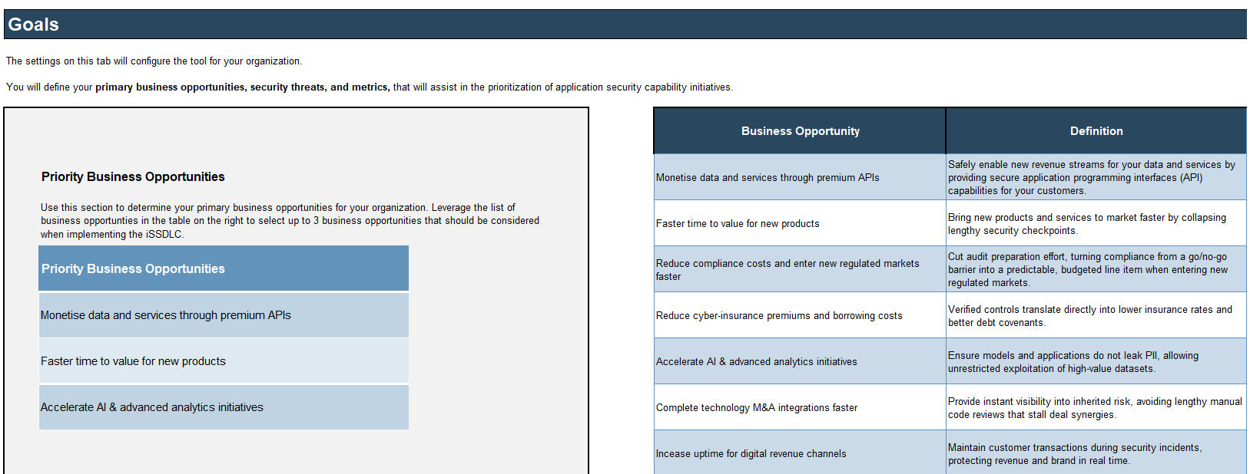

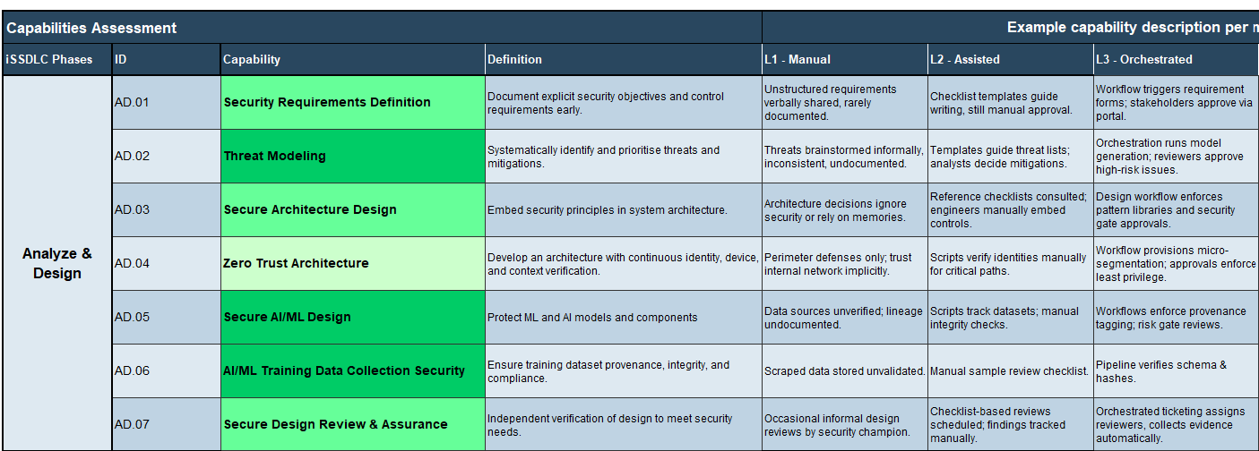
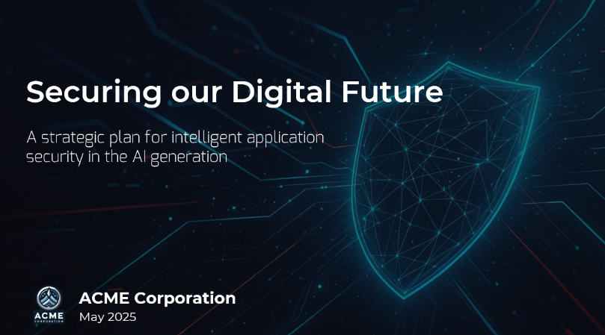
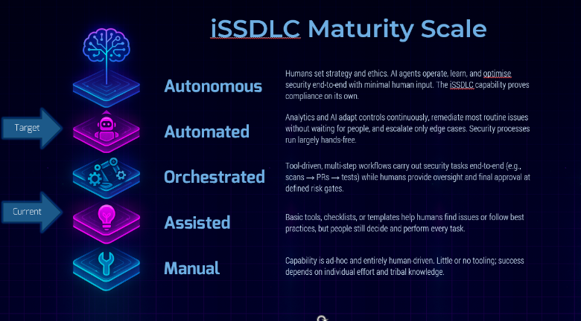
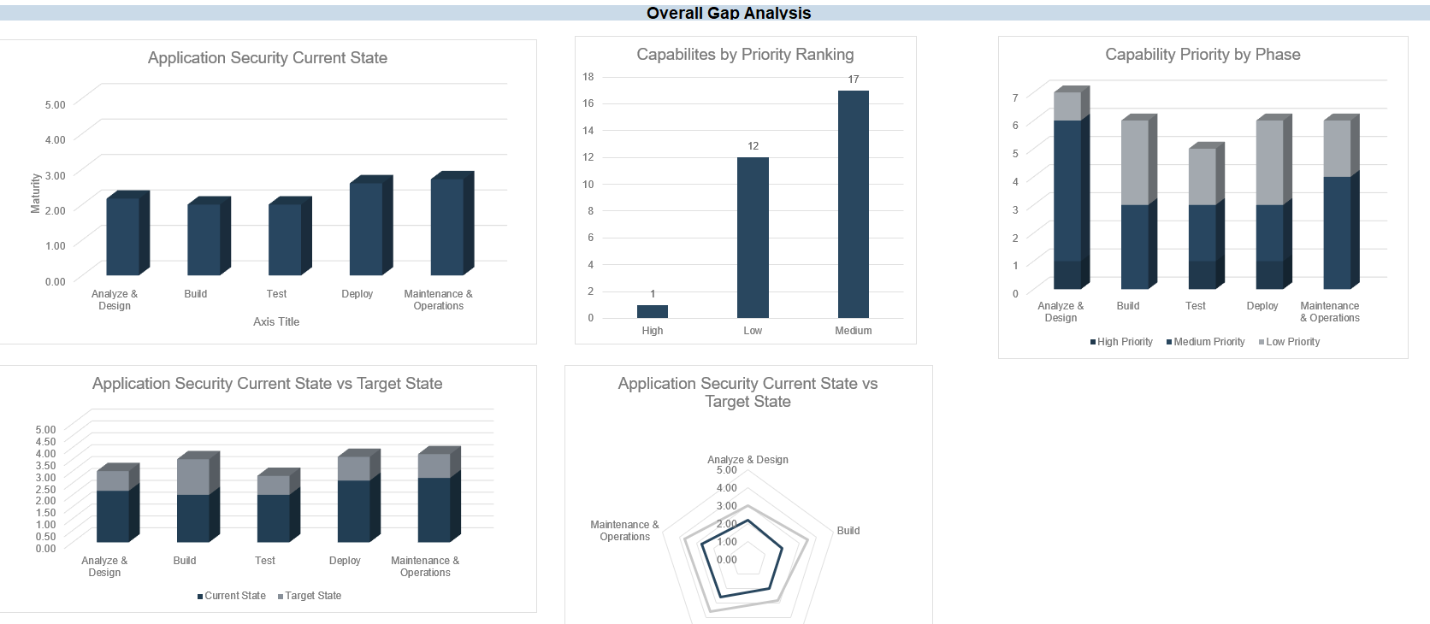
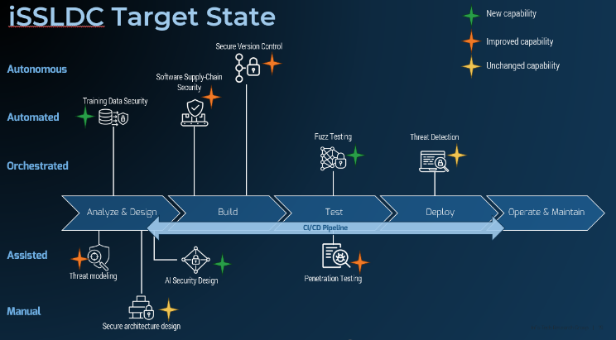
Blueprint deliverables
Key deliverables:
Each step of this blueprint is accompanied by supporting deliverables to help you accomplish your goals:
iSSDLC Strategy Deck
Communication deck to present your iSSDLC strategy to key stakeholders to obtain buy-in and support for your application security improvement plan
iSSDLC Capabilities Assessment Tool
Assessment tool to develop your application security improvement plan

Slide 10
Blueprint benefits
IT Benefits | Business Benefits
Enhanced adoption of DevSecOps, which provides smoother integration of security into development workflows through a maturity-guided improvement plan. Improved visibility of an organization's security risks and gaps across the SDLC, which promotes proactive threat mitigation and enables targeted remediation efforts. Accelerated adoption of application security tools and strengthened organizational readiness for AI-driven development initiatives. | Reduced cost and downtime in application security incidents through the strengthening of foundational controls, which minimizes breach likelihood. Improved time to market of solutions through the embedding of scalable and automated security practices that are aligned to business-critical capabilities. Increased stakeholder confidence and regulatory readiness through the demonstration of a proactive and measurable approach to secure applications.

Slide 11
Info-Tech offers various levels of support to best suit your needs
Guided Implementation
DIY Toolkit
Workshop
Consulting
“Our team has already made this critical project a priority, and we have the time and capability, but some guidance along the way would be helpful.”
“Our team knows that we need to fix a process, but we need assistance to determine where to focus. Some check-ins along the way would help keep us on track.”
“We need to hit the ground running and get this project kicked off immediately. Our team has the ability to take this over once we get a framework and strategy in place.”
“Our team does not have the time or the knowledge to take this project on. We need assistance through the entirety of this project.”
Diagnostics and consistent frameworks are used throughout all four options.

Slide 12

Guided Implementation
A Guided Implementation (GI) is a series
of calls with an Info-Tech analyst to help implement our best practices in your organization.
A typical GI is 6 to 12 calls over the course of 4 to 6 months.
What does a typical GI on this topic look like?
Phase 1
Phase 2
Phase 3
Call #1: Identify requirements and goals.
Call #3:
Conduct capabilities assessment to determine current state.
Call #5: Develop and prioritize initiatives.
Call #2:
Review pain points and policies and establish metrics.
Call #6:
Finalize roadmap, develop metrics, and complete strategy deck.
Call #4:
Finalize capabilities assessment to determine target state.
Info-Tech Research Group | 12

Slide 13
Workshop overview
Contact your account representative for more information. workshops@infotech.com 1-888-670-8889
 | Day 1 | Day 2 | Day 3 | Day 4 | Day 5
 | Prioritize iSSDLC capabilities. | Assess application security maturity. | Develop initiatives. | Finalize strategy. | Complete next steps and wrap-up (offsite).
Activities | 1.1 Identify business opportunities. 1.2​ Identify security threats. 1.3 Identify compliance requirements. 1.4 Review pain points and existing policies. 1.5 Review and establish metrics. | 2.1 Review capability prioritization. 2.2 Assess current state. 2.3 Determine target state. 2.4 Assign roles and responsibilities. | 3.1 Develop gap closure action initiatives. 3.2 Conduct cost-benefit analysis to prioritize initiatives. 3.3 Develop one-pagers for high-priority initiatives. | 4.1 Finalize prioritization of initiatives. 4.2 Develop roadmap. 4.3 Develop strategy deck. | 5.1 Finalize deliverables. 5.2 Review implementation strategy and communications as required.
Deliverables | iSSDLC Capabilities Assessment Tool iSSDLC Strategic Plan Template | iSSDLC Capabilities Assessment Tool | iSSDLC Capabilities Assessment Tool iSSDLC Strategic Plan Template | iSSDLC Capabilities Assessment Tool iSSDLC Strategic Plan Template | Final deliverables

Slide 14
Measure the value of this blueprint
The value of this research can be measured by considering key application security metrics, as identified in step 1.3. These metrics should improve after implementation of the research, with examples shown to the right. Potential metrics can include:
Security metrics
Mean time to remediate (MTTR) critical vulnerabilities
Percentage of third-party components without known vulnerabilities
Credential stuffing detection rate
Security coverage in CI/CD pipeline
Time to patch zero-day vulnerabilities
Percentage of APIs with business logic testing
Data exposure events from AI workloads
Quantum resilience readiness
Insider threat detections

Slide 15
Case study
INDUSTRY
SOURCE
Reducing risk, improving visibility, and empowering developers with a modernized secure coding practice.
Banking
“Case Study: How Escape enhanced Shine's application security”, Escape, 2024
Challenge
Solution
Results
Shine, an online banking subsidiary of one of the leading financial services groups in Europe, Société Générale, faced challenges handling escalating application security threats. This included a lack of visibility in identifying all exposed APIs, limited ability in assessing the associated security risks of APIs, inefficient remediation process within the SDLC, and the challenge of meeting stringent security standards. This left Shine’s application security in a reactive state that lacked a unified, proactive security practice within the SDLC.
To address the various challenges, Shine implemented an AI-driven secure SDLC platform that will integrate into their development pipeline. A modern DAST solution was implemented, which included such innovative features as:
Automated API discovery
Continuous vulnerability scanning
CI/CD integration
Developer-friendly remediation
GraphQL security support
These capabilities will become the pillar of modernizing Shine’s DevSecOps practice.
Shine’s application security modernization efforts through advanced secure SDLC resulted in improvements to their security, risk mitigation, and development efficiency. Achieving full visibility into their API and attack surface controls helped prioritize initiatives to protect their assets. Continuous scanning and AI-driven analysis enable Shine’s security team to quickly assess and address emerging vulnerabilities and threats. Overall, Shine’s embrace of automation and collaboration transformed its application security while supporting innovation across the organization.

Slide 16
Phase 1
This phase will walk you through the following activities:
1.1 Identify business and security requirements.
1.2 Identify goals.
1.3 Establish metrics.
1.4 Assign roles and responsibilities.
Outcome:
Defined security requirements
Defined priority business opportunity and security threats
Established metrics
Established governance
This phase involves the following participants:
Information security
Application/delivery managers
Business
Prioritize iSSDLC Capabilities
Phase 1
Phase 2
Phase 3
1.1 Identify business and security requirements.
1.2 Identify goals.
1.3 Establish metrics.
1.4 Assign roles and responsibilities.
2.1 Assess current application security state.
2.2 Determine target state.
3.1 Develop and prioritize initiatives.
3.2 Develop roadmap.
3.3 Develop strategy deck.
Develop a strategic plan for intelligent application security.

Slide 17

1.1 Define requirements for application security
Input | Output
Brainstorm stakeholders Regulations Customer contracts | Identified requirements​
Materials | Participants
Whiteboard Capabilities Assessment Tool | Information security Business Privacy Compliance
30 minutes
Gather the required participants and use the Capabilities Assessment Tool to configure the tool within the following categories:
Initiative cost estimation: estimated ranges for initial and ongoing cost and staffing hours.
Security initiative benefit: categorization of alignment to business and security benefits.
FTE equivalent and roadmap start year: full-time equivalent hours defined by your organization, along with the estimated start year for your iSSDLC roadmap.
The following slides provide more information on this step.
Download the Capabilities Assessment Tool
Info-Tech Research Group | 17

Slide 18
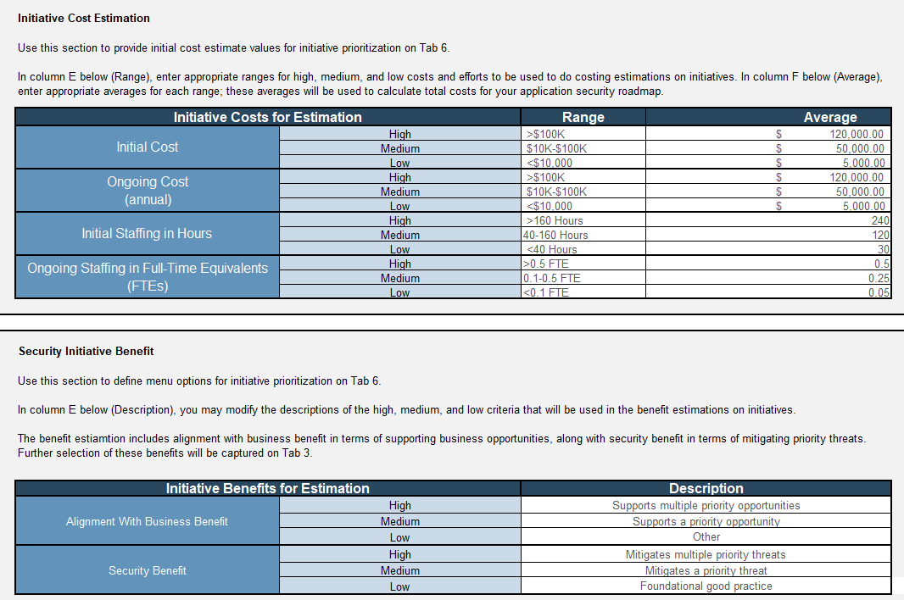
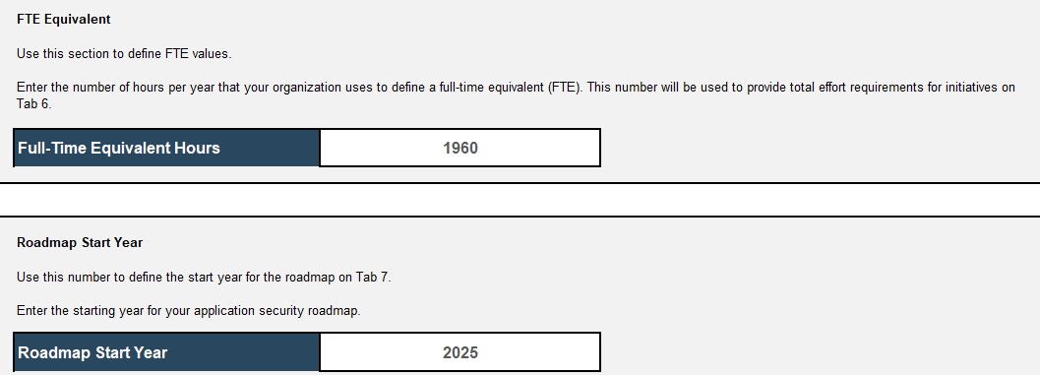
Define requirements
In Tab 2 of the iSSDLC Capabilities Assessment Tool, configure the tool for your organization by estimating the initial and ongoing cost, the staffing hours, the security benefits of the initiative, and the estimated year to commence the roadmap.
In cells E9:E20, define the ranges for your initial and ongoing cost and staffing hours.
In cells F26:F28, define your ranges for alignment with business benefit in terms of supporting business opportunities.
In cells F29:F31, define the ranges for the security benefits of your roadmap in terms of mitigating priority threats.
In cell D36, enter the number of hours per year used to define a full-time equivalent (FTE).
In cell D42, enter the starting year for your application security roadmap.
Info-Tech Research Group | 18

Slide 19
1.2 Define goals for the iSSDLC​
Input | Output
Brainstorm stakeholders Regulations Customer contracts | Identified requirements​
Materials | Participants
Whiteboard iSSDLC Capabilities Assessment Tool | Information security Business Privacy Compliance
60 minutes
Gather the required participants and leverage the iSSDLC Capabilities Assessment Tool to capture the following application security goals.
Business opportunities: Develop strategic enterprise goals that can be supported by improvements to the organization’s application security program.
Security threats: List highest priority security threats that can be mitigated through improvements to the organization’s application security program.
Application security metrics: KPIs measure the effectiveness of initiatives and alignment with business opportunities and security threats.
The following slides provide more information on this step.
Download the iSSDLC Capabilities Assessment Tool
Info-Tech Research Group | 19

Slide 20

1.2.1 Identify business opportunities​
Improving an organization’s application security program should focus not only on the technical components but also on the business impact and its alignment to the enterprise goals.
Identifying business opportunities that could be supported through an application security strategy will demonstrate strategic alignment and ROI to executives.
Business opportunities help influence prioritization of security capabilities.
Application security capabilities can support multiple business opportunities, which shows greater alignment with the business.
Info-Tech Insight
Business-aligned security enables speed without foregoing trust. By focusing on what drives business goals, organizations can innovate securely and confidently.
Info-Tech Research Group | 20

Slide 21
Examples of business opportunities​
Below are examples of business opportunities and their relation to application security capabilities.
Business opportunity | Definition
Monetize data and services through premium APIs. | Safely enable new revenue streams for your data and services by providing secure application programming interface (API) capabilities for your customers.
Faster time to value for new products. | Bring new products and services to market faster by collapsing lengthy security checkpoints.
Reduce compliance costs and enter new regulated markets faster. | Cut audit preparation effort, turning compliance from a go/no‑go barrier into a predictable, budgeted line item when entering new regulated markets.
Reduce cyberinsurance premiums and borrowing costs. | Verified controls translate directly into lower insurance rates and better debt covenants.
Accelerate AI and advanced analytics initiatives. | Ensure models and applications do not leak personally identifiable information (PII), allowing unrestricted exploitation of high‑value data sets.
Complete technology M&A integrations faster. | Provide instant visibility into inherited risk, avoiding lengthy manual code reviews that stall deal synergies.
Increase uptime for digital revenue channels. | Maintain customer transactions during security incidents, protecting revenue and brand in real time.
Scale partner ecosystems without expanding the attack surface. | Add partners rapidly while keeping every integration compartmentalized and auditable.
Strengthen brand loyalty and customer trust. | Build digital trust by safeguarding customer journeys that shape digital experience and perception.
Info-Tech Research Group | 21

Slide 22
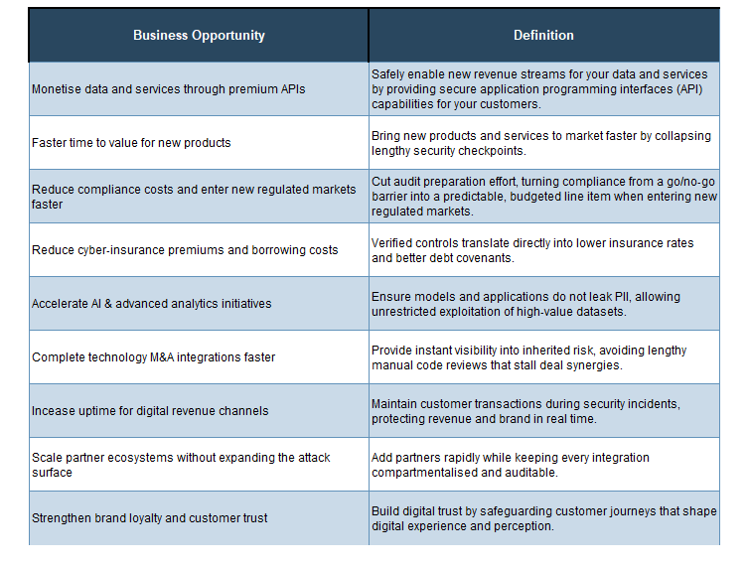
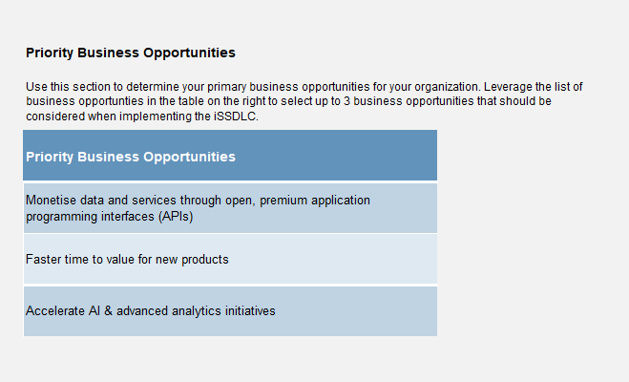
Select business opportunities​
In the iSSDLC Capabilities Assessment tool, select the Goals tab (Tab 3) to view the list of business opportunities in cells G6:H14.
In cells C9:C11, select your three top-priority business opportunities. Consider some of the following factors to assist in selecting your top business opportunities:
Strategic alignment with business objectives.
Urgency and timing of business opportunity.
Potential ROI and impact across multiple priorities.
Download the iSSDLC Capabilities Assessment Tool
Info-Tech Research Group | 22

Slide 23

1.2.2 Identify security threats
Prioritizing the right capabilities to address begins with not only understanding the potential business opportunities but also recognizing the most pressing threats that can be mitigated.
Security threats are business risks shown in a technical form, which could affect the organization’s reputation, revenue, and customer trust. Focusing on security threats that can be mitigated by business-aligned capabilities will increase executive buy-in and support.
By framing threats at an executive level in terms of business outcomes, driving capability improvement plans becomes a strategic roadmap, not just technical.
Info-Tech Insight
Security threats define urgency. Knowing which attack vectors would cause the most impact to your business will help in prioritizing your capabilities initiatives.
Info-Tech Research Group | 23

Slide 24
Security threats
Below is a list of security threats along with their importance from an executive level.
Security threat | Importance
Software supply chain compromise | Reduce risk of business impacts due to compromised software supply chains.
Mass credential stuffing and account takeover | Protect the company’s revenue channels and brand trust by preventing fraudulent transactions.
Business logic abuse through exposed APIs | Turn APIs from a liability into a controlled asset, preserving digital revenues and preventing competitor access to your data.
Ransomware beachhead via vulnerable web apps | Shrink attack window from weeks to hours, denying cybercriminals the foothold they need to disrupt revenue‑producing systems.
Prolonged service outage due to zero-day attacks | Keep critical digital services online even when patching is impossible, preserving daily revenue and market confidence.
Sensitive data leakage in AI‑enabled apps | Enable aggressive AI adoption without triggering privacy fines or IP loss, safeguarding future growth bets.
Insider misuse or privileged‑user abuse of critical functions | Turn insider risk into a detectable, auditable event, limiting impact and demonstrating diligence to shareholders.
Quantum computing rendering legacy encryption obsolete | Safeguard crown jewel data when current generation encryption fails under attack by quantum computers.
Nation state attack on critical infrastructure via sleeper accounts | Protect critical infrastructure from advanced persistent threats using long-term account compromise.
Info-Tech Research Group | 24

Slide 25
1.2.3 Identify threat impacts
Examples of security threats and associated potential business impacts:
When selecting the threats most crucial for your organization to mitigate, it is important to identify the potential business impacts that will influence your selection.
Consider some of the following factors when assessing the potential business impacts:
The customer, financial, and/or operational damage caused by the threat.
Delays to product delivery that could affect your competitive advantage.
Compromised data that could violate compliance obligations.
Security threat | Potential business impacts
Mass credential stuffing and account takeover | Erosion of customer trust Expenses related to customer redress due to cyberfraud Increased cyberinsurance premiums Pollution in customer identity databases
Software supply chain compromise | Delayed product launches due to security concerns with software components Increased liability of redistributing compromised software
Sensitive data leakage in AI‑enabled apps | Erosion of customer trust Potential regulatory fines
Info-Tech Insight
Conceptualizing the impact of a security threat is more than a technical analysis; it requires a business lens to assess the impact to critical operations, potential data leakage, as well as the financial and reputational risks that could hinder an organization’s growth.
Info-Tech Research Group | 25

Slide 26
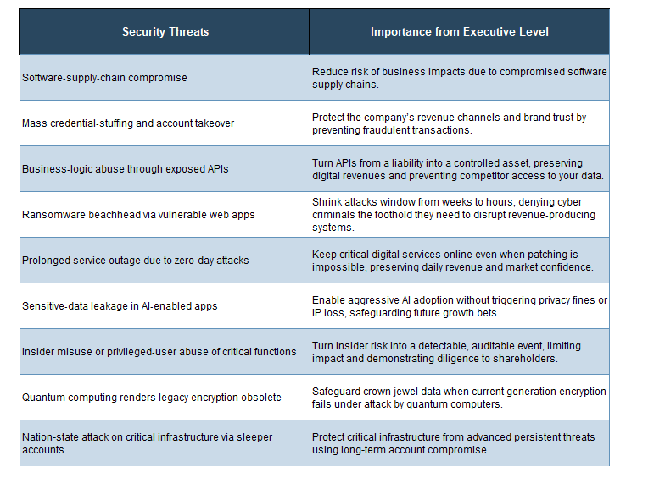
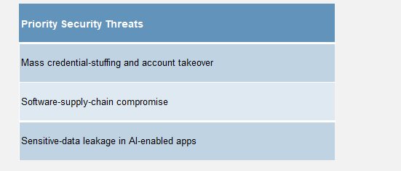
Selecting security threats
In the iSSDLC Capabilities Assessment Tool, select the Goals tab (Tab 3) to view the list of security threats in cells G17:H25.
In cells C20:C22, select the top three security threats that your executives would be the most concerned about. Consider some of the following factors to assist in selecting your top security threats:
Strategic alignment with business objectives.
Urgency and timing of business opportunity.
Potential ROI and impact across multiple priorities.
Download the iSSDLC Capabilities Assessment Tool
Info-Tech Research Group | 26

Slide 27
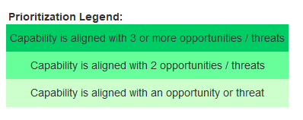
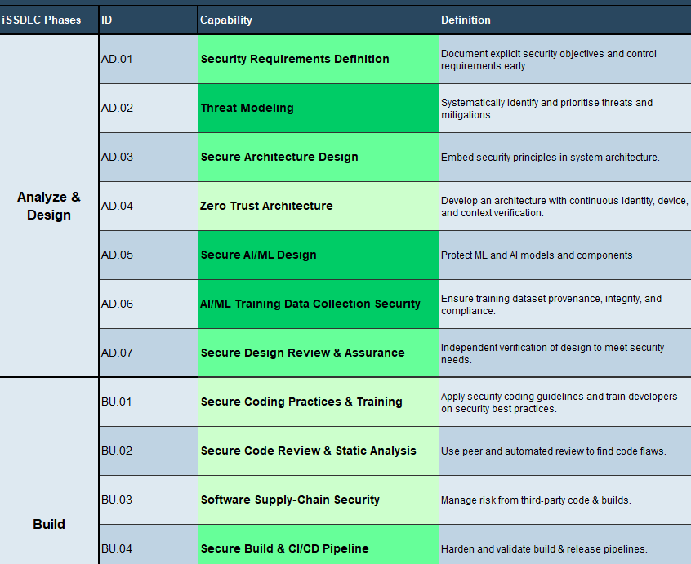
Prioritize capabilities
Once the business opportunities and security threats are defined in the Goals tab (Tab 3), a prioritization of the capabilities will be depicted in the Capability column (Column D) of the Capabilities Assessment tab (Tab 4).
The capabilities are prioritized based on the number of business opportunities and security threats they are aligned to, with the prioritization legend depicted on cells G6:G8.
Prioritizing capabilities based on their alignment to enterprise goals that will support application security initiatives ensures that organizations can mature their program more efficiently by:
Maximizing ROI. Focusing on capabilities that support multiple business opportunities and/or mitigate multiple security threats ensures investments will deliver meaningful value across the organization.
Allocating resources strategically. With limited time and budget, organizations can prioritize capabilities that will ensure the most critical areas are addressed.
Gaining more executive buy-in. Aligning capabilities to multiple business opportunities and security threats helps security leaders better communicate the value of initiatives to stakeholders, justify investments, and gain support for future application security modernization initiatives.
Info-Tech Research Group | 27

Slide 28

1.3 Establish metrics​
Prioritizing the right capabilities requires establishing effective metrics to showcase security’s ability to enable business goals and growth and manage risks.
Establishing metrics must reflect the business opportunities and risks, rather than just the technical activity. It should enable progress assessments to identify bottlenecks and justify future investments.
By framing threats at an executive level and in terms of business outcomes, driving capability improvement plans becomes a strategic roadmap, not just a technical one.
The metrics should focus on minimizing vulnerabilities, demonstrating operational efficiency, and reducing the organization’s third-party risk exposure while ensuring alignment to business outcomes.
Info-Tech Insight
Define metrics and KPIs early to ensure alignment with business drivers and prioritization of capabilities-based initiatives.
Info-Tech Research Group | 28

Slide 29
Sample metrics
Below are examples of some of the metrics that can be selected to guide the implementation of the iSSDLC.
Security metric | How to measure
Mean time to remediate (MTTR) critical vulnerabilities | Average number of days from detection to remediation for CVEs rated critical or high (track via SAST/DAST/SCA tools + ticketing system).
Percentage of third-party components without known vulnerabilities | Count of external libraries/packages scanned by SCA tools with zero known CVEs or total components used.
Credential stuffing detection rate | Number of credential stuffing attempts detected per month, tracked via WAF logs, SIEM, or identity provider analytics.
Security coverage in CI/CD pipeline | Percentage of CI/CD jobs that include SAST, DAST, SCA, secrets scanning, or IaC scanning.
Time to patch zero-day vulnerabilities | Measure time from vendor disclosure of zero day to patch deployment in production.
Percentage of APIs with business logic testing | Number of APIs with completed business logic abuse tests and total APIs in production.
Data exposure events from AI workloads | Count of security events involving PII or sensitive data leaks from AI features, tracked via DLP tools or incident logs.
Quantum resilience readiness | Percentage of crypto assets inventoried and evaluated for post-quantum readiness.
Insider threat detections | Number of suspicious privileged actions or misuse attempts logged and investigated.
Info-Tech Research Group | 29

Slide 30
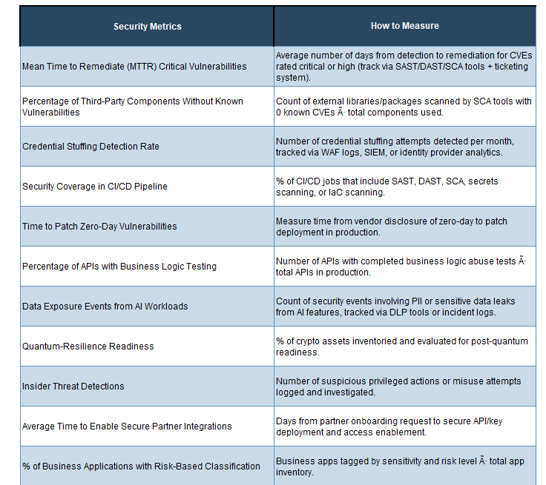
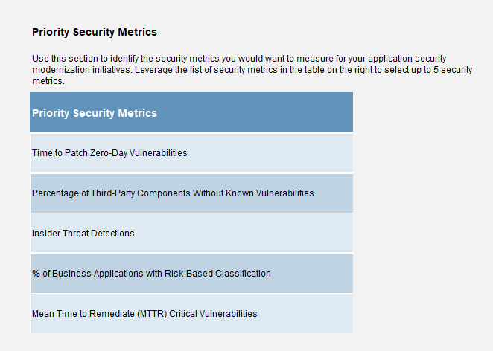
Select metrics
In the iSSDLC Capabilities Assessment Tool, select the Goals tab (Tab 3) to view the list of metrics in cells G28:H42.
In cells C31:C35, select up to five metrics that can measure the effectiveness of your application security strategic roadmap. Consider some of the following factors to assist in selecting your metrics:
Strategic alignment with business objectives.
Urgency and timing of business opportunity.
Potential ROI and impact across multiple priorities.
Download the iSSDLC Capabilities Assessment Tool
Info-Tech Research Group | 30

Slide 31
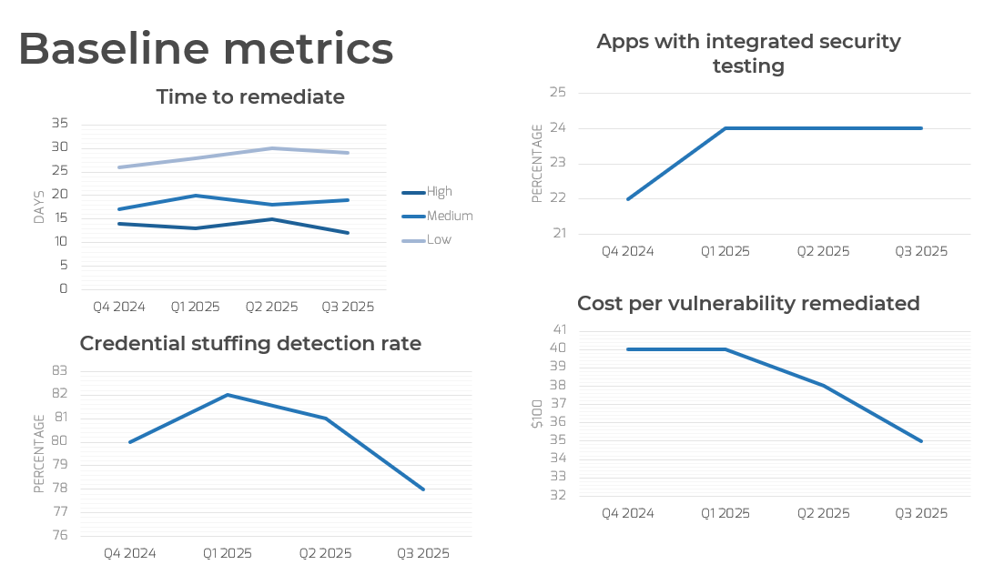
1.3.1 Document baseline metrics​
Along with establishing key metrics to assess the effectiveness of your iSSDLC strategic initiatives, it is important to develop their baseline metrics to assess your improvements.
In the iSSDLC Strategic Plan Template, slide 13 provides examples of charts that can be leveraged to visualize your metrics.
To customize the chart, right-click on it and select “Edit data” to update the figures, titles, and chart type.
Info-Tech Research Group | 31

Slide 32
1.4 Assign roles and responsibilities
Input | Output
Brainstorm stakeholders Define roles and responsibilities across governance functions | RACI chart
Materials | Participants
Whiteboard iSSDLC strategy deck | Information security Others to be determined
3 hours
Gather the required participants and use a whiteboard along with the dedicated slide on the iSSDLC strategy deck to develop a RACI chart. You will be able to:
Identify stakeholders. Identify the right stakeholders as part of your application security governance initiative. This might include security leaders, application managers, and governance and risk management functions.
Define clear roles and responsibilities. Ensure each role is assigned an appropriate responsibility with respect to the application security governance functions.
Document the RACI chart. Document the chart on slide 20 of the iSSDLC strategy deck.
The following slides provide more information on this step.
Download the iSSDLC Capabilities Assessment Tool
Info-Tech Research Group | 32

Slide 33
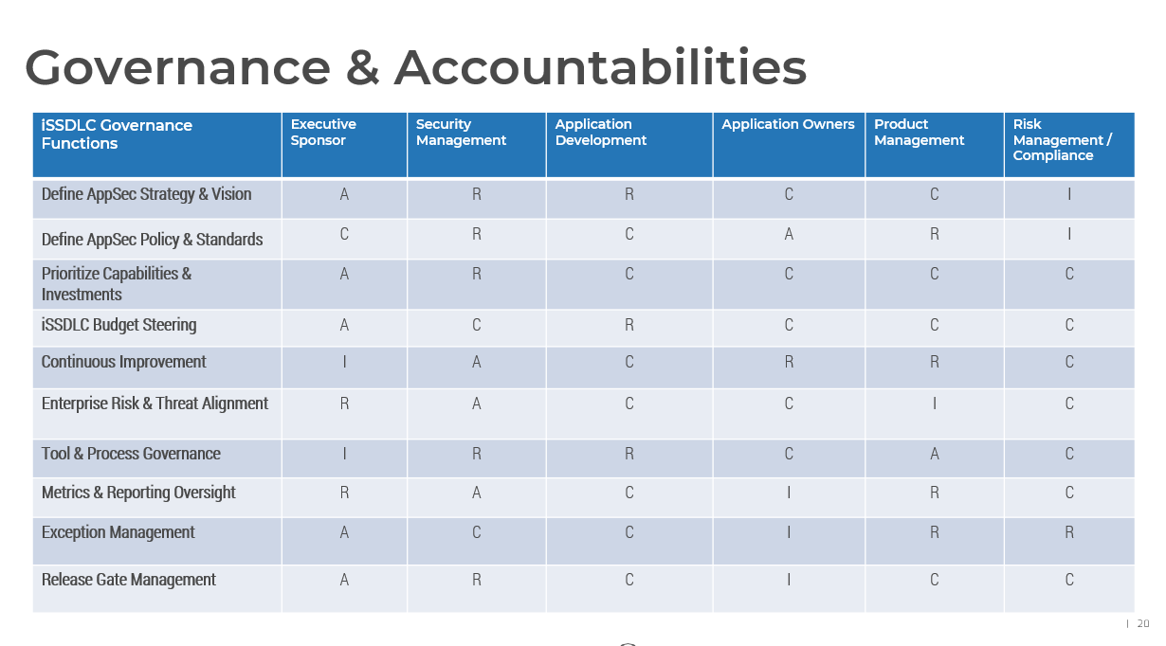
Complete the RACI matrix
Use slide 20 of the iSSDLC Strategic Plan Template to complete the Responsible/Accountable/Consulted/Informed (RACI) matrix.
Add additional roles, if required, by creating additional columns.
With all participants in the workshop, brainstorm the different steps within the process and customize the matrix.
Modify, remove, or delete governance function as required.
Change the responsibilities as required for your organization.
R = Responsible. The person who carries out the activity. Usually, there is only one person responsible, but you can have more.
A = Accountable. The person who is ultimately accountable for ensuring the activity is complete. There should be only one person accountable.
C = Consulted. Subject matter experts or affected stakeholders who need to provide input into the activity.
I = Informed. Stakeholders who need to be provided with status updates or outcomes.
Info-Tech Research Group | 33

Slide 34
Phase 2
This phase will walk you through the following activities:
2.1 Assess current application security state.
2.2 Determine target state.
Outcome:
Defined current and target maturity states
This phase involves the following participants:
Information security
IT risk
Privacy and compliance
Business
Assess Application Security Maturity
Phase 1
Phase 2
Phase 3
1.1 Identify business and security requirements.
1.2 Identify goals.
1.3 Establish metrics.
1.4 Assign roles and responsibilities.
2.1 Assess current application security state.
2.2 Determine target state.
3.1 Develop and prioritize initiatives.
3.2 Develop roadmap.
3.3 Develop strategy deck.
Develop a strategic plan for intelligent application security.

Slide 35
2.1 Assess current state
Input | Output
Maturity stage Obtain feedback on responsibilities | Current state assessment
Materials | Participants
iSSDLC Capabilities Assessment Tool | Information security Others to be determined
6-8 hours
Gather the required participants and leverage the iSSDLC Capabilities Assessment Tool to assess your current state.
Review capabilities and maturity scale: Review the list of capabilities and associated maturity levels.
Determine current state: Assess your current maturity state for each applicable capability.
Provide current state comments: Provide additional insights on the current state of each capability.
The following slides provide more information on this step.
Download the iSSDLC Capabilities Assessment Tool
Info-Tech Research Group | 35

Slide 36
iSSDLC capabilities assessment
The core of the intelligent secure software development lifecycle is a set of advanced application security capabilities.
Info-Tech’s iSSDLC capabilities provide a structured approach to application security, combining modern innovation controls with foundational best practices.
The iSSDLC maps capabilities to business opportunities and security threats, allowing rapid prioritization for targeted investment.
An iSSDLC approach enables adaptive controls, scalable governance, and data-driven decision-making throughout the development lifecycle.
By providing a flexible maturity model, the iSSDLC allows organizations to determine where they need advanced security intelligence and where they don’t.
Info-Tech’s iSSDLC capabilities were built in consideration of and alignment with:
OWASP Software Assurance Maturity Model (SAMM) 2.0.
US NIST SP 800-218 Secure Software Development Framework (SSDF) Version 1.1.
US NIST SP 800-218A Secure Software Development Practices for Generative AI and Dual-Use Foundation Models.
The iSSDLC improves upon these foundation standards by adding additional advanced capabilities to leverage intelligent application security tools.
The following slide illustrates the full set of iSSDLC capabilities.
Info-Tech Insight
Security must be integrated into an SDLC from architecture to operations, and it must contain a structured process that supports governance, accountability, and culture.

Slide 37












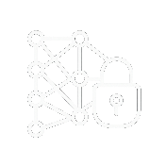


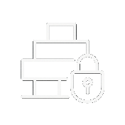




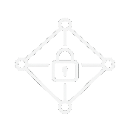
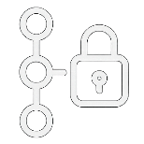



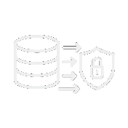




iSSLDC Capabilities
Analyze and design
Build
Test
Deploy
Operate and maintain
Icons generated by Sora
Security requirements definition
Secure coding practices and training
Secure deployment and infrastructure as code (IaC)
Security monitoring and threat detection
Automated security testing
Secure code review and static analysis
Penetration testing and red teaming
Container and orchestrator security
Incident response and recovery
Threat modeling
Secure architecture design
Fuzz and chaos testing
Vulnerability management and patching
Software supply chain security
Policy as code (PaC) deployment
Zero trust architecture
Secure build and CI/CD pipeline
Security requirements validation
Artifact signing and provenance
API security
Secure version control and repository management
Secure test environments and data management
Deployment security gates and reviews
Environment management and configuration
Secure AI/ML design
AI/ML training data collection security
Secrets management in development
Vulnerability disclosure and bug bounty
Secure design review and assurance
Agentic AI oversight and control

Slide 38
iSSDLC capabilities definitions Analyze and design phase
Analyze and design
Security requirements definition
Embedding security early ensures foundational decisions are developed with risk in mind and helps prevent architectural flaws, which are costly to fix if they reach further phases.
Threat modeling
Capability | Definition
Security requirements definition | Document explicit security objectives and control requirements early.
Threat modeling | Systematically identify and prioritize threats and mitigations.
Secure architecture design | Embed security principles in system architecture.
Zero trust architecture | Develop an architecture with continuous identity, device, and context verification.
Secure AI/ML design | Protect ML and AI models and components.
AI/ML training data collection security | Ensure training data set provenance, integrity, and compliance.
Secure design review and assurance | Independently verify design to meet security needs.
Secure architecture design
Zero trust architecture
Secure AI/ML design
AI/ML training data collection security
Secure design review and assurance

Slide 39
iSSDLC capabilities definitions Build phase
Build
Secure coding practices and training
Embedding developer-centric security practices during development will reduce vulnerabilities at the source, enabling developers to be the first line of defense.
Secure code review and static analysis
Capability | Definition
Secure coding practices and training | Apply security coding guidelines and train developers on security best practices.
Secure code review and static analysis | Use peer and automated review to find code flaws.
Software supply chain security | Manage risk from third‑party code and builds.
Secure build and CI/CD pipeline | Harden and validate build and release pipelines.
Secure version control and repository management | Protect code repositories from unauthorized or malicious changes.
Secrets management in development | Handle credentials and keys safely in development.
Software supply chain security
Secure build and CI/CD pipeline
Secure version control and repository management
Secrets management in development

Slide 40
iSSDLC capabilities definitions Test phase
Test
Security testing during the QA helps detect risks early as well as fostering a shared accountability across QAs and security teams, which ensures consistent enforcement of security controls and minimizes the likelihood of misconfigurations.
Automated security testing
Penetration testing and red teaming
Capability | Definition
Automated security testing | Run automated security testing (e.g. DAST, IAST) against applications.
Penetration testing and red teaming | Use human adversarial testing for deep flaws.
Fuzz and chaos testing | Test with mutation and random input to provoke faults.
Security requirements validation | Prove system meets security requirements.
Secure test environments and data management | Isolate test environments and protect data used for testing.
Fuzz and chaos Testing
Security requirements validation
Secure test environments and data management

Slide 41
iSSDLC capabilities definitions Deploy phase
Deploy
Secure deployment and infrastructure as code (IaC)
Policies and environment hardening validates integrity and compliance, which prevents unauthorized or malicious code from being deployed.
Capability | Definition
Secure deployment and infrastructure as code (IaC) | Ensure infrastructure definitions and live configurations are securely authored, validated, deployed, and maintained.
Container and orchestrator security | Secure images, runtime, and orchestration.
Policy as code (PaC) deployment | Encode and enforce policies as code.
Artifact signing and provenance | Cryptographically sign and attest artifacts.
Deployment security gates and reviews | Automated approval gates for release risk.
Container and orchestrator security
Policy as code (PaC) deployment
Artifact signing and provenance
Deployment security gates and reviews

Slide 42
iSSDLC capabilities definitions Operate and maintain phase
Operate and maintain
Security monitoring and threat detection
Continuous monitoring, anomaly detection, and vulnerability management enables faster detection and response, reduces the window of exposure for known exploits, and ensures security evolves with the threat landscape.
Incident response and recovery
Capability | Definition
Security monitoring and threat detection | Monitor applications in operation for security threats.
Incident response and recovery | Handle security incidents and restore service.
Vulnerability management and patching | Identify, prioritize, and fix vulnerabilities in applications and underlying operating systems.
API security | Securely deploy and monitor API gateways.
Environment management and configuration | Maintain secure configurations across environments.
Vulnerability disclosure and bug bounty | Receive and reward external vulnerability reports.
Agentic AI oversight and control | Govern autonomous AI agent actions and ethics.
Vulnerability management and patching
API security
Environment management and configuration
Vulnerability disclosure and bug bounty
Agentic AI oversight and control

Slide 43

Reduce the impact of false positives on your development lifecycle
One of the most common challenges in application security is correctly flagging security issues, also known as false positives. This occurs mainly when using automated testing tools such as SAST, DAST, and SCA.
High volumes of false positives can overwhelm development and security teams, which results in additional efforts to investigate nonissues that can delay the remediation of critical vulnerabilities.
It can also result in alert fatigue, which can cause teams to deprioritize important findings, reducing trust amongst the security and application team and delaying remediation workflows.
Developing best practices for effective false positive management will help reduce or manage false positives and improve collaboration efforts.
Fine-tuning tools to be tailored to specific codebases, prioritizing context-aware testing, and tracking false positive rates as metrics will help faster development of secure applications while also focusing on high-impact risks.
Image generated by Sora

Slide 44
iSSDLC capabilities for mitigating false positives
Capability | How it is addressed
Secure code review and static analysis | Advanced SAST tools with customizable rule sets and contextual analysis reduce irrelevant alerts; human-in-the-loop reviews help validate findings.
Automated security testing | Integrate tools that support dynamic and static testing with tuned thresholds to eliminate noise and prioritize exploitable vulnerabilities.
Security integration in CI/CD pipeline | Enable contextual scanning based on environment, branch, or asset criticality, reducing unnecessary or duplicate findings.
Interactive application security testing (IAST) | Use runtime data during functional testing to correlate findings with real execution paths, drastically lowering false positives compared to SAST/DAST alone.
Security requirements validation | Help align testing outcomes with business risk and policy, ensuring tools are only flagging issues that truly violate defined security baselines.
Continuous improvement and metrics | Regular tuning and evaluation of tool performance using metrics (e.g. signal-to-noise ratio) ensures alerts stay relevant and trustworthy.
Security champion program | Empower developers to review and refine security tool outputs, allowing better tuning and faster validation of false positives.
Security gate policies in CI/CD | Ensure only actionable, high-confidence findings can block builds or deployments, reducing unnecessary friction in workflows.

Slide 45
iSSDLC maturity model
Intelligent application security capabilities need a maturity model that considers intelligence.
An effective iSSDLC capabilities assessment requires a structured model to help evolve security practices from manual processes to intelligent, autonomous controls.
The assessment will help identify gaps across not only the technologies and tools in place but also the people, processes, and governance that may impact the secure software delivery.
Prioritization of investments could be influenced by the maturity gaps of each capability, along with its associated benefit to business alignment and security risk mitigation.
The maturity model will also establish a baseline for continuous improvement through the implementation of metrics to assess the maturity progress.
Info-Tech’s iSSDLC maturity model was built in consideration of and in alignment with the Autonomous Software Development Levels (ASDL).
The iSSDLC simplifies the ASDL by combining L2 (Partial) and L3 (Conditional) levels into an orchestrated maturity level to reduce confusion between the levels.
The following slide illustrates the full set of iSSDLC capabilities.
Info-Tech Insight
An intelligence-driven, risk-aligned, and adaptive maturity model helps guide organizations to a more agile, intelligent, and risk-aware modernization of secure development.

Slide 46

iSSDLC Maturity Model
Humans set strategy and ethics. AI agents operate, learn, and optimize security end to end with minimal human input. The iSSDLC capability proves compliance on its own.
Autonomous
Analytics and AI adapt controls continuously, remediate most routine issues without waiting for people, and escalate only edge cases. Security processes run largely hands-free.
Automated
Orchestrated
Tool-driven, multistep workflows carry out security tasks end to end (e.g. scans → PRs → tests) while humans provide oversight and final approval at defined risk gates.
Assisted
Basic tools, checklists, or templates help humans find issues or follow best practices, but people still decide and perform every task.
Manual
Capability is ad hoc and entirely human-driven. Little or no tooling; success depends on individual effort and group knowledge.
Image generated by ChatGPT

Slide 47
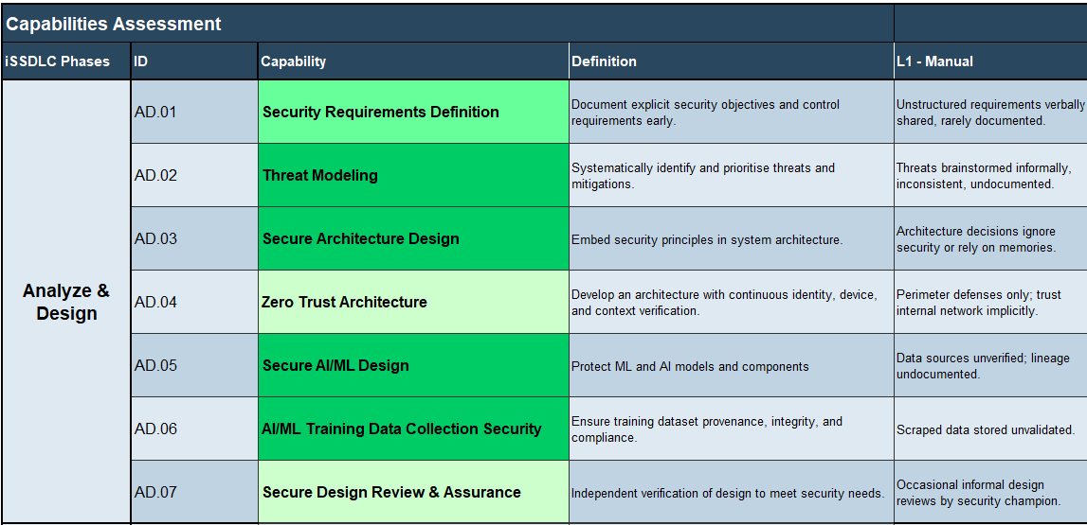
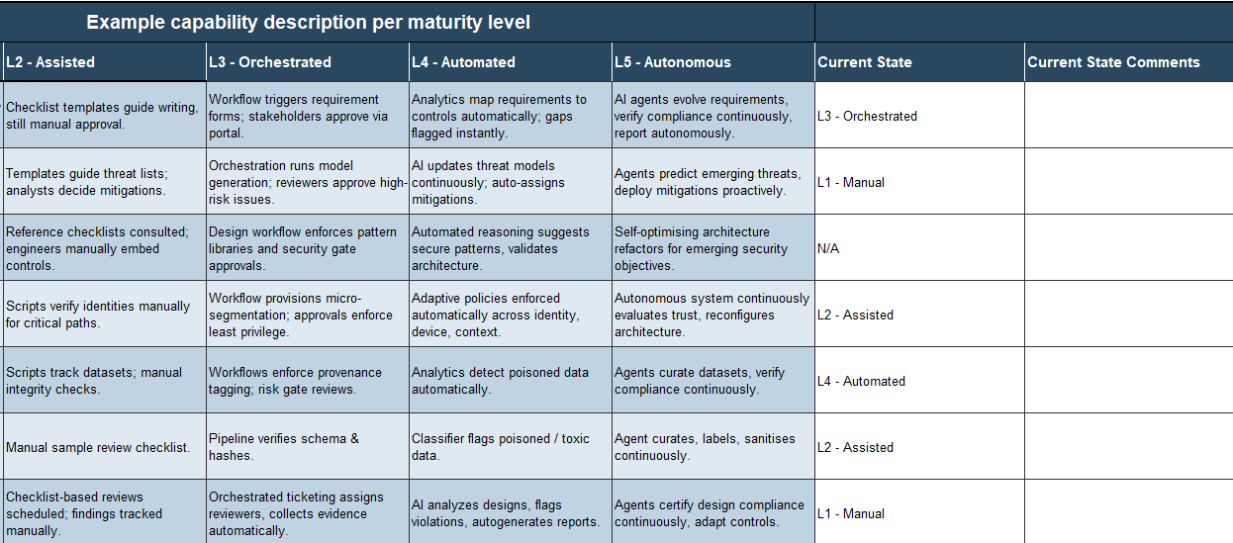
2.1.1 Assess iSSDLC current state
In the iSSDLC Capabilities Assessment Tool, review the example capability description per maturity level in cells F14:J43 and input your current state in cells K14:K43.
In cells L14:L43, provide optional current state comments to further describe your current maturity level. You can include comments such as:
Tooling or process details.
Ownership and accountability.
Quality or effectiveness of capability.
Pain points or bottlenecks.
Download the iSSDLC Capabilities Assessment Tool

Slide 48
2.2 Determine target state
Input | Output
Maturity stage Obtain feedback on responsibilities | Target state assessment
Materials | Participants
Whiteboard iSSDLC Capabilities Assessment Tool | Information security Others to be determined
1 hour
Gather the required participants and leverage the iSSDLC Capabilities Assessment Tool to determine your target state.
Review current state: Review the list of capabilities and associated current maturity state.
Determine target state: Determine your target maturity state for each applicable capability.
The following slides provide more information on this step.
Download the iSSDLC Capabilities Assessment Tool
Info-Tech Research Group | 48

Slide 49
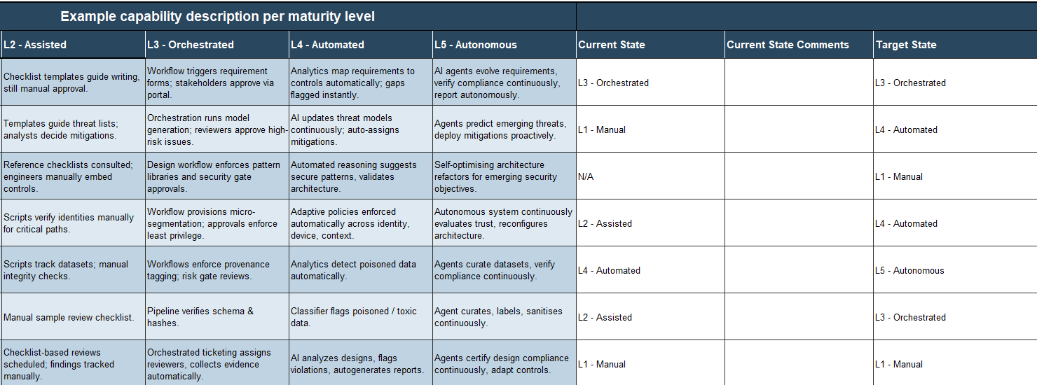
2.2.1 Determine iSSDLC target state
In the iSSDLC Capabilities Assessment Tool, select your target state for each capability in cells M14:M43 of the Capabilities Assessment tab (Tab 4).
Consider the following factors when determining your target state:
Alignment with business objectives and strategic priorities.
Current gaps and risk exposures that could be mitigated with a higher maturity level.
Regulatory and industry compliance that requires a certain maturity to ensure audit readiness.
Organizational readiness and culture to support initiatives required to achieve target maturity.
Automation potential that could increase scalability and reduce manual workload.
Download the iSSDLC Capabilities Assessment Tool

Slide 50
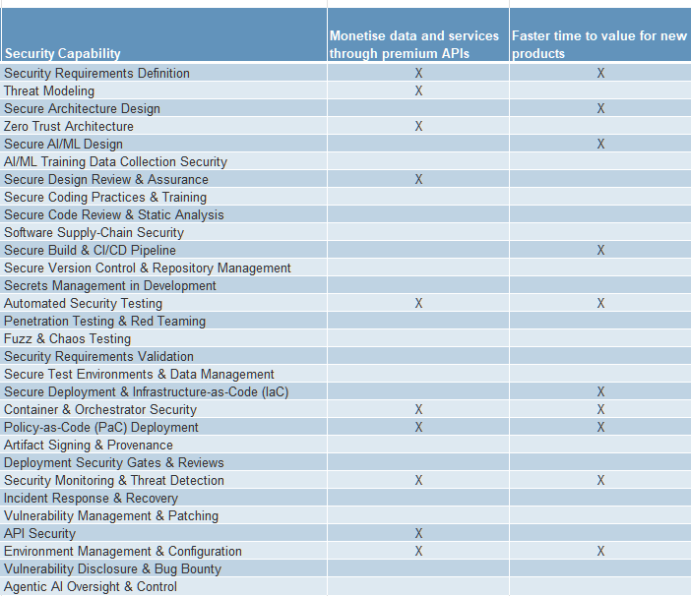
Customize the iSSDLC capability prioritization (optional)
The iSSDLC Capabilities Assessment Tool allows for rapid prioritization of capabilities based on the extent to which each capability can enable your top business opportunities and mitigate your top security threats.
Each capability has the potential to support every opportunity and mitigate every threat. However, to enable prioritization, the tool contains matrices showing the opportunities and threats each capability can most contribute to, as shown in the screenshot to the right.
These matrices were developed by Info-Tech, combining the security expertise of Info-Tech’s research analysts with advanced AI.
You may modify these matrices if desired, adding or changing the set business opportunities and security threats.
The matrices can be found in the tool by unhiding the “10. Capability Matrix” tab in the tool.

Slide 51
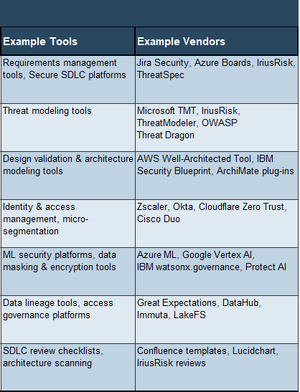
Identify potential tools and technologies
In the iSSDLC Capabilities Assessment Tool, select the Capabilities Assessment tab (Tab 4) to view the list of example tools and vendors in cells O14:P43.
The examples provides insights on the type of tools that can be leveraged to help automate tasks, reduce manual workload, and support AI readiness for scalability.
When assessing technology and tools, consider some of the following factors:
Ease of integration: Whether the tool can seamlessly integrate with your existing SDLC, CI/CD pipelines, developer toolchains, and other technologies.
Scalability: Whether the tool can support future scalability and automation potential with its features.
Developer usability: Whether the tools are developer-friendly and can provide actionable guidance and guardrails for developers to help remediate issues early.
Innovation Whether the technology is innovative and embeds emerging technology and trends into their product lines.
Info-Tech Insight
Security must be integrated into an SDLC from architecture to operation, and it must contain a structured process that supports governance, accountability, and culture.

Slide 52
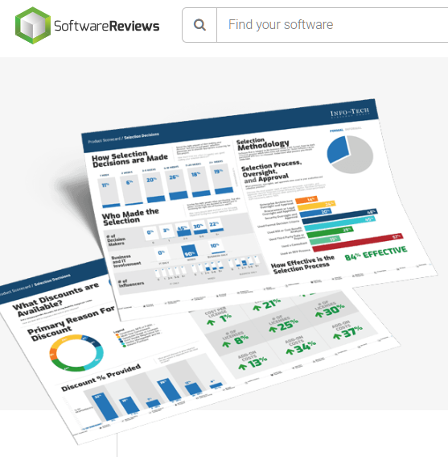
Leverage SoftwareReviews.com
Info-Tech’s SoftwareReviews provides a catalog of technology vendors grouped by software categories to help organizations accelerate and improve their software selection process.
Our catalog covers a wide of application security tools, including the following:
API Security: Tools used to ensure that data from APIs is protected from cyberattacks.
Application Security Testing Tools (AST): AST tools identify security vulnerabilities in applications and includes SAST (which analyzes source code), DAST (which tests code while it executes), and SCA (which identifies vulnerabilities in third-party components, modules, and libraries).
Mobile Application Security Software: Tools can be used to identify and fix vulnerabilities before launch with app security testing, safeguard against real-time attacks with mobile threat defense, and shield applications at runtime with self-protection features.
Web Application Firewall (WAF) Software: Security tool designed to protect web applications.

Slide 53
Phase 3
This phase will walk you through the following activities:
3.1 Develop and prioritize initiatives.
3.2 Develop roadmap.
Outcome:
List of prioritized application security initiatives
iSSDLC strategic roadmap deck
This phase involves the following participants:
Information security
Application/delivery managers
Business
Develop Strategic Plan
Phase 1
Phase 2
Phase 3
1.1 Identify business and security requirements.
1.2 Identify goals.
1.3 Establish metrics.
1.4 Assign roles and responsibilities.
2.1 Assess current application security state.
2.2 Determine target state.
3.1 Develop and prioritize initiatives.
3.2 Develop roadmap.
3.3 Develop strategy deck.
Develop a strategic plan for intelligent application security.

Slide 54
3.1 Develop and prioritize initiatives
Input | Output
Maturity stage Obtain feedback on responsibilities | List of initiatives
Materials | Participants
Whiteboard iSSDLC Capabilities Assessment Tool | Information security Others to be determined
2 hours
Gather the required participants and leverage the iSSDLC Capabilities Assessment Tool to develop and prioritize your initiatives.
Develop initiatives: Develop gap closure initiatives.
Prioritize initiatives: Prioritize your initiatives based on a cost-benefit analysis.
The following slides provide more information on this step.
Download the iSSDLC Capabilities Assessment Tool
Info-Tech Research Group | 54

Slide 55
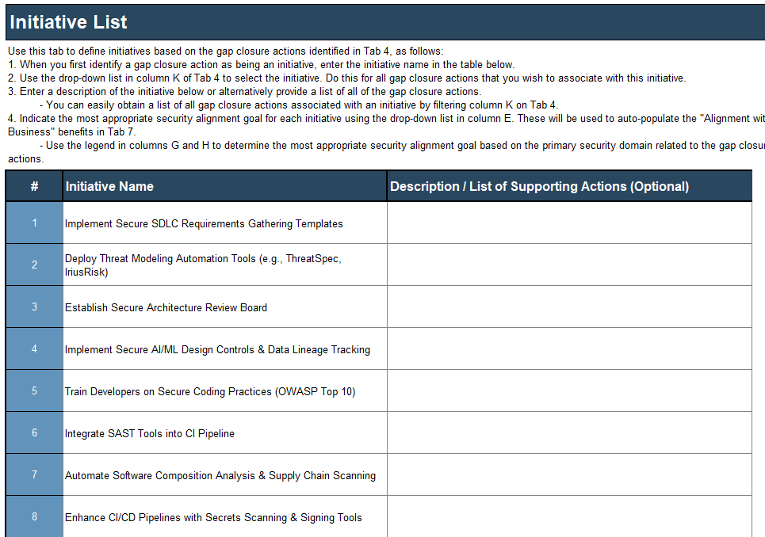
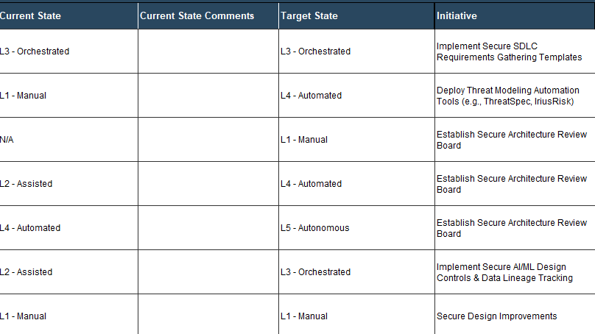
3.1.1 Develop gap closure initiatives
In the iSSDLC Capabilities Assessment Tool, develop your initiatives in the Initiative List tab (Tab 5), which will be used to identify the initiative for each capability in the Capabilities Assessment tab (Tab 4).
Develop your initiatives in cells C6:C45. Consider some of the following factors when developing your initiatives:
Ensure the initiatives are targeted, feasible, and outcome-driven.
Prioritize initiatives that can support multiple capabilities.
Ensure the initiatives can be measured and tracked with KPIs to assess progress and overall effectiveness.
In cells N14:N43 of the Capabilities Assessment tab (Tab 4), select the appropriate initiative from the drop-down list of initiatives developed in Tab 5.
Download the iSSDLC Capabilities Assessment Tool

Slide 56
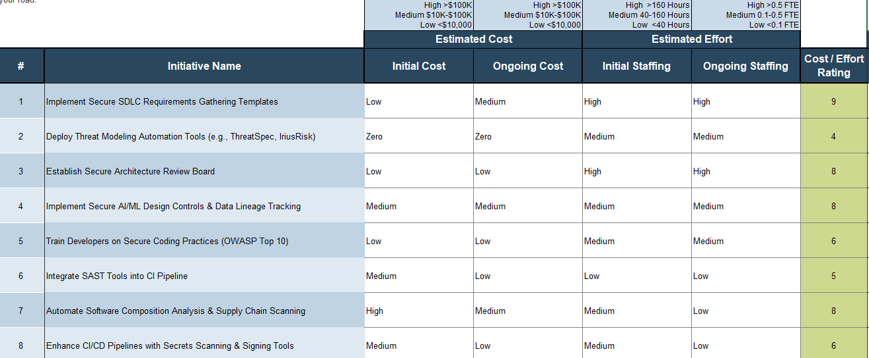
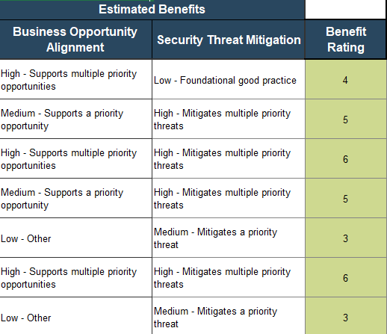
3.1.2 Conduct cost-benefit analysis
In the iSSDLC Capabilities Assessment Tool, conduct your cost-benefit analysis prioritization (Tab 6).
In columns D and E, estimate your initial and ongoing cost for each initiative.
In columns F and G, estimate the initial and ongoing staffing hours and FTE.
A cost/effort rating would be depicted in column H.
In columns I and J, estimate the benefits in terms of whether the initiative will support multiple business opportunities and mitigate multiple security threats.
A benefit rating would be depicted in column K.

Slide 57
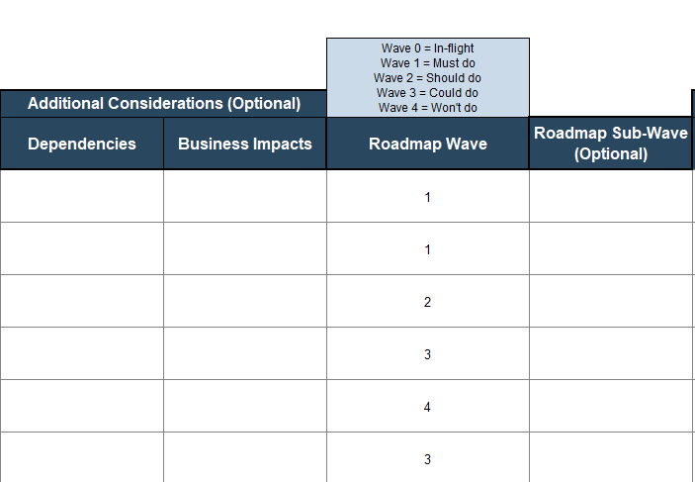
3.1.3 Prioritize initiatives
In the iSSDLC Capabilities Assessment Tool, prioritize your initiatives in the Prioritization tab (Tab 6).
In column N, determine the roadmap wave in which the initiatives should be implemented. Label the initiatives based on the following list of execution waves:
Wave 0 (In flight): Initiative currently implemented/being implemented.
Wave 1 (Must do): Initiatives that need to get moving right away. They may be quick wins, items with critical importance, or foundational projects upon which many other initiatives depend.
Wave 2 (Should do): Important initiatives that need to get done but cannot launch immediately due to budget constraints, dependencies, or business impacts that require preparation.
Wave 3 (Could do): Initiatives that have merit but are not a priority.
Wave 4 (Won’t do): Initiatives where the costs outweigh the benefits.

Slide 58


3.1.4 Create an effort map
Low cost
The cost/effort and benefit ratings in columns H and K respectively can be assessed to determine the execution waves.
An effort map is a visual representation of a cost-benefit analysis you can use to illustrate the prioritization of your initiatives.
In this example, the initiative “Integrate SAST tools in CI pipeline” is shown as a medium cost/effort (5) and medium benefit (6).
On a whiteboard, draw the quadrant diagram shown.
Create sticky notes for each initiative on your initiative list.
For each initiative, use the cost/effort rating and the benefit rating calculated on the Prioritization tab to place the corresponding sticky note onto the diagram.
Low benefit
High benefit
Integrate SAST tools in CI pipeline
Cost
5
Benefit
6
High cost

Slide 59
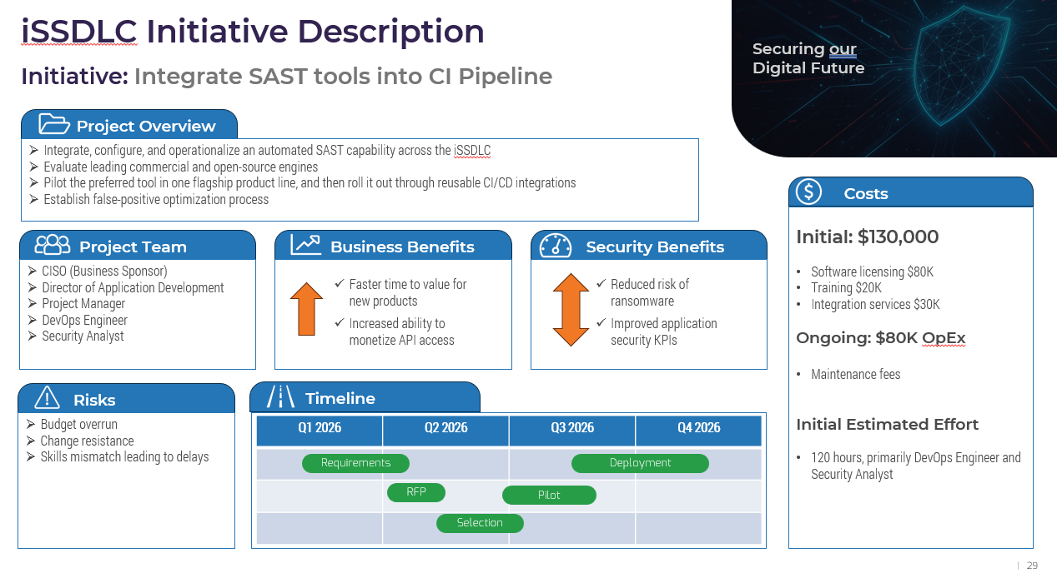
3.1.5 Develop one-page information slides for top initiatives
In the iSSDLC Strategic Plan Template, develop your one-pager slide for key initiatives that will be presented to stakeholders. A sample of the one-pager slide is on slide 29, which can be customized to update the project description, benefits, cost, and timeline.
Download the iSSDLC Strategic Plan Template

Slide 60
3.2 Build roadmap
Input | Output
Capabilities assessment Cost-benefit analysis Prioritized initiative list | iSSDLC strategic roadmap
Materials | Participants
Whiteboard iSSDLC Capabilities Assessment Tool iSSDLC Strategic Plan Template | Information security Others to be determined
2 hours
Gather the required participants and leverage the iSSDLC Capabilities Assessment Tool to build your roadmap.
Develop and review your roadmap: Schedule your initiatives using the Gantt chart.
Develop and review your iSSDLC strategy deck: Finalize your communication deck, which will be leveraged to communicate to stakeholders.
The following slides provide more information on this step.
Download the iSSDLC Capabilities Assessment Tool
Info-Tech Research Group | 60

Slide 61
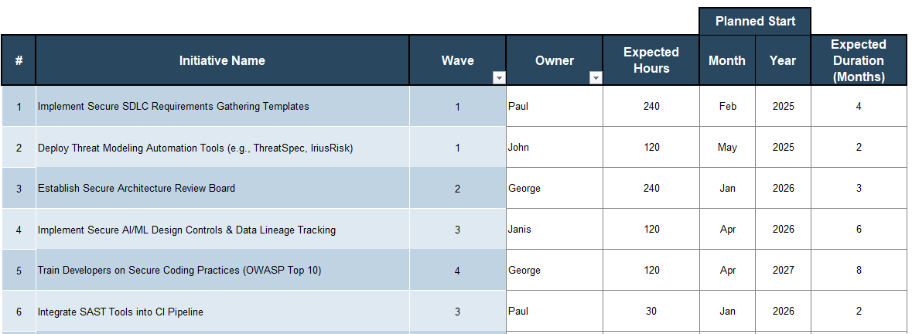
3.2.1 Schedule initiatives using the Gantt chart
On the Gantt Chart tab for each initiative, enter an owner (the individual who will be primarily responsible for execution).
The Owner column can help identify resourcing constraints. If a single individual is responsible for many different initiatives that are planned to start at the same time, consider staggering those initiatives.
Next, enter a start month and year for the initiative and the expected duration in months.
The expected hours column will help estimate the total FTE that will be required to complete the initiative.

Slide 62
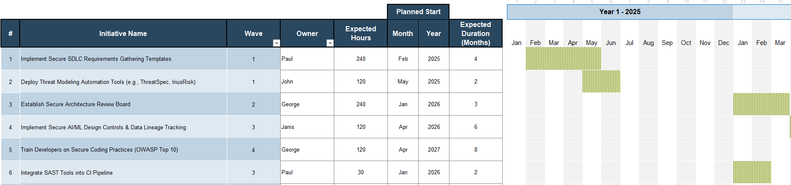
3.2.2 Review your roadmap
Review the roadmap to ensure the outcome is reasonable. Consider:
Do you have other IT or business projects planned during this time frame that may impact your resourcing or scheduling?
Does your organization have regular change freezes throughout the year that will impact the schedule?
Do you have oversubscribed resources? You can filter the list on the Owner column to identify potential oversubscription of resources.
Have you considered any long vacations, sabbaticals, parental leaves, or other planned longer-term absences?
Are your initiatives adequately aligned to your budget cycle? For instance, if you have an initiative that is expected to make recommendations for capital expenditure, it must be completed prior to budget planning.

Slide 63
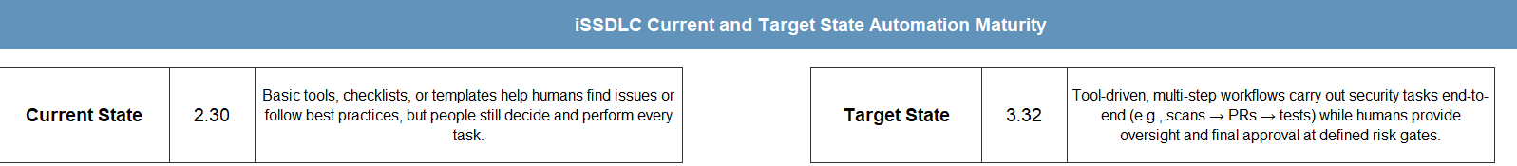
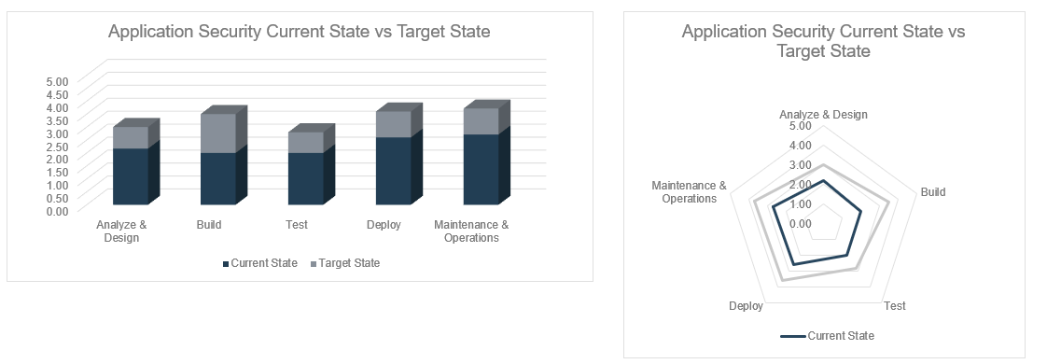
3.2.3 Review expected roadmap progression
Once the capabilities assessment has been completed, you can review your iSSDLC current and target maturity state in the Results tab (Tab 8).
Review the roadmap progression along with the associated charts that visualize your maturity for each SDLC phase. Remember that the expected maturity at the end of the roadmap assumes that you will complete all the initiatives (including wave 4 initiatives).

Slide 64
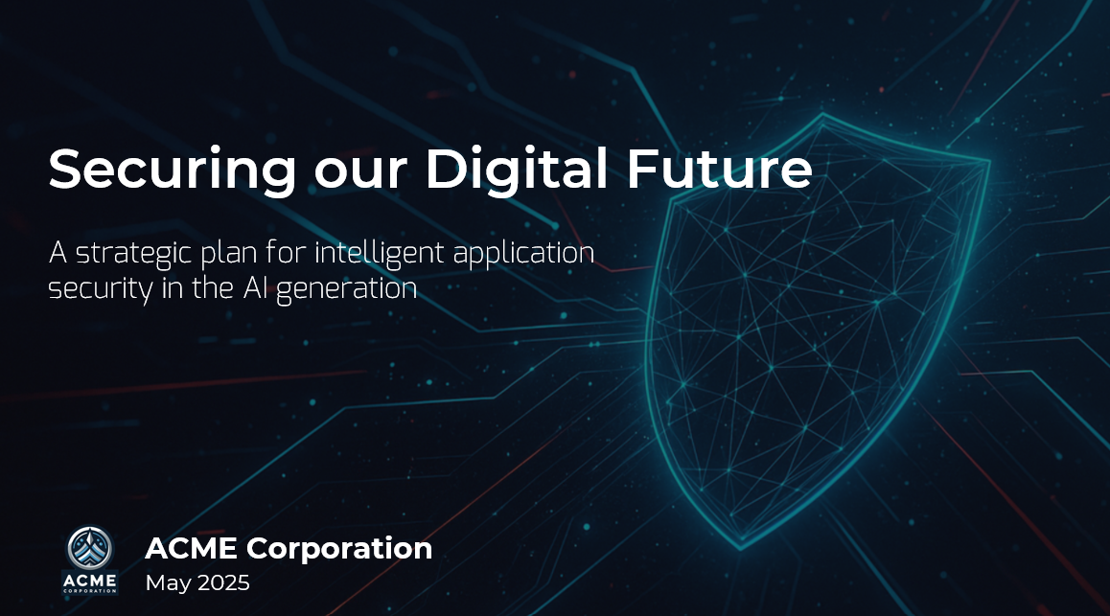
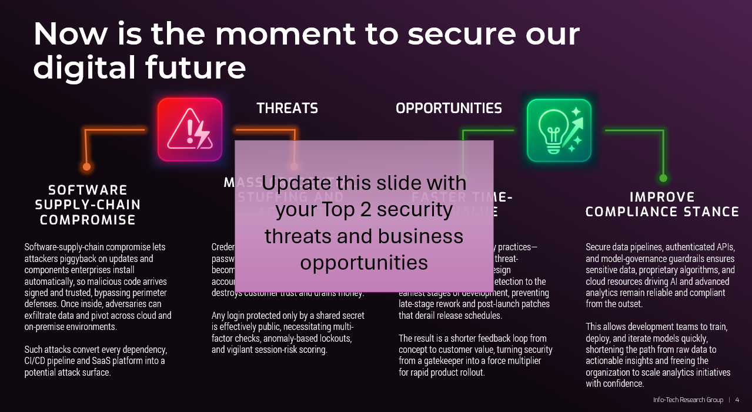
3.3 Develop iSSDLC strategy deck
Review the iSSDLC strategy deck. Identify slides that contain instructions in red text boxes. Follow the instructions then delete the boxes.
Most slides only require you to copy and paste screenshots or tables from your tools into the slides. However, some require that you customize or add text explanations that reflect unique findings.
Pay close attention to the Next Steps slide at the end of the deck. This will likely have a large impact on your audience.
Once you customize the existing slides, consider whether you need additional slides. For instance, you may wish to add more context to the risk assessment or pressure analysis diagrams or provide details on high-priority initiatives.
Consider developing targeted presentations for different audiences. Senior management may only want an executive summary, while the CIO may be more interested in the methodology used to develop the strategy.
A useful tactic is to build a core presentation with an appendix of additional slides to supplement the deck as needed.

Slide 65
If you would like additional support, have our analysts guide you through other phases as part of an Info-Tech workshop.
Knowledge gained:
Defined goals around business opportunities supported and security threats mitigated through a modernized application security program.
Enhanced understanding of the application security capability landscape required for an intelligent secure software development lifecycle.
Developed maturity model that fosters automation and AI readiness.
Improved prioritization framework based on a cost-benefit analysis to assist in the development of an application security roadmap.
Defined application security governance model, with clear roles and responsibilities.
Processes optimized:
Application security governance and accountability
Maturity assessment for application security
Deliverables completed:
iSSDLC Capabilities Assessment Tool
iSSDLC Strategic Plan Template
Contact your account representative for more information.
workshops@infotech.com 1-888-670-8889

Slide 66

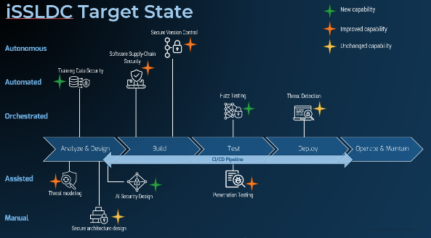
Contact your account representative for more information. workshops@infotech.com 1-888-670-8889
If you would like additional support, have our analysts guide you through other phases as part of an Info-Tech Workshop.
The following are sample activities that will be conducted by Info-Tech analysts with your team:
To accelerate this project, engage your IT team in an Info-Tech workshop with an Info-Tech analyst team.
Info-Tech analysts will join you and your team at your location or welcome you to Info-Tech’s historic Toronto office to participate in an innovative onsite workshop.
Performing Capabilities Assessment
Developing iSSDLC Strategy Deck
Facilitate requirements gathering and draft your vendor security policy.​
Facilitate the development of a RACI matrix and a set of process diagrams.​

Slide 67
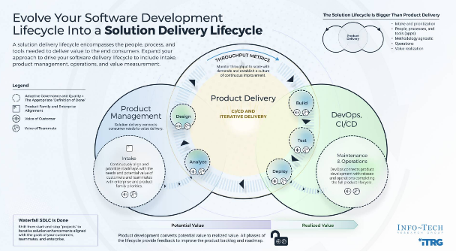
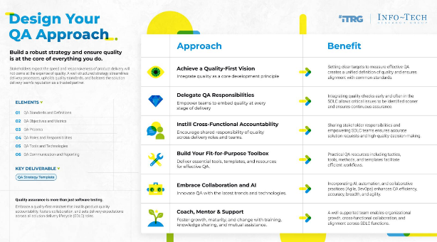
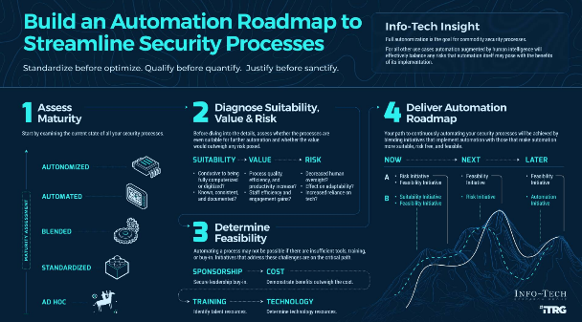
Related Info-Tech Research
Evolve Your Software Development Lifecycle Into a Solution Delivery Lifecycle
Build a Software Quality Assurance Program
Build an Automation Roadmap to Streamline Security Processes
Transform your SDLC into a solution delivery lifecycle that encompasses the people, processes, and tools needed to deliver value to the end consumers of the solution.
Develop a product-centric approach that promotes the continuous delivery of value to end users.
Embed quality and compliance standards into each step of your delivery team’s methodology using definitions of done.
Build a robust strategy and ensure quality is at the core of everything you do.
Standardize your definition of quality. Come to an organizational agreement of what attributes define a high-quality solution. Accommodate both business and IT perspectives in your definition.
Adopt good QA practices to better support your quality definition and business and IT environments and priorities.
Start by examining the current state of all your security processes, from ad hoc to fully autonomized.
Assess the presence of showstopping prerequisites such as technology underpinnings, training, or incurred costs.
Implementing automation is the end goal, but your roadmap will also contain initiatives that address critical prerequisites to this goal.

Slide 68
Bibliography
“2024 Accelerate State of DevOps Report.” DORA, 22 Oct. 2024. Accessed 31 July 2025.
“2024 Software Vulnerability Snapshot.” Black Duck Software, Nov. 2024. Accessed 31 July 2025.
“2024 State of Application Security Report.” CrowdStrike, Feb. 2024. Accessed 31 July 2025.
“2025 Application Security Threat Report.” Digital.ai, 2025. Accessed 31 July 2025.
“2025 State of Application Risk: An ASPM View of the Security of Software Factories.” Legit Security, 22 Jan. 2025. Accessed 31 July 2025.
“API Security in 2025: Securing the Nervous System of the Digital Enterprise.” Risk Insights Hub, 15 May 2025. Accessed 31 July 2025.
“Application Security: A Practitioner’s Guide.” Palo Alto Networks Cyberpedia, 2025. Accessed 31 July 2025.
“Application Security Strategy Guide.” Black Duck Software, 2024. Accessed 31 July 2025.
“AppSec Strategy Guide: A Step-by-Step Breakdown to Achieve DevSecOps.” Black Duck Software, 2023. Accessed 31 July 2025.
Chawdhary, Gyan. “Top 15 Application Security Best Practices.” Security Compass, 21 Mar. 2025. Accessed 31 July 2025.
Vizard, Michael. “CISO Survey Surfaces Shift in Application Security Responsibilities.” Security Boulevard, 13 May 2025. Accessed 31 July 2025.
“DevSecOps Evolution.” Checkmarx, Mar. 2025. Accessed 31 July 2025.
“DevSecOps Is Just the Beginning Playbook.” Snyk Ltd., 2023. Accessed 31 July 2025.
“Digital Fortresses Under Siege: Threats to Modern Application Architectures.” Akamai Technologies, 2024. Accessed 31 July 2025.
“Digital Fortresses Under Siege: Threats to Modern Application Architectures.” Akamai Technologies, 1 July 2024. Accessed 31 July 2025.
“Eliminating Vulnerabilities Early in the SDLC for Société Française du Radiotelephone.” Black Duck Software, Oct. 2024. Accessed 31 July 2025.

Slide 69
Bibliography
Gazit, Tiferet. “Fixing Security Vulnerabilities with AI.” GitHub Blog, 14 Feb. 2024. Accessed 31 July 2025.
“The Future of Application Security 2024.” Checkmarx, February 2024. Accessed 31 July 2025.
Kungla, Valter. “GitHub Autonomous Software Development Levels (ASDL)” GitHub, 2025. Accessed 30 June 2025.
“GitLab 2024 Global DevSecOps Survey.” GitLab, 2024. Accessed 31 July 2025.
“OWASP Software Assurance Maturity Model (SAMM)” OWASP Foundation. Accessed 5 May 2025.
“OWASP Top Ten.” OWASP Foundation, 2021. Accessed 31 July 2025.
“Recommendations for Securing a Development Lifecycle.” Microsoft Learn, 10 May 2024. Accessed 31 July 2025.
“Secure Development Lifecycle for Power Platform.” Microsoft Learn, 16 May 2024. Accessed 31 July 2025.
Souppaya, Murugiah et al. “SP 800-218 Secure Software Development Framework (SSDF) Version 1.1: Recommendations for Mitigating the Risk of Software Vulnerabilities” NIST, Feb. 2022. Accessed 5 May 2025.

