Slide 1

Securing Our Digital Future
A strategic plan for intelligent application security in the AI generation.
ACME Corporation
May 2025
Image generated by Sora

Slide 2
How to use this template
This slide deck is a template and completed example of an iSSDLC strategic plan. It is intended to be informed by the activities in Info-Tech’s Develop a Strategic Plan for Intelligent Application Security
blueprint.
Model your own action plan presentation on the examples provided here. Modify the presentation’s flow, style, and content to reflect your organization’s approach to uncertainty, your presentation style, and your intended audience.
This template consists of four core sections:
Executive summary of your strategic plan. This is the overarching summary of the presentation and should be modified to reflect your own approach.
Section 1: Starting point. This section focuses on the critical risks and opportunities that organizations should consider when designing an iSSDLC.
Section 2: Destination. Document the vision for the iSSDLC target state.
Appendix A: Initiative one-pagers. Use the example provided to develop one-page descriptions for your top initiatives for the iSSDLC.
Add, change, or remove content as needed to fit your specific requirements. If you add new slides, make sure the additional content is relevant and provides value to the reader, the format follows the other slides within the deck, and the narrative flow of the deck remains logical and clear.
Info-Tech Research Group | 2

Slide 3
EXECUTIVE BRIEF

Slide 4


Now is the moment to secure our digital future
THREATS
OPPORTUNITIES
Update this slide with your top two security threats and business opportunities.
Software Supply chain compromise
Mass credential stuffing and account takeover
Faster time to value
Improved compliance stance
Software supply chain compromise lets attackers piggyback on updates and components enterprises install automatically so that malicious code arrives signed and trusted, bypassing perimeter defenses. Once inside, adversaries can exfiltrate data and pivot across cloud and on-premises environments. Such attacks convert every dependency, CI/CD pipeline, and SaaS platform into a potential attack surface.
Credential stuffing — the automated replay of passwords leaked in earlier breaches — has become the fastest growing path to account takeover. Account takeover destroys customer trust and drains money. Any login protected only by a shared secret is effectively public, necessitating multifactor checks, anomaly-based lockouts, and vigilant session-risk scoring.
Robust application security practices —automated code scanning, threat modeling, and secure-by-design frameworks — shift defect detection to the earliest stages of development, preventing late-stage rework and post-launch patches that derail release schedules. The result is a shorter feedback loop from concept to customer value, turning security from a gatekeeper into a force multiplier for rapid product rollout.
Secure data pipelines, authenticated APIs, and model-governance guardrails ensure sensitive data, proprietary algorithms, and cloud resources driving AI and advanced analytics remain reliable and compliant from the outset. This allows development teams to train, deploy, and iterate models quickly, shortening the path from raw data to actionable insights and freeing the organization to scale analytics initiatives with confidence.
Info-Tech Research Group | 4

Slide 5


We must chart a bold path toward intelligent application security
Summarize the current state, target state, and roadmap.
manual security
Intelligent security
Our application security posture is still mostly manual. Without automated capabilities, flaws surface late, frequently forcing hotfixes that stall new factory-analytics and supplier-portal rollouts.
Developers rely on ad hoc checklists rather than a defined secure coding standard, so we struggle to satisfy California privacy audits and customer cybersecurity questionnaires. Lacking versioned dependency tracking and continuous monitoring, we remain vulnerable to supply chain exploits that could spill from IT into operational technology. This low-maturity SSDLC drives rework costs, slows time to market, and leaves compliance and uptime at risk.
Transitioning to an intelligent secure software development lifecycle (iSSDLC) will embed security checks directly into each commit and build.
Autogenerated SBOMs and compliance reports will satisfy California privacy mandates and aerospace-customer audits in minutes instead of weeks. Real-time dependency monitoring and automated patch orchestration will shrink exposure windows for supply chain exploits, reducing unplanned downtime across both IT and shop floor OT networks.
Overall, security shifts from a last-minute hurdle to a streamlined, invisible partner that accelerates product releases and preserves uptime.
Info-Tech Research Group | 5

Slide 6


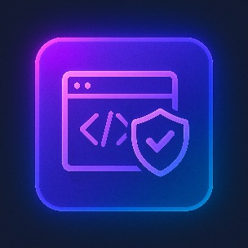

To ensure success on this journey we shall follow our guiding stars
Time to remediate vulnerabilities
Reducing “time to remediate” shortens the window in which attackers can exploit known flaws, limiting potential business disruption, regulatory penalties, and emergency patch costs—turning security fixes from fire drills into routine operational hygiene.
Summarize the top metrics selected.
Credential stuffing detection rate
Elevating the credential stuffing detection rate closes the gap between automated login attacks and defensive response, preventing bulk account takeovers that can siphon funds, expose sensitive data, and undermine user trust before damage spreads across integrated systems.
Applications with integrated security testing
Boosting the share of applications with integrated security testing uncovers flaws at build time, cutting costly rework, shrinking breach exposure, and letting new features reach customers faster and more safely.
Cost per vulnerability remediated
Lowering the cost per vulnerability remediated directs scarce security dollars toward innovation instead of emergency fixes, enabling more flaws to be resolved within the same budget while preserving resources for strategic growth and resilience initiatives.
Info-Tech Research Group | 6

Slide 7



Every successful new venture starts with solid support
Summarize requests for funding and staffing from the Results tab.
costs
Staffing
timeline
Implementing the iSSDLC will require a total investment of ≈ $1.5 million over three years, front-loaded to fund tooling licenses, pipeline integrations, and staff up-skilling: roughly 20% ($300,000) in Year 1 for planning and pilot deployments, 60% ($900,000) in Year 2 for full rollout and training, and the remaining 20% ($300,000) in Year 3 for optimization and ongoing support.
Staffing scales in lockstep with rollout: add one dedicated application security engineer in Year 1 to lead tooling integration and standards work, then free up a second engineer in Year 2 by reallocating a developer whose effort is released through automation-driven efficiency gains — so the second position comes from existing headcount rather than an incremental hire.
The three-year roadmap is deliberately front-loaded: core automation — CI/CD security gates, continuous SAST/DAST, and autogenerated SBOMs — lands in the first year to deliver immediate risk reduction and developer efficiency. Years 2 and 3 then shift to longer term work, bringing legacy apps under the same guardrails, expanding model-governance and data-privacy tooling, and maturing metrics-driven oversight so the program can scale sustainably.
Info-Tech Research Group | 7

Slide 8
OUR STARTING POINT

Slide 9
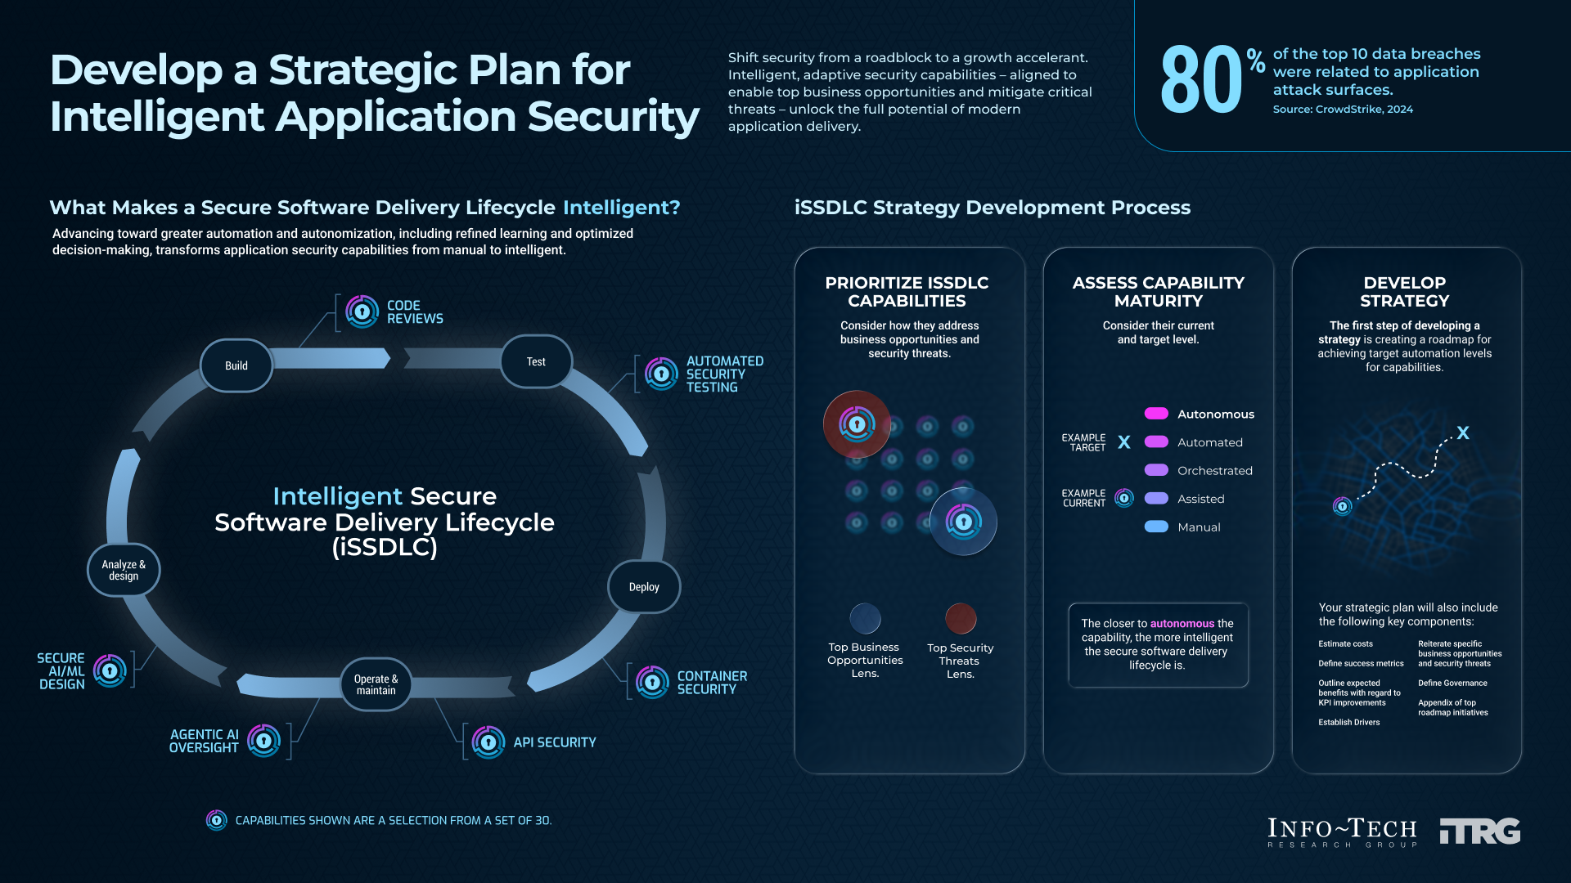

Slide 10

iSSDLC Maturity Scale
Humans set strategy and ethics. AI agents operate, learn, and optimize security end to end with minimal human input. The iSSDLC capability proves compliance on its own.
Autonomous
Target
Move arrows to indicate current and target states.
Analytics and AI adapt controls continuously, remediate most routine issues without waiting for people, and escalate only edge cases. Security processes run largely hands-free.
Automated
Orchestrated
Tool-driven, multistep workflows carry out security tasks end to end (e.g. scans → PRs → tests) while humans provide oversight and final approval at defined risk gates.
Current
Assisted
Basic tools, checklists, or templates help humans find issues or follow best practices, but people still decide and perform every task.
Manual
Capability is ad hoc and entirely human-driven. Little or no tooling; success depends on individual effort and local knowledge.
Image generated by ChatGPT

Slide 11




Drivers
The drivers behind the need to evolve application security.
Business opportunities
Monetize data and services through open, premium application programming interfaces (APIs).
Faster time to value for new products.
Accelerate AI and advanced analytics initiatives.
Compliance requirements
PCI Data Security Standards.
California privacy laws.
CMMC Level 2 requirements.
Describe major business drivers for change (compliance, business needs).
Pain points
Manual SBOMs become obsolete too quickly to be of use.
Security architecture reviews take too long and hold up development.
Developers are expected to lead security but aren’t getting the training they need.
Security threats
Mass credential stuffing and account takeover.
Software supply chain compromise.
Sensitive data leakage in AI‑enabled apps.

Slide 12
Current state assessment
Strengths:
Strong vulnerability management
Robust deployment security gates
Effective code reviews
Concerns:
No security architecture reviews
Poor secure test environment practices
Ineffective threat modeling
Current maturity
2.3
Basic tools, checklists, or templates help humans find issues or follow best practices, but people still decide and perform every task.
Add charts showing the current state of capabilities and provide comments.

Slide 13
Baseline metrics
Update charts showing the current metrics, if available.

Slide 14

Threat impacts
Examine high-priority security threats and associated potential business impacts.
Security threat | Potential business impacts
Mass credential stuffing and account takeover | Erosion of customer trust Expenses related to customer redress due to cyberfraud Increased cyberinsurance premiums Pollution in customer identity databases
Software supply chain compromise | Delayed product launches due to security concerns with software components Increased liability of redistributing compromised software
Sensitive data leakage in AI‑enabled apps | Erosion of customer trust Potential regulatory fines
Enter your priority security threats and include potential business impacts.

Slide 15
Capability prioritization
Top iSSDLC capabilities prioritized.
Copy the capability prioritization table from the Results tab.

Slide 16
OUR DESTINATION

Slide 17
Gap assessment
Biggest gap: Build
The build phase represents our largest opportunity for improvement.
Software supply chain security represents a significant threat where automation can play a major role in efficiencies and threat reduction.
Version control and repository management is another key area for improvement.
Add charts showing the current state of capabilities and provide comments.

Slide 18
Target state assessment
Target maturity: 3.3
Tool-driven, multistep workflows carry out security tasks end to end (e.g. scans → PRs → tests) while humans provide oversight and final approval at defined risk gates.
Add chart showing the current and target state of capabilities. Summarize target state.

Slide 19
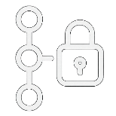
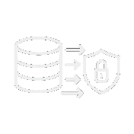

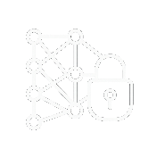


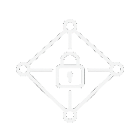

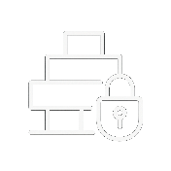
iSSLDC Target State
New capability
Improved capability
Secure Version Control
Autonomous
Unchanged capability
Software Supply Chain Security
Training Data Security
Automated
Illustrate target state with prioritized capabilities. Appendix B contains additional icons.
Analyze & Design
Build
Test
Deploy
Operate & Maintain
Fuzz Testing
Threat Detection
Orchestrated
CI/CD Pipeline
Assisted
Threat modeling
AI Security Design
Penetration Testing
Manual
Secure architecture design

Slide 20
Governance and accountabilities
iSSDLC governance functions | Executive sponsor | Security management | Application development | Application owners | Product management | Risk management / compliance
Define AppSec strategy and vision | A | R | R | C | C | I
Define AppSec policy and standards | C | R | C | A | R | I
Prioritize capabilities and investments | A | R | C | C | C | C
iSSDLC budget steering | A | C | R | C | C | C
Continuous improvement | I | A | C | R | R | C
Enterprise risk and threat alignment | R | A | C | C | I | C
Tool and process governance | I | R | R | C | A | C
Metrics and reporting oversight | R | A | C | I | R | C
Exception management | A | C | C | I | R | R
Release gate management | A | R | C | I | C | C
RACI matrix to define the application security governance.

Slide 21
iSSDLC improvement initiatives
List of all initiatives mapped to opportunities and threats.
List of potential initiatives mapped to drivers and risks from the Results tab.

Slide 22
Priority initiatives
1
2
3
Describe the top three initiatives on the roadmap.
Deploy threat modeling automation tools.
Automate software composition analysis and supply chain scanning.
Establish fuzzing and red team engagement programs.
Integrate, configure, and operationalize an automated threat modeling platform across the iSSDLC, giving on-demand security design feedback without slowing delivery. The project will evaluate leading commercial and open-source engines, pilot the preferred tool in one flagship product line, and then roll it out company-wide through reusable CI/CD integrations, secure infrastructure as code templates, and developer enablement workshops.
Weave continuous vulnerability and license risk detection into every build pipeline, from source to production container registry. The effort will benchmark commercial SCA/SBOM vendors against emerging open-source scanners, select a unified platform, and embed it via Git hooks, CI/CD jobs, and Kubernetes admission controllers so that any third-party package or container layer is checked in under 60 seconds.
This project is designed to deploy tools and processes to uncover deep-logic flaws and adversarial attack paths before they reach production. The initiative will stand up coverage-guided and grammar-based fuzzing pipelines for critical APIs, parsers, and IoT firmware, with nightly jobs feeding crashes and stack traces directly into the defect tracking system.

Slide 23
Roadmap
Copy proposed implementation timeline from Gantt chart.

Slide 24
Expected costs and resourcing
Table showing estimated costs and staffing.

Slide 25
Expected benefits
Table or charts showing expected improvements in metrics.

Slide 26
Next steps
1 | Socialize strategy with executive management (Q1).
2 | Submit budget proposals for next fiscal year (Q2).
3 | Form program steering committee (Q3).
4 | Assign program manager (Q3).
5 | Develop detailed project plans for top three initiatives (Q3).
6 | Launch first project (Q4).
Numbered list of next steps for plan.

Slide 27
ACME Corporation
May 2025

Slide 28
APPENDIX A: INITIATIVE ONE-PAGERS

Slide 29







iSSDLC Initiative Description
Securing Our
Digital Future
Initiative: Integrate SAST tools into CI pipeline.
Project overview
Integrate, configure, and operationalize an automated SAST capability across the iSSDLC.
Evaluate leading commercial and open-source engines.
Pilot the preferred tool in one flagship product line and then roll it out through reusable CI/CD integrations.
Establish false-positive optimization process.
Sample one-pager.
Costs
Initial: $130,000
Software licensing $80K
Training $20K
Integration services $30K
Ongoing: $80,000 OpEx
Maintenance fees
Initial estimated effort
120 hours, primarily DevOps engineer and security analyst
Project team
Business benefits
Security benefits
CISO (business sponsor)
Director of application development
Project manager
DevOps engineer
Security analyst
Faster time to value for new products
Increased ability to monetize API access
Reduced risk of ransomware
Improved application security KPIs
Risks
Timeline
Budget overrun
Change resistance
Skills mismatch leading to delays
Q1 2026 | Q2 2026 | Q3 2026 | Q4 2026
Requirements
Deployment
RFP
Pilot
Selection

Slide 30
APPENDIX B: ICONS

Slide 31
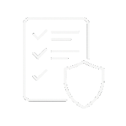
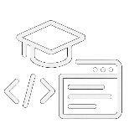





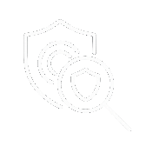


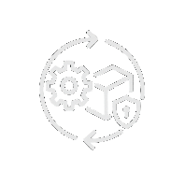








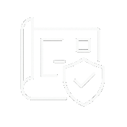

iSSLDC Icons
Analyze and design
Build
Test
Deploy
Operate and maintain
Icons generated by Sora
Security requirements definition
Secure coding practices and training
Secure deployment and infrastructure as code (IaC)
Security monitoring and threat detection
Automated security testing
Secure code review and static analysis
Penetration testing and red Teaming
Container and orchestrator security
Incident response and recovery
Threat modeling
Secure architecture design
Software supply chain security
Vulnerability management and patching
Fuzz and chaos Testing
Policy as code (PaC) deployment
Zero trust architecture
Secure build and CI/CD pipeline
Security requirements validation
Artifact signing and provenance
API security
Secure version control and repository management
Secure test environments and data management
Deployment security gates and reviews
Environment management and configuration
Secure AI/ML design
AI/ML training data collection security
Secrets management in development
Vulnerability disclosure and bug bounty
Secure design review and assurance
Agentic AI oversight and control

