Slide 1

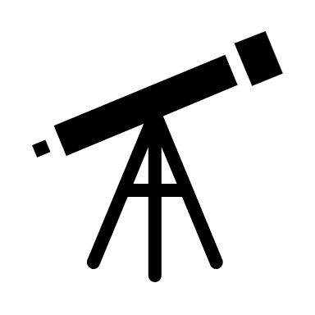
Concepts Behind Image Formation: Telescopes, Mobile Cameras, etc.
Lecture 5
22/08/2024
SPA613M: Introduction to Celestial Observational Techniques

Slide 2

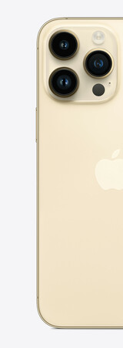
Why Multiple Camera’s

Slide 3

Image Formation
Image: Projection of 3D scene on 2D plane.
Screen
Scene
Won’t form a clear image

Slide 4
Pinhole Camera
Perspective Projection
Scene
Screen
Notes:
Angle is same, focal length = distance of pinhole decides the FOV, one to one mapping

Slide 5
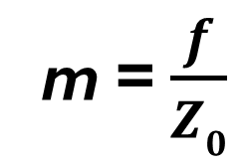
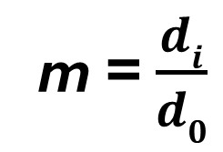
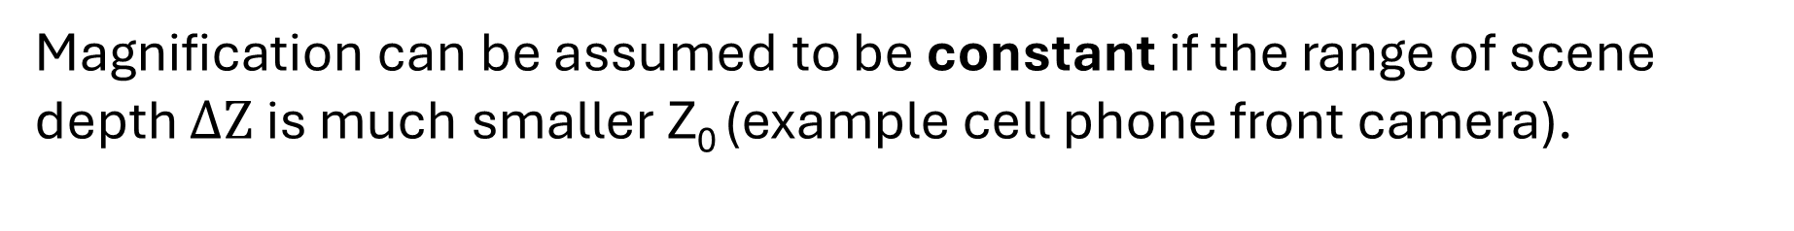
Image Magnification
m = $\frac{di}{d0}$
d₀
f
z₀
m = $\frac{f}{Z0}$
d_{i}
Magnification can be assumed to be constant if the range of scene depth $ΔZ$is much smaller Z₀ (example cell phone front camera).
Notes:
Angle is same, focal length = distance of pinhole decides the FOV, one to one mapping

Slide 6
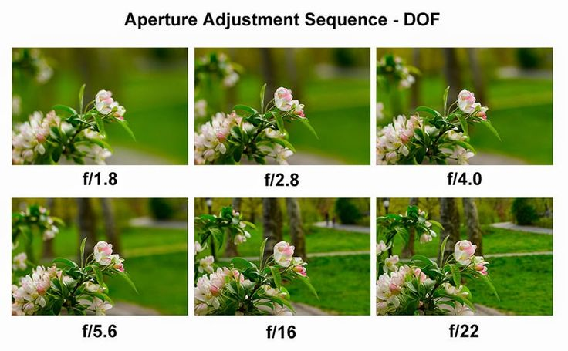

Slide 7
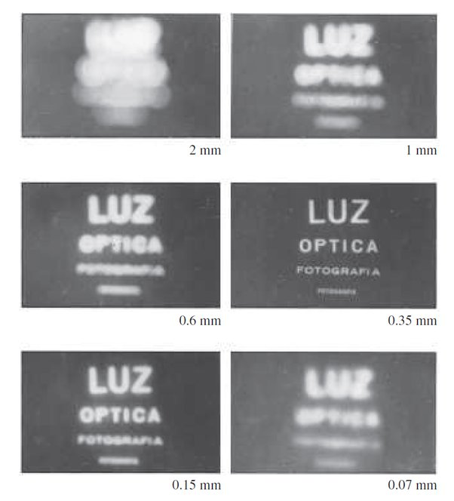
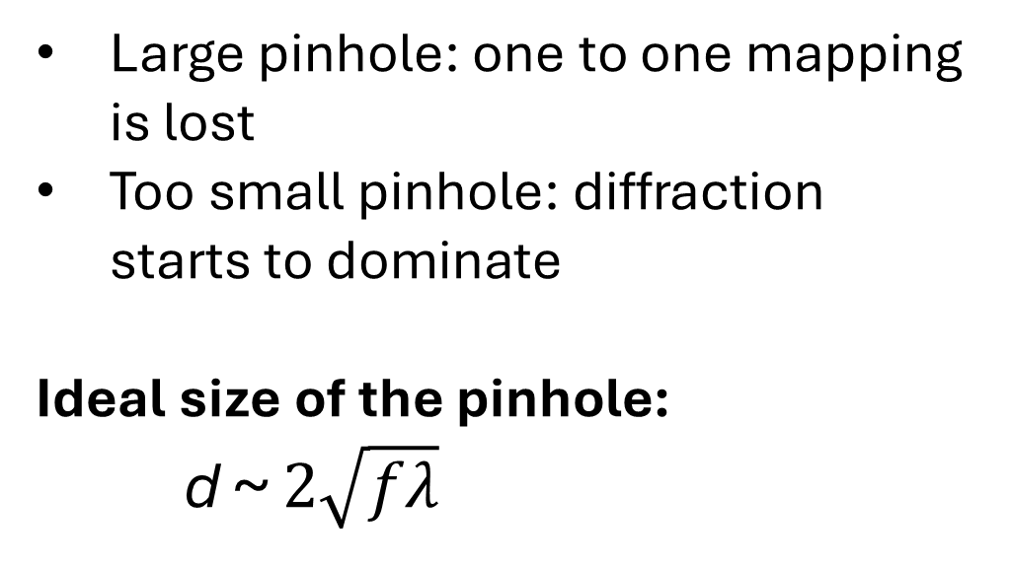
What is Ideal Size of the Pinhole
Large pinhole: one to one mapping is lost
Too small pinhole: diffraction starts to dominate
Ideal size of the pinhole:
d ~ $2\sqrt{fλ}$
Limitations: sharpness and light gathering

Slide 8
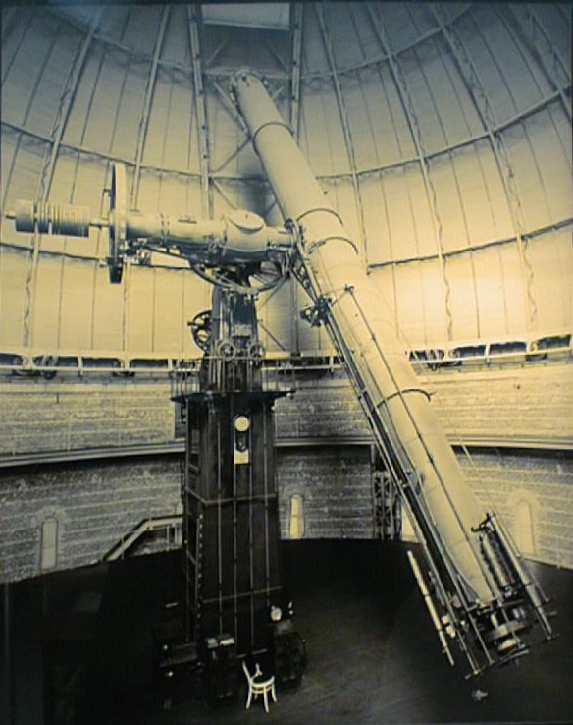
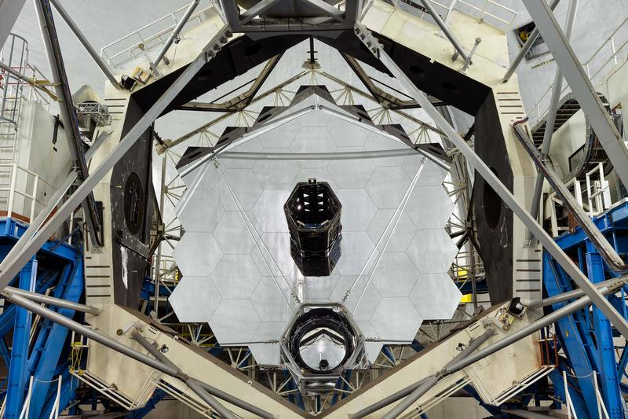
10-meter reflector (Keck telescope),
Mauna Kea, Hawaii
1-meter refractor, Yerkes Observatory, Wisconsin
A 10-meter telescope gathers 100 times as much light as a 1-meter telescope.

Slide 9
Lenses
F
S: source
F
P: image

Slide 10
Lenses
F
F
P: image
S: source

Slide 11

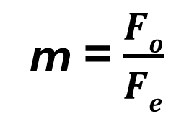
Simple Telescope
S: source
F_{e}
F_{o}
P: image
m = $\frac{Fo}{Fe}$
Example: Objective 10 cm and eyepiece 2 cm will magnify image 5x

Slide 12
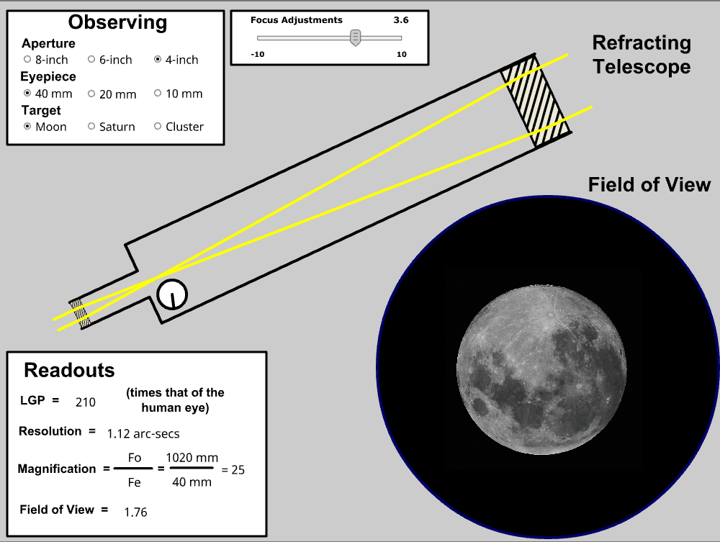
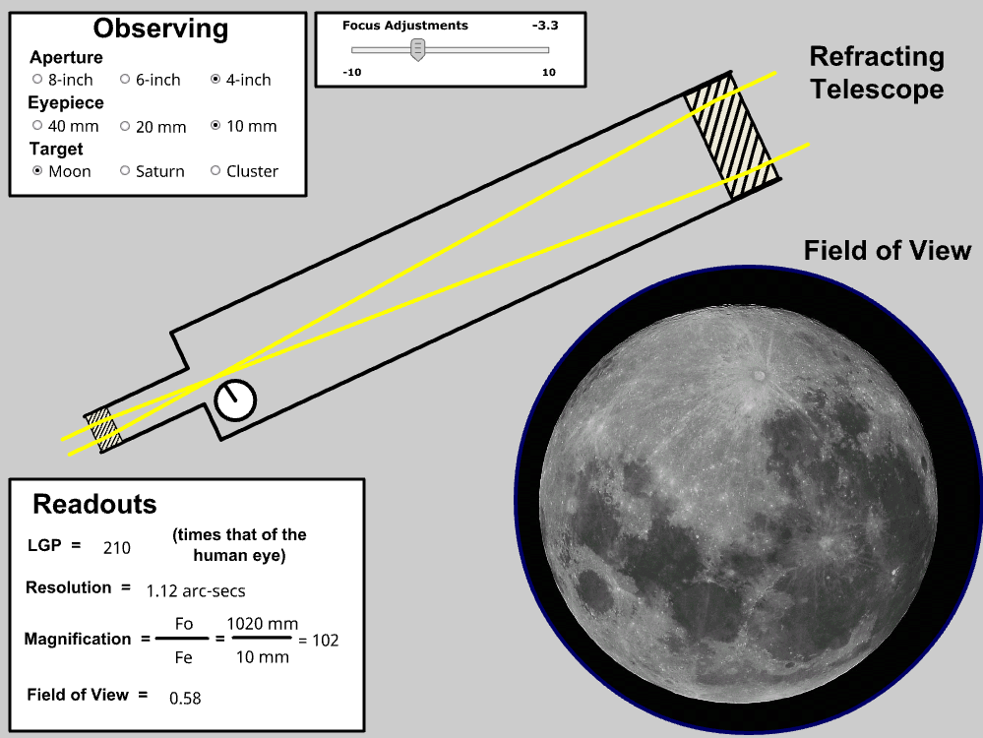
Example
https://astro.unl.edu/classaction/animations/telescopes/telescope10.html

Slide 13
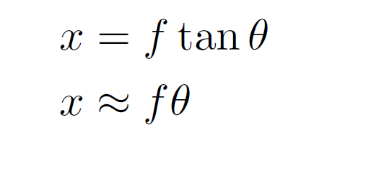
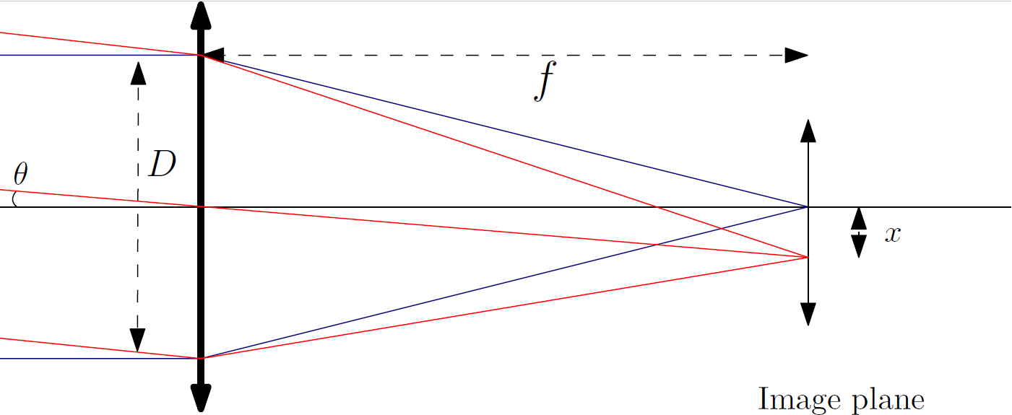
Field of View (plate scale) of a Telescope
Image formation (Simple Telescope);
The plate scale of a telescope can be described as the angle, corresponding to the distance at the focal plane.

Slide 14
Energy Density
The energy density U of the focused light can be estimated by knowing the amount of energy E in the light beam and dividing by the area A :
U = E / A
As the f increases, the energy density decreases.
The effect is that a light-sensitive detector will take a longer time to reach the integrated light intensity using a longer focal length system compared to using a shorter focal length system.

Slide 15
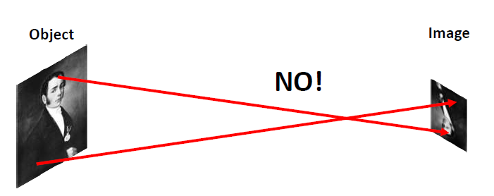
Image Formation (Isn’t just ray tracing)

Slide 16
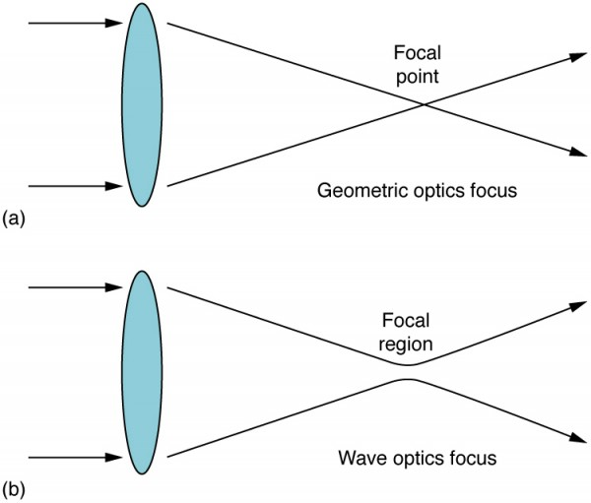
Image Formation by a Lens

Slide 17


Diffraction by Circular Aperture
Fresnel diffraction integral:

Slide 18
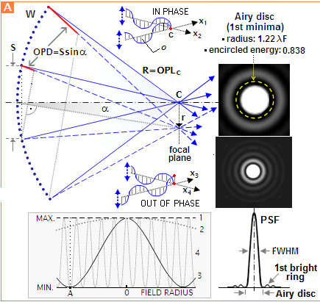
https://www.telescope-optics.net/

Slide 19
Image formation by a Telescope

Slide 20
Airy disk and the Rayleigh criterion

Slide 21
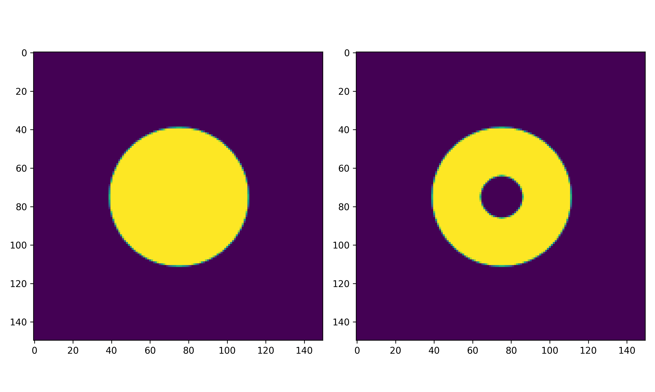
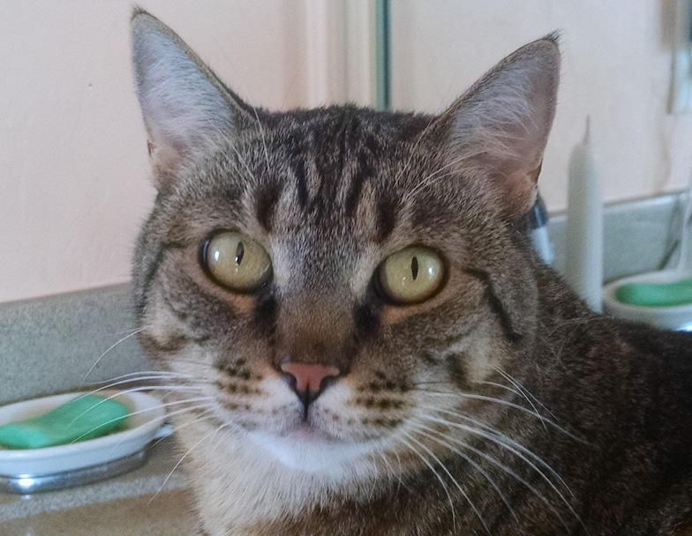
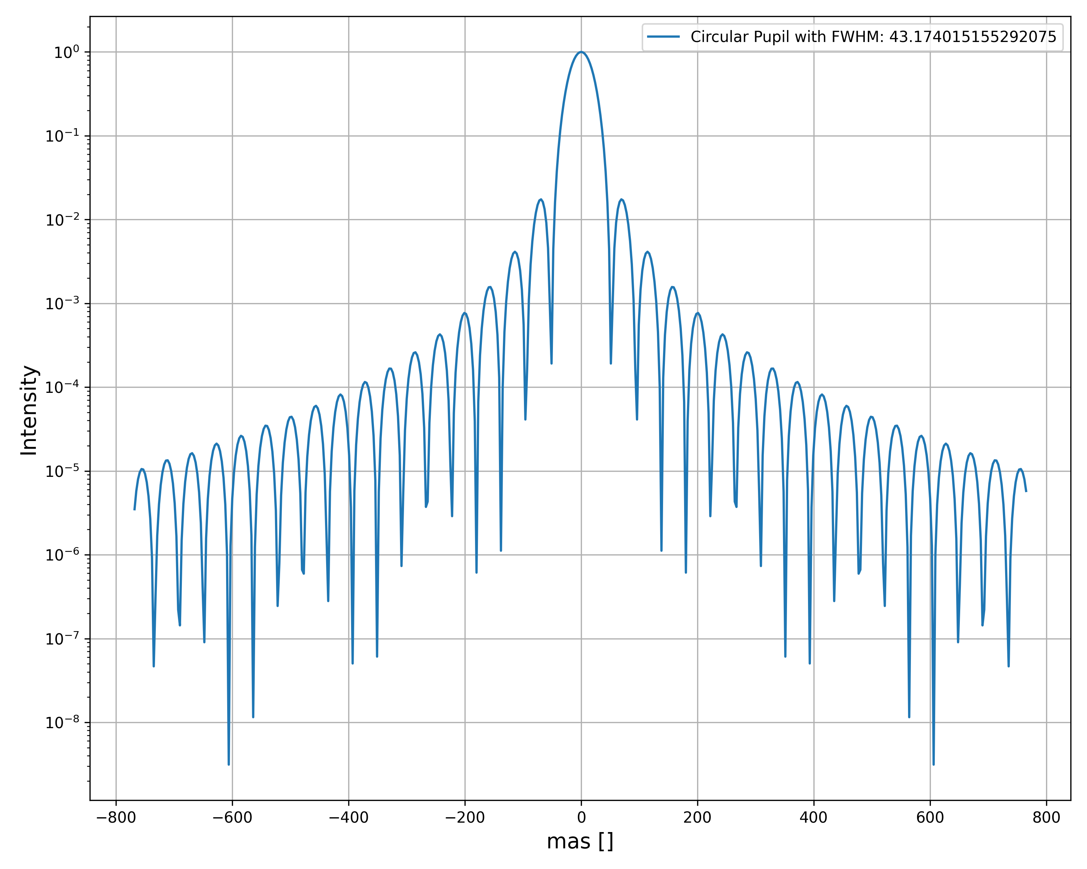
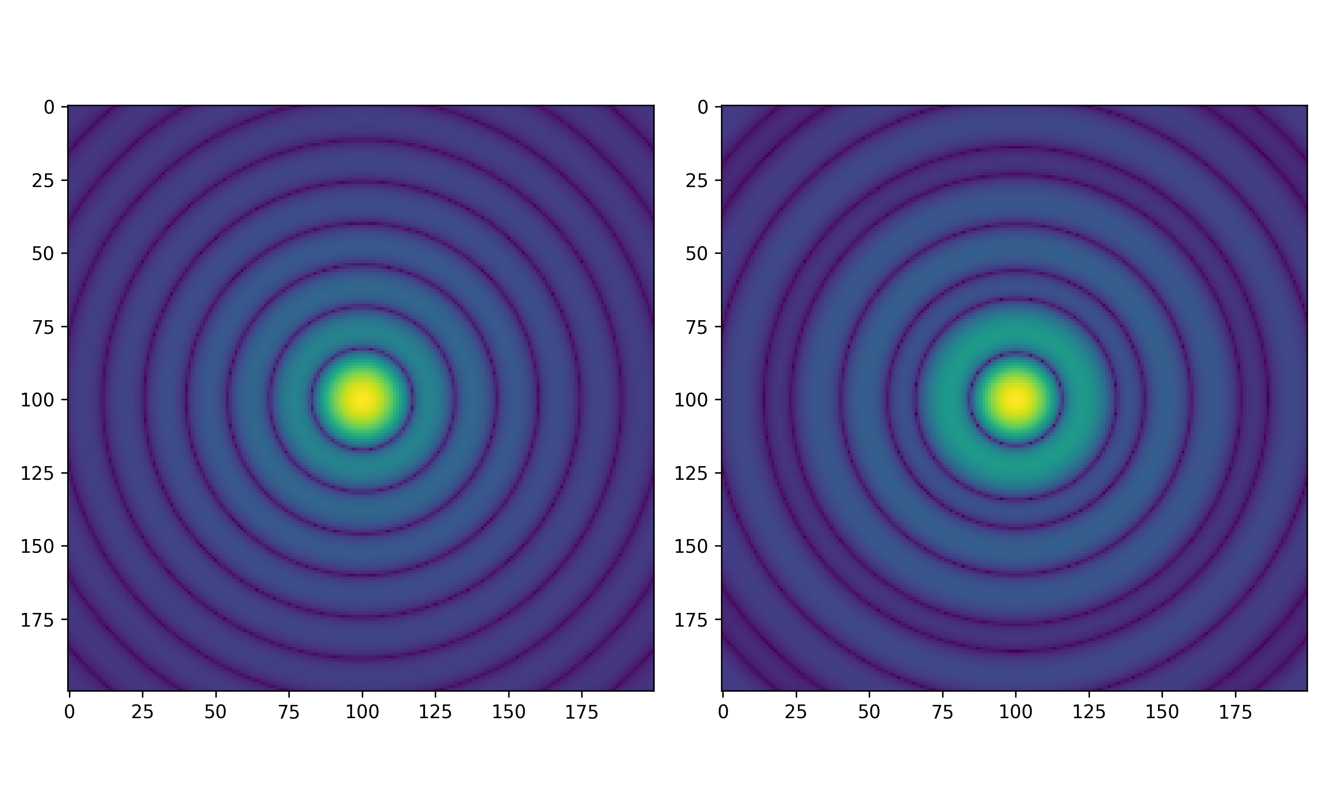
Diffraction Through Circular Pupil

Slide 22
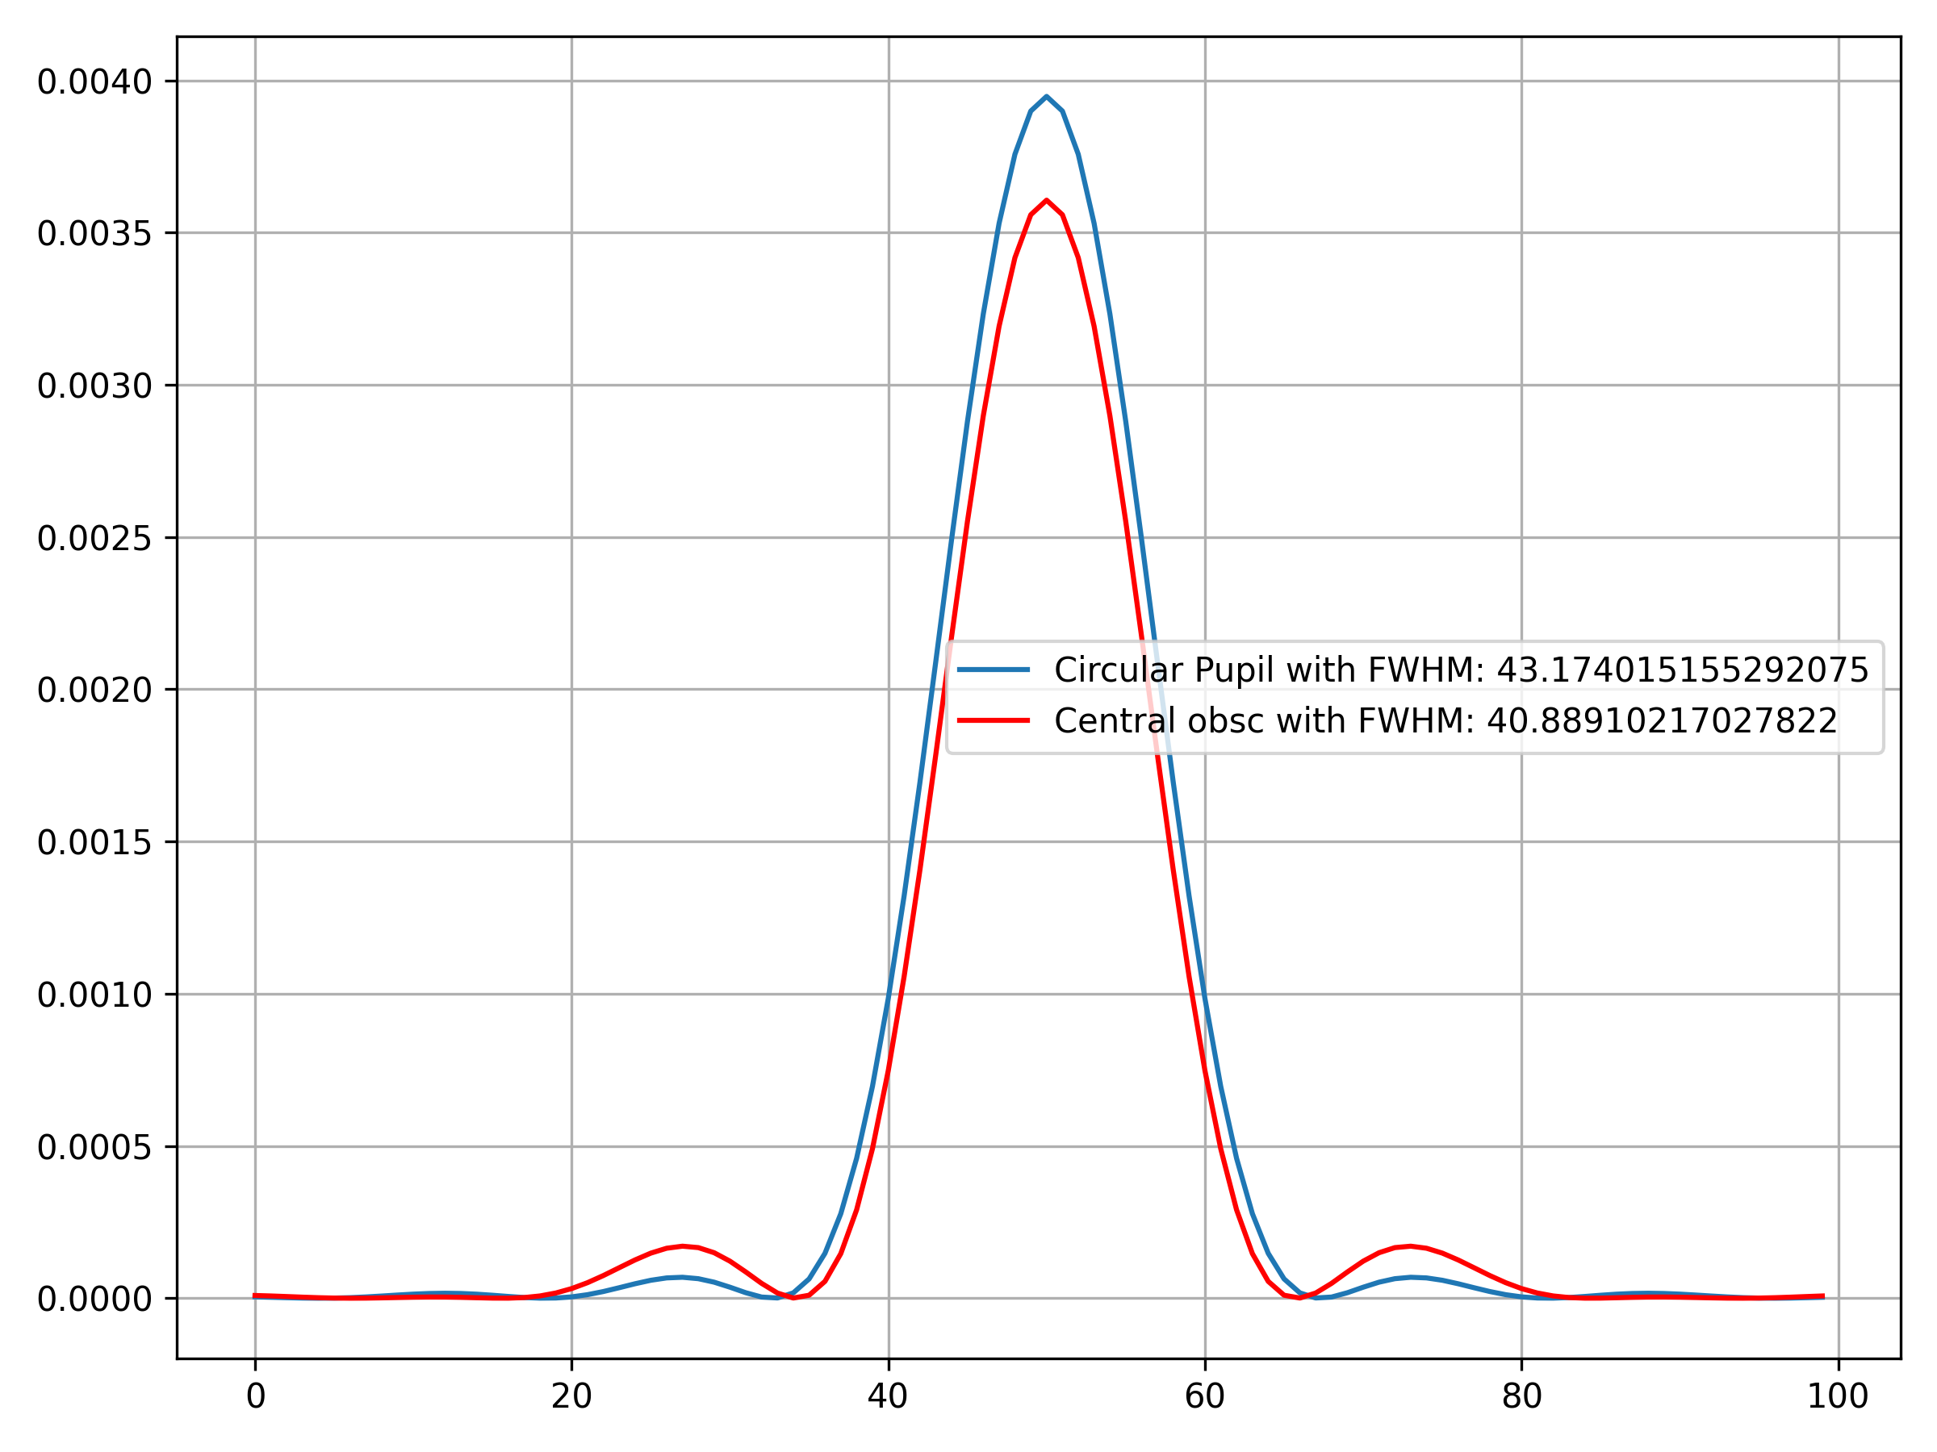
Diffraction Pattern for Other Pattern

Slide 23
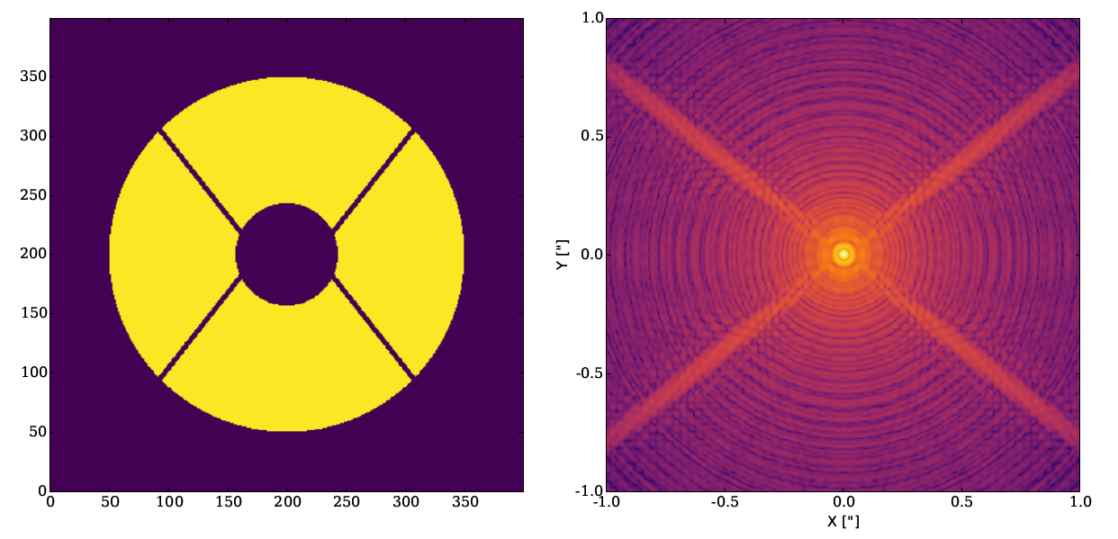
PSF of a typical Telescope
Subaru Telescope Pupil
8-m class telescope

