Slide 1

CAPSTONE PROJECT - 2 BIKE SHARING DEMAND PREDICTION
COHORT - OSLO
TEAM MEMBER:
ANUP A. JAMBULKAR
VIBHU SHARMA
GAURAV MALAKAR
ANKIT WALDE
ANIL BHATT

Slide 2

CONTENTS:
Problem statement
Introduction
Data Summary
Exploratory Data Analysis
Model Building
Evaluation
Challenges
Conclusion

Slide 3

PROBLEM STATEMENT :
Currently Rental bikes are introduced in many urban cities for the enhancement of mobility comfort.
It is important to make the rental bike available and accessible to the public at the right time as it lessens the waiting time.
Eventually, providing the city with a stable supply of rental bikes becomes a major concern.
The crucial part is the prediction of bike count required at each hour for the stable supply of rental bikes.

Slide 4

INTRODUCTION :
Prediction of bike sharing demand can help bike sharing companies to allocate bikes better and ensure more sufficient circulation of bikes for customers.
This presentation proposes a real-time method for predicting bike renting based on historical data, weather data, and time data.
This demand prediction model can provide a significant theoretical basis for management strategies and vehicle scheduling in the public bike rental system.

Slide 5

DATA SUMMARY :
The dataset contains weather information (Temperature, Humidity, Windspeed, Visibility, Dewpoint, Solar radiation, Snowfall, Rainfall), the number of bikes rented per hour, and date information.
Date: year-month-day
Rented Bike count - Count of bikes rented at each hour
Hour - Hour of the day
Temperature-Temperature in Celsius
Humidity - %
Windspeed - m/s
Visibility - 10m
Dew point temperature - Celsius
Solar radiation - MJ/m2
Rainfall - mm

Slide 6
DATA SUMMARY Cont. :
Snowfall - cm
Seasons - Winter, Spring, Summer, Autumn
Holiday - Holiday/No holiday
Functional Day - NoFunc(Non Functional Hours), Fun(Functional hours)
This dataset contains 8760 rows and 14 columns
Numerical variables - temperature, humidity,wind,visibility,dew point temp, solar radiation,rainfall,snowfall
Categorical variables - seasons, holidays and functioning day
Rented bike column - which we need to predict for new observations

Slide 7
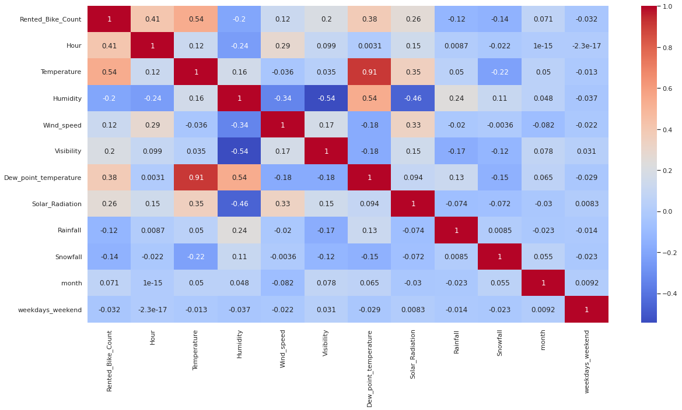
CHECKING MULTICOLLINEARITY :
Variables like Dew Point Temperature, and Temperature are highly correlated.
We don’t want Multicollinearity in our dataset it affects the performance metrics so we are dropping Dew Point Temperature.

Slide 8

EXPLORATORY DATA ANALYSIS (EDA) :
Exploratory Data Analysis refers to the critical process of performing initial investigations on data to discover patterns, spot anomalies, test hypotheses, and check assumptions with the help of summary statistics and graphical representations.
EDA is for seeing what the data can tell us beyond the formal modeling or hypothesis testing task.

Slide 9
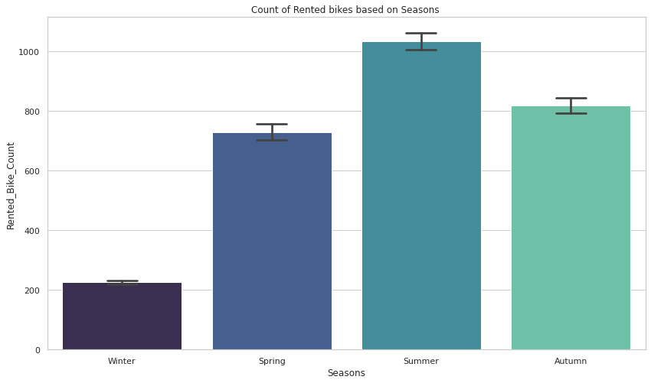
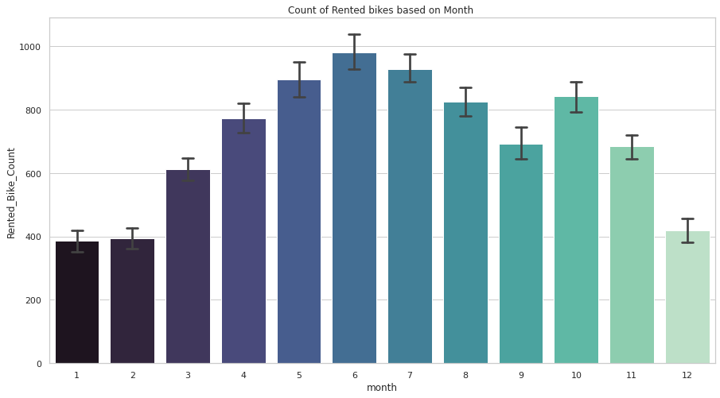
ANALYSIS BY DATA VISUALIZATION:
In the summer season, the use of rented bikes is high whereas in the winter season the use of rented bikes is very low.
The demand for the rented bike is high from the month 5 to 10

Slide 10
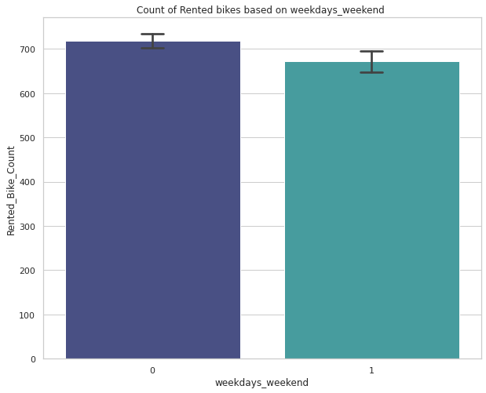
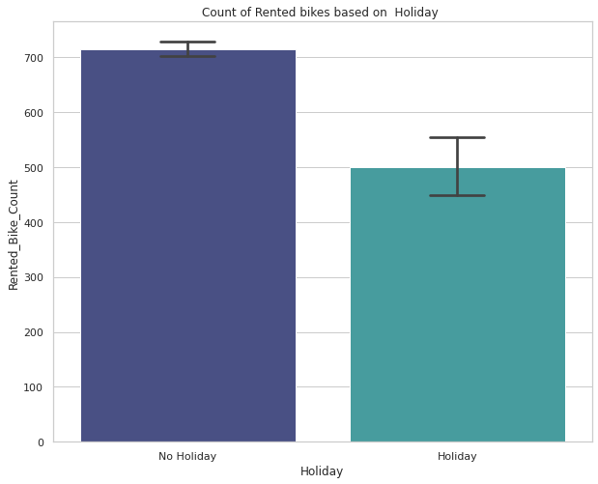
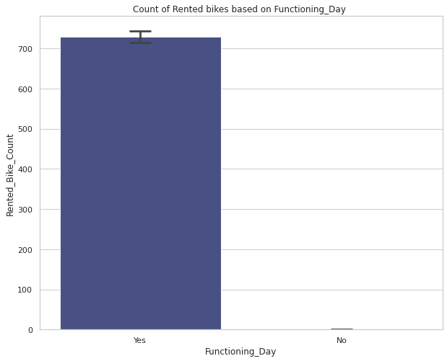
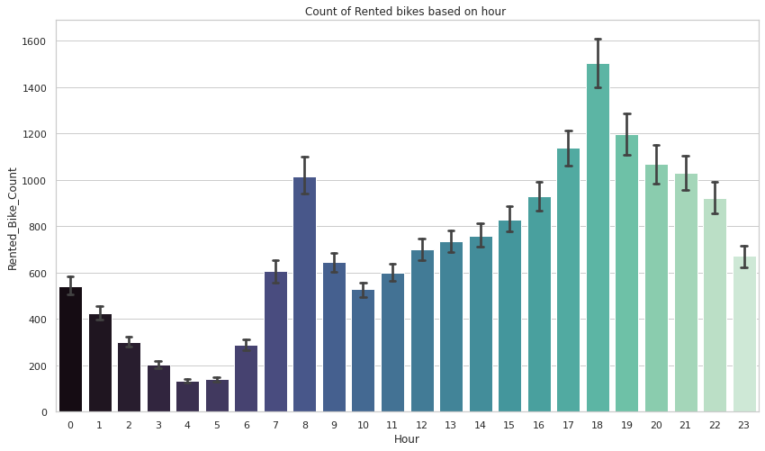
By visualizing graph 1, People prefer to rent bikes on the weekdays but the difference is not significant.
By visualizing graph 2, People prefer bikes to rent on non-holidays as compared to holidays.
By visualizing graph 3, People use rented bikes only on functioning days.
By visualizing graph 4, people generally use rented bikes during their working hours from 7 am to 9 am and 5 pm to 8 pm.

Slide 11
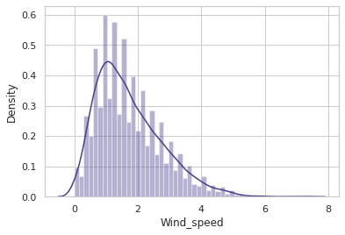
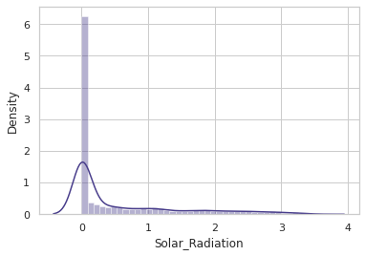
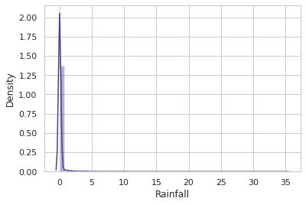
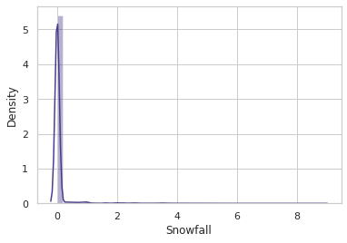
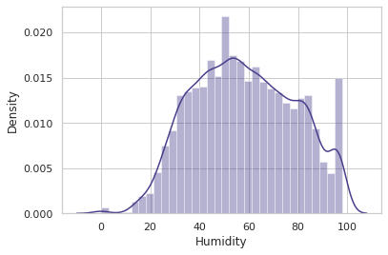
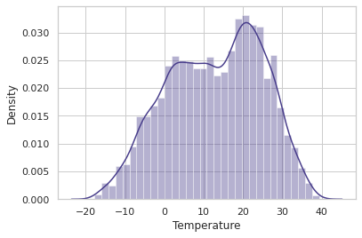
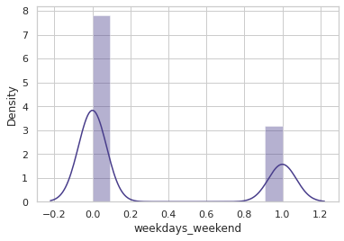
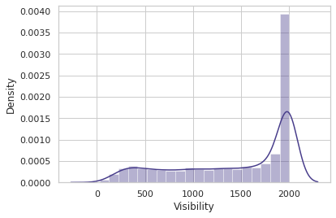
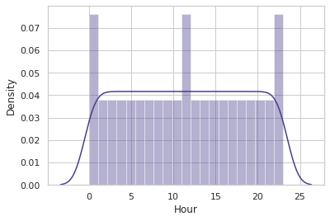
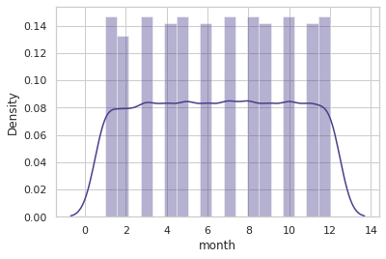
VISUALISING DISTRIBUTIONS :

Slide 12

ANALYSIS FROM VISUALISING DISTRIBUTIONS :
“Temperature”, “Hour”, “Month” and “Humidity” columns follow a uniform distribution.
“Wind Speed”, “Solar Radiation”, “Rainfall” and “Snowfall” are having positively skewed distribution.
“Visibility” column is negatively skewed.

Slide 13
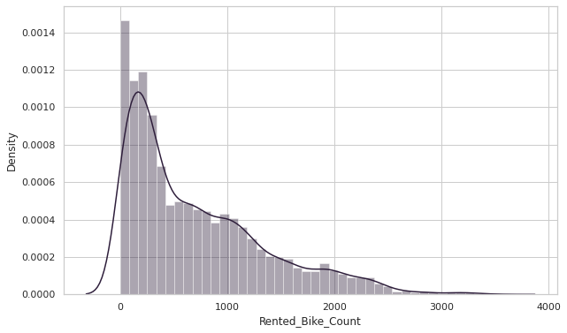
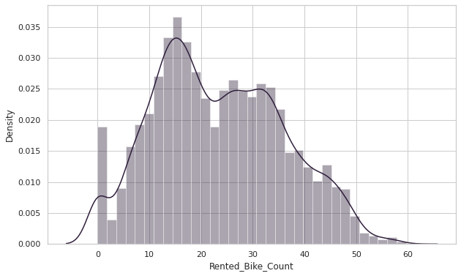
DISTRIBUTION OF TARGETED FEATURE :
CONVERTED THE POSITIVELY SKEWED DATA
TO NORMALISED

Slide 14
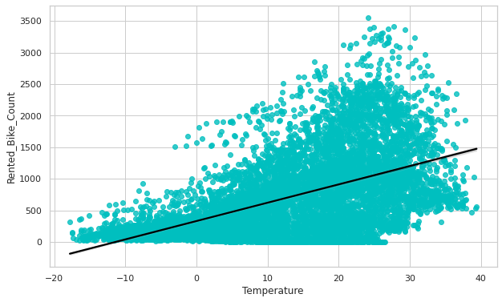
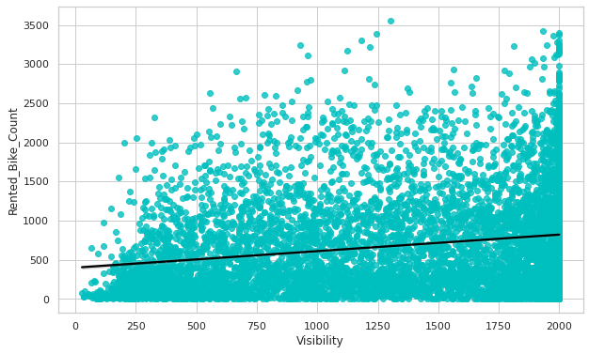
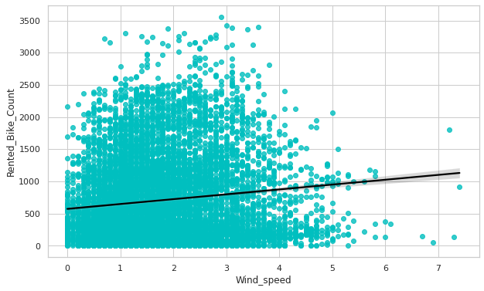
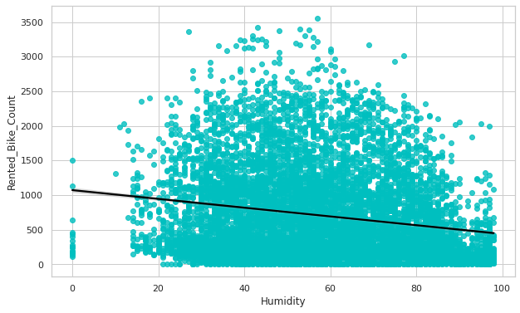
REGRESSION PLOTS : DEPENDENDENT FEATURE TO TARGETED FEATURE

Slide 15
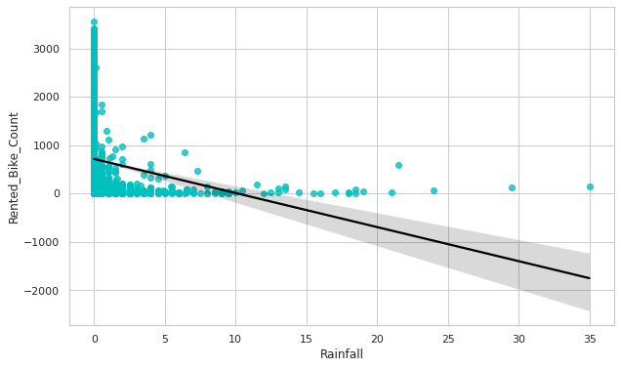
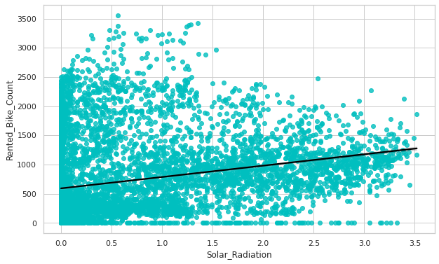
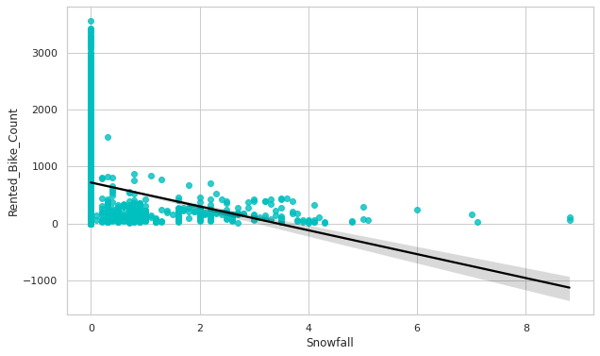
CONT….

Slide 16

MODEL BUILDING :
Linear regression model
Regularized linear regression:
Lasso regression model
Ridge regression model
Elastic net regression model
Decision tree regression model
Ensemble techniques:
Random-forest regression model
XG–Boost regression model
XG–Boost GridsearchCV Regression model

Slide 17
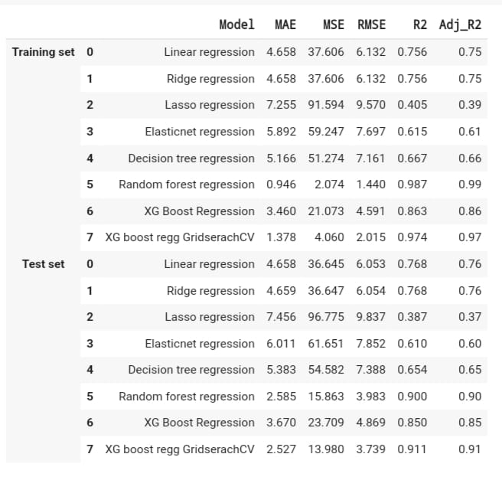

EVALUATION OF MODELS :
Out of all the above models “Random forest Regressor” gives the highest Adj.R2 score of 99%.
For the Train Set and “XG Boost Grid search CV” gives the highest Adj.R2 score of 91% for the Test set.
No overfitting is seen.

Slide 18

CHALLENGES FACED
Feature engineering.
Feature selection.
Dummy encoding in XG-boost regressor. (because it does not support sparse data type)
Model Training and performance improvement.

Slide 19
CONCLUSIONS :
No overfitting is seen.
When we compare the root mean squared error and mean absolute error of all the models, the XG- boost grid search CV regression model has less root mean squared error and mean absolute error, ending with the Adj. R-squared of 91% in test data. So, finally, this model is best for predicting the bike rental count on daily basis.
For all the models, temperature and Functioning days were ranked as the most influential variable to predict the rental bike demand at each hour.

Slide 20


