Slide 1

Human Voice Recognition in the Regional Language
By
ANUP BURNWAL (Roll No. 10700116043)
&
VIVEK KUMAR YADAV (Roll No. 10700116002)
Under the supervision of Dr. Alok Ranjan Pal
DEPARTMENT OF COMPUTER SCIENCE & ENGINEERING
COLLEGE OF ENGINEERING & MANAGEMENT, KOLAGHAT

Slide 2
ABSTRACT
This project ‘Human Voice Recognition in the Regional Language’ is a speech recognition system to recognize a phone from a set of phones in a regional Language (Hindi), Speech recognition mechanism comes under the domain of Natural Language Processing(NLP).
The aim here is to recognize the human voice in regional language(Hindi) from a specific set of phones (which are आगे(āge), पीछे(peechhe), बाएँ(bāen), दाएं (dāen), चलो (chalo), रूको (ruko)) and then use this recognition system to operate an Arduino based vehicle through on-spot human voice.
For making the training module, a Recurrent Neural Network was made which was fed with a MFCC value of around 400 audio files (manually collected) consisting of the mentioned phones and a model was trained.
The final results are quite encouraging giving an accuracy of (80-85) % when tested on the files present in the system whereas gives promising on-spot testing for other phones except for the phone āge (आगे) as this phone is somewhat similar in structure to other phones like (dāen, bāen).

Slide 3
TABLE OF CONTENTS
INTRODUCTION
A BRIEF SURVEY
3. PREPROCESSING WORK
4. PROPOSED APPROACH
5. RESULT AND CORRESPONDING EVALUATION
6. FEW CLOSE OBSERVATIONS
7. FUTURE SCOPE
CONCLUSION
REFERENCES

Slide 4
INTRODUCTION
Speech recognition is simply the ability of a software to recognise speech. Anything that a person says, in a language of their choice, must be recognised by the software.
We can use speech recognition system to perform an action based on the instructions defined by the human voice. For that we need to train the speech recognition system by storing speech patterns and vocabulary of their language into the system & based on these patterns we have to define some certain actions.
Now a days many complex recognition system has been built in English language. Be it Google (OK Google), Alexa etc. they are able to recognise complex sentences and give results according to that. But any complex system in Indian Regional Language is not yet developed.
The proposed approach is making a speech recognition system which can predict human voice from specific domain of phones (that are आगे(āge), पीछे(peechhe), बाएँ(bāen), दाएं (dāen), चलो (chalo), रूको (ruko)). The expectation from the system is to make a promising model which can predict voices from human which is expected to be fed to an Arduino based toy vehicles which can be operated from the human voice.

Slide 5
A BRIEF SURVEY

Slide 6
Survey on Tamil & Telugu Automatic Speech Recognition System
a) Krishnaveni present a Continuous Speech Recognition (CSR) system for Tamil language using Hidden Markov Model (HMM) approach. Used Most powerful and widely used MFCC feature extraction front-end for the proposed system. The monophone based acoustic model is chosen to recognize the given set of sentences from medium vocabulary. The results are found to be satisfactory with 92% of word recognition accuracy and 81% of sentence accuracy for the developed system.
b) Vimala C. and V. Radha present a speaker independent isolated speech recognition system for Tamil language. The experiments furnish high-quality word accuracy of 88% for trained and test utterances spoken by the speakers. The performance evaluation of the system is done based on the Word Error Rate (WER) which gives 0.88 WER for the above research work.

Slide 7
Survey on Assamese & Bengali Automatic Speech Recognition System
a) In 2010, K.K Sarma worked for the development of numeral speech recognition system for Assamese language. Gender and mood variations were given consideration during the recording of speech signals of 10 numeral digits at 8 KHz in mono channel mode.
b) S. Mandal, in their paper introduce the SPHINX3-based Bengali Automatic Speech Recognition system Shruti-II and an E-mail application based on it. This ASR system converts standard Bengali continuous speech to Bengali Unicode. This paper also demonstrates an application based on Shruti-II which enables visually challenged people to send E-mail by using this system.

Slide 8
Survey on Kannada ASR System
a) M. A. Anusuya and K.K Katti proposed a new scheme for recognition of isolated words in Kannada Language speech, based on the Discrete Wavelet Transform (DWT) and Principal Component Analysis (PCA). Initially the Discrete wavelet transform of a speech signal is computed and then LPC coefficients are calculated.
b) Shiva Kumar C worked to provide a low cost alternative for the literate deaf people. The project describes Isolated Word Recognition of Kannada Digits. The system reads the spoken speech signal. Wavelet transform of the speech signal is taken and MFCC (Mel Frequency Cepstral Coefficients) are calculated followed by Vector Quantization. Euclidean Distance measure is used to correlate the test speech signal with pre-recorded speech signals from the speech database. The nearest match is identified and its respective text equivalent is displayed. The project is carried out for Kannada digits, which can be extended to words later. The programming is done using Matlab.

Slide 9
Survey on Gujarati ASR System
a) Speech recognition of Gujarati Language is presented by Patel Pravin and Harikrishna Jethva. Neural network was used for developing the system. They have used joint features derived from the modified group delay function and MFCC for Continuous speech recognition.
b) A technique for fast bootstrapping of initial phone models of a Gujarati language is presented by Himanshu N. Patel. The training data for the Gujarati language is aligned using an existing speech recognition engine for English language. This aligned data is used to obtain the initial acoustic models for the phones of the Gujarati language.

Slide 10
PREPROCESSING WORK
Pre-processing of speech signals is considered a crucial step in the development of a robust and efficient speech recognition system. In the pre-processing of speech signals we perform some statistical outlier detection to segregate the silence/unvoiced part of the speech signal from the voiced portion. The noise free speech signals help to determine various parameters accurately and to improve the overall system performance for subsequent offline analysis process. The audio files collected where in different formats (such as.mp3, opus, .m4a etc.). All these files where converted to a uniform format (.wav) for making the training module. We plotted 3 different graphs for each phone, which are:
1.Time series graph
2. Fast Fourier transform
3.MFCC graph
After taking the insights of these graphs it was seen that all the audio samples are not sampled at the same frequency instead they have varying sampling frequency, thus all the audio files were sampled at the same frequency in this step. After that the unvoiced signals having low amplitude were discarded making an envelope over the audio of real part of the signal.

Slide 11
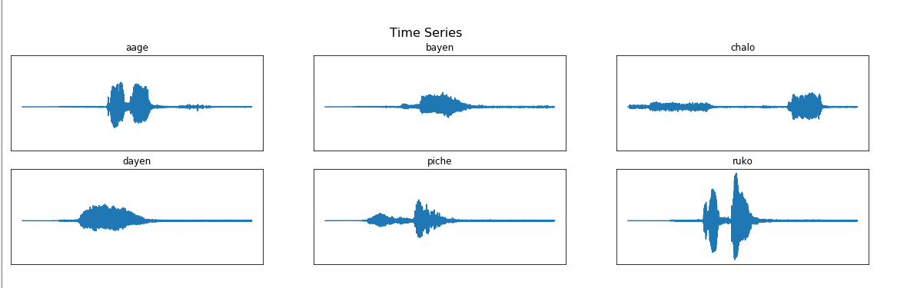
PREPROCESSING WORK-CONTD.
1. Time series graph: Time series plot is a 2D plot of the Amplitude of a signal with respect to time. Insights of the visual structure of the audio files, the unvoiced data, and similarity and dissimilarity can be inferenced from this plot. This helped us to find the amplitude value below which the audio waves are discarded and not used as they don’t have any useful information.

Slide 12
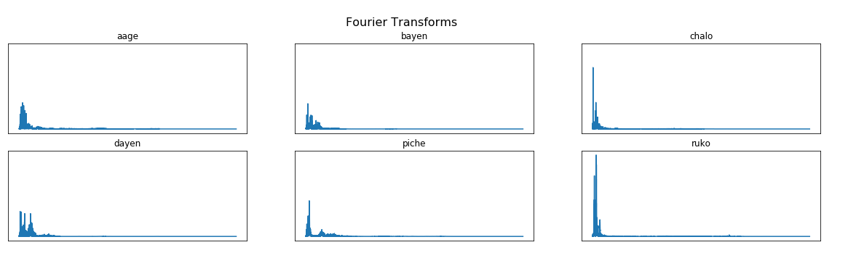
PREPROCESSING WORK-CONTD.
2. Fast Fourier transform: Fast Fourier Transform basically transform the signal from time domain to frequency domain such that the constituent frequency of a signal can be fetched. The higher frequency components of the wave basically consist of noise in the audio.

Slide 13
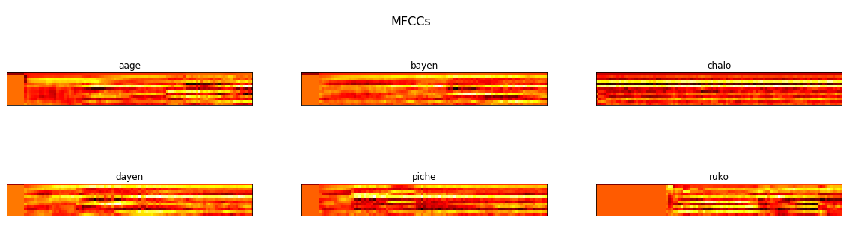
PREPROCESSING WORK-CONTD.
3. MFCC graph: MFCC gives the co-efficient by applying the Mel-scale to the audio signal transformed after DFT as the human ear perceives the frequencies in a similar way. These co-efficient help in analysing the voice based on the movement of human vocal tract.

Slide 14
PROPOSED APPROACH
Speech recognition: A technique by which specialized software and systems are created to identify, distinguish and authenticate the voice of an individual speaker.
The world has gone far ahead in Speech Recognition with Development of Siri, Alexa etc.
Many works are done or many are under process in Indian regional languages also but the complexity is not that huge compared to English Language.
The purpose of selecting this project is that we want to develop a voice recognition system which can work in a regional language (Hindi) and will identify 6 phones(that are आगे(āge), पीछे(peechhe), बाएँ(bāen), दाएं (dāen), चलो (chalo), रूको (ruko)).
Further this recognition system will be used to operate an Arduino based vehicle which will be fed with the text received from the recognition system and it will take action accordingly

Slide 15
ALGORITHM_1: SPEECH_RECOGNITION_SYSTEM
Input: Voice Sample
Output: A system which can predict these phones.
Step_1: Collecting voice of different peoples for the required phones & save them in a directory to make a repository.
Step_2: Pre-process those audio files by removing unwanted voice signals from each file.
Step_3: Split the pre-processed audio files into two parts (files for training & testing).
Step_4: Feed the training part of audio files into the training module so that our model will be trained to recognize those phones.
Step_5: Feed the audio files in testing folder into the trained module, and test it for accuracy.
Step_6: Feed the Voice Sample to the trained model, a vector having probability value for each of the phones is generated.
Step_6: Use the vector index with maximum probability to find the name of the phone.
Step_7: Display the name of the phone.
Step_8: Stop

Slide 16
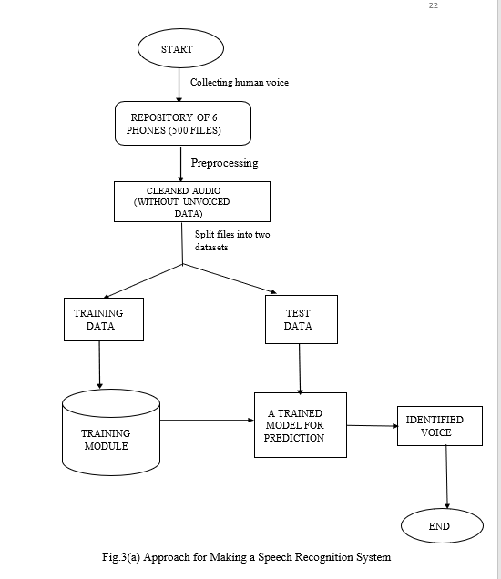

Slide 17
ALGORITHM_2: PREPROCESSING_STEPS
Input: The manually collected repository of audio files.
Output: Audio files after removing all unwanted signals.
Step_1: Convert all the audio files in the same format(.wav)
Step_2: Plot graphs to gather insights about the phones. These are Time-Series, MFCC, FFT plots
Step_3: Analysing plots, make an envelope over the audio to discard all unwanted, unvoiced part of the audio.
Step_4: Save the cleaned audio files in the repository.
Step_5: Stop.

Slide 18
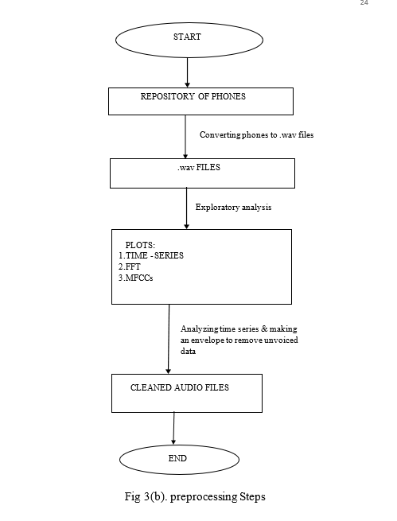

Slide 19
ALGORITHM_3: TRAINING_MODULE
Input: Repository of pre-processed audio files.
Output: A supervised trained model which can further be used for testing.
Step_1: Initialise Sample_number with the number of files in the repository
Step_2: For I=1 to Sample_number, repeat
Step_2.1: Random selection of an audio file from the repository of pre-processed audio files.
Step_2.2: Random selection of 1/10th of a second from that random audio file.
Step_2.3: Extracting the mfcc features for that 1/10th second of audio.
Step_2.4: Append those features in a 2 dimensional vector.
Step_2.5: Append the name of the phone in a vector
Step_3: Feed the recurrent neural network of our training module with the two vectors formed in Step_2.4 and Step_2.5
Step_4: Save the trained Recurrent Neural Network model
Step_5: Stop

Slide 20
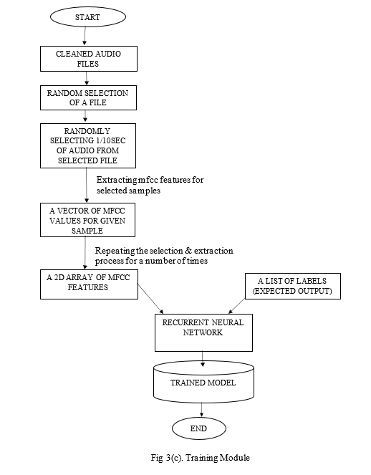

Slide 21
ALGORITHM_4: ONSPOT_TESTING
Input: Human voice for a particular phone among those six phones through microphone.
Output: Name of the phone predicted by the Speech Recognition System.
Step_1: Save the voice taken as input in .wav format.
Step_2: Perform pre-processing and clean the voice.
Step_3: Feed the cleaned voice into the trained model.
Step_4: Test for closeness of the voice with one of the phone among the six used for training.
Step_5: Display the phone name having maximum probability.
Step_6: Stop

Slide 22
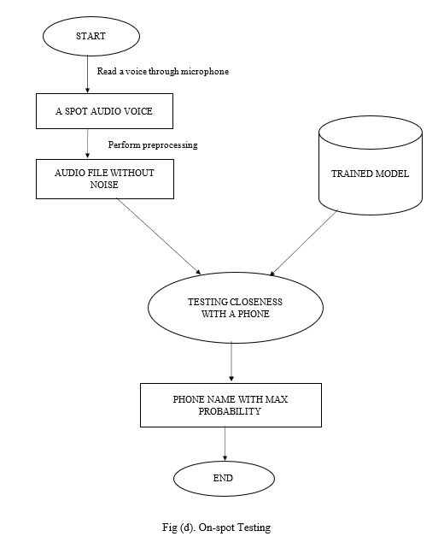

Slide 23
RESULT AND CORRESPONDING EVALUATION

Slide 24
Common Terms Used
1) Feature Selection: Feature shape is m*number of mfcc filters.
2) Number of Samples = No. of times any random selection was made from the repository and used for training
Normal number of samples simply means the number of audio files in the repository i.e. 390
Increased number of Samples means number of Audio files in the repository (390) * 20(Arbitrarily chosen)
3) Threshold = A value below which all audio features are discarded. Only features above are taken
4) Training Done on 390 Audio Samples
5) Testing Done on 124 Audio Samples

Slide 25
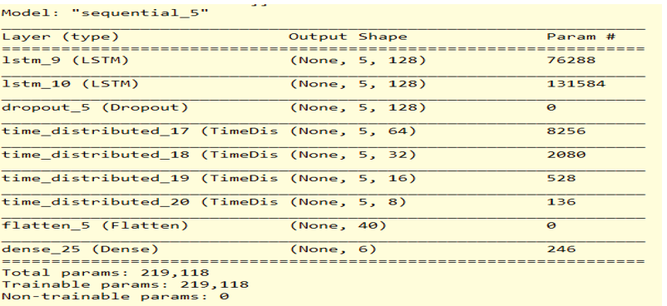
Model 1
Dimension of Feature vector = (5*20)
Threshold = 0.005
Sample size = no. of audio files i.e. 390
The training accuracy for this model is (54-56) % while validation accuracy is 40%.
Layer Structure of RNN for model 1

Slide 26
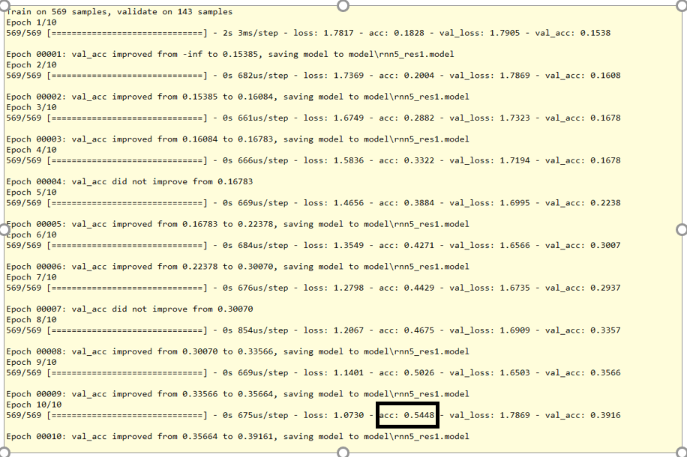
Accuracy per Epoch for model 1

Slide 27
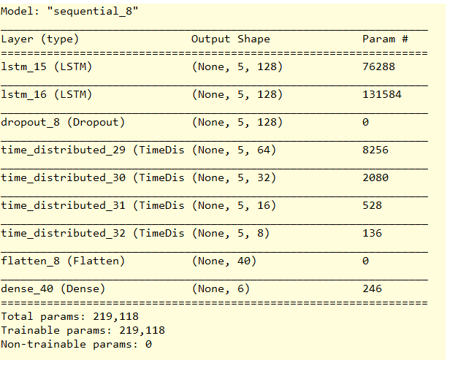
Model 2
Dimension of Feature vector = (5*20)
Threshold = 0.009
Sample size = no. of audio files i.e. 390
The training accuracy for this model was around 65% with a validation accuracy of 45%
Layer Structure of RNN for model 2

Slide 28
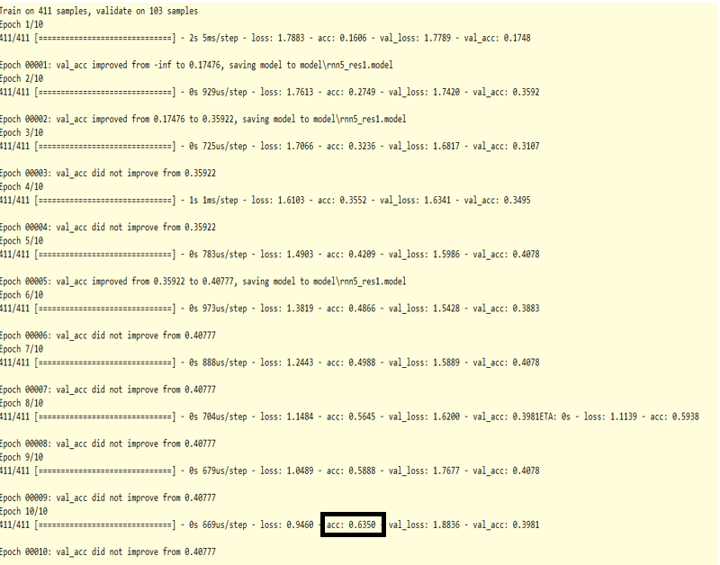
Accuracy per Epoch for model 2

Slide 29
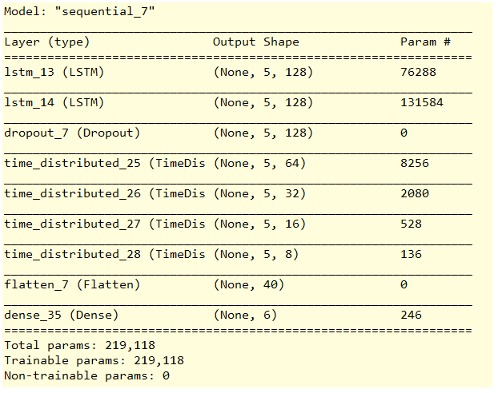
Model 3
Dimension of Feature vector = (5*20)
Threshold = 0.005
Sample size = (20*no. of audio files)
The training and validation accuracy both were quite near to 80%.
Layer Structure of RNN for model 3

Slide 30
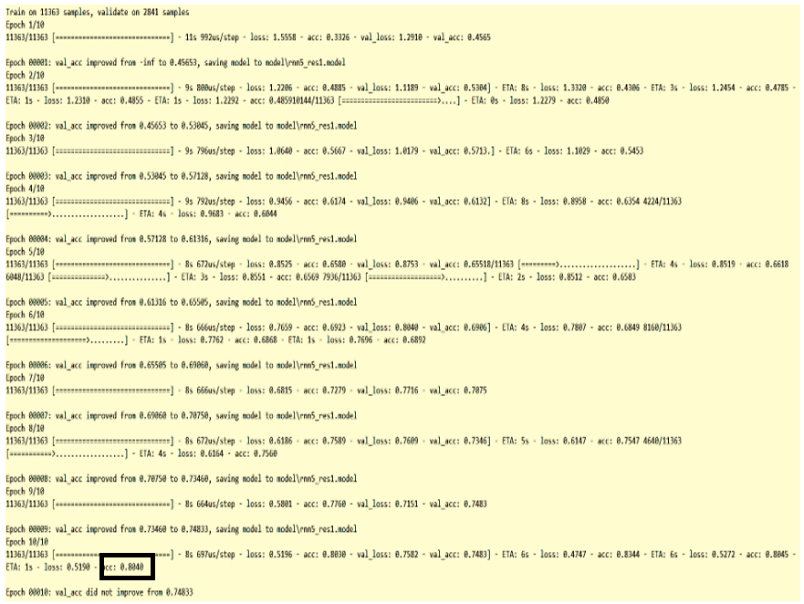
Accuracy per Epoch for model 3

Slide 31
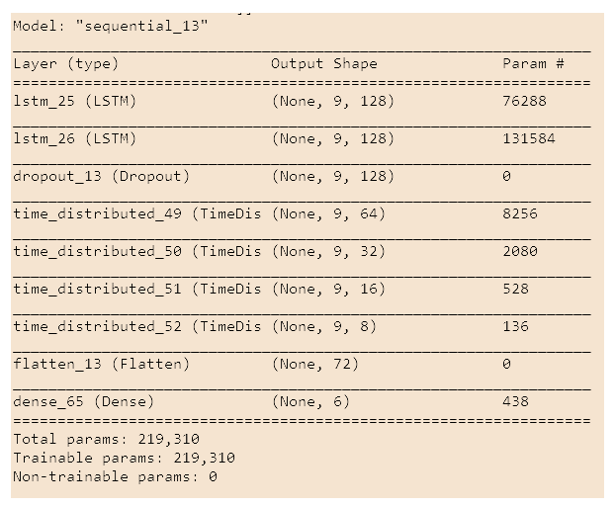
Model 4
Dimension of Feature vector = (9*20)
Threshold = 0.005
Sample size = (20*no. of audio files)
Training accuracy for this approach was (81-85) % with a validation accuracy of 75% however shows some acceptable results for the instant testing.
Layer Structure of RNN for model 4

Slide 32
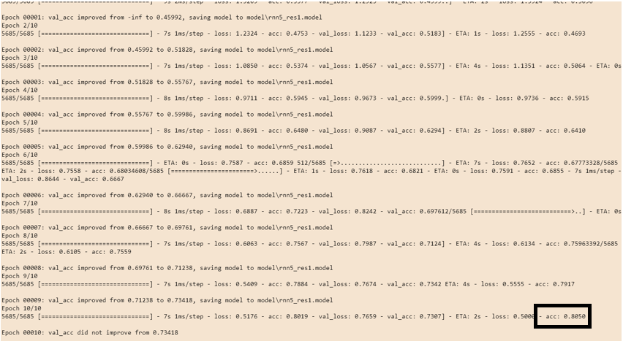
Accuracy per Epoch for model 4

Slide 33
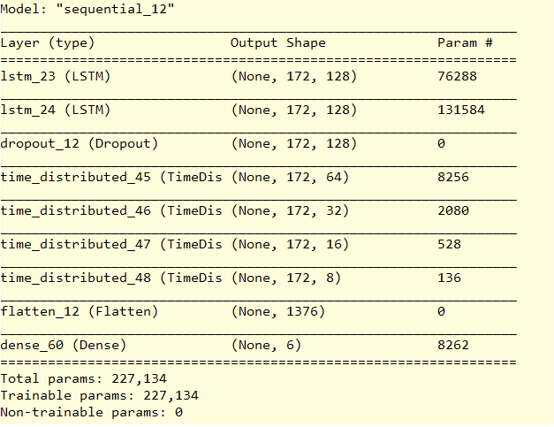
Model 5
Dimension of Feature vector = (172*20)
Threshold = 0.005
Sample size = (20*no. of audio files)
The training and validation accuracy showed a result of 100% which seems to be perfect but the on-spot testing fails to a huge extend (due to overfitting).
Layer Structure of RNN for model 5

Slide 34
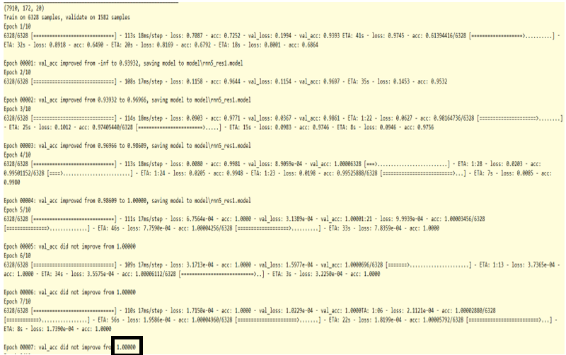
Accuracy per Epoch for model 5

Slide 35
FEW CLOSE OBSERVATIONS
While working on this project, many insights about the phones were gathered and some problems regarding the collected data was faced, which are mentioned as follows:
i) Size or Duration of the audio files were not uniform
ii) The structure of the phone ‘āge’ has huge unvoiced data, thus mismatching occurs.
iii) The phonic structure of the word ‘bāen’ and ‘dāen’ are similar, thus, many a times these two words were interchangeably predicted.
iv) The voices ‘dāen’ and ‘bāen’ are quite long in duration thus their impact on the overall training made some bias towards these words and for all the phones these words have some part of probability in the result which somehow decreases the original phonic probability.
v) The computational power and resource requirement to achieve greater results is also needed.

Slide 36
FUTURE SCOPE
Speech Recognition is the immediate future of human interaction with computer systems. With this technology growing rapidly, speech engines are becoming more accurate and are well on their way to replace traditional ways of interaction.
i) With increase in the number of samples and different phones this can help to recognize a huge amount of phones of the language.
ii) This project can be used for any other language just by changing the repository and training the model with those phones.
iii) The predictions can further be fed to many home appliances which performs basic operations and automate them just by passing human voices.
iv) With the achievement of huge resources and computational power the model can cover more and more phones.

Slide 37
CONCLUSION
Speech Recognition is a challenging Computer recognizing problem that requires robust Neural Networks that are capable of extracting and processing every minute detail in order to give the best prediction. Researches and studies are going on to establish systems or algorithms enabling better, faster and more efficient recognition.
We trained a deep Recurrent Neural Network to recognize a given phone given through microphone. The models parameters were tweaked changing the feature vectors and envelope threshold, thus changing these parameters we trained 5 models giving different accuracies.
Thus we can conclude that the threshold should not be huge as it might remove useful information and the model 4 was showing better results for further approach.

Slide 38
REFERENCES
[1] Python Speech Features Documentation visited on 12/10/2019 (https://python-speech- features.readthedocs.io/en/latest/)
[2] Introduction to Convolutional Neural Networks last visited on 13/11/2019 (https://web.stanford.edu/class/cs231a/lectures/intro_cnn.pdf)
[3] Deep Learning Concepts using Python(https://www.youtube.com).
[4] http://datagenetics.com/blog/november32012/index.html visited on 15/11/2019
[5] Keras Documentation for the Neural Network and deep learning concepts visited from 13/10/2019 to 02/12/2019 (https://keras.io/)
[6] https://sonix.ai/history-of-speech-recognition visited on 24/05/2020
[7] History of voice recognition system last visited on 12/02/2020
https://www.condecosoftware.com/blog/a-history-of-voice-recognition-technology/

Slide 39
[8] Survey on Hidden Markov Model and works in regional languages visited on 25/03/2020
(https://www.researchgate.net/publication/280628018_Speech_Recognition_in_Indian_Languages-A_Survey_Hidden_Markov_model_HMM_Gaussian_mixture_model_GMM_Artificial_neural_network_ANN)
[9] Recurrent Neural Network by Mahendran Venkatachalam last visited on 24/05/2020 (https://towardsdatascience.com/recurrent-neural-networks-d4642c9bc7ce)
[10] Fast Fourier Transform visited 25/06/20202 (https://towardsdatascience.com/fast-fourier-transform-937926e591cb#:~:text=As%20the%20name%20implies%2C%20the,)%20to%20O(NlogN)%20.)
[11] Hegde, S., Achary, K.K., Shetty, S., "Isolated Word Recognition for Kannada Language Using Support Vector Machine," In: Wireless Networks and Computational Intelligence Communications in Computer and Information Science, Volume 292, 2012, pp 262- 269.
[12] Review on the progress of NLP in India last visited on 01/04/2020 (http://www.academia.edu/download/36415761/7I23-IJAET0723718-v7-iss5-1420-1425.pdf)

Slide 40
THANK YOU!

