Slide 1

A NATIONAL LEVEL HACKATHON

Slide 2








Profile Overview
Theme - TERRA
Problem Statement Title – Ideal Spraying Condition Detection
Team ID – U03N3WS0
Team Name –Agro-Minds
INN V-ERA
https://www.innov-era.in

Slide 3

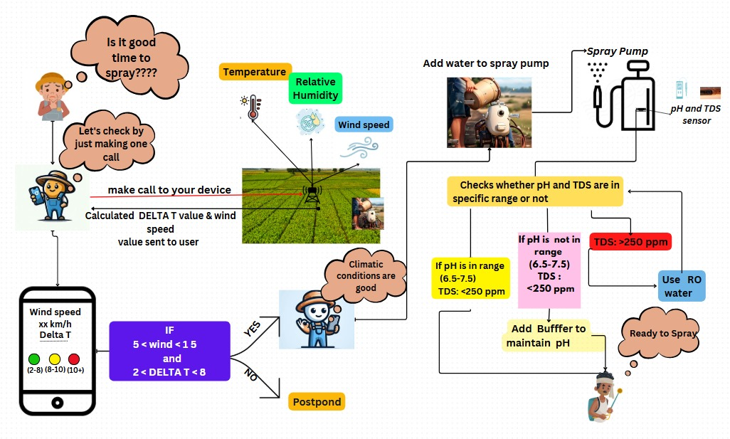

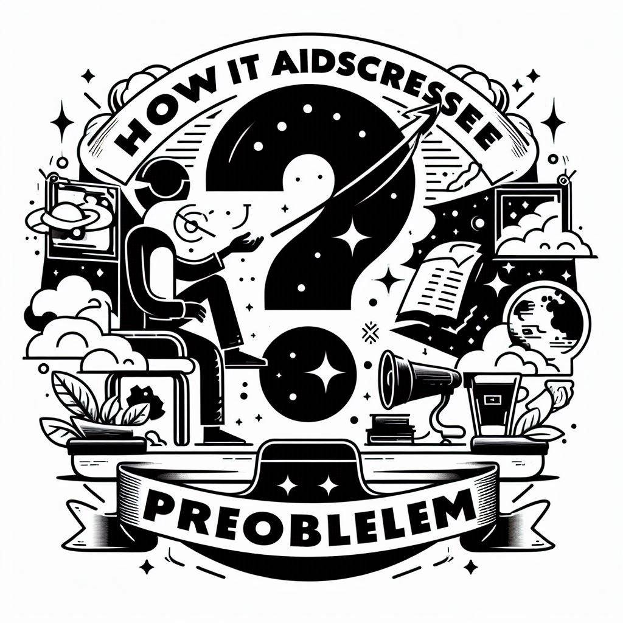

IDEAL SPRAYING CONDITION DETECTION
The Problem : In agricultural sector, efficient pesticide spraying is crucial for crop’s health and yield. Non-ideal condition such as high wind speed, high temperature , pH and TDS of the water used , etc. can lead to inefficient spraying which can cause economic loss , environmental contaminate-on and adverse effect on yield of the farmer.
Proposed solution :
The proposed solution is use of GSM* and Arduino based spraying condition detection system which will analyze Real time data from the interfaced sensors to calculate wind speed and Delta-T value and send it directly to the farmer’s phone.
Also proposed solution include Arduino based Water Quality detection system which will be integrated directly to the sprayer & will monitor pH & TDS* of the water for spraying.
How it addresses the problem :
Monitors real time conditions and calculates Delta-T conditions
Checks water quality for spraying
Gives Remote access of conditions to farmer
Uniqueness:
More accurate system
More Efficient
Sustainable
*GSM:Global system for mobile communication
*TDS:Total dissolved salts
INN V-ERA
https://www.innov-era.in

Slide 4
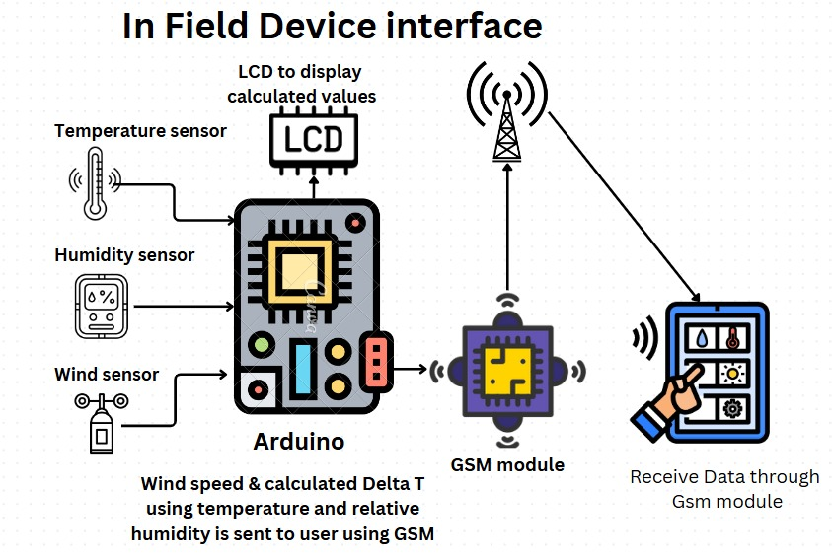
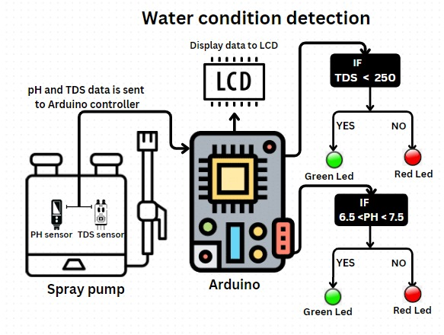
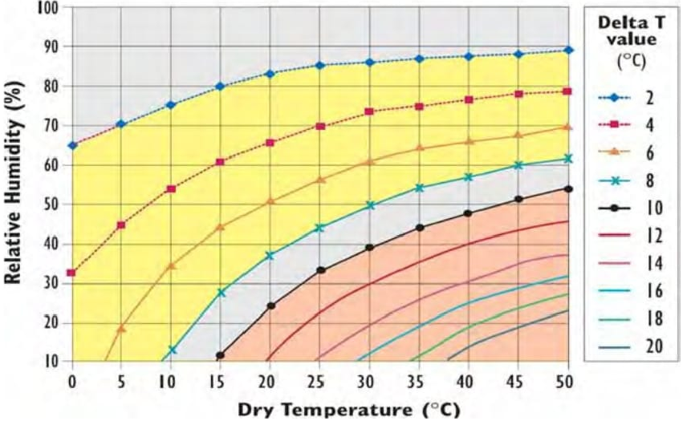
TECHNOLOGY TO BE USED
1
The wind ,temperature and relative humidity sensor will analyze real time conditions and send it to Arduino.
Arduino will calculate the Delta-T* and analyze the wind speed.
Whenever the farmer will call on the given number then GSM module will directly send the real time data through SMS.
Components Required
Arduino Uno | TDS Sensor
Arduino Nano | Relative humidity and temp sensor
GSM module | Wind speed sensor
pH sensor | Power Supply(battery)
Delta-T Graph
2
When the water will be poured in the sprayer , the TDS & pH sensor will share the condition with Arduino.
Arduino will analyze it on the basis of Arduino code and will glow the LED on the basis of that.
*Delta-T:point of intersection of relative humidity & temperature in the Delta-T Graph
INN V-ERA
https://www.innov-era.in

Slide 5
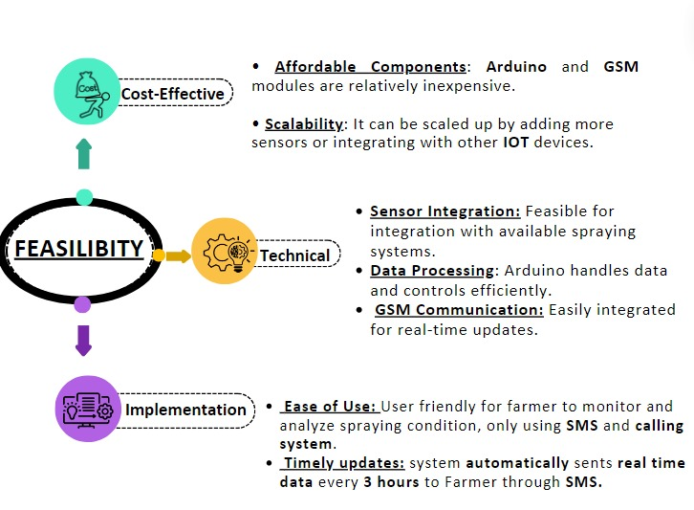
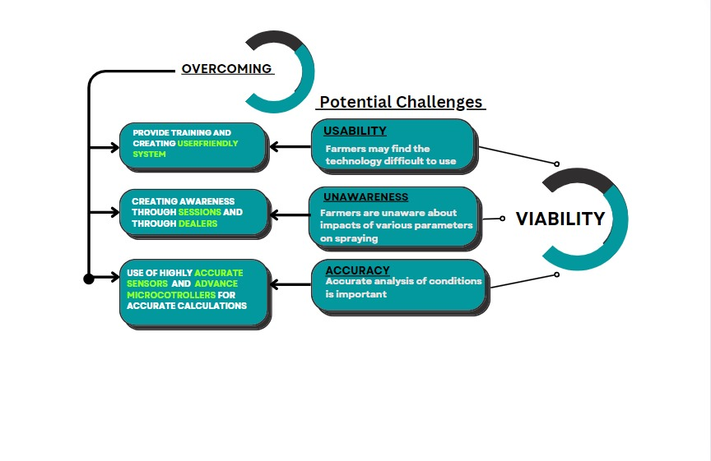
FEASIBILITY AND VIABILITY
https://drive.google.com/file/d/157IJ0rLwWnHpoMPHwKezcdIY5lX0WhBl/view?usp=sharing
INN V-ERA
VIDEO:
https://youtu.be/YNPtbMSXM58
https://www.innov-era.in

Slide 6
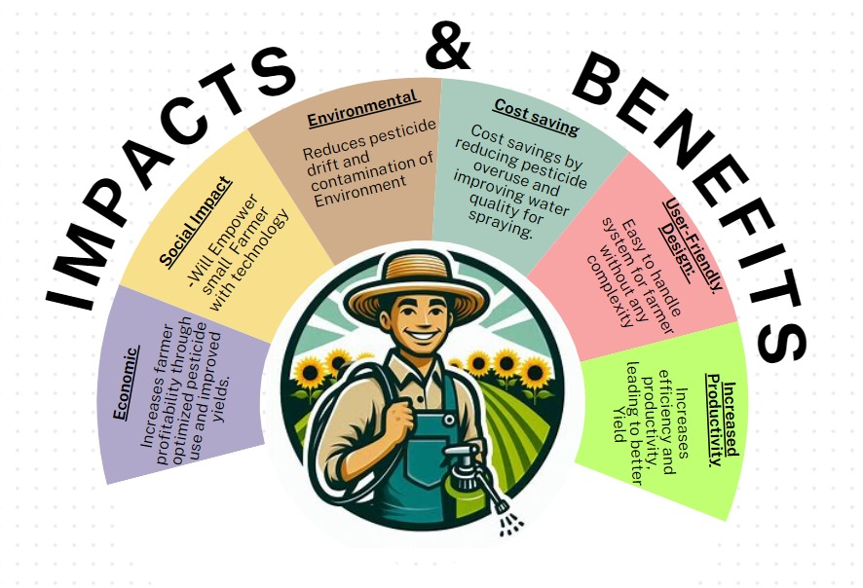
IMPACT AND BENEFITS
INN V-ERA
https://www.innov-era.in

Slide 7
RESEARCH AND REFERENCES
1. | “https://grdc.com.au/__data/assets/pdf_file/0033/579525/GRDC_WeatherEssen2205_Grower_Final.pdf ” Source:-Grains Research and Development Corporation
2. | D52 - Majewski and Capel. 1996. Pesticides in the Atmosphere.pdf (noaa.gov) Source:-U.S. GEOLOGICAL SURVEY
3. | ”https://www.mdpi.com/1660-4601/18/3/1112” Source:-International Journal of Environmental Research and Public Health
4. | Andrew Storrie,”The Real Story behind PH and Spray Water Hardness”,Sprayers101,2019
5. | Tom Wolf,”Water Quality and Spray Application”,Sprayers101,2015
6. | ” https://onlinelibrary.wiley.com/doi/10.1155/2022/9408535” Source:-Indu, Anurag Singh Baghel, Arpit Bhardwaj, Wubshet Ibrahim,Publication-Wiley online library
INN V-ERA
https://www.innov-era.in

