Slide 1
GAP ANALYSIS
MAPP Planning Module and PR/PO
Client target (PRISM SP&A deck, SP&A Campaign workflow, 26 context specs) compared with MAPP as built
27 October 2026
Scope: Planning module (plan → campaign → initiative → activity → line item) and the PR/PO processes attached to it

Slide 2
EXECUTIVE SUMMARY
The bottom line
Planning is strong up to "activity approved". The client's SP&A flow beyond that point (SWBS → PR → GSAP PR/PO numbers → invoice approval → SE/GR → top-up) is missing or only partly there, and building it starts with a scope decision.
■ Built well: hierarchy, budgets flowing down and costs rolling up, line-item spreads, activity approvals (levels, conditions, delegation, escalation), All work views, audit log, recycle bin, read-only GSAP transactions.
■ Not built: Purchase Requests (D-243, out of scope), SWBS round trip, budget hard stop and release, Latest Estimate, Business Case and PIR records, bulk actions and import (012).
■ Built differently: approvals handle Activities only; one current exchange rate instead of fiscal-year rates; broader re-approval triggers; self-approval off org-wide; admin "on behalf" decisions; the Zero-Based Budgeting values are wrong.
■ Next: client answers on ~20 questions → planning rule alignment → engine and finance foundations → PR/PO once it is in scope.
MAPP · Planning module & PR/PO gap analysis · 27 Oct 2026
2

Slide 3
BUILD STATUS VS CLIENT TARGET
Two views that both hold
Against our own specs: core build done
Against the client's target: more to decide
■ Checked 27 Oct: build clean; 36/36 test packages pass; 1,501 Go tests; 0 TODO/FIXME; 176 API paths; no "Coming soon" sections.
■ Open: 012 bulk and import (11 operations answer 404: build or remove), 016 filters/Breakdown/help tips, 014 role-aware screens (UX gap only, the API refuses), 017 roles from 014 and line manager, 015 delete dialogs.
■ Not in the note: 12 e2e tasks (001, 008, 014–017), 013 SP&A Draft, 019 spec empty.
■ Estimate: 1–2 weeks to UAT, for this finishing work.
■ PR/PO: workflow steps 2–5 and 9 have no support; purchase requests are out of scope today (D-243).
■ Rules: approvals for Activities only, current-rate FX, re-approval triggers, self-approval, hard stop, Latest Estimate, BC/PIR, ZBB values.
■ Not in the 1–2 weeks: needs client answers and, for PR/PO, a change of scope.
MAPP · Planning module & PR/PO gap analysis · 27 Oct 2026
3

Slide 4
SCOPE AND METHOD
What we analysed
■ Client material: PRISM SP&A deck (19 slides, incl. the PR flow diagram on slide 11 rebuilt from its vector drawing) and the SP&A Campaign workflow (HD).
■ Client specs: all 26 read; 16 in scope assessed requirement by requirement.
■ MAPP: 29 feature specs and their open tasks, the decision log, the feature map, the domain model, and the code: backend packages, 176 API paths (234 operations), migrations, seed, frontend features.
■ Method: 5 parallel reviews by area; every status backed by file evidence; key claims spot-checked.
In scope (16) | Out of scope (9)
001 Shell · 002 Config · 003 People | 016–020 Measure
004 Hierarchy · 005 Line items | 023 AI assistant
006 BCPIR/SP&A · 007 Views | 024 Budget optimizer
008 Bulk/import · 009 Approvals | 025 Dashboard builder
010 Audit/bin · 012 Actuals
013 Purchase requests · 015 GSAP
011, 014, 021 (planning parts only)
022 Access · 026 Work board
MAPP · Planning module & PR/PO gap analysis · 27 Oct 2026
4

Slide 5
COVERAGE
442 items assessed: coverage by area
Status | Items | Share
DONE | 88 | 20%
PARTIAL | 110 | 25%
MISSING | 120 | 27%
DIFFERENT | 65 | 15%
DEFERRED | 58 | 13%
Area E counts single requirements; A–D count requirement groups.
Without client spec 013 (PRs), planning is ~24% done, 28% partial, 19% missing, 17% different, 12% deferred.
MAPP · Planning module & PR/PO gap analysis · 27 Oct 2026
5

Slide 6
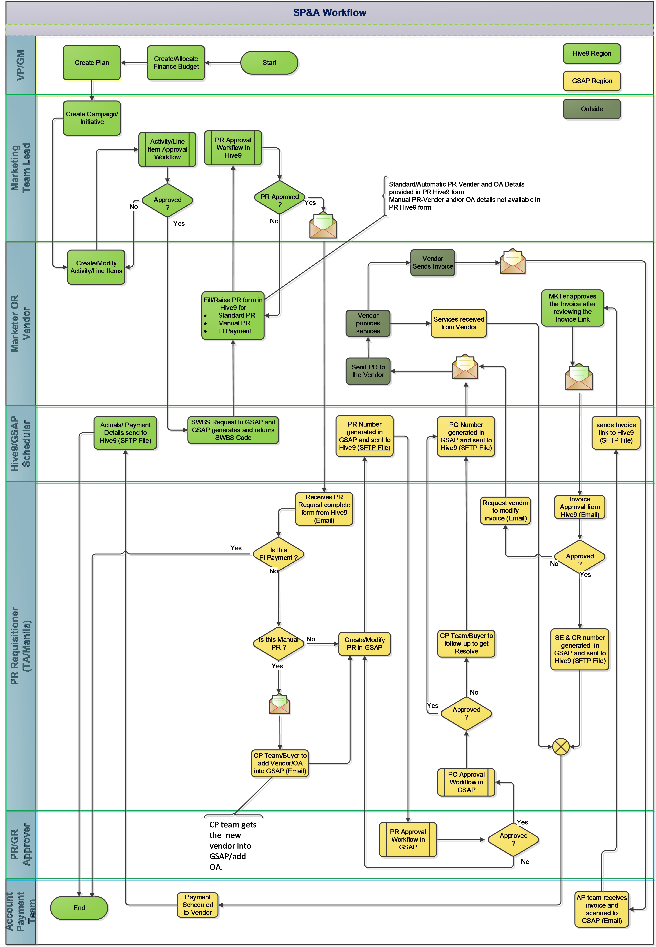
TARGET PROCESS
The client's target: SP&A workflow
■ 7 swimlanes: VP/GM · Marketing Team Lead · Marketer/Vendor · Hive9/GSAP Scheduler · PR Requisitioner (TA/Manila) · PR/GR Approver · Account Payment Team.
■ Hive9 (green) does: budget → plan → campaign/initiative → activity and line items → approval → SWBS request → PR form → PR approval → invoice approval.
■ GSAP (yellow) returns by SFTP: SWBS code, PR number, PO number, invoice link, SE/GR number, actuals and payments (24–48 h).
■ PR types: Standard (vendor and OA known), Manual (CP team adds vendor/OA), FI Payment (own approval).
■ Modify/top-up: a released PR goes through Hive9 approval again, then a GSAP top-up approval and a modified PO.
MAPP · Planning module & PR/PO gap analysis · 27 Oct 2026
6

Slide 7
TARGET PROCESS VS MAPP
Where MAPP stops in the workflow
# | Workflow step | MAPP | Evidence / gap
0 | Budget → plan → campaign → activity and line items → activity approval | DONE | 004–008, 017, global budgets
1 | SWBS request to GSAP; code returned (24–48 h) | PARTIAL | Flag and derived status only; no file, no stored code (D-255)
2 | Marketer raises PR form (Standard / Manual / FI Payment) | MISSING | No PR record (D-243, scope)
3 | PR approval workflow in Hive9 | MISSING | Approval engine is activity-only
4 | PR form routed to the requisitioner; Manual and FI branches | MISSING | E-mail out of scope; no routing record
5 | PR created in GSAP; PR number returned; GSAP approval | MISSING | No GSAP PR number in the feed
6 | PO approval in GSAP; PO number returned; PO to vendor | PARTIAL | PO lines imported as Committed; no PO status, link or PR link
7 | Invoice link to Hive9; marketer approves or rejects; SE/GR returned | PARTIAL | Invoices shown; no approval (BUS.FIN.050), no GR/SE
8 | Payment and actuals to Hive9 (daily) | PARTIAL | Paid = actuals; manual simulated import
9 | Modify / top up a PR (Released) | MISSING | No PR; "Released" not a client 013 status
MAPP · Planning module & PR/PO gap analysis · 27 Oct 2026
7

Slide 8
EXECUTIVE SUMMARY
Ten findings that matter most
# | Finding | Type
1 | No Purchase Request record: no form, approval, routing or top-up (workflow steps 2–5, 9) | MISSING
2 | Approval engine only approves Activities: no PR, modified PR, BC, PIR, accrual or budget-increase approval | DIFFERENT
3 | SWBS round trip is a flag: nothing sent, no code stored, no Sent/Confirmed | PARTIAL
4 | One current exchange rate instead of annual planned (and monthly) rates per fiscal year | DIFFERENT
5 | No budget hard stop or release: finance budget items carry no amounts | MISSING
6 | No Latest Estimate (LE1–LE4, locked LE); the deck relies on LE vs PO vs actuals | DEFERRED
7 | No Business Case or PIR records; our SP&A/BCPIR views (013) are Draft | MISSING
8 | Zero-Based Budgeting values seeded wrong (Media, Agency… instead of the 7 ZBB categories) | DIFFERENT
9 | Bulk actions and import (012) designed but not served | MISSING
10 | Approval rules differ: re-approval triggers, self-approval, admin on-behalf, re-submit from Submitted | DIFFERENT
MAPP · Planning module & PR/PO gap analysis · 27 Oct 2026
8

Slide 9
AREA A · CLIENT 001, 002, 003, 022
Shell, configuration, people and access
Works well
Gap | Status | Prio
Fiscal-year annual and monthly exchange rates | DIFFERENT | High
Membership flags Can Approve? / Can Edit Team Content? | DIFFERENT | High
Owners from the plan's teams at every level | PARTIAL | High
Assigned-approver lock; self-approval per workflow | DIFFERENT | High
Screens hide/explain forbidden actions (014 T043–T051) | PARTIAL | High
Master-data lists with codes (GL, cost centre) | DIFFERENT | High
Attribute types: date, currency, decimal, attachment | PARTIAL | Med
Calculated/roll-up attributes; approvable groups | MISSING | Med
Organisation settings page | MISSING | Med
SSO with MFA (demo sign-in until SSO) | DEFERRED | —
■ One layout, breadcrumbs, all errors at once, Undo
■ Teams, person picker, delegation
■ Access fails closed; scopes; 404 outside scope
■ Full audit of access changes
MAPP · Planning module & PR/PO gap analysis · 27 Oct 2026
9

Slide 10
AREA B · CLIENT 004, 005, 006
Plan hierarchy, line items, BC/PIR and SP&A
Works well
Gap | Status | Prio
SWBS code stored; GSAP status Draft→Sent→Confirmed | PARTIAL | High
PR & PO section; Create PR; cost ≥ PR amount | MISSING | High
Hard limit / remaining-budget check (hard stop) | MISSING | High
Latest Estimate LE1–LE4 and lock | DEFERRED | High
SP&A view; BC and PIR records with approval | MISSING | High
Zero-Based Budgeting cost hierarchy values | DIFFERENT | High
Activities may cross years / sit outside initiative | DIFFERENT | Med
Line-item changes never restart approval | DIFFERENT | Med
Refuse delete with transactions or PRs | DIFFERENT | Med
Separate cost and performance splits | PARTIAL | Med
■ Hierarchy and validation
■ Budget down, cost up; negative remaining warns
■ Waterfall goals
■ Line-item spreads and Sys_Gen_Balance
■ Copy rules; statuses; audit
MAPP · Planning module & PR/PO gap analysis · 27 Oct 2026
10

Slide 11
AREA C · CLIENT 007, 008, 010, 026
Views, bulk and import, audit log, work board
Works well
Gap | Status | Prio
Bulk select, change owner/field, copy, move, delete | MISSING | High
Import activities from a template | MISSING | High
Inline editing and row actions in the workspace | DEFERRED | High
Audit source, on-behalf, year, operation ID | PARTIAL | High
Calendar drag to reschedule | DIFFERENT | Med
Filters remembered across sessions and devices | DIFFERENT | Med
Share saved views with teams or users | MISSING | Med
Log export; retention (bin 90 d, audit 7 y) | MISSING | Med
8 summary cards incl. Actual @ FX | PARTIAL | Med
Activity Work Board (client: "Proposed") | MISSING | Low
■ Grid, Budget & cost, Calendar
■ Roll-ups, column chooser, saved views
■ Export .xlsx/.csv
■ Write-once audit; history on every record
■ Bin: restore with parents, purge
MAPP · Planning module & PR/PO gap analysis · 27 Oct 2026
11

Slide 12
AREA D · CLIENT 009, 021
Approvals and notifications
Works well
Gap | Status | Prio
Workflow object types PR, Modified PR, Accrual… | PARTIAL | High
Per-workflow: comments, self-approval, currency | DIFFERENT | High
Conditions on Country/OU and custom attributes | PARTIAL | High
Re-approval only on planned cost, per model | DIFFERENT | High
Bulk-load 100+ workflow definitions | MISSING | High
Re-Submit from Submitted | DIFFERENT | Med
Queue: item type, dates, per-row actions, paging | PARTIAL | Med
Per-user notification rules; list page | MISSING | Med
Planning events (edited, assigned, due date) | MISSING | Med
Notify submitter as well as owner | PARTIAL | Low
■ Levels Any/All, conditions, frozen rounds
■ Auto-approve, recall, 409 on stale action
■ Delegation, reminders, escalation
■ Monitoring, history, inbox
■ In-app approval notifications
MAPP · Planning module & PR/PO gap analysis · 27 Oct 2026
12

Slide 13
AREA E · CLIENT 013, 012, 015, 011/014 PARTS
Purchase requests, actuals and GSAP
Works well
Gap | Status | Prio
Whole PR lifecycle (013: 50 of 71 FRs missing) | MISSING | High
PR reservation and release | MISSING | High
Submit gates: activity approved + SWBS present | MISSING | High
Route PR form to requisitioner (no e-mail) | DEFERRED | High
SWBS request file and code return | DEFERRED | High
Inbound PR no., PO status/link, GR/SE, invoice link | PARTIAL | High
Match to PR lines; company-code check | DIFFERENT | High
Exception list with Dismiss / Assign | PARTIAL | High
Invoice approval by the marketer | DEFERRED | Med
Split a transaction across line items | DIFFERENT | Med
■ Simulated GSAP feed: PO lines, invoices, payments, accruals
■ Check-then-import, idempotent
■ Matching: line item → HX → PO → SWBS
■ Committed / Invoiced / Paid at every level
MAPP · Planning module & PR/PO gap analysis · 27 Oct 2026
13

Slide 14
WHAT HAS TO CHANGE
Business-logic and flow changes (1/2)
# | Change | Touches | Size
L1 | Approve any record type (subject kind + id; workflow object type) | approval, adapters, routes, inbox | L
L2 | Per-workflow comments, self-approval, threshold currency; on-behalf rule | approval, access rules | M
L3 | Re-approval rule agreed and made a per-model setting | activity, lineitem, settings | M
L4 | Store SWBS code + GSAP status; simulated outbound request; code upload | lineitem, financials, new ADR | L
L5 | Purchase Request record with lines, reservation, approval, modification | new purchaserequest package, UI | XL
L6 | GSAP matching to PR lines; PR no., PO status/link, GR/SE, invoice status | financials, CSV layout | L
L7 | Exchange rates by fiscal year (annual planned + monthly) | settings, money, rollup, allwork | L
L8 | Budget hard stop and release; budget-increase approval (empty 019) | settings, budget, lineitem | M–L
MAPP · Planning module & PR/PO gap analysis · 27 Oct 2026
14

Slide 15
WHAT HAS TO CHANGE
Business-logic and flow changes (2/2)
# | Change | Touches | Size
L9 | Latest Estimate LE1–LE4, lock per round and year, LE vs PO vs actuals | activity, allwork, financials | M
L10 | Business Case and PIR records with approval, attachments, PPT export | new package(s), file storage ADR | L
L11 | Owners from the plan's teams at every level; team flags if kept | activity, campaign, people | M
L12 | Refuse delete with linked transactions or PRs | delete paths | S
L13 | Relax "activity inside its initiative" for cross-year work | activity dates, rollup | M
L14 | Master data with codes; atomic import updating by code | settings | M
L15 | Audit source/on-behalf/year/operation; export; retention | history, migration, ADR | M
L16 | Notifications as a module with an event catalogue and rules | new notification package | M
Q1 | Quick fixes: ZBB values, re-submit from Submitted, year +10, BCPIR marker, header currency | seed, approval, plan, TopBar | S
MAPP · Planning module & PR/PO gap analysis · 27 Oct 2026
15

Slide 16
FOR DISCUSSION
Proposed Purchase Request model
PurchaseRequest (PR-1001)
Plan, company code | All lines in one plan; one company code
Type | Standard · Manual · FI Payment
Status | Created → Submitted → In review → Approved / Declined → Closed
Workflows | Approval + modification
Attributes | Vendor, OA, MoA approver, short text, e-mail group…
From GSAP (read-only) | GSAP PR number and date
PurchaseRequestLine
Line item | One line per line item per PR
HX key | "HX" + line-item number
Money | Currency, amount, limit, closed amount
From GSAP | PO no., line, status, date, value, link
■ Reserve: sum of live PR lines; planned cost can't drop below it.
■ Gate: activity Approved and SWBS code received.
■ Route: in-app record + downloadable PR form (no e-mail).
■ Access: pr.view, pr.edit, pr.submit, pr.route; Requisitioner role.
MAPP · Planning module & PR/PO gap analysis · 27 Oct 2026
16

Slide 17
BEFORE WE BUILD
Open on our side, and scope decisions
Open in our own features
Scope decisions needed
Feature | Open
012 Bulk & import | 11 operations answer 404: build or remove
016 Planning ext. | Filters/Breakdown UI; field help; rates route
014 Access | Role-aware screens (UX only); e2e
017 Approval rules | Roles from 014; line-manager field; e2e
015 Financials | Delete dialogs; Home no-access; e2e
e2e tests | 12 tasks open across 001, 008, 014–017
013 BCPIR & SP&A | Spec Draft (Q-001); no code
019 Budget increase | Spec folder is empty
■ 1. Bring purchase requests into scope (constitution, CLAUDE.md #13, D-243).
■ 2. E-mail: keep excluded (in-app routing + PR form) or allow via an adapter.
■ 3. Outbound files to GSAP (SWBS request): new ADR; reverse D-255.
■ 4. BRD Later items: invoice approval, documents, hard stop.
■ 5. Actuals model: Paid at current rate vs CO postings with annual and monthly FX.
■ 6. Which decision log is authoritative (client D-numbers clash with ours).
MAPP · Planning module & PR/PO gap analysis · 27 Oct 2026
17

Slide 18
PLAN
Recommended roadmap
0
Finish for UAT
All open tasks incl. 12 e2e tests · decide 012 (build or remove) · ZBB values · re-submit · year +10 · write or remove the 019 spec
1
Planning rules
Per-workflow approval settings · re-approval rule · owners and team flags · delete protection · master-data codes · build 012
2
Foundations
Approve any record type · fiscal-year rates · Latest Estimate · hard stop and release · audit fields
3
PR/PO
SWBS round trip · Purchase Request · GSAP matching to PR lines · PR list · in-app routing and PR form
4
BC/PIR
BC and PIR records · SP&A and BCPIR views · PPT export · notifications module
MAPP · Planning module & PR/PO gap analysis · 27 Oct 2026
18

Slide 19
TO UNBLOCK PHASES 1–3
Questions for the client
■ PR origin: raised in MAPP and sent to GSAP, or raised in GSAP and shown?
■ "Released": what is it in the PR status model?
■ PR types: do Manual and FI Payment change MAPP behaviour?
■ Reservation: committed spend, or inside planned cost?
■ Routing: in-app + PR form acceptable without e-mail?
■ SWBS: per line item or activity; automatic on approval; SLA misses?
■ Layouts: FSSI 1523 / PGSI 941 files during the freeze?
■ Rates: annual planned rate per fiscal year, or latest rate?
■ Re-approval: planned cost only, per model?
■ Self-approval / on-behalf: per workflow? admin may decide?
■ Hard stop: which level; block or warn; who releases?
■ Latest Estimate: who locks; level; currency?
■ BC/PIR: records with approval and attachments? PPT content?
■ ZBB: confirm the 7 values, level, BU limits.
MAPP · Planning module & PR/PO gap analysis · 27 Oct 2026
19

