Slide 1
Augmenting Data-Structures

Slide 2
Choose a base data structure and add information to each node.
Maintain that information as the structure changes.
Use it to answer the target query
Let us start with an extremely simple example using stacks

Slide 3
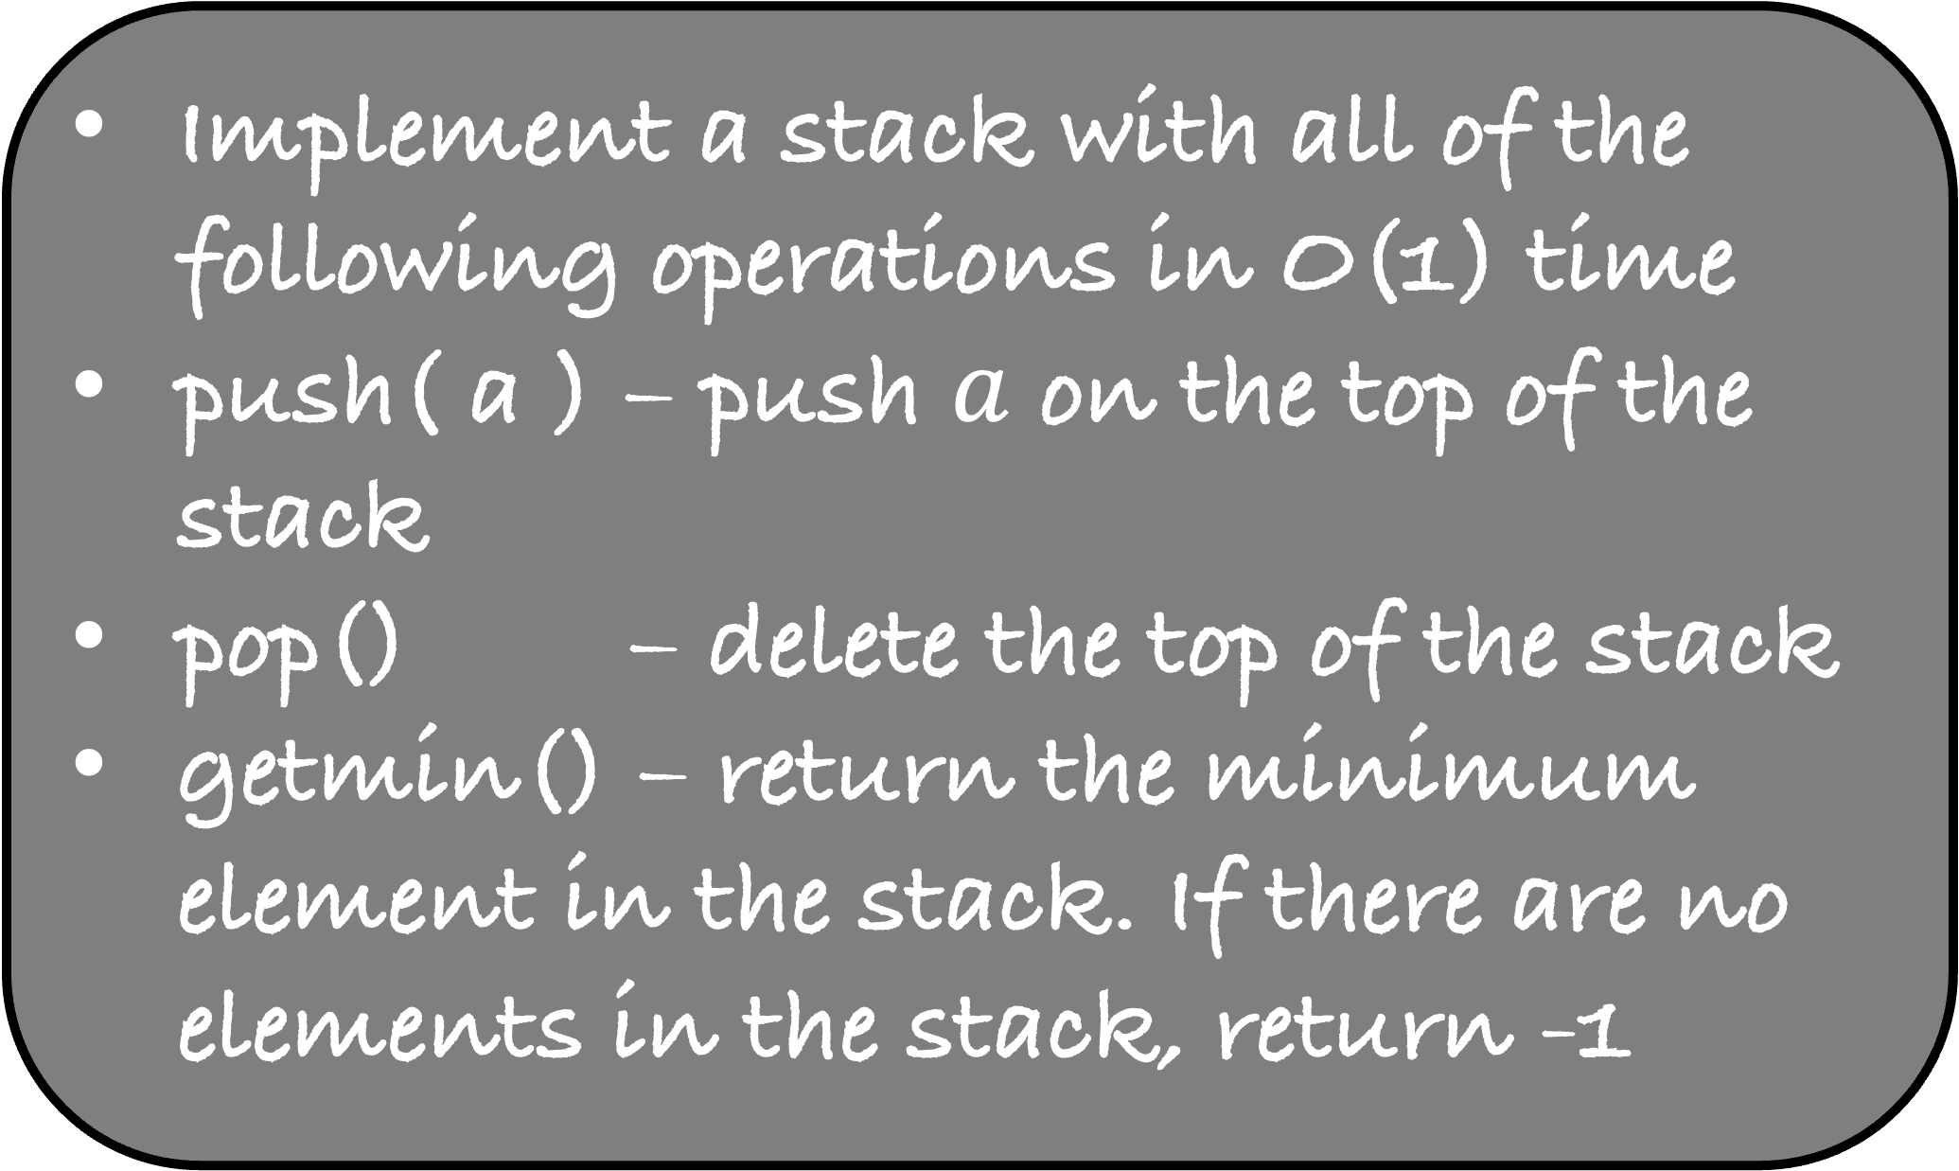
Implement a stack with all of the following operations in O(1) time
push( a ) – push $a$ on the top of the stack
pop() – delete the top of the stack
getmin() – return the minimum element in the stack. If there are no elements in the stack, return -1
2
8
9
9
8

Slide 4
Implement a stack with all of the following operations in O(1) time
push( a ) – push $a$ on the top of the stack
pop() – delete the top of the stack
getmin() – return the minimum element in the stack. If there are no elements in the stack, return -1
8
9
9
8

Slide 5
Implement a stack with all of the following operations in O(1) time
push( a ) – push $a$ on the top of the stack
pop() – delete the top of the stack
getmin() – return the minimum element in the stack. If there are no elements in the stack, return -1
9
9
8

Slide 6
#include <stdio.h>
#include <stdlib.h>
struct node {
int num;
struct node *next;
};
struct node *top = NULL;
void push(int element)
{
}
int pop()
{
}
int findMin(){
}
int main() {
return 0;
}
In the node, we need to add some extra information that will help us find the minimum
Just by looking at the top, we should know about the minimum
What is the information we should add at each node?
At the k-th element in the stack, we store
Minimum of bottom k elements of the stack

Slide 7

Implement a stack with all of the following operations in O(1) time
push( a ) – push $a$ on the top of the stack
pop() – delete the top of the stack
getmin() – return the minimum element in the stack. If there are no elements in the stack, return -1
2
2
8
8
8
9
8
9
8
8

Slide 8
#include <stdio.h>
#include <stdlib.h>
struct node {
int num;
int minimum;
struct node *next;
};
struct node *top = NULL;
void push(int element)
{
}
int pop()
{
}
int findMin(){
}
int main() {
return 0;
}
In the node, we need to add some extra information that will help us find the minimum
Just by looking at the top, we should know about the minimum
What is the information we should add at each node?
At the k-th element in the stack, we store
Minimum of bottom k elements of the stack

Slide 9
#include <stdio.h>
#include <stdlib.h>
struct node {
int num;
int minimum;
struct node *next;
};
struct node *top = NULL;
int main() {
return 0;
}
void push(int element){
}
int pop(){
if (top == NULL)
exit(1);
struct node *p = top ;
int element = p->num;
top = top->next;
free(p);
return element;
}
int findMin(){
if (top == NULL)
return -1;
else
return top->minimum;
}

Slide 10
void push(int element){
struct node *p = malloc(sizeof(struct node));
if( p == NULL)
exit(1);
p->num = element;
p->next = top;
if( top == NULL || element < top->minimum)
p->minimum = element;
else
p->minimum = top->minimum;
top = p;
}

Slide 11
Augmenting BST

Slide 12
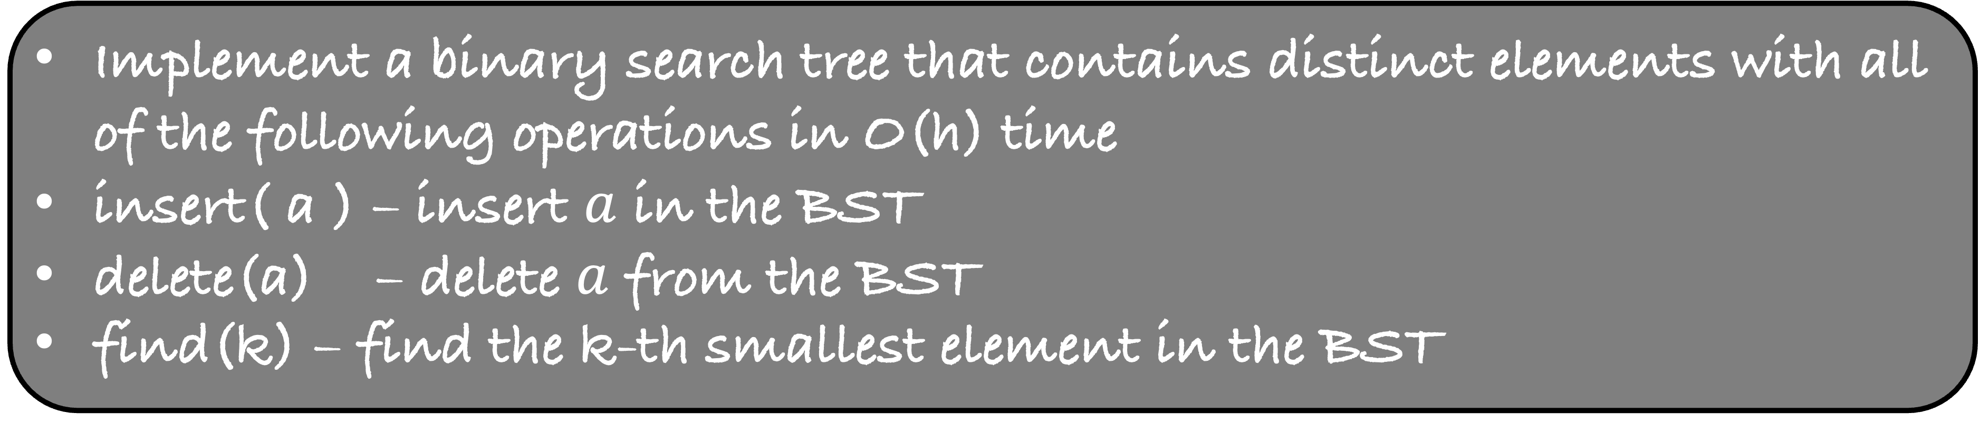
Implement a binary search tree that contains distinct elements with all of the following operations in O(h) time
insert( a ) – insert $a$ in the BST
delete(a) – delete $a$ from the BST
find(k) – find the k-th smallest element in the BST
Remember that using inorder traversal, we can find the k-th smallest element of the BST in O(n) time
If you are more careful, you can do it in O(h+k) time
However, we want a running time of O(h)

Slide 13
4
If I ask you for the 5-th smallest element, you should not go to the left subtree of 4 at all
What should each node store to choose the next direction in O(1) time?
2
9
0
6
5
Number of nodes in its left subtree

Slide 14
find(v->4,5)
4
2
2
2
9
1
0
1
6
0
5
0

Slide 15
find(v->9,2)
4
2
2
2
9
1
0
1
6
0
5
0

Slide 16
4
2
find(v->6,2)
2
2
9
1
0
1
6
0
5
0

Slide 17
#include <stdio.h>
#include <stdlib.h>
struct node {
int num;
struct node *left;
struct node *right;
};
struct node *root = NULL;
struct node *makenode(int element)
{
struct node *p = malloc(sizeof(struct node));
if( p == NULL)
exit(1);
p->num = element;
p->left = NULL;
p->right = NULL;
return p;
}
int main() {
return 0;
}

Slide 18
#include <stdio.h>
#include <stdlib.h>
struct node {
int num;
int lessThanNum;
struct node *left;
struct node *right;
};
struct node *root = NULL;
struct node *makenode(int element)
{
struct node *p = malloc(sizeof(struct node));
if( p == NULL)
exit(1);
p->num = element;
p-> lessThanNum = 0;
p->left = NULL;
p->right = NULL;
return p;
}
int main() {
return 0;
}

Slide 19
void insert(int element){
struct node* p = makenode(element);
if (root == NULL){
root = p ;
return;
}
struct node *v = root;
while(1){
if(element < v->num){
if( v->left == NULL){
v->left = p;
break;
}
else
v = v->left;
}
else if(element > v->num){
if( v->right == NULL){
v->right = p;
break;
}
else
v = v->right;
}
}
}
#include <stdio.h>
#include <stdlib.h>
struct node {
int num;
int lessThanNum;
struct node *left;
struct node *right;
};
struct node *root = NULL;
struct node *makenode(int element)
{
struct node *p = malloc(sizeof(struct node));
if( p == NULL)
exit(1);
p->num = element;
p-> lessThanNum = 0;
p->left = NULL;
p->right = NULL;
return p;
}
int main() {
return 0;
}

Slide 20
void insert(int element){
struct node* p = makenode(element);
if (root == NULL){
root = p ;
return;
}
struct node *v = root;
while(1){
if(element < v->num){
(v->lessThanNum)++;
if( v->left == NULL){
v->left = p;
break;
}
else
v = v->left;
}
else if(element > v->num){
if( v->right == NULL){
v->right = p;
break;
}
else
v = v->right;
}
}
}
#include <stdio.h>
#include <stdlib.h>
struct node {
int num;
int lessThanNum;
struct node *left;
struct node *right;
};
struct node *root = NULL;
struct node *makenode(int element)
{
struct node *p = malloc(sizeof(struct node));
if( p == NULL)
exit(1);
p->num = element;
p-> lessThanNum = 0;
p->left = NULL;
p->right = NULL;
return p;
}
int main() {
return 0;
}

Slide 21
Write the function int find(struct node *v, int k) to find the k-th smallest element in the BST under the node v
#include <stdio.h>
#include <stdlib.h>
struct node {
int num;
int lessThanNum;
struct node *left;
struct node *right;
};
struct node *root = NULL;
struct node *makenode(int element)
{
struct node *p = malloc(sizeof(struct node));
if( p == NULL)
exit(1);
p->num = element;
p-> lessThanNum = 0;
p->left = NULL;
p->right = NULL;
return p;
}
int main() {
return 0;
}
void insert(int element){
struct node* p = makenode(element);
if (root == NULL){
root = p ;
return;
}
struct node *v = root;
while(1){
if(element < v->num){
(v->lessThanNum)++;
if( v->left == NULL){
v->left = p;
break;
}
else
v = v->left;
}
else if(element > v->num){
if( v->right == NULL){
v->right = p;
break;
}
else
v = v->right;
}
}
}

Slide 22
Write the function int find(struct node *v, int k) to find the k-th smallest element in the BST under the node v
int find(struct node *v, int k){
if(v->lessThanNum == k-1)
return v->num;
else if(v->lessThanNum < k-1)
return find(v->right, k - v->lessThanNum -1);
else
return find(v->left, k);
}

Slide 23
int find(struct node *v, int k){
if(v->lessThanNum == k-1)
return v->num;
else if(v->lessThanNum < k-1)
return find(v->right, k - v->lessThanNum -1);
else
return find(v->left, k);
}
find(v,3)
4
2
2
2
9
1
0
1
6
0
5
0

Slide 24
int find(struct node *v, int k){
if(v->lessThanNum == k-1)
return v->num;
else if(v->lessThanNum < k-1)
return find(v->right, k - v->lessThanNum -1);
else
return find(v->left, k);
}
find(v,3)
4
2
2
2
9
1
0
1
6
0
5
0

Slide 25
int find(struct node *v, int k){
if(v->lessThanNum == k-1)
return v->num;
else if(v->lessThanNum < k-1)
return find(v->right, k - v->lessThanNum -1);
else
return find(v->left, k);
}
find(v,4)
4
2
2
2
9
1
0
1
6
0
5
0

Slide 26
int find(struct node *v, int k){
if(v->lessThanNum == k-1)
return v->num;
else if(v->lessThanNum < k-1)
return find(v->right, k - v->lessThanNum -1);
else
return find(v->left, k);
}
find(v,4)
4
2
2
2
9
1
0
1
6
0
5
0

Slide 27
int find(struct node *v, int k){
if(v->lessThanNum == k-1)
return v->num;
else if(v->lessThanNum < k-1)
return find(v->right, k - v->lessThanNum -1);
else
return find(v->left, k);
}
find(v->right,1)
4
2
2
2
9
1
0
1
6
0
5
0

Slide 28
int find(struct node *v, int k){
if(v->lessThanNum == k-1)
return v->num;
else if(v->lessThanNum < k-1)
return find(v->right, k - v->lessThanNum -1);
else
return find(v->left, k);
}
find(v,1)
4
2
2
2
9
1
0
1
6
0
5
0

Slide 29
int find(struct node *v, int k){
if(v->lessThanNum == k-1)
return v->num;
else if(v->lessThanNum < k-1)
return find(v->right, k - v->lessThanNum -1);
else
return find(v->left, k);
}
find(v,1)
4
2
2
2
9
1
0
1
6
0
5
0

Slide 30
int find(struct node *v, int k){
if(v->lessThanNum == k-1)
return v->num;
else if(v->lessThanNum < k-1)
return find(v->right, k - v->lessThanNum -1);
else
return find(v->left, k);
}
find(v->left,1)
4
2
2
2
9
1
0
1
6
0
5
0

Slide 31
void delete(int element)
{
struct node *v = root;
struct node *parent = NULL;
while( v!= NULL && v->num != element){
parent = v;
if (element < v->num)
v = v->left;
else
v = v->right;
}
if ( v == NULL)
return;
if( v->right == NULL){
struct node *child = v->left;
if( parent == NULL)
root = child;
else if( parent->left == v)
parent->left = child;
else
parent->right = child;
free(v);
}
else if( v->left == NULL){
//symmetrical to above code
}
else{
struct node *q = v;
struct node *p = v->right;
while( p->left != NULL){
q = p;
p = p->left;
}
v->num = p->num;
if( q->left == p)
q->left = p->right;
else
q->right = p->right;
free(p);
}
}
struct node *u = root;
while(u->num != element){
if (element < u->num){
u->lessThanNum--;
u = u->left;
}
else
u = u->right;
}

Slide 32
void delete(int element)
{
struct node *v = root;
struct node *parent = NULL;
while( v!= NULL && v->num != element){
parent = v;
if (element < v->num)
v = v->left;
else
v = v->right;
}
if ( v == NULL)
return;
if( v->right == NULL){
struct node *child = v->left;
if( parent == NULL)
root = child;
else if( parent->left == v)
parent->left = child;
else
parent->right = child;
free(v);
}
else if( v->left == NULL){
//symmetrical to above code
}
else{
struct node *q = v;
struct node *p = v->right;
while( p->left != NULL){
q = p;
p = p->left;
}
v->num = p->num;
if( q->left == p)
q->left = p->right;
else
q->right = p->right;
free(p);
}
}
4
2
v
2
2
10
0
3
9
13
q
0
1
2
6
11
15
0
0
p
1
If you see, the node will element 11 is deleted
Look at all the ancestor of 11 and update their count appropriately
12
14
20
0
0
0

Slide 33
void delete(int element)
{
struct node *v = root;
struct node *parent = NULL;
while( v!= NULL && v->num != element){
parent = v;
if (element < v->num)
v = v->left;
else
v = v->right;
}
if ( v == NULL)
return;
if( v->right == NULL){
struct node *child = v->left;
if( parent == NULL)
root = child;
else if( parent->left == v)
parent->left = child;
else
parent->right = child;
free(v);
}
else if( v->left == NULL){
//symmetrical to above code
}
else{
struct node *q = v;
struct node *p = v->right;
while( p->left != NULL){
q = p;
p = p->left;
}
v->num = p->num;
if( q->left == p)
q->left = p->right;
else
q->right = p->right;
free(p);
}
}
struct node *u = root;
while(u->num != element){
if (element < u->num){
u->lessThanNum--;
u = u->left;
}
else
u = u->right;
}
struct node *u = root;
while(u->num != p->num){
if (element < u->num){
u->lessThanNum--;
u = u->left;
}
else
u = u->right;
}

Slide 34
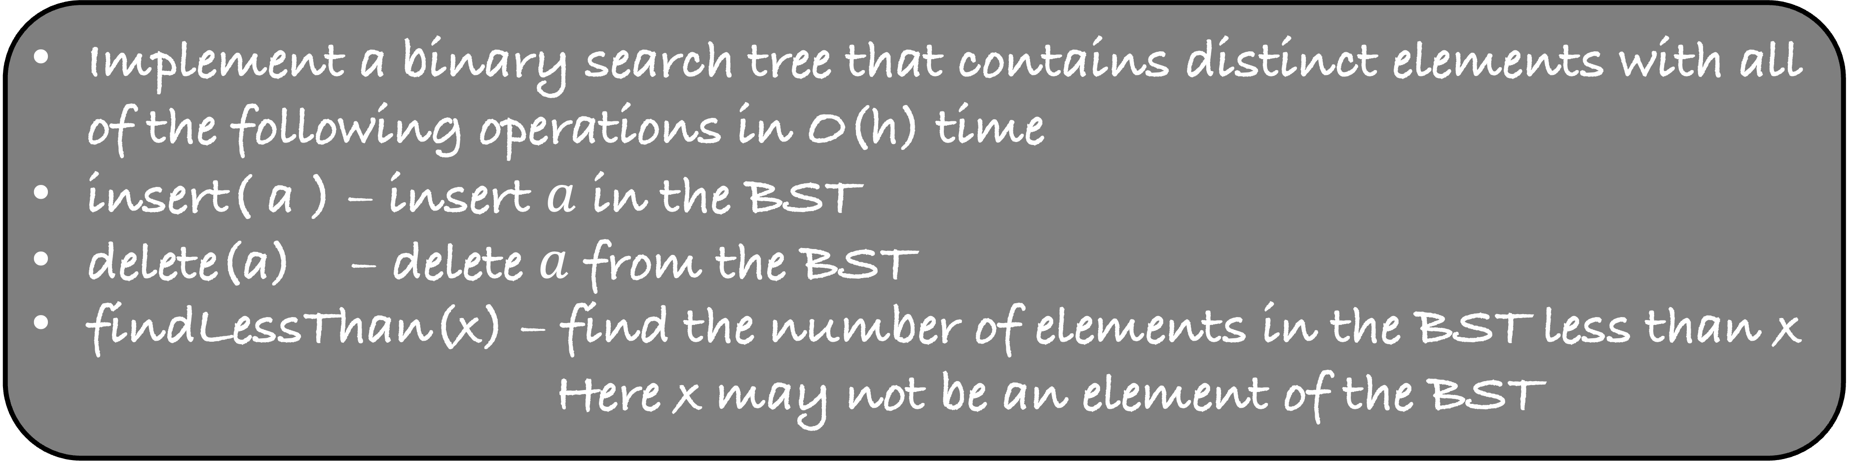
Implement a binary search tree that contains distinct elements with all of the following operations in O(h) time
insert( a ) – insert $a$ in the BST
delete(a) – delete $a$ from the BST
findLessThan(x) – find the number of elements in the BST less than x
Here x may not be an element of the BST
All the operations should take O(h) time

Slide 35
4
If I ask you for the findLessThan(7), your answer should be 5
What should each node store to choose the next direction in O(1) time?
2
9
0
6
5

Slide 36
findLessThan(v->4, 7)
count = 0
4
2
2
2
9
1
0
1
6
0
5
0

Slide 37
findLessThan(v->9, 7)
count = 3
4
2
2
2
9
1
0
1
6
0
5
0

Slide 38
4
2
findLessThan(v->6, 7)
count = 3
2
2
9
1
0
1
6
0
5
0

Slide 39
4
2
2
2
9
1
0
1
6
0
findLessThan(v->NULL, 7)
count = 5
5
0

Slide 40
Implement a binary search tree that contains distinct elements with all of the following operations in O(h) time
insert( a ) – insert $a$ in the BST
delete(a) – delete $a$ from the BST
findLessThan(x) – find the number of elements in the BST less than x
Here x may not be an element of the BST
All the operations should take O(h) time
Try to implement this data-structure

Slide 41
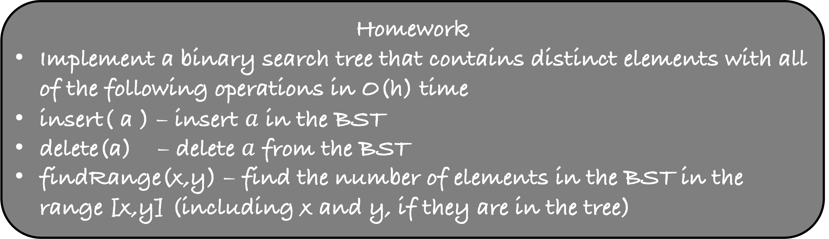
Homework
Implement a binary search tree that contains distinct elements with all of the following operations in O(h) time
insert( a ) – insert $a$ in the BST
delete(a) – delete $a$ from the BST
findRange(x,y) – find the number of elements in the BST in the range [x,y] (including x and y, if they are in the tree)
The previous problem can be used to solve this problem

Slide 42
Segment Trees

Slide 43
Let us now look at a problem which is quite similar to what we have done with BSTs till now
You are given an array A of size n where n is a power of 2
You need to answer the following query quickly
findMin(u,v): return min{A[u], A[u+1], …., A[v]}
How much time your algorithm will take?
O(v-u)
Can you answer each query in O(1) time?
Yes
15
7
35
8
80
55
23
3

Slide 44
15
7
35
8
80
55
23
3
For each, (u,v) pair compute the minimum and keep it in a 2-D matrix, say B
For findMin(u,v): return B[u][v]
The space taken by this algorithm is

Slide 45

15
7
35
8
80
55
23
3
For each, (u,v) pair compute the minimum and keep it in a 2-D matrix, say B
For findMin(u,v): return B[u][v]
The space taken by this algorithm is O($n^{2}$)
The preprocessing time is O($n^{3}$)
And the query time is O(1)

Slide 46
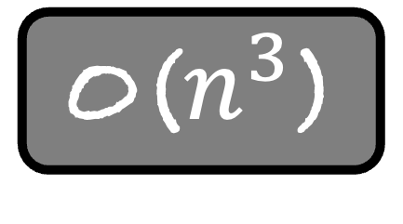
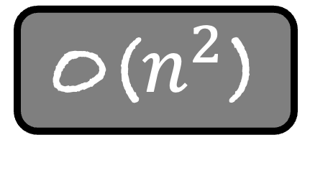
Let us now look at a problem which is quite similar to what we have done with BSTs till now
You are given an array A of size n where n is a power of 2
You need to answer the following query quickly
findMin(u,v): return min{A[u], A[u+1], …., A[v]}
Extra Space
Preprocessing
Query Time
O(1)
O(1)
O(n)
O($n^{2}$)
O($n^{3}$)
O(1)
Is there a middle ground?
Can we do something better by using extra, say O(n log n) space?

Slide 47
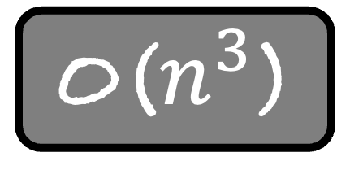
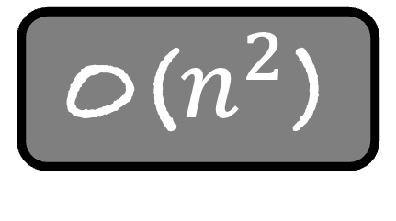
Extra Space
Preprocessing
Query Time
O(1)
O(1)
O(n)
O($n^{2}$)
O($n^{3}$)
O(1)
Is there a middle ground?
Can we do something better by using extra, say O(n log n) space?
Such problems pop up as subproblems in algorithmic research
On one end, we do no preprocessing but have to pay a large query time
On the other hand, we have to do heavy preprocessing, but our query time is low
Is there a middle ground? Both preprocessing and query time are small

Slide 48
15
7
35
8
80
55
23
3
What will you keep at each node?
The minimum of the left and right child

Slide 49
7
8
55
3
15
7
35
8
80
55
23
3
What will you keep at each node?
The minimum of the left and right child

Slide 50
7
3
7
8
55
3
15
7
35
8
80
55
23
3
What will you keep at each node?
The minimum of the left and right child

Slide 51
3
7
3
7
8
55
3
15
7
35
8
80
55
23
3
What is the extra space taken by this data-structure?
O(n)
What is the height of this tree?
O(log n)
What is the preprocessing time?
O(n)

Slide 52
3
7
3
7
8
55
3
15
7
35
8
80
55
23
3
For findMin(0,7), the answer is at the root
It stands to reason that the above structure should be useful to answer the query
But how?

Slide 53
1
3
1
7
3
2
1
7
8
55
3
2
9
10
1
15
7
35
8
80
55
23
3
2
3
15
9
10
14
12
1
u
v

Slide 54
1
3
1
7
3
2
1
7
8
55
3
2
9
10
1
15
7
35
8
80
55
23
3
2
3
15
9
10
14
12
1
u
v

Slide 55
1
3
1
7
3
2
1
7
8
55
3
2
9
10
1
15
7
35
8
80
55
23
3
2
3
15
9
10
14
12
1
u
v
Look at these 5 nodes
The minimum of these 5 nodes will give you the minimum in the range (u,v)
But how do we find these nodes?

Slide 56
1
3
1
7
3
2
1
7
8
55
3
2
9
10
1
15
7
35
8
80
55
23
3
2
3
15
9
10
14
12
1
u
v
Initially Ans = min{A[u],A[v]}

Slide 57
1
3
1
7
3
2
1
parentu
7
8
55
3
2
9
10
1
15
7
35
8
80
55
23
3
2
3
15
9
10
14
12
1
u
v
Find the parent of u
Should we use the value at this node to update our minimum?
No

Slide 58
1
3
1
7
3
2
1
parentu
7
8
55
3
2
9
10
1
15
7
35
8
80
55
23
3
2
3
15
9
10
14
12
1
u
v
Rule 1
If u is the right child of its parent, do nothing

Slide 59
1
3
1
7
3
2
1
parentu
7
8
55
3
2
9
10
1
15
7
35
8
80
55
23
3
2
3
15
9
10
14
12
1
u
v
Rule 1
If u is the right child of its parent, do nothing
If v is the left child of its parent, do nothing

Slide 60
1
3
1
7
3
2
1
parentu
parentv
7
8
55
3
2
9
10
1
15
7
35
8
80
55
23
3
2
3
15
9
10
14
12
1
u
v
Rule 1
If u is the right child of its parent, do nothing
If v is the left child of its parent, do nothing
What should we do for v?

Slide 61
1
3
1
7
3
2
1
parentu
parentv
7
8
55
3
2
9
10
1
15
7
35
8
80
55
23
3
2
3
15
9
10
14
12
1
u
siblingv
v
Use the value stored in the sibling of v
Ans = min {8, 14, 10}

Slide 62
1
3
1
7
3
2
1
parentu
parentv
7
8
55
3
2
9
10
1
15
7
35
8
80
55
23
3
2
3
15
9
10
14
12
1
u
siblingv
v
Rule 2
If v is the right child of its parent, use the sibling of v to update the minimum
If u is the left child of its parent, use the sibling of u to update the minimum

Slide 63
1
3
1
parentu
parentv
7
3
2
1
u
v
7
8
55
3
2
9
10
1
15
7
35
8
80
55
23
3
2
3
15
9
10
14
12
1
Rule 1
If u is the right child of its parent, do nothing
If v is the left child of its parent, do nothing

Slide 64
1
3
1
u
v
7
3
2
1
7
8
55
3
2
9
10
1
15
7
35
8
80
55
23
3
2
3
15
9
10
14
12
1
Rule 1
If u is the right child of its parent, do nothing
If v is the left child of its parent, do nothing

Slide 65
1
parentu
3
1
u
siblingu
v
7
3
2
1
7
8
55
3
2
9
10
1
15
7
35
8
80
55
23
3
2
3
15
9
10
14
12
1
Rule 2
If v is the right child of its parent, use the sibling of v to update the minimum
If u is the left child of its parent, use the sibling of u to update the minimum

Slide 66
1
parentu
parentv
3
1
u
siblingu
siblingv
v
7
3
2
1
7
8
55
3
2
9
10
1
15
7
35
8
80
55
23
3
2
3
15
9
10
14
12
1
Rule 2
If v is the right child of its parent, use the sibling of v to update the minimum
If u is the left child of its parent, use the sibling of u to update the minimum

Slide 67
1
u
v
3
1
7
3
2
1
7
8
55
3
2
9
10
1
15
7
35
8
80
55
23
3
2
3
15
9
10
14
12
1
At the end, both u and v have the same parent
What should we do now?
Nothing, we are already done
Let us try to implement this algorithm for other ranges

Slide 68
1
3
1
7
3
2
1
7
8
55
3
2
9
10
1
15
7
35
8
80
55
23
3
2
3
15
9
10
14
12
1
u
v

Slide 69
1
3
1
7
3
2
1
7
8
55
3
2
9
10
1
15
7
35
8
80
55
23
3
2
3
15
9
10
14
12
1
u
v
What is the height of this tree?
O( log n)
This implies that the running time of our algorithm is O(log n)
Let us now try to implement this algorithm

Slide 70
We will use only arrays to implement our strategy
Given n, we will construct an array of size 2n-1
The last n entries correspond to the input
The first n-1 correspond to the internal nodes of the tree (remember heaps)
The root is the 0-th index in the tree
For a node at index i, its left child is at index 2i+1 and its right child is at index 2i+2

Slide 71
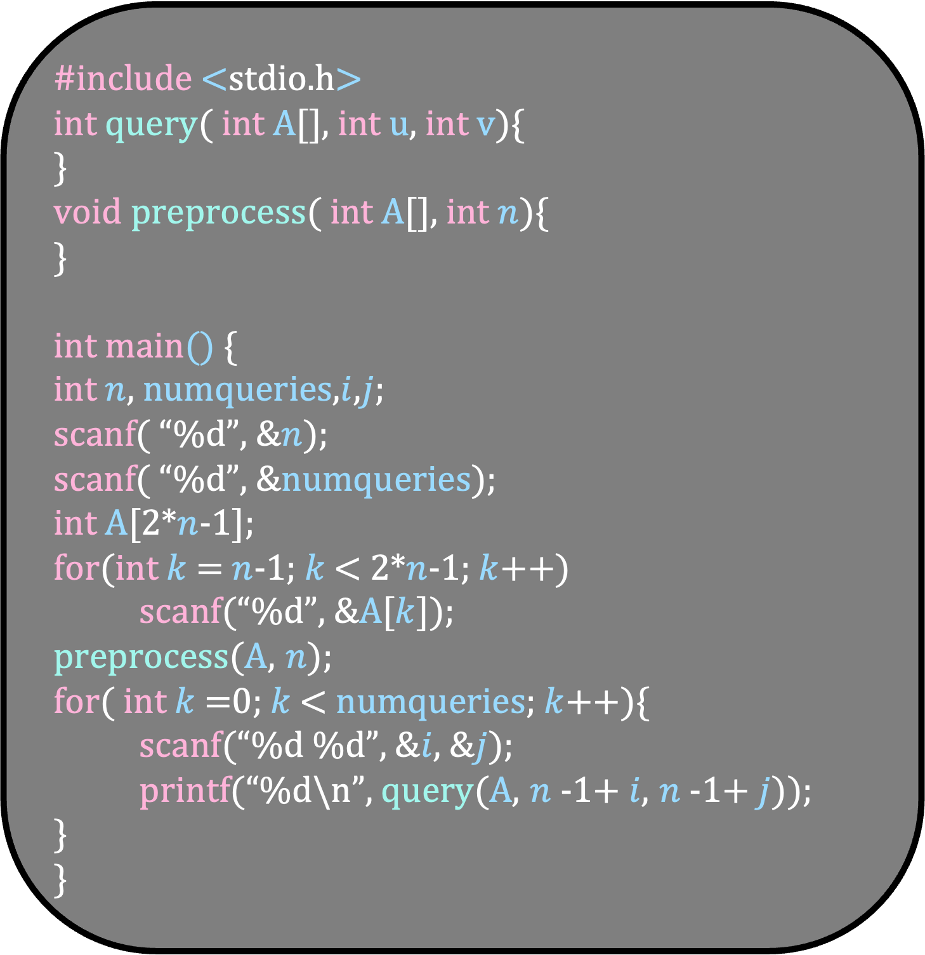
#include <stdio.h>
int query( int A[], int u, int v){
}
void preprocess( int A[], int $n$){
}
int main() {
int $n$, numqueries,$i$,$j$;
scanf( “%d”, &$n$);
scanf( “%d”, &numqueries);
int A[2*$n$-1];
for(int $k$ = $n$-1; $k$ < 2*$n$-1; $k$++)
scanf(“%d”, &A[$k$]);
preprocess(A, $n$);
for( int $k$=0; $k$< numqueries; $k$++){
scanf(“%d %d”, &$i$, &$j$);
printf(“%d\n”, query(A, $n$-1+ $i$, $n$-1+ $j$));
}
}
Rule 1
If u is the right child of its parent, do nothing
If v is the left child of its parent, do nothing
Rule 2
If v is the right child of its parent, use the sibling of v to update the minimum
If u is the left child of its parent, use the sibling of u to update the minimum

Slide 72
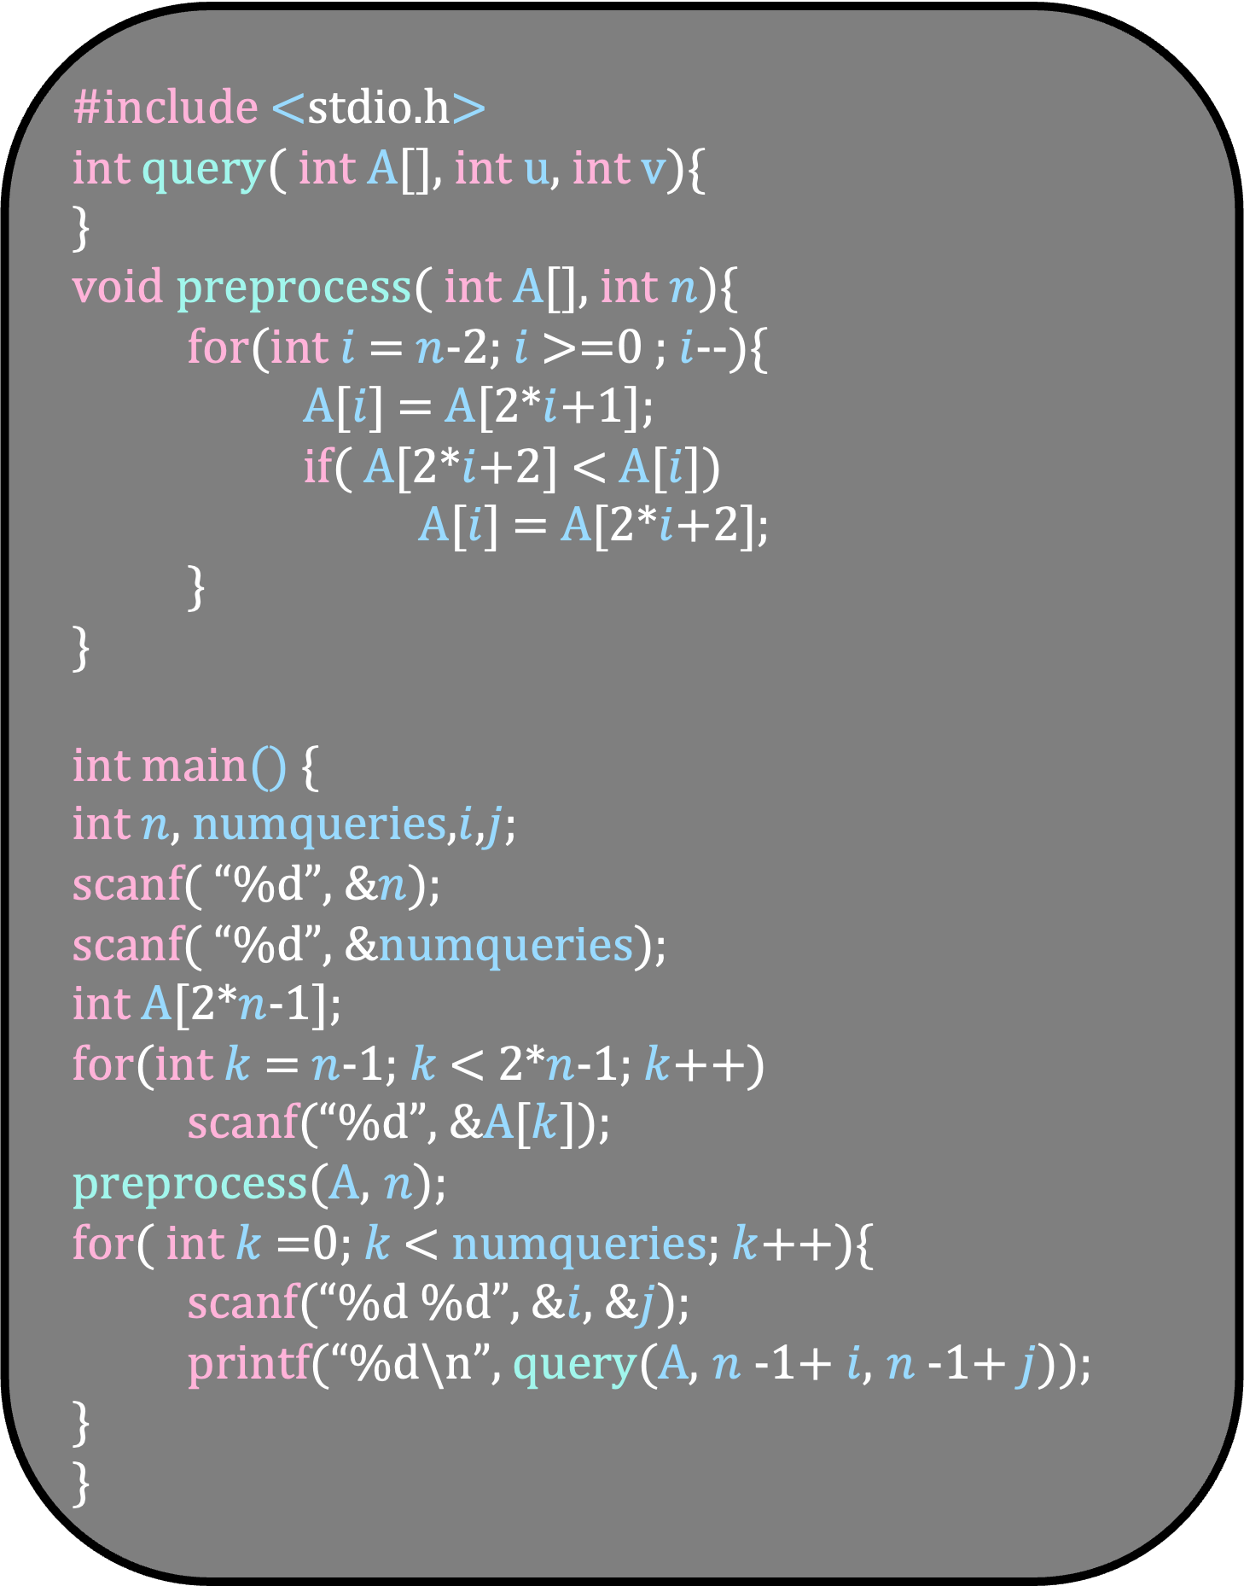
#include <stdio.h>
int query( int A[], int u, int v){
}
void preprocess( int A[], int $n$){
for(int $i$ = $n$-2; $i$ >=0 ; $i$--){
A[$i$] = A[2*$i$+1];
if( A[2*$i$+2] < A[$i$])
A[$i$] = A[2*$i$+2];
}
}
int main() {
int $n$, numqueries,$i$,$j$;
scanf( “%d”, &$n$);
scanf( “%d”, &numqueries);
int A[2*$n$-1];
for(int $k$ = $n$-1; $k$ < 2*$n$-1; $k$++)
scanf(“%d”, &A[$k$]);
preprocess(A, $n$);
for( int $k$=0; $k$< numqueries; $k$++){
scanf(“%d %d”, &$i$, &$j$);
printf(“%d\n”, query(A, $n$-1+ $i$, $n$-1+ $j$));
}
}
Rule 1
If u is the right child of its parent, do nothing
If v is the left child of its parent, do nothing
Rule 2
If v is the right child of its parent, use the sibling of v to update the minimum
If u is the left child of its parent, use the sibling of u to update the minimum

Slide 73
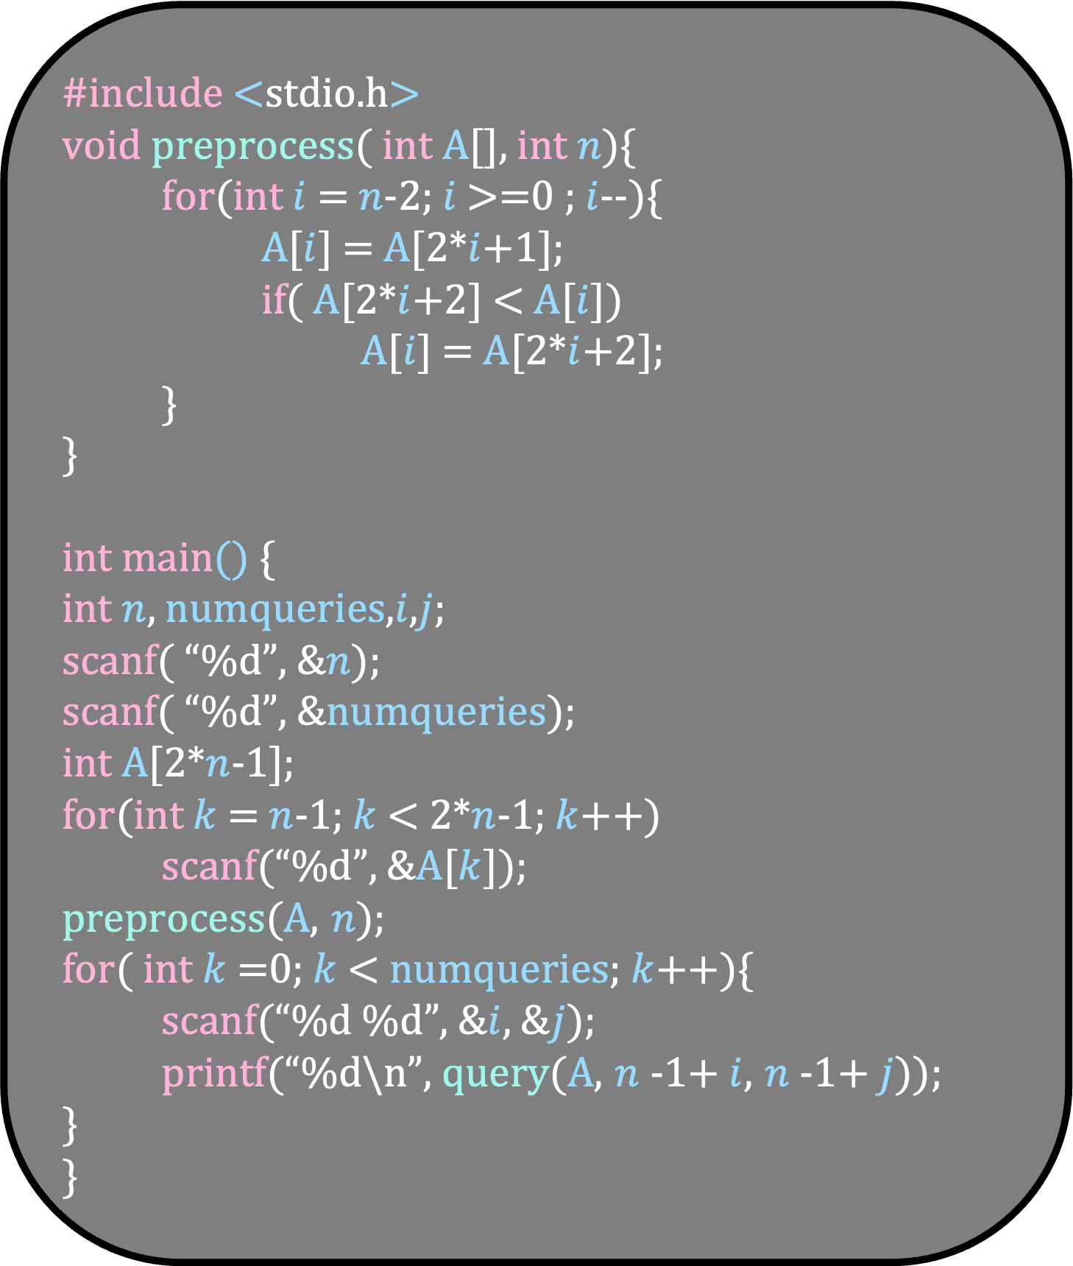
int query( int A[], int u, int v){
int ans = A[u];
if( A[v] < ans)
ans = A[v];
while(1){
int parentu = (u-1)/2;
int parentv = (v-1)/2;
if( parentu == parentv)
return ans;
if( u == 2*parentu +1){
int siblingu = 2*parentu +2;
if( A[siblingu] < ans)
ans = A[siblingu];
}
if( v == 2*parentv +2){
int siblingv = 2*parentv +1;
if( A[siblingv] < ans)
ans = A[siblingv];
}
u = parentu;
v = parentv;
}
}
#include <stdio.h>
void preprocess( int A[], int $n$){
for(int $i$ = $n$-2; $i$ >=0 ; $i$--){
A[$i$] = A[2*$i$+1];
if( A[2*$i$+2] < A[$i$])
A[$i$] = A[2*$i$+2];
}
}
int main() {
int $n$, numqueries,$i$,$j$;
scanf( “%d”, &$n$);
scanf( “%d”, &numqueries);
int A[2*$n$-1];
for(int $k$ = $n$-1; $k$ < 2*$n$-1; $k$++)
scanf(“%d”, &A[$k$]);
preprocess(A, $n$);
for( int $k$=0; $k$< numqueries; $k$++){
scanf(“%d %d”, &$i$, &$j$);
printf(“%d\n”, query(A, $n$-1+ $i$, $n$-1+ $j$));
}
}

Slide 74
int query( int A[], int u, int v){
int ans = A[u];
if( A[v] < ans)
ans = A[v];
while(1){
int parentu = (u-1)/2;
int parentv = (v-1)/2;
if( parentu == parentv)
return ans;
if( u == 2*parentu +1){
int siblingu = 2*parentu +2;
if( A[siblingu] < ans)
ans = A[siblingu];
}
if( v == 2*parentv +2){
int siblingv = 2*parentv +1;
if( A[siblingv] < ans)
ans = A[siblingv];
}
u = parentu;
v = parentv;
}
}
3
7
3
7
8
55
3
15
7
35
8
80
55
23
3
u
v
ans = 7

Slide 75
int query( int A[], int u, int v){
int ans = A[u];
if( A[v] < ans)
ans = A[v];
while(1){
int parentu = (u-1)/2;
int parentv = (v-1)/2;
if( parentu == parentv)
return ans;
if( u == 2*parentu +1){
int siblingu = 2*parentu +2;
if( A[siblingu] < ans)
ans = A[siblingu];
}
if( v == 2*parentv +2){
int siblingv = 2*parentv +1;
if( A[siblingv] < ans)
ans = A[siblingv];
}
u = parentu;
v = parentv;
}
}
3
7
3
parentu
parentv
7
8
55
3
15
7
35
8
80
55
23
3
u
v
ans = 7

Slide 76
int query( int A[], int u, int v){
int ans = A[u];
if( A[v] < ans)
ans = A[v];
while(1){
int parentu = (u-1)/2;
int parentv = (v-1)/2;
if( parentu == parentv)
return ans;
if( u == 2*parentu +1){
int siblingu = 2*parentu +2;
if( A[siblingu] < ans)
ans = A[siblingu];
}
if( v == 2*parentv +2){
int siblingv = 2*parentv +1;
if( A[siblingv] < ans)
ans = A[siblingv];
}
u = parentu;
v = parentv;
}
}
3
7
3
parentu
parentv
7
8
55
3
15
7
35
8
80
55
23
3
u
v
ans = 7

Slide 77
int query( int A[], int u, int v){
int ans = A[u];
if( A[v] < ans)
ans = A[v];
while(1){
int parentu = (u-1)/2;
int parentv = (v-1)/2;
if( parentu == parentv)
return ans;
if( u == 2*parentu +1){
int siblingu = 2*parentu +2;
if( A[siblingu] < ans)
ans = A[siblingu];
}
if( v == 2*parentv +2){
int siblingv = 2*parentv +1;
if( A[siblingv] < ans)
ans = A[siblingv];
}
u = parentu;
v = parentv;
}
}
3
7
3
parentu
parentv
7
8
55
3
15
7
35
8
80
55
23
3
u
v
ans = 7

Slide 78
int query( int A[], int u, int v){
int ans = A[u];
if( A[v] < ans)
ans = A[v];
while(1){
int parentu = (u-1)/2;
int parentv = (v-1)/2;
if( parentu == parentv)
return ans;
if( u == 2*parentu +1){
int siblingu = 2*parentu +2;
if( A[siblingu] < ans)
ans = A[siblingu];
}
if( v == 2*parentv +2){
int siblingv = 2*parentv +1;
if( A[siblingv] < ans)
ans = A[siblingv];
}
u = parentu;
v = parentv;
}
}
3
7
3
parentu
parentv
7
8
55
3
15
7
35
8
80
55
23
3
u
v
ans = 7

Slide 79
int query( int A[], int u, int v){
int ans = A[u];
if( A[v] < ans)
ans = A[v];
while(1){
int parentu = (u-1)/2;
int parentv = (v-1)/2;
if( parentu == parentv)
return ans;
if( u == 2*parentu +1){
int siblingu = 2*parentu +2;
if( A[siblingu] < ans)
ans = A[siblingu];
}
if( v == 2*parentv +2){
int siblingv = 2*parentv +1;
if( A[siblingv] < ans)
ans = A[siblingv];
}
u = parentu;
v = parentv;
}
}
3
7
3
parentu
parentv
7
8
55
3
siblingv
15
7
35
8
80
55
23
3
u
v
ans = 7

Slide 80
int query( int A[], int u, int v){
int ans = A[u];
if( A[v] < ans)
ans = A[v];
while(1){
int parentu = (u-1)/2;
int parentv = (v-1)/2;
if( parentu == parentv)
return ans;
if( u == 2*parentu +1){
int siblingu = 2*parentu +2;
if( A[siblingu] < ans)
ans = A[siblingu];
}
if( v == 2*parentv +2){
int siblingv = 2*parentv +1;
if( A[siblingv] < ans)
ans = A[siblingv];
}
u = parentu;
v = parentv;
}
}
3
7
3
parentu
parentv
7
8
55
3
siblingv
15
7
35
8
80
55
23
3
u
v
ans = 7

Slide 81
int query( int A[], int u, int v){
int ans = A[u];
if( A[v] < ans)
ans = A[v];
while(1){
int parentu = (u-1)/2;
int parentv = (v-1)/2;
if( parentu == parentv)
return ans;
if( u == 2*parentu +1){
int siblingu = 2*parentu +2;
if( A[siblingu] < ans)
ans = A[siblingu];
}
if( v == 2*parentv +2){
int siblingv = 2*parentv +1;
if( A[siblingv] < ans)
ans = A[siblingv];
}
u = parentu;
v = parentv;
}
}
3
7
3
u
v
7
8
55
3
15
7
35
8
80
55
23
3
ans = 7

Slide 82
int query( int A[], int u, int v){
int ans = A[u];
if( A[v] < ans)
ans = A[v];
while(1){
int parentu = (u-1)/2;
int parentv = (v-1)/2;
if( parentu == parentv)
return ans;
if( u == 2*parentu +1){
int siblingu = 2*parentu +2;
if( A[siblingu] < ans)
ans = A[siblingu];
}
if( v == 2*parentv +2){
int siblingv = 2*parentv +1;
if( A[siblingv] < ans)
ans = A[siblingv];
}
u = parentu;
v = parentv;
}
}
3
parentu
parentv
7
3
u
v
7
8
55
3
15
7
35
8
80
55
23
3
ans = 7

Slide 83
int query( int A[], int u, int v){
int ans = A[u];
if( A[v] < ans)
ans = A[v];
while(1){
int parentu = (u-1)/2;
int parentv = (v-1)/2;
if( parentu == parentv)
return ans;
if( u == 2*parentu +1){
int siblingu = 2*parentu +2;
if( A[siblingu] < ans)
ans = A[siblingu];
}
if( v == 2*parentv +2){
int siblingv = 2*parentv +1;
if( A[siblingv] < ans)
ans = A[siblingv];
}
u = parentu;
v = parentv;
}
}
3
parentu
parentv
7
3
u
v
7
8
55
3
15
7
35
8
80
55
23
3
ans = 7

Slide 84
int query( int A[], int u, int v){
int ans = A[u];
if( A[v] < ans)
ans = A[v];
while(1){
int parentu = (u-1)/2;
int parentv = (v-1)/2;
if( parentu == parentv)
return ans;
if( u == 2*parentu +1){
int siblingu = 2*parentu +2;
if( A[siblingu] < ans)
ans = A[siblingu];
}
if( v == 2*parentv +2){
int siblingv = 2*parentv +1;
if( A[siblingv] < ans)
ans = A[siblingv];
}
u = parentu;
v = parentv;
}
}
3
parentu
parentv
7
3
u
v
7
8
55
3
15
7
35
8
80
55
23
3
ans = 7

Slide 85
int query( int A[], int u, int v){
int ans = A[u];
if( A[v] < ans)
ans = A[v];
while(1){
int parentu = (u-1)/2;
int parentv = (v-1)/2;
if( parentu == parentv)
return ans;
if( u == 2*parentu +1){
int siblingu = 2*parentu +2;
if( A[siblingu] < ans)
ans = A[siblingu];
}
if( v == 2*parentv +2){
int siblingv = 2*parentv +1;
if( A[siblingv] < ans)
ans = A[siblingv];
}
u = parentu;
v = parentv;
}
}
3
parentu
parentv
7
3
u
siblingu
v
7
8
55
3
15
7
35
8
80
55
23
3
ans = 7

Slide 86
int query( int A[], int u, int v){
int ans = A[u];
if( A[v] < ans)
ans = A[v];
while(1){
int parentu = (u-1)/2;
int parentv = (v-1)/2;
if( parentu == parentv)
return ans;
if( u == 2*parentu +1){
int siblingu = 2*parentu +2;
if( A[siblingu] < ans)
ans = A[siblingu];
}
if( v == 2*parentv +2){
int siblingv = 2*parentv +1;
if( A[siblingv] < ans)
ans = A[siblingv];
}
u = parentu;
v = parentv;
}
}
3
parentu
parentv
7
3
u
siblingu
v
7
8
55
3
15
7
35
8
80
55
23
3
ans = 7

Slide 87
int query( int A[], int u, int v){
int ans = A[u];
if( A[v] < ans)
ans = A[v];
while(1){
int parentu = (u-1)/2;
int parentv = (v-1)/2;
if( parentu == parentv)
return ans;
if( u == 2*parentu +1){
int siblingu = 2*parentu +2;
if( A[siblingu] < ans)
ans = A[siblingu];
}
if( v == 2*parentv +2){
int siblingv = 2*parentv +1;
if( A[siblingv] < ans)
ans = A[siblingv];
}
u = parentu;
v = parentv;
}
}
3
parentu
parentv
7
3
u
siblingu
v
7
8
55
3
15
7
35
8
80
55
23
3
ans = 7

Slide 88
int query( int A[], int u, int v){
int ans = A[u];
if( A[v] < ans)
ans = A[v];
while(1){
int parentu = (u-1)/2;
int parentv = (v-1)/2;
if( parentu == parentv)
return ans;
if( u == 2*parentu +1){
int siblingu = 2*parentu +2;
if( A[siblingu] < ans)
ans = A[siblingu];
}
if( v == 2*parentv +2){
int siblingv = 2*parentv +1;
if( A[siblingv] < ans)
ans = A[siblingv];
}
u = parentu;
v = parentv;
}
}
3
u
v
7
3
7
8
55
3
15
7
35
8
80
55
23
3
ans = 7

Slide 89
parentu
int query( int A[], int u, int v){
int ans = A[u];
if( A[v] < ans)
ans = A[v];
while(1){
int parentu = (u-1)/2;
int parentv = (v-1)/2;
if( parentu == parentv)
return ans;
if( u == 2*parentu +1){
int siblingu = 2*parentu +2;
if( A[siblingu] < ans)
ans = A[siblingu];
}
if( v == 2*parentv +2){
int siblingv = 2*parentv +1;
if( A[siblingv] < ans)
ans = A[siblingv];
}
u = parentu;
v = parentv;
}
}
parentv
3
u
v
7
3
7
8
55
3
15
7
35
8
80
55
23
3
ans = 7

Slide 90
You are given an array A of size n where n is a power of 2
You need to answer the following query quickly
findSum(u,v): return A[u]+ A[u+1]+ ….+ A[v]

Slide 91
15
7
17
8
10
5
23
3
What will you keep at each node?
The sum of the left and right child

Slide 92
98
47
51
22
25
15
26
15
7
17
8
10
5
23
3
What will you keep at each node?
The sum of the left and right child

Slide 93
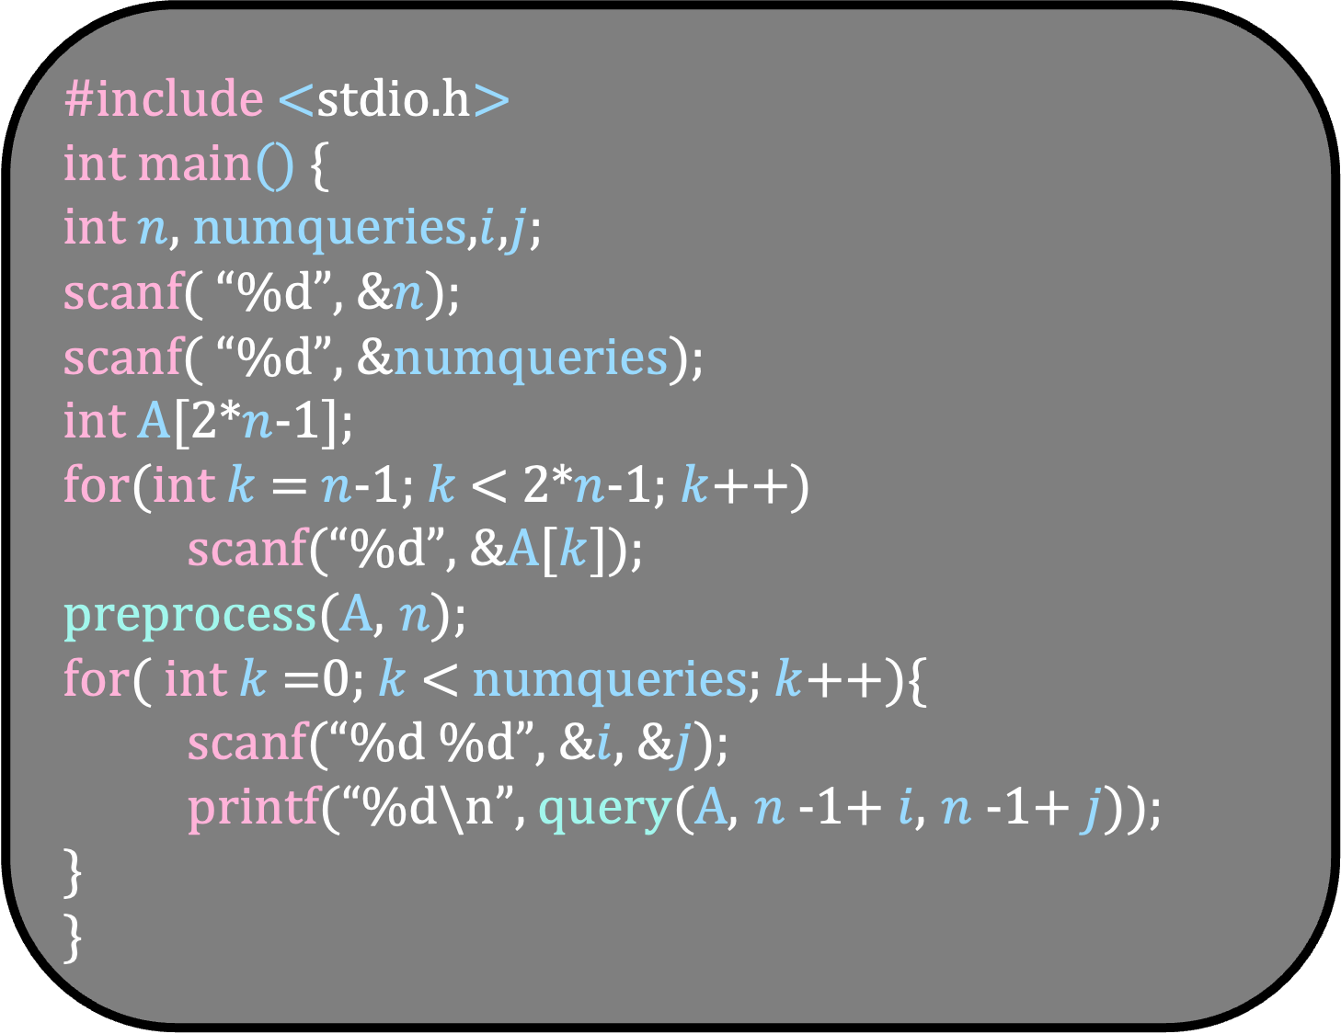
Rule 1
If u is the right child of its parent, do nothing
If v is the left child of its parent, do nothing
#include <stdio.h>
int main() {
int $n$, numqueries,$i$,$j$;
scanf( “%d”, &$n$);
scanf( “%d”, &numqueries);
int A[2*$n$-1];
for(int $k$ = $n$-1; $k$ < 2*$n$-1; $k$++)
scanf(“%d”, &A[$k$]);
preprocess(A, $n$);
for( int $k$=0; $k$< numqueries; $k$++){
scanf(“%d %d”, &$i$, &$j$);
printf(“%d\n”, query(A, $n$-1+ $i$, $n$-1+ $j$));
}
}
Rule 2
If v is the right child of its parent, use the sibling of v to update the sum
If u is the left child of its parent, use the sibling of u to update the sum
Complete the code for the sum query

Slide 94
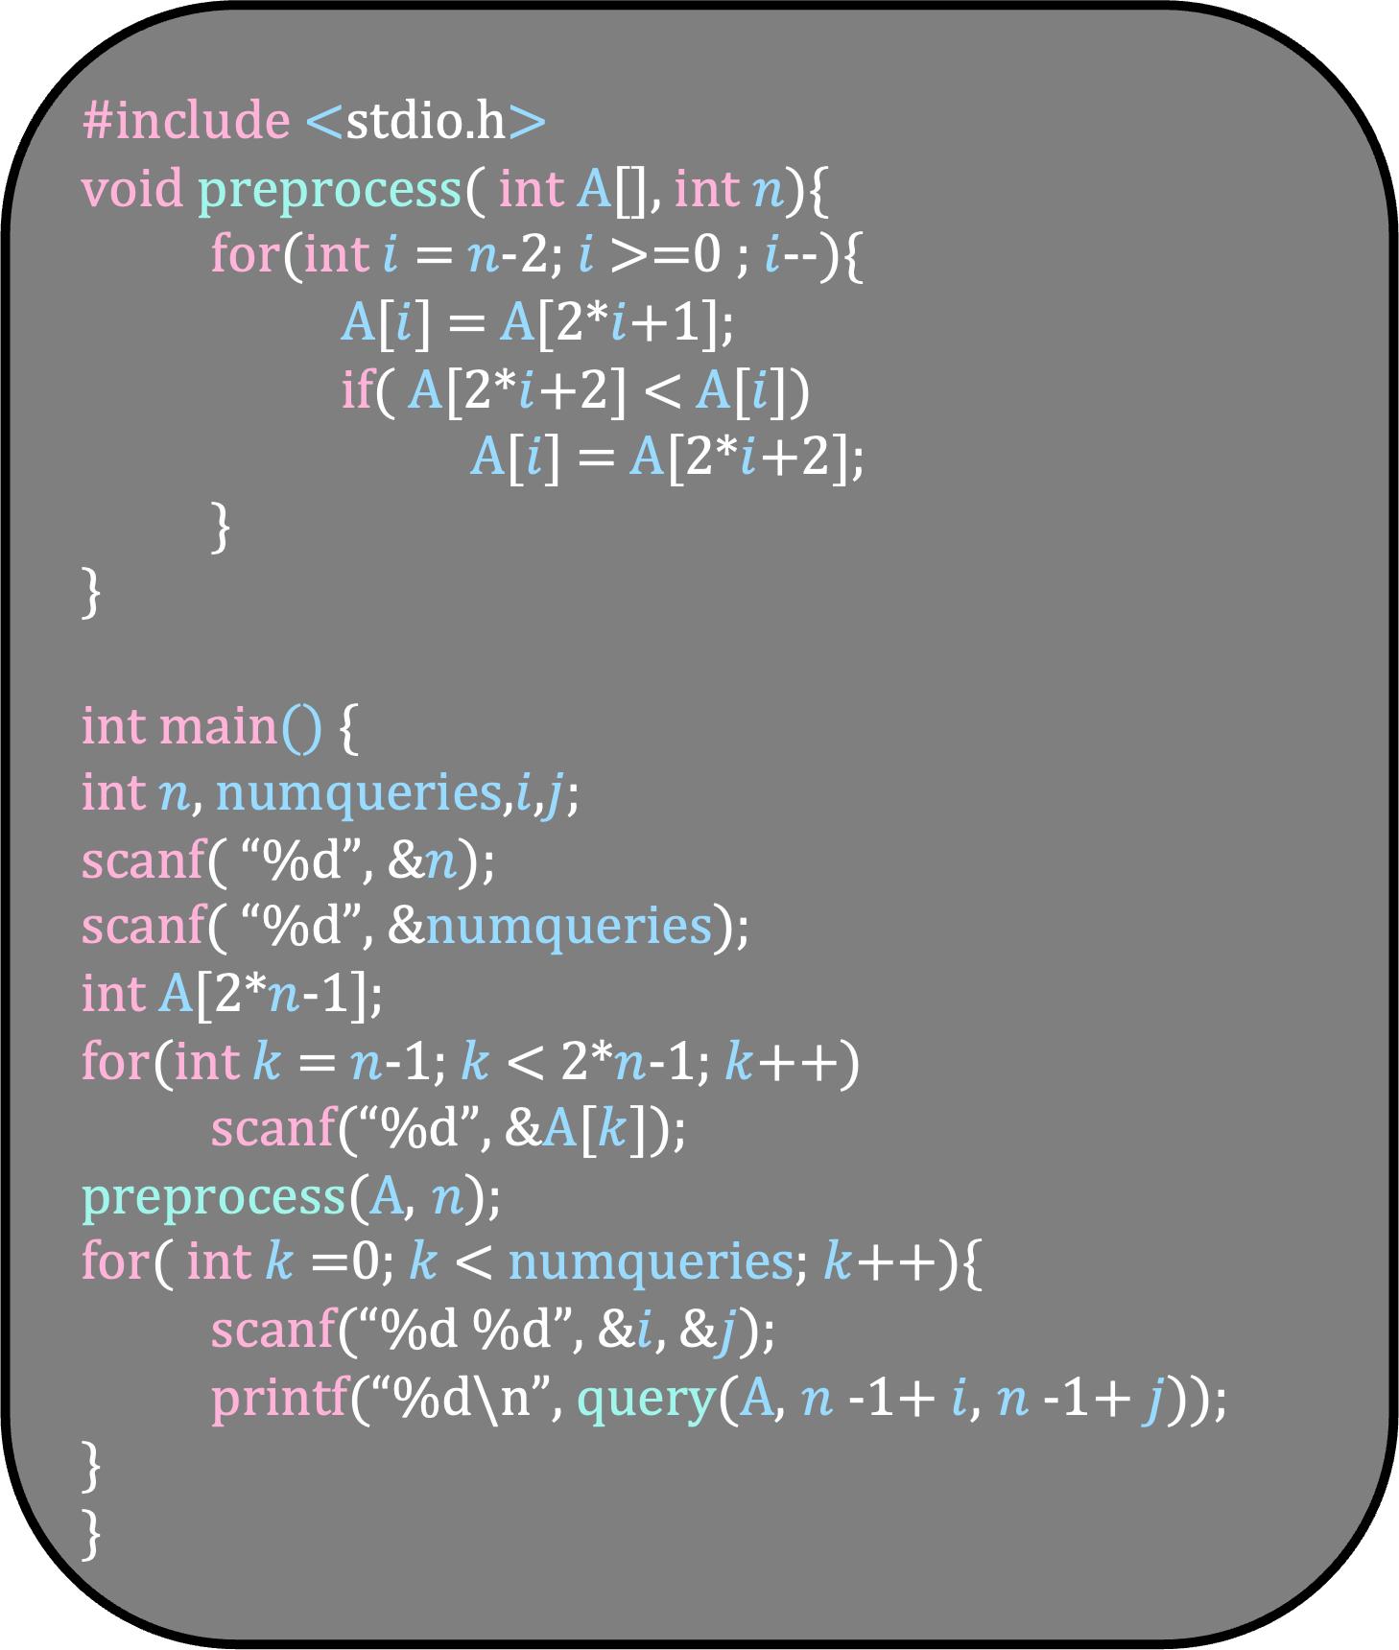
int query( int A[], int u, int v){
int ans = A[u];
if( A[v] < ans)
ans = A[v];
while(1){
int parentu = (u-1)/2;
int parentv = (v-1)/2;
if( parentu == parentv)
return ans;
if( u == 2*parentu +1){
int siblingu = 2*parentu +2;
if( A[siblingu] < ans)
ans = A[siblingu];
}
if( v == 2*parentv +2){
int siblingv = 2*parentv +1;
if( A[siblingv] < ans)
ans = A[siblingv];
}
u = parentu;
v = parentv;
}
}
#include <stdio.h>
void preprocess( int A[], int $n$){
for(int $i$ = $n$-2; $i$ >=0 ; $i$--){
A[$i$] = A[2*$i$+1];
if( A[2*$i$+2] < A[$i$])
A[$i$] = A[2*$i$+2];
}
}
int main() {
int $n$, numqueries,$i$,$j$;
scanf( “%d”, &$n$);
scanf( “%d”, &numqueries);
int A[2*$n$-1];
for(int $k$ = $n$-1; $k$ < 2*$n$-1; $k$++)
scanf(“%d”, &A[$k$]);
preprocess(A, $n$);
for( int $k$=0; $k$< numqueries; $k$++){
scanf(“%d %d”, &$i$, &$j$);
printf(“%d\n”, query(A, $n$-1+ $i$, $n$-1+ $j$));
}
}

Slide 95
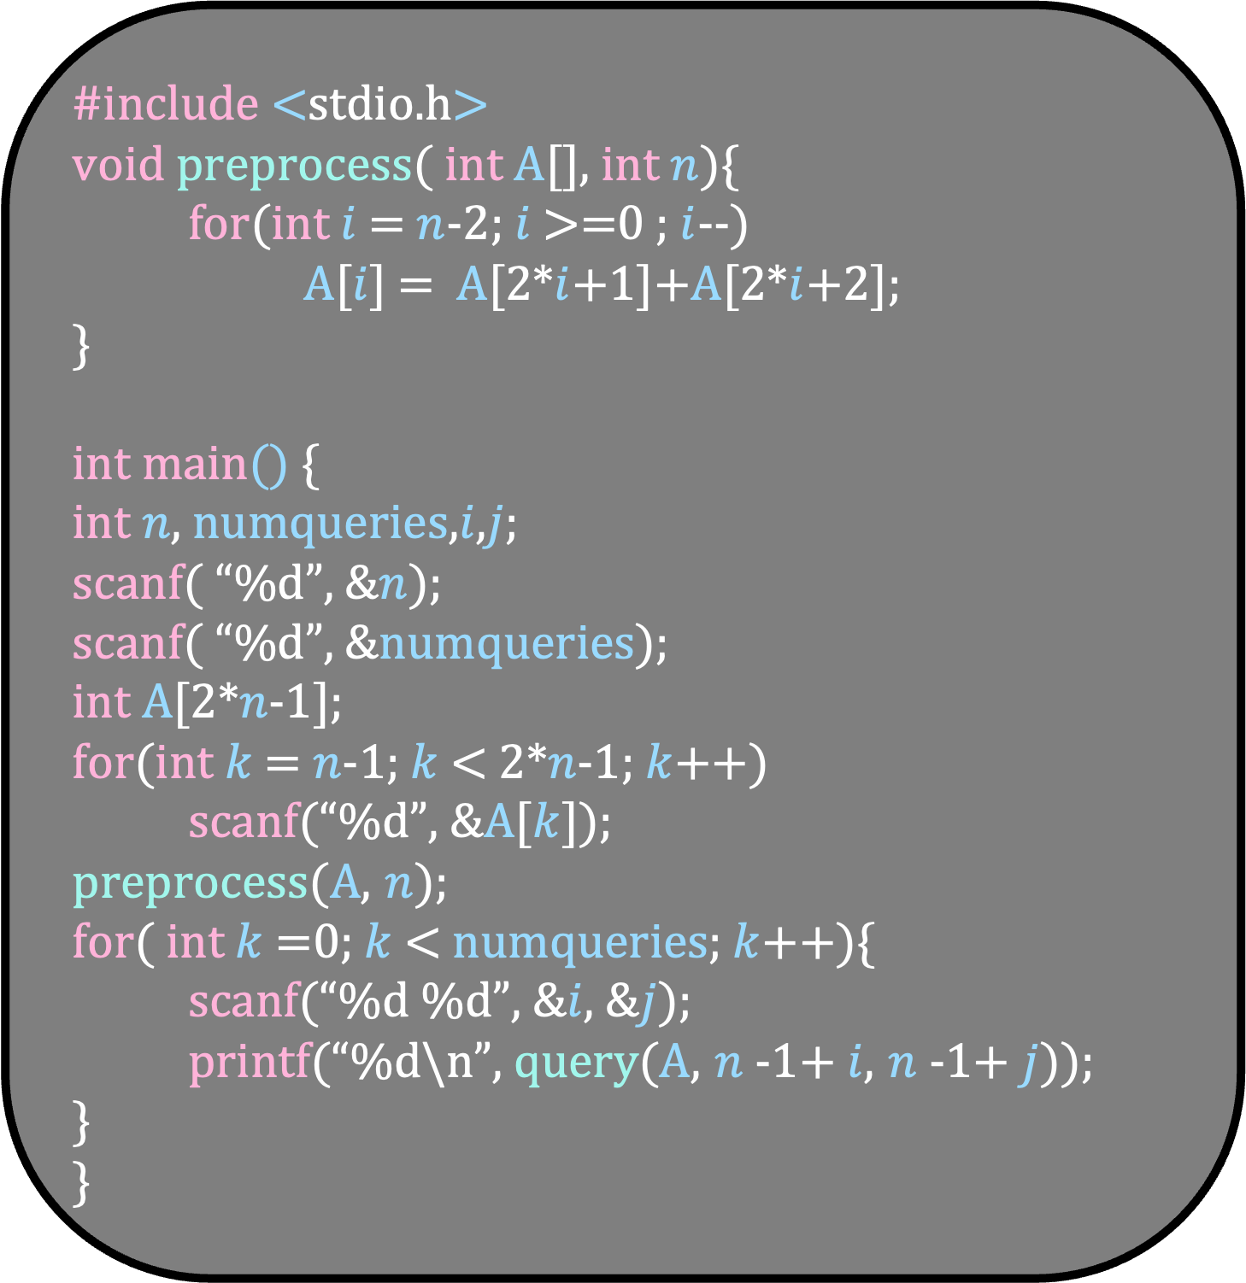
int query( int A[], int u, int v){
int sum = A[u];
if( u != v)
sum += A[v];
while(1){
int parentu = (u-1)/2;
int parentv = (v-1)/2;
if( parentu == parentv)
return sum;
if( u == 2*parentu +1){
int siblingu = 2*parentu +2;
sum += A[siblingu];
}
if( v == 2*parentv +2){
int siblingv = 2*parentv +1;
sum += A[siblingv];
}
u = parentu;
v = parentv;
}
}
#include <stdio.h>
void preprocess( int A[], int $n$){
for(int $i$ = $n$-2; $i$ >=0 ; $i$--)
A[$i$] = A[2*$i$+1]+A[2*$i$+2];
}
int main() {
int $n$, numqueries,$i$,$j$;
scanf( “%d”, &$n$);
scanf( “%d”, &numqueries);
int A[2*$n$-1];
for(int $k$ = $n$-1; $k$ < 2*$n$-1; $k$++)
scanf(“%d”, &A[$k$]);
preprocess(A, $n$);
for( int $k$=0; $k$< numqueries; $k$++){
scanf(“%d %d”, &$i$, &$j$);
printf(“%d\n”, query(A, $n$-1+ $i$, $n$-1+ $j$));
}
}

Slide 96

You are given an array A of size n where n is a power of 2
You need to answer the following query quickly
Update(u,v,x): for each u $≤$ i $≤$ v, set A[i] = A[i]+x
Report(u): return A[u]

Slide 97
15
7
17
8
10
5
23
3
What will you keep at each node?
Updates done in the corresponding range

Slide 98
15
7
17
8
10
5
23
3
What will you keep at each node?
Updates done in the corresponding range

Slide 99
15
7
17
8
10
5
23
3
What will you keep at each node?
Updates done in the corresponding range

Slide 100
0
0
0
0
0
0
0
15
7
17
8
10
5
23
3
What will you keep at each node?
Updates done in the corresponding range

Slide 101
0
0
0
0
0
0
0
0
0
0
0
0
0
0
0
15
7
35
8
80
55
23
3
2
3
15
9
10
14
12
1
Update(2,10,5)

Slide 102
0
0
0
0
0
0
0
0
0
0
0
0
0
0
0
15
7
35
8
80
55
23
3
2
3
15
9
10
14
12
1
u
v
Update(2,10,5)

Slide 103
0
0
0
0
0
0
0
0
0
0
0
0
0
0
0
15
7
35
8
80
55
23
3
2
3
15
9
10
14
12
1
u
v
These are the nodes we will update
Update u and v

Slide 104
0
0
0
0
0
0
0
0
0
0
0
0
0
0
0
15
7
40
8
80
55
23
3
2
3
20
9
10
14
12
1
u
v
These are the nodes we will update
Update u and v

Slide 105
0
0
0
0
0
0
0
parentu
parentv
0
0
0
0
0
0
0
0
15
7
40
8
80
55
23
3
2
3
20
9
10
14
12
1
u
siblingu
v
Rule 2
If u is the left child of its parent, use the sibling of u to make changes
If v is the right child of its parent, use the sibling of v to make changes

Slide 106
0
0
0
0
0
0
0
parentu
parentv
0
0
0
0
0
0
0
0
15
7
40
13
80
55
23
3
2
3
20
9
10
14
12
1
u
siblingu
v
Rule 1
If u is the right child of its parent, do nothing
If v is the left child of its parent, do nothing

Slide 107
0
0
0
parentu
parentv
0
0
0
0
u
v
0
0
0
0
0
0
0
0
15
7
40
13
80
55
23
3
2
3
20
9
10
14
12
1
Rule 1
If u is the right child of its parent, do nothing
If v is the left child of its parent, do nothing

Slide 108
0
0
0
parentu
parentv
0
0
0
0
u
siblingv
v
0
0
0
0
0
0
0
0
15
7
40
13
80
55
23
3
2
3
20
9
10
14
12
1
Rule 2
If u is the left child of its parent, use the sibling of u to make changes
If v is the right child of its parent, use the sibling of v to make changes

Slide 109
0
0
0
parentu
parentv
0
0
0
0
u
siblingv
v
0
0
0
0
5
0
0
0
15
7
40
13
80
55
23
3
2
3
20
9
10
14
12
1
Rule 2
If u is the left child of its parent, use the sibling of u to make changes
If v is the right child of its parent, use the sibling of v to make changes

Slide 110
0
parentu
parentv
0
0
u
siblingu
v
0
0
0
0
0
0
0
0
5
0
0
0
15
7
40
13
80
55
23
3
2
3
20
9
10
14
12
1
Rule 2
If u is the left child of its parent, use the sibling of u to make changes
If v is the right child of its parent, use the sibling of v to make changes

Slide 111
0
parentu
parentv
0
0
u
siblingu
v
0
5
0
0
0
0
0
0
5
0
0
0
15
7
40
13
80
55
23
3
2
3
20
9
10
14
12
1
Rule 2
If u is the left child of its parent, use the sibling of u to make changes
If v is the right child of its parent, use the sibling of v to make changes

Slide 112
parentu
0
parentv
u
v
0
0
0
5
0
0
0
0
0
0
5
0
0
0
15
7
40
13
80
55
23
3
2
3
20
9
10
14
12
1
Rule 2
If u is the left child of its parent, use the sibling of u to make changes
If v is the right child of its parent, use the sibling of v to make changes

Slide 113
0
0
0
0
5
0
0
0
0
0
0
5
0
0
0
15
7
40
13
80
55
23
3
2
3
20
9
10
14
12
1
u
Report(5)

Slide 114
0
0
0
0
5
0
0
0
0
0
0
5
0
0
0
15
7
40
13
80
55
23
3
2
3
20
9
10
14
12
1
u
Add all these nodes and return the sum
Report(5)

Slide 115
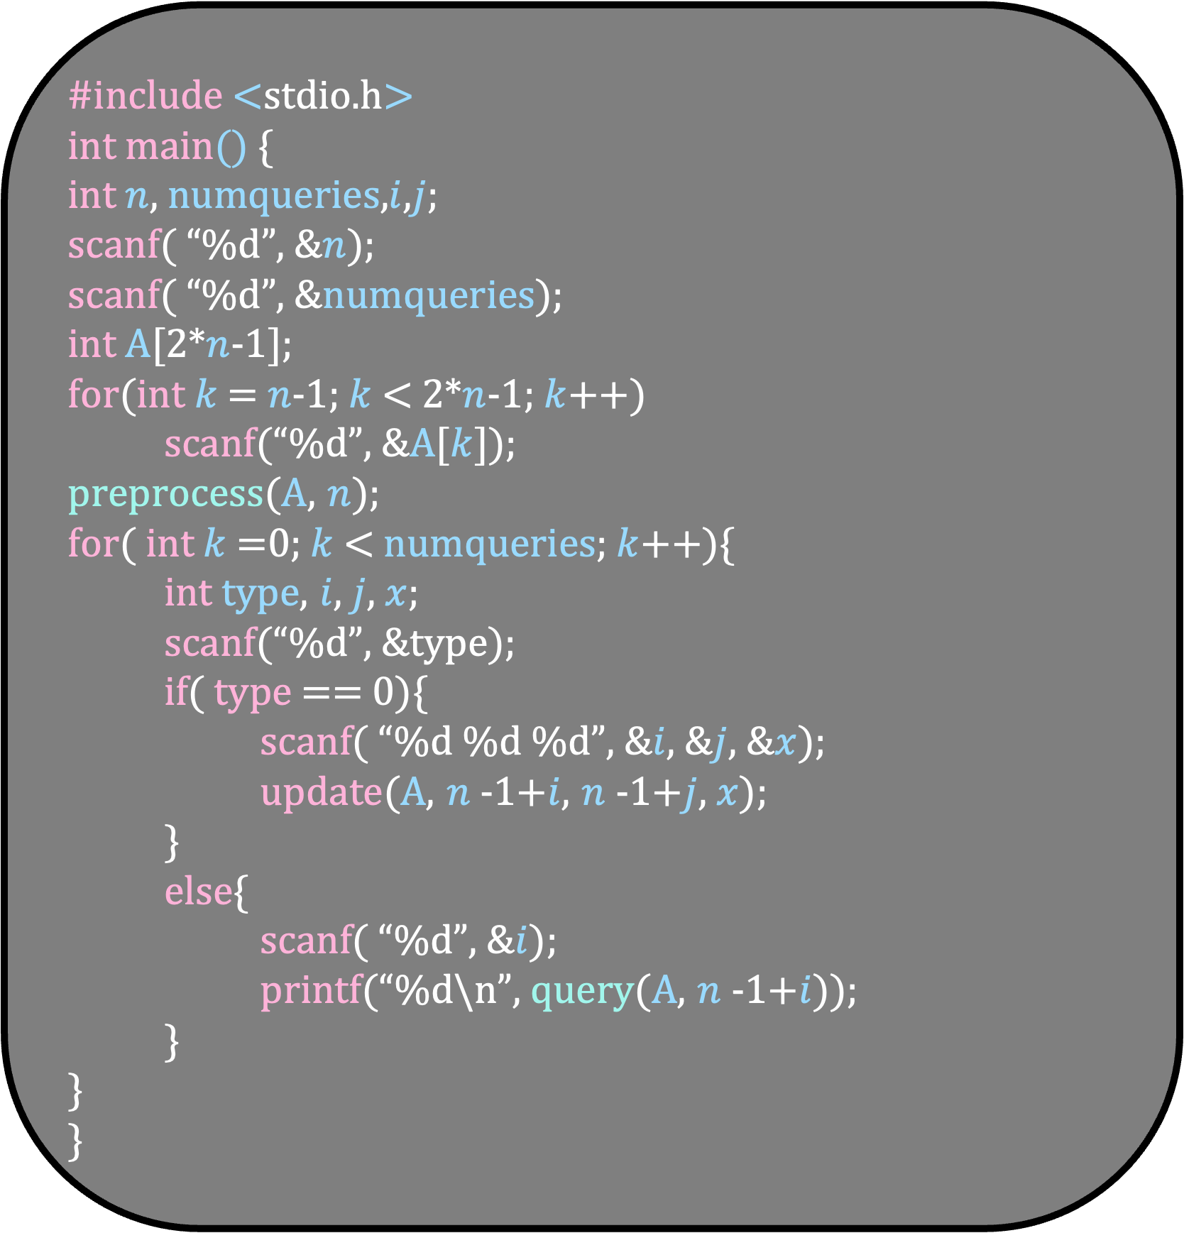
#include <stdio.h>
int main() {
int $n$, numqueries,$i$,$j$;
scanf( “%d”, &$n$);
scanf( “%d”, &numqueries);
int A[2*$n$-1];
for(int $k$ = $n$-1; $k$ < 2*$n$-1; $k$++)
scanf(“%d”, &A[$k$]);
preprocess(A, $n$);
for( int $k$=0; $k$< numqueries; $k$++){
int type, $i$, $j$, $x$;
scanf(“%d”, &type);
if( type == 0){
scanf( “%d %d %d”, &$i$, &$j$, &$x$);
update(A, $n$-1+$i$, $n$-1+$j$, $x$);
}
else{
scanf( “%d”, &$i$);
printf(“%d\n”, query(A, $n$-1+$i$));
}
}
}
Rule 1
If u is the right child of its parent, do nothing
If v is the left child of its parent, do nothing
Rule 2
If v is the right child of its parent, use the sibling of v to make the changes
If u is the left child of its parent, use the sibling of u to make the changes
Complete the code

Slide 116
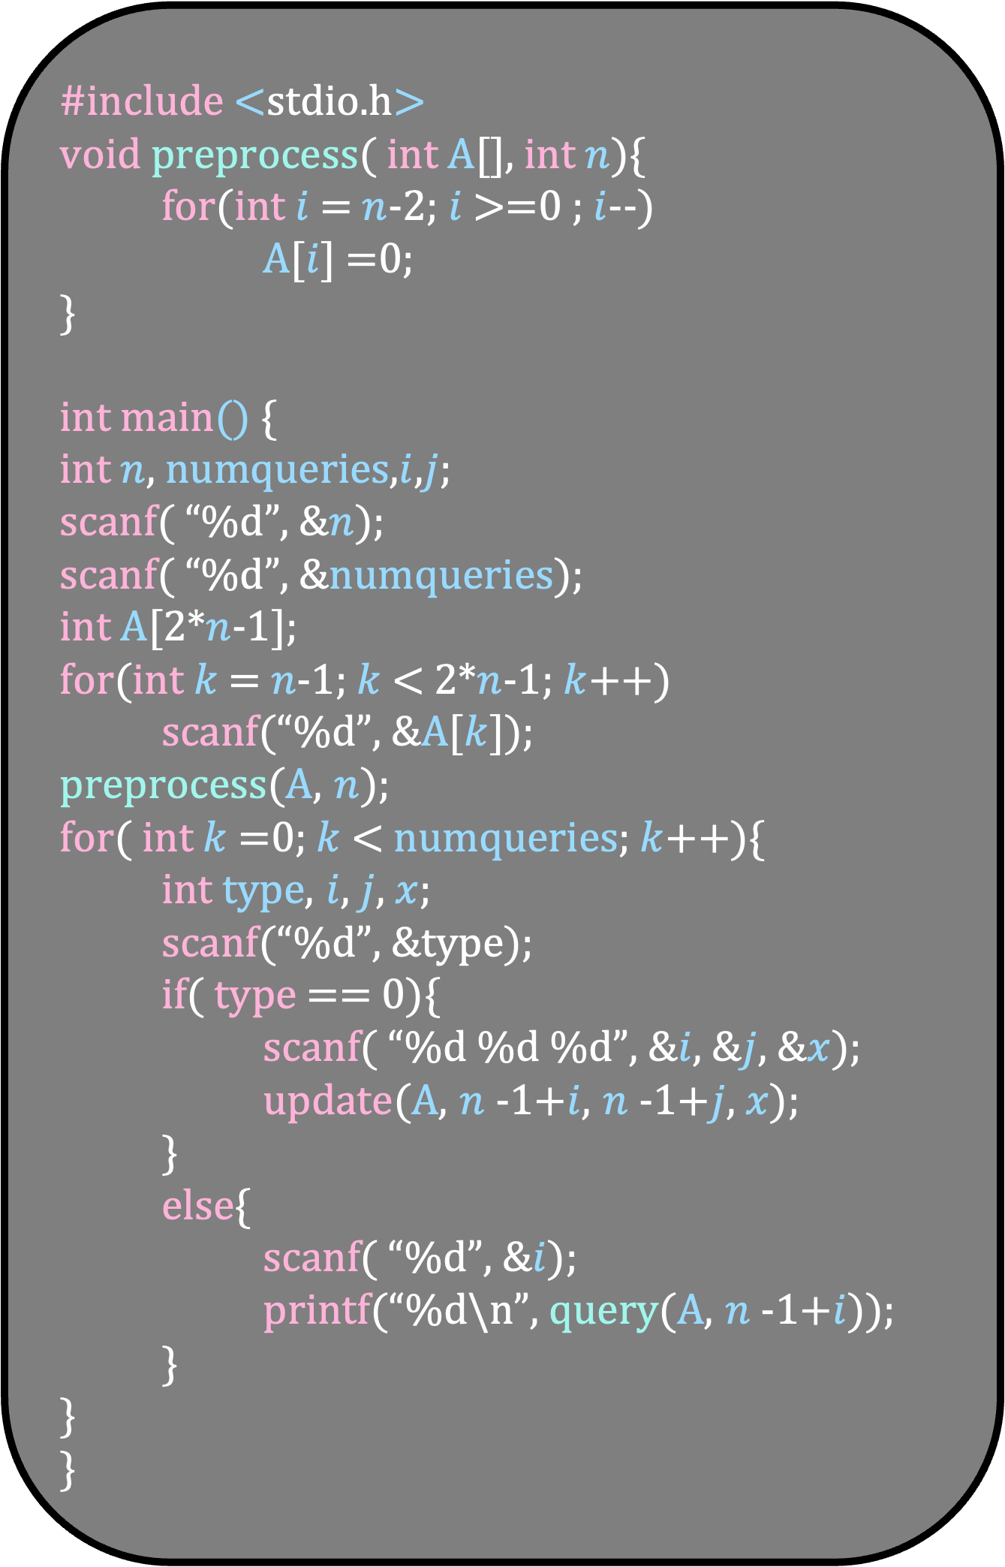
#include <stdio.h>
void preprocess( int A[], int $n$){
for(int $i$ = $n$-2; $i$ >=0 ; $i$--)
A[$i$] =0;
}
int main() {
int $n$, numqueries,$i$,$j$;
scanf( “%d”, &$n$);
scanf( “%d”, &numqueries);
int A[2*$n$-1];
for(int $k$ = $n$-1; $k$ < 2*$n$-1; $k$++)
scanf(“%d”, &A[$k$]);
preprocess(A, $n$);
for( int $k$=0; $k$< numqueries; $k$++){
int type, $i$, $j$, $x$;
scanf(“%d”, &type);
if( type == 0){
scanf( “%d %d %d”, &$i$, &$j$, &$x$);
update(A, $n$-1+$i$, $n$-1+$j$, $x$);
}
else{
scanf( “%d”, &$i$);
printf(“%d\n”, query(A, $n$-1+$i$));
}
}
}
int query( int A[], int u){
int sum = 0;
while( u != 0){
sum+= A[u];
u = (u-1)/2;
}
return sum;
}
void update( int A[], int u, int v, int x){
A[u] += x;
if( u != v)
A[v] += x;
while(1){
int parentu = (u-1)/2;
int parentv = (v-1)/2;
if( parentu == parentv)
return;
if( u == 2*parentu +1){
int siblingu = 2*parentu +2;
A[siblingu] += x;
}
if( v == 2*parentv +2){
int siblingv = 2*parentv +1; A[siblingv] += x;
}
u = parentu;
v = parentv;
}
}

