Slide 1
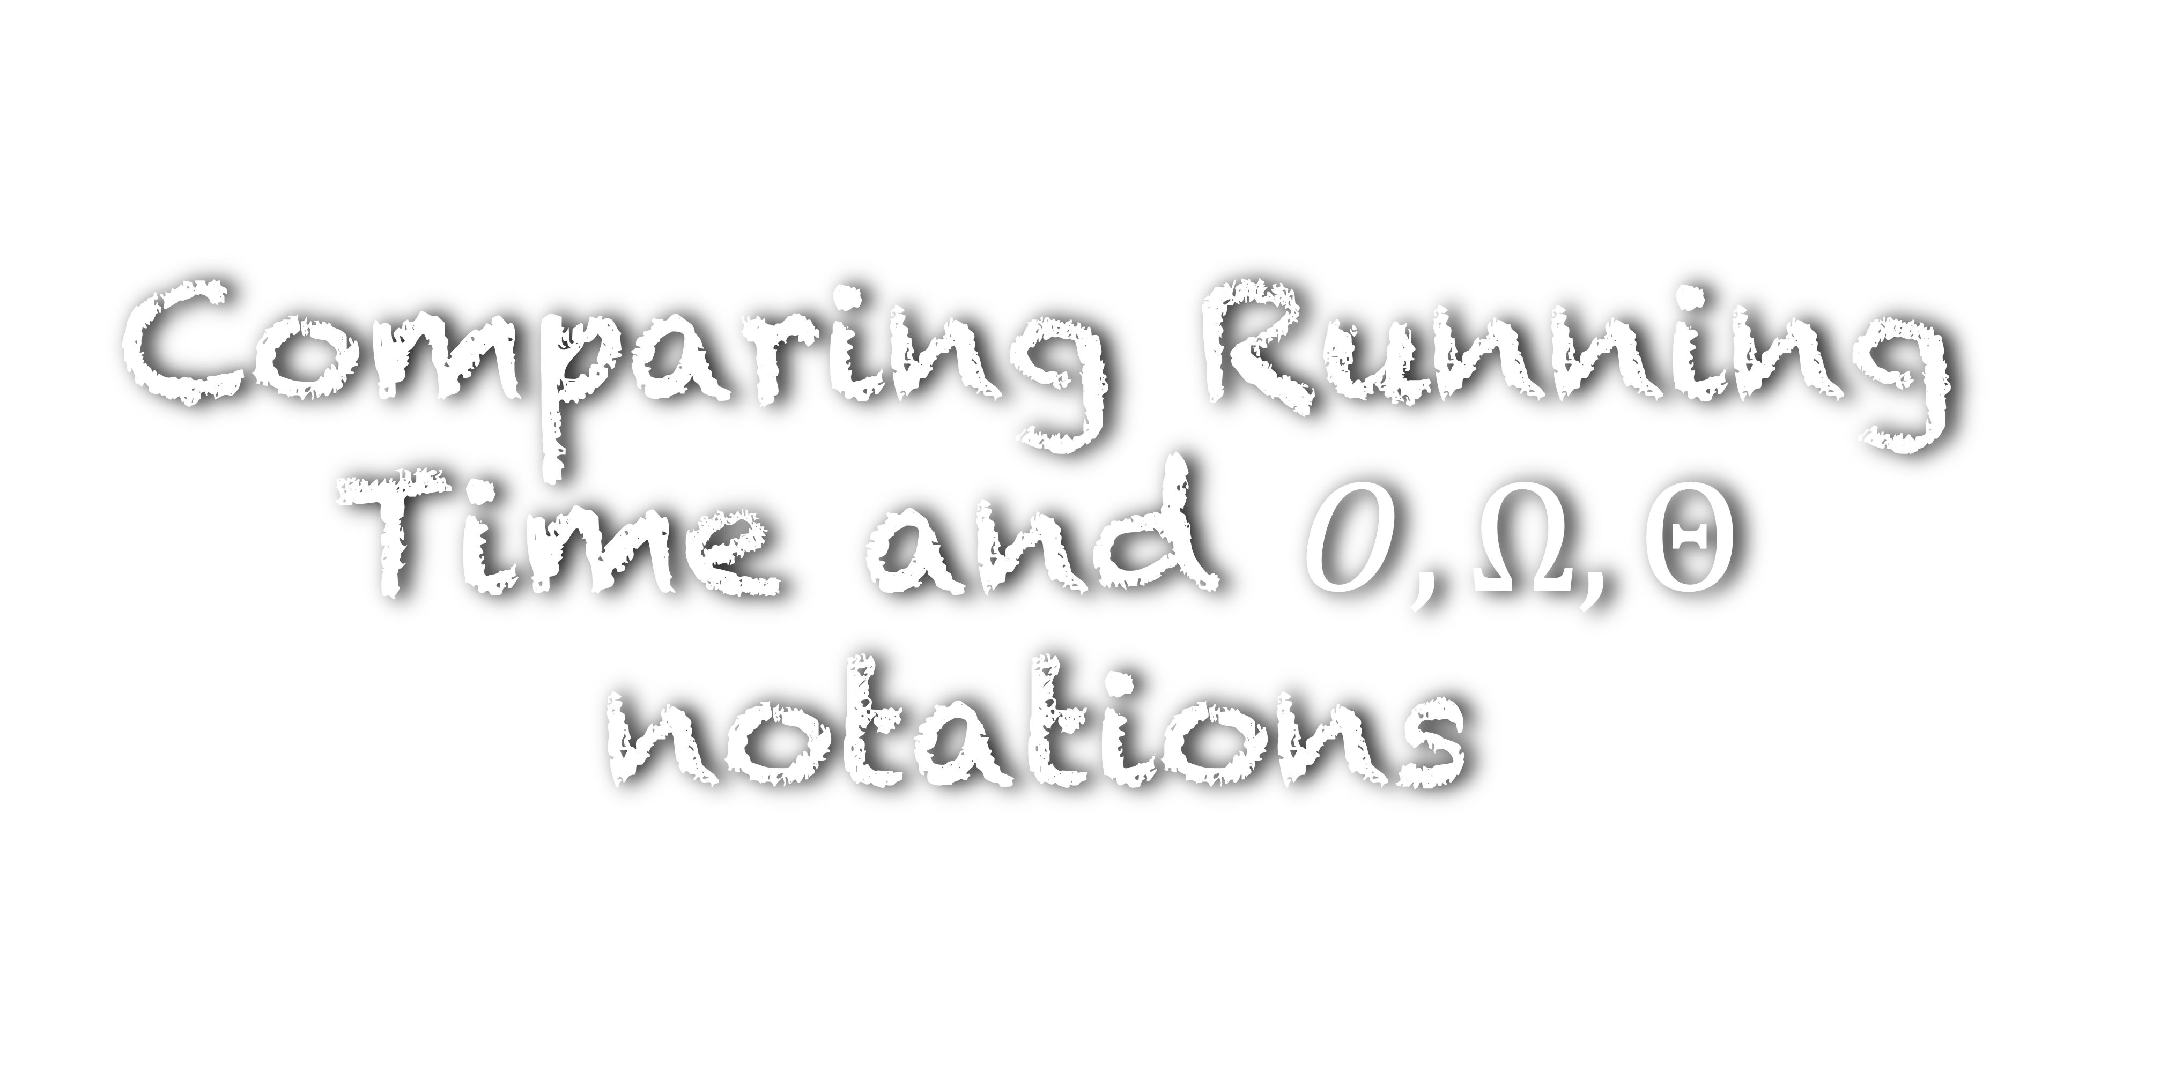
Comparing Running Time and $O,Ω,Θ$ notations

Slide 2
#include <stdio.h> int main() {
int num;
scanf(“%d”,&num);
int max = num;
while( num != 0)
{
if (num > max)
{
max = num;
}
scanf(“%d”,&num);
} printf(”%d”, max); return 0; }
What is the running time of this algorithm?
Run this program on my computer and tell the running time
Input size Running Time
3ms
100000 30ms
100000000 2s
The running time is machine dependent
Can we define a machine-independent notion of running time?

Slide 3




#include <stdio.h> int main() {
int num;
scanf(“%d”,&num);
int max = num;
while( num != 0)
{
if (num > max)
{
max = num;
}
scanf(“%d”,&num);
} printf(”%d”, max); return 0; }
$$c_{1}$$
$$c_{2}$$
$$c_{3}$$
$$c_{4}$$

Slide 4

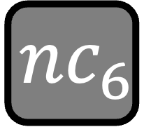




#include <stdio.h> int main() {
int num;
scanf(“%d”,&num);
int max = num;
while( num != 0)
{
if (num > max)
{
max = num;
}
scanf(“%d”,&num);
} printf(”%d”, max); return 0; }
$$c_{1}$$
$$c_{2}$$
$$c_{3}$$
$${nc}_{4}$$
$${nc}_{5}$$
$${nc}_{6}$$
$${nc}_{7}$$
$$c_{8}$$
$$c_{9}$$
Observation:
We assumed that the if condition is always satisfied
We are calculating the worst case running time of the algorithm

Slide 5


#include <stdio.h> int main() {
int num;
scanf(“%d”,&num);
int max = num;
while( num != 0)
{
if (num > max)
{
max = num;
}
scanf(“%d”,&num);
} printf(”%d”, max); return 0; }
Best case
9 8 7 6 5 4 3 2 1 0
Worst case
1 2 3 4 5 6 7 8 9 0
Observation:
We are calculating the worst case running time of the algorithm
The running time of an algorithm is its running time on the worst case input

Slide 6
#include <stdio.h> int main() {
int num;
scanf(“%d”,&num);
int max = num;
while( num != 0)
{
if (num > max)
{
max = num;
}
scanf(“%d”,&num);
} printf(”%d”, max); return 0; }
$$c_{1}$$
$$c_{2}$$
$$c_{3}$$
$${nc}_{4}$$
$${nc}_{5}$$
$${nc}_{6}$$
$${nc}_{7}$$
$$c_{8}$$
$$c_{9}$$
Running time

Slide 7









#include <stdio.h> int main() {
int num;
scanf(“%d”,&num);
int max = num;
while( num != 0)
{
if (num > max)
{
max = num;
}
scanf(“%d”,&num);
} printf(”%d”, max); return 0; }
Running time
$$c_{1}$$
$$c_{2}$$
$$c_{3}$$
$${nc}_{4}$$
$${nc}_{5}$$
$${nc}_{6}$$
$${nc}_{7}$$
$$c_{8}$$
$$c_{9}$$

Slide 8
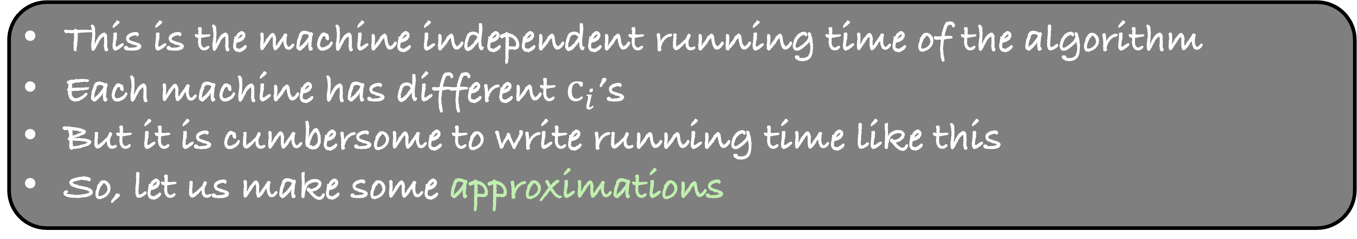
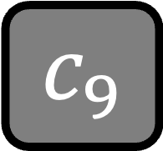


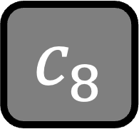





Running time
$$c_{1}$$
$$c_{2}$$
$$c_{3}$$
$${nc}_{4}$$
$${nc}_{5}$$
$${nc}_{6}$$
$${nc}_{7}$$
$$c_{8}$$
$$c_{9}$$
This is the machine independent running time of the algorithm
Each machine has different $c_{i}$’s
But it is cumbersome to write running time like this
So, let us make some approximations

Slide 9


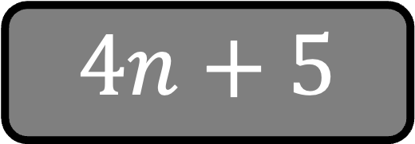





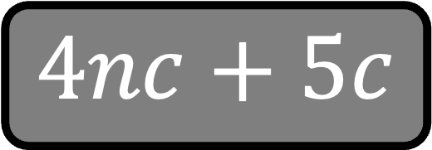


Running time
$$c_{1}$$
$$c_{2}$$
$$c_{3}$$
$${nc}_{4}$$
$${nc}_{5}$$
$${nc}_{6}$$
$${nc}_{7}$$
$$c_{8}$$
$$c_{9}$$
Approximation 1: Assume all $c_{i}^{′}s$ are same
$$c$$
$$c$$
$$c$$
$$nc$$
$$nc$$
$$nc$$
$$nc$$
$$c$$
$$c$$
$$4nc+5c$$
Approximation 2: Remove $c$ also. Assume $c=1$
$$4n+5$$

Slide 10
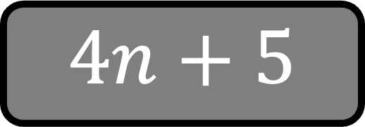
Running time
$$4n+5$$
Machine independent running time
Indicates that the running time increases linearly with n

Slide 11
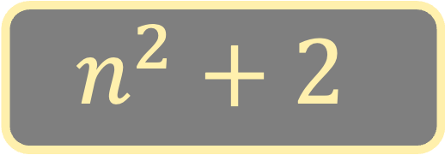
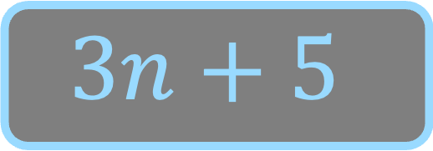
A
B
$$3n+5$$
$$n^{2}+2$$
Which algorithm is better?
Depends on n

Slide 12

A
B
$$3n+5$$
$$n^{2}+2$$
n Running Time of A Running Time of B
8 3
2 11 6
3 14 11
4 17 18
5 20 27
Observations
After $n=3$, A consistently beats B
So, we deduce that A is better than B

Slide 13
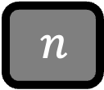
A
B
$$3n+5$$
$$n^{2}+2$$
Running Time
$n$
1
2
3
4
5
6
7
8
9

Slide 14
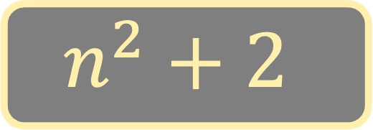
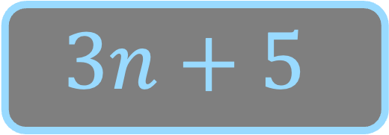

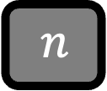
$$n^{2}+2$$
Running Time
$$3n+5$$
$n$
1
2
3
4
5
6
7
8
9
After $n=3$, A consistently beats B
For high values of $n$, A consistently beats B

Slide 15
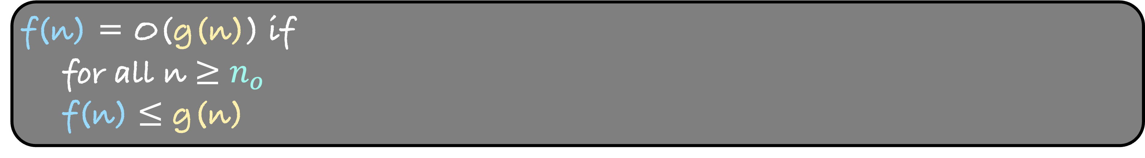
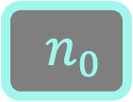
g(n)
Running Time
f(n)
$n$
$n_{0}$
f(n) = O(g(n)) if
for all n $≥$ $n_{o}$
f(n) $≤$ g(n)

Slide 16
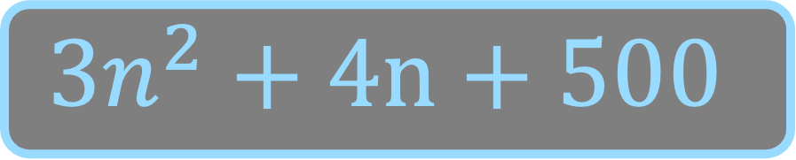
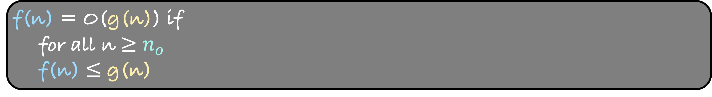
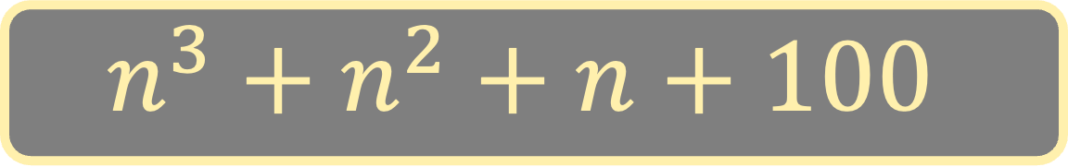
f(n) = O(g(n)) if
for all n $≥$ $n_{o}$
f(n) $≤$ g(n)
Consequence of this definition
Lower order terms in running time do not matter
A
B
$$3n^{2}+4n+500$$
$$n^{3}+n^{2}+n+100$$

Slide 17

Consequence of this definition
Lower order terms in running time do not matter
#include <stdio.h> int main() {
int num;
scanf(“%d”,&num);
int max = num;
while( num != 0)
{
if (num > max)
{
max = num;
}
scanf(“%d”,&num);
} printf(”%d”, max); return 0; }
Identify the most time-consuming part of the code and calculate its running time
Running time = cn+……
Looks ugly to write the running time like this
So, let us change our definition of the order notation a bit to solve this problem
$$cn$$

Slide 18
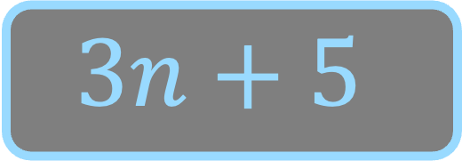
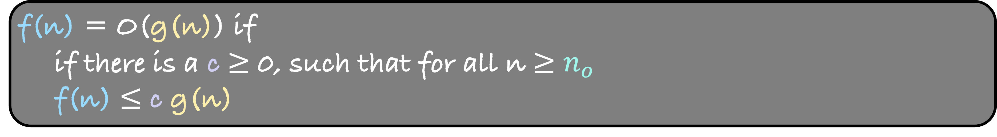
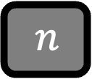
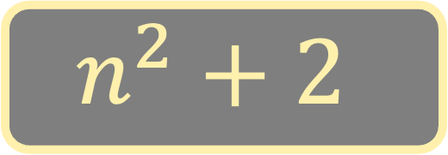
f(n) = O(g(n)) if
if there is a c $≥$ 0, such that for all n $≥$ $n_{o}$
f(n) $≤$ c g(n)
$$n^{2}+2$$
Running Time
$$3n+5$$
$n$

Slide 19
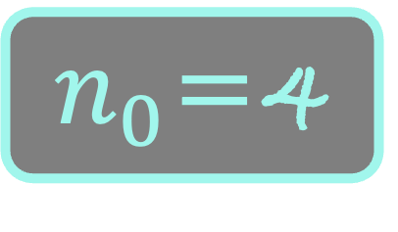
f(n) = O(g(n)) if
if there is a c $≥$ 0, such that for all n $≥$ $n_{o}$
f(n) $≤$ c g(n)
$$n^{2}+2$$
Running Time
1
c
1
$$3n+5$$
$n$
$n_{0}$=4

Slide 20
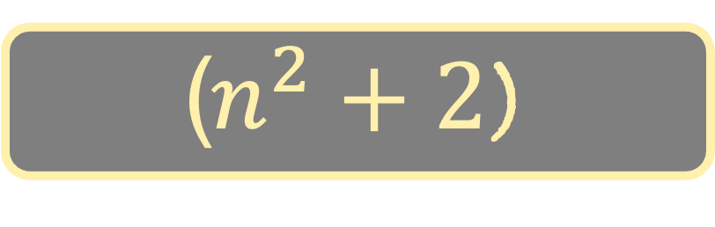
f(n) = O(g(n)) if
if there is a c $≥$ 0, such that for all n $≥$ $n_{o}$
f(n) $≤$ c g(n)
($n^{2}+2$)
1
Running Time
c
1
$$3n+5$$
$n$
$n_{0}$=4

Slide 21
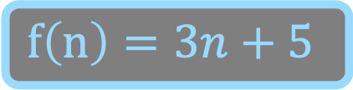
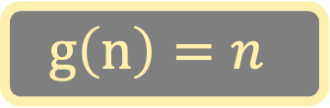
f(n) = O(g(n)) if
if there is a c $≥$ 0, such that for all n $≥$ $n_{o}$
f(n) $≤$ c g(n)
Running Time
Is f(n) = O(g(n))?
Yes. Put c = 8
$$f\left(n\right)=3n+5$$
$$g\left(n\right)=n$$
$n$

Slide 22
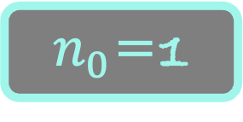
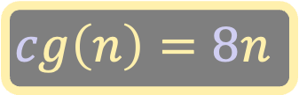
f(n) = O(g(n)) if
if there is a c $≥$ 0, such that for all n $≥$ $n_{o}$
f(n) $≤$ c g(n)
Running Time
Using this definition,
f(n)= O(g(n)) = O(n)
Is f(n) = O(g(n))?
Yes. Put c = 8
$$cg\left(n\right)=8n$$
$$f\left(n\right)=3n+5$$
$n$
$n_{0}$=1

Slide 23
#include <stdio.h> int main() {
int num;
scanf(“%d”,&num);
int max = num;
while( num != 0)
{
if (num > max)
{
max = num;
}
scanf(“%d”,&num);
} printf(”%d”, max); return 0; }
Identify the most time-consuming part of the code and calculate its running time
Running time = cn+……
Running time = O(n)
$$cn$$

Slide 24

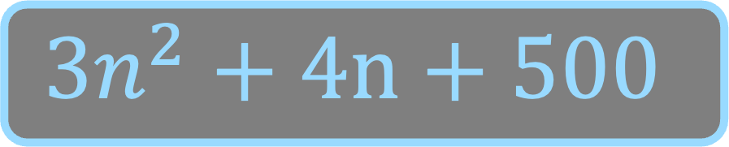
f(n) = O(g(n)) if
if there is a c $≥$ 0, such that for all n $≥$ $n_{o}$
f(n) $≤$ c g(n)
A
B
$$3n^{2}+4n+500$$
$$n^{2}+n+100$$
Consequence of this definition
Lower order terms in running time do not matter
Constants do not matter

Slide 25
f(n) = O(g(n)) if
if there is a c $≥$ 0, such that for all n $≥$ $n_{o}$
f(n) $≤$ c g(n)
A
B
$$3n^{2}+4n+500$$
$$n^{2}+n+100$$
Consequence of this definition
Lower order terms in running time do not matter
Constants do not matter

Slide 26

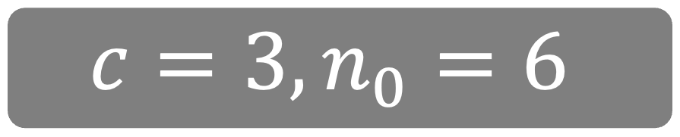

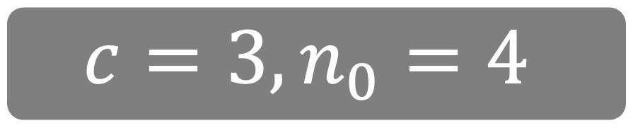



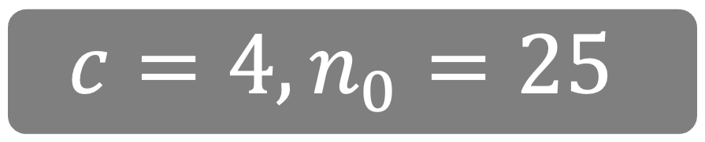
f(n) = O(g(n)) if
if there is a c $≥$ 0, such that for all n $≥$ $n_{o}$
f(n) $≤$ c g(n)
A
$$3n^{2}+4n+500$$
$$O(n^{4})$$
$$c=3,n_{0}=4$$
$$O(n^{3})$$
$$c=3,n_{0}=6$$
$$O(n^{2})$$
$$c=4,n_{0}=25$$
No such c and $n_{0}$ possible
$$O(n)$$

Slide 27

f(n) = O(g(n)) if
if there is a c $≥$ 0, such that for all n $≥$ $n_{o}$
f(n) $≤$ c g(n)
A
$$3n^{2}+4n+500$$
$$O(n^{2})$$

Slide 28
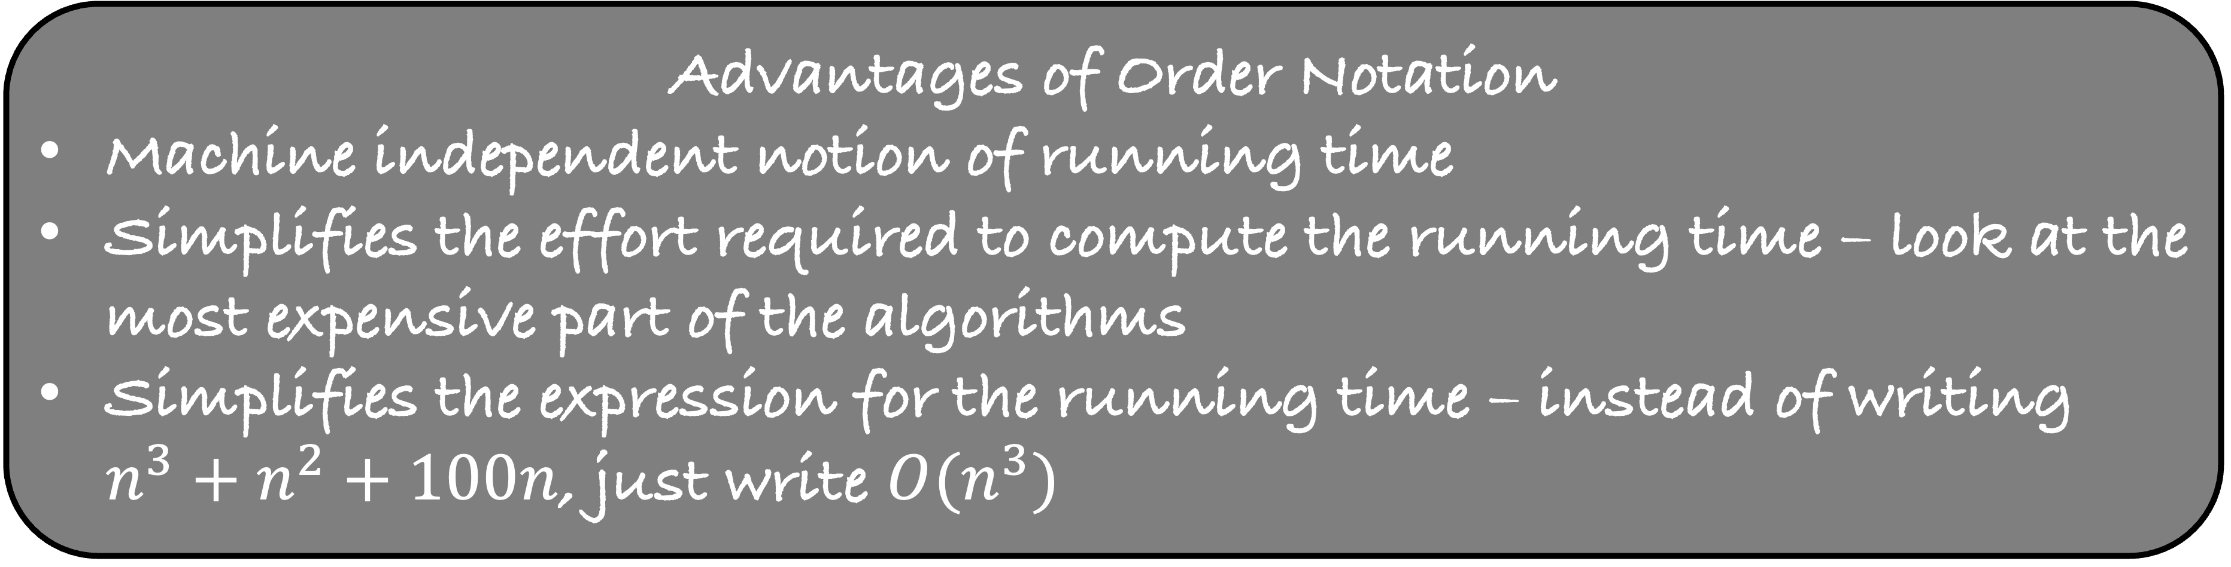
Advantages of Order Notation
Machine independent notion of running time
Simplifies the effort required to compute the running time – look at the most expensive part of the algorithms
Simplifies the expression for the running time – instead of writing $n^{3}+n^{2}+100n$, just write $O(n^{3})$
What are the disadvantages of order notation?

Slide 29




What are the disadvantages of order notation?
A
B
$$100n$$
$$n\log{n}$$
$$O(n)$$
$$O(n\log{n)}$$
Which algorithm is better?
Algorithm A beats algorithm B for high values of n
But what is this high value?

Slide 30


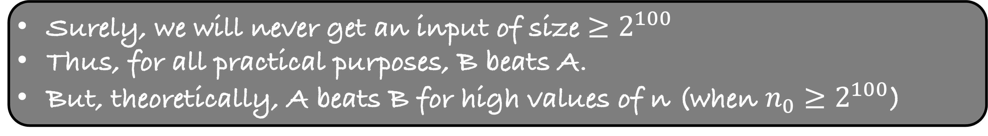

What are the disadvantages of order notation?
A
B
$$100n$$
$$n\log{n}$$
$$O(n)$$
$$O(n\log{n)}$$
100n $≤$ n log n
100 $≤$ log n
n $≥2^{100}$
Surely, we will never get an input of size $≥2^{100}$
Thus, for all practical purposes, B beats A.
But, theoretically, A beats B for high values of n (when $n_{0}≥2^{100}$)

Slide 31
What are the disadvantages of order notation?
Constants are disregarded in the order notation but they may be important

Slide 32
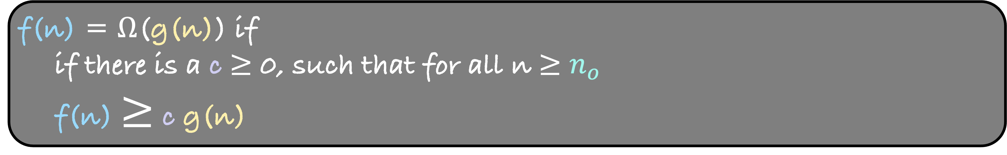



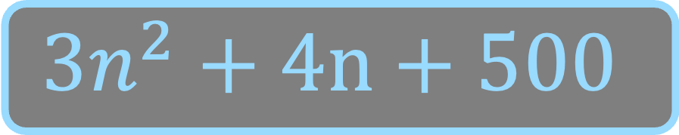
f(n) = O(g(n)) if
if there is a c $≥$ 0, such that for all n $≥$ $n_{o}$
f(n) $≤$ c g(n)
f(n) = $Ω$(g(n)) if
if there is a c $≥$ 0, such that for all n $≥$ $n_{o}$
f(n) $≥$ c g(n)
$$3n^{2}+4n+500$$
$$Ω(n^{2})$$
$$Ω(n)$$
$$Ω(1)$$

Slide 33
f(n) = O(g(n)) if
if there is a c $≥$ 0, such that for all n $≥$ $n_{o}$
f(n) $≤$ c g(n)
f(n) = $Ω$(g(n)) if
if there is a c $≥$ 0, such that for all n $≥$ $n_{o}$
f(n) $≥$ c g(n)
$$3n^{2}+4n+500$$
$$Ω(n^{2})$$

Slide 34
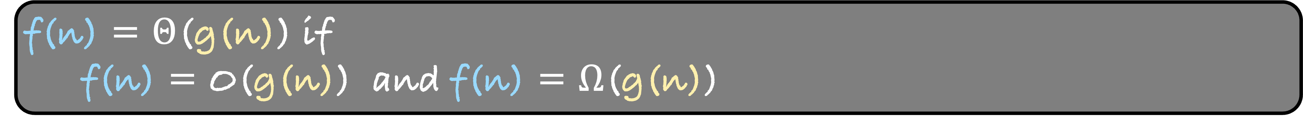
f(n) = O(g(n)) if
if there is a c $≥$ 0, such that for all n $≥$ $n_{o}$
f(n) $≤$ c g(n)
f(n) = $Ω$(g(n)) if
if there is a c $≥$ 0, such that for all n $≥$ $n_{o}$
f(n) $≥$ c g(n)
f(n) = $Θ$(g(n)) if
f(n) = O(g(n)) and f(n) = $Ω$(g(n))

Slide 35

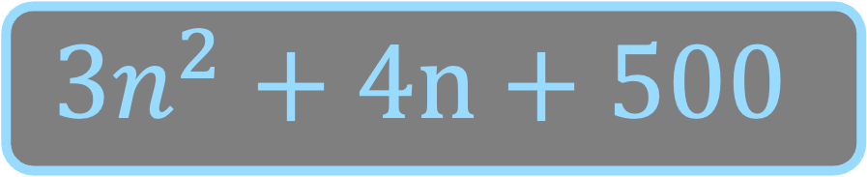






f(n) = $Θ$(g(n)) if
f(n) = O(g(n)) and f(n) = $Ω$(g(n))
$$O(n^{4})$$
$$Ω(n^{2})$$
$$O(n^{3})$$
$$3n^{2}+4n+500$$
$$Ω(n)$$
$$O(n^{2})$$
$$Ω(1)$$

Slide 36


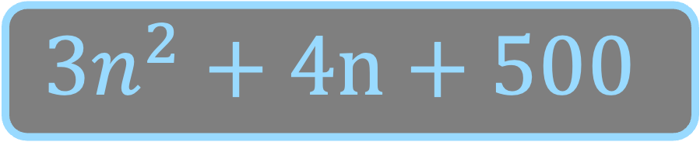

f(n) = $Θ$(g(n)) if
f(n) = O(g(n)) and f(n) = $Ω$(g(n))
$$O(n^{2})$$
$$3n^{2}+4n+500$$
$$Ω(n^{2})$$
$$3n^{2}+4n+500$$
$$Θ(n^{2})$$

Slide 37
If f(n) = O(g(n)) and g(n) = O(h(n)), then
f(n) =

Slide 38
If f(n) = O(g(n)) and g(n) = O(h(n)), then
f(n) = O(h(n))
If f(n) = O(h(n)) and g(n) = O(h(n)), then
f(n) + g(n)=

Slide 39
If f(n) = O(g(n)) and g(n) = O(h(n)), then
f(n) = O(h(n))
If f(n) = O(h(n)) and g(n) = O(h(n)), then
f(n) + g(n)= O(h(n))
Use the definition of order notation to prove these properties

