Slide 1
Let us C

Slide 2
Hello World in C
#include <stdio.h> int main() { printf("Hello World\n"); return 0; }
The standard input output library
Gives access to print and get input from the user
You can assume that the file contains the function printf and we must include it in our program to use it

Slide 3
Hello World in C
#include <stdio.h> int main() { printf("Hello World\n"); return 0; }
Our main program starts here
This is a special function which will be executed if we compile and run this file
This function returns an integer and does not take any arguments
The function starts with { and ends with }

Slide 4
Hello World in C
#include <stdio.h> int main() { printf("Hello World\n"); return 0; }
Syntax for printing Hello World

Slide 5
Hello World in C
#include <stdio.h> int main() { printf("Hello World\n"); return 0; }
This function should return an integer
So, let us return 0

Slide 6
Hello World in C
There is no indentation in C, though it is a good practice to indent
Each statement ends with a semicolon
You can write multiple statements on a single line
#include <stdio.h> int main() { printf("Hello World\n"); return 0; }

Slide 7
Hello World in C
There is no indentation in C, though it is a good practice to indent
Each statement ends with a semicolon
You can write multiple statements on a single line
#include <stdio.h> int main() { printf("Hello World\n");return 0; }

Slide 8
Variables
Unlike python, you have to declare the data type of each variable
Let us see some of them
#include <stdio.h> int main() { int a = 5;
float b = 3.2;
char c = ‘M’;
char d[6] = “ES242”;
int e[5] = {0,1,2,3,4};
char f[2][6] = {“one”, ”three”};
return 0; }

Slide 9
Input and Output
Memory
#include <stdio.h> int main() { int a;
scanf (“%d”, &a);
return 0; }

Slide 10
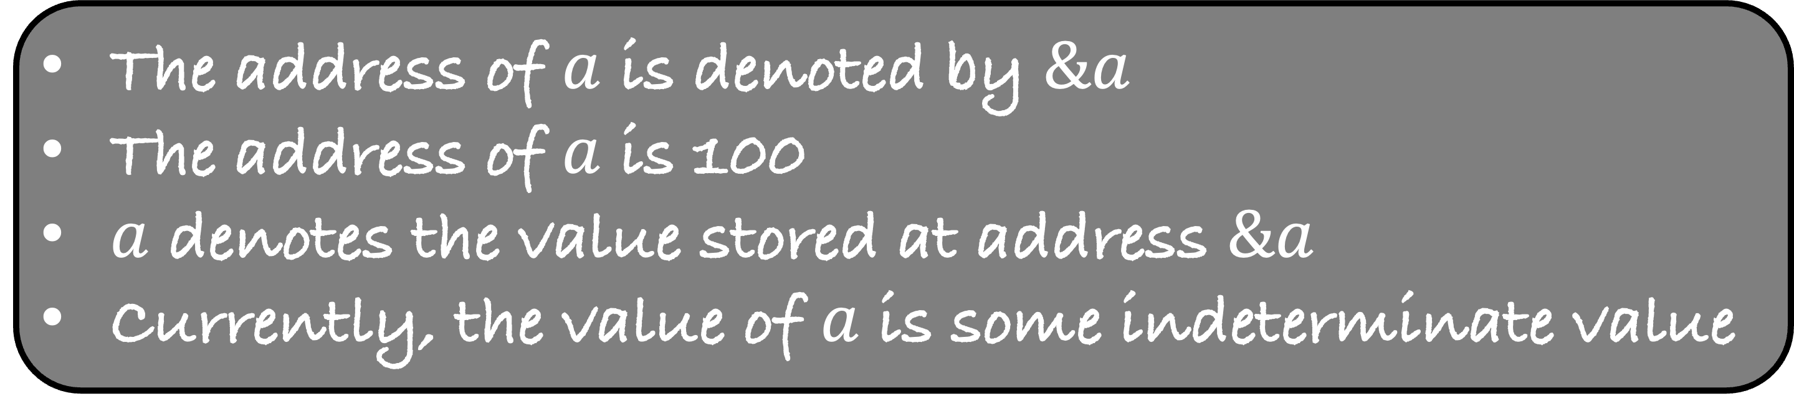
Input and Output
Memory
#include <stdio.h> int main() { int a;
scanf (“%d”, &a);
return 0; }
100
The address of $a$ is denoted by $\&a$
The address of $a$ is 100
$a$ denotes the value stored at address $\&a$
Currently, the value of $a$ is some indeterminate value

Slide 11
Input and Output
Memory
#include <stdio.h> int main() { int a;
scanf (“%d”, &a);
return 0; }
100
Format String -- Format of input
“%d” means that the input is an integer
scanf will take the input from the input stream, then convert it into an integer and then store it. But where?

Slide 12
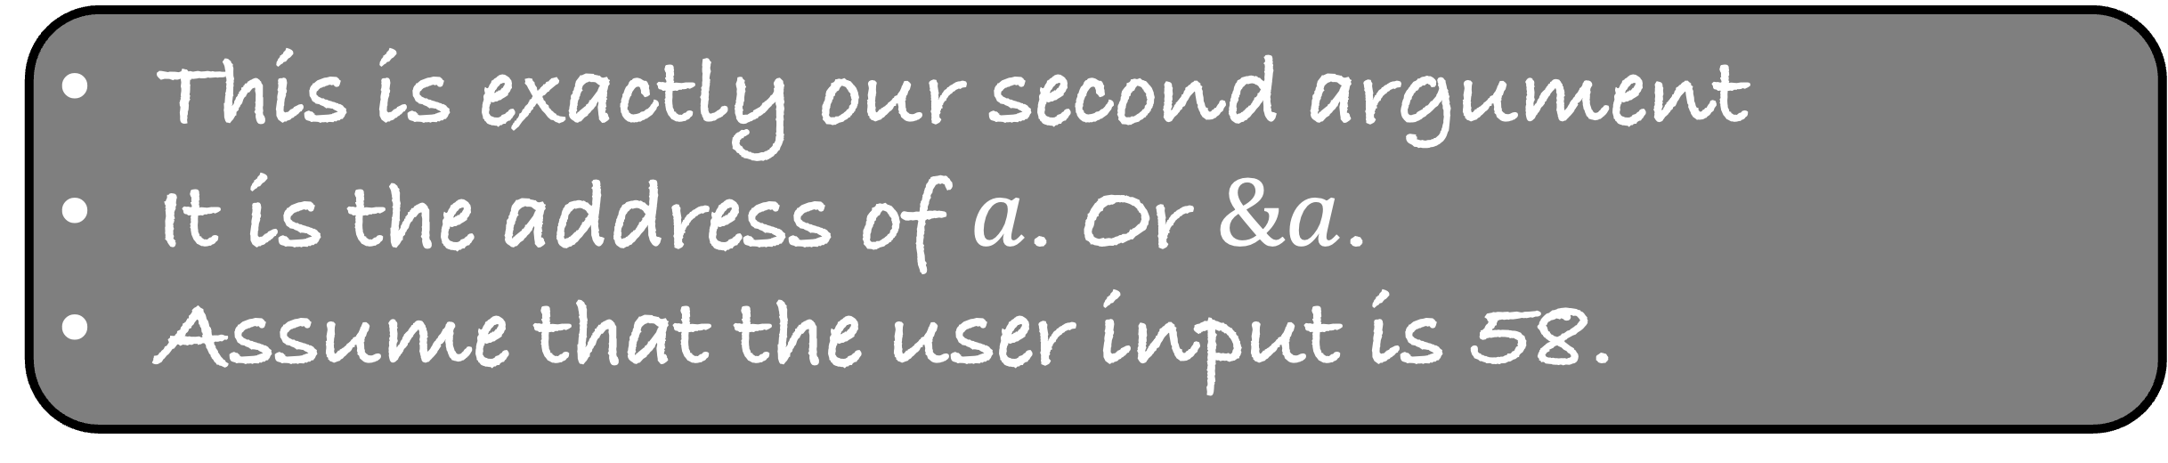
Input and Output
Memory
#include <stdio.h> int main() { int a;
scanf (“%d”, &a);
return 0; }
100
This is exactly our second argument
It is the address of $a$. Or $\&a$.
Assume that the user input is 58.

Slide 13
Input and Output
Memory
#include <stdio.h> int main() { int a;
scanf (“%d”, &a);
return 0; }
100
58
This is exactly our second argument
It is the address of $a$. Or $\&a$.
Assume that the user input is 58.

Slide 14
int %d
float %f
char %c
String or char[] %s

Slide 15
Input and Output
Memory
#include <stdio.h> int main() { float a = 5.1;
printf (“%f”, a);
return 0; }

Slide 16
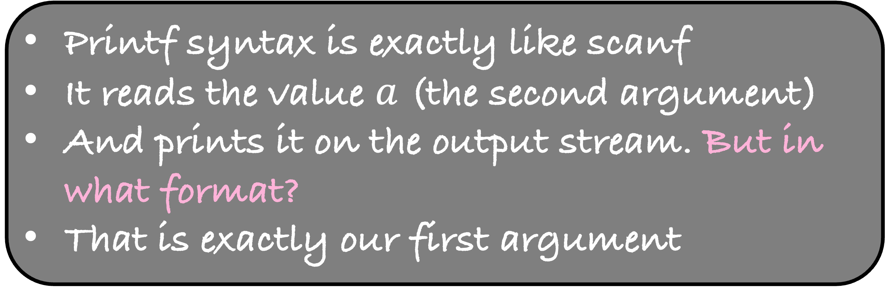
Input and Output
Memory
#include <stdio.h> int main() { float a = 5.1;
printf (“%f”, a);
return 0; }
10
5.1
Printf syntax is exactly like scanf
It reads the value $a$ (the second argument)
And prints it on the output stream. But in what format?
That is exactly our first argument

Slide 17
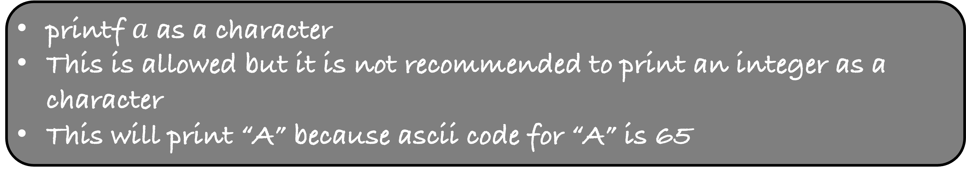
Input and Output
#include <stdio.h> int main() { int a = 65;
printf (“%c”, a);
return 0; }
printf $a$ as a character
This is allowed but it is not recommended to print an integer as a character
This will print “A” because ascii code for “A” is 65

Slide 18
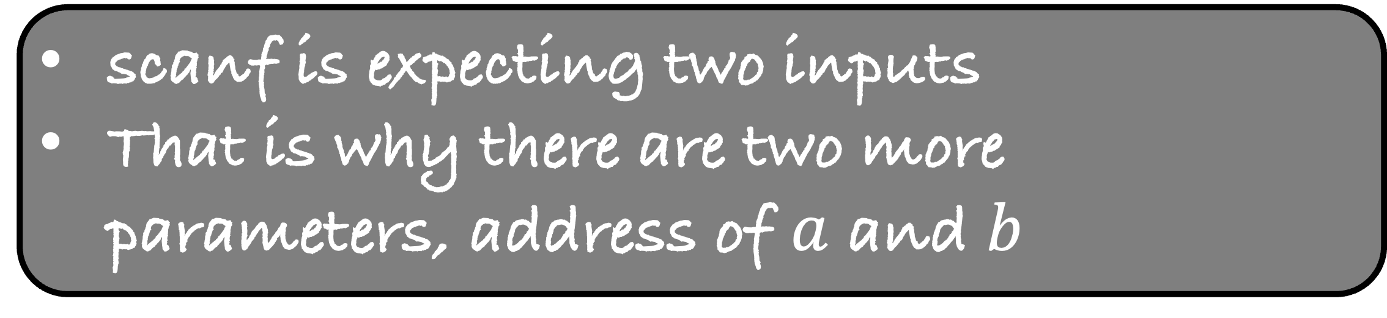
Take multiple inputs
#include <stdio.h> int main() { int a,b,c;
scanf (“%d %d”, &a, &b);
c = a+b;
printf(“%d”, c) ;
return 0; }
scanf is expecting two inputs
That is why there are two more parameters, address of $a$ and $b$

Slide 19
If Else Conditions
#include <stdio.h> int main() { int a,b;
scanf (“%d %d”, &a, &b);
if ( a > b )
{
printf(“%d”,a);
}
else
{
printf(“%d”,b);
}
return 0; }
Syntax for if
if ( condition )
{
statements;
}
The programs prints the maximum of two inputs

Slide 20
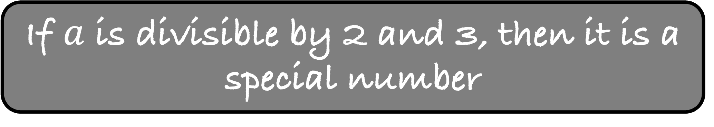
And and Or operators
#include <stdio.h> int main() { int a;
scanf (“%d”, &a);
if ( a%2 == 0 and a%3 == 0)
{
printf(“%d is a special number”, a);
}
else
{
printf(“%d is not a special number”, a);
}
return 0; }
If $a$ is divisible by 2 and 3, then it is a special number

Slide 21
And and Or operators
#include <stdio.h> int main() { int a;
scanf (“%d”, &a);
if ( a%2 == 0 && a%3 == 0)
{
printf(“%d is a special number”, a);
}
else
{
printf(“%d is not a special number”, a);
}
return 0; }
If $a$ is divisible by 2 and 3, then it is a special number

Slide 22
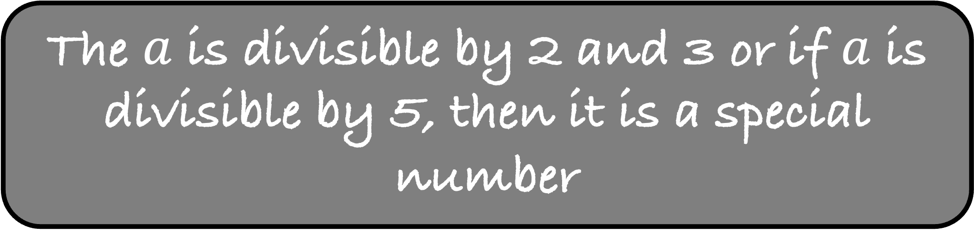
And and Or operators
#include <stdio.h> int main() { int a;
scanf (“%d”, &a);
if ((a%2 == 0 and a%3 == 0) or a%5 == 0)
{
printf(“%d is a special number”, a);
}
else
{
printf(“%d is not a special number”, a);
}
return 0; }
The $a$ is divisible by 2 and 3 or if $a$ is divisible by 5, then it is a special number

Slide 23
And and Or operators
#include <stdio.h> int main() { int a;
scanf (“%d”, &a);
if ((a%2 == 0 && a%3 == 0) || a%5 == 0)
{
printf(“%d is a special number”, a);
}
else
{
printf(“%d is not a special number”, a);
}
return 0; }
The $a$ is divisible by 2 and 3 or if $a$ is divisible by 5, then it is a special number

Slide 24
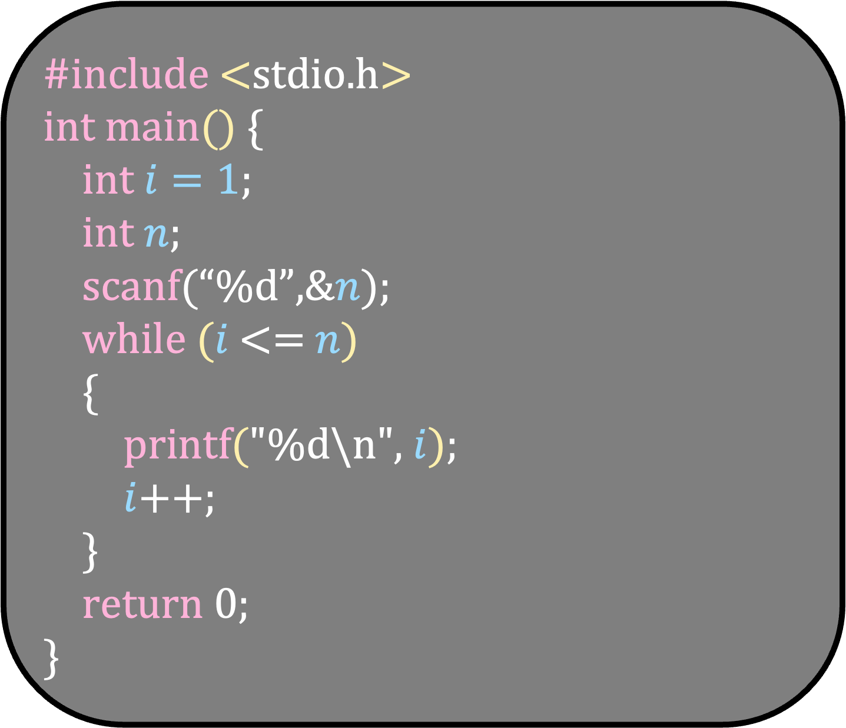
While loop
Syntax for while
#include <stdio.h> int main() { int $i=1$;
int $n$;
scanf(“%d”,&$n$);
while $(i$<= $n$)
{
printf("%d\n", $i$);
$i$++;
}
return 0; }
while ( condition )
{
statements;
}
The programs prints the first n numbers

Slide 25
Write a program that prints the first n Fibonacci numbers using a while loop
Input: 1
Output: 0
Input: 2
Output: 0 1
Input: 5
Output: 0 1 1 2 3

Slide 26
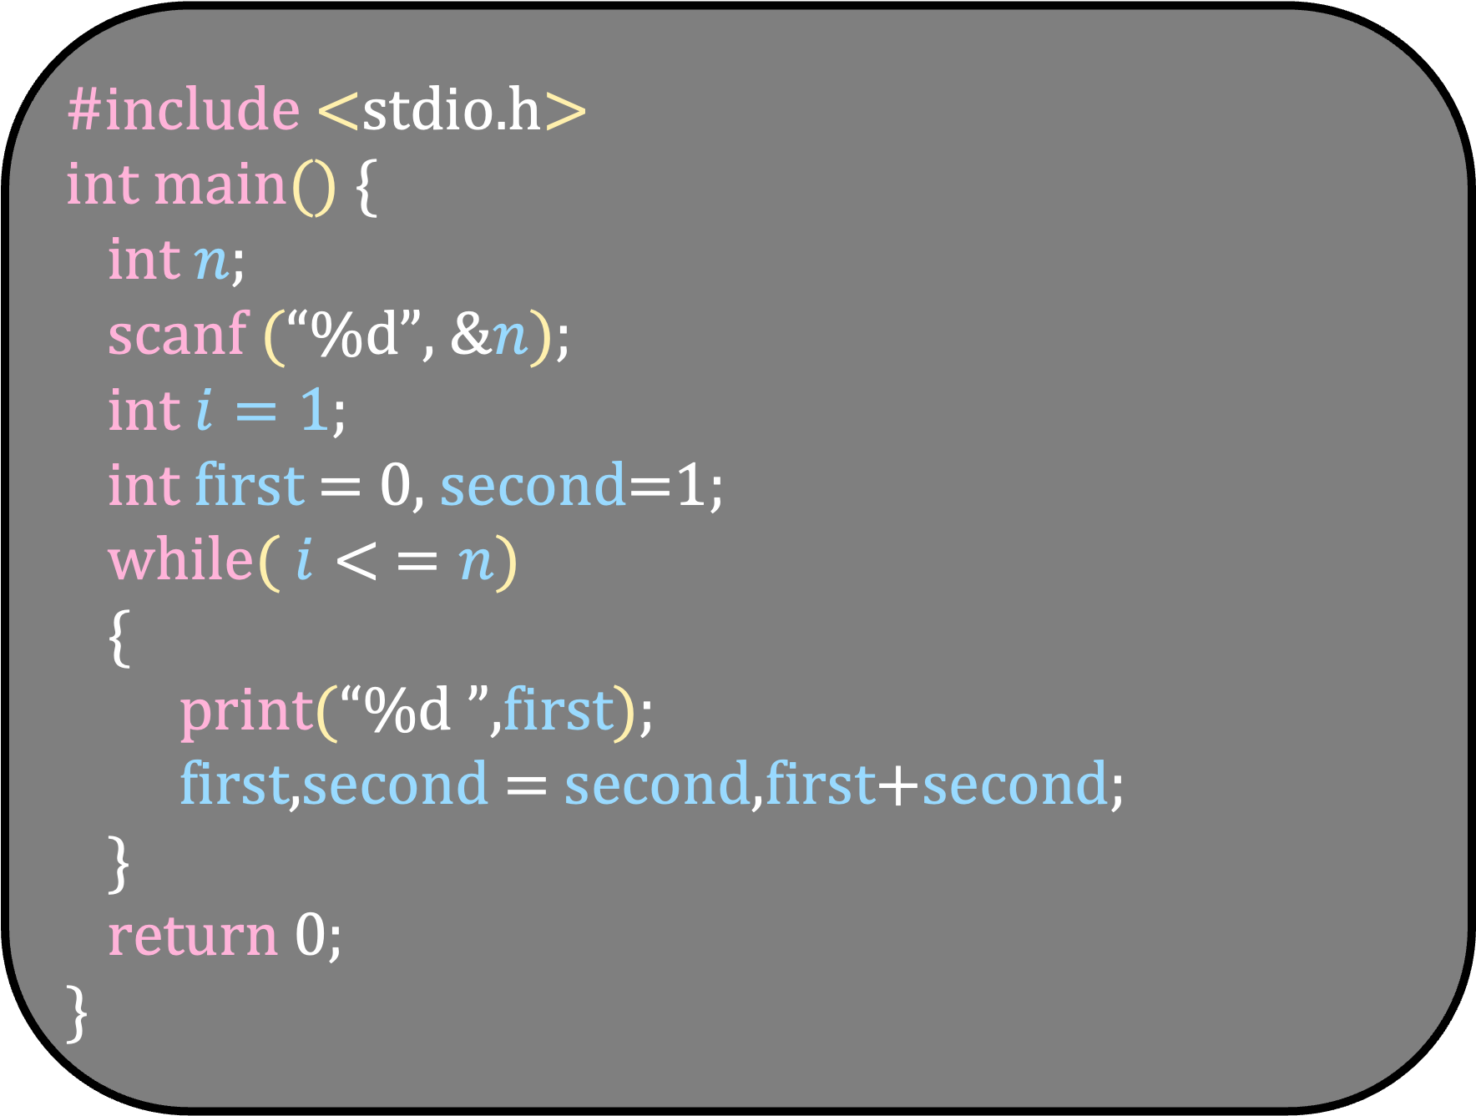
#include <stdio.h> int main() { int $n$;
scanf (“%d”, &$n$);
int $i=1$;
int first = 0, second=1;
while( $i< =n$)
{
print(“%d ”,first);
first,second = second,first+second;
}
return 0; }
Unfortunately, we cannot write this in C

Slide 27
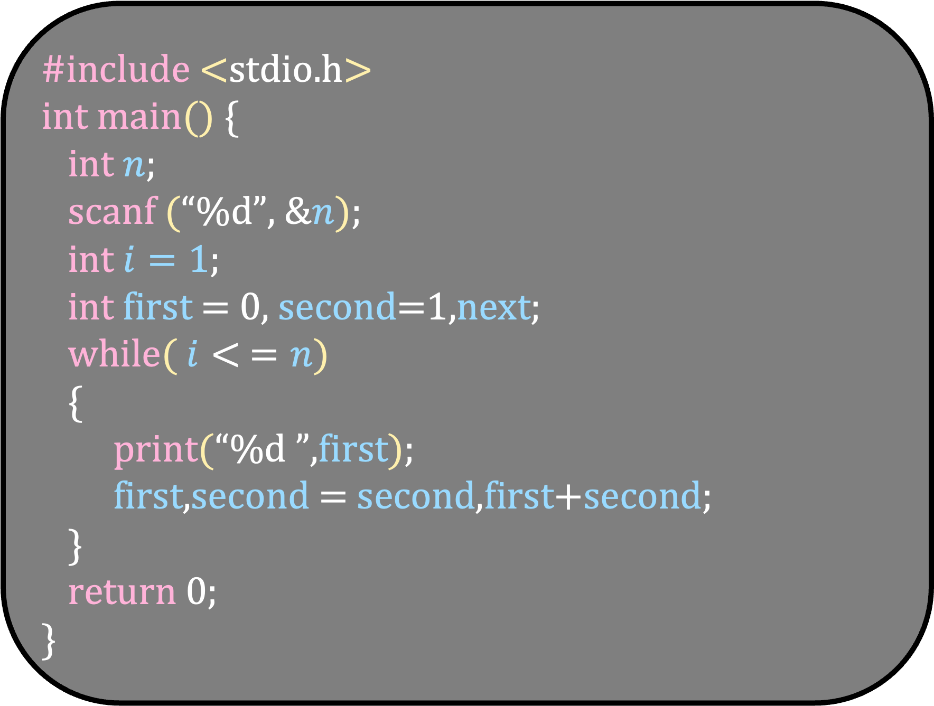
#include <stdio.h> int main() { int $n$;
scanf (“%d”, &$n$);
int $i=1$;
int first = 0, second=1,next;
while( $i< =n$)
{
print(“%d ”,first);
first,second = second,first+second;
}
return 0; }
Unfortunately, we cannot write this in C

Slide 28
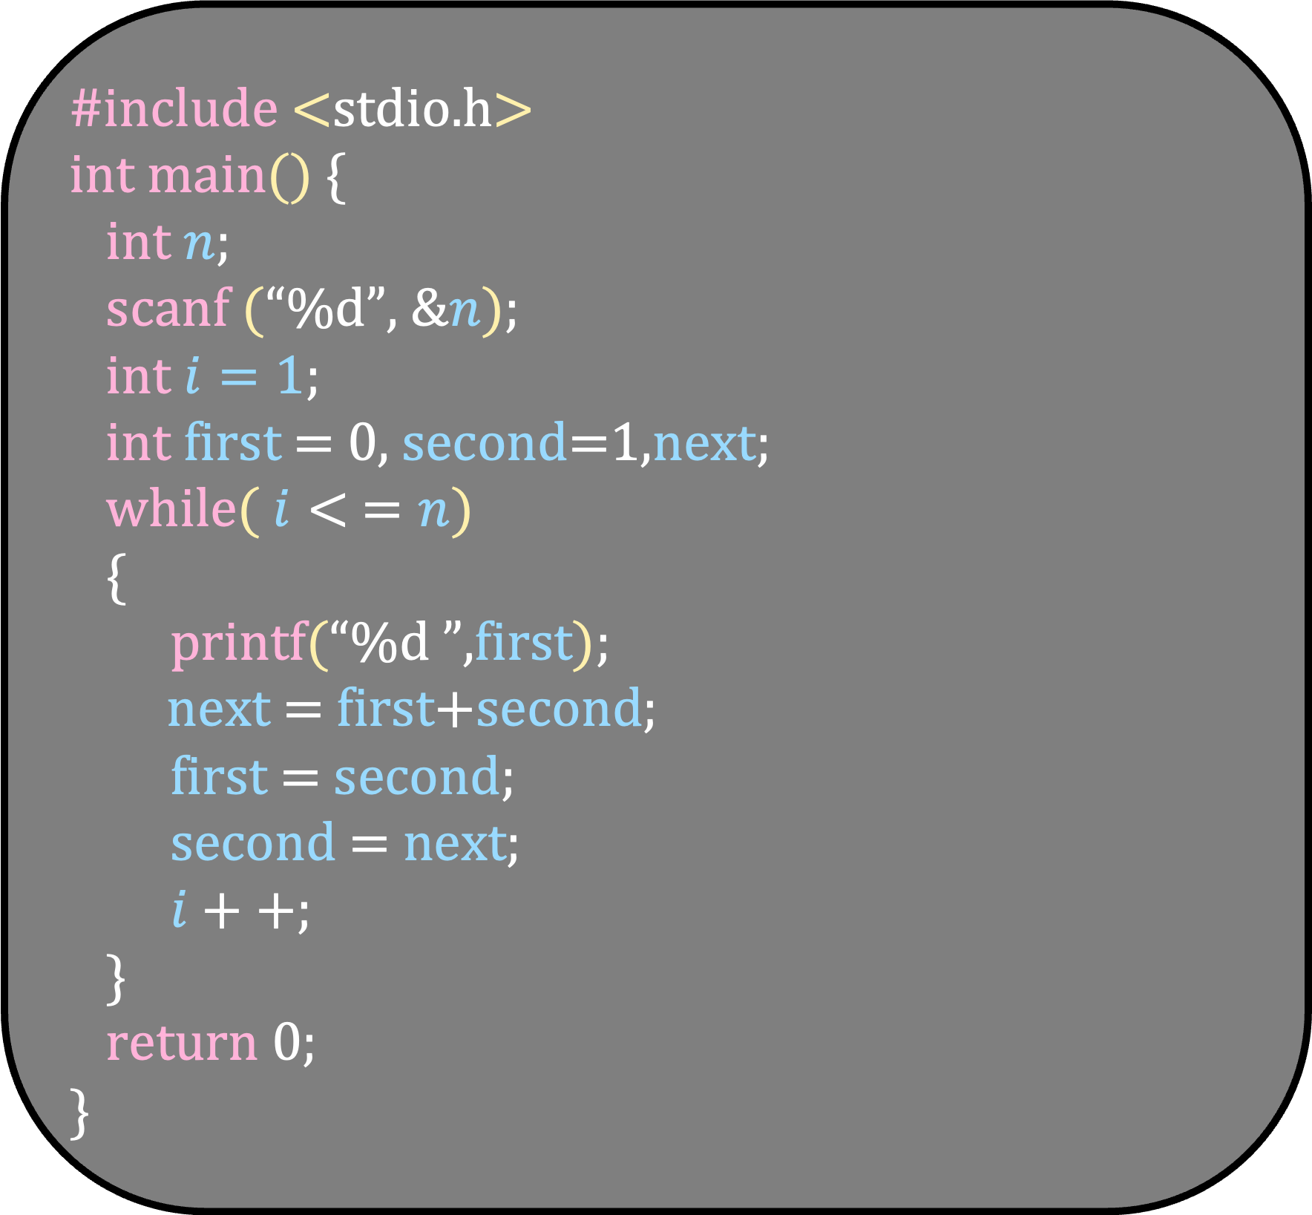
#include <stdio.h> int main() { int $n$;
scanf (“%d”, &$n$);
int $i=1$;
int first = 0, second=1,next;
while( $i< =n$)
{
printf(“%d ”,first);
next = first+second;
first = second;
second = next;
$i++$;
}
return 0; }

Slide 29
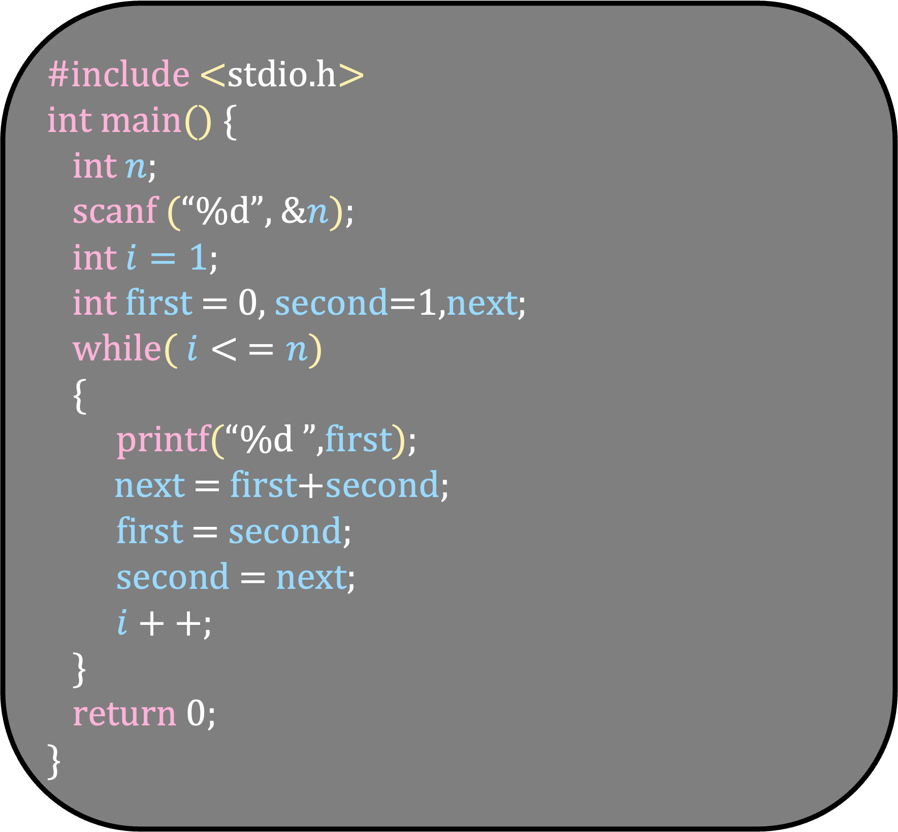
#include <stdio.h> int main() { int $n$;
scanf (“%d”, &$n$);
int $i=1$;
int first = 0, second=1,next;
while( $i< =n$)
{
printf(“%d ”,first);
next = first+second;
first = second;
second = next;
$i++$;
}
return 0; }
Variables
Input/Output

Slide 30
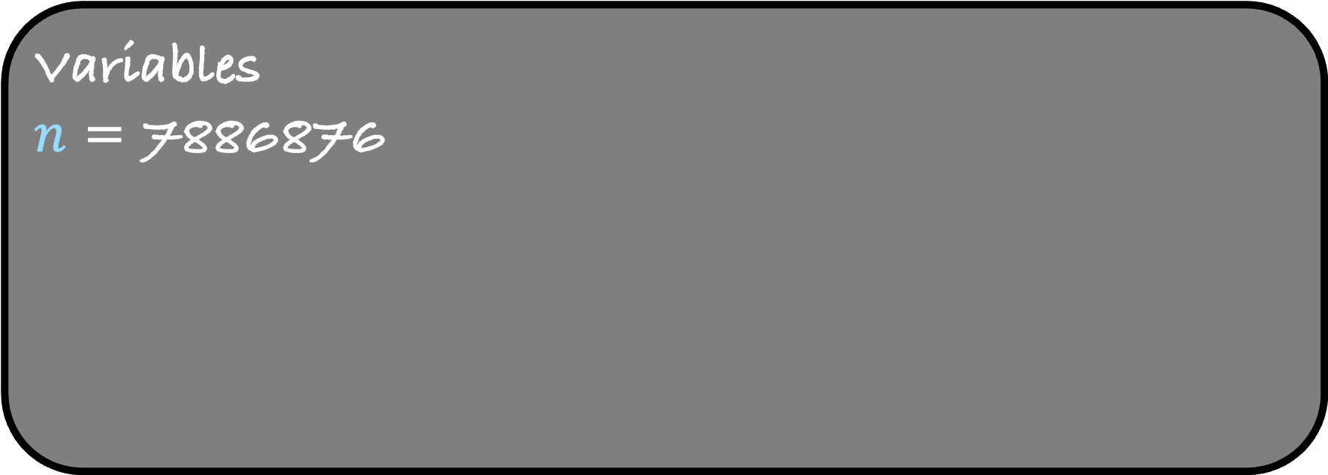
#include <stdio.h> int main() { int $n$;
scanf (“%d”, &$n$);
int $i=1$;
int first = 0, second=1,next;
while( $i< =n$)
{
printf(“%d ”,first);
next = first+second;
first = second;
second = next;
$i++$;
}
return 0; }
Variables
$n$ = 7886876
Input/Output

Slide 31
#include <stdio.h> int main() { int $n$;
scanf (“%d”, &$n$);
int $i=1$;
int first = 0, second=1,next;
while( $i< =n$)
{
printf(“%d ”,first);
next = first+second;
first = second;
second = next;
$i++$;
}
return 0; }
Variables
$n$ = 7886876
Input/Output
1

Slide 32
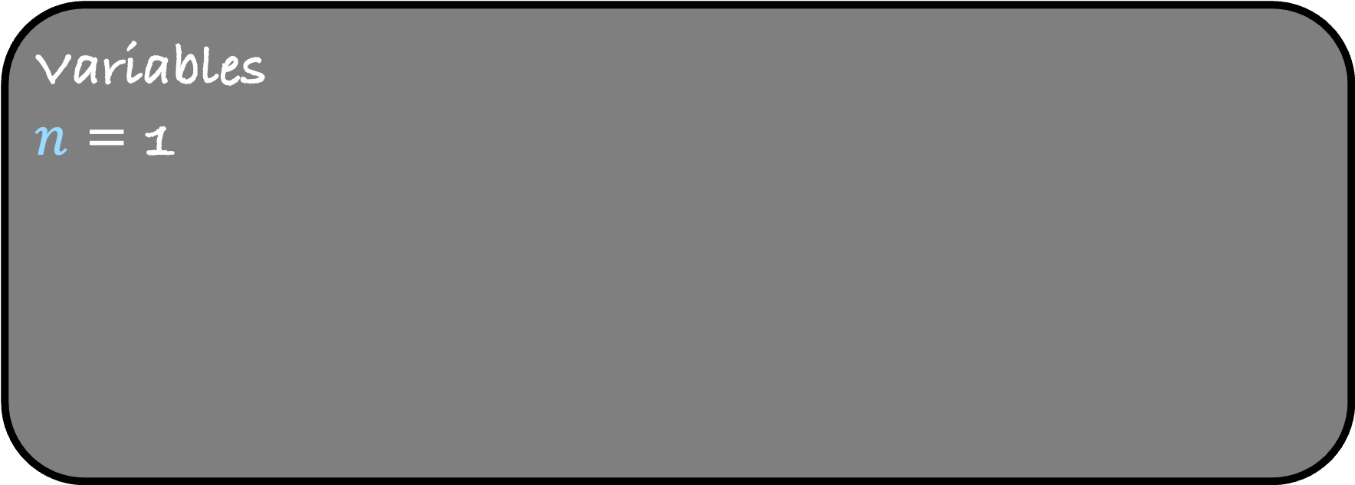
#include <stdio.h> int main() { int $n$;
scanf (“%d”, &$n$);
int $i=1$;
int first = 0, second=1,next;
while( $i< =n$)
{
printf(“%d ”,first);
next = first+second;
first = second;
second = next;
$i++$;
}
return 0; }
Variables
$n$ = 1
Input/Output
1

Slide 33
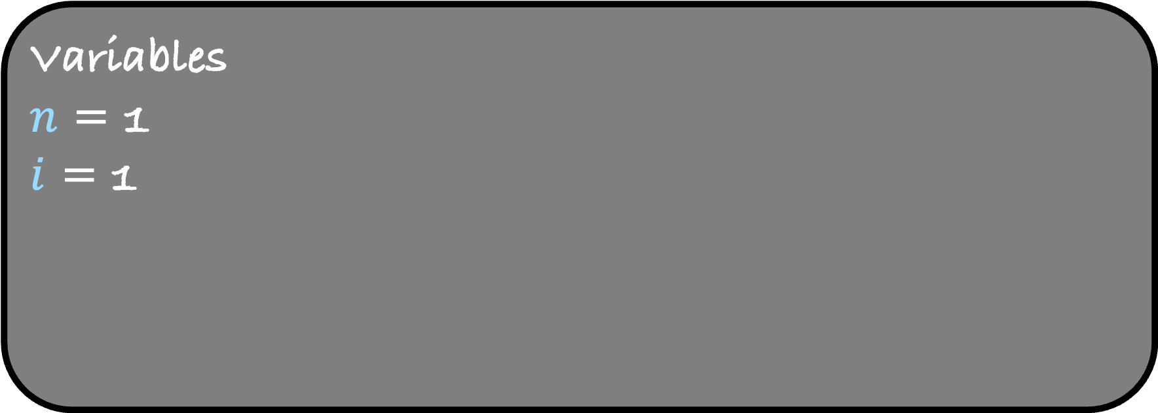
#include <stdio.h> int main() { int $n$;
scanf (“%d”, &$n$);
int $i=1$;
int first = 0, second=1,next;
while( $i< =n$)
{
printf(“%d ”,first);
next = first+second;
first = second;
second = next;
$i++$;
}
return 0; }
Variables
$n$ = 1
$i$ = 1
Input/Output
1

Slide 34
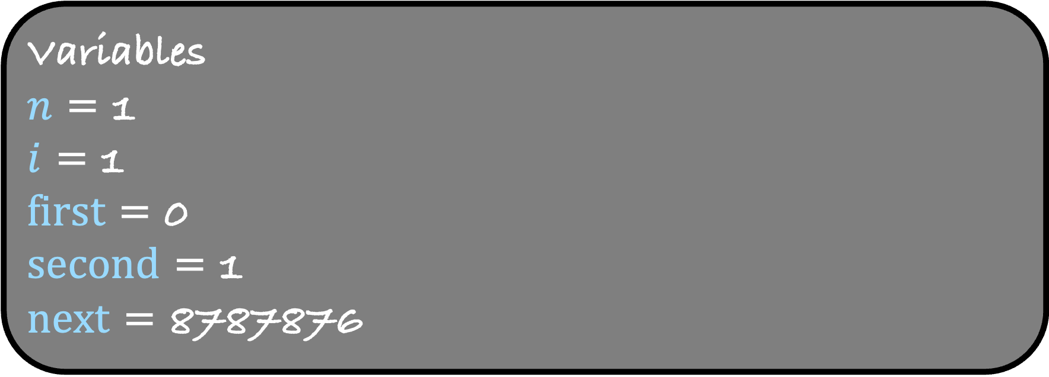
#include <stdio.h> int main() { int $n$;
scanf (“%d”, &$n$);
int $i=1$;
int first = 0, second=1,next;
while( $i< =n$)
{
printf(“%d ”,first);
next = first+second;
first = second;
second = next;
$i++$;
}
return 0; }
Variables
$n$ = 1
$i$ = 1
first = 0
second = 1
next = 8787876
Input/Output
1

Slide 35
#include <stdio.h> int main() { int $n$;
scanf (“%d”, &$n$);
int $i=1$;
int first = 0, second=1,next;
while( $i< =n$)
{
printf(“%d ”,first);
next = first+second;
first = second;
second = next;
$i++$;
}
return 0; }
Variables
$n$ = 1
$i$ = 1
first = 0
second = 1
next = 8787876
Input/Output
1

Slide 36
#include <stdio.h> int main() { int $n$;
scanf (“%d”, &$n$);
int $i=1$;
int first = 0, second=1,next;
while( $i< =n$)
{
printf(“%d ”,first);
next = first+second;
first = second;
second = next;
$i++$;
}
return 0; }
Variables
$n$ = 1
$i$ = 1
first = 0
second = 1
next = 8787876
Input/Output
1
0

Slide 37
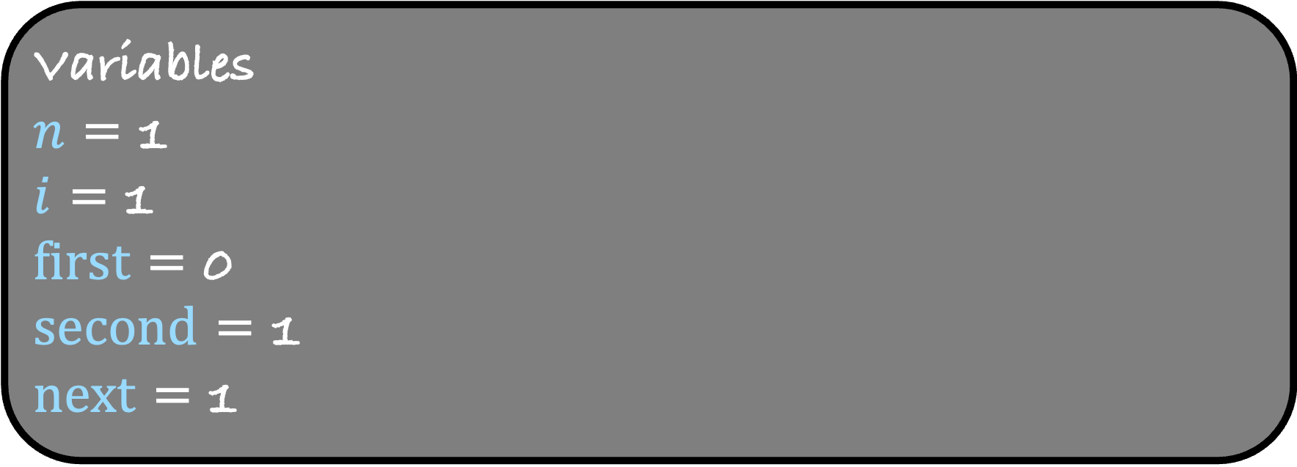
#include <stdio.h> int main() { int $n$;
scanf (“%d”, &$n$);
int $i=1$;
int first = 0, second=1,next;
while( $i< =n$)
{
printf(“%d ”,first);
next = first+second;
first = second;
second = next;
$i++$;
}
return 0; }
Variables
$n$ = 1
$i$ = 1
first = 0
second = 1
next = 1
Input/Output
1
0

Slide 38

#include <stdio.h> int main() { int $n$;
scanf (“%d”, &$n$);
int $i=1$;
int first = 0, second=1,next;
while( $i< =n$)
{
printf(“%d ”,first);
next = first+second;
first = second;
second = next;
$i++$;
}
return 0; }
Variables
$n$ = 1
$i$ = 1
first = 1
second = 1
next = 1
Input/Output
1
0

Slide 39
#include <stdio.h> int main() { int $n$;
scanf (“%d”, &$n$);
int $i=1$;
int first = 0, second=1,next;
while( $i< =n$)
{
printf(“%d ”,first);
next = first+second;
first = second;
second = next;
$i++$;
}
return 0; }
Variables
$n$ = 1
$i$ = 1
first = 1
second = 1
next = 1
Input/Output
1
0

Slide 40
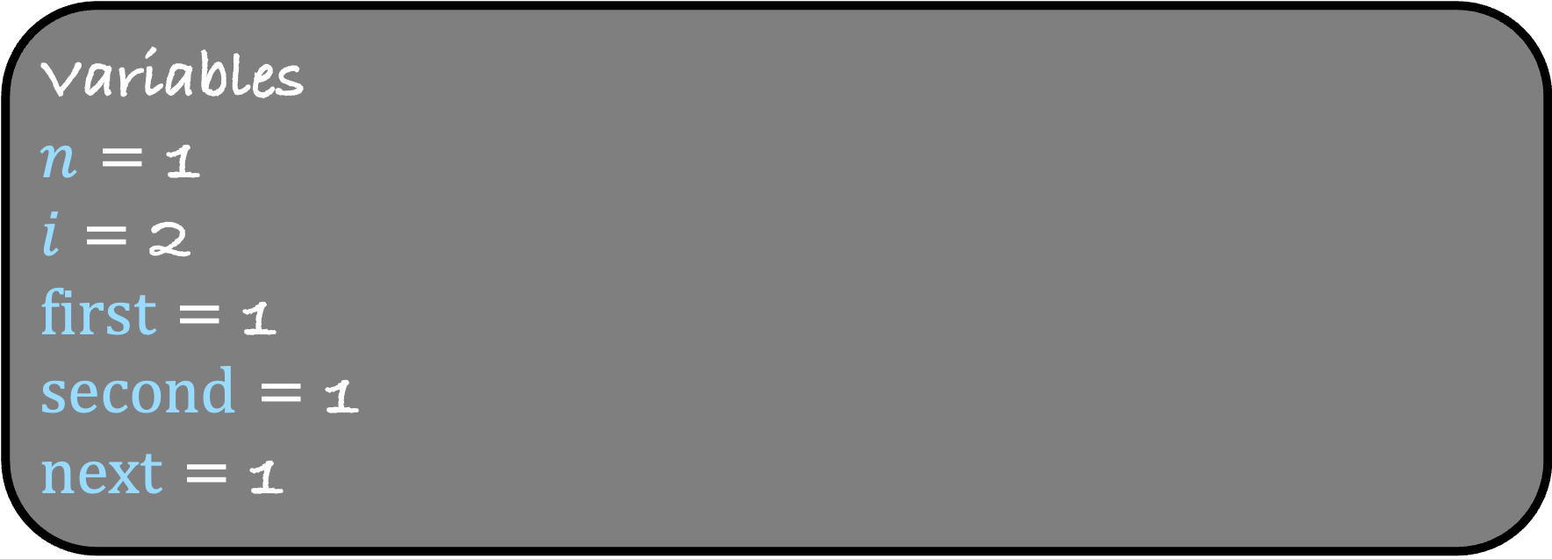
#include <stdio.h> int main() { int $n$;
scanf (“%d”, &$n$);
int $i=1$;
int first = 0, second=1,next;
while( $i< =n$)
{
printf(“%d ”,first);
next = first+second;
first = second;
second = next;
$i++$;
}
return 0; }
Variables
$n$ = 1
$i$ = 2
first = 1
second = 1
next = 1
Input/Output
1
0

Slide 41
#include <stdio.h> int main() { int $n$;
scanf (“%d”, &$n$);
int $i=1$;
int first = 0, second=1,next;
while( $i< =n$)
{
printf(“%d ”,first);
next = first+second;
first = second;
second = next;
$i++$;
}
return 0; }
Variables
$n$ = 1
$i$ = 2
first = 1
second = 1
next = 1
Input/Output
1
0

Slide 42
#include <stdio.h> int main() { int $n$;
scanf (“%d”, &$n$);
int $i=1$;
int first = 0, second=1,next;
while( $i< =n$)
{
printf(“%d ”,first);
next = first+second;
first = second;
second = next;
$i++$;
}
return 0; }
Variables
$n$ = 1
$i$ = 2
first = 1
second = 1
next = 1
Input/Output
1
0

Slide 43
For loop
Syntax for for
for ( initialization; condition; update )
{
statements;
}
Write a program that prints the first n Fibonacci numbers using a for loop

Slide 44
#include <stdio.h> int main() { int $n$;
scanf (“%d”, &$n$);
int $i=1$;
int first = 0, second=1,next;
while( $i< =n$)
{
printf(“%d ”,first);
next = first+second;
first = second;
second = next;
$i++$;
}
return 0; }

Slide 45
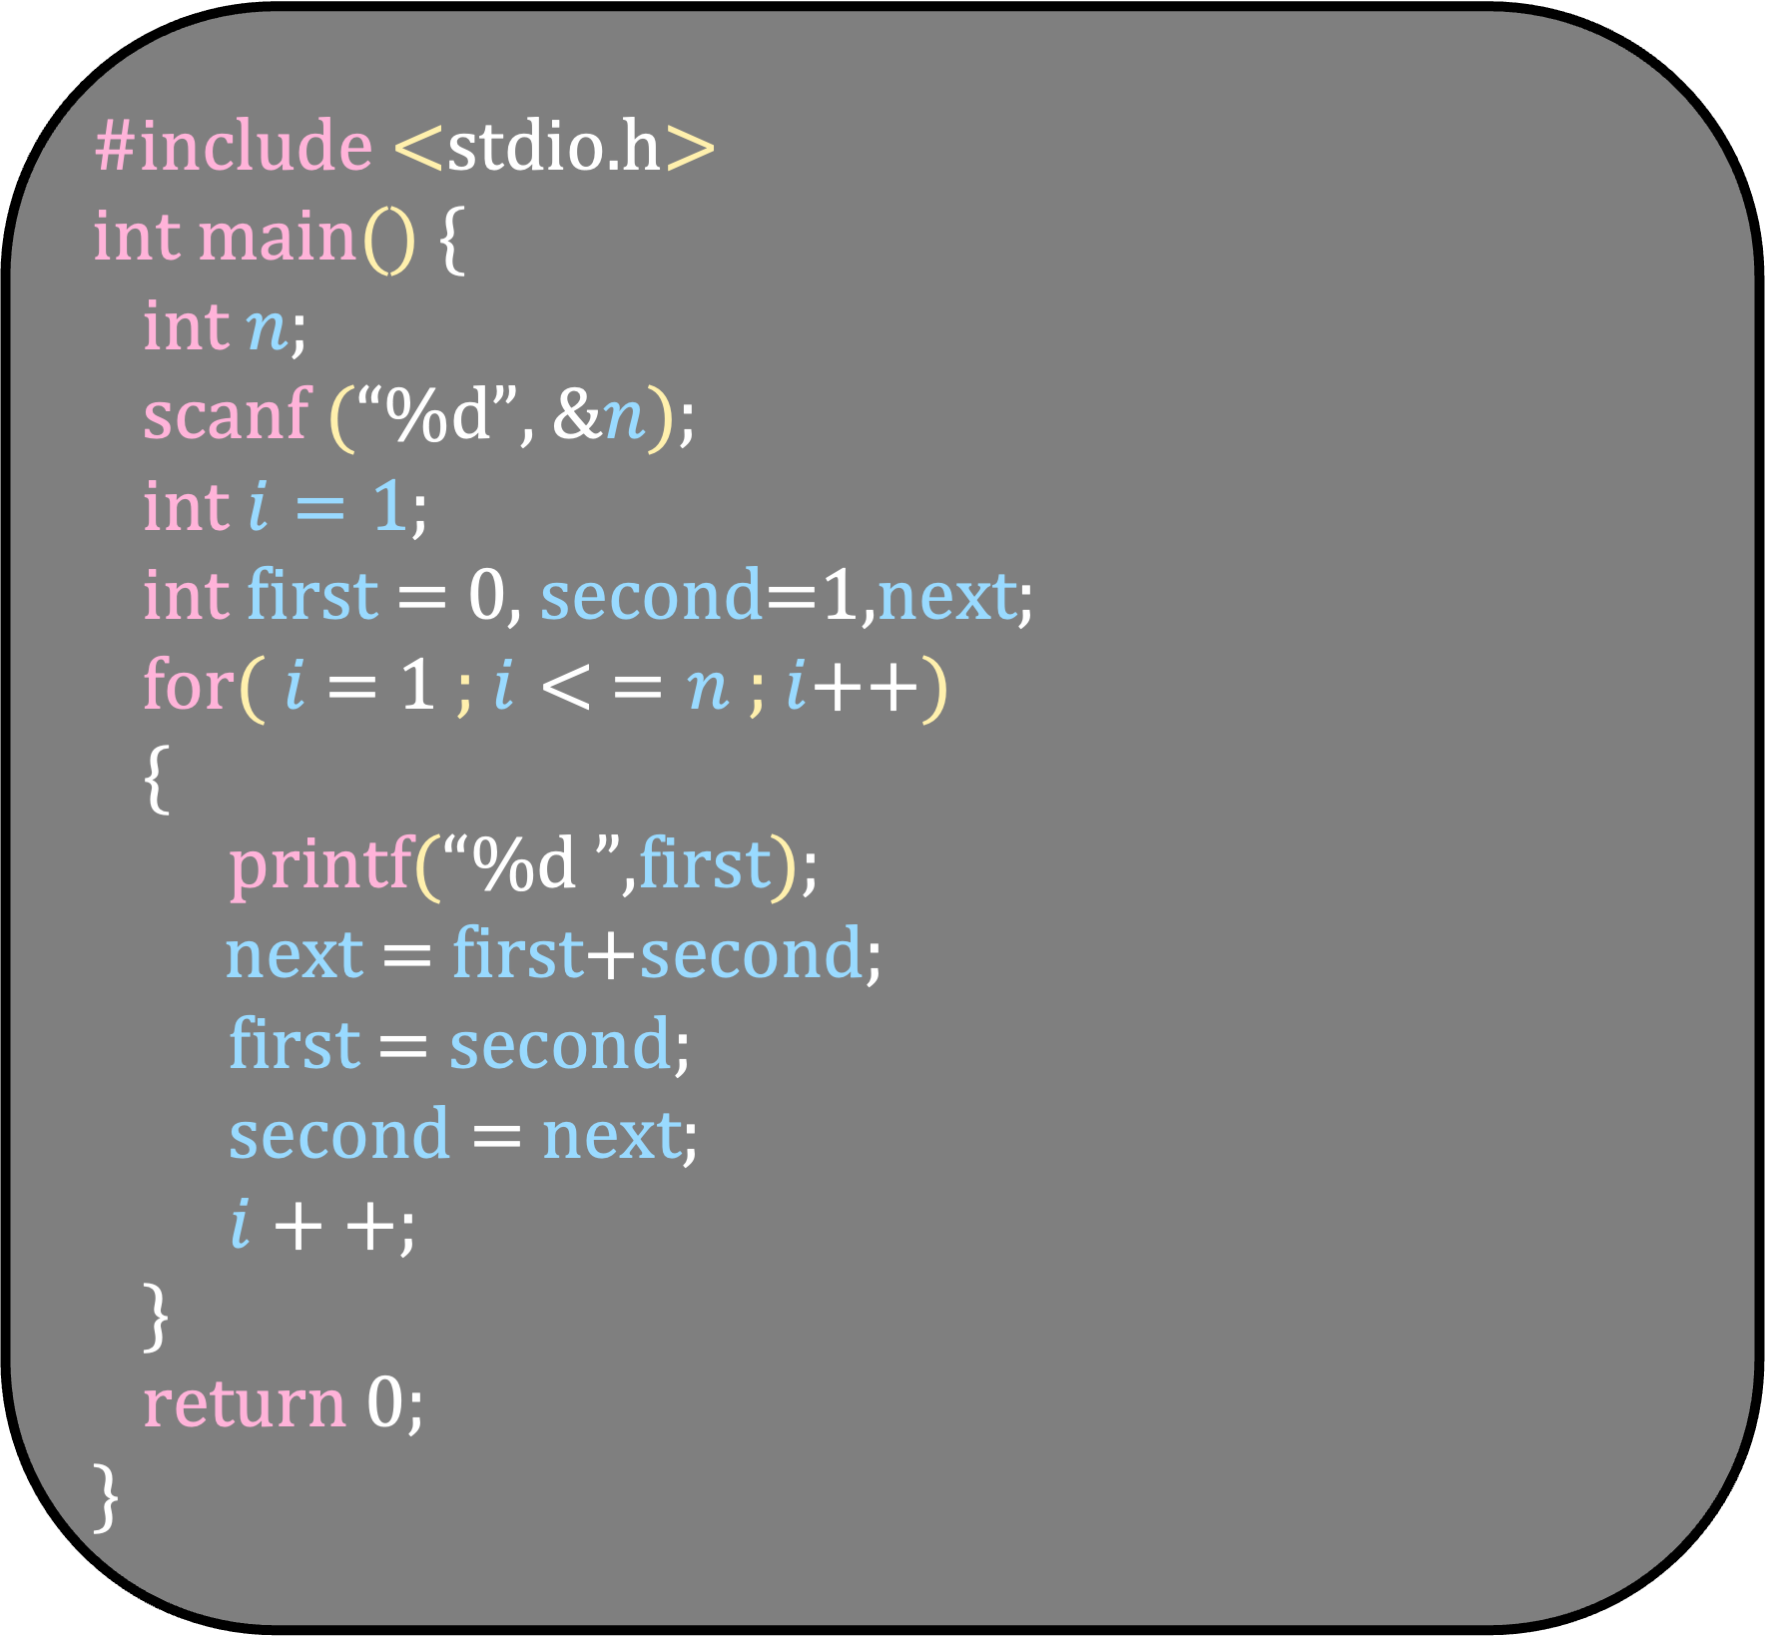
#include <stdio.h> int main() { int $n$;
scanf (“%d”, &$n$);
int $i=1$;
int first = 0, second=1,next;
for( $i$ = 1 ; $i< =n$ ; $i$++)
{
printf(“%d ”,first);
next = first+second;
first = second;
second = next;
$i++$;
}
return 0; }

Slide 46
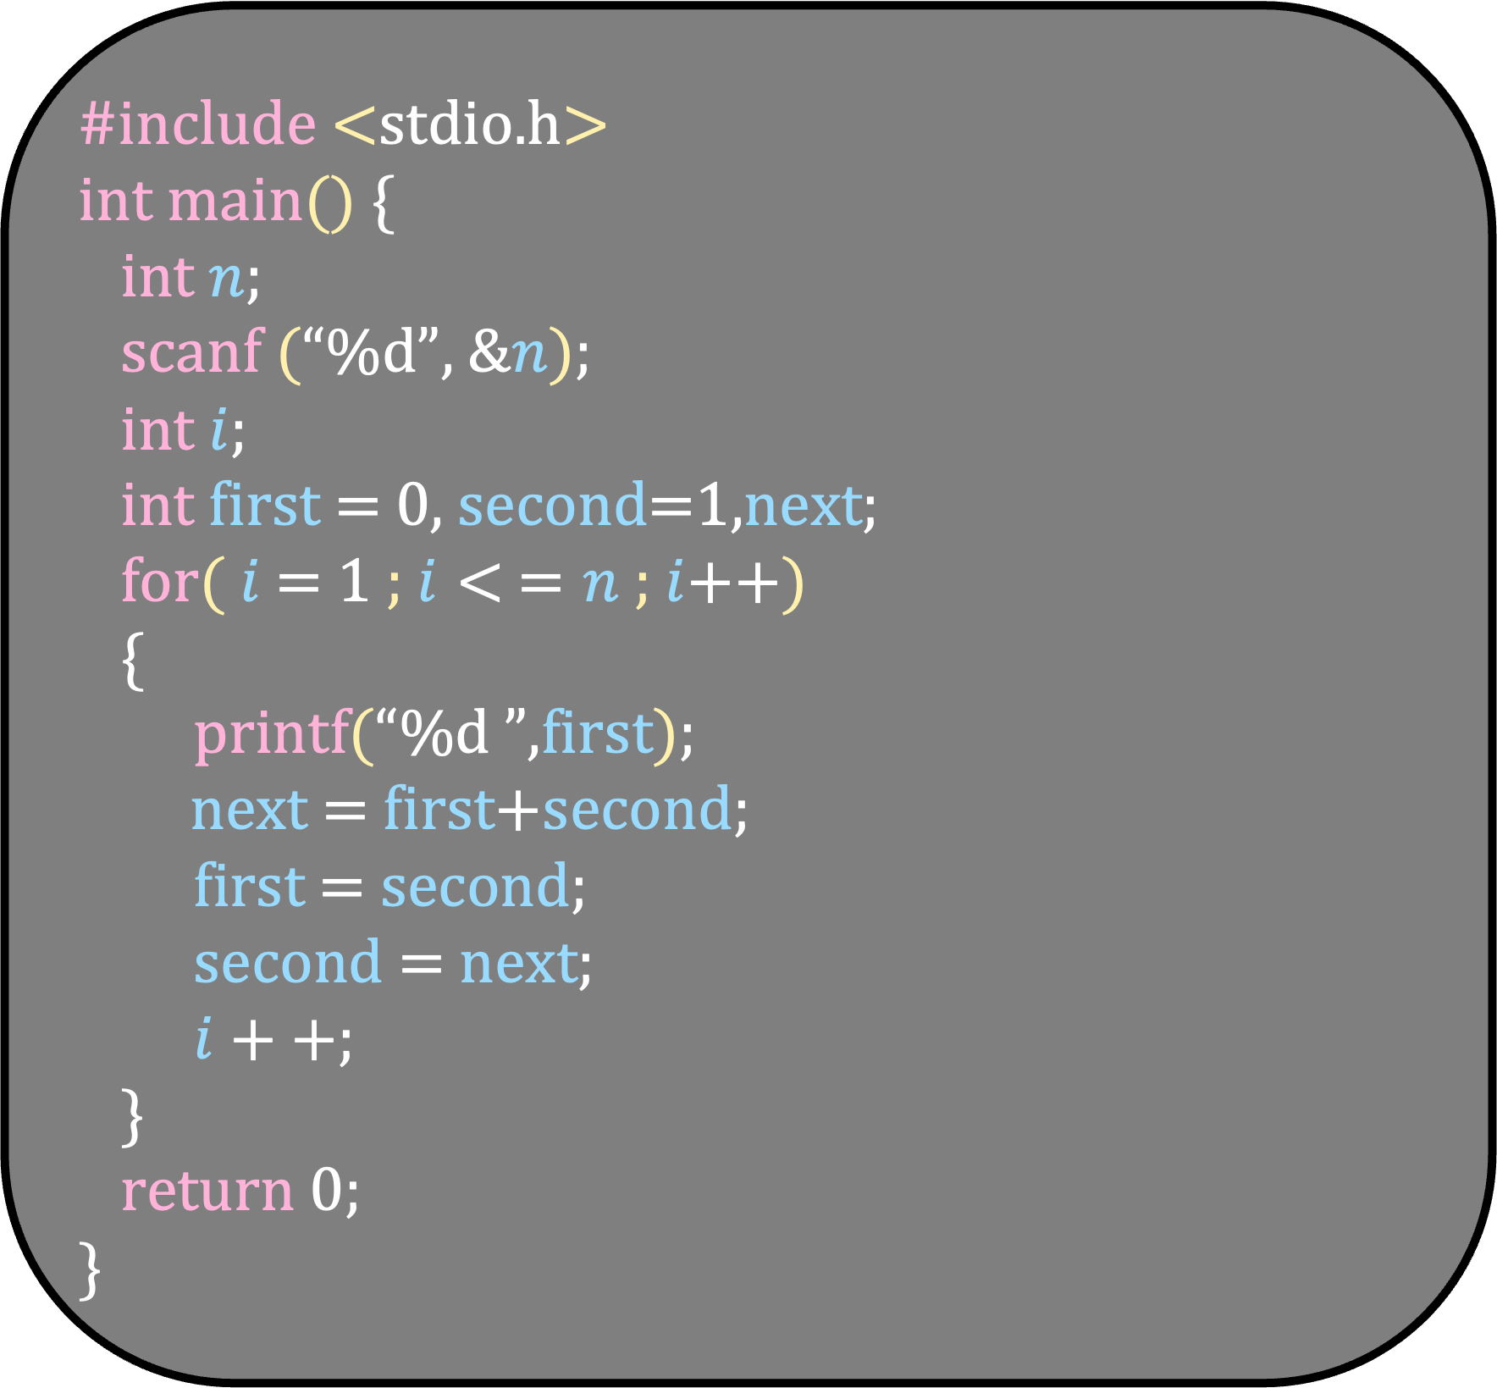
#include <stdio.h> int main() { int $n$;
scanf (“%d”, &$n$);
int $i$;
int first = 0, second=1,next;
for( $i$ = 1 ; $i< =n$ ; $i$++)
{
printf(“%d ”,first);
next = first+second;
first = second;
second = next;
$i++$;
}
return 0; }

Slide 47
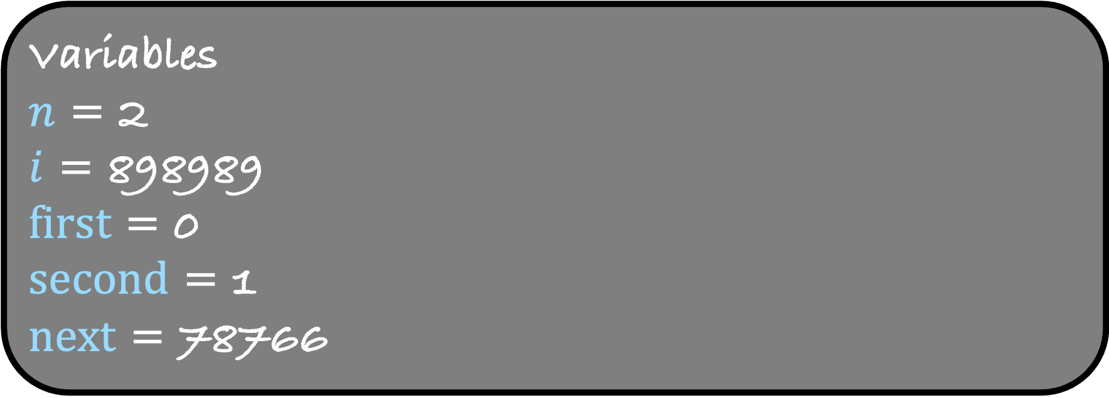
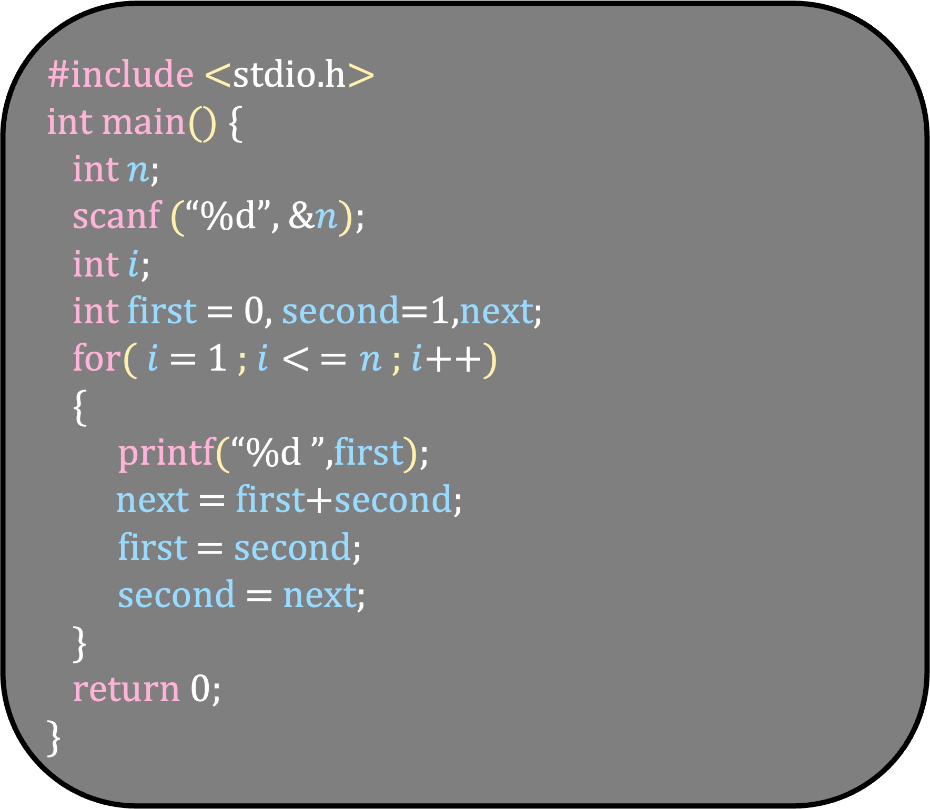
#include <stdio.h> int main() { int $n$;
scanf (“%d”, &$n$);
int $i$;
int first = 0, second=1,next;
for( $i$ = 1 ; $i< =n$ ; $i$++)
{
printf(“%d ”,first);
next = first+second;
first = second;
second = next;
}
return 0; }
Variables
$n$ = 2
$i$ = 898989
first = 0
second = 1
next = 78766
Input/Output
2

Slide 48
#include <stdio.h> int main() { int $n$;
scanf (“%d”, &$n$);
int $i$;
int first = 0, second=1,next;
for( $i$ = 1 ; $i< =n$ ; $i$++)
{
printf(“%d ”,first);
next = first+second;
first = second;
second = next;
}
return 0; }
Variables
$n$ = 2
$i$ = 898989
first = 0
second = 1
next = 78766
Input/Output
2

Slide 49
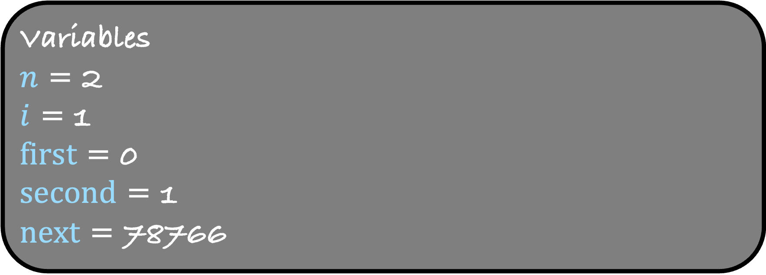
#include <stdio.h> int main() { int $n$;
scanf (“%d”, &$n$);
int $i$;
int first = 0, second=1,next;
for( $i$ = 1 ; $i< =n$ ; $i$++)
{
printf(“%d ”,first);
next = first+second;
first = second;
second = next;
}
return 0; }
Variables
$n$ = 2
$i$ = 1
first = 0
second = 1
next = 78766
Input/Output
2

Slide 50
#include <stdio.h> int main() { int $n$;
scanf (“%d”, &$n$);
int $i$;
int first = 0, second=1,next;
for( $i$ = 1 ; $i< =n$ ; $i$++)
{
printf(“%d ”,first);
next = first+second;
first = second;
second = next;
}
return 0; }
Variables
$n$ = 2
$i$ = 1
first = 0
second = 1
next = 78766
Input/Output
2

Slide 51
#include <stdio.h> int main() { int $n$;
scanf (“%d”, &$n$);
int $i$;
int first = 0, second=1,next;
for( $i$ = 1 ; $i< =n$ ; $i$++)
{
printf(“%d ”,first);
next = first+second;
first = second;
second = next;
}
return 0; }
Variables
$n$ = 2
$i$ = 1
first = 0
second = 1
next = 78766
Input/Output
2
0

Slide 52

#include <stdio.h> int main() { int $n$;
scanf (“%d”, &$n$);
int $i$;
int first = 0, second=1,next;
for( $i$ = 1 ; $i< =n$ ; $i$++)
{
printf(“%d ”,first);
next = first+second;
first = second;
second = next;
}
return 0; }
Variables
$n$ = 2
$i$ = 1
first = 0
second = 1
next = 1
Input/Output
2
0

Slide 53

#include <stdio.h> int main() { int $n$;
scanf (“%d”, &$n$);
int $i$;
int first = 0, second=1,next;
for( $i$ = 1 ; $i< =n$ ; $i$++)
{
printf(“%d ”,first);
next = first+second;
first = second;
second = next;
}
return 0; }
Variables
$n$ = 2
$i$ = 1
first = 1
second = 1
next = 1
Input/Output
2
0

Slide 54
#include <stdio.h> int main() { int $n$;
scanf (“%d”, &$n$);
int $i$;
int first = 0, second=1,next;
for( $i$ = 1 ; $i< =n$ ; $i$++)
{
printf(“%d ”,first);
next = first+second;
first = second;
second = next;
}
return 0; }
Variables
$n$ = 2
$i$ = 1
first = 1
second = 1
next = 1
Input/Output
2
0

Slide 55
#include <stdio.h> int main() { int $n$;
scanf (“%d”, &$n$);
int $i$;
int first = 0, second=1,next;
for( $i$ = 1 ; $i< =n$ ; $i$++)
{
printf(“%d ”,first);
next = first+second;
first = second;
second = next;
}
return 0; }
Variables
$n$ = 2
$i$ = 1
first = 1
second = 1
next = 1
Input/Output
2
0

Slide 56

#include <stdio.h> int main() { int $n$;
scanf (“%d”, &$n$);
int $i$;
int first = 0, second=1,next;
for( $i$ = 1 ; $i< =n$ ; $i$++)
{
printf(“%d ”,first);
next = first+second;
first = second;
second = next;
}
return 0; }
Variables
$n$ = 2
$i$ = 2
first = 1
second = 1
next = 1
Input/Output
2
0

Slide 57
#include <stdio.h> int main() { int $n$;
scanf (“%d”, &$n$);
int $i$;
int first = 0, second=1,next;
for( $i$ = 1 ; $i< =n$ ; $i$++)
{
printf(“%d ”,first);
next = first+second;
first = second;
second = next;
}
return 0; }
Variables
$n$ = 2
$i$ = 2
first = 1
second = 1
next = 1
Input/Output
2
0

Slide 58
#include <stdio.h> int main() { int $n$;
scanf (“%d”, &$n$);
int $i$;
int first = 0, second=1,next;
for( $i$ = 1 ; $i< =n$ ; $i$++)
{
printf(“%d ”,first);
next = first+second;
first = second;
second = next;
}
return 0; }
Variables
$n$ = 2
$i$ = 2
first = 1
second = 1
next = 1
Input/Output
2
0 1

Slide 59

#include <stdio.h> int main() { int $n$;
scanf (“%d”, &$n$);
int $i$;
int first = 0, second=1,next;
for( $i$ = 1 ; $i< =n$ ; $i$++)
{
printf(“%d ”,first);
next = first+second;
first = second;
second = next;
}
return 0; }
Variables
$n$ = 2
$i$ = 2
first = 1
second = 1
next = 2
Input/Output
2
0 1

Slide 60
#include <stdio.h> int main() { int $n$;
scanf (“%d”, &$n$);
int $i$;
int first = 0, second=1,next;
for( $i$ = 1 ; $i< =n$ ; $i$++)
{
printf(“%d ”,first);
next = first+second;
first = second;
second = next;
}
return 0; }
Variables
$n$ = 2
$i$ = 2
first = 1
second = 1
next = 2
Input/Output
2
0 1

Slide 61

#include <stdio.h> int main() { int $n$;
scanf (“%d”, &$n$);
int $i$;
int first = 0, second=1,next;
for( $i$ = 1 ; $i< =n$ ; $i$++)
{
printf(“%d ”,first);
next = first+second;
first = second;
second = next;
}
return 0; }
Variables
$n$ = 2
$i$ = 2
first = 1
second = 2
next = 2
Input/Output
2
0 1

Slide 62
#include <stdio.h> int main() { int $n$;
scanf (“%d”, &$n$);
int $i$;
int first = 0, second=1,next;
for( $i$ = 1 ; $i< =n$ ; $i$++)
{
printf(“%d ”,first);
next = first+second;
first = second;
second = next;
}
return 0; }
Variables
$n$ = 2
$i$ = 2
first = 1
second = 2
next = 2
Input/Output
2
0 1

Slide 63

#include <stdio.h> int main() { int $n$;
scanf (“%d”, &$n$);
int $i$;
int first = 0, second=1,next;
for( $i$ = 1 ; $i< =n$ ; $i$++)
{
printf(“%d ”,first);
next = first+second;
first = second;
second = next;
}
return 0; }
Variables
$n$ = 2
$i$ = 3
first = 1
second = 2
next = 2
Input/Output
2
0 1

Slide 64
#include <stdio.h> int main() { int $n$;
scanf (“%d”, &$n$);
int $i$;
int first = 0, second=1,next;
for( $i$ = 1 ; $i< =n$ ; $i$++)
{
printf(“%d ”,first);
next = first+second;
first = second;
second = next;
}
return 0; }
Variables
$n$ = 2
$i$ = 3
first = 1
second = 2
next = 2
Input/Output
2
0 1

Slide 65
#include <stdio.h> int main() { int $n$;
scanf (“%d”, &$n$);
int $i$;
int first = 0, second=1,next;
for( $i$ = 1 ; $i< =n$ ; $i$++)
{
printf(“%d ”,first);
next = first+second;
first = second;
second = next;
}
return 0; }
Variables
$n$ = 2
$i$ = 3
first = 1
second = 2
next = 2
Input/Output
2
0 1

Slide 66
Loop Controls: break
Syntax for break
while (condition)
{
statements;
if (condition for exit)
break;
}
Write a program that prints the smallest divisor (greater than 1) of a number

Slide 67
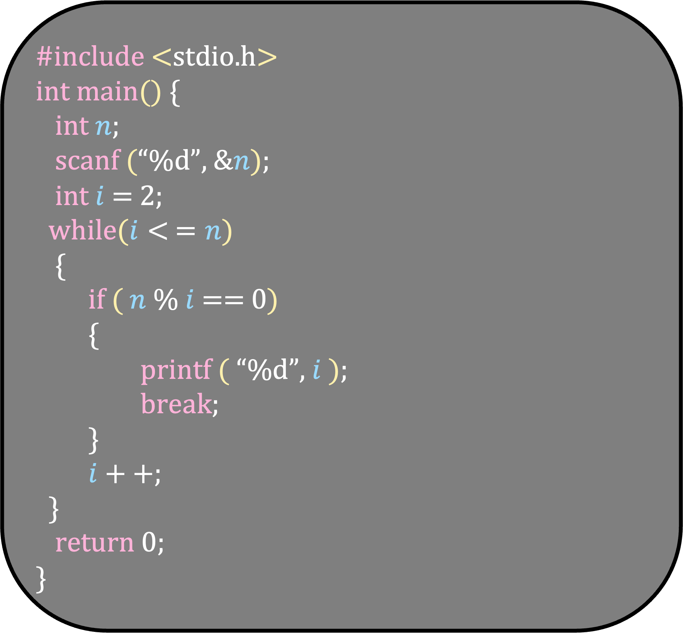
#include <stdio.h> int main() { int $n$;
scanf (“%d”, &$n$);
int $i$ = 2;
while($i< =n$)
{
if ( $n$ % $i$ == 0)
{
printf ( “%d”, $i$ );
break;
}
$i++$;
}
return 0; }

Slide 68
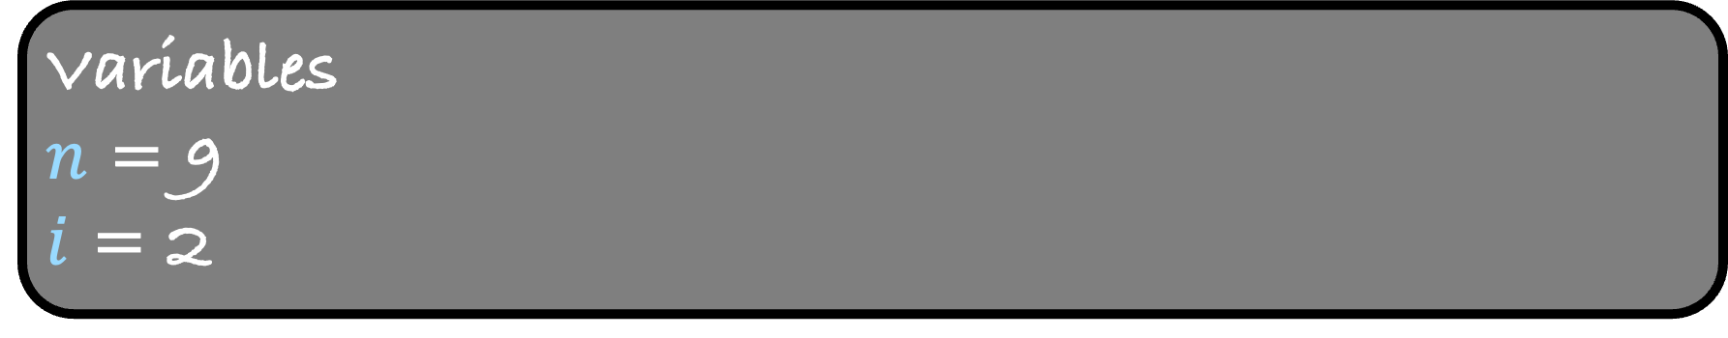
#include <stdio.h> int main() { int $n$;
scanf (“%d”, &$n$);
int $i$ = 2;
while($i< =n$)
{
if ( $n$ % $i$ == 0)
{
printf ( “%d”, $i$ );
break;
}
$i++$;
}
return 0; }
Variables
$n$ = 9
$i$ = 2
Input/Output
9

Slide 69
#include <stdio.h> int main() { int $n$;
scanf (“%d”, &$n$);
int $i$ = 2;
while($i< =n$)
{
if ( $n$ % $i$ == 0)
{
printf ( “%d”, $i$ );
break;
}
$i++$;
}
return 0; }
Variables
$n$ = 9
$i$ = 2
Input/Output
9

Slide 70
#include <stdio.h> int main() { int $n$;
scanf (“%d”, &$n$);
int $i$ = 2;
while($i< =n$)
{
if ( $n$ % $i$ == 0)
{
printf ( “%d”, $i$ );
break;
}
$i++$;
}
return 0; }
Variables
$n$ = 9
$i$ = 2
Input/Output
9

Slide 71

#include <stdio.h> int main() { int $n$;
scanf (“%d”, &$n$);
int $i$ = 2;
while($i< =n$)
{
if ( $n$ % $i$ == 0)
{
printf ( “%d”, $i$ );
break;
}
$i++$;
}
return 0; }
Variables
$n$ = 9
$i$ = 3
Input/Output
9

Slide 72
#include <stdio.h> int main() { int $n$;
scanf (“%d”, &$n$);
int $i$ = 2;
while($i< =n$)
{
if ( $n$ % $i$ == 0)
{
printf ( “%d”, $i$ );
break;
}
$i++$;
}
return 0; }
Variables
$n$ = 9
$i$ = 3
Input/Output
9

Slide 73
#include <stdio.h> int main() { int $n$;
scanf (“%d”, &$n$);
int $i$ = 2;
while($i< =n$)
{
if ( $n$ % $i$ == 0)
{
printf ( “%d”, $i$ );
break;
}
$i++$;
}
return 0; }
Variables
$n$ = 9
$i$ = 3
Input/Output
9

Slide 74
#include <stdio.h> int main() { int $n$;
scanf (“%d”, &$n$);
int $i$ = 2;
while($i< =n$)
{
if ( $n$ % $i$ == 0)
{
printf ( “%d”, $i$ );
break;
}
$i++$;
}
return 0; }
Variables
$n$ = 9
$i$ = 3
Input/Output
9
3

Slide 75
#include <stdio.h> int main() { int $n$;
scanf (“%d”, &$n$);
int $i$ = 2;
while($i< =n$)
{
if ( $n$ % $i$ == 0)
{
printf ( “%d”, $i$ );
break;
}
$i++$;
}
return 0; }
Variables
$n$ = 9
$i$ = 3
Input/Output
9
3

Slide 76
#include <stdio.h> int main() { int $n$;
scanf (“%d”, &$n$);
int $i$ = 2;
while($i< =n$)
{
if ( $n$ % $i$ == 0)
{
printf ( “%d”, $i$ );
break;
}
$i++$;
}
return 0; }
Variables
$n$ = 9
$i$ = 3
Input/Output
9
3

Slide 77
Loop Controls: continue
Syntax for continue
for (initialization ; condition ; update)
{
statements;
if (condition for not executing the following statements)
continue ;
statements;
}

Slide 78
Functions
Syntax for functions
return_type functionname (parameters)
{
statements;
return value;
}
void functionname (parameters)
{
statements;
}

Slide 79
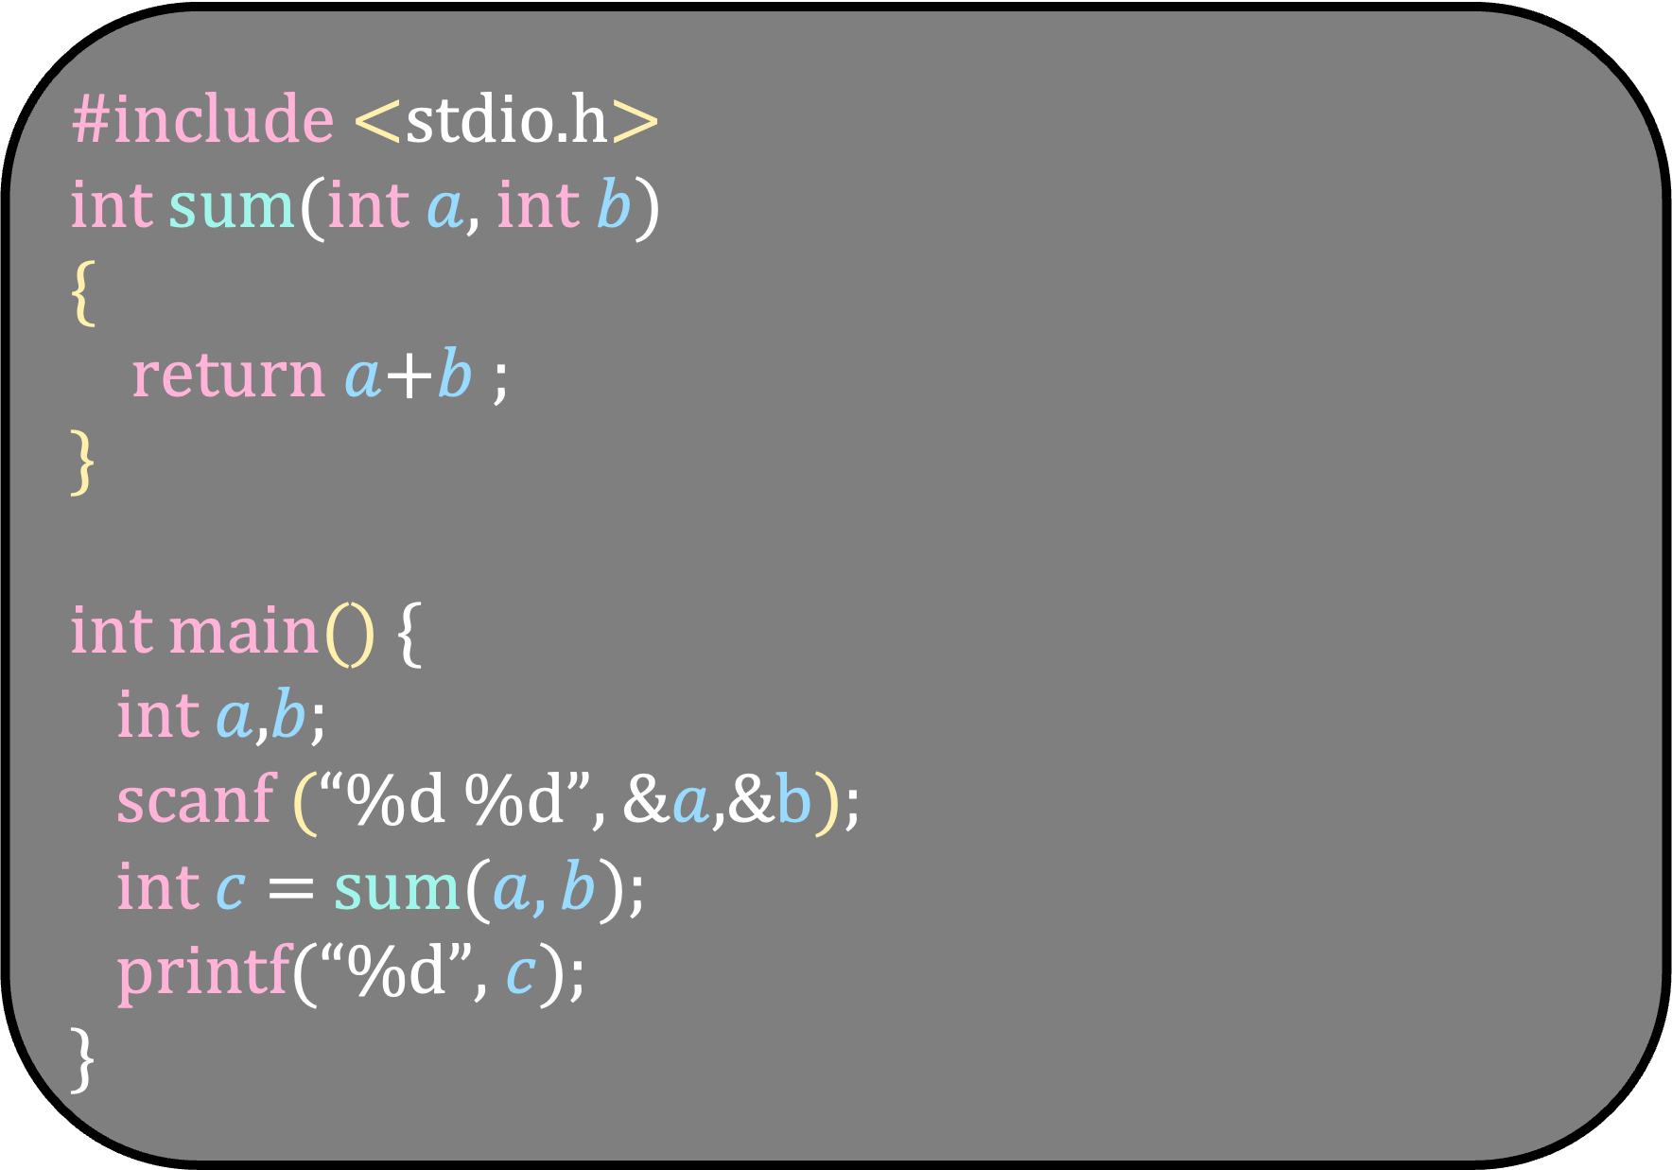
#include <stdio.h>
int sum(int $a$, int $b$)
{
return $a$+$b$ ;
}
int main() { int $a$,$b$;
scanf (“%d %d”, &$a$,&b);
int $c$ = sum($a,b$);
printf(“%d”, $c$); }

