Slide 1
Tree Traversals

Slide 2
void inorder(struct node *v)
{
if(v != NULL)
{
inorder(v->left);
printf( “%d”, v->num);
inorder(v->right);
}
}
4
4
2
2
9
9
0
3
0
3
6
6
5
5

Slide 3
void inorder(struct node *v)
{
if(v != NULL)
{
inorder(v->left);
printf( “%d”, v->num);
inorder(v->right);
}
}
4
4
2
2
9
9
0
3
0
3
6
6
5
5

Slide 4
void inorder(struct node *v)
{
if(v != NULL)
{
inorder(v->left);
printf( “%d”, v->num);
inorder(v->right);
}
}
4
4
2
2
9
9
0
3
0
3
6
6
5
5

Slide 5
void inorder(struct node *v)
{
if(v != NULL)
{
inorder(v->left);
printf( “%d”, v->num);
inorder(v->right);
}
}
4
4
2
2
9
9
0
3
3
6
6
5
5
0

Slide 6
void inorder(struct node *v)
{
if(v != NULL)
{
inorder(v->left);
printf( “%d”, v->num);
inorder(v->right);
}
}
4
4
2
9
9
0
3
0
3
6
6
5
5
0
2

Slide 7
void inorder(struct node *v)
{
if(v != NULL)
{
inorder(v->left);
printf( “%d”, v->num);
inorder(v->right);
}
}
4
4
2
9
9
0
0
3
6
6
5
5
0
2
3

Slide 8
void inorder(struct node *v)
{
if(v != NULL)
{
inorder(v->left);
printf( “%d”, v->num);
inorder(v->right);
}
}
4
2
9
9
0
0
3
6
6
5
5
0
2
3
4

Slide 9
void inorder(struct node *v)
{
if(v != NULL)
{
inorder(v->left);
printf( “%d”, v->num);
inorder(v->right);
}
}
4
2
9
0
0
3
6
5
0
2
3
4
5
6
9

Slide 10
void inorder(struct node *v)
{
if(v != NULL)
{
inorder(v->left);
printf( “%d”, v->num);
inorder(v->right);
}
}
Inorder traversal of the BST prints the tree in the sorted order
The running time of inorder traversal is

Slide 11
void inorder(struct node *v)
{
if(v != NULL)
{
inorder(v->left);
printf( “%d”, v->num);
inorder(v->right);
}
}
Inorder traversal of the BST prints the tree in the sorted order
The running time of inorder traversal is O(n)

Slide 12
Check if the binary tree is a BST
You are given the root of a tree. You need to check if the tree is a BST
Using inorder traversal, add all the elements of the tree in an array
If the array is sorted, then the tree is a BST
Else no

Slide 13
void inorder(struct node *v, int A[], int *count)
{
if(v != NULL)
{
inorder(v->left, A, count);
A[*count] = v->num;
(*count)++;
inorder(v->right, A, count);
}
}
4
2
9
0
0
3
6
5
A
0
2
3
4
5
6
9

Slide 14
Find the k-th smallest element in the BST
You are given the root of a BST. Write the function
void findk( struct node *v, int k)
to print the k-th smallest element in the BST
Initially, we call findk( root, k)

Slide 15
findk( v -> 4, k=2)
void findk(struct node *v, int k)
{
if(v != NULL)
{
findk(v->left, k);
count++;
if( count == k)
printf( “%d”, v->num);
findk(v->right , k);
}
}
4
4
2
2
9
9
0
3
0
3
6
6
5
5
count = 0

Slide 16
void findk(struct node *v, int k)
{
if(v != NULL)
{
findk(v->left, k);
count++;
if( count == k)
printf( “%d”, v->num);
findk(v->right , k);
}
}
4
4
findk( v -> 2, k=2)
2
2
9
9
0
3
0
3
6
6
5
5
count = 0

Slide 17
void findk(struct node *v, int k)
{
if(v != NULL)
{
findk(v->left, k);
count++;
if( count == k)
printf( “%d”, v->num);
findk(v->right , k);
}
}
4
4
2
2
9
9
findk( v -> 0, k=2)
0
3
0
3
6
6
5
5
count = 0

Slide 18
void findk(struct node *v, int k)
{
if(v != NULL)
{
findk(v->left, k);
count++;
if( count == k)
printf( “%d”, v->num);
findk(v->right , k);
}
}
4
4
2
2
9
9
findk( v -> 0, k=2)
0
3
0
3
6
6
5
5
count = 1

Slide 19
void findk(struct node *v, int k)
{
if(v != NULL)
{
findk(v->left, k);
count++;
if( count == k)
printf( “%d”, v->num);
findk(v->right , k);
}
}
4
4
findk( v -> 2, k=2)
2
2
9
9
0
3
0
3
6
6
5
5
count = 1

Slide 20
void findk(struct node *v, int k)
{
if(v != NULL)
{
findk(v->left, k);
count++;
if( count == k)
printf( “%d”, v->num);
findk(v->right , k);
}
}
4
4
findk( v -> 2, k=2)
2
2
9
9
0
3
0
3
6
6
5
5
count = 2

Slide 21
Other Tree Traversals

Slide 22
void inorder(struct node *v)
{
if(v != NULL)
{
inorder(v->left);
printf( “%d”, v->num);
inorder(v->right);
}
}

Slide 23
void preorder(struct node *v)
{
if(v != NULL)
{
preorder(v->left);
printf( “%d”, v->num);
preorder(v->right);
}
}

Slide 24
4
void preorder(struct node *v)
{
if(v != NULL)
{
printf( “%d”, v->num);
preorder(v->left);
preorder(v->right);
}
}
4
2
2
9
9
0
3
0
3
6
6
5
5
4
2
0
3
9
6
5

Slide 25
void postorder(struct node *v)
{
if(v != NULL)
{
printf( “%d”, v->num);
postorder(v->left);
postorder(v->right);
}
}

Slide 26
4
void postorder(struct node *v)
{
if(v != NULL)
{
postorder(v->left);
postorder(v->right);
printf( “%d”, v->num);
}
}
4
2
2
9
9
0
3
0
3
6
6
5
5
0
3
2
5
6
9
4

Slide 27
void inorder(struct node *v)
{
if(v != NULL)
{
inorder(v->left);
printf( “%d”, v->num);
inorder(v->right);
}
}
void preorder(struct node *v)
{
if(v != NULL)
{
printf( “%d”, v->num);
preorder(v->left);
preorder(v->right);
}
}
void postorder(struct node *v)
{
if(v != NULL)
{
postorder(v->left);
postorder(v->right);
printf( “%d”, v->num);
}
}
The running time of each traversal is

Slide 28
void inorder(struct node *v)
{
if(v != NULL)
{
inorder(v->left);
printf( “%d”, v->num);
inorder(v->right);
}
}
void preorder(struct node *v)
{
if(v != NULL)
{
printf( “%d”, v->num);
preorder(v->left);
preorder(v->right);
}
}
void postorder(struct node *v)
{
if(v != NULL)
{
postorder(v->left);
postorder(v->right);
printf( “%d”, v->num);
}
}
The running time of each traversal is O(n)

Slide 29
4
4
Some Observations
2
2
9
Where is the root printed in each traversal?
9
0
3
0
3
6
6
5
5
0
2
3
4
5
6
9
After all the elements in the left tree are printed
Inorder
4
2
0
3
9
6
5
First
Preorder
0
3
2
5
6
9
4
Last
Postorder

Slide 30
4
4
2
2
9
9
0
3
0
3
6
6
5
5
0
2
3
4
5
6
9
After all the elements in the left tree are printed
Inorder
4
2
0
3
9
6
5
First
Preorder
0
3
2
5
6
9
4
Last
Postorder
This property is enough to construct the tree given the inorder and preorder

Slide 31
Inorder
0
2
3
4
5
6
9
4
2
0
3
9
6
5
Preorder
Where is the root?

Slide 32
Inorder
0
2
3
5
6
9
2
0
3
9
6
5
Preorder
The left subtree contains 0,2,3 and the right subtree contains 5,6,9
4
4
What are the roots of the left and the right subtrees?
The number that comes first in the preorder sequence.

Slide 33
Inorder
0
3
5
6
0
3
6
5
Preorder
4
4
2
2
9
9
The left subtree of 2 contains 0 and the right subtree contains 3

Slide 34
Inorder
5
6
6
5
Preorder
4
4
Completely visualize this algorithm
2
2
9
9
0
0
3
3

Slide 35
Given inorder and preorder, we can find the tree
Given inorder and postorder,

Slide 36
Given inorder and preorder, we can find the tree
Given inorder and postorder, again we can find the tree
Given preorder and postorder,

Slide 37
Preorder
a
b
c
c
b
a
Postorder
What is the root?
a
What are the left and right subtrees of the root?
Don’t know

Slide 38
Preorder
a
b
c
c
b
a
Postorder
a
a
a
a
b
b
b
b
c
c
c
c

Slide 39
Given inorder and preorder, we can find the tree
Given inorder and postorder, again we can find the tree
Given preorder and postorder, we cannot find the tree

Slide 40
Given an inorder and preorder traversal of a tree containing distinct integers, print its postorder traversal

Slide 41
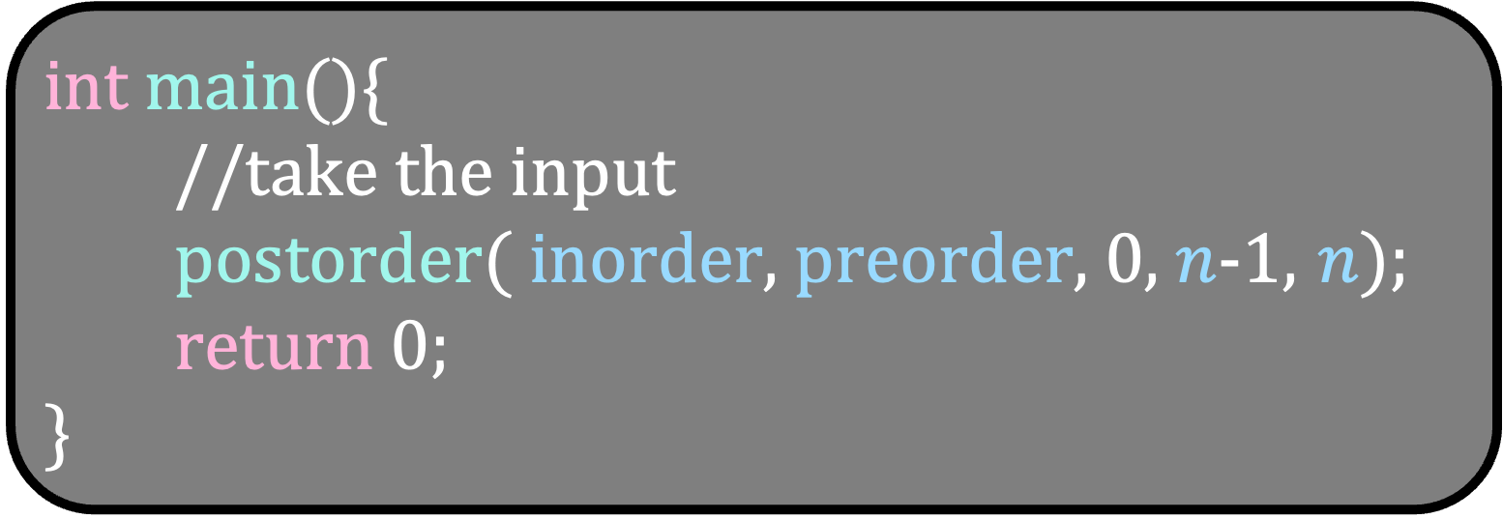
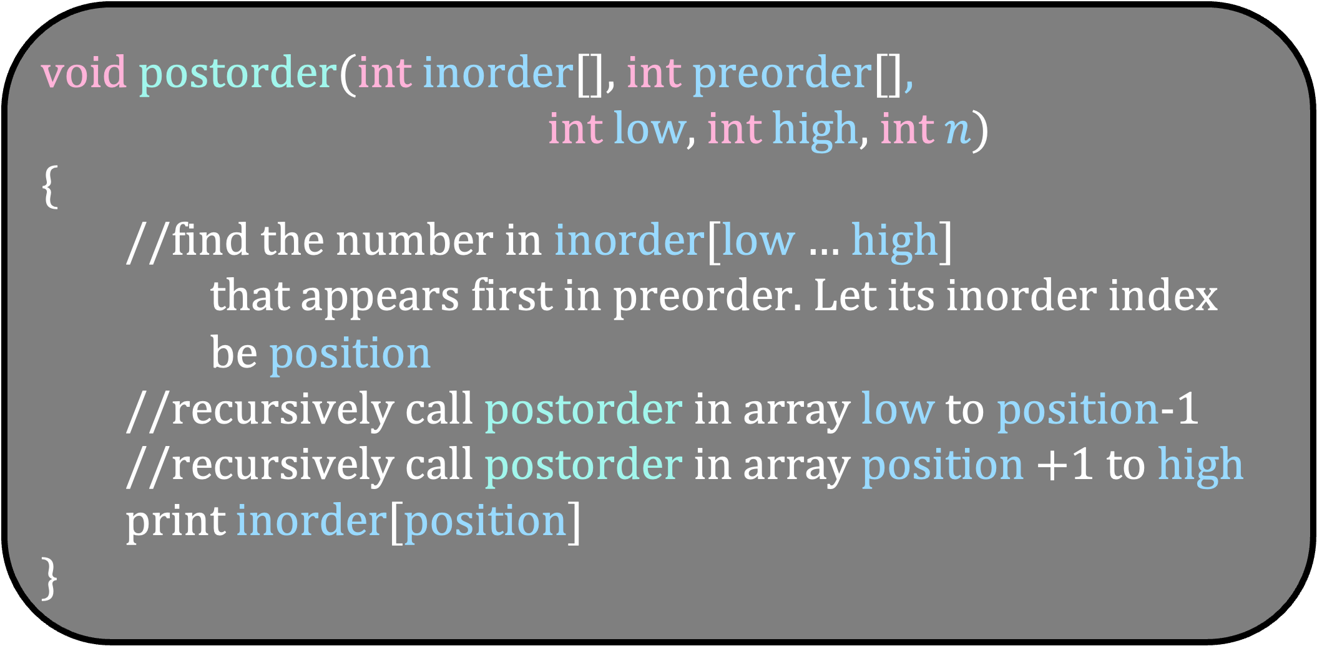
void postorder(int inorder[], int preorder[],
int low, int high, int $n$)
{
//find the number in inorder[low $…$ high]
that appears first in preorder. Let its inorder index
be position
//recursively call postorder in array low to position-1
//recursively call postorder in array position +1 to high
print inorder[position]
}
int main(){
//take the input
postorder( inorder, preorder, 0, $n$-1, $n$);
return 0;
}

Slide 42
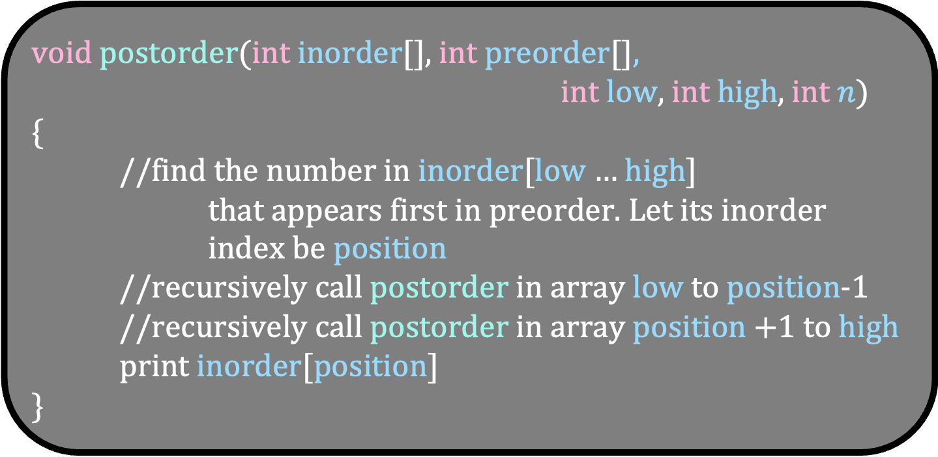
Inorder
0
2
3
4
5
6
9
low
high
4
2
0
3
9
6
5
Preorder
void postorder(int inorder[], int preorder[],
int low, int high, int $n$)
{
//find the number in inorder[low $…$ high]
that appears first in preorder. Let its inorder index be position
//recursively call postorder in array low to position-1
//recursively call postorder in array position +1 to high
print inorder[position]
}

Slide 43
Inorder
0
2
3
4
5
6
9
low
position
high
4
2
0
3
9
6
5
Preorder
void postorder(int inorder[], int preorder[],
int low, int high, int $n$)
{
//find the number in inorder[low $…$ high]
that appears first in preorder. Let its inorder index be position
//recursively call postorder in array low to position-1
//recursively call postorder in array position +1 to high
print inorder[position]
}

Slide 44
Inorder
0
2
3
4
5
6
9
low
position
high
4
2
0
3
9
6
5
Preorder
void postorder(int inorder[], int preorder[],
int low, int high, int $n$)
{
//find the number in inorder[low $…$ high]
that appears first in preorder. Let its inorder index be position
//recursively call postorder in array low to position-1
//recursively call postorder in array position +1 to high
print inorder[position]
}

Slide 45
Inorder
0
2
3
4
5
6
9
low
position
high
4
2
0
3
9
6
5
Preorder
void postorder(int inorder[], int preorder[],
int low, int high, int $n$)
{
//find the number in inorder[low $…$ high]
that appears first in preorder. Let its inorder index be position
//recursively call postorder in array low to position-1
//recursively call postorder in array position +1 to high
print inorder[position]
}

Slide 46
Inorder
0
2
3
4
5
6
9
low
position
high
4
2
0
3
9
6
5
Preorder
void postorder(int inorder[], int preorder[],
int low, int high, int $n$)
{
//find the number in inorder[low $…$ high]
that appears first in preorder. Let its inorder index be position
//recursively call postorder in array low to position-1
//recursively call postorder in array position +1 to high
print inorder[position]
}

Slide 47
Inorder
0
2
3
4
5
6
9
low
position
high
4
2
0
3
9
6
5
Preorder
void postorder(int inorder[], int preorder[],
int low, int high, int $n$)
{
//find the number in inorder[low $…$ high]
that appears first in preorder. Let its inorder index be position
//recursively call postorder in array low to position-1
//recursively call postorder in array position +1 to high
print inorder[position]
}
4

Slide 48
Inorder
0
2
3
4
5
6
9
low
position
high
4
2
0
3
9
6
5
Preorder
void postorder(int inorder[], int preorder[],
int low, int high, int $n$)
{
//find the number in inorder[low $…$ high]
that appears first in preorder. Let its inorder index be position
//recursively call postorder in array low to position-1
//recursively call postorder in array position +1 to high
print inorder[position]
}
4

Slide 49
Inorder
0
2
3
4
5
6
9
low
high
4
2
0
3
9
6
5
Preorder
void postorder(int inorder[], int preorder[],
int low, int high, int $n$)
{
//find the number in inorder[low $…$ high]
that appears first in preorder. Let its inorder index be position
//recursively call postorder in array low to position-1
//recursively call postorder in array position +1 to high
print inorder[position]
}
4

Slide 50
Inorder
0
2
3
4
5
6
9
low
position
high
4
2
0
3
9
6
5
Preorder
void postorder(int inorder[], int preorder[],
int low, int high, int $n$)
{
//find the number in inorder[low $…$ high]
that appears first in preorder. Let its inorder index be position
//recursively call postorder in array low to position-1
//recursively call postorder in array position +1 to high
print inorder[position]
}
4

Slide 51
Inorder
0
2
3
4
5
6
9
low
position
high
4
2
0
3
9
6
5
Preorder
void postorder(int inorder[], int preorder[],
int low, int high, int $n$)
{
//find the number in inorder[low $…$ high]
that appears first in preorder. Let its inorder index be position
//recursively call postorder in array low to position-1
//recursively call postorder in array position +1 to high
print inorder[position]
}
0
4

Slide 52
Inorder
0
2
3
4
5
6
9
low
position
high
4
2
0
3
9
6
5
Preorder
void postorder(int inorder[], int preorder[],
int low, int high, int $n$)
{
//find the number in inorder[low $…$ high]
that appears first in preorder. Let its inorder index be position
//recursively call postorder in array low to position-1
//recursively call postorder in array position +1 to high
print inorder[position]
}
0
3
4

Slide 53
Inorder
0
2
3
4
5
6
9
4
2
0
3
9
6
5
Preorder
void postorder(int inorder[], int preorder[],
int low, int high, int $n$)
{
//find the number in inorder[low $…$ high]
that appears first in preorder. Let its inorder index be position
//recursively call postorder in array low to position-1
//recursively call postorder in array position +1 to high
print inorder[position]
}
0
3
2
4

Slide 54
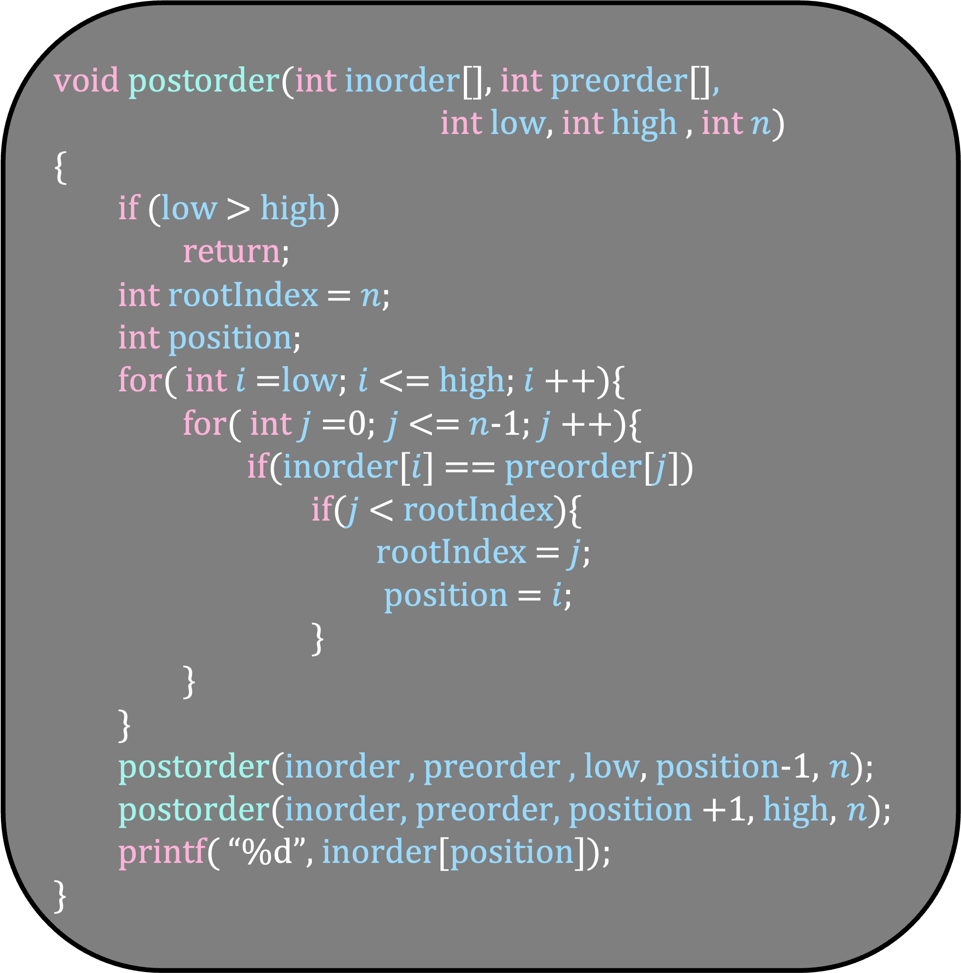
void postorder(int inorder[], int preorder[],
int low, int high , int $n$)
{
if (low > high)
return;
int rootIndex = $n$;
int position;
for( int $i$=low; $i$<= high; $i$++){
for( int $j$=0; $j$<= $n$-1; $j$++){
if(inorder[$i$] == preorder[$j$])
if($j$< rootIndex){
rootIndex = $j$;
position = $i$;
}
}
}
postorder(inorder , preorder , low, position-1, $n$);
postorder(inorder, preorder, position +1, high, $n$);
printf( “%d”, inorder[position]);
}
What is the running time of this algorithm?

Slide 55

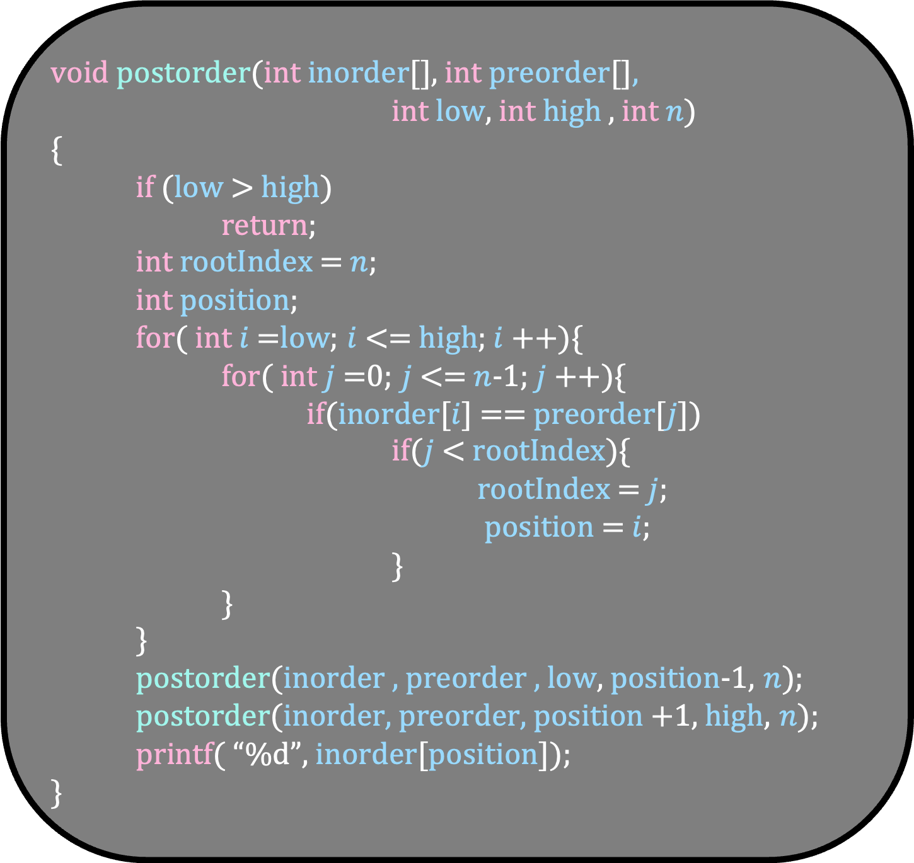
void postorder(int inorder[], int preorder[],
int low, int high , int $n$)
{
if (low > high)
return;
int rootIndex = $n$;
int position;
for( int $i$=low; $i$<= high; $i$++){
for( int $j$=0; $j$<= $n$-1; $j$++){
if(inorder[$i$] == preorder[$j$])
if($j$< rootIndex){
rootIndex = $j$;
position = $i$;
}
}
}
postorder(inorder , preorder , low, position-1, $n$);
postorder(inorder, preorder, position +1, high, $n$);
printf( “%d”, inorder[position]);
}
T(n)
This is wrong. Can you see why?
$$n^{2}$$

Slide 56

void postorder(int inorder[], int preorder[],
int low, int high , int $n$)
{
if (low > high)
return;
int rootIndex = $n$;
int position;
for( int $i$=low; $i$<= high; $i$++){
for( int $j$=0; $j$<= $n$-1; $j$++){
if(inorder[$i$] == preorder[$j$])
if($j$< rootIndex){
rootIndex = $j$;
position = $i$;
}
}
}
postorder(inorder , preorder , low, position-1, $n$);
postorder(inorder, preorder, position +1, high, $n$);
printf( “%d”, inorder[position]);
}
T(k)
$$kn$$
Unfortunately, finding the answer to this recurrence relation is not easy
T(position-low)
T(high-position)

Slide 57


0
2
3
4
5
6
9
void postorder(int inorder[], int preorder[],
int low, int high , int $n$)
{
if (low > high)
return;
int rootIndex = $n$;
int position;
for( int $i$=low; $i$<= high; $i$++){
for( int $j$=0; $j$<= $n$-1; $j$++){
if(inorder[$i$] == preorder[$j$])
if($j$< rootIndex){
rootIndex = $j$;
position = $i$;
}
}
}
postorder(inorder , preorder , low, position-1, $n$);
postorder(inorder, preorder, position +1, high, $n$);
printf( “%d”, inorder[position]);
}
low
high
Time
0,n-1
$$n^{2}$$
$$kn$$

Slide 58
0
2
3
4
5
6
9
void postorder(int inorder[], int preorder[],
int low, int high , int $n$)
{
if (low > high)
return;
int rootIndex = $n$;
int position;
for( int $i$=low; $i$<= high; $i$++){
for( int $j$=0; $j$<= $n$-1; $j$++){
if(inorder[$i$] == preorder[$j$])
if($j$< rootIndex){
rootIndex = $j$;
position = $i$;
}
}
}
postorder(inorder , preorder , low, position-1, $n$);
postorder(inorder, preorder, position +1, high, $n$);
printf( “%d”, inorder[position]);
}
low
high
Time
0,n-1
$$n^{2}$$
$$kn$$
0,p-1

Slide 59


0
2
3
4
5
6
9
void postorder(int inorder[], int preorder[],
int low, int high , int $n$)
{
if (low > high)
return;
int rootIndex = $n$;
int position;
for( int $i$=low; $i$<= high; $i$++){
for( int $j$=0; $j$<= $n$-1; $j$++){
if(inorder[$i$] == preorder[$j$])
if($j$< rootIndex){
rootIndex = $j$;
position = $i$;
}
}
}
postorder(inorder , preorder , low, position-1, $n$);
postorder(inorder, preorder, position +1, high, $n$);
printf( “%d”, inorder[position]);
}
low
high
Time
0,n-1
$$n^{2}$$
$$kn$$
0,p-1
p+1,n-1
$$pn$$
$$\left(n−p\right)n$$

Slide 60




0
2
3
4
5
6
9
void postorder(int inorder[], int preorder[],
int low, int high , int $n$)
{
if (low > high)
return;
int rootIndex = $n$;
int position;
for( int $i$=low; $i$<= high; $i$++){
for( int $j$=0; $j$<= $n$-1; $j$++){
if(inorder[$i$] == preorder[$j$])
if($j$< rootIndex){
rootIndex = $j$;
position = $i$;
}
}
}
postorder(inorder , preorder , low, position-1, $n$);
postorder(inorder, preorder, position +1, high, $n$);
printf( “%d”, inorder[position]);
}
low
high
Time
0,n-1
$$n^{2}$$
$$kn$$
0,p-1
p+1,n-1
$$n^{2}$$
$$pn$$
$$\left(n−p\right)n$$
$$n^{2}$$

Slide 61




Time
0,n-1
$$n^{2}$$
0,p-1
p+1,n-1
$$n^{2}$$
$$n^{2}$$
The time taken in each layer is O($n^{2}$)
The number of layers in the worst case

Slide 62

Time
0,n-1
$$n^{2}$$
0,p-1
p+1,n-1
$$n^{2}$$
$$n^{2}$$
The time taken in each layer is O($n^{2}$)
The number of layers in the worst case is $n$
Thus, the running time of this algorithm is O($n^{3}$)
This problem can be solved in $O(n)$ time. Do it as homework

Slide 63
We have seen three types of traversals.
Out of them, postorder is useful when the node’s result depends on the result of its children
Let us solve some problems that use postorder traversal
void postorder(struct node *v)
{
if(v != NULL)
{
postorder(v->left);
postorder(v->right);
printf( “%d”, v->num);
}
}

Slide 64
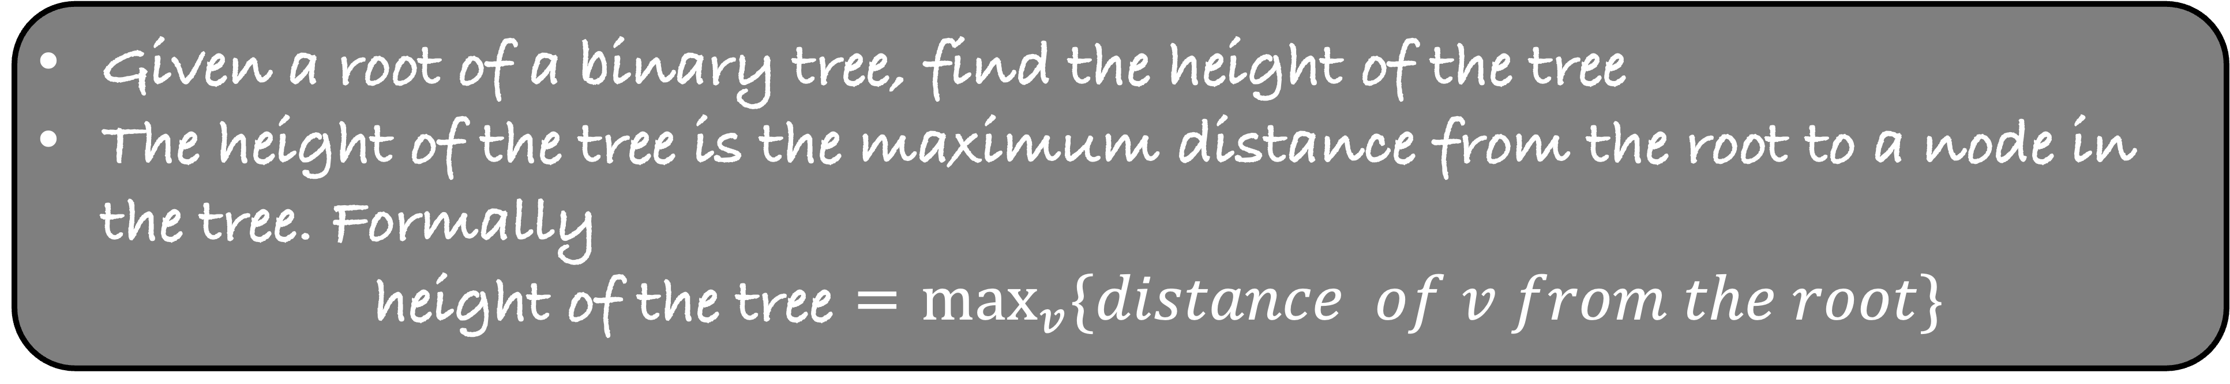
Given a root of a binary tree, find the height of the tree
The height of the tree is the maximum distance from the root to a node in the tree. Formally
  height of the tree = $\max_{v}{\{distance of v from the root}\}$

Slide 65
Height
4
4
0
2
2
9
9
1
0
3
0
3
6
6
2
5
3
5
Height of the tree is 3

Slide 66
Given a root of a binary tree, find the height of the tree
The height of the tree is the maximum distance from the root to a node in the tree. Formally
  height of the tree = $\max_{v}{\{distance of v from the root}\}$
Write a recursive function int findHeight( struct node *v) that returns the height of the subtree at v
Use postorder traversal to solve this problem

Slide 67
findHeight(v ->4)
1
2
4
4
findHeight(v ->2)
findHeight(v ->9)
2
2
9
9
0
3
0
3
6
6
5
5

Slide 68
int findHeight(struct node *v)
{
if ( v == NULL)
return -1;
int leftheight = findHeight(v->left);
int rightheight = findHeight(v->right);
int height = leftheight+1;
if( rightheight > leftheight)
height = rightheight+1;
return height;
}
Running Time
O(n)

Slide 69
The diameter of the tree is the length of the longest path in it

Slide 70
The diameter of the tree is the length of the longest path in it

Slide 71
The diameter of the tree is the length of the longest path in it

Slide 72
The diameter of the tree is the length of the longest path in it

Slide 73
The diameter of the tree is the length of the longest path in it
Given a tree, find its diameter
Write a function
int diameter( struct node *v) that finds the diameter of the tree

Slide 74
int findHeight(struct node *v)
{
if ( v == NULL)
return -1;
int leftheight = findHeight(v->left);
int rightheight = findHeight(v->right);
int height = leftheight+1;
if( rightheight > leftheight)
height = rightheight+1;
return height;
}

Slide 75
int diameter(struct node *v)
{
if ( v == NULL)
return -1;
int leftheight = diameter(v->left);
int rightheight = diameter(v->right);
int height = leftheight+1;
if( rightheight > leftheight)
height = rightheight+1;
return height;
}
The function diameter will also return the height of subtree rooted at v
But we will use this answer to find the longest path that passes through v

Slide 76
int maxdistance = 0;
int diameter(struct node *v)
{
if ( v == NULL)
return -1;
int leftheight = diameter(v->left);
int rightheight = diameter(v->right);
int longestPathThroughv = leftheight+rightheight+2;
if(longestPathThroughv > maxdistance)
maxdistance = longestPathThroughv;
int height = leftheight+1;
if( rightheight > leftheight)
height = rightheight+1;
return height;
}
The function diameter will also return the height of subtree rooted at v
But we will use this answer to find the longest path that passes through v

Slide 77
You are given a tree where each node is colored red or yellow.
Given a node in the tree, its subtree contains all the nodes in its left and right subtree plus the node itself

Slide 78
You are given a tree where each node is colored red or yellow.
Given a node in the tree, its subtree contains all the nodes in its left and right subtree plus the node itself
A node is called yellow-heavy if its subtree contains more yellow nodes than red nodes
Else the node is called red heavy
red-heavy
red-heavy
yellow-heavy
red-heavy
red-heavy
red-heavy
yellow-heavy

Slide 79
Write a recursive function int findHeavy( struct node *v) that does the post-order traversal of the tree and prints if the node is yellow-heavy or red-heavy
Each node v contains a variable color
If the node is yellow, v->color = 1, else v->color = 0
In the post-order traversal of the tree, for each yellow-heavy node print 1, else print 0. All the numbers must be printed on a new line

Slide 80
red-heavy
red-heavy
yellow-heavy
red-heavy
red-heavy
red-heavy
yellow-heavy

Slide 81
0
0
1
0
0
0
1

Slide 82
0
0
1
0
0
1
0

Slide 83
0
0
1
0
1
0
0

Slide 84
0
1
0
1
0
0
0

Slide 85
0
0
0
0
1
0
1

Slide 86
0
0
0
1
0
1
0

Slide 87
Write a recursive function int findHeavy( struct node *v) that does the post-order traversal of the tree and prints if the node is yellow-heavy or red-heavy
Each node v contains a variable color
If the node is yellow, v->color = 1, else v->color = 0
In the post-order traversal of the tree, for each yellow-heavy node print 1, else print 0. All the numbers must be printed on a new line

Slide 88
int findHeavy(struct node *v)
{
}
Return the difference between the yellow and red nodes in the subtree under v
At v, if
Yellow nodes in the subtree of v – red nodes in the subtree of v > 0, then
-1
-1

Slide 89
int findHeavy(struct node *v)
{
}
Return the difference between the yellow and red nodes in the subtree under v
At v, if
Yellow nodes in the subtree of v – red nodes in the subtree of v > 0, then
V is yellow-heavy, else v is red-heavy
-1
-1

Slide 90
int findHeavy(struct node *v)
{
}
Return the difference between the yellow and red nodes in the subtree under v
-1
-1

Slide 91
int findHeavy(struct node *v)
{
}
Return the difference between the yellow and red nodes in the subtree under v
1+-1+(-1)=-1
-1
-1

Slide 92
int findHeavy(struct node *v)
{
}
Return the difference between the yellow and red nodes in the subtree under v
-1
-1
-1
1

Slide 93
int findHeavy(struct node *v)
{
}
Return the difference between the yellow and red nodes in the subtree under v
-1
-1
-1
1+(-1)=0
1

Slide 94
int findHeavy(struct node *v)
{
}
Return the difference between the yellow and red nodes in the subtree under v
-1
-1
-1
0
1

Slide 95
int findHeavy(struct node *v)
{
}
Return the difference between the yellow and red nodes in the subtree under v
-1
1+0=1
-1
-1
0
1

Slide 96
int findHeavy(struct node *v)
{
}
Return the difference between the yellow and red nodes in the subtree under v
-1
1
-1
-1
0
1

Slide 97
int findHeavy(struct node *v)
{
}
Return the difference between the yellow and red nodes in the subtree under v
1+(-1)-1=-1
-1
1
-1
-1
0
1

Slide 98
int findHeavy(struct node *v)
{
}
Return the difference between the yellow and red nodes in the subtree under v
-1
-1
1
-1
-1
0
1

Slide 99
int findHeavy(struct node *v)
{
if( v == NULL)
return 0;
int leftans, rightans, ans;
leftans = findHeavy( v->left);
rightans = findHeavy( v->right);
if( v->color == 1)
ans = 1+leftans+rightans;
else
ans = leftans+rightans -1;
if( ans >= 1)
printf(“1\n”);
else
printf(“0\n”);
return ans;
}

Slide 100
You are given a tree where each node is colored red or yellow.
Find the minimal subtree that connects all the yellow nodes

Slide 101
You are given a tree where each node is colored red or yellow.
Find the minimal subtree that connects all the yellow nodes

Slide 102
You are given a tree where each node is colored red or yellow.
Find the minimal subtree that connects all the yellow nodes

Slide 103
You are given a tree where each node is colored red or yellow.
Find the minimal subtree that connects all the yellow nodes
Write a function int minimal(struct node* v) that finds the number of nodes in the minimal subtree

Slide 104
int findHeavy(struct node *v)
{
if( v == NULL)
return 0;
int leftans, rightans, ans;
leftans = findHeavy( v->left);
rightans = findHeavy( v->right);
if( v->color == 1)
ans = 1+leftans+rightans;
else
ans = leftans+rightans -1;
if( ans >= 1)
printf(“1\n”);
else
printf(“0\n”);
return ans;
}

Slide 105
int maxAns = 0;
int minimal(struct node *v)
{
if( v == NULL)
return 0;
int leftans, rightans, ans;
leftans = minimal( v->left);
rightans = minimal( v->right);
return ans;
}
If the subtree of v contains yellow nodes,
return the number of nodes in the smallest connected subtree containing v and all those yellow nodes
Else
return 0

Slide 106
int maxAns = 0;
int minimal(struct node *v)
{
if( v == NULL)
return 0;
int leftans, rightans, ans;
leftans = minimal( v->left);
rightans = minimal( v->right);
if( leftans + rightans > 0){
ans = leftans+rightans+1;
if( ans == leftans+1 || ans == rightans+1)
{
if(v->color == 1)
if( ans > maxAns)
maxAns = ans;
}
else{
if( ans > maxAns)
maxAns = ans;
}
}
else{
if ( v->color == 1)
ans = 1;
else
ans = 0;
if ( ans > maxAns)
maxAns = ans;
}
return ans;
}
If the subtree of v contains yellow nodes,
return the number of nodes in the smallest connected subtree containing v and all those yellow nodes
Else
return 0

Slide 107
Case 1: Exactly one subtree contains yellow nodes

Slide 108
int maxAns = 0;
int minimal(struct node *v)
{
if( v == NULL)
return 0;
int leftans, rightans, ans;
leftans = minimal( v->left);
rightans = minimal( v->right);
if( leftans + rightans > 0){
ans = leftans+rightans+1;
if( ans == leftans+1 || ans == rightans+1)
{
if(v->color == 1)
if( ans > maxAns)
maxAns = ans;
}
else{
if( ans > maxAns)
maxAns = ans;
}
}
else{
if ( v->color == 1)
ans = 1;
else
ans = 0;
if ( ans > maxAns)
maxAns = ans;
}
return ans;
}
v

Slide 109
int maxAns = 0;
int minimal(struct node *v)
{
if( v == NULL)
return 0;
int leftans, rightans, ans;
leftans = minimal( v->left);
rightans = minimal( v->right);
if( leftans + rightans > 0){
ans = leftans+rightans+1;
if( ans == leftans+1 || ans == rightans+1)
{
if(v->color == 1)
if( ans > maxAns)
maxAns = ans;
}
else{
if( ans > maxAns)
maxAns = ans;
}
}
else{
if ( v->color == 1)
ans = 1;
else
ans = 0;
if ( ans > maxAns)
maxAns = ans;
}
return ans;
}
v
3
maxAns = 3

Slide 110
int maxAns = 0;
int minimal(struct node *v)
{
if( v == NULL)
return 0;
int leftans, rightans, ans;
leftans = minimal( v->left);
rightans = minimal( v->right);
if( leftans + rightans > 0){
ans = leftans+rightans+1;
if( ans == leftans+1 || ans == rightans+1)
{
if(v->color == 1)
if( ans > maxAns)
maxAns = ans;
}
else{
if( ans > maxAns)
maxAns = ans;
}
}
else{
if ( v->color == 1)
ans = 1;
else
ans = 0;
if ( ans > maxAns)
maxAns = ans;
}
return ans;
}
v
3
0
maxAns = 3

Slide 111
int maxAns = 0;
int minimal(struct node *v)
{
if( v == NULL)
return 0;
int leftans, rightans, ans;
leftans = minimal( v->left);
rightans = minimal( v->right);
if( leftans + rightans > 0){
ans = leftans+rightans+1;
if( ans == leftans+1 || ans == rightans+1)
{
if(v->color == 1)
if( ans > maxAns)
maxAns = ans;
}
else{
if( ans > maxAns)
maxAns = ans;
}
}
else{
if ( v->color == 1)
ans = 1;
else
ans = 0;
if ( ans > maxAns)
maxAns = ans;
}
return ans;
}
v
3
0
maxAns = 3

Slide 112
int maxAns = 0;
int minimal(struct node *v)
{
if( v == NULL)
return 0;
int leftans, rightans, ans;
leftans = minimal( v->left);
rightans = minimal( v->right);
if( leftans + rightans > 0){
ans = leftans+rightans+1;
if( ans == leftans+1 || ans == rightans+1)
{
if(v->color == 1)
if( ans > maxAns)
maxAns = ans;
}
else{
if( ans > maxAns)
maxAns = ans;
}
}
else{
if ( v->color == 1)
ans = 1;
else
ans = 0;
if ( ans > maxAns)
maxAns = ans;
}
return ans;
}
4
v
3
0
maxAns = 3

Slide 113
int maxAns = 0;
int minimal(struct node *v)
{
if( v == NULL)
return 0;
int leftans, rightans, ans;
leftans = minimal( v->left);
rightans = minimal( v->right);
if( leftans + rightans > 0){
ans = leftans+rightans+1;
if( ans == leftans+1 || ans == rightans+1)
{
if(v->color == 1)
if( ans > maxAns)
maxAns = ans;
}
else{
if( ans > maxAns)
maxAns = ans;
}
}
else{
if ( v->color == 1)
ans = 1;
else
ans = 0;
if ( ans > maxAns)
maxAns = ans;
}
return ans;
}
4
v
3
0
maxAns = 3

Slide 114
int maxAns = 0;
int minimal(struct node *v)
{
if( v == NULL)
return 0;
int leftans, rightans, ans;
leftans = minimal( v->left);
rightans = minimal( v->right);
if( leftans + rightans > 0){
ans = leftans+rightans+1;
if( ans == leftans+1 || ans == rightans+1)
{
if(v->color == 1)
if( ans > maxAns)
maxAns = ans;
}
else{
if( ans > maxAns)
maxAns = ans;
}
}
else{
if ( v->color == 1)
ans = 1;
else
ans = 0;
if ( ans > maxAns)
maxAns = ans;
}
return ans;
}
4
v
3
0
maxAns = 3

Slide 115
int maxAns = 0;
int minimal(struct node *v)
{
if( v == NULL)
return 0;
int leftans, rightans, ans;
leftans = minimal( v->left);
rightans = minimal( v->right);
if( leftans + rightans > 0){
ans = leftans+rightans+1;
if( ans == leftans+1 || ans == rightans+1)
{
if(v->color == 1)
if( ans > maxAns)
maxAns = ans;
}
else{
if( ans > maxAns)
maxAns = ans;
}
}
else{
if ( v->color == 1)
ans = 1;
else
ans = 0;
if ( ans > maxAns)
maxAns = ans;
}
return ans;
}
4
v
3
0
maxAns = 3

Slide 116
int maxAns = 0;
int minimal(struct node *v)
{
if( v == NULL)
return 0;
int leftans, rightans, ans;
leftans = minimal( v->left);
rightans = minimal( v->right);
if( leftans + rightans > 0){
ans = leftans+rightans+1;
if( ans == leftans+1 || ans == rightans+1)
{
if(v->color == 1)
if( ans > maxAns)
maxAns = ans;
}
else{
if( ans > maxAns)
maxAns = ans;
}
}
else{
if ( v->color == 1)
ans = 1;
else
ans = 0;
if ( ans > maxAns)
maxAns = ans;
}
return ans;
}
4
v
3
0
maxAns = 4

Slide 117
Case 2: Both subtrees contain yellow nodes

Slide 118
int maxAns = 0;
int minimal(struct node *v)
{
if( v == NULL)
return 0;
int leftans, rightans, ans;
leftans = minimal( v->left);
rightans = minimal( v->right);
if( leftans + rightans > 0){
ans = leftans+rightans+1;
if( ans == leftans+1 || ans == rightans+1)
{
if(v->color == 1)
if( ans > maxAns)
maxAns = ans;
}
else{
if( ans > maxAns)
maxAns = ans;
}
}
else{
if ( v->color == 1)
ans = 1;
else
ans = 0;
if ( ans > maxAns)
maxAns = ans;
}
return ans;
}
v
3
2
maxAns = 3

Slide 119
int maxAns = 0;
int minimal(struct node *v)
{
if( v == NULL)
return 0;
int leftans, rightans, ans;
leftans = minimal( v->left);
rightans = minimal( v->right);
if( leftans + rightans > 0){
ans = leftans+rightans+1;
if( ans == leftans+1 || ans == rightans+1)
{
if(v->color == 1)
if( ans > maxAns)
maxAns = ans;
}
else{
if( ans > maxAns)
maxAns = ans;
}
}
else{
if ( v->color == 1)
ans = 1;
else
ans = 0;
if ( ans > maxAns)
maxAns = ans;
}
return ans;
}
6
v
3
2
maxAns = 3

Slide 120
int maxAns = 0;
int minimal(struct node *v)
{
if( v == NULL)
return 0;
int leftans, rightans, ans;
leftans = minimal( v->left);
rightans = minimal( v->right);
if( leftans + rightans > 0){
ans = leftans+rightans+1;
if( ans == leftans+1 || ans == rightans+1)
{
if(v->color == 1)
if( ans > maxAns)
maxAns = ans;
}
else{
if( ans > maxAns)
maxAns = ans;
}
}
else{
if ( v->color == 1)
ans = 1;
else
ans = 0;
if ( ans > maxAns)
maxAns = ans;
}
return ans;
}
6
v
3
2
maxAns = 3

Slide 121
int maxAns = 0;
int minimal(struct node *v)
{
if( v == NULL)
return 0;
int leftans, rightans, ans;
leftans = minimal( v->left);
rightans = minimal( v->right);
if( leftans + rightans > 0){
ans = leftans+rightans+1;
if( ans == leftans+1 || ans == rightans+1)
{
if(v->color == 1)
if( ans > maxAns)
maxAns = ans;
}
else{
if( ans > maxAns)
maxAns = ans;
}
}
else{
if ( v->color == 1)
ans = 1;
else
ans = 0;
if ( ans > maxAns)
maxAns = ans;
}
return ans;
}
6
v
3
2
maxAns = 6

Slide 122
Case 2: Neither subtree contains yellow nodes

Slide 123
int maxAns = 0;
int minimal(struct node *v)
{
if( v == NULL)
return 0;
int leftans, rightans, ans;
leftans = minimal( v->left);
rightans = minimal( v->right);
if( leftans + rightans > 0){
ans = leftans+rightans+1;
if( ans == leftans+1 || ans == rightans+1)
{
if(v->color == 1)
if( ans > maxAns)
maxAns = ans;
}
else{
if( ans > maxAns)
maxAns = ans;
}
}
else{
if ( v->color == 1)
ans = 1;
else
ans = 0;
if ( ans > maxAns)
maxAns = ans;
}
return ans;
}
v
0
0
maxAns = 0

Slide 124
int maxAns = 0;
int minimal(struct node *v)
{
if( v == NULL)
return 0;
int leftans, rightans, ans;
leftans = minimal( v->left);
rightans = minimal( v->right);
if( leftans + rightans > 0){
ans = leftans+rightans+1;
if( ans == leftans+1 || ans == rightans+1)
{
if(v->color == 1)
if( ans > maxAns)
maxAns = ans;
}
else{
if( ans > maxAns)
maxAns = ans;
}
}
else{
if ( v->color == 1)
ans = 1;
else
ans = 0;
if ( ans > maxAns)
maxAns = ans;
}
return ans;
}
v
0
0
maxAns = 0

Slide 125
int maxAns = 0;
int minimal(struct node *v)
{
if( v == NULL)
return 0;
int leftans, rightans, ans;
leftans = minimal( v->left);
rightans = minimal( v->right);
if( leftans + rightans > 0){
ans = leftans+rightans+1;
if( ans == leftans+1 || ans == rightans+1)
{
if(v->color == 1)
if( ans > maxAns)
maxAns = ans;
}
else{
if( ans > maxAns)
maxAns = ans;
}
}
else{
if ( v->color == 1)
ans = 1;
else
ans = 0;
if ( ans > maxAns)
maxAns = ans;
}
return ans;
}
0
v
0
0
maxAns = 0

