Slide 1
Merge

Slide 2

Write a function that takes three arrays A, B and C as input. It computes A+B and the output is returned in C.
#include <stdio.h> void add(int A[], int B[], int C[], int $n$)
{
int $i$;
for($i$=0 ; $i$< $n$; $i$++)
{
C[$i$] = A[$i$] + B[$i$];
}
} int main() {
int $n$ = 4;
int A[] = {1,2,3,4};
int B[] = {9,8,7,6};
int C[$n$];
add(A, B, C , $n$ ); return 0; }
There is no need to specify the number of elements in the array if you are initializing it on a single line
The function read A and B and writes in C

Slide 3



Write a function merge that takes two sorted arrays A and B, and an output array C. The function should merge the elements of A and B into C so that C is also sorted in non-decreasing order.
7
9
15
25
2
7
9
15
25
A
2
$$i$$
3
3
4
4
8
B
1
8
1
$$j$$
C
$$k$$

Slide 4
Write a function merge that takes two sorted arrays A and B, and an output array C. The function should merge the elements of A and B into C so that C is also sorted in non-decreasing order.
7
9
15
25
2
7
9
15
25
A
2
$$i$$
3
3
4
4
8
B
1
8
$$j$$
C
1
$$k$$

Slide 5


Write a function merge that takes two sorted arrays A and B, and an output array C. The function should merge the elements of A and B into C so that C is also sorted in non-decreasing order.
7
9
15
25
2
7
9
15
25
A
2
$$i$$
3
3
4
4
8
B
1
8
$$j$$
C
1
$$k$$

Slide 6
Write a function merge that takes two sorted arrays A and B, and an output array C. The function should merge the elements of A and B into C so that C is also sorted in non-decreasing order.
7
9
15
25
A
2
7
9
15
25
$$i$$
3
3
4
4
8
B
1
8
$$j$$
C
1
2
$$k$$

Slide 7


Write a function merge that takes two sorted arrays A and B, and an output array C. The function should merge the elements of A and B into C so that C is also sorted in non-decreasing order.
7
9
15
25
A
2
7
9
15
25
$$i$$
3
3
4
4
8
B
1
8
$$j$$
C
1
2
$$k$$

Slide 8
Write a function merge that takes two sorted arrays A and B, and an output array C. The function should merge the elements of A and B into C so that C is also sorted in non-decreasing order.
7
9
15
25
A
2
7
9
15
25
$$i$$
3
4
4
8
B
1
8
$$j$$
C
1
2
3
$$k$$

Slide 9

Write a function merge that takes two sorted arrays A and B, and an output array C. The function should merge the elements of A and B into C so that C is also sorted in non-decreasing order.
7
9
15
25
A
2
7
9
15
25
$$i$$
3
4
4
8
B
1
8
$$j$$
C
1
2
3
$$k$$

Slide 10
Write a function merge that takes two sorted arrays A and B, and an output array C. The function should merge the elements of A and B into C so that C is also sorted in non-decreasing order.
7
9
15
25
A
2
7
9
15
25
$$i$$
3
4
8
B
1
8
$$j$$
C
1
2
3
4
$$k$$

Slide 11


Write a function merge that takes two sorted arrays A and B, and an output array C. The function should merge the elements of A and B into C so that C is also sorted in non-decreasing order.
7
9
15
25
A
2
7
9
15
25
$$i$$
3
4
8
B
1
8
$$j$$
C
1
2
3
4
$$k$$

Slide 12
Write a function merge that takes two sorted arrays A and B, and an output array C. The function should merge the elements of A and B into C so that C is also sorted in non-decreasing order.
7
9
15
25
A
2
9
15
25
$$i$$
3
4
8
B
1
8
$$j$$
C
1
2
3
4
7
$$k$$

Slide 13


Write a function merge that takes two sorted arrays A and B, and an output array C. The function should merge the elements of A and B into C so that C is also sorted in non-decreasing order.
7
9
15
25
A
2
9
15
25
$$i$$
3
4
8
B
1
8
$$j$$
C
1
2
3
4
7
$$k$$

Slide 14
Write a function merge that takes two sorted arrays A and B, and an output array C. The function should merge the elements of A and B into C so that C is also sorted in non-decreasing order.
7
9
15
25
A
2
9
15
25
$$i$$
B
1
3
4
8
$$j$$
C
1
2
3
4
7
8
$$k$$

Slide 15

Write a function merge that takes two sorted arrays A and B, and an output array C. The function should merge the elements of A and B into C so that C is also sorted in non-decreasing order.
7
9
15
25
A
2
9
15
25
$$i$$
But array B is finished
What to do now?
Blindly copy all the elements of array A
B
1
3
4
8
$$j$$
C
1
2
3
4
7
8
$$k$$

Slide 16


Write a function merge that takes two sorted arrays A and B, and an output array C. The function should merge the elements of A and B into C so that C is also sorted in non-decreasing order.
7
9
15
25
A
2
15
25
$$i$$
But array B is finished
What to do now?
Blindly copy all the elements of array A
B
1
3
4
8
$$j$$
C
1
2
3
4
7
8
9
$$k$$

Slide 17

Write a function merge that takes two sorted arrays A and B, and an output array C. The function should merge the elements of A and B into C so that C is also sorted in non-decreasing order.
7
9
15
25
A
2
25
$$i$$
But array B is finished
What to do now?
Blindly copy all the elements of array A
B
1
3
4
8
$$j$$
C
1
2
3
4
7
8
9
15
$$k$$

Slide 18

Write a function merge that takes two sorted arrays A and B, and an output array C. The function should merge the elements of A and B into C so that C is also sorted in non-decreasing order.
A
2
7
9
15
25
$$i$$
But array B is finished
What to do now?
Blindly copy all the elements of array A
B
1
3
4
8
$$j$$
C
1
2
3
4
7
8
9
15
25
$$k$$

Slide 19
Write a function merge that takes two sorted arrays A and B, and an output array C. The function should merge the elements of A and B into C so that C is also sorted in non-decreasing order.
Implement the function merge( int A[], int B[], int C[], int $n_{1}$, int $n_{2}$)

Slide 20
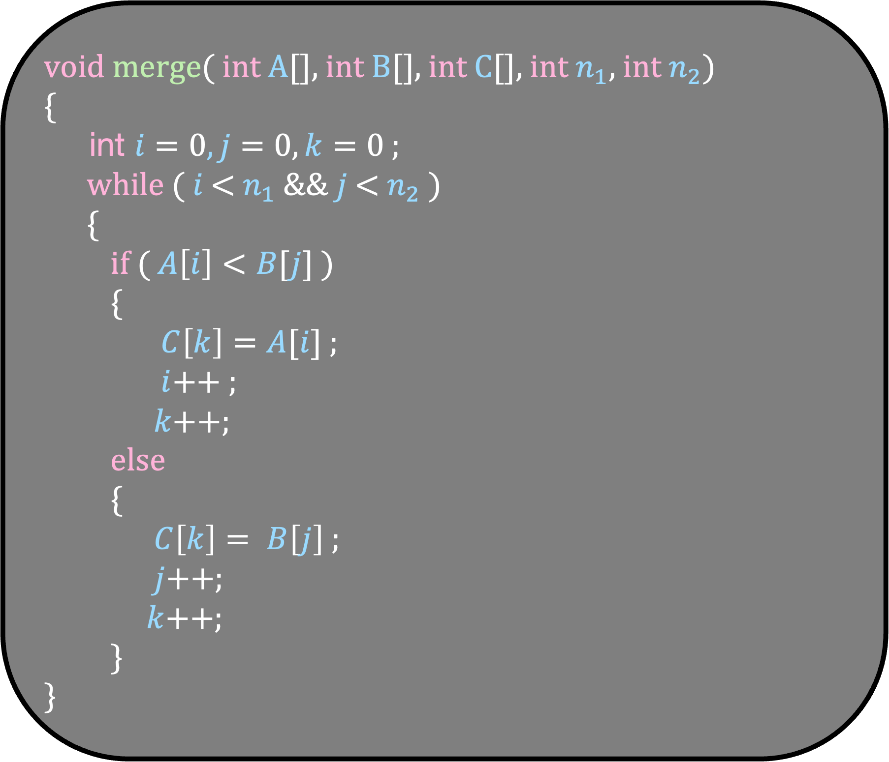
void merge( int A[], int B[], int C[], int $n_{1}$, int $n_{2}$)
{
int $i=0,j=0,k=0$ ;
while ( $i$ < $n_{1}$ && $j$ < $n_{2}$ )
{
if ( $A\left[i\right]<B[j]$ )
{
$C\left[k\right]=A[i]$ ;
$i$++ ;
$k$++;
else
{
$C\left[k\right]= B\left[j\right]$ ;
$j$++;
$k$++;
}
}

Slide 21
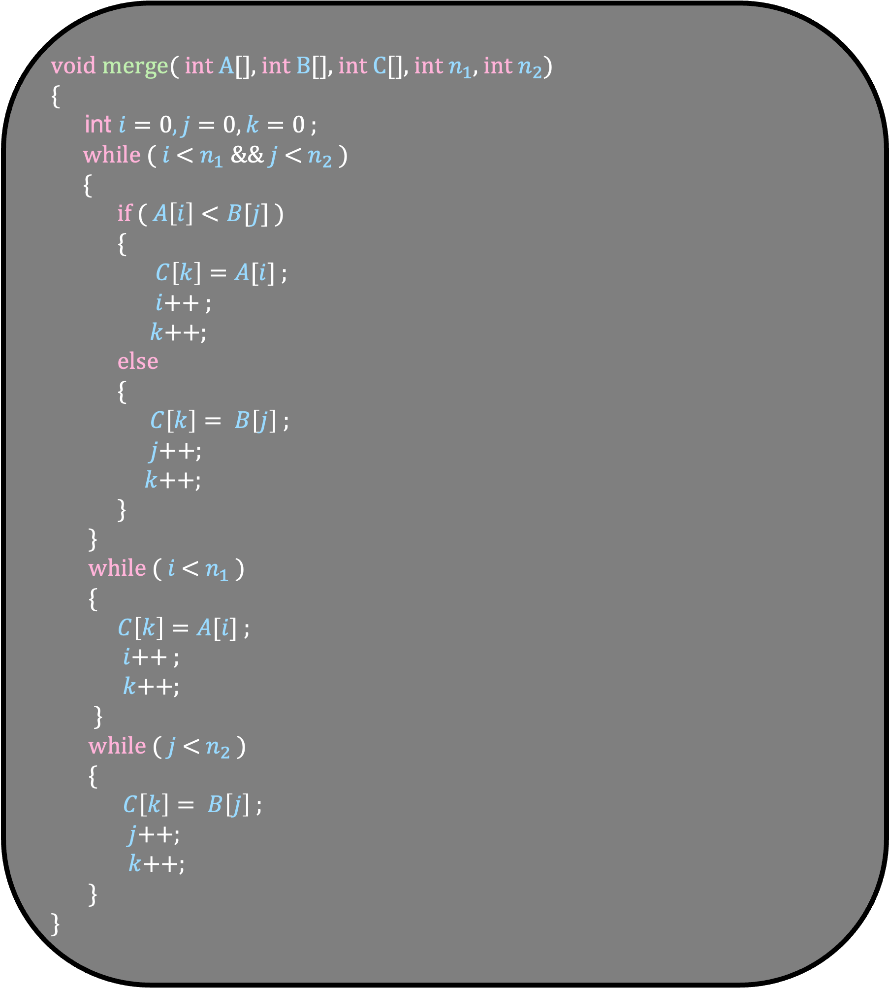
void merge( int A[], int B[], int C[], int $n_{1}$, int $n_{2}$)
{
int $i=0,j=0,k=0$ ;
while ( $i$ < $n_{1}$ && $j$ < $n_{2}$ )
{
if ( $A\left[i\right]<B[j]$ )
{
$C\left[k\right]=A[i]$ ;
$i$++ ;
$k$++;
else
{
$C\left[k\right]= B\left[j\right]$ ;
$j$++;
$k$++;
}
}
while ( $i$ < $n_{1}$ )
{
$C\left[k\right]=A[i]$ ;
$i$++ ;
$k$++;
}
while ( $j$ < $n_{2}$ )
{
$C\left[k\right]= B\left[j\right]$ ;
$j$++;
$k$++;
}
}

Slide 22

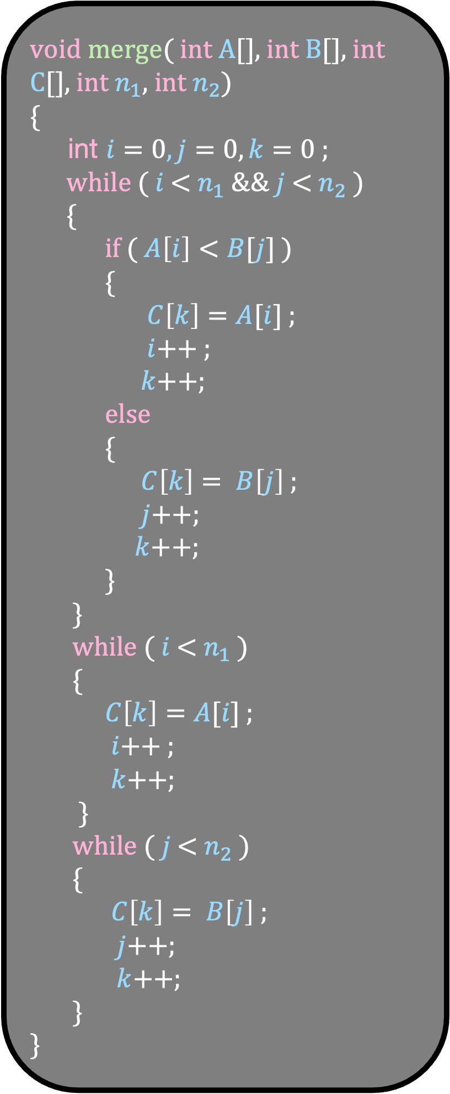

void merge( int A[], int B[], int C[], int $n_{1}$, int $n_{2}$)
{
int $i=0,j=0,k=0$ ;
while ( $i$ < $n_{1}$ && $j$ < $n_{2}$ )
{
if ( $A\left[i\right]<B[j]$ )
{
$C\left[k\right]=A[i]$ ;
$i$++ ;
$k$++;
else
{
$C\left[k\right]= B\left[j\right]$ ;
$j$++;
$k$++;
}
}
while ( $i$ < $n_{1}$ )
{
$C\left[k\right]=A[i]$ ;
$i$++ ;
$k$++;
}
while ( $j$ < $n_{2}$ )
{
$C\left[k\right]= B\left[j\right]$ ;
$j$++;
$k$++;
}
}
7
9
15
25
2
7
9
15
25
A
2
$$i$$
3
3
4
4
8
B
1
8
1
$$j$$
C
$$k$$

Slide 23
void merge( int A[], int B[], int C[], int $n_{1}$, int $n_{2}$)
{
int $i=0,j=0,k=0$ ;
while ( $i$ < $n_{1}$ && $j$ < $n_{2}$ )
{
if ( $A\left[i\right]<B[j]$ )
{
$C\left[k\right]=A[i]$ ;
$i$++ ;
$k$++;
else
{
$C\left[k\right]= B\left[j\right]$ ;
$j$++;
$k$++;
}
}
while ( $i$ < $n_{1}$ )
{
$C\left[k\right]=A[i]$ ;
$i$++ ;
$k$++;
}
while ( $j$ < $n_{2}$ )
{
$C\left[k\right]= B\left[j\right]$ ;
$j$++;
$k$++;
}
}
7
9
15
25
2
7
9
15
25
A
2
$$i$$
3
3
4
4
8
B
1
8
1
$$j$$
C
$$k$$

Slide 24
void merge( int A[], int B[], int C[], int $n_{1}$, int $n_{2}$)
{
int $i=0,j=0,k=0$ ;
while ( $i$ < $n_{1}$ && $j$ < $n_{2}$ )
{
if ( $A\left[i\right]<B[j]$ )
{
$C\left[k\right]=A[i]$ ;
$i$++ ;
$k$++;
else
{
$C\left[k\right]= B\left[j\right]$ ;
$j$++;
$k$++;
}
}
while ( $i$ < $n_{1}$ )
{
$C\left[k\right]=A[i]$ ;
$i$++ ;
$k$++;
}
while ( $j$ < $n_{2}$ )
{
$C\left[k\right]= B\left[j\right]$ ;
$j$++;
$k$++;
}
}
7
9
15
25
2
7
9
15
25
A
2
$$i$$
3
3
4
4
8
B
1
8
1
$$j$$
C
$$k$$

Slide 25
void merge( int A[], int B[], int C[], int $n_{1}$, int $n_{2}$)
{
int $i=0,j=0,k=0$ ;
while ( $i$ < $n_{1}$ && $j$ < $n_{2}$ )
{
if ( $A\left[i\right]<B[j]$ )
{
$C\left[k\right]=A[i]$ ;
$i$++ ;
$k$++;
else
{
$C\left[k\right]= B\left[j\right]$ ;
$j$++;
$k$++;
}
}
while ( $i$ < $n_{1}$ )
{
$C\left[k\right]=A[i]$ ;
$i$++ ;
$k$++;
}
while ( $j$ < $n_{2}$ )
{
$C\left[k\right]= B\left[j\right]$ ;
$j$++;
$k$++;
}
}
7
9
15
25
2
7
9
15
25
A
2
$$i$$
3
3
4
4
8
B
1
8
$$j$$
C
1
$$k$$

Slide 26
void merge( int A[], int B[], int C[], int $n_{1}$, int $n_{2}$)
{
int $i=0,j=0,k=0$ ;
while ( $i$ < $n_{1}$ && $j$ < $n_{2}$ )
{
if ( $A\left[i\right]<B[j]$ )
{
$C\left[k\right]=A[i]$ ;
$i$++ ;
$k$++;
else
{
$C\left[k\right]= B\left[j\right]$ ;
$j$++;
$k$++;
}
}
while ( $i$ < $n_{1}$ )
{
$C\left[k\right]=A[i]$ ;
$i$++ ;
$k$++;
}
while ( $j$ < $n_{2}$ )
{
$C\left[k\right]= B\left[j\right]$ ;
$j$++;
$k$++;
}
}
7
9
15
25
2
7
9
15
25
A
2
$$i$$
3
3
4
4
8
B
1
8
$$j$$
C
1
$$k$$

Slide 27

void merge( int A[], int B[], int C[], int $n_{1}$, int $n_{2}$)
{
int $i=0,j=0,k=0$ ;
while ( $i$ < $n_{1}$ && $j$ < $n_{2}$ )
{
if ( $A\left[i\right]<B[j]$ )
{
$C\left[k\right]=A[i]$ ;
$i$++ ;
$k$++;
else
{
$C\left[k\right]= B\left[j\right]$ ;
$j$++;
$k$++;
}
}
while ( $i$ < $n_{1}$ )
{
$C\left[k\right]=A[i]$ ;
$i$++ ;
$k$++;
}
while ( $j$ < $n_{2}$ )
{
$C\left[k\right]= B\left[j\right]$ ;
$j$++;
$k$++;
}
}
7
9
15
25
2
7
9
15
25
A
2
$$i$$
3
3
4
4
8
B
1
8
$$j$$
C
1
$$k$$

Slide 28
void merge( int A[], int B[], int C[], int $n_{1}$, int $n_{2}$)
{
int $i=0,j=0,k=0$ ;
while ( $i$ < $n_{1}$ && $j$ < $n_{2}$ )
{
if ( $A\left[i\right]<B[j]$ )
{
$C\left[k\right]=A[i]$ ;
$i$++ ;
$k$++;
else
{
$C\left[k\right]= B\left[j\right]$ ;
$j$++;
$k$++;
}
}
while ( $i$ < $n_{1}$ )
{
$C\left[k\right]=A[i]$ ;
$i$++ ;
$k$++;
}
while ( $j$ < $n_{2}$ )
{
$C\left[k\right]= B\left[j\right]$ ;
$j$++;
$k$++;
}
}
7
9
15
25
2
7
9
15
25
A
2
$$i$$
3
3
4
4
8
B
1
8
$$j$$
C
1
$$k$$

Slide 29
void merge( int A[], int B[], int C[], int $n_{1}$, int $n_{2}$)
{
int $i=0,j=0,k=0$ ;
while ( $i$ < $n_{1}$ && $j$ < $n_{2}$ )
{
if ( $A\left[i\right]<B[j]$ )
{
$C\left[k\right]=A[i]$ ;
$i$++ ;
$k$++;
else
{
$C\left[k\right]= B\left[j\right]$ ;
$j$++;
$k$++;
}
}
while ( $i$ < $n_{1}$ )
{
$C\left[k\right]=A[i]$ ;
$i$++ ;
$k$++;
}
while ( $j$ < $n_{2}$ )
{
$C\left[k\right]= B\left[j\right]$ ;
$j$++;
$k$++;
}
}
7
9
15
25
2
7
9
15
25
A
2
$$i$$
3
3
4
4
8
B
1
8
$$j$$
C
1
$$k$$

Slide 30
void merge( int A[], int B[], int C[], int $n_{1}$, int $n_{2}$)
{
int $i=0,j=0,k=0$ ;
while ( $i$ < $n_{1}$ && $j$ < $n_{2}$ )
{
if ( $A\left[i\right]<B[j]$ )
{
$C\left[k\right]=A[i]$ ;
$i$++ ;
$k$++;
else
{
$C\left[k\right]= B\left[j\right]$ ;
$j$++;
$k$++;
}
}
while ( $i$ < $n_{1}$ )
{
$C\left[k\right]=A[i]$ ;
$i$++ ;
$k$++;
}
while ( $j$ < $n_{2}$ )
{
$C\left[k\right]= B\left[j\right]$ ;
$j$++;
$k$++;
}
}
7
9
15
25
A
2
7
9
15
25
$$i$$
3
3
4
4
8
B
1
8
$$j$$
C
1
2
$$k$$

Slide 31

void merge( int A[], int B[], int C[], int $n_{1}$, int $n_{2}$)
{
int $i=0,j=0,k=0$ ;
while ( $i$ < $n_{1}$ && $j$ < $n_{2}$ )
{
if ( $A\left[i\right]<B[j]$ )
{
$C\left[k\right]=A[i]$ ;
$i$++ ;
$k$++;
else
{
$C\left[k\right]= B\left[j\right]$ ;
$j$++;
$k$++;
}
}
while ( $i$ < $n_{1}$ )
{
$C\left[k\right]=A[i]$ ;
$i$++ ;
$k$++;
}
while ( $j$ < $n_{2}$ )
{
$C\left[k\right]= B\left[j\right]$ ;
$j$++;
$k$++;
}
}
7
9
15
25
A
2
7
9
15
25
$$i$$
3
3
4
4
8
B
1
8
$$j$$
C
1
2
$$k$$

Slide 32
void merge( int A[], int B[], int C[], int $n_{1}$, int $n_{2}$)
{
int $i=0,j=0,k=0$ ;
while ( $i$ < $n_{1}$ && $j$ < $n_{2}$ )
{
if ( $A\left[i\right]<B[j]$ )
{
$C\left[k\right]=A[i]$ ;
$i$++ ;
$k$++;
else
{
$C\left[k\right]= B\left[j\right]$ ;
$j$++;
$k$++;
}
}
while ( $i$ < $n_{1}$ )
{
$C\left[k\right]=A[i]$ ;
$i$++ ;
$k$++;
}
while ( $j$ < $n_{2}$ )
{
$C\left[k\right]= B\left[j\right]$ ;
$j$++;
$k$++;
}
}
7
9
15
25
A
2
7
9
15
25
$$i$$
3
3
4
4
8
B
1
8
$$j$$
C
1
2
$$k$$

Slide 33


void merge( int A[], int B[], int C[], int $n_{1}$, int $n_{2}$)
{
int $i=0,j=0,k=0$ ;
while ( $i$ < $n_{1}$ && $j$ < $n_{2}$ )
{
if ( $A\left[i\right]<B[j]$ )
{
$C\left[k\right]=A[i]$ ;
$i$++ ;
$k$++;
else
{
$C\left[k\right]= B\left[j\right]$ ;
$j$++;
$k$++;
}
}
while ( $i$ < $n_{1}$ )
{
$C\left[k\right]=A[i]$ ;
$i$++ ;
$k$++;
}
while ( $j$ < $n_{2}$ )
{
$C\left[k\right]= B\left[j\right]$ ;
$j$++;
$k$++;
}
}
7
9
15
25
A
2
9
15
25
$$i$$
3
4
8
B
1
8
$$j$$
C
1
2
3
4
7
$$k$$

Slide 34
void merge( int A[], int B[], int C[], int $n_{1}$, int $n_{2}$)
{
int $i=0,j=0,k=0$ ;
while ( $i$ < $n_{1}$ && $j$ < $n_{2}$ )
{
if ( $A\left[i\right]<B[j]$ )
{
$C\left[k\right]=A[i]$ ;
$i$++ ;
$k$++;
else
{
$C\left[k\right]= B\left[j\right]$ ;
$j$++;
$k$++;
}
}
while ( $i$ < $n_{1}$ )
{
$C\left[k\right]=A[i]$ ;
$i$++ ;
$k$++;
}
while ( $j$ < $n_{2}$ )
{
$C\left[k\right]= B\left[j\right]$ ;
$j$++;
$k$++;
}
}
7
9
15
25
A
2
9
15
25
$$i$$
3
4
8
B
1
8
$$j$$
C
1
2
3
4
7
$$k$$

Slide 35
void merge( int A[], int B[], int C[], int $n_{1}$, int $n_{2}$)
{
int $i=0,j=0,k=0$ ;
while ( $i$ < $n_{1}$ && $j$ < $n_{2}$ )
{
if ( $A\left[i\right]<B[j]$ )
{
$C\left[k\right]=A[i]$ ;
$i$++ ;
$k$++;
else
{
$C\left[k\right]= B\left[j\right]$ ;
$j$++;
$k$++;
}
}
while ( $i$ < $n_{1}$ )
{
$C\left[k\right]=A[i]$ ;
$i$++ ;
$k$++;
}
while ( $j$ < $n_{2}$ )
{
$C\left[k\right]= B\left[j\right]$ ;
$j$++;
$k$++;
}
}
7
9
15
25
A
2
9
15
25
$$i$$
3
4
8
B
1
8
$$j$$
C
1
2
3
4
7
$$k$$

Slide 36
void merge( int A[], int B[], int C[], int $n_{1}$, int $n_{2}$)
{
int $i=0,j=0,k=0$ ;
while ( $i$ < $n_{1}$ && $j$ < $n_{2}$ )
{
if ( $A\left[i\right]<B[j]$ )
{
$C\left[k\right]=A[i]$ ;
$i$++ ;
$k$++;
else
{
$C\left[k\right]= B\left[j\right]$ ;
$j$++;
$k$++;
}
}
while ( $i$ < $n_{1}$ )
{
$C\left[k\right]=A[i]$ ;
$i$++ ;
$k$++;
}
while ( $j$ < $n_{2}$ )
{
$C\left[k\right]= B\left[j\right]$ ;
$j$++;
$k$++;
}
}
7
9
15
25
A
2
9
15
25
$$i$$
B
1
3
4
8
$$j$$
C
1
2
3
4
7
8
$$k$$

Slide 37

void merge( int A[], int B[], int C[], int $n_{1}$, int $n_{2}$)
{
int $i=0,j=0,k=0$ ;
while ( $i$ < $n_{1}$ && $j$ < $n_{2}$ )
{
if ( $A\left[i\right]<B[j]$ )
{
$C\left[k\right]=A[i]$ ;
$i$++ ;
$k$++;
else
{
$C\left[k\right]= B\left[j\right]$ ;
$j$++;
$k$++;
}
}
while ( $i$ < $n_{1}$ )
{
$C\left[k\right]=A[i]$ ;
$i$++ ;
$k$++;
}
while ( $j$ < $n_{2}$ )
{
$C\left[k\right]= B\left[j\right]$ ;
$j$++;
$k$++;
}
}
7
9
15
25
A
2
9
15
25
$$i$$
B
1
3
4
8
$$j$$
C
1
2
3
4
7
8
$$k$$

Slide 38

void merge( int A[], int B[], int C[], int $n_{1}$, int $n_{2}$)
{
int $i=0,j=0,k=0$ ;
while ( $i$ < $n_{1}$ && $j$ < $n_{2}$ )
{
if ( $A\left[i\right]<B[j]$ )
{
$C\left[k\right]=A[i]$ ;
$i$++ ;
$k$++;
else
{
$C\left[k\right]= B\left[j\right]$ ;
$j$++;
$k$++;
}
}
while ( $i$ < $n_{1}$ )
{
$C\left[k\right]=A[i]$ ;
$i$++ ;
$k$++;
}
while ( $j$ < $n_{2}$ )
{
$C\left[k\right]= B\left[j\right]$ ;
$j$++;
$k$++;
}
}
7
9
15
25
A
2
9
15
25
$$i$$
B
1
3
4
8
$$j$$
C
1
2
3
4
7
8
$$k$$

Slide 39
void merge( int A[], int B[], int C[], int $n_{1}$, int $n_{2}$)
{
int $i=0,j=0,k=0$ ;
while ( $i$ < $n_{1}$ && $j$ < $n_{2}$ )
{
if ( $A\left[i\right]<B[j]$ )
{
$C\left[k\right]=A[i]$ ;
$i$++ ;
$k$++;
else
{
$C\left[k\right]= B\left[j\right]$ ;
$j$++;
$k$++;
}
}
while ( $i$ < $n_{1}$ )
{
$C\left[k\right]=A[i]$ ;
$i$++ ;
$k$++;
}
while ( $j$ < $n_{2}$ )
{
$C\left[k\right]= B\left[j\right]$ ;
$j$++;
$k$++;
}
}
7
9
15
25
A
2
9
15
25
$$i$$
B
1
3
4
8
$$j$$
C
1
2
3
4
7
8
$$k$$

Slide 40
void merge( int A[], int B[], int C[], int $n_{1}$, int $n_{2}$)
{
int $i=0,j=0,k=0$ ;
while ( $i$ < $n_{1}$ && $j$ < $n_{2}$ )
{
if ( $A\left[i\right]<B[j]$ )
{
$C\left[k\right]=A[i]$ ;
$i$++ ;
$k$++;
else
{
$C\left[k\right]= B\left[j\right]$ ;
$j$++;
$k$++;
}
}
while ( $i$ < $n_{1}$ )
{
$C\left[k\right]=A[i]$ ;
$i$++ ;
$k$++;
}
while ( $j$ < $n_{2}$ )
{
$C\left[k\right]= B\left[j\right]$ ;
$j$++;
$k$++;
}
}
7
9
15
25
A
2
15
25
$$i$$
B
1
3
4
8
$$j$$
C
1
2
3
4
7
8
9
$$k$$

Slide 41
void merge( int A[], int B[], int C[], int $n_{1}$, int $n_{2}$)
{
int $i=0,j=0,k=0$ ;
while ( $i$ < $n_{1}$ && $j$ < $n_{2}$ )
{
if ( $A\left[i\right]<B[j]$ )
{
$C\left[k\right]=A[i]$ ;
$i$++ ;
$k$++;
else
{
$C\left[k\right]= B\left[j\right]$ ;
$j$++;
$k$++;
}
}
while ( $i$ < $n_{1}$ )
{
$C\left[k\right]=A[i]$ ;
$i$++ ;
$k$++;
}
while ( $j$ < $n_{2}$ )
{
$C\left[k\right]= B\left[j\right]$ ;
$j$++;
$k$++;
}
}
7
9
15
25
A
2
15
25
$$i$$
B
1
3
4
8
$$j$$
C
1
2
3
4
7
8
9
$$k$$

Slide 42


void merge( int A[], int B[], int C[], int $n_{1}$, int $n_{2}$)
{
int $i=0,j=0,k=0$ ;
while ( $i$ < $n_{1}$ && $j$ < $n_{2}$ )
{
if ( $A\left[i\right]<B[j]$ )
{
$C\left[k\right]=A[i]$ ;
$i$++ ;
$k$++;
else
{
$C\left[k\right]= B\left[j\right]$ ;
$j$++;
$k$++;
}
}
while ( $i$ < $n_{1}$ )
{
$C\left[k\right]=A[i]$ ;
$i$++ ;
$k$++;
}
while ( $j$ < $n_{2}$ )
{
$C\left[k\right]= B\left[j\right]$ ;
$j$++;
$k$++;
}
}
A
2
7
9
15
25
$$i$$
B
1
3
4
8
$$j$$
C
1
2
3
4
7
8
9
15
25
$$k$$

Slide 43
void merge( int A[], int B[], int C[], int $n_{1}$, int $n_{2}$)
{
int $i=0,j=0,k=0$ ;
while ( $i$ < $n_{1}$ && $j$ < $n_{2}$ )
{
if ( $A\left[i\right]<B[j]$ )
{
$C\left[k\right]=A[i]$ ;
$i$++ ;
$k$++;
else
{
$C\left[k\right]= B\left[j\right]$ ;
$j$++;
$k$++;
}
}
while ( $i$ < $n_{1}$ )
{
$C\left[k\right]=A[i]$ ;
$i$++ ;
$k$++;
}
while ( $j$ < $n_{2}$ )
{
$C\left[k\right]= B\left[j\right]$ ;
$j$++;
$k$++;
}
}
A
2
7
9
15
25
$$i$$
B
1
3
4
8
$$j$$
C
1
2
3
4
7
8
9
15
25
$$k$$

Slide 44
void merge( int A[], int B[], int C[], int $n_{1}$, int $n_{2}$)
{
int $i=0,j=0,k=0$ ;
while ( $i$ < $n_{1}$ && $j$ < $n_{2}$ )
{
if ( $A\left[i\right]<B[j]$ )
{
$C\left[k\right]=A[i]$ ;
$i$++ ;
$k$++;
else
{
$C\left[k\right]= B\left[j\right]$ ;
$j$++;
$k$++;
}
}
while ( $i$ < $n_{1}$ )
{
$C\left[k\right]=A[i]$ ;
$i$++ ;
$k$++;
}
while ( $j$ < $n_{2}$ )
{
$C\left[k\right]= B\left[j\right]$ ;
$j$++;
$k$++;
}
}
A
2
7
9
15
25
$$i$$
B
1
3
4
8
$$j$$
C
1
2
3
4
7
8
9
15
25
$$k$$

Slide 45
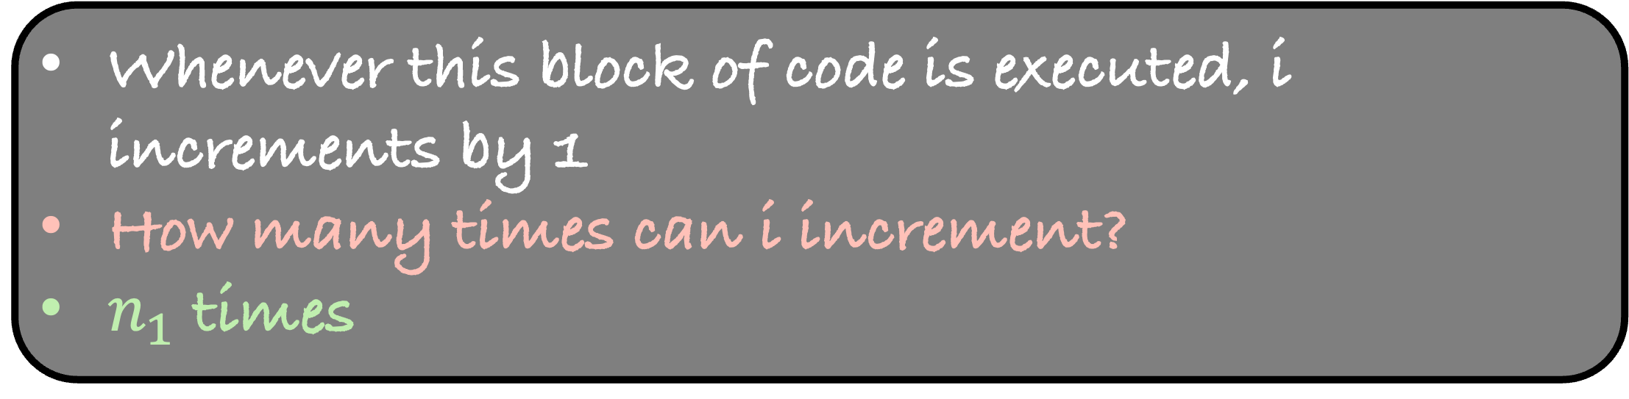
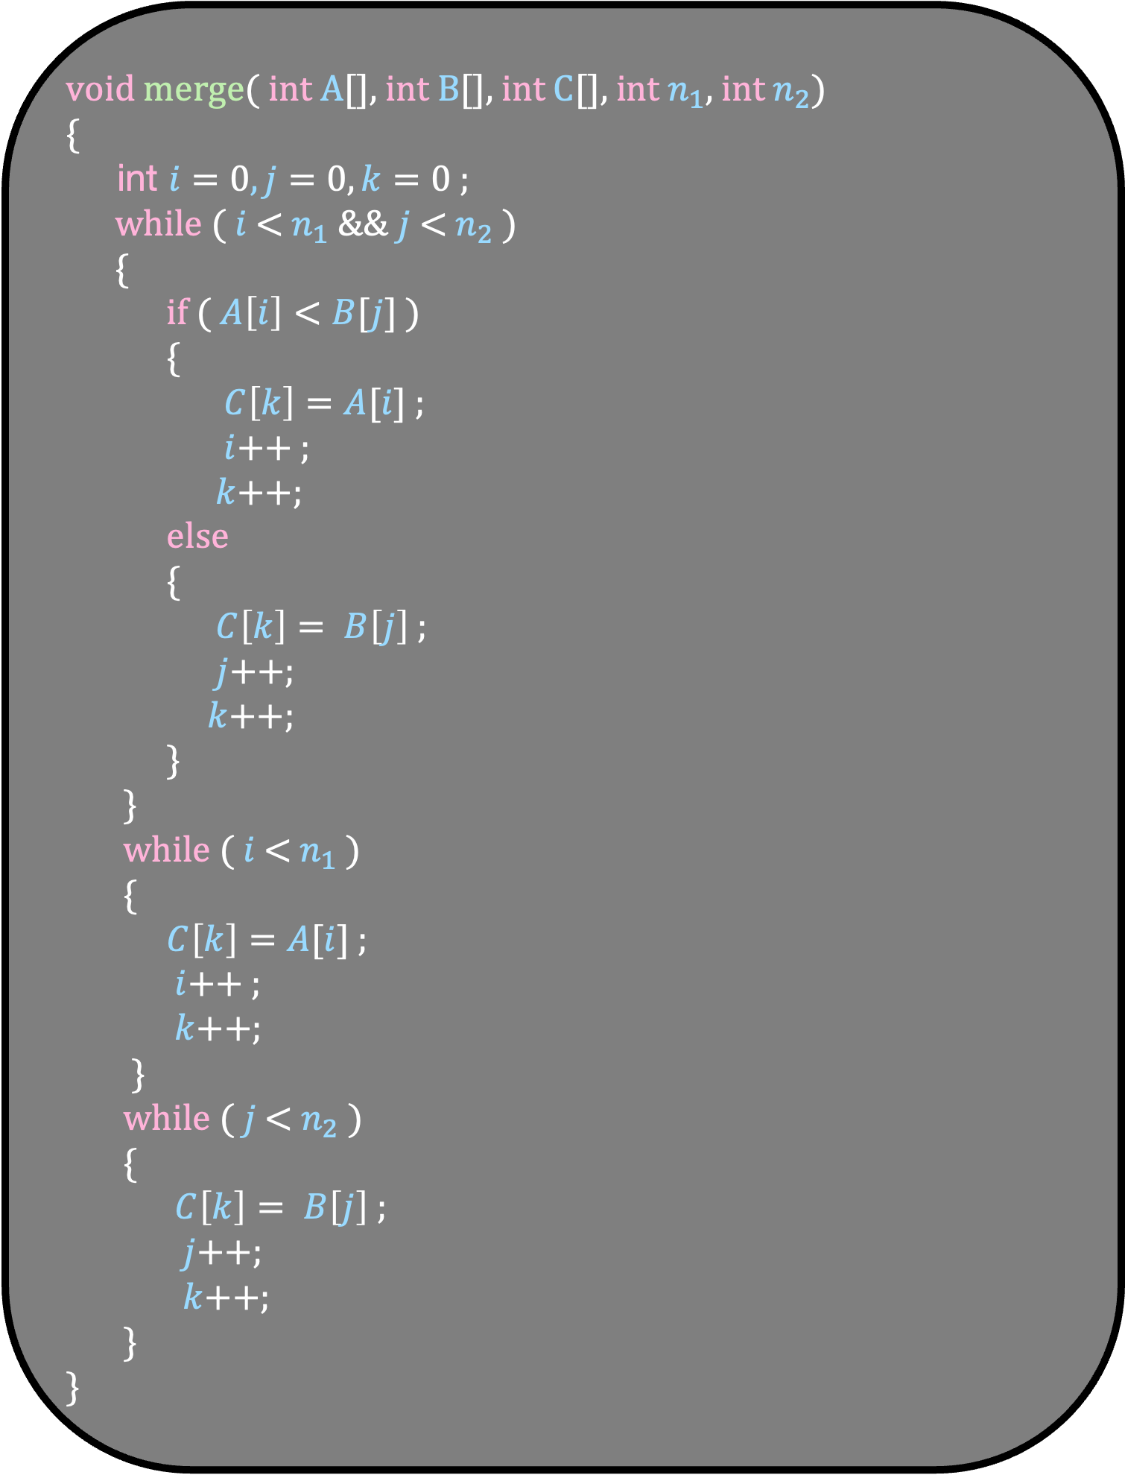
void merge( int A[], int B[], int C[], int $n_{1}$, int $n_{2}$)
{
int $i=0,j=0,k=0$ ;
while ( $i$ < $n_{1}$ && $j$ < $n_{2}$ )
{
if ( $A\left[i\right]<B[j]$ )
{
$C\left[k\right]=A[i]$ ;
$i$++ ;
$k$++;
else
{
$C\left[k\right]= B\left[j\right]$ ;
$j$++;
$k$++;
}
}
while ( $i$ < $n_{1}$ )
{
$C\left[k\right]=A[i]$ ;
$i$++ ;
$k$++;
}
while ( $j$ < $n_{2}$ )
{
$C\left[k\right]= B\left[j\right]$ ;
$j$++;
$k$++;
}
}
What is the running time of merge?
Whenever this block of code is executed, i increments by 1
How many times can i increment?
$n_{1}$ times

Slide 46
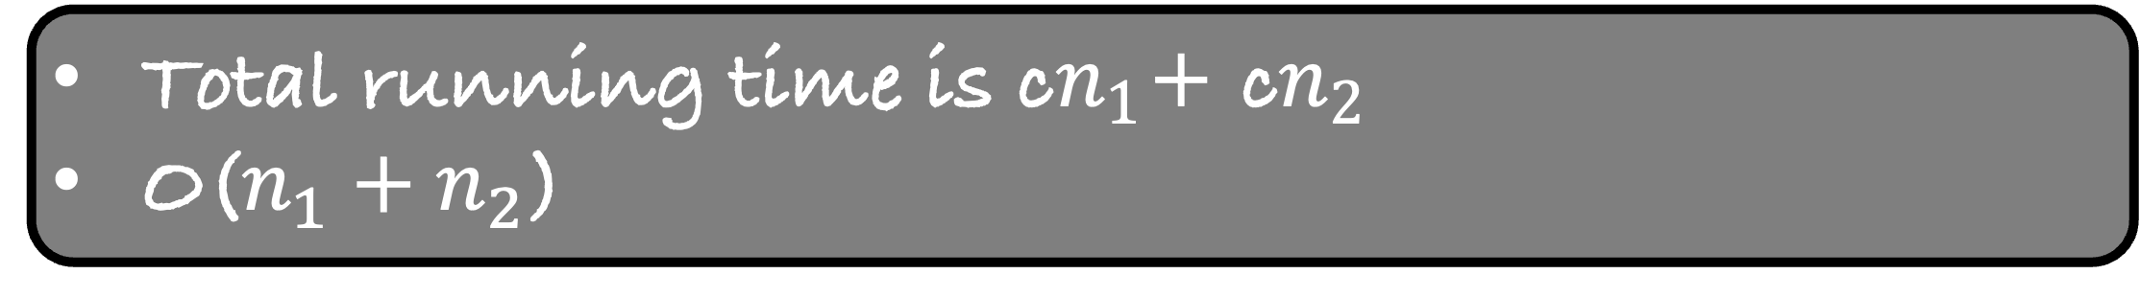
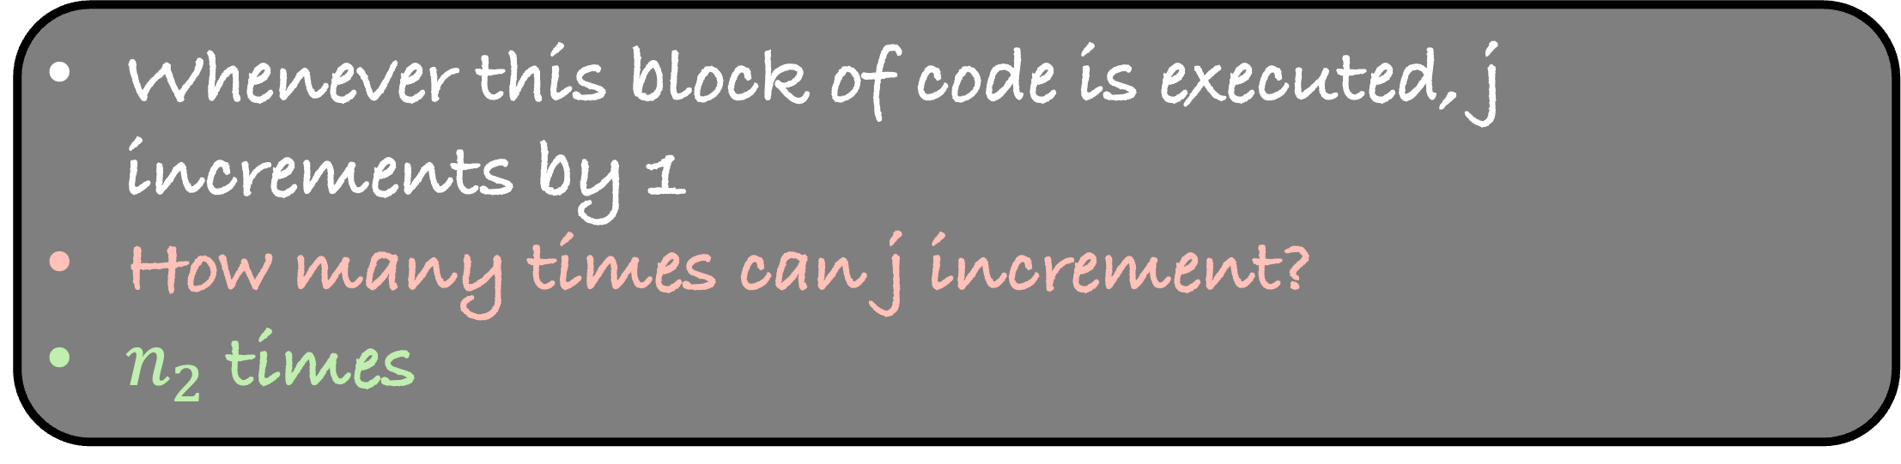
void merge( int A[], int B[], int C[], int $n_{1}$, int $n_{2}$)
{
int $i=0,j=0,k=0$ ;
while ( $i$ < $n_{1}$ && $j$ < $n_{2}$ )
{
if ( $A\left[i\right]<B[j]$ )
{
$C\left[k\right]=A[i]$ ;
$i$++ ;
$k$++;
else
{
$C\left[k\right]= B\left[j\right]$ ;
$j$++;
$k$++;
}
}
while ( $i$ < $n_{1}$ )
{
$C\left[k\right]=A[i]$ ;
$i$++ ;
$k$++;
}
while ( $j$ < $n_{2}$ )
{
$C\left[k\right]= B\left[j\right]$ ;
$j$++;
$k$++;
}
}
What is the running time of merge?
Whenever this block of code is executed, i increments by 1
How many times can i increment?
$n_{1}$ times
Whenever this block of code is executed, j increments by 1
How many times can j increment?
$n_{2}$ times
Total running time is c$n_{1}$+ c$n_{2}$
O($n_{1}+n_{2}$)

Slide 47
Write a function merge that takes two sorted arrays A and B, and an output array C. The function should merge the elements of A and B into C so that C is also sorted in non-decreasing order.
Implement the function merge( int A[], int low, int mid, int high)
Imagine A itself contains two sorted arrays
The first one starts from low and ends at mid
The second one starts at mid+1 and ends at high
Merge these two arrays and store the output back in A
A
1
2
3
7
8
25
4
9
15
low
mid
high

Slide 48
Write a function merge that takes two sorted arrays A and B, and an output array C. The function should merge the elements of A and B into C so that C is also sorted in non-decreasing order.
Implement the function merge( int A[], int low, int mid, int high)
Imagine A itself contains two sorted arrays
The first one starts from low and ends at mid
The second one starts at mid+1 and ends at high
Merge these two arrays and store the output back in A
A
1
2
3
7
8
25
4
9
15
low
mid
high

Slide 49
Write a function merge that takes two sorted arrays A and B, and an output array C. The function should merge the elements of A and B into C so that C is also sorted in non-decreasing order.
Implement the function merge( int A[], int low, int mid, int high)
Imagine A itself contains two sorted arrays
The first one starts from low and ends at mid
The second one starts at mid+1 and ends at high
Merge these two arrays and store the output back in A
A
1
2
3
4
7
8
9
15
25
low
mid
high

Slide 50
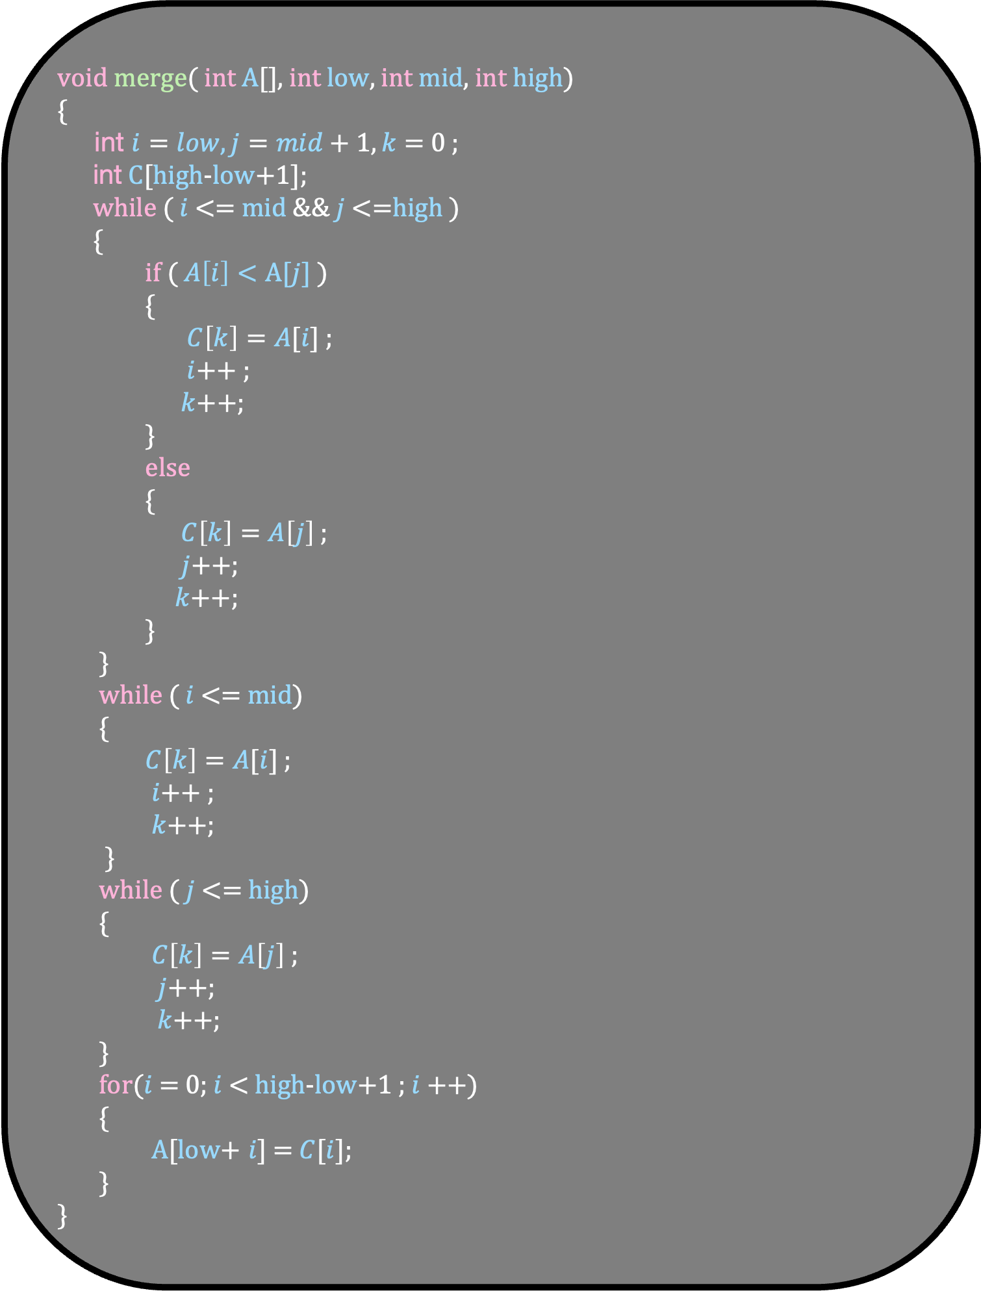
void merge( int A[], int low, int mid, int high)
{
int $i=low,j=mid+1,k=$ 0 ;
int C[high-low+1];
while ( $i$ <= mid && $j$ <=high )
{
if ( $A\left[i\right]<A[j]$ )
{
$C\left[k\right]=A[i]$ ;
$i$++ ;
$k$++;
}
else
{
$C\left[k\right]=A\left[j\right]$ ;
$j$++;
$k$++;
}
}
while ( $i$ <= mid)
{
$C\left[k\right]=A[i]$ ;
$i$++ ;
$k$++;
}
while ( $j$ <= high)
{
$C\left[k\right]=A\left[j\right]$ ;
$j$++;
$k$++;
}
for($i$ = 0; $i$< high-low+1 ; $i$++)
{
A[low+ $i$] = $C$[$i$];
}
}

Slide 51
Merge Sort

Slide 52
A
1
15
3
25
9
7
8
4
2
If somehow, we could sort the left and the right half of the array.

Slide 53
A
1
15
3
25
9
7
8
4
2
If somehow, we could sort the left and the right half of the array.

Slide 54
A
1
3
9
15
25
2
4
7
8
If somehow, we could sort the left and the right half of the array.
Then, we can use merge to get the sorted array

Slide 55
void mergeSort( int A[], int low, int high)
{
int mid = low + (high-low)/2;
//sort the array from low to mid
//sort the array from mid+1 to high
merge(A , low , mid , high);
}
But how do we sort these two arrays?
Use MergeSort recursively

Slide 56
void mergeSort( int A[], int low, int high)
{
int mid = low + (high-low)/2;
mergeSort( A, low, mid);
mergeSort( A, mid+1, high);
merge(A , low , mid , high);
}
But something is wrong with this program?
The base case

Slide 57
void mergeSort( int A[], int low, int high)
{
if (high <= low)
return;
int mid = low + (high-low)/2;
mergeSort( A, low, mid);
mergeSort( A, mid+1, high);
merge(A , low , mid , high);
}
But something is wrong with this program?
The base case

Slide 58


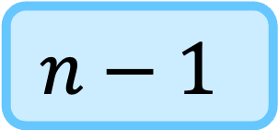

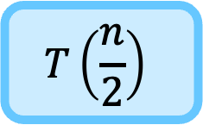

0
$$n−1$$
void mergeSort( int A[], int low, int high)
{
if (high <= low)
return;
int mid = low + (high-low)/2;
mergeSort( A, low, mid);
mergeSort( A, mid+1, high);
merge(A , low , mid , high);
}
$$T(n)$$
$$c$$
$$T\left(\frac{n}{2}\right)$$
What is the running time of this algorithm?
$$T\left(\frac{n}{2}\right)$$
$$n$$

Slide 59


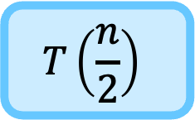
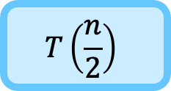
0
$$n−1$$
void mergeSort( int A[], int low, int high)
{
if (high <= low)
return;
int mid = low + (high-low)/2;
mergeSort( A, low, mid);
mergeSort( A, mid+1, high);
merge(A , low , mid , high);
}
$$c$$
What is the running time of this algorithm?
$$T(n)$$
$$T\left(\frac{n}{2}\right)$$
$$T\left(\frac{n}{2}\right)$$
$$n$$

Slide 60


0
$$n−1$$
void mergeSort( int A[], int low, int high)
{
if (high <= low)
return;
int mid = low + (high-low)/2;
mergeSort( A, low, mid);
mergeSort( A, mid+1, high);
merge(A , low , mid , high);
}
What is the running time of this algorithm?
$$T(n)$$
$$T\left(\frac{n}{2}\right)$$
$$T\left(\frac{n}{2}\right)$$
$$n$$
This is a recurrence relation
We need to solve it to find the running time of mergerSort
$$T(1)$$
$$c$$

Slide 61
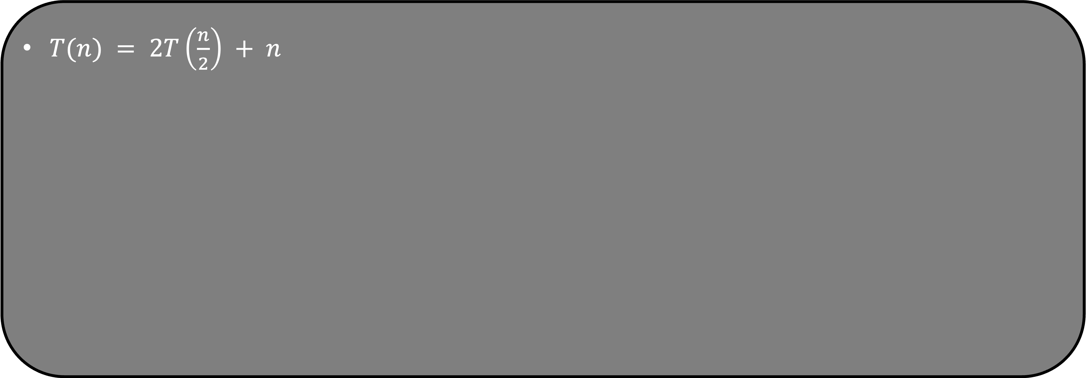
$T(n) = 2T\left(\frac{n}{2}\right) + n$

Slide 62
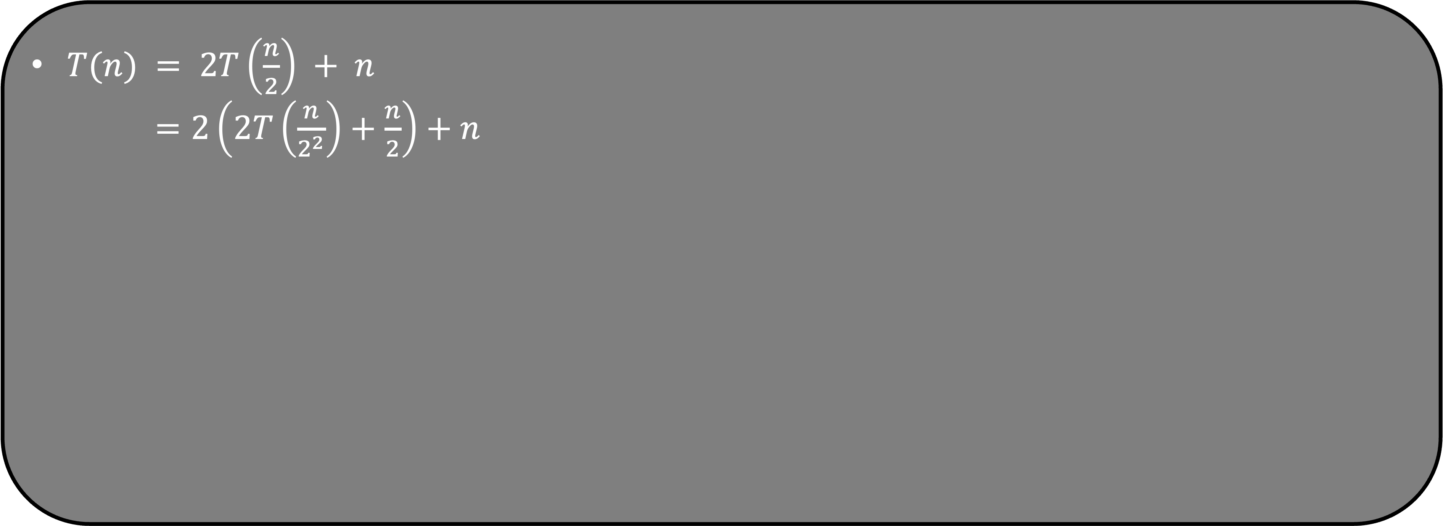
$T(n) = 2T\left(\frac{n}{2}\right) + n$
$=2\left(2T\left(\frac{n}{2^{2}}\right)+\frac{n}{2}\right)+n$

Slide 63
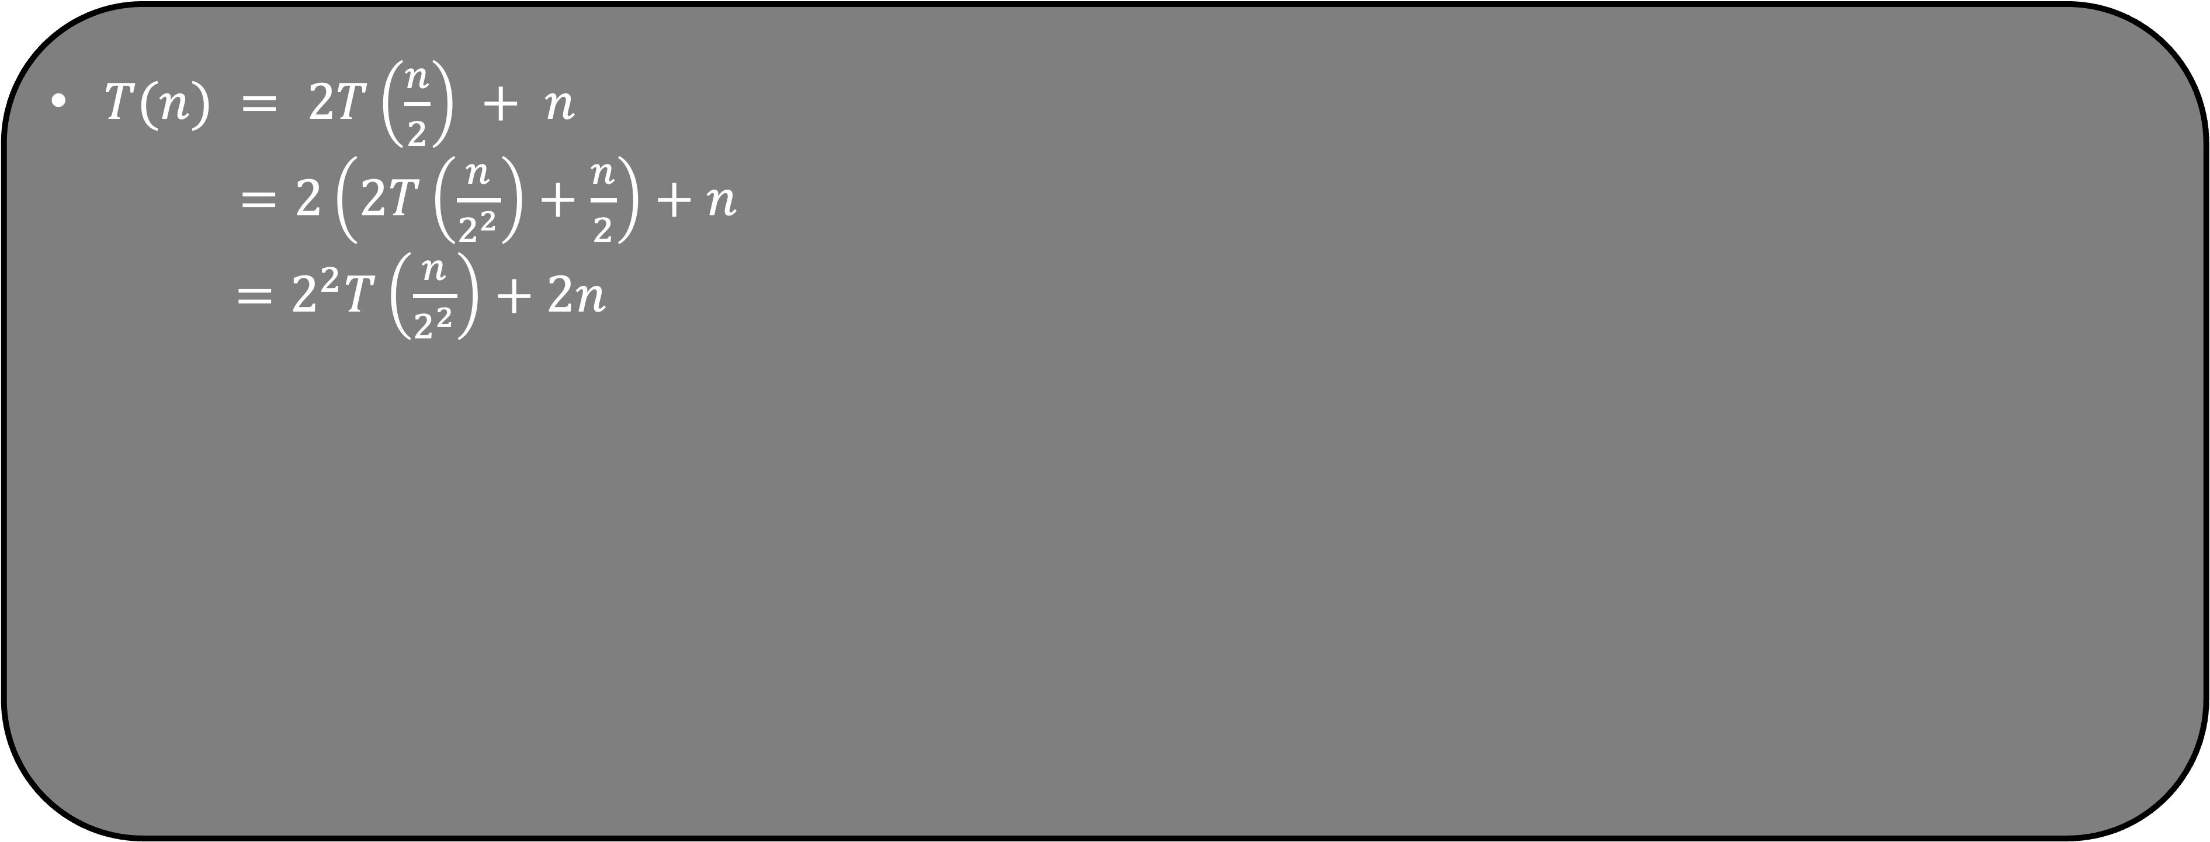
$T(n) = 2T\left(\frac{n}{2}\right) + n$
$=2\left(2T\left(\frac{n}{2^{2}}\right)+\frac{n}{2}\right)+n$
$=2^{2}T\left(\frac{n}{2^{2}}\right)+2n$

Slide 64
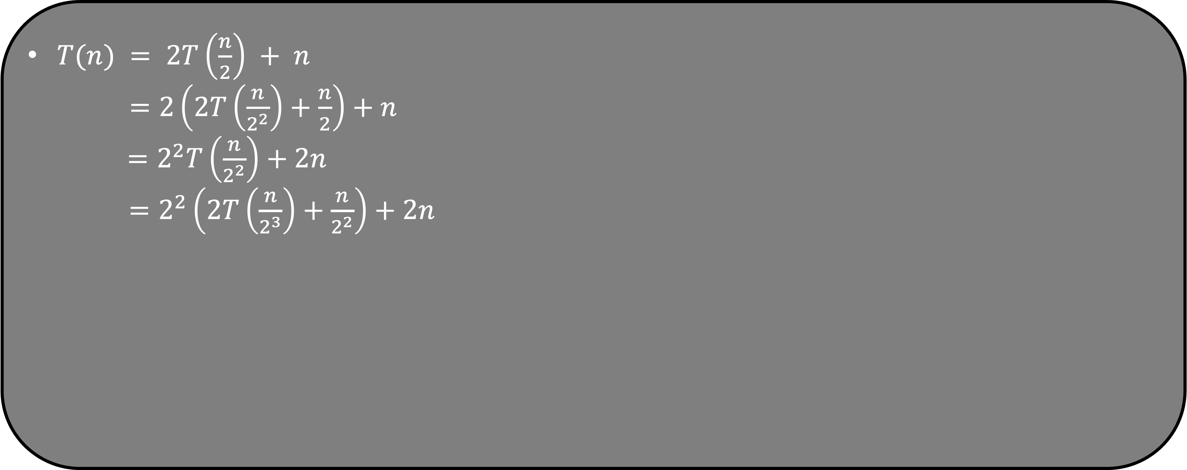
$T(n) = 2T\left(\frac{n}{2}\right) + n$
$=2\left(2T\left(\frac{n}{2^{2}}\right)+\frac{n}{2}\right)+n$
$=2^{2}T\left(\frac{n}{2^{2}}\right)+2n$
$=2^{2}\left(2T\left(\frac{n}{2^{3}}\right)+\frac{n}{2^{2}}\right)+2n$

Slide 65
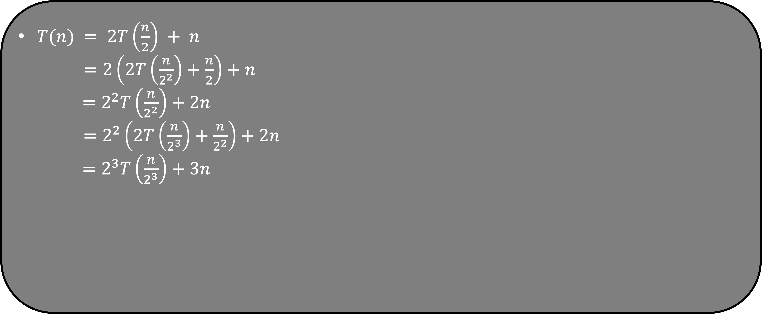
$T(n) = 2T\left(\frac{n}{2}\right) + n$
$=2\left(2T\left(\frac{n}{2^{2}}\right)+\frac{n}{2}\right)+n$
$=2^{2}T\left(\frac{n}{2^{2}}\right)+2n$
$=2^{2}\left(2T\left(\frac{n}{2^{3}}\right)+\frac{n}{2^{2}}\right)+2n$
$=2^{3}T\left(\frac{n}{2^{3}}\right)+3n$
Do you see the pattern?

Slide 66
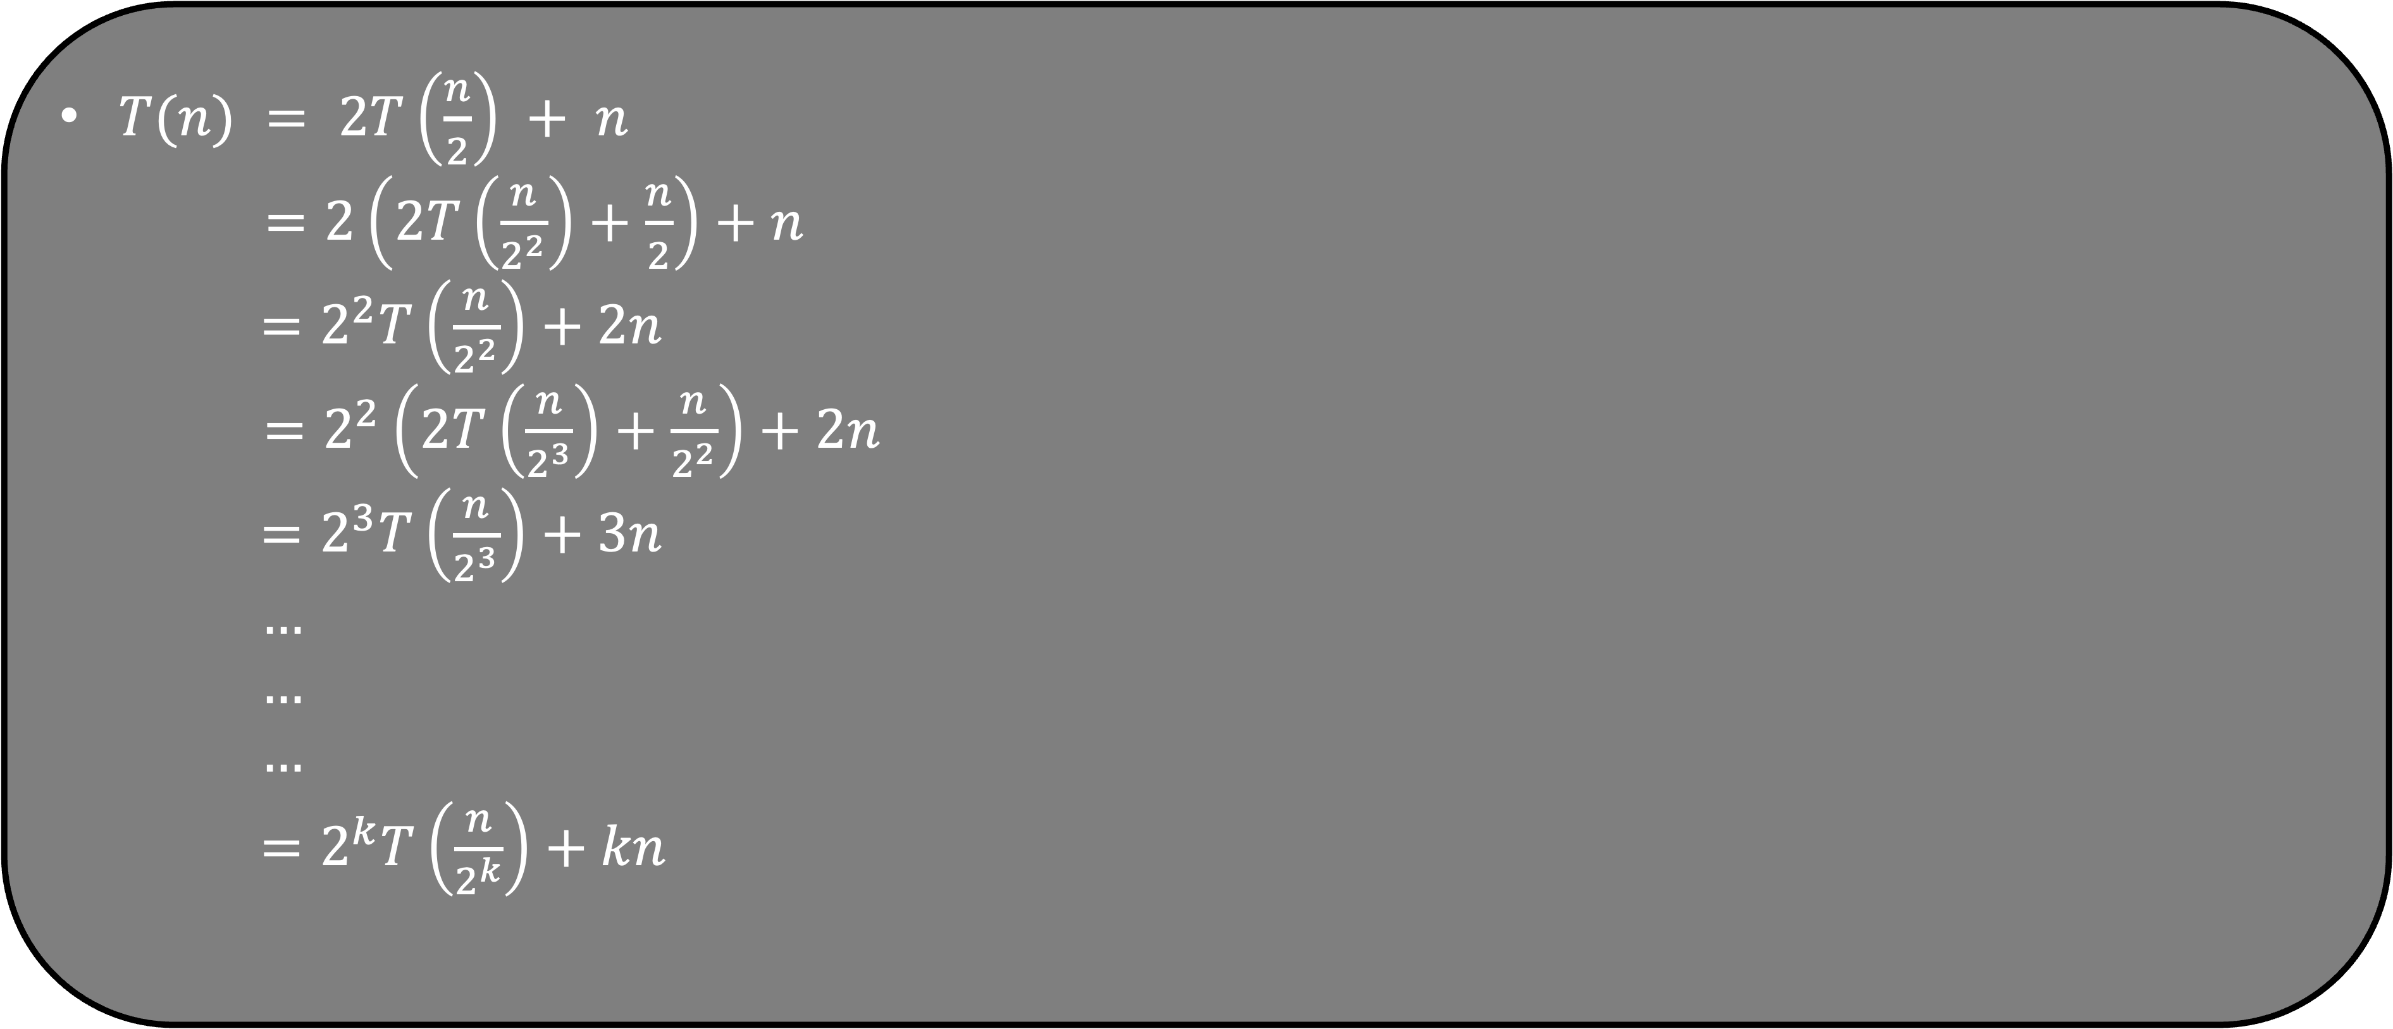
$T(n) = 2T\left(\frac{n}{2}\right) + n$
$=2\left(2T\left(\frac{n}{2^{2}}\right)+\frac{n}{2}\right)+n$
$=2^{2}T\left(\frac{n}{2^{2}}\right)+2n$
$=2^{2}\left(2T\left(\frac{n}{2^{3}}\right)+\frac{n}{2^{2}}\right)+2n$
$=2^{3}T\left(\frac{n}{2^{3}}\right)+3n$
$…$
$…$
$…$
$=2^{k}T\left(\frac{n}{2^{k}}\right)+kn$
But this cannot continue forever. We must stop when $\frac{n}{2^{k}}=1$ as that is our base case.
$\frac{n}{2^{k}}=1$ $→$ $n=2^{k}$ $→$ $k=\log{n}$

Slide 67
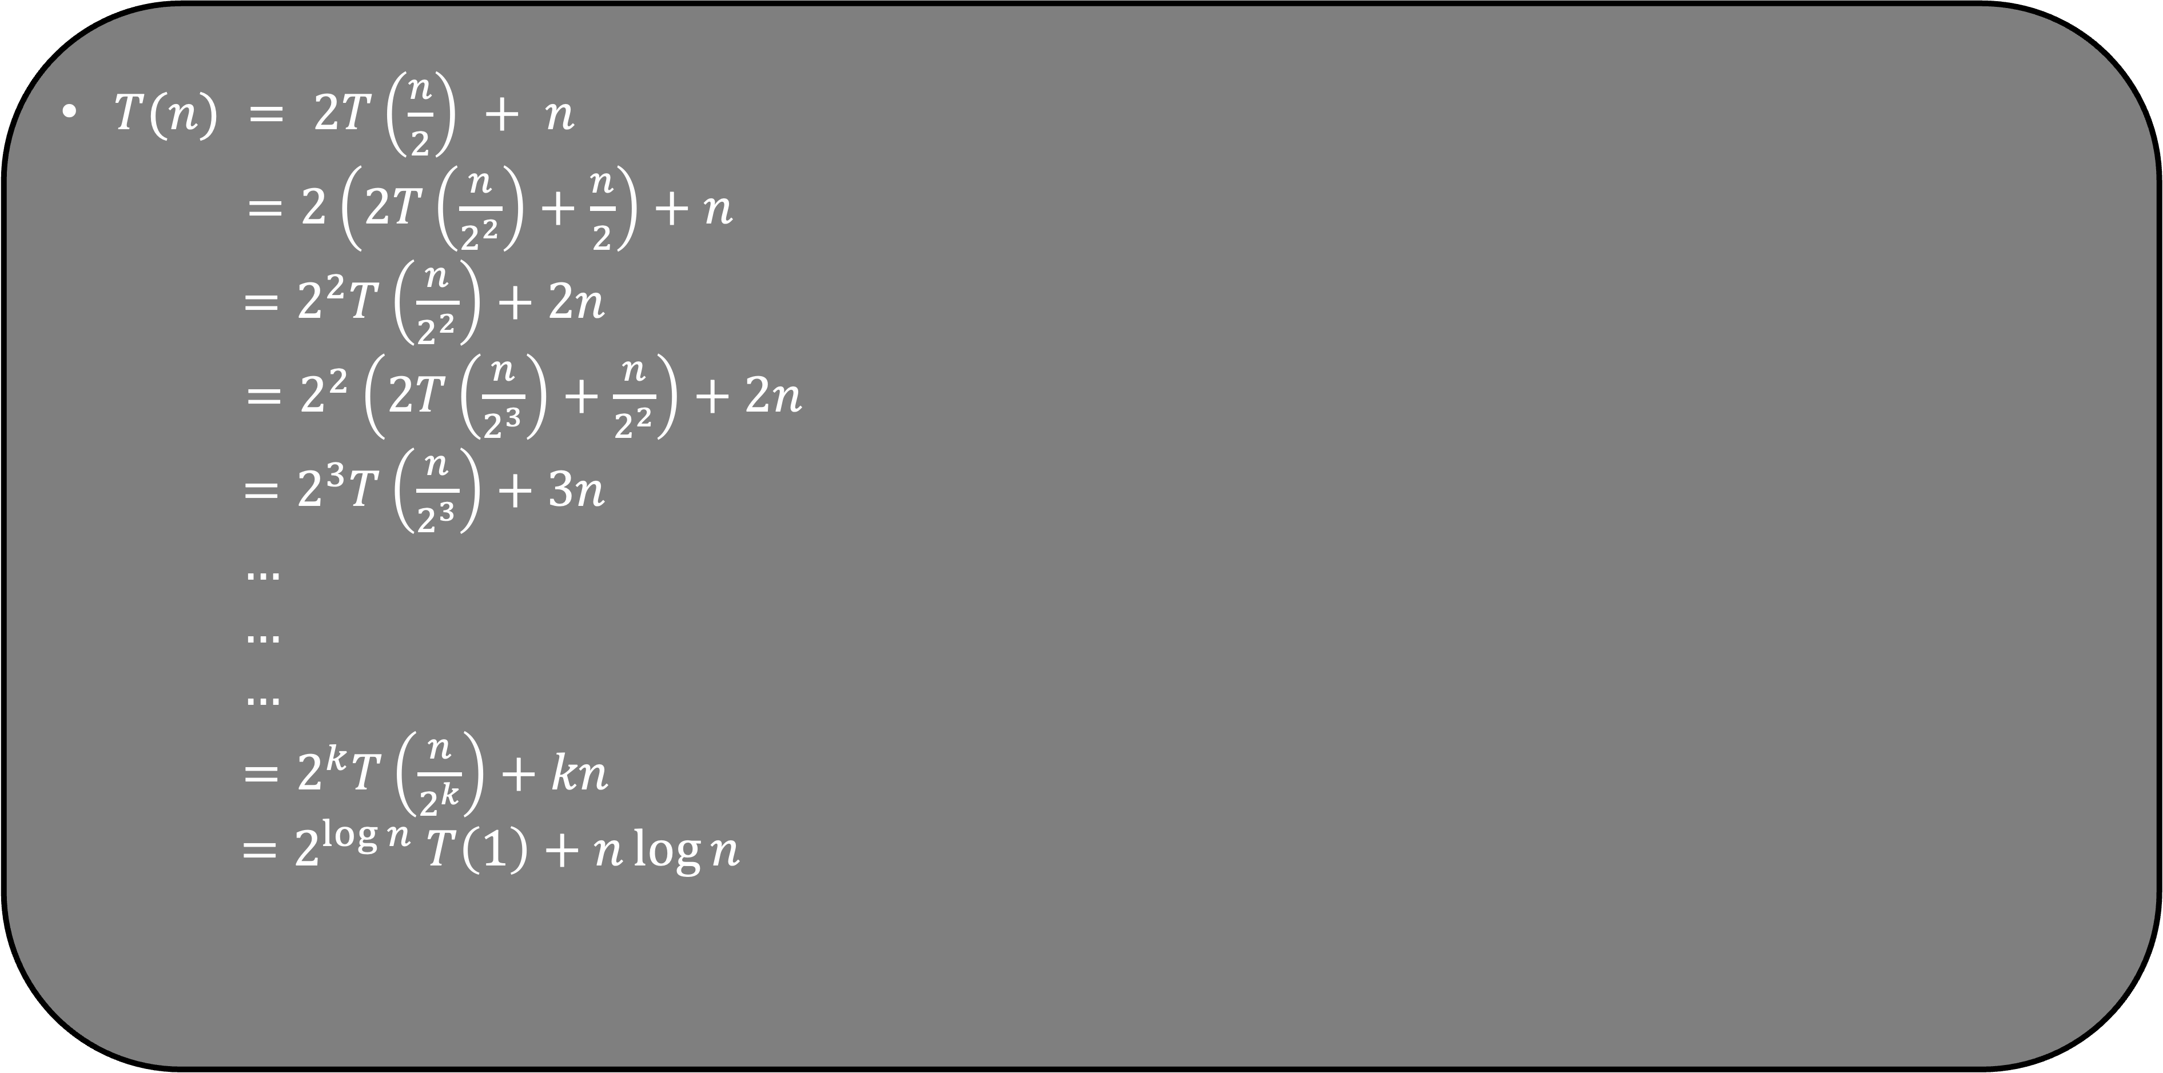
$T(n) = 2T\left(\frac{n}{2}\right) + n$
$=2\left(2T\left(\frac{n}{2^{2}}\right)+\frac{n}{2}\right)+n$
$=2^{2}T\left(\frac{n}{2^{2}}\right)+2n$
$=2^{2}\left(2T\left(\frac{n}{2^{3}}\right)+\frac{n}{2^{2}}\right)+2n$
$=2^{3}T\left(\frac{n}{2^{3}}\right)+3n$
$…$
$…$
$…$
$=2^{k}T\left(\frac{n}{2^{k}}\right)+kn$
$=$ $2^{\log{n}} T\left(1\right)+n\log{n}$

Slide 68
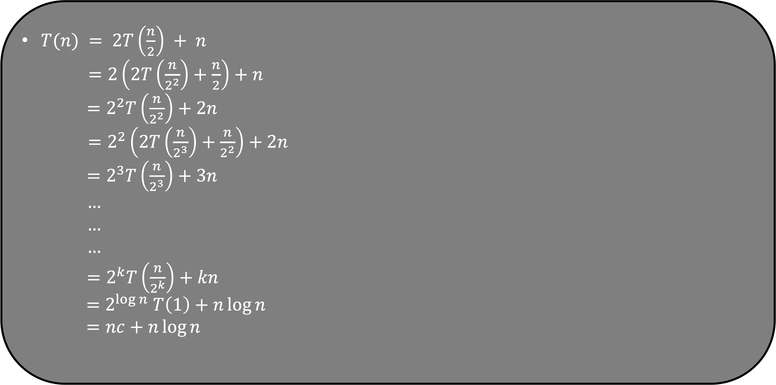
$T(n) = 2T\left(\frac{n}{2}\right) + n$
$=2\left(2T\left(\frac{n}{2^{2}}\right)+\frac{n}{2}\right)+n$
$=2^{2}T\left(\frac{n}{2^{2}}\right)+2n$
$=2^{2}\left(2T\left(\frac{n}{2^{3}}\right)+\frac{n}{2^{2}}\right)+2n$
$=2^{3}T\left(\frac{n}{2^{3}}\right)+3n$
$…$
$…$
$…$
$=2^{k}T\left(\frac{n}{2^{k}}\right)+kn$
$=$ $2^{\log{n}} T\left(1\right)+n\log{n}$
$=nc+n\log{n}$

Slide 69
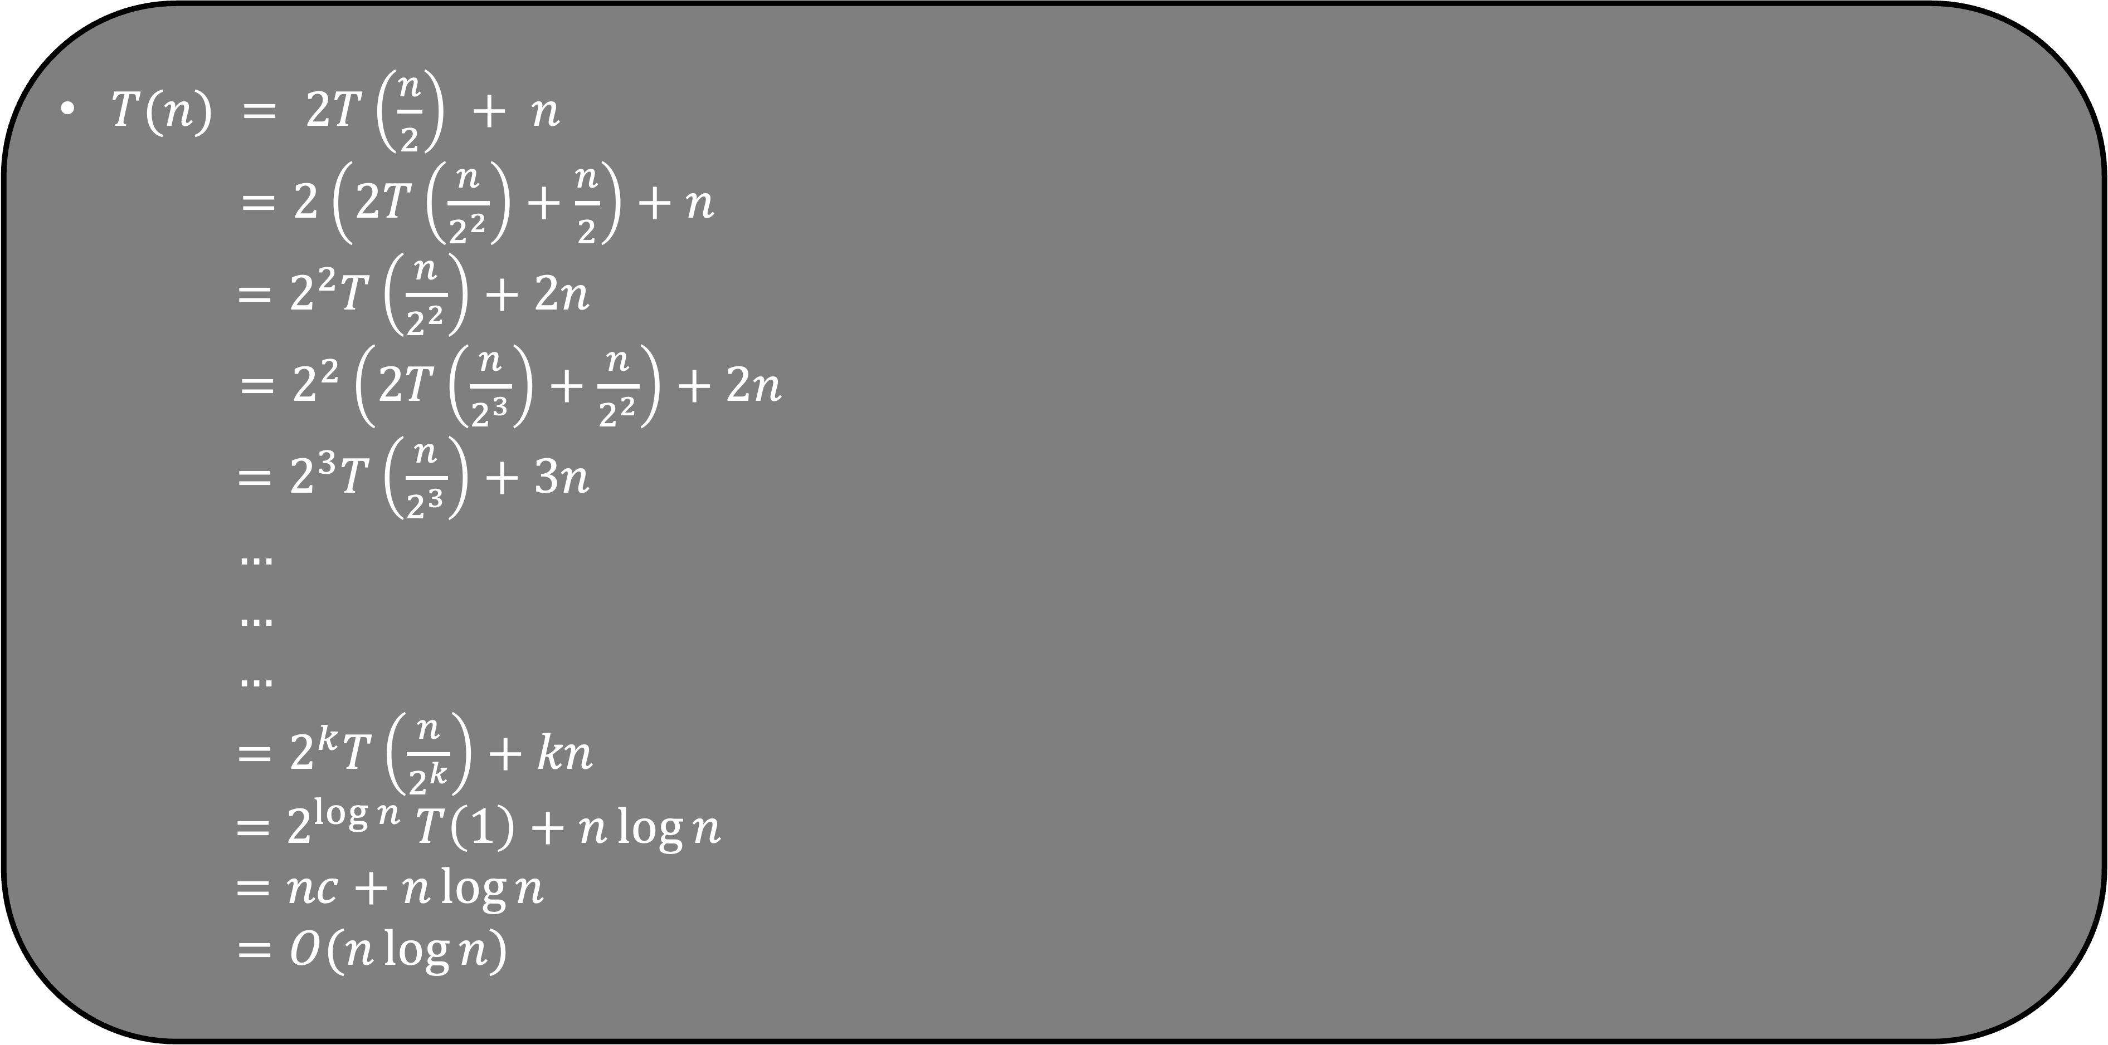
$T(n) = 2T\left(\frac{n}{2}\right) + n$
$=2\left(2T\left(\frac{n}{2^{2}}\right)+\frac{n}{2}\right)+n$
$=2^{2}T\left(\frac{n}{2^{2}}\right)+2n$
$=2^{2}\left(2T\left(\frac{n}{2^{3}}\right)+\frac{n}{2^{2}}\right)+2n$
$=2^{3}T\left(\frac{n}{2^{3}}\right)+3n$
$…$
$…$
$…$
$=2^{k}T\left(\frac{n}{2^{k}}\right)+kn$
$=$ $2^{\log{n}} T\left(1\right)+n\log{n}$
$=nc+n\log{n}$
$=O(n\log{n)}$

Slide 70
What is the best case and worst running time of Merge Sort?
void mergeSort( int A[], int low, int high)
{
if (high <= low)
return;
int mid = low + (high-low)/2;
mergeSort( A, low, mid);
mergeSort( A, mid+1, high);
merge(A , low , mid , high);
}
Both are O(n log n)
Average case is also O(n log n)

