Slide 1
Arrays and Pointers

Slide 2
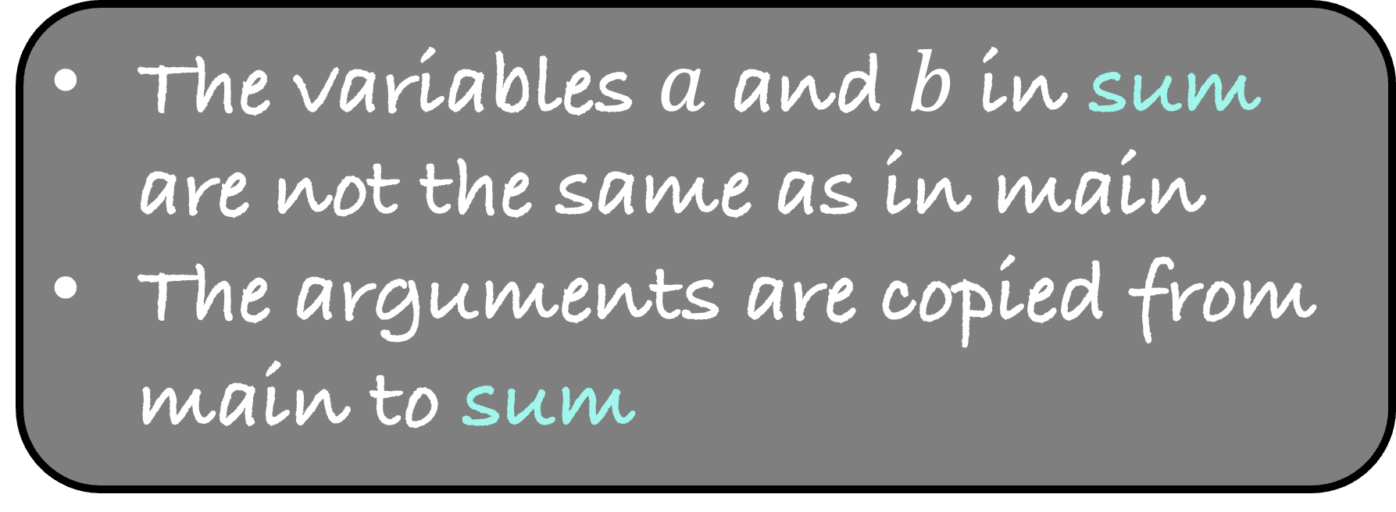
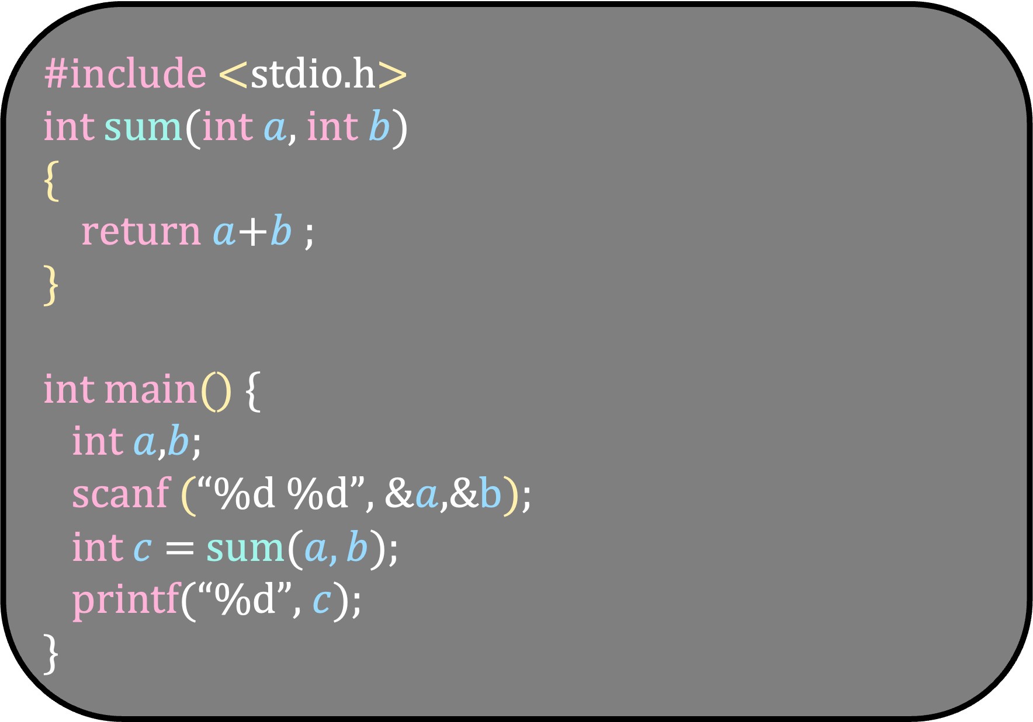
#include <stdio.h>
int sum(int $a$, int $b$)
{
return $a$+$b$ ;
}
int main() {
int $a$,$b$;
scanf (“%d %d”, &$a$,&b);
int $c$ = sum($a,b$);
printf(“%d”, $c$);
}
The variables $a$ and $b$ in sum are not the same as in main
The arguments are copied from main to sum

Slide 3
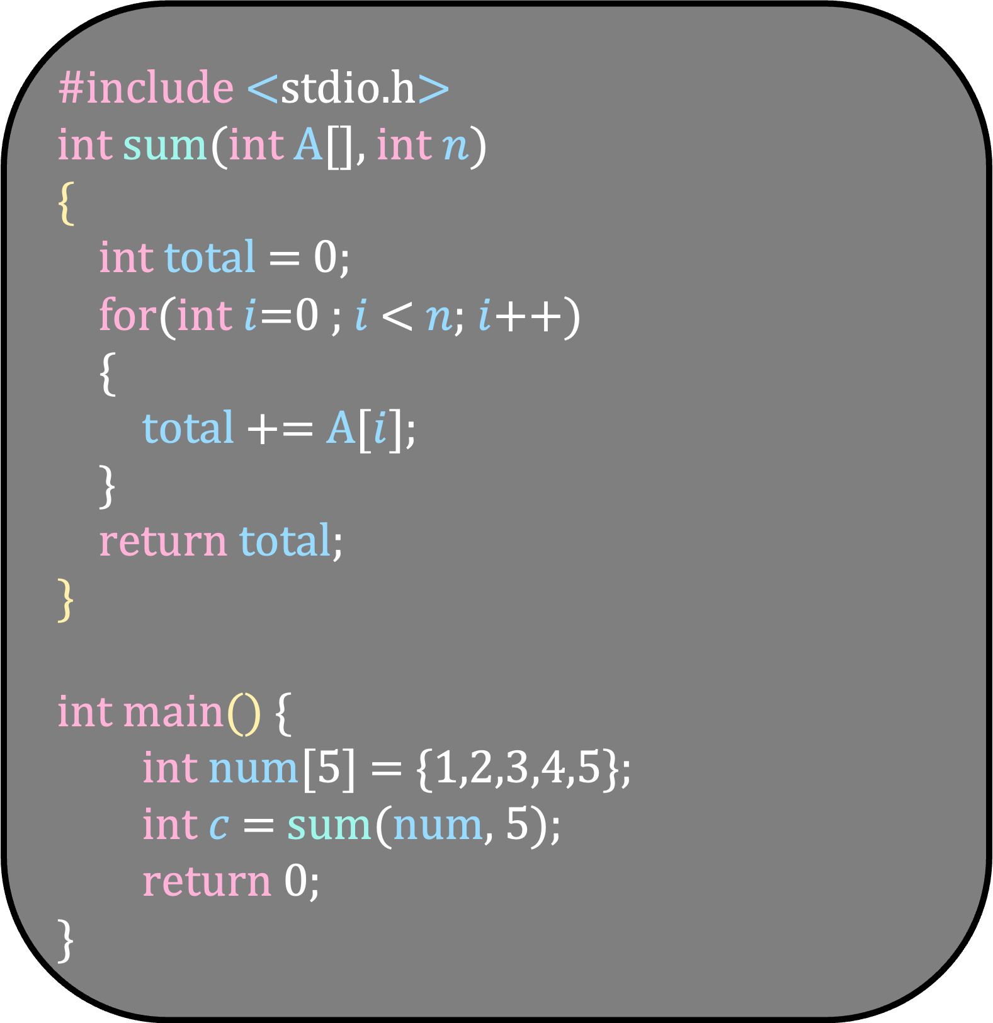
How is this array passed?
Is A a copy of num?
Or is it same as num?
#include <stdio.h>
int sum(int A[], int $n$)
{
int total = 0;
for(int $i$=0 ; $i$ < $n$; $i$++)
{
total += A[$i$];
}
return total;
}
int main() {
int num[5] = {1,2,3,4,5};
int $c$ = sum(num, 5);
return 0;
}
As a designer of the language, you have these two choices.
What will be your choice?
Copying will take huge time just to pass the argument
I makes sense to make A same as num

Slide 4
#include <stdio.h>
int sum(int A[], int $n$)
{
int total = 0;
for(int $i$=0 ; $i$ < $n$; $i$++)
{
total += A[$i$];
}
return total;
}
int main() {
int num[5] = {1,2,3,4,5};
int $c$ = sum(num, 5);
return 0;
}
Pointers
A is actually a pointer to an integer
It means that A contains address of an integer
Let us explore pointers in detail

Slide 5
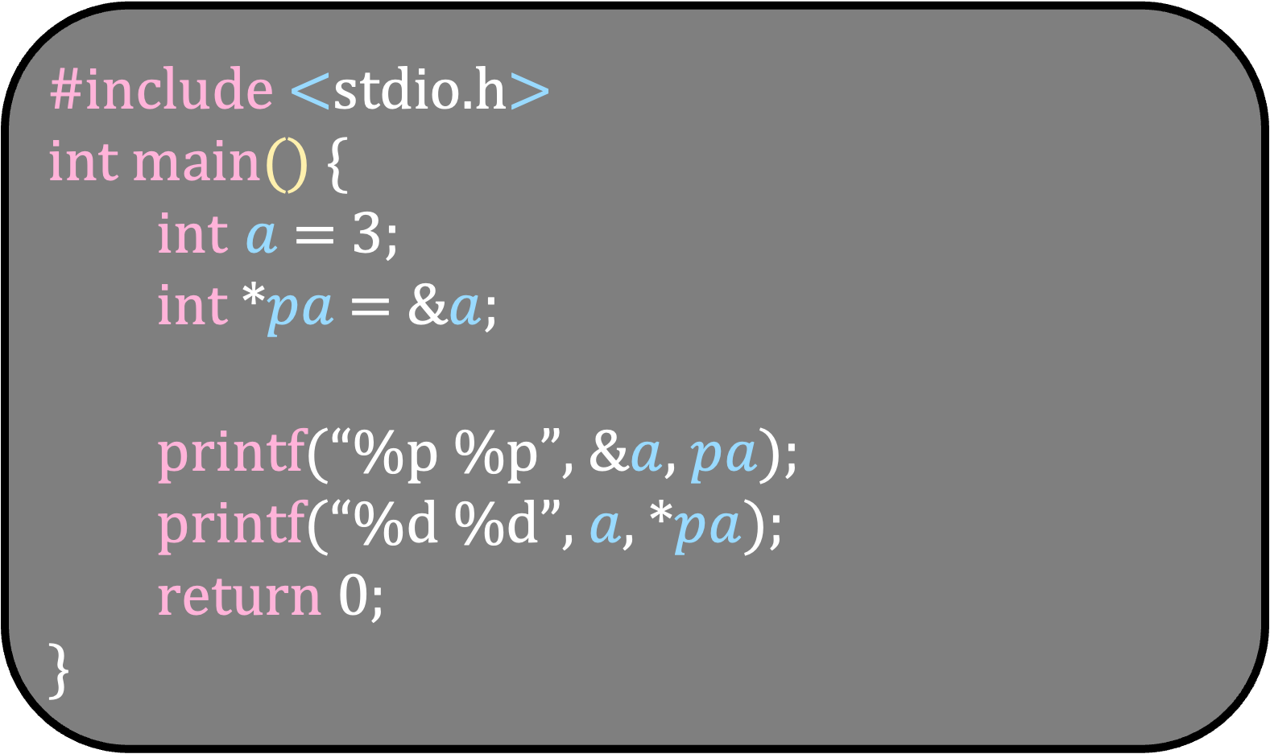
#include <stdio.h>
int main() {
int $a$ = 3;
int *$pa$ = &$a$;
printf(“%p %p”, &$a$, $pa$);
printf(“%d %d”, $a$, *$pa$);
return 0;
}
The real power of pointer manifests when we are dealing with arrays

Slide 6
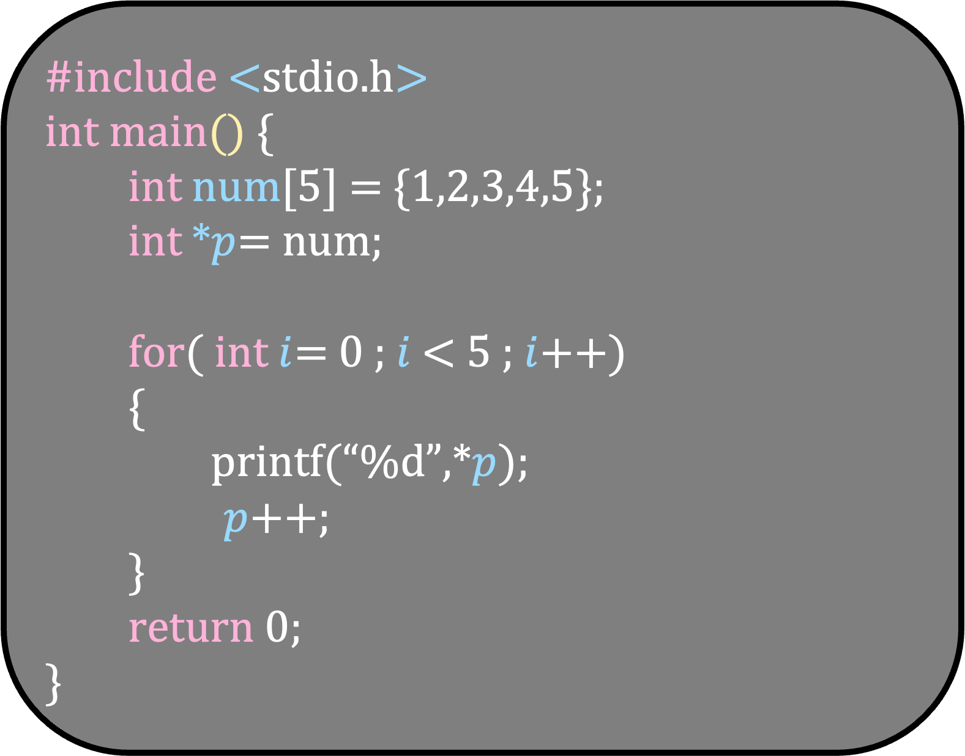
#include <stdio.h>
int main() {
int num[5] = {1,2,3,4,5};
int $∗p$= num;
for( int $i$= 0 ; $i$< 5 ; $i$++)
{
printf(“%d”,*$p$);
$p$++;
}
return 0;
}

Slide 7
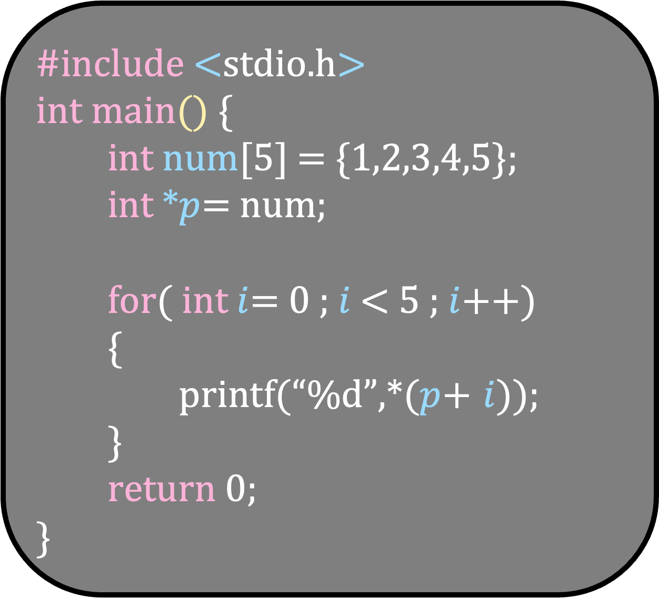
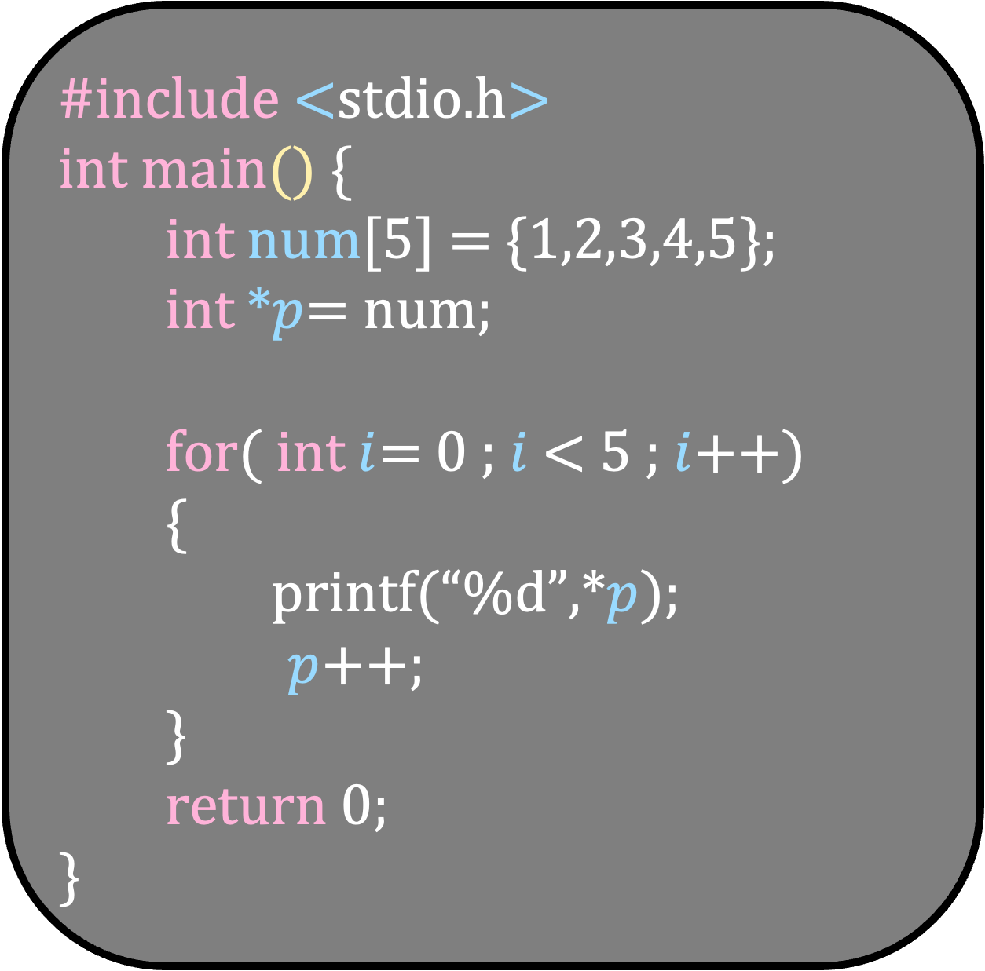
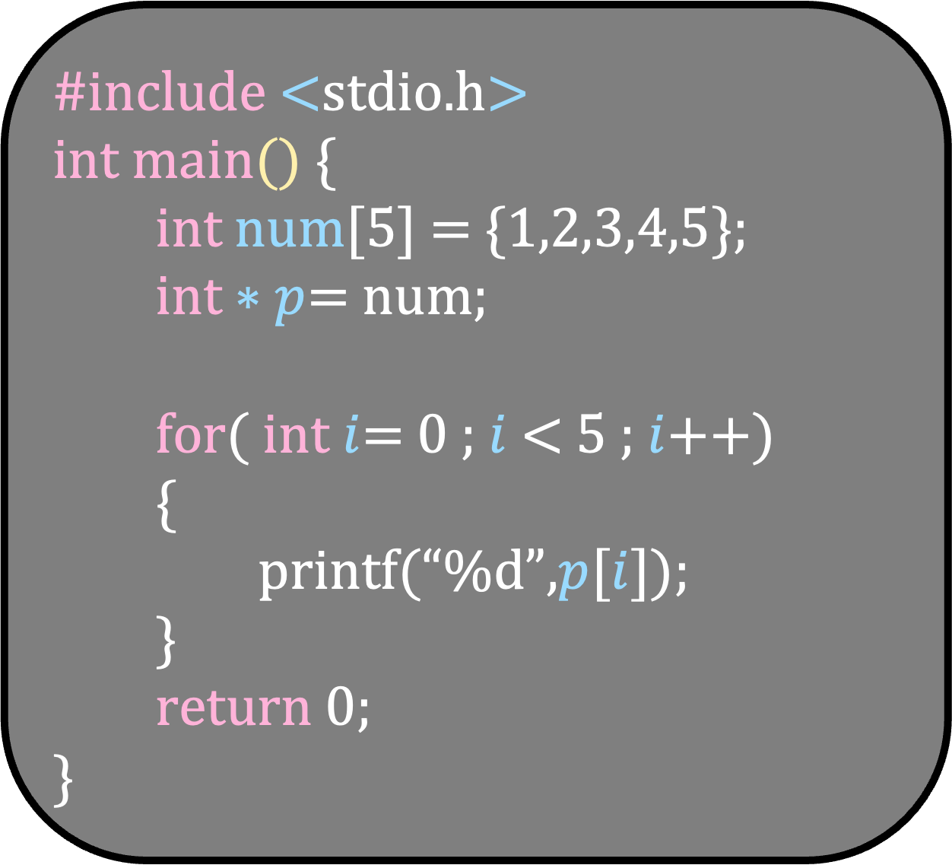
#include <stdio.h>
int main() {
int num[5] = {1,2,3,4,5};
int $∗p$= num;
for( int $i$= 0 ; $i$< 5 ; $i$++)
{
printf(“%d”,*$p$);
$p$++;
}
return 0;
}
#include <stdio.h>
int main() {
int num[5] = {1,2,3,4,5};
int $∗p$= num;
for( int $i$= 0 ; $i$< 5 ; $i$++)
{
printf(“%d”,*($p$+ $i$));
}
return 0;
}
#include <stdio.h>
int main() {
int num[5] = {1,2,3,4,5};
int $∗p$= num;
for( int $i$= 0 ; $i$< 5 ; $i$++)
{
printf(“%d”,$p$[$i$]);
}
return 0;
}
*(p+i) – go to the address (p+i) and then fetch the value there
p[i] is same as *(p+i)

Slide 8
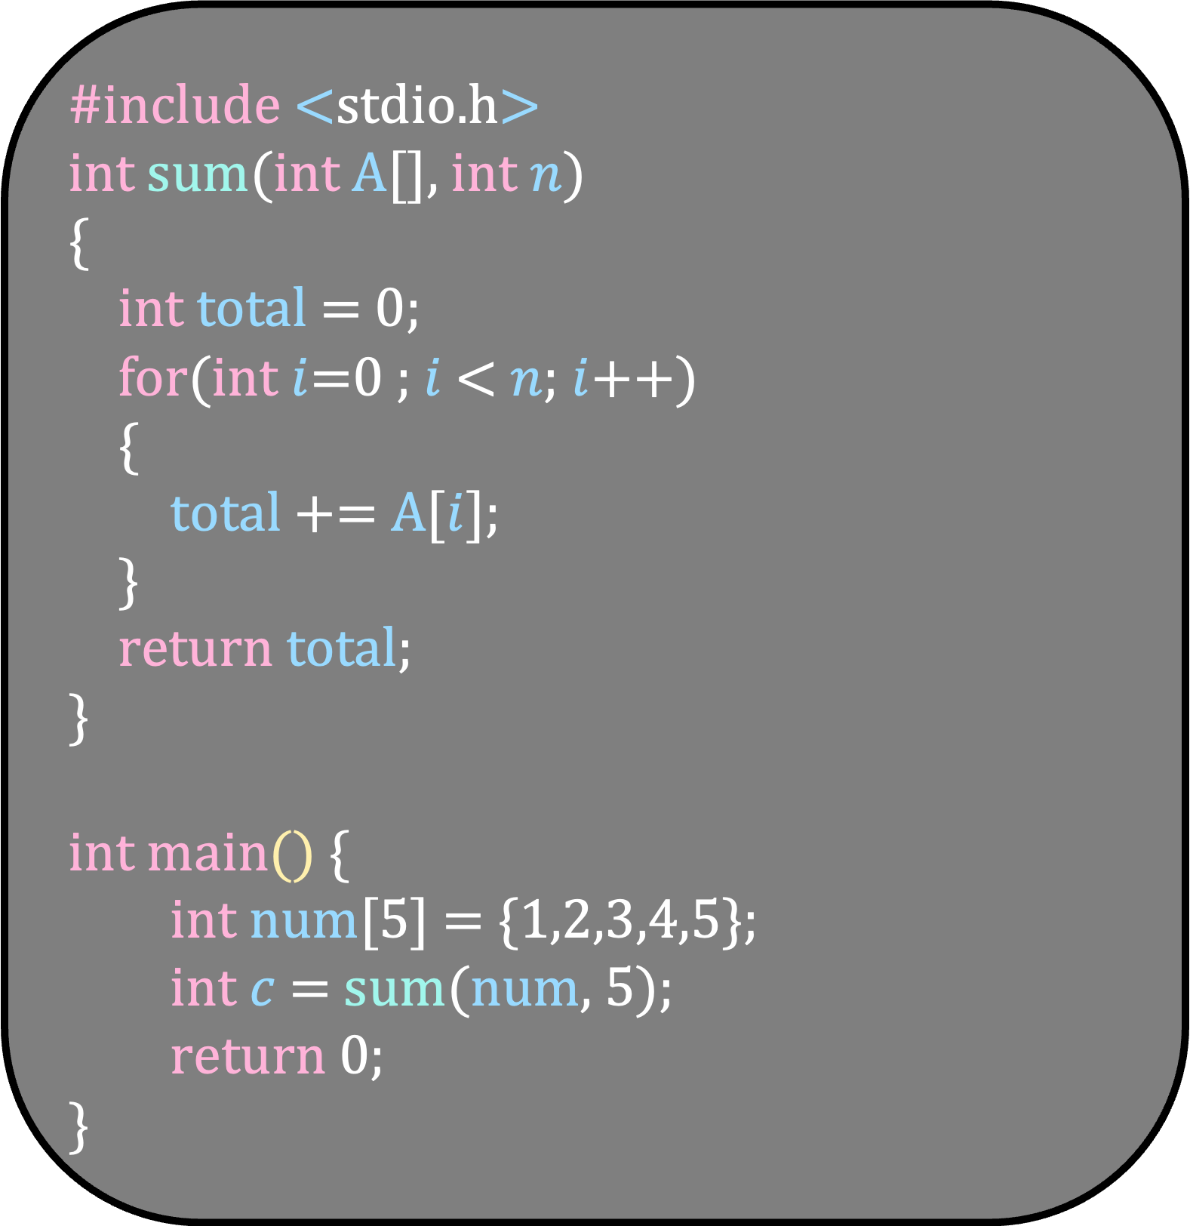
#include <stdio.h>
int sum(int A[], int $n$)
{
int total = 0;
for(int $i$=0 ; $i$ < $n$; $i$++)
{
total += A[$i$];
}
return total;
}
int main() {
int num[5] = {1,2,3,4,5};
int $c$ = sum(num, 5);
return 0;
}
A is a pointer to the first element of num

Slide 9
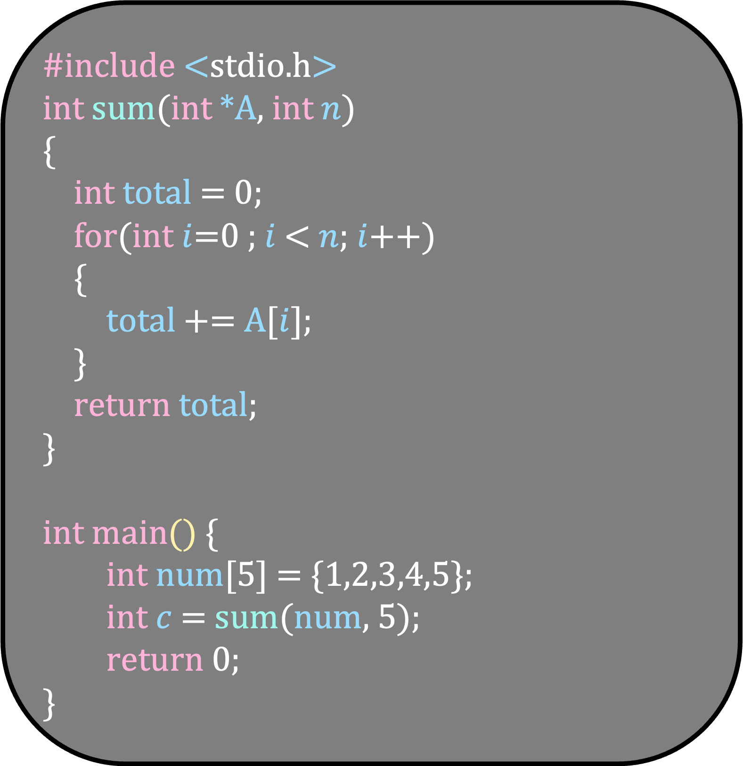
#include <stdio.h>
int sum(int *A, int $n$)
{
int total = 0;
for(int $i$=0 ; $i$ < $n$; $i$++)
{
total += A[$i$];
}
return total;
}
int main() {
int num[5] = {1,2,3,4,5};
int $c$ = sum(num, 5);
return 0;
}
A is a pointer to the first element of num

Slide 10
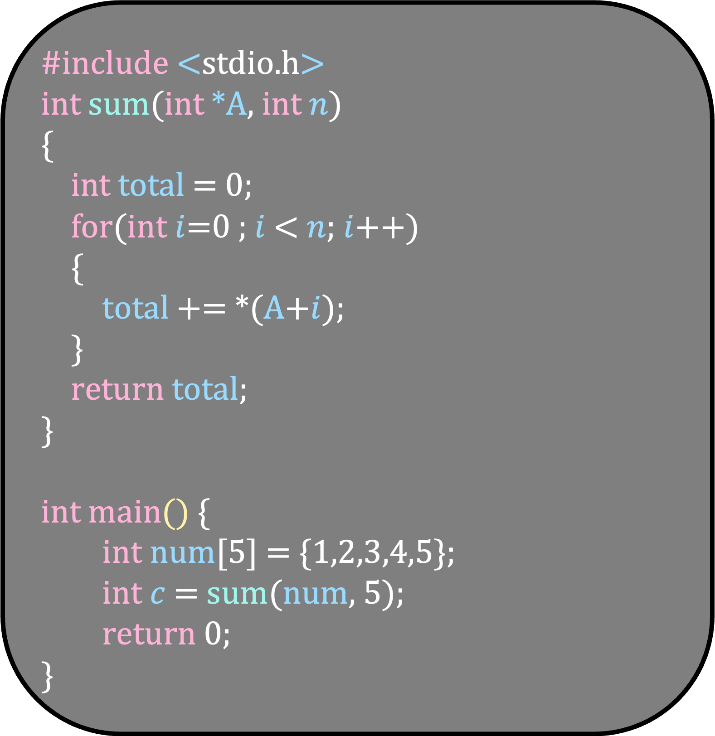
#include <stdio.h>
int sum(int *A, int $n$)
{
int total = 0;
for(int $i$=0 ; $i$ < $n$; $i$++)
{
total += *(A+$i$);
}
return total;
}
int main() {
int num[5] = {1,2,3,4,5};
int $c$ = sum(num, 5);
return 0;
}
A is a pointer to the first element of num

Slide 11
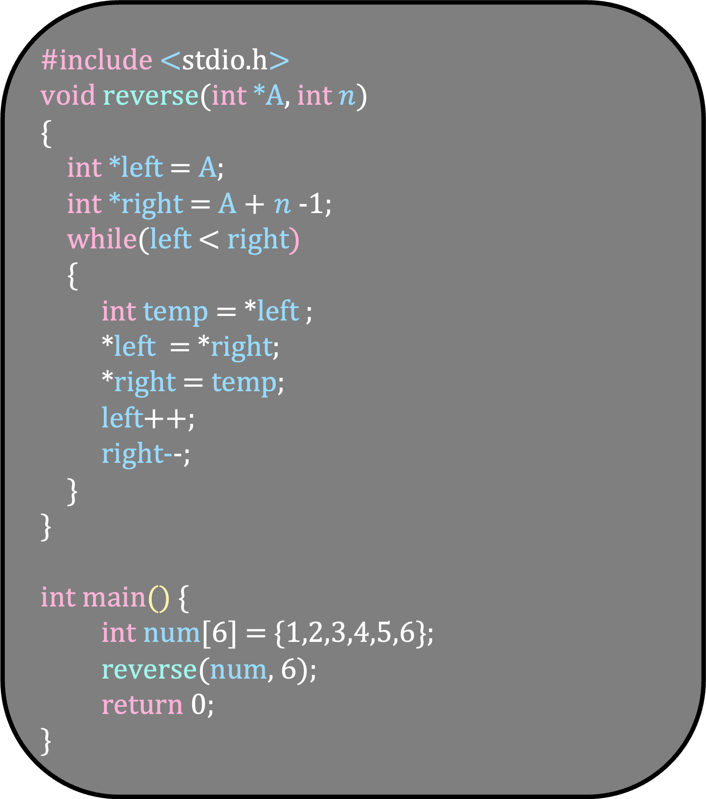
Write a function that reverses the array
#include <stdio.h>
void reverse(int *A, int $n$)
{
int *left = A;
int *right = A + $n$-1;
while(left < right)
{
int temp = *left ;
*left = *right;
*right = temp;
left++;
right--;
}
}
int main() {
int num[6] = {1,2,3,4,5,6};
reverse(num, 6);
return 0;
}

Slide 12
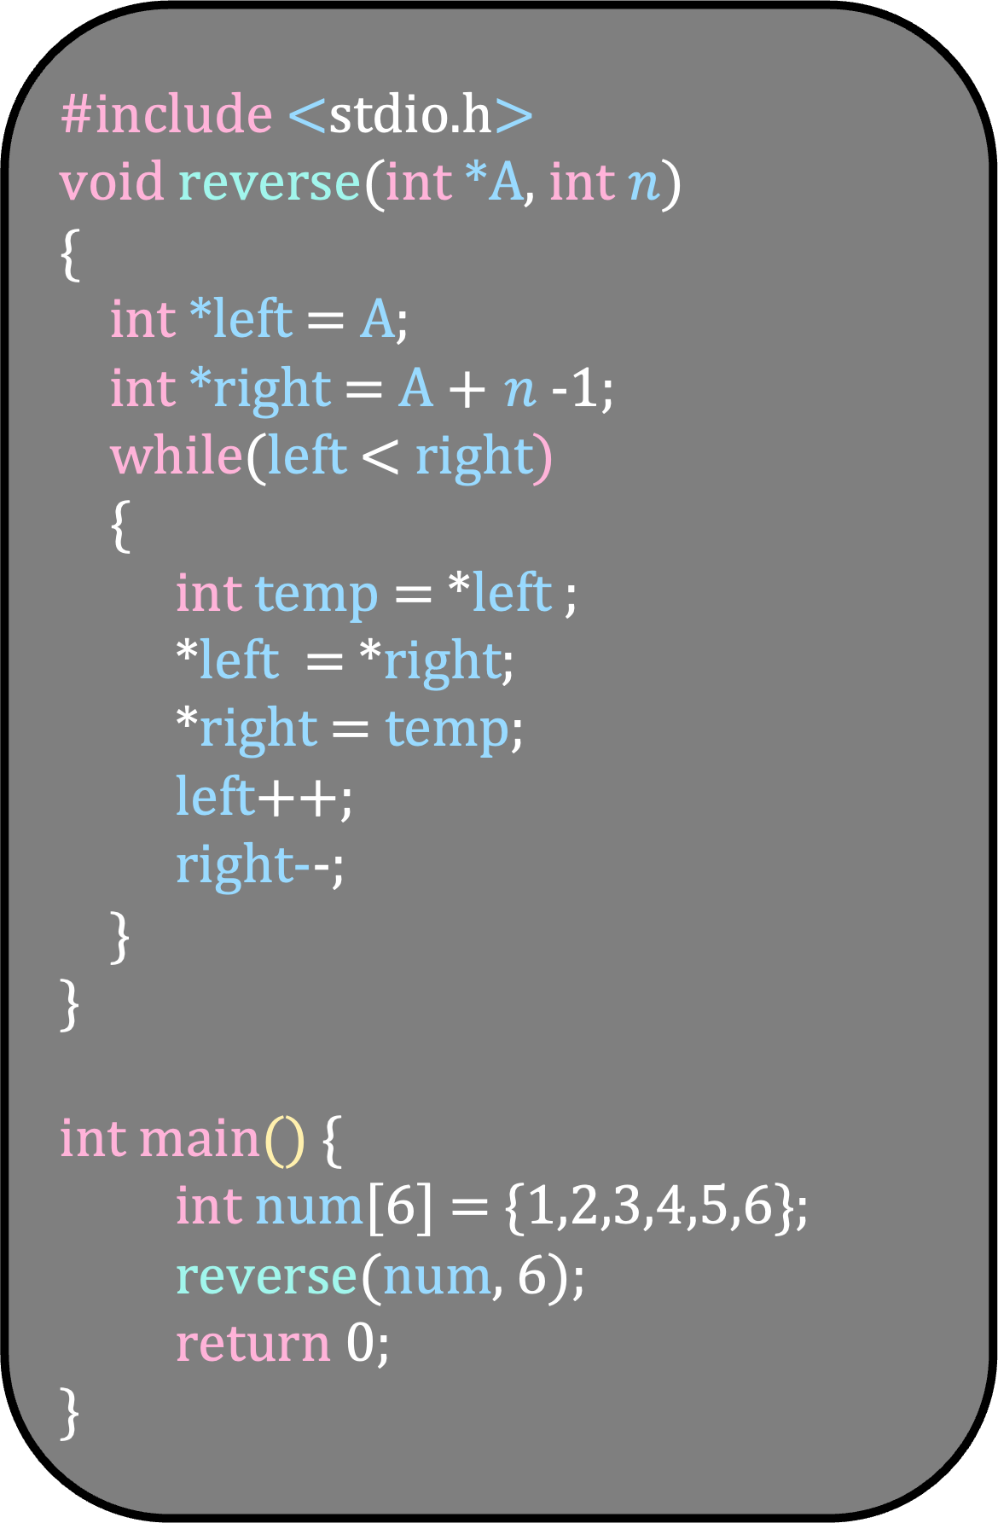
#include <stdio.h>
void reverse(int *A, int $n$)
{
int *left = A;
int *right = A + $n$-1;
while(left < right)
{
int temp = *left ;
*left = *right;
*right = temp;
left++;
right--;
}
}
int main() {
int num[6] = {1,2,3,4,5,6};
reverse(num, 6);
return 0;
}
1
2
3
4
5
6
A

Slide 13
#include <stdio.h>
void reverse(int *A, int $n$)
{
int *left = A;
int *right = A + $n$-1;
while(left < right)
{
int temp = *left ;
*left = *right;
*right = temp;
left++;
right--;
}
}
int main() {
int num[6] = {1,2,3,4,5,6};
reverse(num, 6);
return 0;
}
1
2
3
4
5
6
A
left

Slide 14
#include <stdio.h>
void reverse(int *A, int $n$)
{
int *left = A;
int *right = A + $n$-1;
while(left < right)
{
int temp = *left ;
*left = *right;
*right = temp;
left++;
right--;
}
}
int main() {
int num[6] = {1,2,3,4,5,6};
reverse(num, 6);
return 0;
}
1
2
3
4
5
6
A
right
left

Slide 15
#include <stdio.h>
void reverse(int *A, int $n$)
{
int *left = A;
int *right = A + $n$-1;
while(left < right)
{
int temp = *left ;
*left = *right;
*right = temp;
left++;
right--;
}
}
int main() {
int num[6] = {1,2,3,4,5,6};
reverse(num, 6);
return 0;
}
1
2
3
4
5
6
A
right
left

Slide 16
#include <stdio.h>
void reverse(int *A, int $n$)
{
int *left = A;
int *right = A + $n$-1;
while(left < right)
{
int temp = *left ;
*left = *right;
*right = temp;
left++;
right--;
}
}
int main() {
int num[6] = {1,2,3,4,5,6};
reverse(num, 6);
return 0;
}
6
2
3
4
5
1
A
right
left

Slide 17
#include <stdio.h>
void reverse(int *A, int $n$)
{
int *left = A;
int *right = A + $n$-1;
while(left < right)
{
int temp = *left ;
*left = *right;
*right = temp;
left++;
right--;
}
}
int main() {
int num[6] = {1,2,3,4,5,6};
reverse(num, 6);
return 0;
}
6
2
3
4
5
1
A
left
right

Slide 18
#include <stdio.h>
void reverse(int *A, int $n$)
{
int *left = A;
int *right = A + $n$-1;
while(left < right)
{
int temp = *left ;
*left = *right;
*right = temp;
left++;
right--;
}
}
int main() {
int num[6] = {1,2,3,4,5,6};
reverse(num, 6);
return 0;
}
6
2
3
4
5
1
A
left
right

Slide 19
#include <stdio.h>
void reverse(int *A, int $n$)
{
int *left = A;
int *right = A + $n$-1;
while(left < right)
{
int temp = *left ;
*left = *right;
*right = temp;
left++;
right--;
}
}
int main() {
int num[6] = {1,2,3,4,5,6};
reverse(num, 6);
return 0;
}
6
2
3
4
5
1
A
left
right

Slide 20
#include <stdio.h>
void reverse(int *A, int $n$)
{
int *left = A;
int *right = A + $n$-1;
while(left < right)
{
int temp = *left ;
*left = *right;
*right = temp;
left++;
right--;
}
}
int main() {
int num[6] = {1,2,3,4,5,6};
reverse(num, 6);
return 0;
}
6
5
3
4
2
1
A
left
right

Slide 21
#include <stdio.h>
void reverse(int *A, int $n$)
{
int *left = A;
int *right = A + $n$-1;
while(left < right)
{
int temp = *left ;
*left = *right;
*right = temp;
left++;
right--;
}
}
int main() {
int num[6] = {1,2,3,4,5,6};
reverse(num, 6);
return 0;
}
6
5
3
4
2
1
A
left
right

Slide 22
#include <stdio.h>
void reverse(int *A, int $n$)
{
int *left = A;
int *right = A + $n$-1;
while(left < right)
{
int temp = *left ;
*left = *right;
*right = temp;
left++;
right--;
}
}
int main() {
int num[6] = {1,2,3,4,5,6};
reverse(num, 6);
return 0;
}
6
5
3
4
2
1
A
left
right

Slide 23
#include <stdio.h>
void reverse(int *A, int $n$)
{
int *left = A;
int *right = A + $n$-1;
while(left < right)
{
int temp = *left ;
*left = *right;
*right = temp;
left++;
right--;
}
}
int main() {
int num[6] = {1,2,3,4,5,6};
reverse(num, 6);
return 0;
}
6
5
4
3
2
1
A
left
right

Slide 24
#include <stdio.h>
void reverse(int *A, int $n$)
{
int *left = A;
int *right = A + $n$-1;
while(left < right)
{
int temp = *left ;
*left = *right;
*right = temp;
left++;
right--;
}
}
int main() {
int num[6] = {1,2,3,4,5,6};
reverse(num, 6);
return 0;
}
6
5
4
3
2
1
A
right
left

Slide 25
So far, we have focussed only on passing the array
How do we return an array from a function?

Slide 26
#include <stdio.h>
int *create()
{
int num[5] = {1,2,3,4,5};
return num;
}
int main() {
int *p = create();
return 0;
}
This does not work because num is a local array in create; its lifetime ends when create returns
How do we create an array inside a function that is not a local variable?

Slide 27
#include <stdio.h>
int *create()
{
int *num = malloc(5*sizeof(int));
if (num == NULL)
{
printf(“Could not allocate”);
return NULL;
}
return num;
}
int main() {
int *p = create();
return 0;
}
Heap is a region of the memory used for persistent dynamic memory allocation

Slide 28
#include <stdio.h>
int *create()
{
int *num = malloc(5*sizeof(int));
if (num == NULL)
{
printf(“Could not allocate”);
return NULL;
}
return num;
}
int main() {
int *p = create();
free(p);
return 0;
}
Heap is a region of the memory used for persistent dynamic memory allocation
malloc requests for memory and free releases the memory

Slide 29
#include <stdio.h>
int main() {
int arr[5];
int *num = malloc(5*sizeof(int)); free(num);
return 0;
}
arr is allocated on the stack and num is allocated on the heap
The memory allocated to arr is released automatically but num needs to be freed explicitly

Slide 30
Write a function int *add( int A[], int n, int num) that adds num to the end of the array A and then return the array
#include <stdio.h>
int main() {
int arr[5];
int *num = malloc(5*sizeof(int)); free(num);
return 0;
}

Slide 31
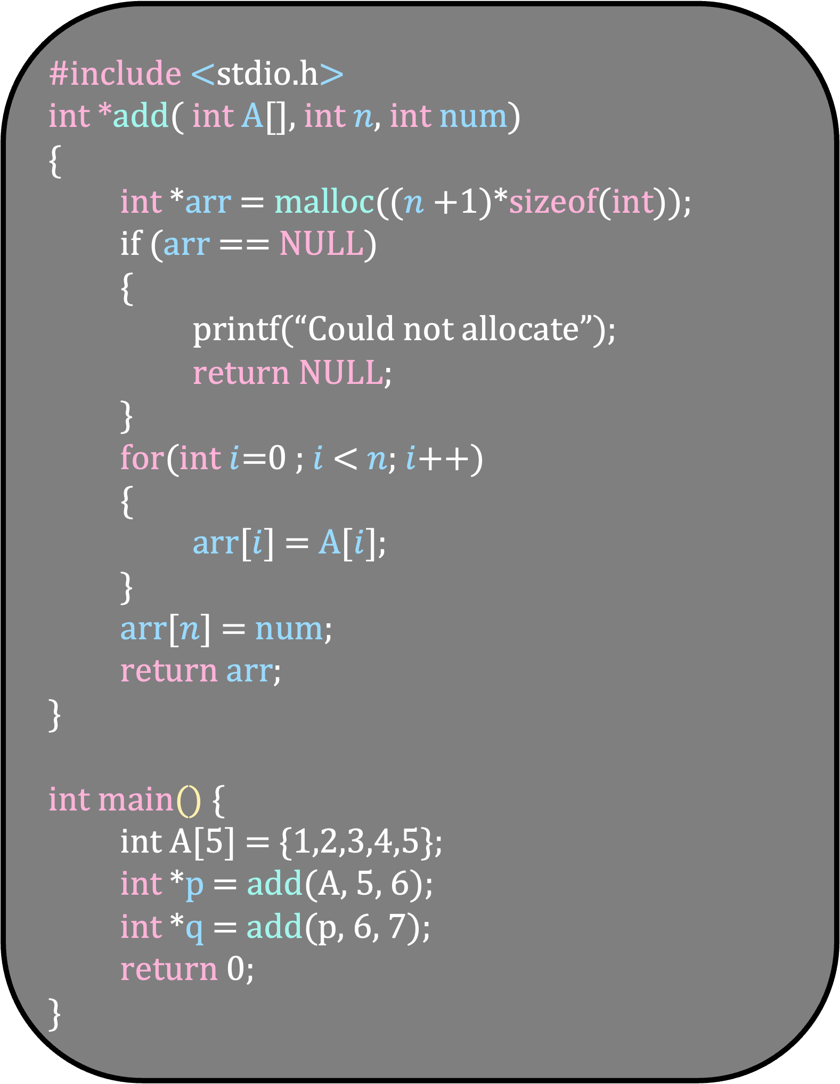
#include <stdio.h>
int *add( int A[], int $n$, int num)
{
int *arr = malloc(($n$+1)*sizeof(int));
if (arr == NULL)
{
printf(“Could not allocate”);
return NULL;
}
for(int $i$=0 ; $i$ < $n$; $i$++)
{
arr[$i$] = A[$i$];
}
arr[$n$] = num;
return arr;
}
int main() {
int A[5] = {1,2,3,4,5};
int *p = add(A, 5, 6);
int *q = add(p, 6, 7);
return 0;
}

Slide 32
Write a program that reads an unknown number of positive integers and prints them in reverse.
Each number is provided on a separate line.
The value -1 marks the end of input and must not be stored in the array
Since the number of integers is not known in advance, dynamically resize the array

Slide 33
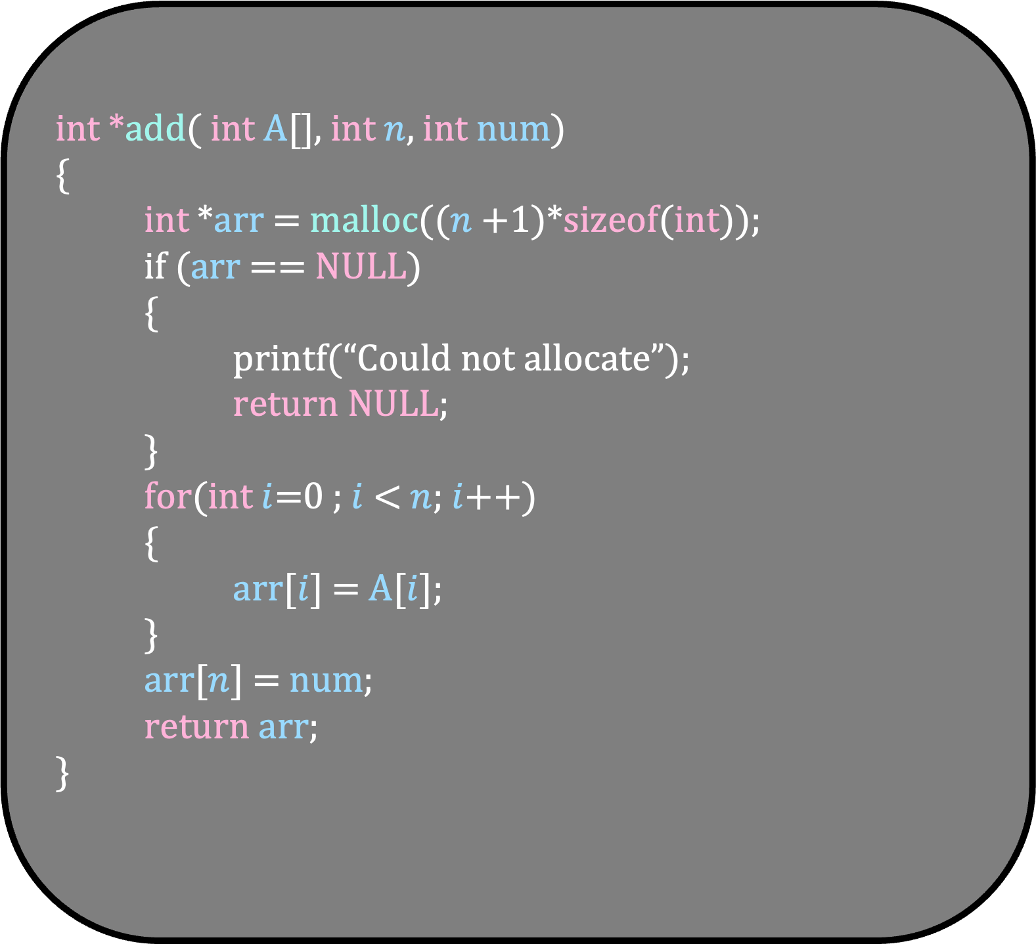
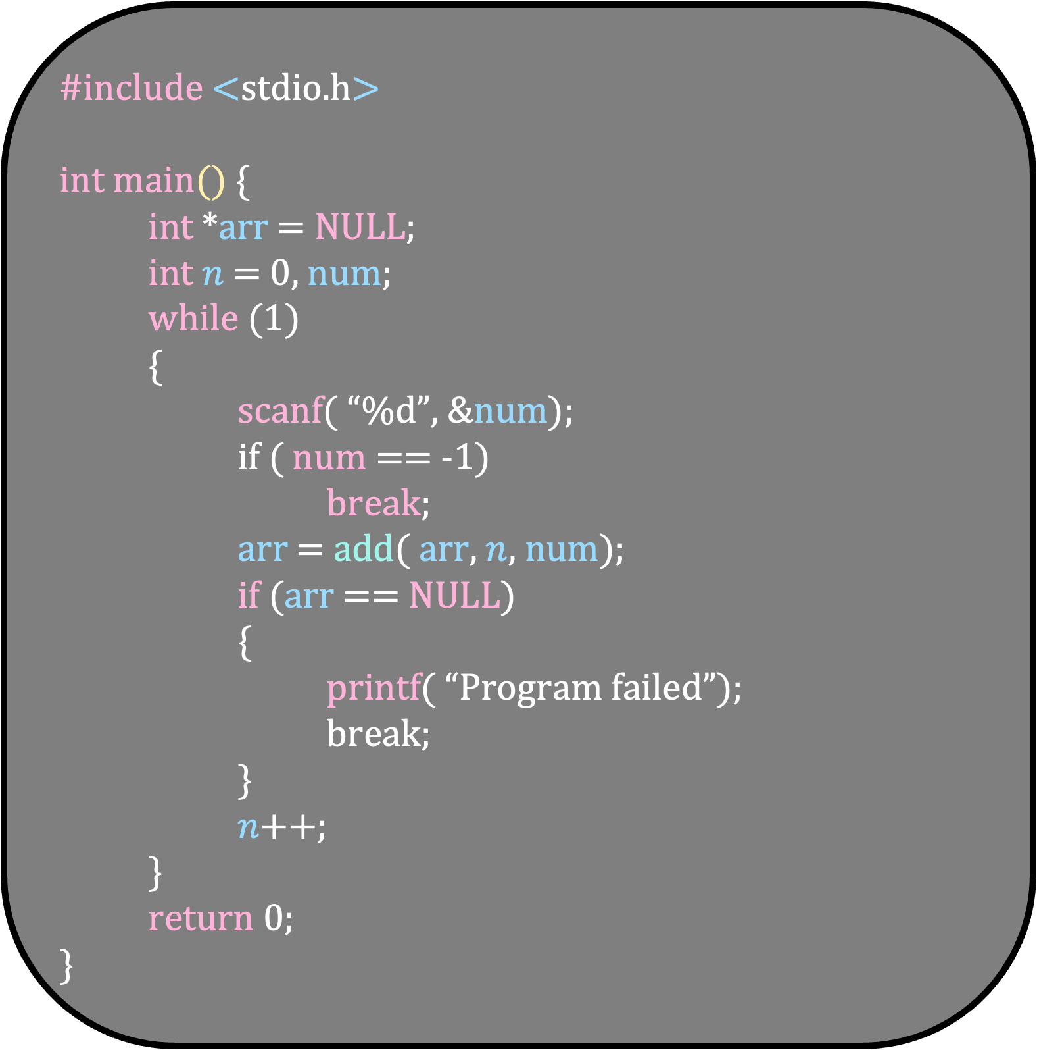
#include <stdio.h>
int main() {
int *arr = NULL;
int $n$ = 0, num;
while (1)
{
scanf( “%d”, &num);
if ( num == -1)
break;
arr = add( arr, $n$, num);
if (arr == NULL)
{
printf( “Program failed”);
break;
}
$n$++;
}
return 0;
}
int *add( int A[], int $n$, int num)
{
int *arr = malloc(($n$+1)*sizeof(int));
if (arr == NULL)
{
printf(“Could not allocate”);
return NULL;
}
for(int $i$=0 ; $i$ < $n$; $i$++)
{
arr[$i$] = A[$i$];
}
arr[$n$] = num;
return arr;
}

Slide 34
Write a function int *removeAt( int *arr, int n, int index) that removes the element at arr[index] and then return the array

Slide 35
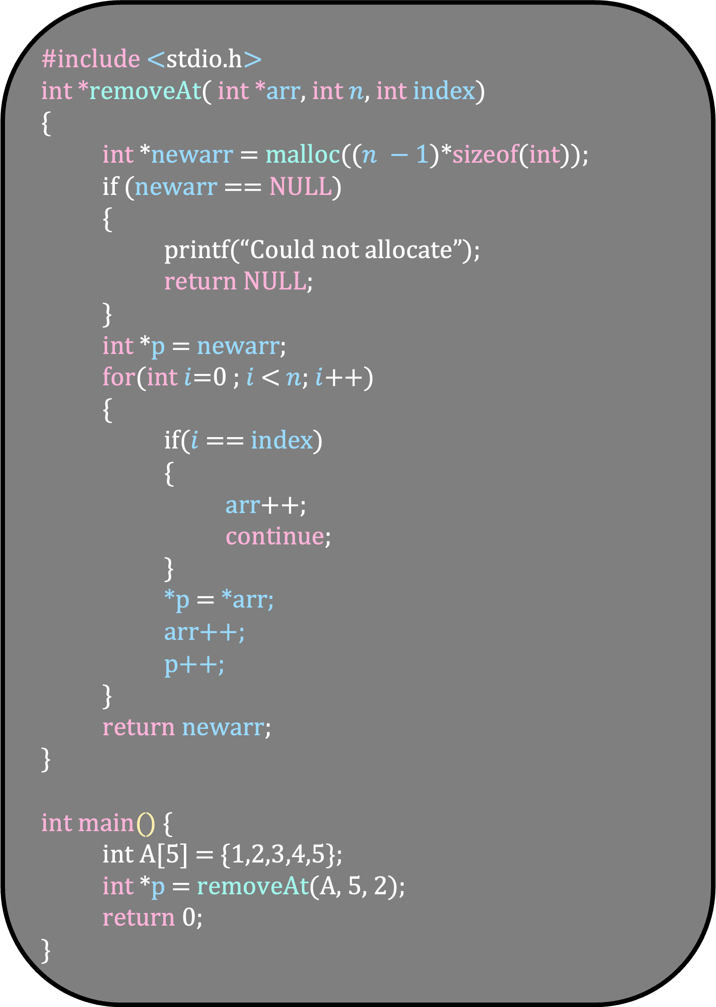
#include <stdio.h>
int *removeAt( int *arr, int $n$, int index)
{
int *newarr = malloc(($n −1$)*sizeof(int));
if (newarr == NULL)
{
printf(“Could not allocate”);
return NULL;
}
int *p = newarr;
for(int $i$=0 ; $i$ < $n$; $i$++)
{
if($i$== index)
{
arr++;
continue;
}
*p = *arr;
arr++;
p++;
}
return newarr;
}
int main() {
int A[5] = {1,2,3,4,5};
int *p = removeAt(A, 5, 2);
return 0;
}

Slide 36
Structures

Slide 37
Structures are the primitive version of classes in programming
#include <stdio.h>
#include <string.h>
struct Person {
char name[50];
int age;
int salary;
};

Slide 38
#include <stdio.h>
#include <string.h>
struct Person {
char name[50];
int age;
int salary;
};
int main()
{
struct Person p1 = { “Ria”, 25, 10000};
struct Person p2;
strcpy( p2.name, “Rahul”);
p2.age = 20;
p2.salary = 5000;
printf( “%s %d %d”, p1.name, p1.age, p1.salary);
struct Person team[2] = {p1,p2};
}
Let us try to pass a structure into a function
Again, how should it be passed?
It makes sense to pass the address of the structure – like we did for arrays
Unfortunately, that is not what happens

Slide 39
#include <stdio.h>
#include <string.h>
struct Person {
char name[50];
int age;
int salary;
};
void print(struct Person p)
{
printf( “%s %d %d”, p.name, p.age, p.salary);
}
int main()
{
struct Person p1 = { “Ria”, 25, 10000};
print(p1);
}
Changing p does not change p1
It will take a huge amount of time just to copy the arguments – making our program slow
So, we use pointers anyway

Slide 40
#include <stdio.h>
#include <string.h>
struct Person {
char name[50];
int age;
int salary;
};
void print(struct Person *p)
{
printf( “%s %d %d”, p.name, p.age, p.salary);
}
int main()
{
struct Person p1 = { “Ria”, 25, 10000};
print(&p1);
}
Changing p does not change p1
It will take a huge amount of time just to copy the arguments – making our program slow
So, we use pointers anyway

Slide 41
#include <stdio.h>
#include <string.h>
struct Person {
char name[50];
int age;
int salary;
};
void print(struct Person *p)
{
printf( “%s %d %d”, p->name, p->age, p->salary);
}
int main()
{
struct Person p1 = { “Ria”, 25, 10000};
print(&p1);
}
Changing p does not change p1
It will take a huge amount of time just to copy the arguments – making our program slow
So, we use pointers anyway

Slide 42
How to return a structure?
#include <stdio.h>
struct Person {
char name[50];
int age;
int salary;
};
struct Person create()
{
struct Person p = { “Ria”, 30, 10000};
return p;
}
int main()
{
struct Person p1 = create();
}
Again, returning a structure takes a huge amount of time -- making our program slow
So, we use pointers anyway

Slide 43
How to return a structure?
#include <stdio.h>
#include <string.h>
struct Person {
char name[50];
int age;
int salary;
};
struct Person *create()
{
struct Person *p = malloc( sizeof(struct Person));
strcpy( p->name, “Rahul”);
p->age = 20;
p->salary = 5000;
return p;
}
int main()
{
struct Person *p1 = create();
}
Again, returning a structure takes a huge amount of time -- making our program slow
So, we use pointers anyway

Slide 44
Array of Structures

Slide 45
#include <stdio.h>
#include <string.h>
struct Person {
char name[50];
int age;
int salary;
};
int main()
{
struct Person p1 = { “Ria”, 25, 10000};
struct Person p2;
strcpy( p2.name, “Rahul”);
p2.age = 20;
p2.salary = 5000;
printf( “%s %d %d”, p1.name, p1.age, p1.salary);
struct Person team[2] = {p1,p2};
}

Slide 46
Write a program that maintains the information about its employees with the following operations. The information is stored dynamically in an array of structures. The input will contain multiple lines of the following form:
0
Rahul
Adds Rahul to your record
1
5
Remove the person from index 5 from your record
Stop the program and print the names of all the employees separated by a space
-1

Slide 47
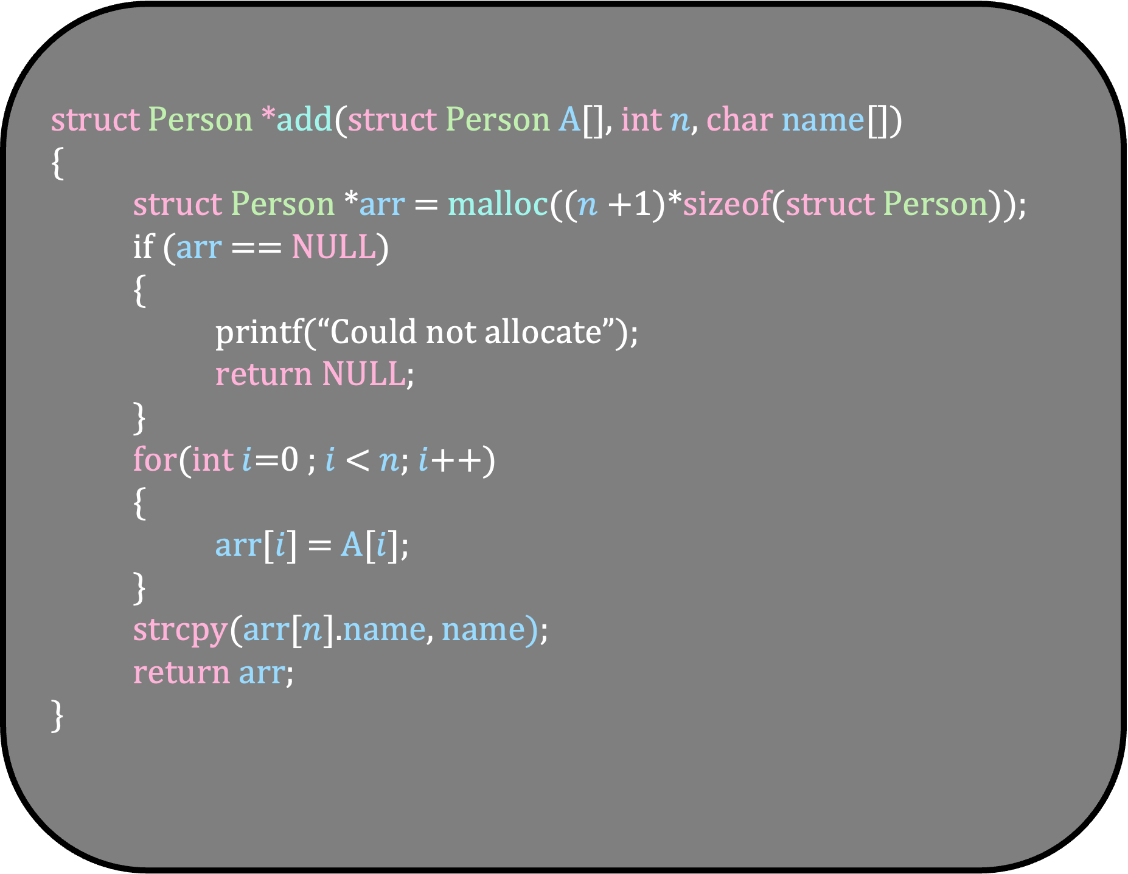
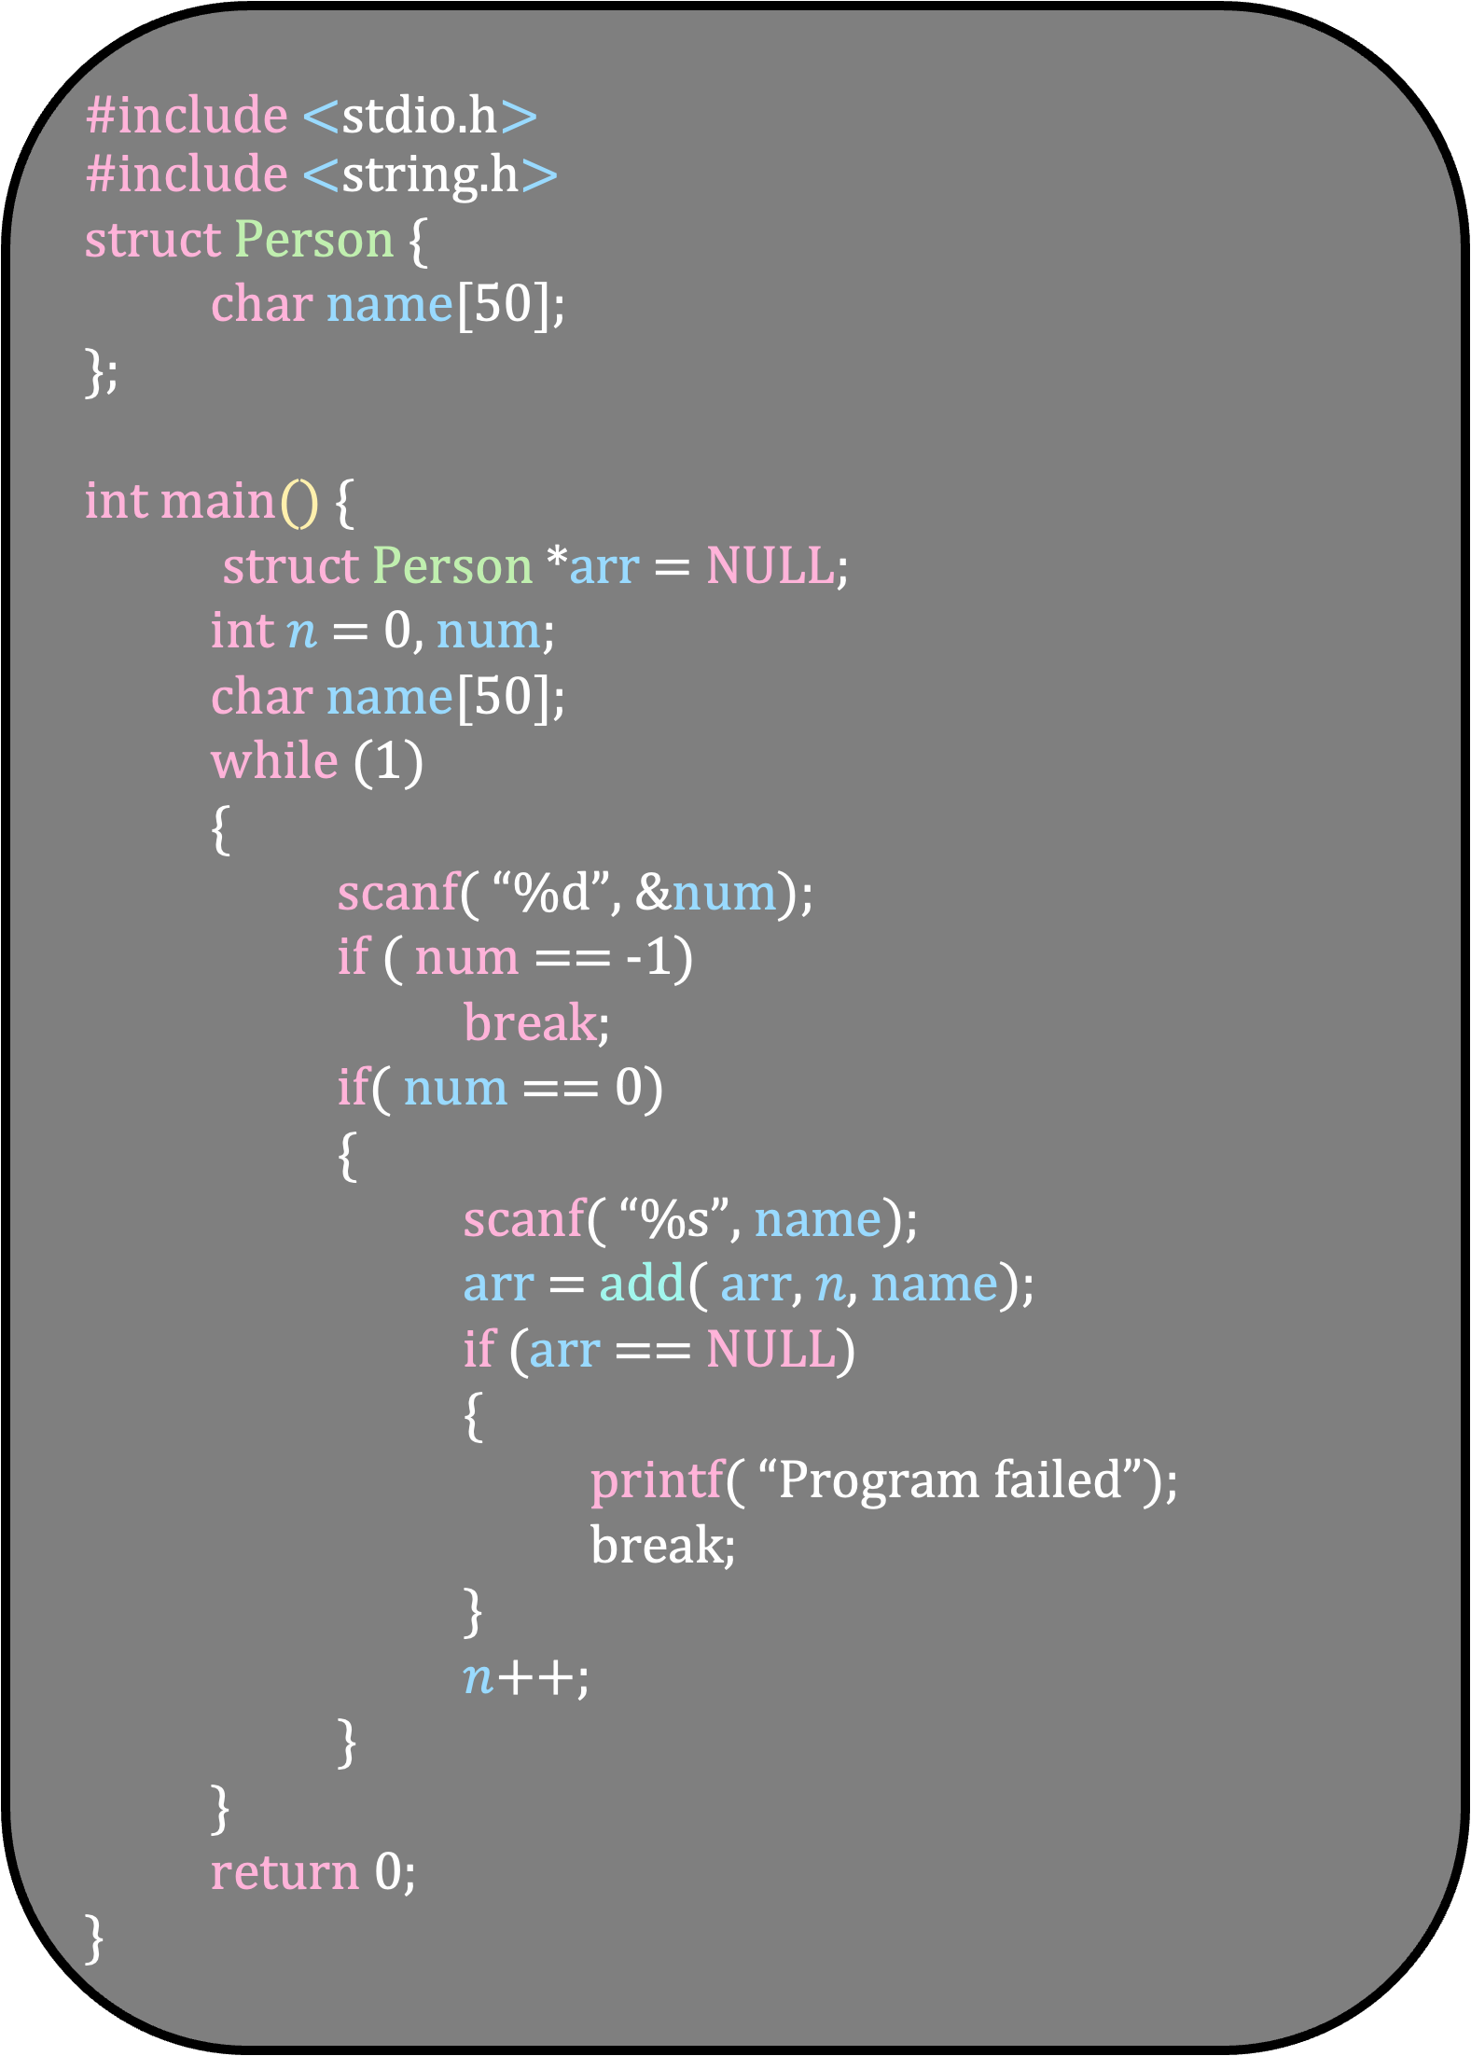
#include <stdio.h>
#include <string.h>
struct Person {
char name[50];
};
int main() {
struct Person *arr = NULL;
int $n$ = 0, num;
char name[50];
while (1)
{
scanf( “%d”, &num);
if ( num == -1)
break;
if( num == 0)
{
scanf( “%s”, name);
arr = add( arr, $n$, name);
if (arr == NULL)
{
printf( “Program failed”);
break;
}
$n$++;
}
}
return 0;
}
struct Person *add(struct Person A[], int $n$, char name[])
{
struct Person *arr = malloc(($n$+1)*sizeof(struct Person));
if (arr == NULL)
{
printf(“Could not allocate”);
return NULL;
}
for(int $i$=0 ; $i$ < $n$; $i$++)
{
arr[$i$] = A[$i$];
}
strcpy(arr[$n$].name, name);
return arr;
}

