Slide 1
Partition

Slide 2
A
9
5
4
10
2
Write a function that takes this array and does the following:
Take the first element of the array as the pivot (in this case, 9).
Rearrange the array so that all elements less than 9 are placed to the left of the 9, and all elements greater than 9 are placed to the right of the 9.

Slide 3
A
5
4
2
9
10
This function is called partition
It partitions the array using the first element as the pivot (in this example, 9).
The array is rearranged so that all elements smaller than the pivot are placed to its left, and all elements larger than the pivot are placed to its right.
The pivot does not have to be the first element; any element of the array can be chosen as the pivot.
This is not sorting, but 9 is at its correct position in the final sorted array

Slide 4
A
9
5
4
10
2
A
Write a function that takes an array A and partitions the array using the first number as the pivot

Slide 5
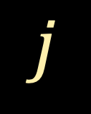
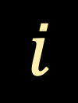

Write a function that takes an array A and partitions the array using the first number as the pivot
A
9
5
4
10
2
A
$$i$$
B will contain numbers less than 9
B
$$j$$
C will contain numbers greater than 9
C
$$k$$

Slide 6
Write a function that takes an array A and partitions the array using the first number as the pivot
A
9
4
10
2
A
$$i$$
B will contain numbers less than 9
B
5
$$j$$
C will contain numbers greater than 9
C
$$k$$

Slide 7
Write a function that takes an array A and partitions the array using the first number as the pivot
A
9
10
2
A
$$i$$
B will contain numbers less than 9
B
5
4
$$j$$
C will contain numbers greater than 9
C
$$k$$

Slide 8

Write a function that takes an array A and partitions the array using the first number as the pivot
A
9
2
A
$$i$$
B will contain numbers less than 9
B
5
4
$$j$$
C will contain numbers greater than 9
C
10
$$k$$

Slide 9
Write a function that takes an array A and partitions the array using the first number as the pivot
A
9
A
$$i$$
B will contain numbers less than 9
B
5
4
2
$$j$$
C will contain numbers greater than 9
C
10
$$k$$

Slide 10
Write a function that takes an array A and partitions the array using the first number as the pivot
A
pivot
9
A
$$i$$
B will contain numbers less than 9
B
5
4
2
$$j$$
C will contain numbers greater than 9
C
10
$$k$$

Slide 11
Write a function that takes an array A and partitions the array using the first number as the pivot
A
5
4
2
pivot
9
A
$$i$$
B will contain numbers less than 9
B
$$j$$
C will contain numbers greater than 9
C
10
$$k$$

Slide 12
Write a function that takes an array A and partitions the array using the first number as the pivot
A
5
4
2
9
pivot
A
$$i$$
B will contain numbers less than 9
B
$$j$$
C will contain numbers greater than 9
C
10
$$k$$

Slide 13
Write a function that takes an array A and partitions the array using the first number as the pivot
A
5
4
2
9
10
pivot
A
$$i$$
B will contain numbers less than 9
B
$$j$$
C will contain numbers greater than 9
C
$$k$$

Slide 14
Write a function int partition(int A[], int n) that takes
an array A
partitions the array using the first number as the pivot
returns the index of the pivot in A after partition

Slide 15

int partition(int A[], int $n$)
{
int $i$, $j$ = 0, $k$ = 0;
int B[$n$],C[$n$];
int pivot = A[0];
for($i$=1 ; $i$< $n$; $i$++)
{
if ( A[$i$] <= pivot )
{
B[$j$] = A[$i$];
$j$++;
}
else
{
C[$k$] = A[$i$];
$k$++;
}
}
for ($i$=0; $i$< $j$; $i$++)
{
A[$i$] = B[$i$];
}
A[$j$] = pivot;
for($i$=0 ; $i$ < $k$ ; $i$++)
{
A[$j$+1+ $i$] = C[$i$];
}
return $j$;
}

Slide 16


int partition(int A[], int $n$)
{
int $i$, $j$ = 0, $k$ = 0;
int B[$n$],C[$n$];
int pivot = A[0];
for($i$=1 ; $i$< $n$; $i$++)
{
if ( A[$i$] <= pivot )
{
B[$j$] = A[$i$];
$j$++;
}
else
{
C[$k$] = A[$i$];
$k$++;
}
}
for ($i$=0; $i$< $j$; $i$++)
{
A[$i$] = B[$i$];
}
A[$j$] = pivot;
for($i$=0 ; $i$ < $k$ ; $i$++)
{
A[$j$+1+ $i$] = C[$i$];
}
return $j$;
}
A
A
$$i$$
B
5
4
2
$$j$$
C
10
$$k$$
pivot
9

Slide 17
int partition(int A[], int $n$)
{
int $i$, $j$ = 0, $k$ = 0;
int B[$n$],C[$n$];
int pivot = A[0];
for($i$=1 ; $i$< $n$; $i$++)
{
if ( A[$i$] <= pivot )
{
B[$j$] = A[$i$];
$j$++;
}
else
{
C[$k$] = A[$i$];
$k$++;
}
}
for ($i$=0; $i$< $j$; $i$++)
{
A[$i$] = B[$i$];
}
A[$j$] = pivot;
for($i$=0 ; $i$ < $k$ ; $i$++)
{
A[$j$+1+ $i$] = C[$i$];
}
return $j$;
}
A
A
B
5
4
2
$$i$$
$$j$$
C
10
$$k$$
pivot
9

Slide 18
int partition(int A[], int $n$)
{
int $i$, $j$ = 0, $k$ = 0;
int B[$n$],C[$n$];
int pivot = A[0];
for($i$=1 ; $i$< $n$; $i$++)
{
if ( A[$i$] <= pivot )
{
B[$j$] = A[$i$];
$j$++;
}
else
{
C[$k$] = A[$i$];
$k$++;
}
}
for ($i$=0; $i$< $j$; $i$++)
{
A[$i$] = B[$i$];
}
A[$j$] = pivot;
for($i$=0 ; $i$ < $k$ ; $i$++)
{
A[$j$+1+ $i$] = C[$i$];
}
return $j$;
}
A
A
B
5
4
2
$$i$$
$$j$$
C
10
$$k$$
pivot
9

Slide 19
int partition(int A[], int $n$)
{
int $i$, $j$ = 0, $k$ = 0;
int B[$n$],C[$n$];
int pivot = A[0];
for($i$=1 ; $i$< $n$; $i$++)
{
if ( A[$i$] <= pivot )
{
B[$j$] = A[$i$];
$j$++;
}
else
{
C[$k$] = A[$i$];
$k$++;
}
}
for ($i$=0; $i$< $j$; $i$++)
{
A[$i$] = B[$i$];
}
A[$j$] = pivot;
for($i$=0 ; $i$ < $k$ ; $i$++)
{
A[$j$+1+ $i$] = C[$i$];
}
return $j$;
}
A
5
A
B
4
2
$$i$$
$$j$$
C
10
$$k$$
pivot
9

Slide 20
int partition(int A[], int $n$)
{
int $i$, $j$ = 0, $k$ = 0;
int B[$n$],C[$n$];
int pivot = A[0];
for($i$=1 ; $i$< $n$; $i$++)
{
if ( A[$i$] <= pivot )
{
B[$j$] = A[$i$];
$j$++;
}
else
{
C[$k$] = A[$i$];
$k$++;
}
}
for ($i$=0; $i$< $j$; $i$++)
{
A[$i$] = B[$i$];
}
A[$j$] = pivot;
for($i$=0 ; $i$ < $k$ ; $i$++)
{
A[$j$+1+ $i$] = C[$i$];
}
return $j$;
}
A
5
A
B
4
2
$$i$$
$$j$$
C
10
$$k$$
pivot
9

Slide 21
int partition(int A[], int $n$)
{
int $i$, $j$ = 0, $k$ = 0;
int B[$n$],C[$n$];
int pivot = A[0];
for($i$=1 ; $i$< $n$; $i$++)
{
if ( A[$i$] <= pivot )
{
B[$j$] = A[$i$];
$j$++;
}
else
{
C[$k$] = A[$i$];
$k$++;
}
}
for ($i$=0; $i$< $j$; $i$++)
{
A[$i$] = B[$i$];
}
A[$j$] = pivot;
for($i$=0 ; $i$ < $k$ ; $i$++)
{
A[$j$+1+ $i$] = C[$i$];
}
return $j$;
}
A
5
4
A
B
2
$$i$$
$$j$$
C
10
$$k$$
pivot
9

Slide 22
int partition(int A[], int $n$)
{
int $i$, $j$ = 0, $k$ = 0;
int B[$n$],C[$n$];
int pivot = A[0];
for($i$=1 ; $i$< $n$; $i$++)
{
if ( A[$i$] <= pivot )
{
B[$j$] = A[$i$];
$j$++;
}
else
{
C[$k$] = A[$i$];
$k$++;
}
}
for ($i$=0; $i$< $j$; $i$++)
{
A[$i$] = B[$i$];
}
A[$j$] = pivot;
for($i$=0 ; $i$ < $k$ ; $i$++)
{
A[$j$+1+ $i$] = C[$i$];
}
return $j$;
}
A
5
4
A
B
2
$$i$$
$$j$$
C
10
$$k$$
pivot
9

Slide 23
int partition(int A[], int $n$)
{
int $i$, $j$ = 0, $k$ = 0;
int B[$n$],C[$n$];
int pivot = A[0];
for($i$=1 ; $i$< $n$; $i$++)
{
if ( A[$i$] <= pivot )
{
B[$j$] = A[$i$];
$j$++;
}
else
{
C[$k$] = A[$i$];
$k$++;
}
}
for ($i$=0; $i$< $j$; $i$++)
{
A[$i$] = B[$i$];
}
A[$j$] = pivot;
for($i$=0 ; $i$ < $k$ ; $i$++)
{
A[$j$+1+ $i$] = C[$i$];
}
return $j$;
}
A
5
4
2
A
B
$$j$$
$$i$$
C
10
$$k$$
pivot
9

Slide 24
int partition(int A[], int $n$)
{
int $i$, $j$ = 0, $k$ = 0;
int B[$n$],C[$n$];
int pivot = A[0];
for($i$=1 ; $i$< $n$; $i$++)
{
if ( A[$i$] <= pivot )
{
B[$j$] = A[$i$];
$j$++;
}
else
{
C[$k$] = A[$i$];
$k$++;
}
}
for ($i$=0; $i$< $j$; $i$++)
{
A[$i$] = B[$i$];
}
A[$j$] = pivot;
for($i$=0 ; $i$ < $k$ ; $i$++)
{
A[$j$+1+ $i$] = C[$i$];
}
return $j$;
}
A
5
4
2
A
B
$$j$$
$$i$$
C
10
$$k$$
pivot
9

Slide 25
int partition(int A[], int $n$)
{
int $i$, $j$ = 0, $k$ = 0;
int B[$n$],C[$n$];
int pivot = A[0];
for($i$=1 ; $i$< $n$; $i$++)
{
if ( A[$i$] <= pivot )
{
B[$j$] = A[$i$];
$j$++;
}
else
{
C[$k$] = A[$i$];
$k$++;
}
}
for ($i$=0; $i$< $j$; $i$++)
{
A[$i$] = B[$i$];
}
A[$j$] = pivot;
for($i$=0 ; $i$ < $k$ ; $i$++)
{
A[$j$+1+ $i$] = C[$i$];
}
return $j$;
}
A
5
4
2
A
$$j$$
B
$$i$$
C
10
$$k$$
pivot
9

Slide 26
int partition(int A[], int $n$)
{
int $i$, $j$ = 0, $k$ = 0;
int B[$n$],C[$n$];
int pivot = A[0];
for($i$=1 ; $i$< $n$; $i$++)
{
if ( A[$i$] <= pivot )
{
B[$j$] = A[$i$];
$j$++;
}
else
{
C[$k$] = A[$i$];
$k$++;
}
}
for ($i$=0; $i$< $j$; $i$++)
{
A[$i$] = B[$i$];
}
A[$j$] = pivot;
for($i$=0 ; $i$ < $k$ ; $i$++)
{
A[$j$+1+ $i$] = C[$i$];
}
return $j$;
}
A
5
4
2
9
A
$$j$$
B
$$i$$
C
10
$$k$$
pivot

Slide 27
int partition(int A[], int $n$)
{
int $i$, $j$ = 0, $k$ = 0;
int B[$n$],C[$n$];
int pivot = A[0];
for($i$=1 ; $i$< $n$; $i$++)
{
if ( A[$i$] <= pivot )
{
B[$j$] = A[$i$];
$j$++;
}
else
{
C[$k$] = A[$i$];
$k$++;
}
}
for ($i$=0; $i$< $j$; $i$++)
{
A[$i$] = B[$i$];
}
A[$j$] = pivot;
for($i$=0 ; $i$ < $k$ ; $i$++)
{
A[$j$+1+ $i$] = C[$i$];
}
return $j$;
}
A
5
4
2
9
A
$$j$$
B
C
10
$$i$$
$$k$$
pivot

Slide 28
int partition(int A[], int $n$)
{
int $i$, $j$ = 0, $k$ = 0;
int B[$n$],C[$n$];
int pivot = A[0];
for($i$=1 ; $i$< $n$; $i$++)
{
if ( A[$i$] <= pivot )
{
B[$j$] = A[$i$];
$j$++;
}
else
{
C[$k$] = A[$i$];
$k$++;
}
}
for ($i$=0; $i$< $j$; $i$++)
{
A[$i$] = B[$i$];
}
A[$j$] = pivot;
for($i$=0 ; $i$ < $k$ ; $i$++)
{
A[$j$+1+ $i$] = C[$i$];
}
return $j$;
}
A
5
4
2
9
A
$$j$$
B
C
10
$$i$$
$$k$$
pivot

Slide 29
int partition(int A[], int $n$)
{
int $i$, $j$ = 0, $k$ = 0;
int B[$n$],C[$n$];
int pivot = A[0];
for($i$=1 ; $i$< $n$; $i$++)
{
if ( A[$i$] <= pivot )
{
B[$j$] = A[$i$];
$j$++;
}
else
{
C[$k$] = A[$i$];
$k$++;
}
}
for ($i$=0; $i$< $j$; $i$++)
{
A[$i$] = B[$i$];
}
A[$j$] = pivot;
for($i$=0 ; $i$ < $k$ ; $i$++)
{
A[$j$+1+ $i$] = C[$i$];
}
return $j$;
}
A
5
4
2
9
10
A
$$j$$
B
C
$$k$$
$$i$$
pivot

Slide 30
int partition(int A[], int $n$)
{
int $i$, $j$ = 0, $k$ = 0;
int B[$n$],C[$n$];
int pivot = A[0];
for($i$=1 ; $i$< $n$; $i$++)
{
if ( A[$i$] <= pivot )
{
B[$j$] = A[$i$];
$j$++;
}
else
{
C[$k$] = A[$i$];
$k$++;
}
}
for ($i$=0; $i$< $j$; $i$++)
{
A[$i$] = B[$i$];
}
A[$j$] = pivot;
for($i$=0 ; $i$ < $k$ ; $i$++)
{
A[$j$+1+ $i$] = C[$i$];
}
return $j$;
}
A
5
4
2
9
10
A
$$j$$
B
C
$$k$$
$$i$$
pivot

Slide 31

int partition(int A[], int $n$)
{
int $i$, $j$ = 0, $k$ = 0;
int B[$n$],C[$n$];
int pivot = A[0];
for($i$=1 ; $i$< $n$; $i$++)
{
if ( A[$i$] <= pivot )
{
B[$j$] = A[$i$];
$j$++;
}
else
{
C[$k$] = A[$i$];
$k$++;
}
}
for ($i$=0; $i$< $j$; $i$++)
{
A[$i$] = B[$i$];
}
A[$j$] = pivot;
for($i$=0 ; $i$ < $k$ ; $i$++)
{
A[$j$+1+ $i$] = C[$i$];
}
return $j$;
}
Running Time of Partition
O(n)
cn
cn
cn

Slide 32
Write a function int partition(int A[], int n) that takes
an array A
partitions the array using the first number as the pivot
returns the index of the pivot in A after partition
Your function should not use any extra array.

Slide 33
A
9
5
14
10
2
19
16
A
6
Count
3
In one pass, count the number less than the pivot
Swap the pivot and the fourth number in the array

Slide 34
A
10
5
14
9
2
19
16
A
6
Count
3
In one pass, count the number less than the pivot
Swap the pivot and the fourth number in the array
Now the pivot is at its correct place
But how to partition the array?

Slide 35
A
10
5
14
9
2
19
16
A
6
$$i$$
$$j$$
Check A[i] and A[j]
If these two numbers are out of place, swap

Slide 36
A
2
5
14
9
10
19
16
A
6
$$i$$
$$j$$
Check A[i] and A[j]
If these two numbers are out of place, swap

Slide 37
A
2
5
14
9
10
19
16
A
6
$$i$$
$$j$$
Check A[i] and A[j]
If these two numbers are out of place, swap

Slide 38
A
2
5
14
9
10
19
16
A
6
$$i$$
$$j$$
Check A[i] and A[j]
If these two numbers are out of place, swap

Slide 39
A
2
5
14
9
10
19
16
A
6
$$i$$
$$j$$
Check A[i] and A[j]
If these two numbers are out of place, swap

Slide 40
A
2
5
6
9
10
19
16
A
14
$$i$$
$$j$$
Check A[i] and A[j]
If these two numbers are out of place, swap
Implement this algorithm

Slide 41
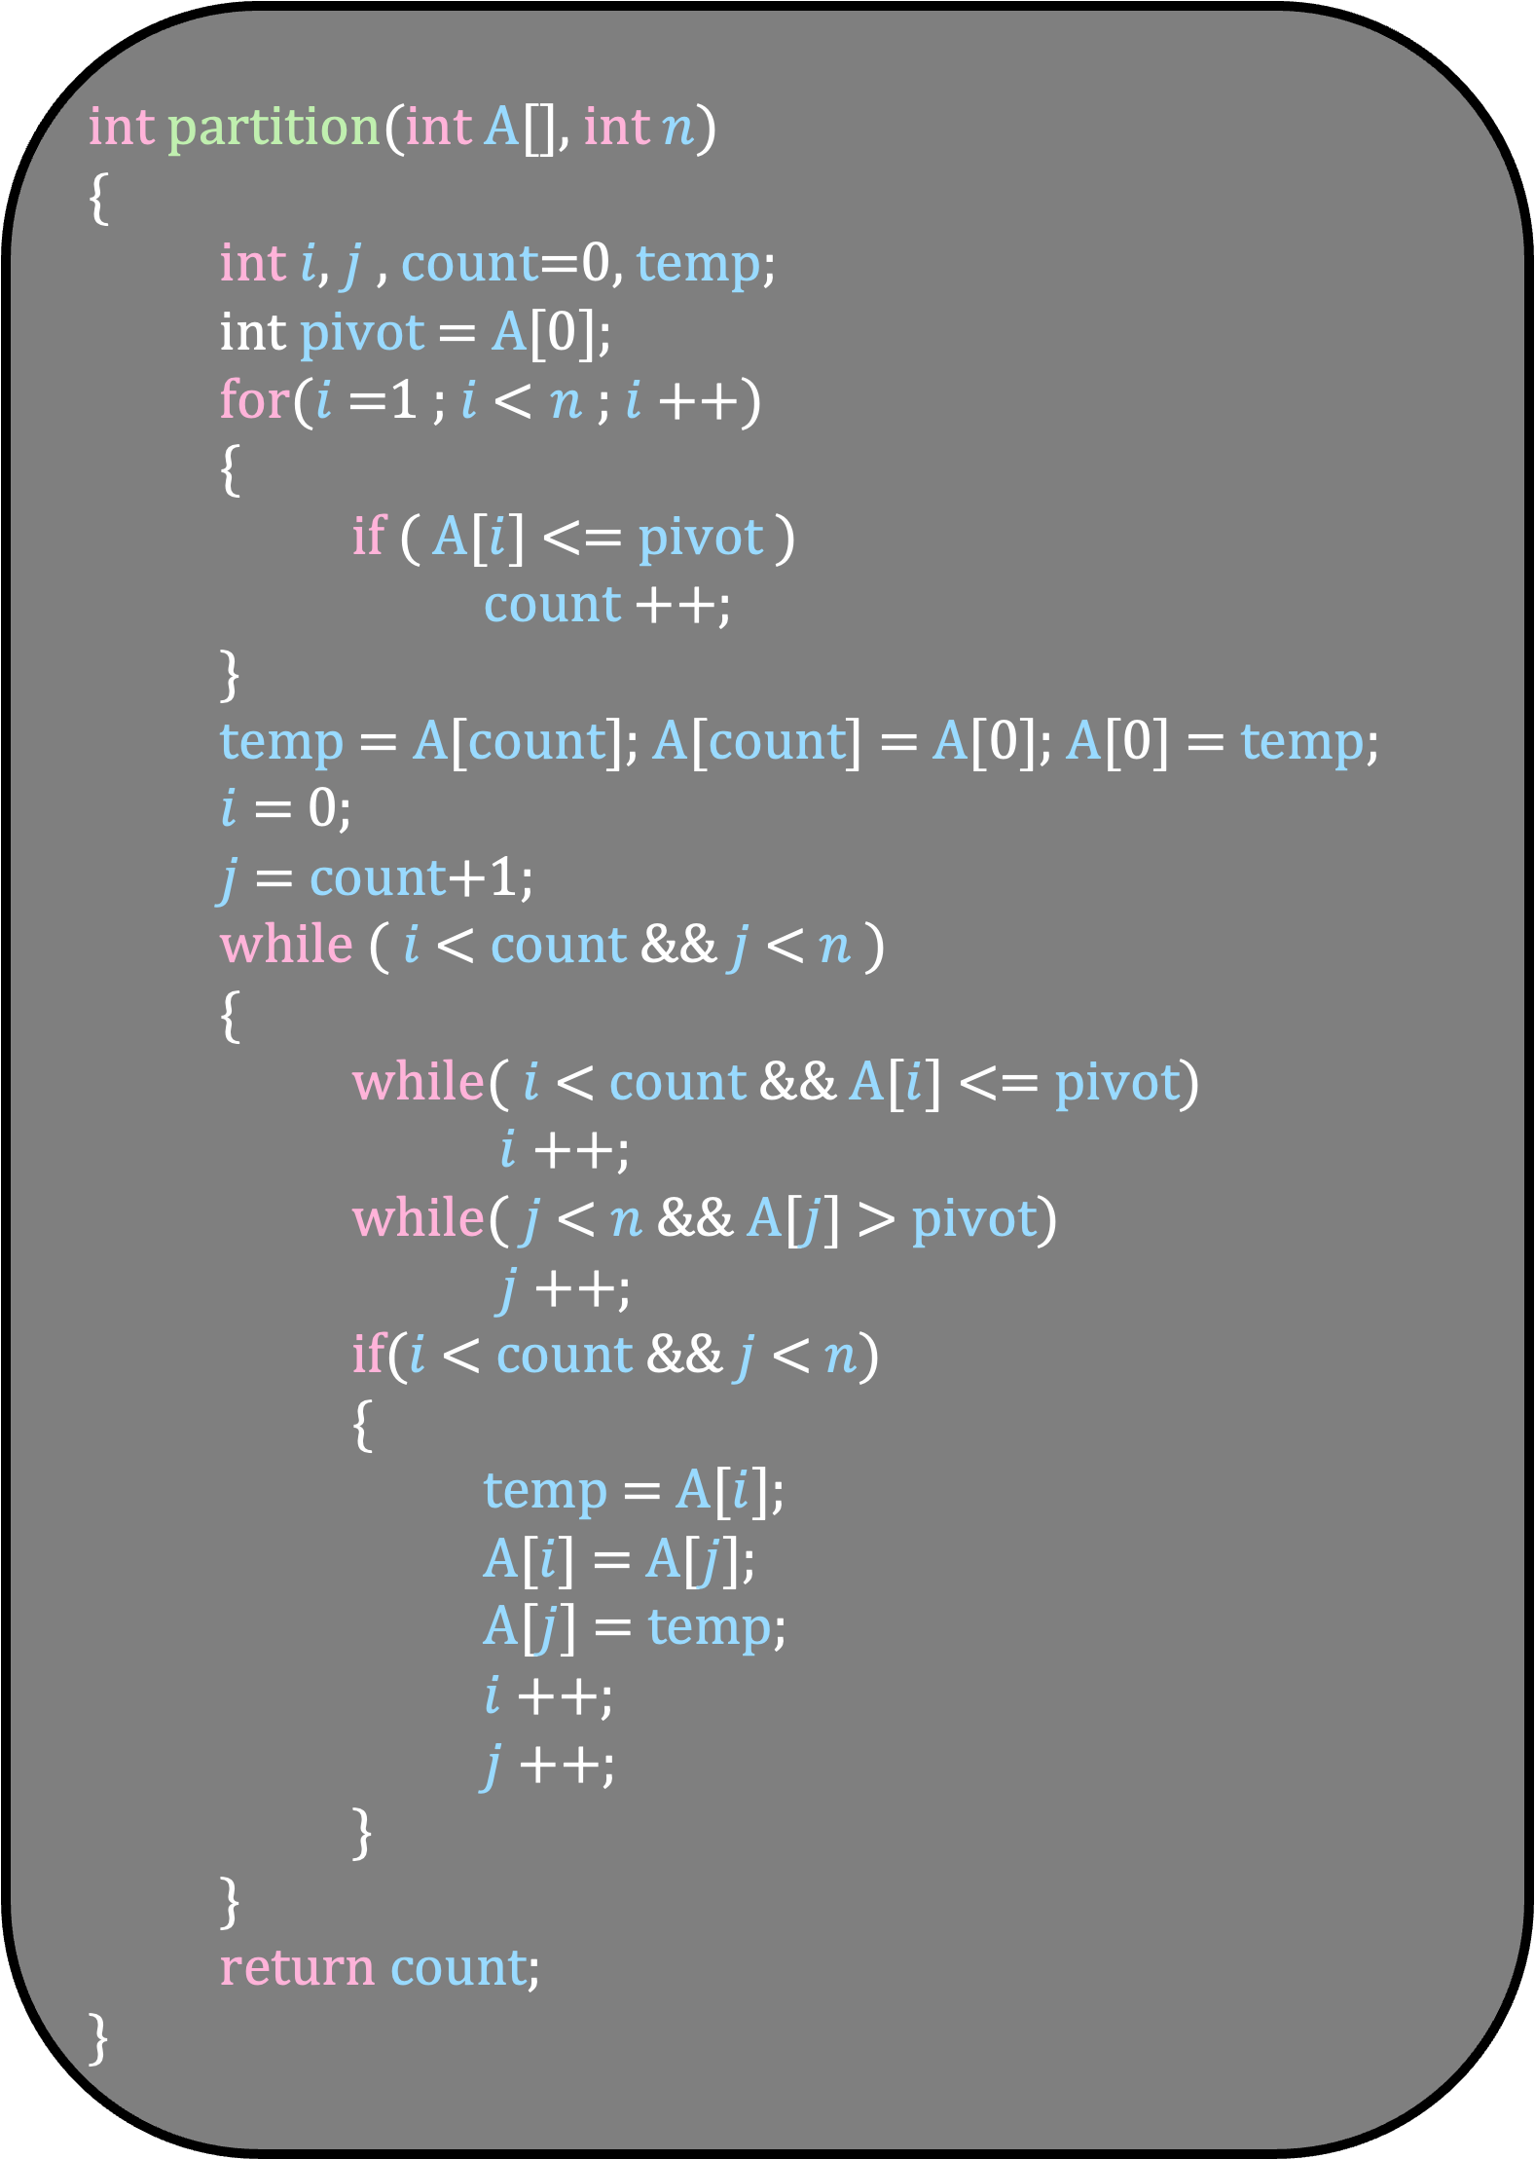
int partition(int A[], int $n$)
{
int $i$, $j$ , count=0, temp;
int pivot = A[0];
for($i$=1 ; $i$< $n$ ; $i$++)
{
if ( A[$i$] <= pivot )
count ++;
}
temp = A[count]; A[count] = A[0]; A[0] = temp;
$i$ = 0;
$j$ = count+1;
while ( $i$ < count && $j$ < $n$ )
{
while( $i$ < count && A[$i$] <= pivot)
$i$ ++;
while( $j$ < $n$ && A[$j$] > pivot)
$j$++;
if($i$ < count && $j$ < $n$)
{
temp = A[$i$];
A[$i$] = A[$j$];
A[$j$] = temp;
$i$++;
$j$++;
}
}
return count;
}
A
10
5
14
9
2
19
16
6
$$i$$
$$j$$
Count
3

Slide 42
int partition(int A[], int $n$)
{
int $i$, $j$ , count=0, temp;
int pivot = A[0];
for($i$=1 ; $i$< $n$ ; $i$++)
{
if ( A[$i$] <= pivot )
count ++;
}
temp = A[count]; A[count] = A[0]; A[0] = temp;
$i$ = 0;
$j$ = count+1;
while ( $i$ < count && $j$ < $n$ )
{
while( $i$ < count && A[$i$] <= pivot)
$i$ ++;
while( $j$ < $n$ && A[$j$] > pivot)
$j$++;
if($i$ < count && $j$ < $n$)
{
temp = A[$i$];
A[$i$] = A[$j$];
A[$j$] = temp;
$i$++;
$j$++;
}
}
return count;
}
A
10
5
14
9
2
19
16
6
$$i$$
$$j$$
Count
3

Slide 43
int partition(int A[], int $n$)
{
int $i$, $j$ , count=0, temp;
int pivot = A[0];
for($i$=1 ; $i$< $n$ ; $i$++)
{
if ( A[$i$] <= pivot )
count ++;
}
temp = A[count]; A[count] = A[0]; A[0] = temp;
$i$ = 0;
$j$ = count+1;
while ( $i$ < count && $j$ < $n$ )
{
while( $i$ < count && A[$i$] <= pivot)
$i$ ++;
while( $j$ < $n$ && A[$j$] > pivot)
$j$++;
if($i$ < count && $j$ < $n$)
{
temp = A[$i$];
A[$i$] = A[$j$];
A[$j$] = temp;
$i$++;
$j$++;
}
}
return count;
}
A
10
5
14
9
2
19
16
6
$$i$$
$$j$$
Count
3

Slide 44
int partition(int A[], int $n$)
{
int $i$, $j$ , count=0, temp;
int pivot = A[0];
for($i$=1 ; $i$< $n$ ; $i$++)
{
if ( A[$i$] <= pivot )
count ++;
}
temp = A[count]; A[count] = A[0]; A[0] = temp;
$i$ = 0;
$j$ = count+1;
while ( $i$ < count && $j$ < $n$ )
{
while( $i$ < count && A[$i$] <= pivot)
$i$ ++;
while( $j$ < $n$ && A[$j$] > pivot)
$j$++;
if($i$ < count && $j$ < $n$)
{
temp = A[$i$];
A[$i$] = A[$j$];
A[$j$] = temp;
$i$++;
$j$++;
}
}
return count;
}
A
10
5
14
9
2
19
16
6
$$i$$
$$j$$
Count
3

Slide 45
int partition(int A[], int $n$)
{
int $i$, $j$ , count=0, temp;
int pivot = A[0];
for($i$=1 ; $i$< $n$ ; $i$++)
{
if ( A[$i$] <= pivot )
count ++;
}
temp = A[count]; A[count] = A[0]; A[0] = temp;
$i$ = 0;
$j$ = count+1;
while ( $i$ < count && $j$ < $n$ )
{
while( $i$ < count && A[$i$] <= pivot)
$i$ ++;
while( $j$ < $n$ && A[$j$] > pivot)
$j$++;
if($i$ < count && $j$ < $n$)
{
temp = A[$i$];
A[$i$] = A[$j$];
A[$j$] = temp;
$i$++;
$j$++;
}
}
return count;
}
A
2
5
14
9
10
19
16
6
$$i$$
$$j$$
Count
3

Slide 46
int partition(int A[], int $n$)
{
int $i$, $j$ , count=0, temp;
int pivot = A[0];
for($i$=1 ; $i$< $n$ ; $i$++)
{
if ( A[$i$] <= pivot )
count ++;
}
temp = A[count]; A[count] = A[0]; A[0] = temp;
$i$ = 0;
$j$ = count+1;
while ( $i$ < count && $j$ < $n$ )
{
while( $i$ < count && A[$i$] <= pivot)
$i$ ++;
while( $j$ < $n$ && A[$j$] > pivot)
$j$++;
if($i$ < count && $j$ < $n$)
{
temp = A[$i$];
A[$i$] = A[$j$];
A[$j$] = temp;
$i$++;
$j$++;
}
}
return count;
}
A
2
5
14
9
10
19
16
6
$$i$$
$$j$$
Count
3

Slide 47
int partition(int A[], int $n$)
{
int $i$, $j$ , count=0, temp;
int pivot = A[0];
for($i$=1 ; $i$< $n$ ; $i$++)
{
if ( A[$i$] <= pivot )
count ++;
}
temp = A[count]; A[count] = A[0]; A[0] = temp;
$i$ = 0;
$j$ = count+1;
while ( $i$ < count && $j$ < $n$ )
{
while( $i$ < count && A[$i$] <= pivot)
$i$ ++;
while( $j$ < $n$ && A[$j$] > pivot)
$j$++;
if($i$ < count && $j$ < $n$)
{
temp = A[$i$];
A[$i$] = A[$j$];
A[$j$] = temp;
$i$++;
$j$++;
}
}
return count;
}
A
2
5
14
9
10
19
16
6
$$i$$
$$j$$
Count
3

Slide 48
int partition(int A[], int $n$)
{
int $i$, $j$ , count=0, temp;
int pivot = A[0];
for($i$=1 ; $i$< $n$ ; $i$++)
{
if ( A[$i$] <= pivot )
count ++;
}
temp = A[count]; A[count] = A[0]; A[0] = temp;
$i$ = 0;
$j$ = count+1;
while ( $i$ < count && $j$ < $n$ )
{
while( $i$ < count && A[$i$] <= pivot)
$i$ ++;
while( $j$ < $n$ && A[$j$] > pivot)
$j$++;
if($i$ < count && $j$ < $n$)
{
temp = A[$i$];
A[$i$] = A[$j$];
A[$j$] = temp;
$i$++;
$j$++;
}
}
return count;
}
A
2
5
14
9
10
19
16
6
$$i$$
$$j$$
Count
3

Slide 49
int partition(int A[], int $n$)
{
int $i$, $j$ , count=0, temp;
int pivot = A[0];
for($i$=1 ; $i$< $n$ ; $i$++)
{
if ( A[$i$] <= pivot )
count ++;
}
temp = A[count]; A[count] = A[0]; A[0] = temp;
$i$ = 0;
$j$ = count+1;
while ( $i$ < count && $j$ < $n$ )
{
while( $i$ < count && A[$i$] <= pivot)
$i$ ++;
while( $j$ < $n$ && A[$j$] > pivot)
$j$++;
if($i$ < count && $j$ < $n$)
{
temp = A[$i$];
A[$i$] = A[$j$];
A[$j$] = temp;
$i$++;
$j$++;
}
}
return count;
}
A
2
5
14
9
10
19
16
6
$$i$$
$$j$$
Count
3

Slide 50
int partition(int A[], int $n$)
{
int $i$, $j$ , count=0, temp;
int pivot = A[0];
for($i$=1 ; $i$< $n$ ; $i$++)
{
if ( A[$i$] <= pivot )
count ++;
}
temp = A[count]; A[count] = A[0]; A[0] = temp;
$i$ = 0;
$j$ = count+1;
while ( $i$ < count && $j$ < $n$ )
{
while( $i$ < count && A[$i$] <= pivot)
$i$ ++;
while( $j$ < $n$ && A[$j$] > pivot)
$j$++;
if($i$ < count && $j$ < $n$)
{
temp = A[$i$];
A[$i$] = A[$j$];
A[$j$] = temp;
$i$++;
$j$++;
}
}
return count;
}
A
2
5
14
9
10
19
16
6
$$i$$
$$j$$
Count
3

Slide 51
int partition(int A[], int $n$)
{
int $i$, $j$ , count=0, temp;
int pivot = A[0];
for($i$=1 ; $i$< $n$ ; $i$++)
{
if ( A[$i$] <= pivot )
count ++;
}
temp = A[count]; A[count] = A[0]; A[0] = temp;
$i$ = 0;
$j$ = count+1;
while ( $i$ < count && $j$ < $n$ )
{
while( $i$ < count && A[$i$] <= pivot)
$i$ ++;
while( $j$ < $n$ && A[$j$] > pivot)
$j$++;
if($i$ < count && $j$ < $n$)
{
temp = A[$i$];
A[$i$] = A[$j$];
A[$j$] = temp;
$i$++;
$j$++;
}
}
return count;
}
A
2
5
14
9
10
19
16
6
$$i$$
$$j$$
Count
3

Slide 52
int partition(int A[], int $n$)
{
int $i$, $j$ , count=0, temp;
int pivot = A[0];
for($i$=1 ; $i$< $n$ ; $i$++)
{
if ( A[$i$] <= pivot )
count ++;
}
temp = A[count]; A[count] = A[0]; A[0] = temp;
$i$ = 0;
$j$ = count+1;
while ( $i$ < count && $j$ < $n$ )
{
while( $i$ < count && A[$i$] <= pivot)
$i$ ++;
while( $j$ < $n$ && A[$j$] > pivot)
$j$++;
if($i$ < count && $j$ < $n$)
{
temp = A[$i$];
A[$i$] = A[$j$];
A[$j$] = temp;
$i$++;
$j$++;
}
}
return count;
}
A
2
5
14
9
10
19
16
6
$$i$$
$$j$$
Count
3

Slide 53
int partition(int A[], int $n$)
{
int $i$, $j$ , count=0, temp;
int pivot = A[0];
for($i$=1 ; $i$< $n$ ; $i$++)
{
if ( A[$i$] <= pivot )
count ++;
}
temp = A[count]; A[count] = A[0]; A[0] = temp;
$i$ = 0;
$j$ = count+1;
while ( $i$ < count && $j$ < $n$ )
{
while( $i$ < count && A[$i$] <= pivot)
$i$ ++;
while( $j$ < $n$ && A[$j$] > pivot)
$j$++;
if($i$ < count && $j$ < $n$)
{
temp = A[$i$];
A[$i$] = A[$j$];
A[$j$] = temp;
$i$++;
$j$++;
}
}
return count;
}
A
2
5
14
9
10
19
16
6
$$i$$
$$j$$
Count
3

Slide 54
int partition(int A[], int $n$)
{
int $i$, $j$ , count=0, temp;
int pivot = A[0];
for($i$=1 ; $i$< $n$ ; $i$++)
{
if ( A[$i$] <= pivot )
count ++;
}
temp = A[count]; A[count] = A[0]; A[0] = temp;
$i$ = 0;
$j$ = count+1;
while ( $i$ < count && $j$ < $n$ )
{
while( $i$ < count && A[$i$] <= pivot)
$i$ ++;
while( $j$ < $n$ && A[$j$] > pivot)
$j$++;
if($i$ < count && $j$ < $n$)
{
temp = A[$i$];
A[$i$] = A[$j$];
A[$j$] = temp;
$i$++;
$j$++;
}
}
return count;
}
A
2
5
14
9
10
19
16
6
$$i$$
$$j$$
Count
3

Slide 55
int partition(int A[], int $n$)
{
int $i$, $j$ , count=0, temp;
int pivot = A[0];
for($i$=1 ; $i$< $n$ ; $i$++)
{
if ( A[$i$] <= pivot )
count ++;
}
temp = A[count]; A[count] = A[0]; A[0] = temp;
$i$ = 0;
$j$ = count+1;
while ( $i$ < count && $j$ < $n$ )
{
while( $i$ < count && A[$i$] <= pivot)
$i$ ++;
while( $j$ < $n$ && A[$j$] > pivot)
$j$++;
if($i$ < count && $j$ < $n$)
{
temp = A[$i$];
A[$i$] = A[$j$];
A[$j$] = temp;
$i$++;
$j$++;
}
}
return count;
}
A
2
5
14
9
10
19
16
6
$$i$$
$$j$$
Count
3

Slide 56
int partition(int A[], int $n$)
{
int $i$, $j$ , count=0, temp;
int pivot = A[0];
for($i$=1 ; $i$< $n$ ; $i$++)
{
if ( A[$i$] <= pivot )
count ++;
}
temp = A[count]; A[count] = A[0]; A[0] = temp;
$i$ = 0;
$j$ = count+1;
while ( $i$ < count && $j$ < $n$ )
{
while( $i$ < count && A[$i$] <= pivot)
$i$ ++;
while( $j$ < $n$ && A[$j$] > pivot)
$j$++;
if($i$ < count && $j$ < $n$)
{
temp = A[$i$];
A[$i$] = A[$j$];
A[$j$] = temp;
$i$++;
$j$++;
}
}
return count;
}
A
2
5
6
9
10
19
16
14
$$i$$
$$j$$
Count
3

Slide 57
int partition(int A[], int $n$)
{
int $i$, $j$ , count=0, temp;
int pivot = A[0];
for($i$=1 ; $i$< $n$ ; $i$++)
{
if ( A[$i$] <= pivot )
count ++;
}
temp = A[count]; A[count] = A[0]; A[0] = temp;
$i$ = 0;
$j$ = count+1;
while ( $i$ < count && $j$ < $n$ )
{
while( $i$ < count && A[$i$] <= pivot)
$i$ ++;
while( $j$ < $n$ && A[$j$] > pivot)
$j$++;
if($i$ < count && $j$ < $n$)
{
temp = A[$i$];
A[$i$] = A[$j$];
A[$j$] = temp;
$i$++;
$j$++;
}
}
return count;
}
A
2
5
6
9
10
19
16
14
$$i$$
$$j$$
Count
3

Slide 58
int partition(int A[], int $n$)
{
int $i$, $j$ , count=0, temp;
int pivot = A[0];
for($i$=1 ; $i$< $n$ ; $i$++)
{
if ( A[$i$] <= pivot )
count ++;
}
temp = A[count]; A[count] = A[0]; A[0] = temp;
$i$ = 0;
$j$ = count+1;
while ( $i$ < count && $j$ < $n$ )
{
while( $i$ < count && A[$i$] <= pivot)
$i$ ++;
while( $j$ < $n$ && A[$j$] > pivot)
$j$++;
if($i$ < count && $j$ < $n$)
{
temp = A[$i$];
A[$i$] = A[$j$];
A[$j$] = temp;
$i$++;
$j$++;
}
}
return count;
}
Running Time of Partition
All these blocks contain a constant amount of code
We just need to argue how many times these blocks can be executed
Every time a block is executed, either i or j (or both) increment
But how many times can i increment?
count
And j?
n-count

Slide 59
int partition(int A[], int $n$)
{
int $i$, $j$ , count=0, temp;
int pivot = A[0];
for($i$=1 ; $i$< $n$ ; $i$++)
{
if ( A[$i$] <= pivot )
count ++;
}
temp = A[count]; A[count] = A[0]; A[0] = temp;
$i$ = 0;
$j$ = count+1;
while ( $i$ < count && $j$ < $n$ )
{
while( $i$ < count && A[$i$] <= pivot)
$i$ ++;
while( $j$ < $n$ && A[$j$] > pivot)
$j$++;
if($i$ < count && $j$ < $n$)
{
temp = A[$i$];
A[$i$] = A[$j$];
A[$j$] = temp;
$i$++;
$j$++;
}
}
return count;
}
Running Time of Partition
Every time a block is executed, either i or j (or both) increment
But how many times can i increment?
count
And j?
n-count
Total number of times these three blocks are executed is at most n
Thus, the running time is cn = O(n)

Slide 60
Write a function int partition(int A[], int n) that takes
an array A
partitions the array using the first number as the pivot
returns the index of the pivot in A after partition
Your function should not use any extra array
Counting the number of elements less than the pivot is not required
Can you write a function that does not do this counting?

Slide 61
A
9
5
14
2
10
19
16
A
6
$$i$$
$$j$$
Check A[i] and A[j]
If these two numbers are out of place, swap

Slide 62
A
9
5
14
2
10
19
16
A
6
$$i$$
$$j$$
Check A[i] and A[j]
If these two numbers are out of place, swap

Slide 63
A
9
5
6
2
10
19
16
A
14
$$i$$
$$j$$
Check A[i] and A[j]
If these two numbers are out of place, swap

Slide 64
A
9
5
6
2
10
19
16
A
14
$$i$$
$$j$$
Check A[i] and A[j]
If these two numbers are out of place, swap

Slide 65
A
9
5
6
2
10
19
16
A
14
$$i$$
$$j$$
Check A[i] and A[j]
If these two numbers are out of place, swap

Slide 66
A
9
5
6
2
10
19
16
A
14
$$j$$
$$i$$
Check A[i] and A[j]
If these two numbers are out of place, swap

Slide 67
A
9
5
6
2
10
19
16
A
14
$$j$$
$$i$$
Check A[i] and A[j]
If these two numbers are out of place, swap
Swap A[0] with A[j]

Slide 68
A
2
5
6
9
10
19
16
A
14
$$j$$
$$i$$
Check A[i] and A[j]
If these two numbers are out of place, swap
Swap A[0] with A[j]

Slide 69
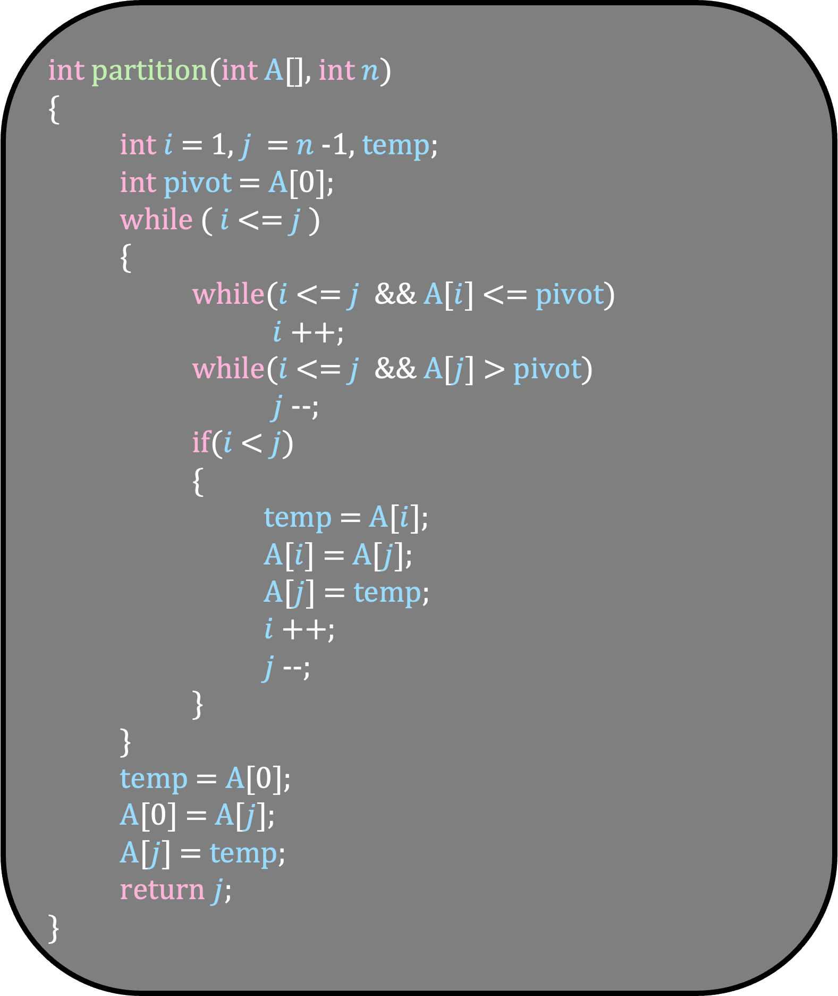
int partition(int A[], int $n$)
{
int $i$ = 1, $j$ = $n$-1, temp;
int pivot = A[0];
while ( $i$ <= $j$ )
{
while($i$ <= $j$ && A[$i$] <= pivot)
$i$ ++;
while($i$ <= $j$ && A[$j$] > pivot)
$j$--;
if($i$ < $j$)
{
temp = A[$i$];
A[$i$] = A[$j$];
A[$j$] = temp;
$i$++;
$j$--;
}
}
temp = A[0];
A[0] = A[$j$];
A[$j$] = temp;
return $j$;
}
Running Time of Partition
Total number of times these three blocks are executed is at most n
Thus, the running time is cn = O(n)

Slide 70
QuickSort

Slide 71
The partition function can be used to sort the array
Let us see how

Slide 72
A
9
5
14
2
10
19
16
6

Slide 73
A
6
5
2
9
10
19
16
14

Slide 74
A
9
6
5
2
10
19
16
14

Slide 75
A
9
2
5
6
10
19
16
14

Slide 76
A
9
6
10
2
5
19
16
14

Slide 77
A
9
6
10
2
5
14
16
19

Slide 78
A
9
6
10
2
19
5
14
16

Slide 79
A
9
6
10
2
19
5
14
16

Slide 80
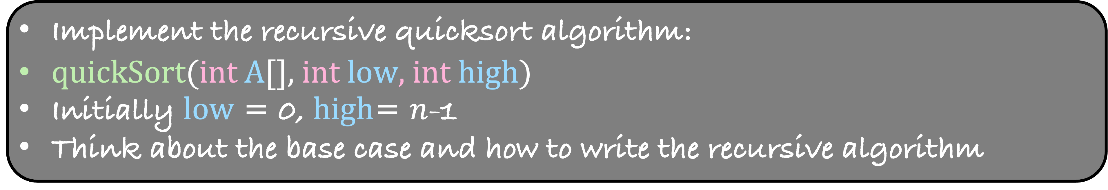
A
2
5
6
9
10
14
16
19
Implement the recursive quicksort algorithm:
quickSort(int A[], int low, int high)
Initially low = 0, high= $n$-1
Think about the base case and how to write the recursive algorithm

Slide 81
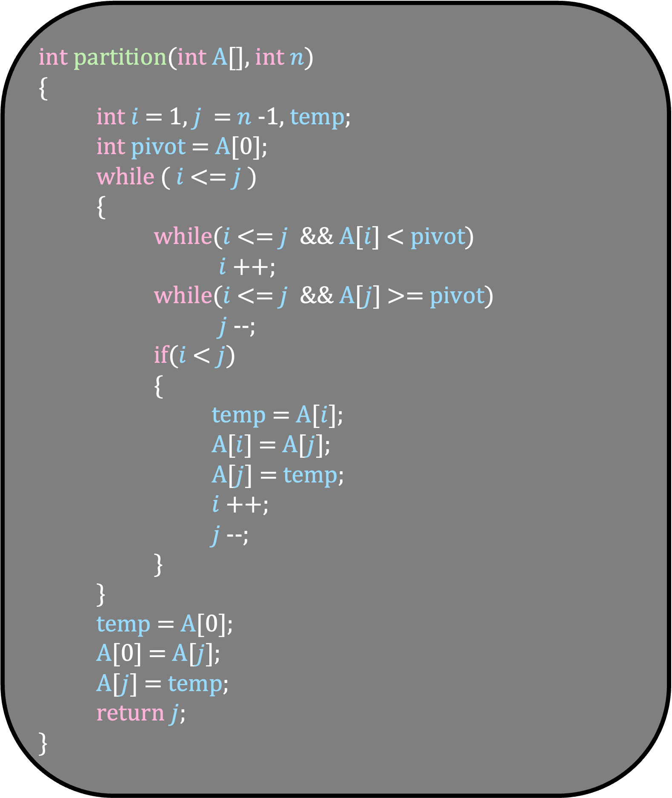
int partition(int A[], int $n$)
{
int $i$ = 1, $j$ = $n$-1, temp;
int pivot = A[0];
while ( $i$ <= $j$ )
{
while($i$ <= $j$ && A[$i$] < pivot)
$i$ ++;
while($i$ <= $j$ && A[$j$] >= pivot)
$j$--;
if($i$ < $j$)
{
temp = A[$i$];
A[$i$] = A[$j$];
A[$j$] = temp;
$i$++;
$j$--;
}
}
temp = A[0];
A[0] = A[$j$];
A[$j$] = temp;
return $j$;
}
void quickSort(int A[], int low, int high)
{
int index = partition(A, low, high);
}

Slide 82
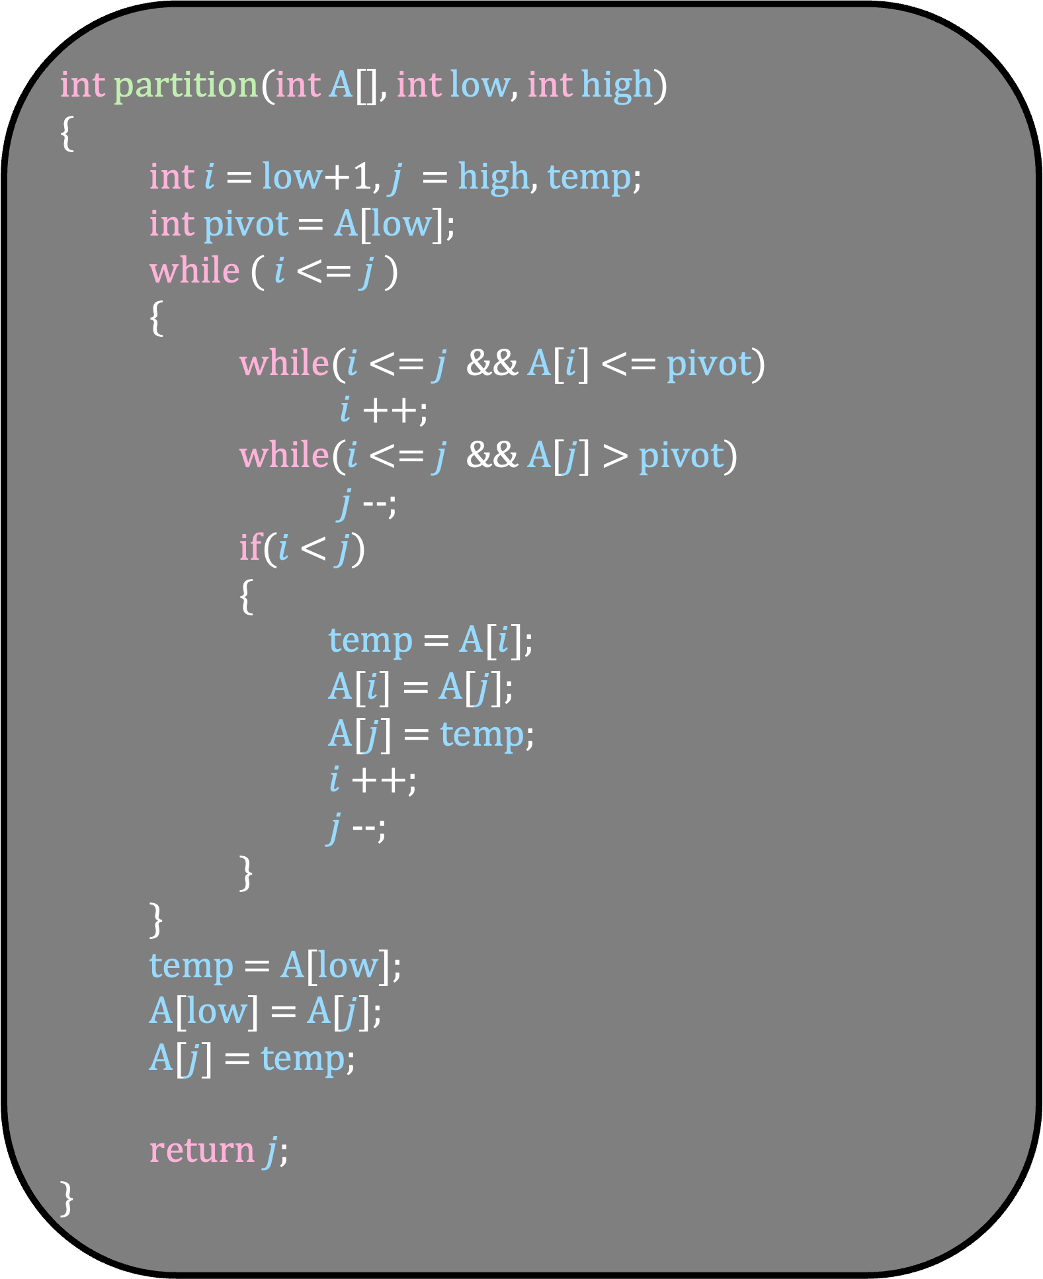
int partition(int A[], int low, int high)
{
int $i$ = low+1, $j$ = high, temp;
int pivot = A[low];
while ( $i$ <= $j$ )
{
while($i$ <= $j$ && A[$i$] <= pivot)
$i$ ++;
while($i$ <= $j$ && A[$j$] > pivot)
$j$--;
if($i$ < $j$)
{
temp = A[$i$];
A[$i$] = A[$j$];
A[$j$] = temp;
$i$++;
$j$--;
}
}
temp = A[low];
A[low] = A[$j$];
A[$j$] = temp;
return $j$;
}
void quickSort(int A[], int low, int high)
{
int index = partition(A, low, high);
}

Slide 83
void quickSort(int A[], int low, int high)
{
if ( low >= high)
return;
int index = partition(A, low, high);
quickSort( A, low, index -1);
quickSort( A, index+1, high);
}
Running Time of QuickSort
What is the worst case running time of quicksort?

Slide 84
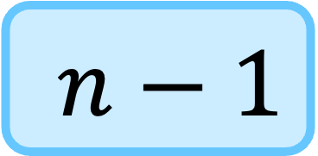
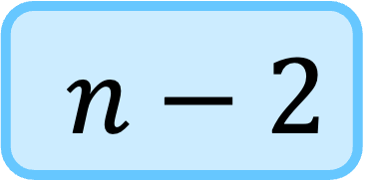

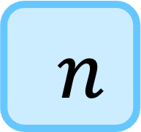
Time
A
1
2
3
4
$$…$$
$n−2$
$n−1$
$n$

Slide 85
Time
A
1
2
3
4
$$…$$
$n−2$
$n−1$
$n$
n

Slide 86
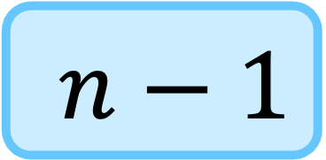
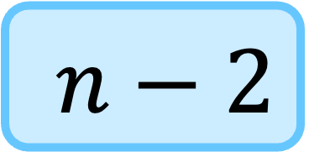

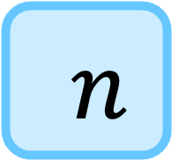
Time
A
1
n
2
3
4
$$…$$
$n−2$
$n−1$
$n$

Slide 87
Time
A
1
n
2
3
4
$$…$$
$n−2$
$n−1$
$n$
n-1

Slide 88
Time
A
1
n
2
n-1
3
4
$$…$$
$n−2$
$n−1$
$n$
n-2

Slide 89
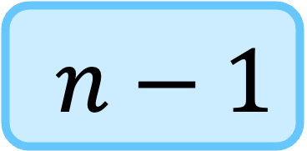
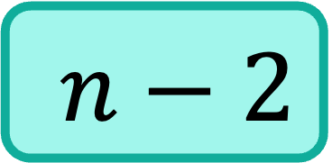


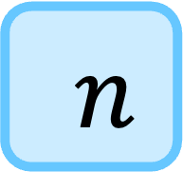
Time
A
1
n
2
n-1
3
4
$$…$$
$n−2$
$n−1$
$n$
n-2
$$…$$
$$…$$
$n−2$
$n−1$
$n$
3

Slide 90
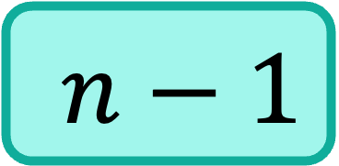
Time
A
1
n
2
n-1
3
4
$$…$$
$n−2$
$n−1$
$n$
n-2
$$…$$
$$…$$
$n−2$
3
$n−1$
$n$
2

Slide 91
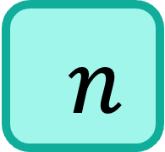
Time
A
1
n
2
n-1
3
4
$$…$$
$n−2$
$n−1$
$n$
n-2
$$…$$
$$…$$
$n−2$
3
$n−1$
2
$n$
1

Slide 92
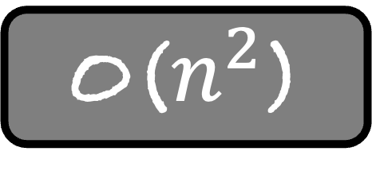

$$…$$
Time
n
n-1
n-2
3
2
1
O($n^{2}$)

Slide 93
What is the best case running time of quicksort?
In each partition function, the pivot magically lands in the middle
Then quickSort behaves like MergeSort

Slide 94
Best case Running Time
void quickSort(int A[], int low, int high)
{
if ( low >= high)
return;
int index = partition(A, low, high);
quickSort( A, low, index -1);
quickSort( A, index+1, high);
}
T(n)
c
n
T(n/2)
T(n/2)

Slide 95
Best case Running Time
void quickSort(int A[], int low, int high)
{
if ( low >= high)
return;
int index = partition(A, low, high);
quickSort( A, low, index -1);
quickSort( A, index+1, high);
}
T(n)
T(n/2)
T(n/2)
n
T(1)
c

Slide 96
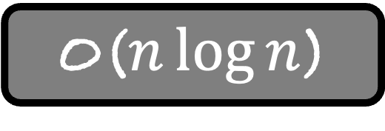
Best case Running Time
void quickSort(int A[], int low, int high)
{
if ( low >= high)
return;
int index = partition(A, low, high);
quickSort( A, low, index -1);
quickSort( A, index+1, high);
}
T(n)
O($n\log{n}$)

Slide 97
The best case running time of quicksort is O($n\log{n)}$
The worst case running time of quicksort is O($n^{2}$)
What is the average case running time of quicksort?
O(n log n) !!!!
There are very few instances on which quicksort takes O($n^{2}$) time
In fact, quicksort is one of the fastest sorting algorithms

