Slide 1
9
5
4
2
What is this structure called?
Tree

Slide 2
9
5
4
2
What is this structure called?
Binary Tree
Because each node has at most two children if we see the structure from top to bottom

Slide 3
9
5
4
10
7
2
3
What is this structure called?
Perfect Binary Tree
All the levels are full

Slide 4
9
5
4
10
7
2
What is this structure called?
Complete Binary Tree
All the levels except the last one are full

Slide 5
9
5
4
10
7
2
The height of this tree is 2
But in general, what is the height of a nearly complete binary tree?

Slide 6
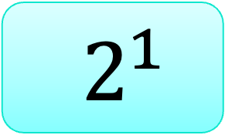
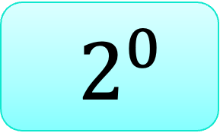
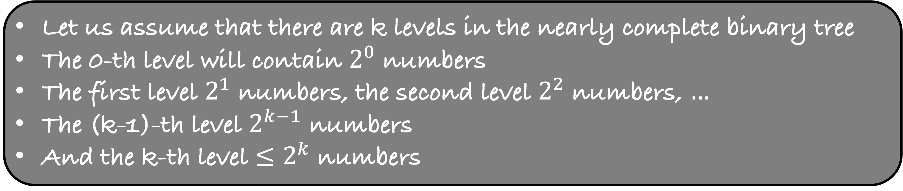
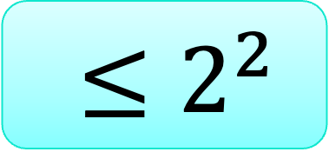
9
$2^{0}$
5
4
$2^{1}$
10
7
2
$≤2^{2}$
Let us assume that there are k levels in the nearly complete binary tree
The 0-th level will contain $2^{0}$ numbers
The first level $2^{1}$ numbers, the second level $2^{2}$ numbers, $…$
The (k-1)-th level $2^{k−1}$ numbers
And the k-th level $≤2^{k}$ numbers

Slide 7


Let us assume that there are k levels in the nearly complete binary tree
The 0-th level will contain $2^{0}$ numbers
The first level $2^{1}$ numbers, the second level $2^{2}$ numbers, $…$
The (k-1)-th level $2^{k−1}$ numbers
And the k-th level $≤2^{k}$ numbers
$$2^{0}+2^{1}+…+2^{k−1}<n$$
$$2^{k}−1<n$$
$$k<\log{(n+1)}$$
The height of a nearly complete binary tree on n numbers is O(log n)

Slide 8
9
9
0
0
5
5
4
4
1
1
2
2
10
10
7
7
2
2
4
4
5
3
5
3

Slide 9
9
5
4
10
7
2
A
0
1
2
3
4
5
9
0
5
4
1
2
10
7
2
3
4
5

Slide 10
9
5
4
10
7
2
A
0
1
2
3
4
5
9
0
Implicit representation of the complete binary tree
But how do we find the child or parent?
5
4
1
2
10
7
2
3
4
5

Slide 11
9
5
4
10
7
2
A
0
1
2
3
4
5
9
0
Implicit representation of the complete binary tree
But how do we find the child or parent?
5
4
1
2
10
7
2
3
4
5

Slide 12
9
5
4
10
7
2
A
0
1
2
3
4
5
9
0
Implicit representation of the complete binary tree
But how do we find the child or parent?
5
4
1
2
10
7
2
3
4
5
For a number at index i, its two children (if they exist) are at index
Left Child – 2i+1
Right Child – 2i+2

Slide 13
9
5
4
10
7
2
A
0
1
2
3
4
5
9
0
Implicit representation of the complete binary tree
But how do we find the child or parent?
5
4
1
2
10
7
2
3
4
5
For a number at index i, its parent is at index
(i-1)/2

Slide 14
Heaps

Slide 15
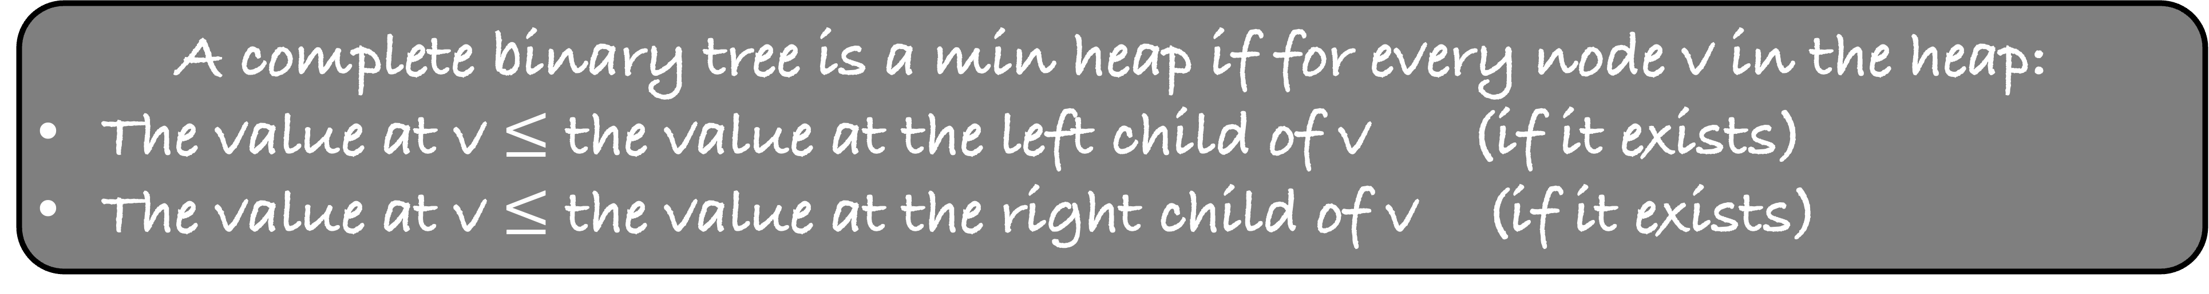
9
5
4
7
10
2
A
0
1
2
3
4
5
9
0
5
4
1
2
7
10
2
3
4
5
A complete binary tree is a min heap if for every node v in the heap:
The value at v $≤$ the value at the left child of v (if it exists)
The value at v $≤$ the value at the right child of v (if it exists)

Slide 16
2
5
4
7
10
9
A
0
1
2
3
4
5
2
0
5
4
1
2
7
10
9
3
4
5
A complete binary tree is a min heap if for every node v in the heap:
The value at v $≤$ the value at the left child of v (if it exists)
The value at v $≤$ the value at the right child of v (if it exists)

Slide 17
2
5
4
7
10
9
A
0
1
2
3
4
5
2
0
5
4
1
2
7
10
9
3
4
5
Given a min heap (implicitly in an array), use it to sort the array.

Slide 18
2
5
4
7
10
9
A
0
1
2
3
4
5
2
0
The smallest element is at the top of the heap
Remove it
5
4
1
2
7
10
9
3
4
5

Slide 19
2
5
4
7
10
9
A
0
1
2
3
4
5
We want to repeat the same step one more time.
Somehow, get the second smallest element at the top of the heap and then remove it
But how to do it?
0
5
4
1
2
7
10
9
3
4
5
B
2

Slide 20
9
5
4
7
10
9
A
0
1
2
3
4
5
9
We want to repeat the same step one more time.
Somehow, get the second smallest element at the top of the heap and then remove it
But how to do it?
0
5
4
1
2
7
10
3
4
5
B
2

Slide 21
9
5
4
7
10
9
A
0
1
2
3
4
5
9
We want to repeat the same step one more time.
Somehow, get the second smallest element at the top of the heap and then remove it
But how to do it?
0
5
4
1
2
7
10
3
4
B
2

Slide 22
9
5
4
7
10
9
A
0
1
2
3
4
5
9
0
Advantage -- the tree is still a complete binary tree
Disadvantage – the tree is not a heap
How to correct it and restore the heap property?
5
4
1
2
7
10
3
4
B
2

Slide 23
9
5
4
7
10
9
A
0
1
2
3
4
5
9
0
Advantage -- the tree is still a complete binary tree
Disadvantage – the tree is not a heap
How to correct it and restore the heap property?
5
4
1
2
7
10
3
4
B
2

Slide 24
4
5
9
7
10
9
A
0
1
2
3
4
5
4
0
The second smallest element is at the top of the heap
Remove it
5
9
1
2
7
10
3
4
B
2

Slide 25
4
5
9
7
10
9
A
0
1
2
3
4
5
0
5
9
1
2
7
10
3
4
B
2
4

Slide 26
10
5
9
7
10
9
A
0
1
2
3
4
5
10
0
5
9
1
2
7
3
4
B
2
4

Slide 27
10
5
9
7
10
9
A
0
1
2
3
4
5
10
0
5
9
1
2
7
3
B
2
4

Slide 28
5
10
9
7
10
9
A
0
1
2
3
4
5
5
0
10
9
1
2
7
3
B
2
4

Slide 29
5
7
9
10
10
9
A
0
1
2
3
4
5
5
0
7
9
1
2
10
3
B
2
4

Slide 30
5
7
9
10
10
9
A
0
1
2
3
4
5
0
7
9
1
2
10
3
B
2
4
5

Slide 31
10
7
9
10
10
9
A
0
1
2
3
4
5
10
0
7
9
1
2
3
B
2
4
5

Slide 32
10
7
9
10
10
9
A
0
1
2
3
4
5
10
0
7
9
1
2
Visualize the algorithm completely
Write a C program that will sort the array :
heapSort(int A[], int n)
B
2
4
5

Slide 33
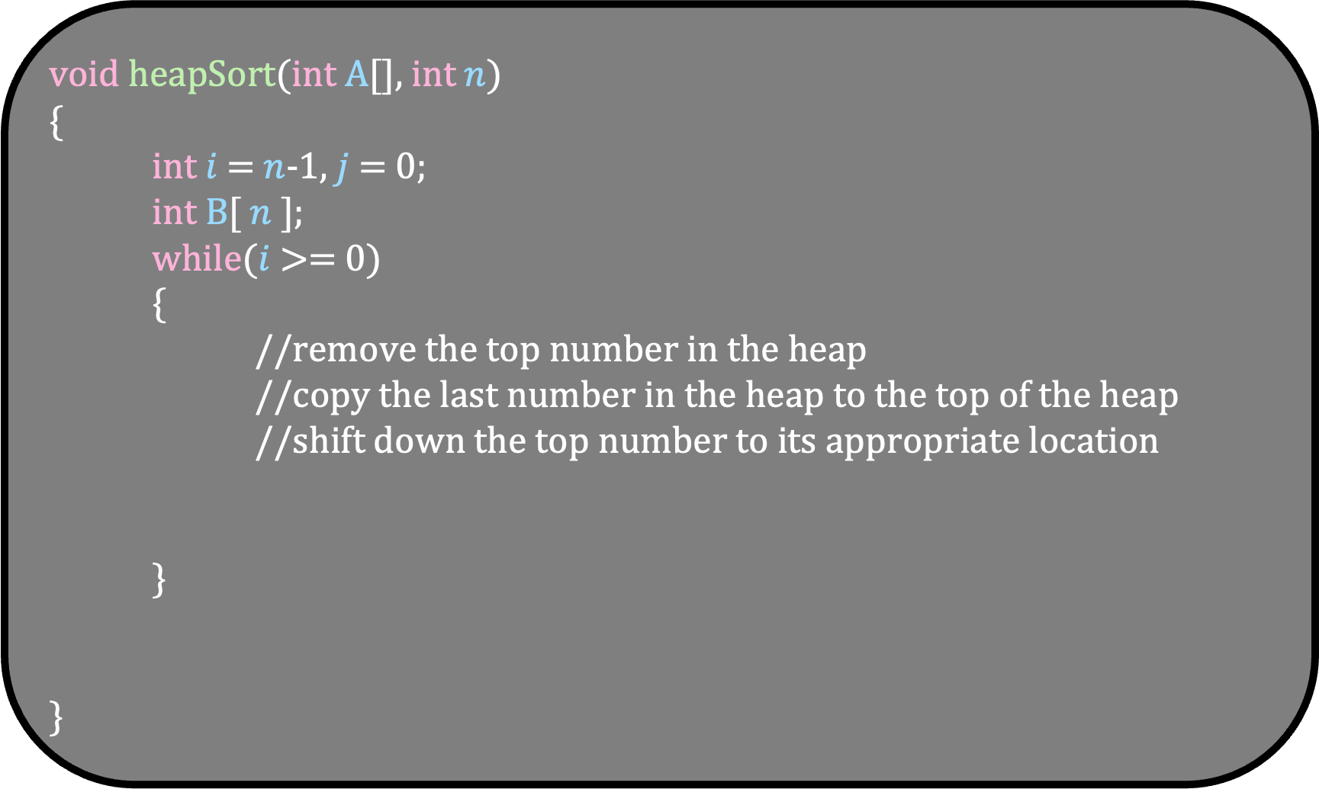
void heapSort(int A[], int $n$)
{
int $i$ = $n$-1, $j$ = 0;
int B[ $n$ ];
while($i$ >= 0)
{
//remove the top number in the heap
//copy the last number in the heap to the top of the heap
//shift down the top number to its appropriate location
}
}

Slide 34
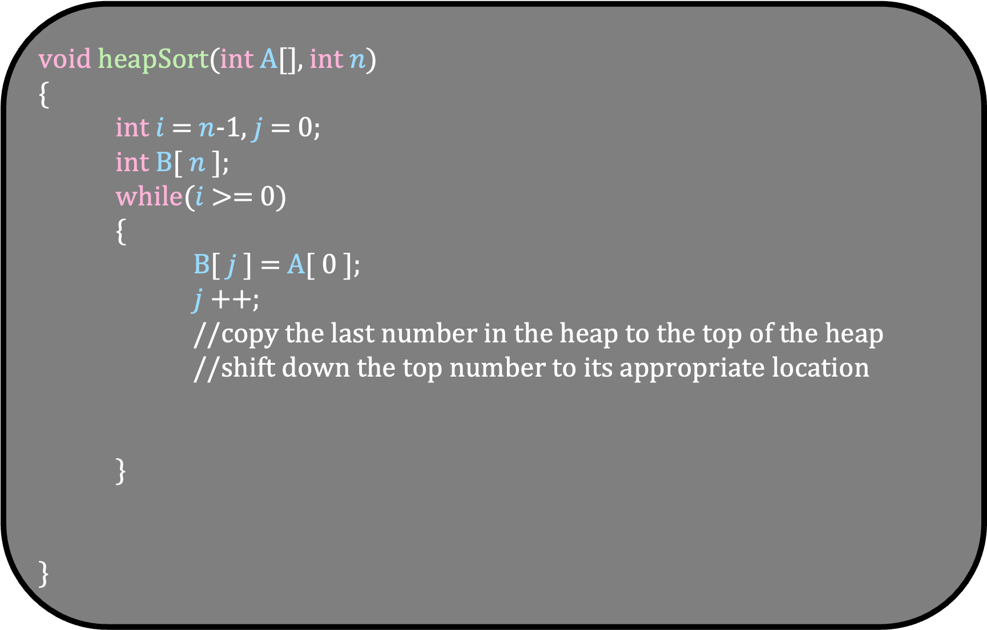
void heapSort(int A[], int $n$)
{
int $i$ = $n$-1, $j$ = 0;
int B[ $n$ ];
while($i$ >= 0)
{
B[ $j$ ] = A[ 0 ];
$j$++;
//copy the last number in the heap to the top of the heap
//shift down the top number to its appropriate location
}
}

Slide 35
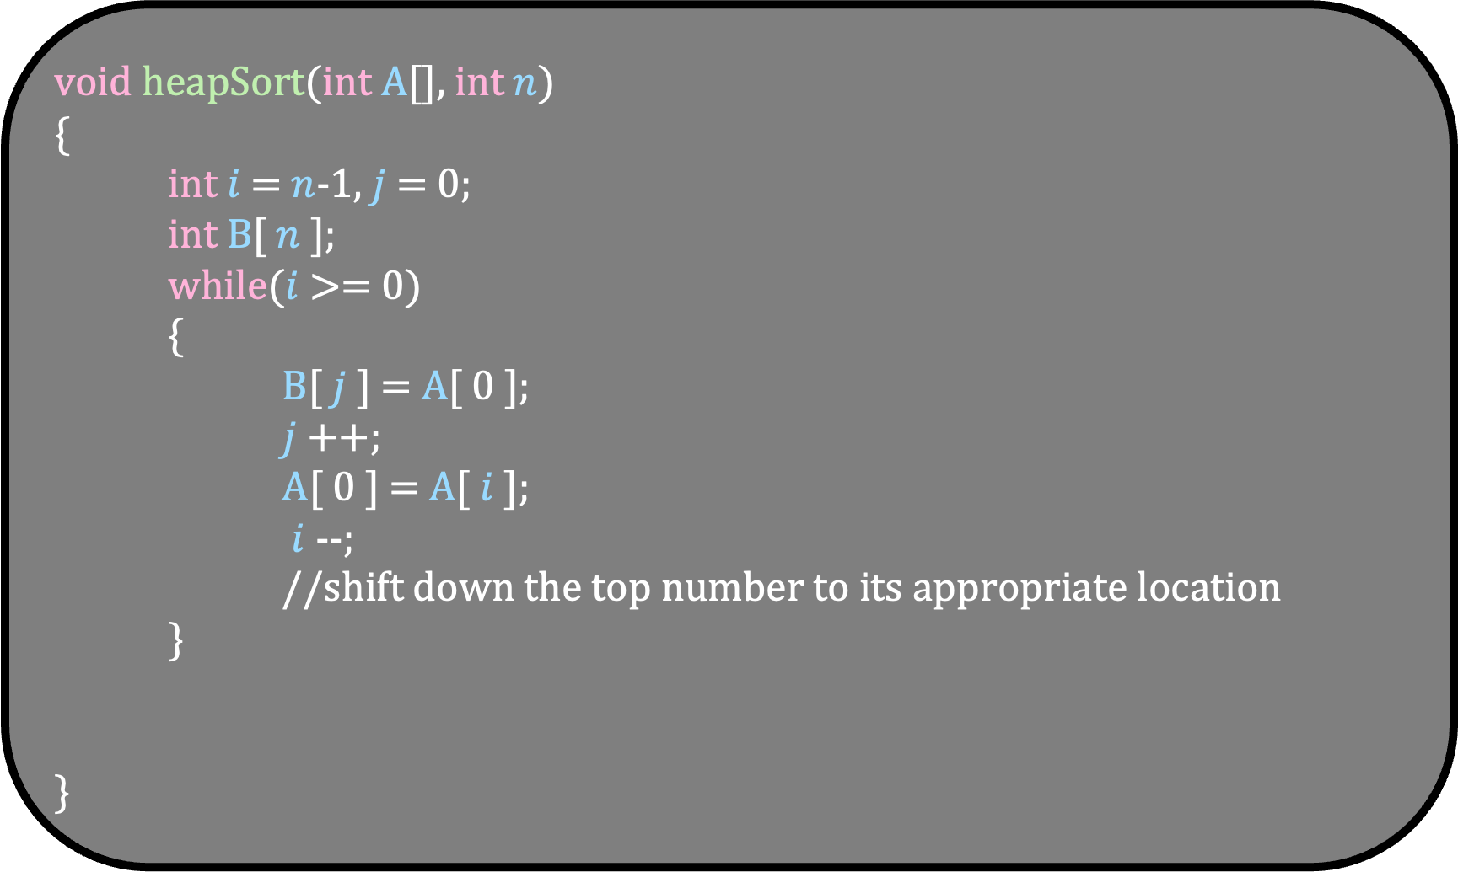
void heapSort(int A[], int $n$)
{
int $i$ = $n$-1, $j$ = 0;
int B[ $n$ ];
while($i$ >= 0)
{
B[ $j$ ] = A[ 0 ];
$j$++;
A[ 0 ] = A[ $i$ ];
$i$--;
//shift down the top number to its appropriate location
}
}

Slide 36
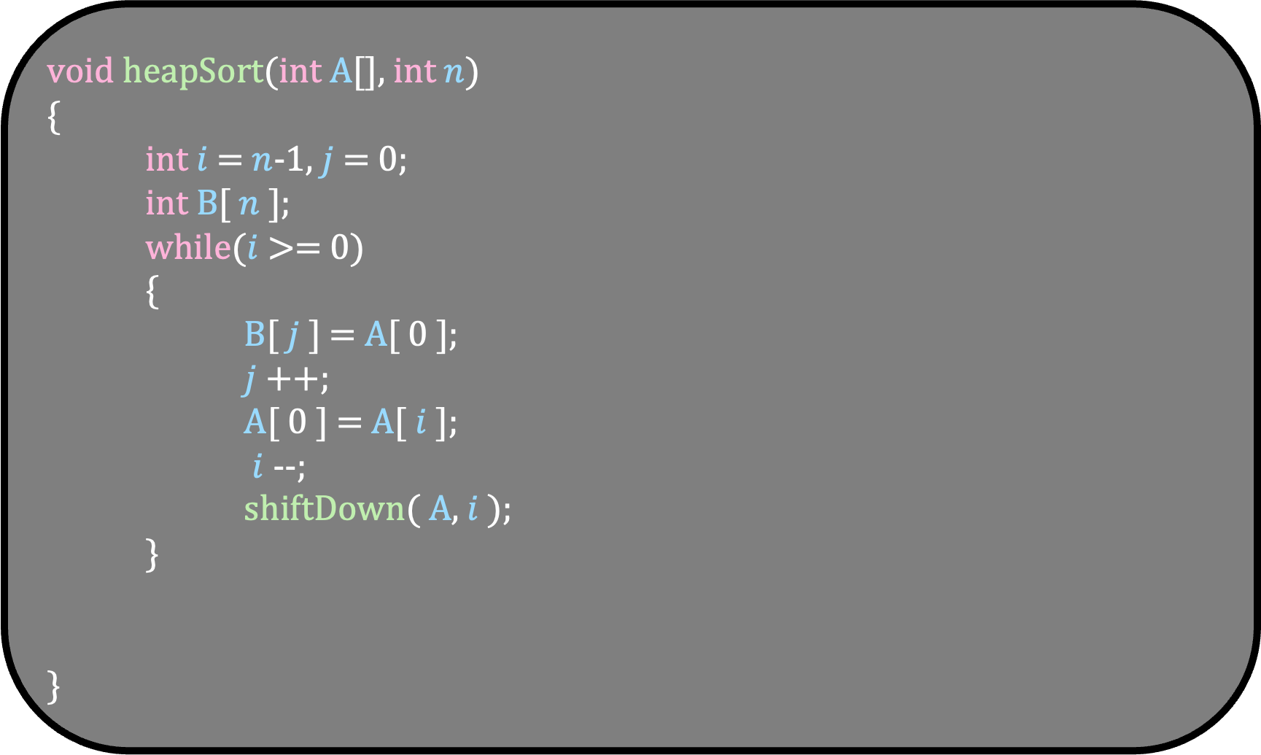
void heapSort(int A[], int $n$)
{
int $i$ = $n$-1, $j$ = 0;
int B[ $n$ ];
while($i$ >= 0)
{
B[ $j$ ] = A[ 0 ];
$j$++;
A[ 0 ] = A[ $i$ ];
$i$--;
shiftDown( A, $i$ );
}
}

Slide 37
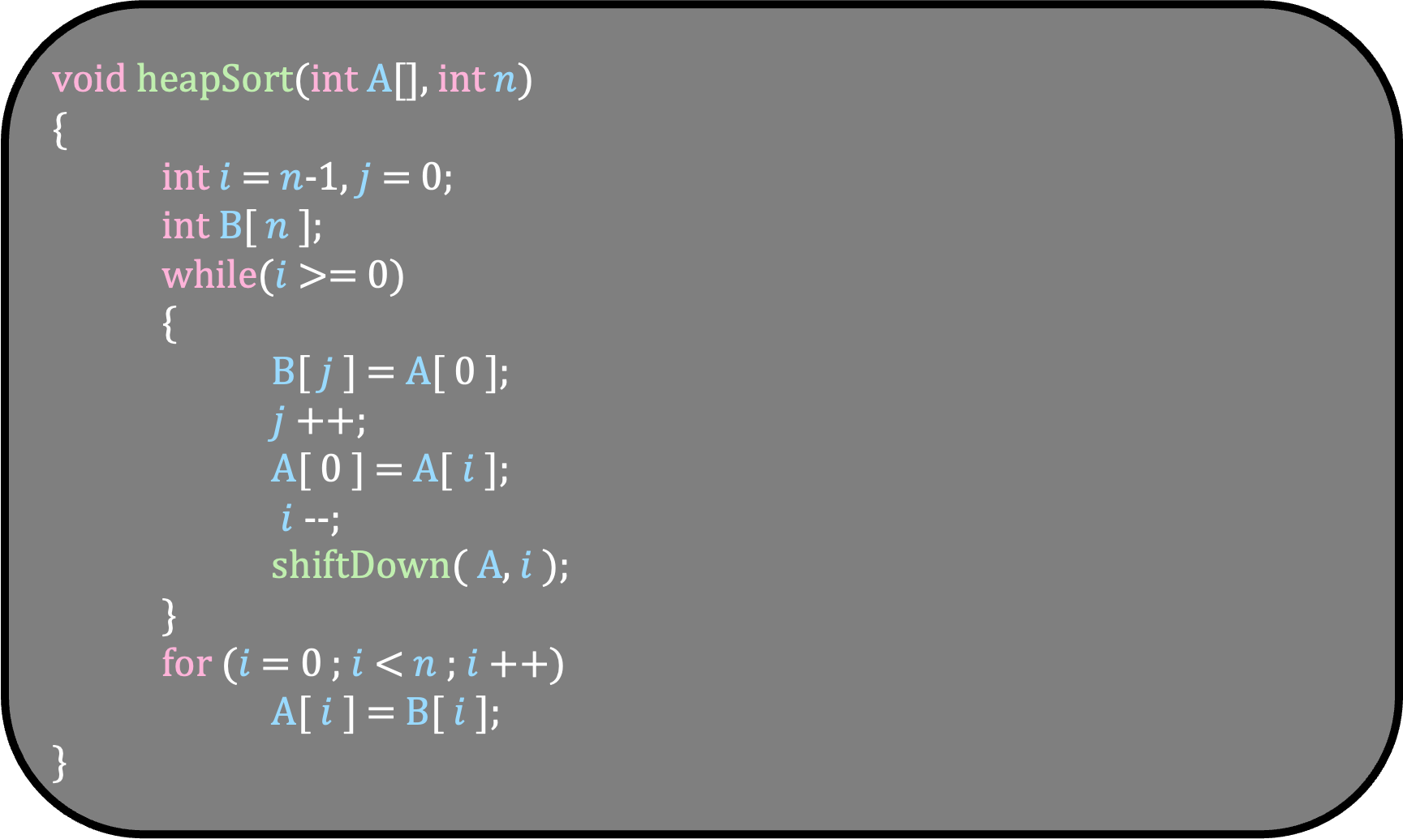
void heapSort(int A[], int $n$)
{
int $i$ = $n$-1, $j$ = 0;
int B[ $n$ ];
while($i$ >= 0)
{
B[ $j$ ] = A[ 0 ];
$j$++;
A[ 0 ] = A[ $i$ ];
$i$--;
shiftDown( A, $i$ );
}
for ($i$ = 0 ; $i$ < $n$ ; $i$++)
A[ $i$ ] = B[ $i$ ];
}

Slide 38
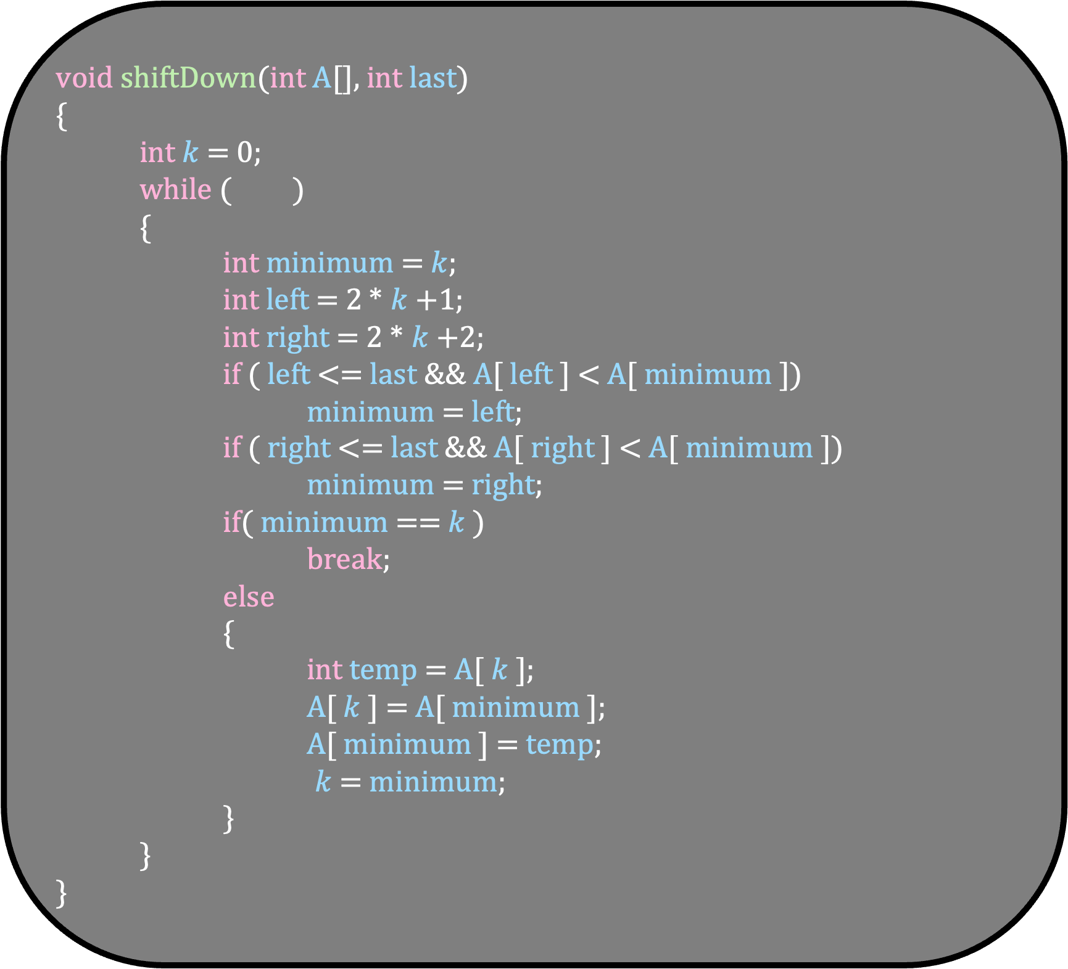
void shiftDown(int A[], int last)
{
int $k$ = 0;
while ( )
{
int minimum = $k$;
int left = 2 * $k$+1;
int right = 2 * $k$+2;
if ( left <= last && A[ left ] < A[ minimum ])
minimum = left;
if ( right <= last && A[ right ] < A[ minimum ])
minimum = right;
if( minimum == $k$ )
break;
else
{
int temp = A[ $k$ ];
A[ $k$ ] = A[ minimum ];
A[ minimum ] = temp;
$k$ = minimum;
}
}
}
void heapSort(int A[], int $n$)
{
int $i$ = $n$-1, $j$ = 0;
int B[ $n$ ];
while($i$ >= 0)
{
B[ $j$ ] = A[ 0 ];
$j$++;
A[ 0 ] = A[ $i$ ];
$i$--;
shiftDown( A, $i$ );
}
for ($i$ = 0 ; $i$ < $n$ ; $i$++)
A[ $i$ ] = B[ $i$ ];
}

Slide 39
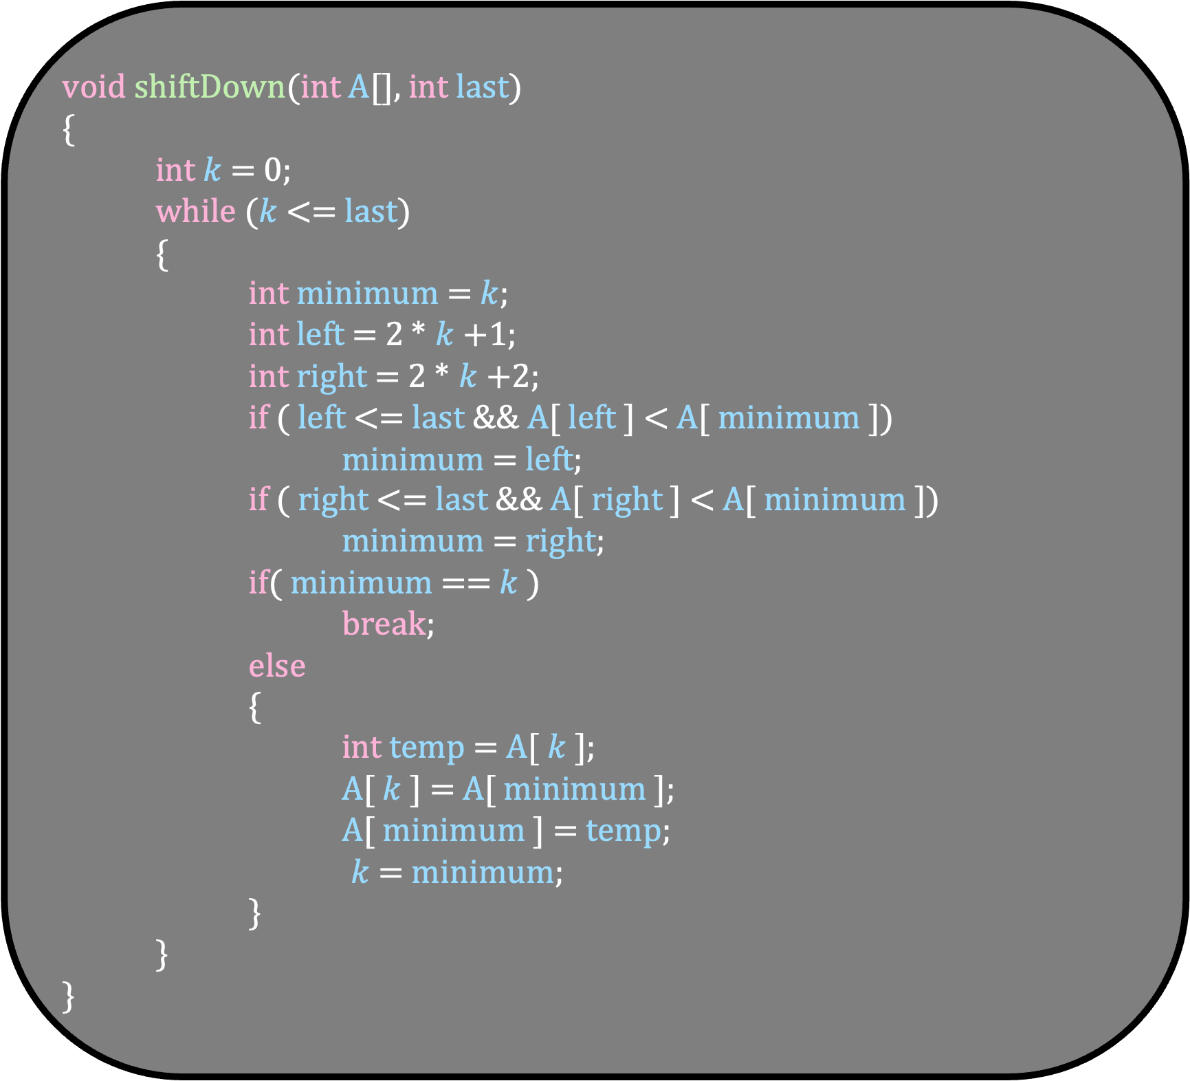
void shiftDown(int A[], int last)
{
int $k$ = 0;
while ($k$ <= last)
{
int minimum = $k$;
int left = 2 * $k$+1;
int right = 2 * $k$+2;
if ( left <= last && A[ left ] < A[ minimum ])
minimum = left;
if ( right <= last && A[ right ] < A[ minimum ])
minimum = right;
if( minimum == $k$ )
break;
else
{
int temp = A[ $k$ ];
A[ $k$ ] = A[ minimum ];
A[ minimum ] = temp;
$k$ = minimum;
}
}
}
void heapSort(int A[], int $n$)
{
int $i$ = $n$-1, $j$ = 0;
int B[ $n$ ];
while($i$ >= 0)
{
B[ $j$ ] = A[ 0 ];
$j$++;
A[ 0 ] = A[ $i$ ];
$i$--;
shiftDown( A, $i$ );
}
for ($i$ = 0 ; $i$ < $n$ ; $i$++)
A[ $i$ ] = B[ $i$ ];
}

Slide 40

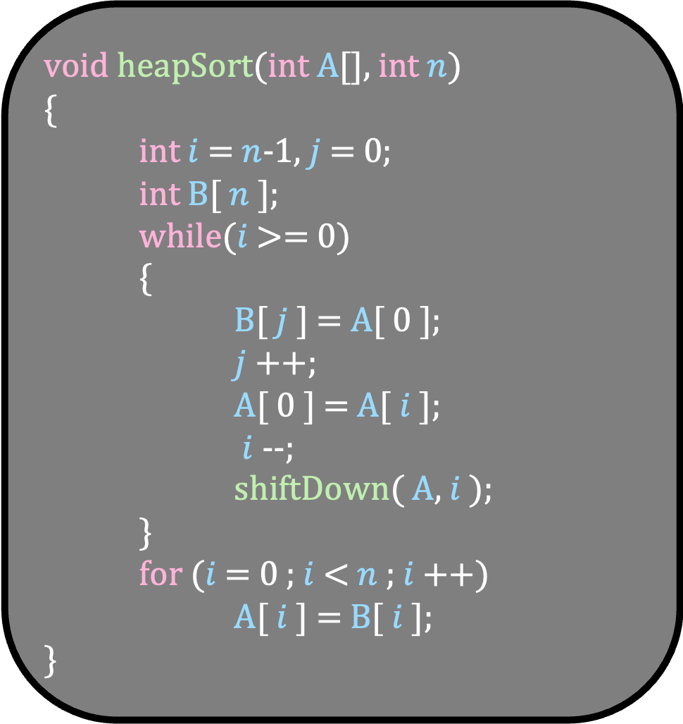
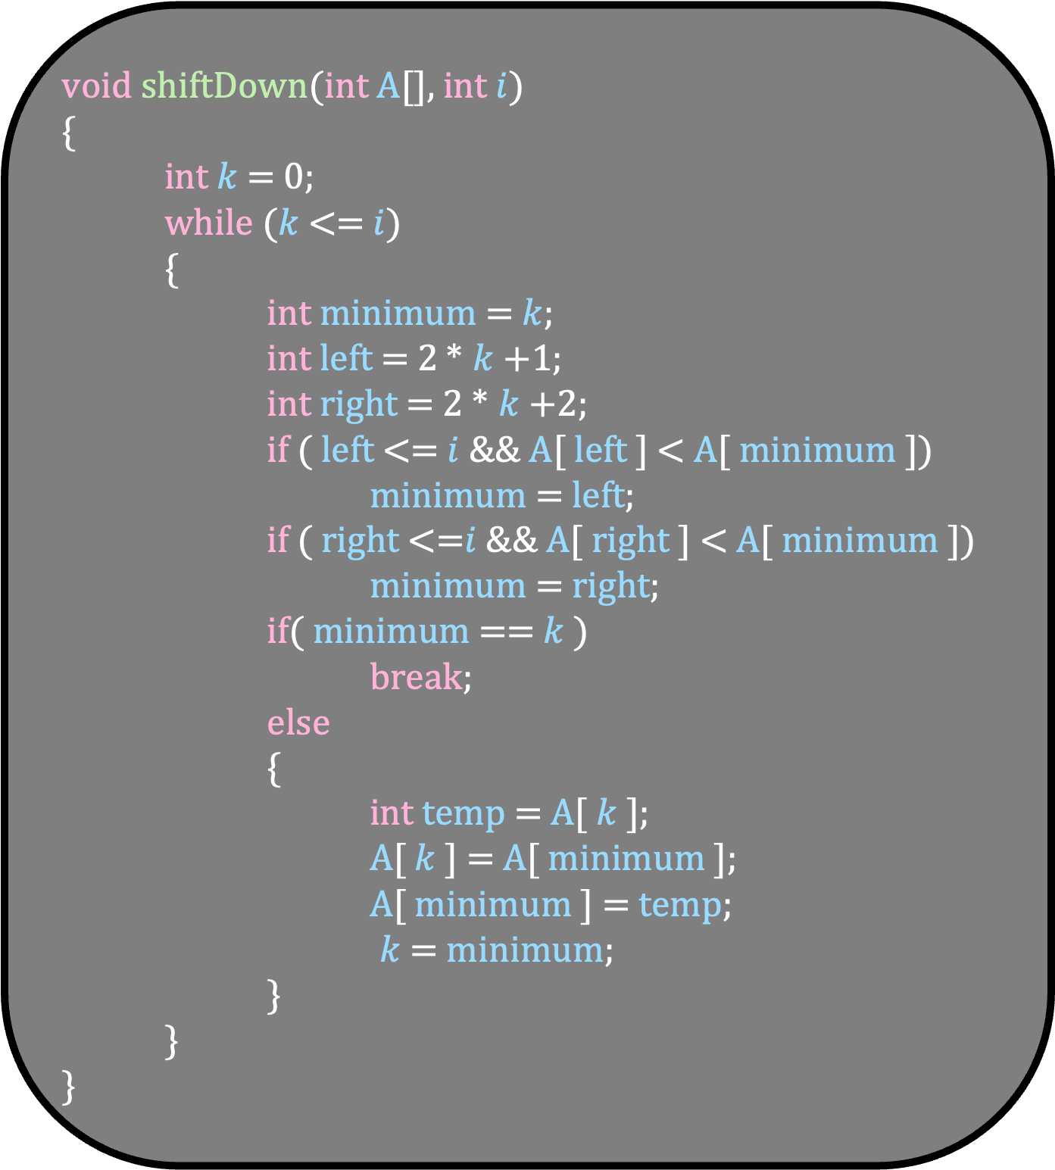
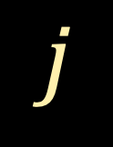
$$i$$
2
5
4
7
10
9
A
void shiftDown(int A[], int $i$)
{
int $k$ = 0;
while ($k$ <= $i$)
{
int minimum = $k$;
int left = 2 * $k$+1;
int right = 2 * $k$+2;
if ( left <= $i$&& A[ left ] < A[ minimum ])
minimum = left;
if ( right <=$i$ && A[ right ] < A[ minimum ])
minimum = right;
if( minimum == $k$ )
break;
else
{
int temp = A[ $k$ ];
A[ $k$ ] = A[ minimum ];
A[ minimum ] = temp;
$k$ = minimum;
}
}
}
0
1
2
3
4
5
void heapSort(int A[], int $n$)
{
int $i$ = $n$-1, $j$ = 0;
int B[ $n$ ];
while($i$ >= 0)
{
B[ $j$ ] = A[ 0 ];
$j$++;
A[ 0 ] = A[ $i$ ];
$i$--;
shiftDown( A, $i$ );
}
for ($i$ = 0 ; $i$ < $n$ ; $i$++)
A[ $i$ ] = B[ $i$ ];
}
2
0
5
4
1
2
7
10
9
3
4
5
$$j$$
B

Slide 41
$$i$$
2
5
4
7
10
9
A
void shiftDown(int A[], int $i$)
{
int $k$ = 0;
while ($k$ <= $i$)
{
int minimum = $k$;
int left = 2 * $k$+1;
int right = 2 * $k$+2;
if ( left <= $i$&& A[ left ] < A[ minimum ])
minimum = left;
if ( right <=$i$ && A[ right ] < A[ minimum ])
minimum = right;
if( minimum == $k$ )
break;
else
{
int temp = A[ $k$ ];
A[ $k$ ] = A[ minimum ];
A[ minimum ] = temp;
$k$ = minimum;
}
}
}
0
1
2
3
4
5
void heapSort(int A[], int $n$)
{
int $i$ = $n$-1, $j$ = 0;
int B[ $n$ ];
while($i$ >= 0)
{
B[ $j$ ] = A[ 0 ];
$j$++;
A[ 0 ] = A[ $i$ ];
$i$--;
shiftDown( A, $i$ );
}
for ($i$ = 0 ; $i$ < $n$ ; $i$++)
A[ $i$ ] = B[ $i$ ];
}
2
0
5
4
1
2
7
10
9
3
4
5
$$j$$
B

Slide 42
$$i$$
2
5
4
7
10
9
A
void shiftDown(int A[], int $i$)
{
int $k$ = 0;
while ($k$ <= $i$)
{
int minimum = $k$;
int left = 2 * $k$+1;
int right = 2 * $k$+2;
if ( left <= $i$&& A[ left ] < A[ minimum ])
minimum = left;
if ( right <=$i$ && A[ right ] < A[ minimum ])
minimum = right;
if( minimum == $k$ )
break;
else
{
int temp = A[ $k$ ];
A[ $k$ ] = A[ minimum ];
A[ minimum ] = temp;
$k$ = minimum;
}
}
}
0
1
2
3
4
5
void heapSort(int A[], int $n$)
{
int $i$ = $n$-1, $j$ = 0;
int B[ $n$ ];
while($i$ >= 0)
{
B[ $j$ ] = A[ 0 ];
$j$++;
A[ 0 ] = A[ $i$ ];
$i$--;
shiftDown( A, $i$ );
}
for ($i$ = 0 ; $i$ < $n$ ; $i$++)
A[ $i$ ] = B[ $i$ ];
}
2
0
5
4
1
2
7
10
9
3
4
5
$$j$$
B

Slide 43
$$i$$
2
5
4
7
10
9
A
void shiftDown(int A[], int $i$)
{
int $k$ = 0;
while ($k$ <= $i$)
{
int minimum = $k$;
int left = 2 * $k$+1;
int right = 2 * $k$+2;
if ( left <= $i$&& A[ left ] < A[ minimum ])
minimum = left;
if ( right <=$i$ && A[ right ] < A[ minimum ])
minimum = right;
if( minimum == $k$ )
break;
else
{
int temp = A[ $k$ ];
A[ $k$ ] = A[ minimum ];
A[ minimum ] = temp;
$k$ = minimum;
}
}
}
0
1
2
3
4
5
void heapSort(int A[], int $n$)
{
int $i$ = $n$-1, $j$ = 0;
int B[ $n$ ];
while($i$ >= 0)
{
B[ $j$ ] = A[ 0 ];
$j$++;
A[ 0 ] = A[ $i$ ];
$i$--;
shiftDown( A, $i$ );
}
for ($i$ = 0 ; $i$ < $n$ ; $i$++)
A[ $i$ ] = B[ $i$ ];
}
0
5
4
1
2
7
10
9
3
4
5
$$j$$
B
2

Slide 44

$$i$$
2
5
4
7
10
9
A
void shiftDown(int A[], int $i$)
{
int $k$ = 0;
while ($k$ <= $i$)
{
int minimum = $k$;
int left = 2 * $k$+1;
int right = 2 * $k$+2;
if ( left <= $i$&& A[ left ] < A[ minimum ])
minimum = left;
if ( right <=$i$ && A[ right ] < A[ minimum ])
minimum = right;
if( minimum == $k$ )
break;
else
{
int temp = A[ $k$ ];
A[ $k$ ] = A[ minimum ];
A[ minimum ] = temp;
$k$ = minimum;
}
}
}
0
1
2
3
4
5
void heapSort(int A[], int $n$)
{
int $i$ = $n$-1, $j$ = 0;
int B[ $n$ ];
while($i$ >= 0)
{
B[ $j$ ] = A[ 0 ];
$j$++;
A[ 0 ] = A[ $i$ ];
$i$--;
shiftDown( A, $i$ );
}
for ($i$ = 0 ; $i$ < $n$ ; $i$++)
A[ $i$ ] = B[ $i$ ];
}
0
5
4
1
2
7
10
9
3
4
5
$$j$$
B
2

Slide 45
$$i$$
9
5
4
7
10
9
A
void shiftDown(int A[], int $i$)
{
int $k$ = 0;
while ($k$ <= $i$)
{
int minimum = $k$;
int left = 2 * $k$+1;
int right = 2 * $k$+2;
if ( left <= $i$&& A[ left ] < A[ minimum ])
minimum = left;
if ( right <=$i$ && A[ right ] < A[ minimum ])
minimum = right;
if( minimum == $k$ )
break;
else
{
int temp = A[ $k$ ];
A[ $k$ ] = A[ minimum ];
A[ minimum ] = temp;
$k$ = minimum;
}
}
}
0
1
2
3
4
5
void heapSort(int A[], int $n$)
{
int $i$ = $n$-1, $j$ = 0;
int B[ $n$ ];
while($i$ >= 0)
{
B[ $j$ ] = A[ 0 ];
$j$++;
A[ 0 ] = A[ $i$ ];
$i$--;
shiftDown( A, $i$ );
}
for ($i$ = 0 ; $i$ < $n$ ; $i$++)
A[ $i$ ] = B[ $i$ ];
}
9
0
5
4
1
2
7
10
3
4
$$j$$
B
2

Slide 46

$$i$$
9
5
4
7
10
9
A
void shiftDown(int A[], int $i$)
{
int $k$ = 0;
while ($k$ <= $i$)
{
int minimum = $k$;
int left = 2 * $k$+1;
int right = 2 * $k$+2;
if ( left <= $i$&& A[ left ] < A[ minimum ])
minimum = left;
if ( right <=$i$ && A[ right ] < A[ minimum ])
minimum = right;
if( minimum == $k$ )
break;
else
{
int temp = A[ $k$ ];
A[ $k$ ] = A[ minimum ];
A[ minimum ] = temp;
$k$ = minimum;
}
}
}
0
1
2
3
4
5
void heapSort(int A[], int $n$)
{
int $i$ = $n$-1, $j$ = 0;
int B[ $n$ ];
while($i$ >= 0)
{
B[ $j$ ] = A[ 0 ];
$j$++;
A[ 0 ] = A[ $i$ ];
$i$--;
shiftDown( A, $i$ );
}
for ($i$ = 0 ; $i$ < $n$ ; $i$++)
A[ $i$ ] = B[ $i$ ];
}
9
0
5
4
1
2
7
10
3
4
$$j$$
B
2

Slide 47
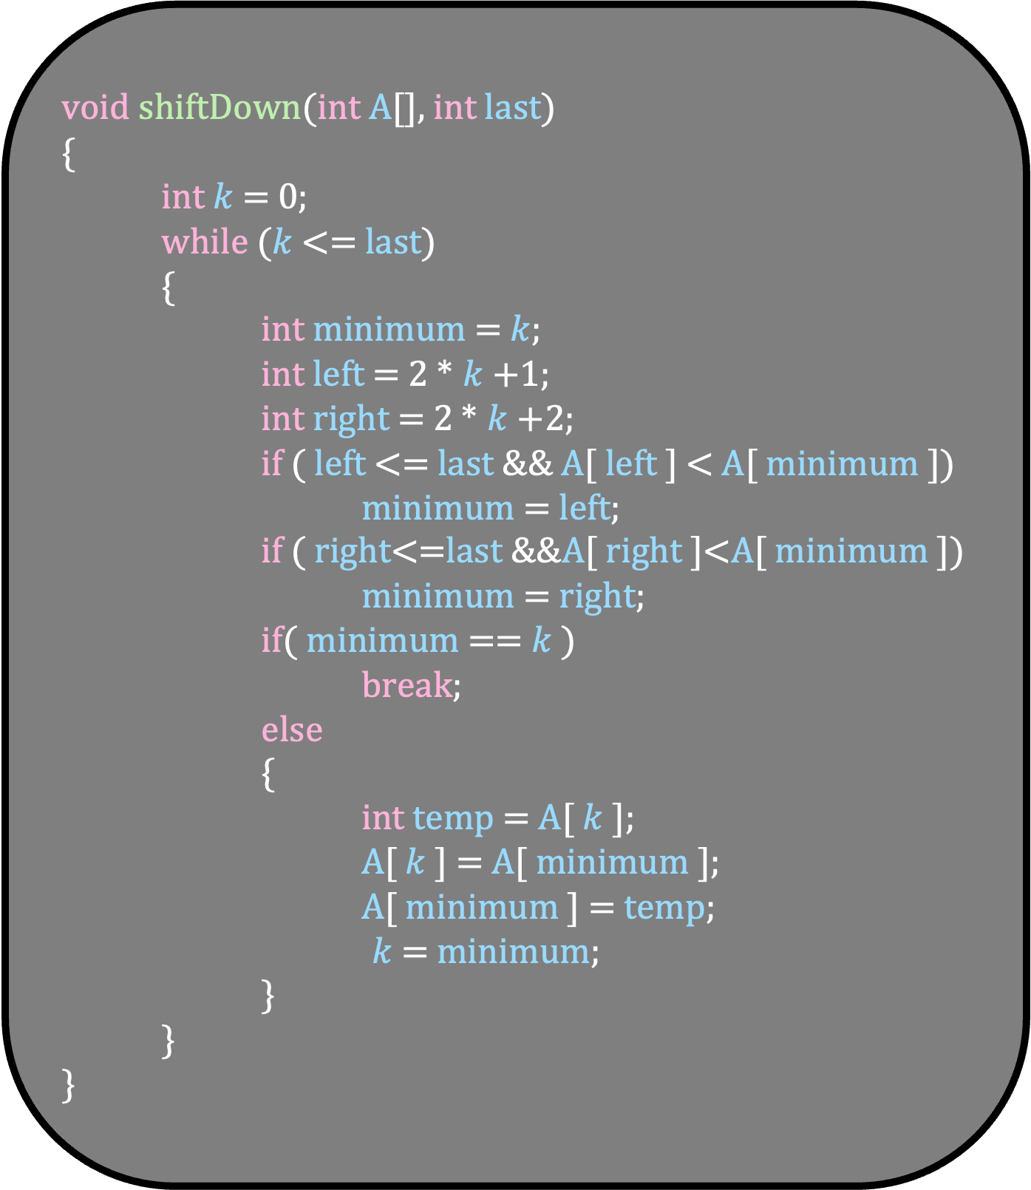
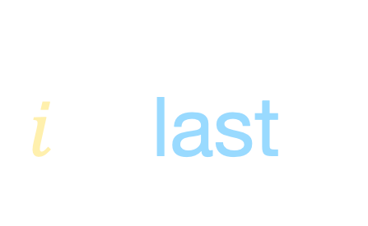
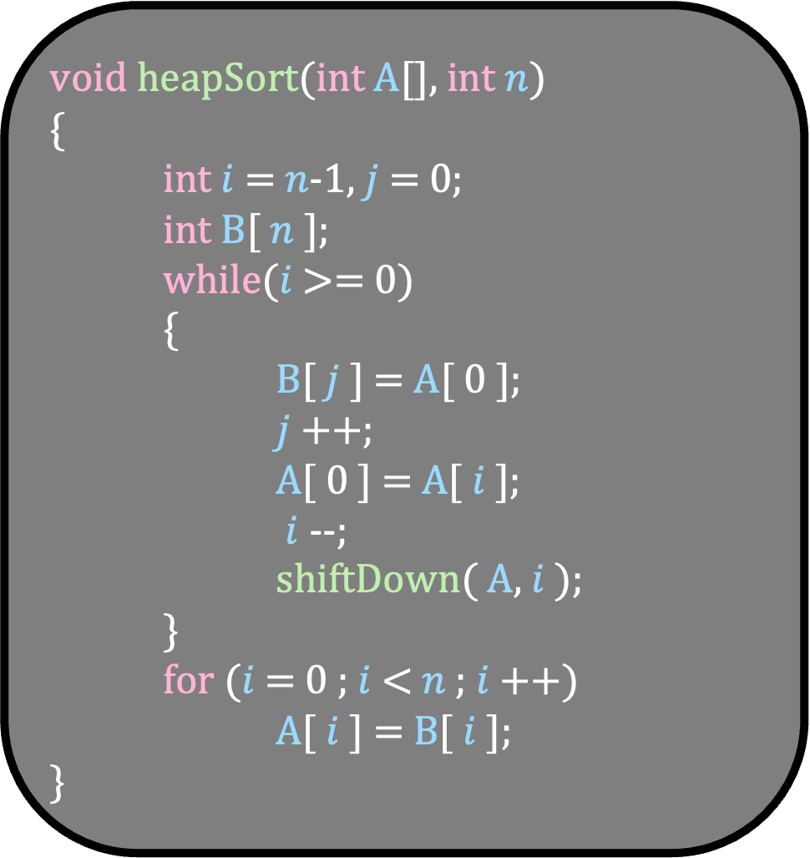
$i$ = last
9
5
4
7
10
9
A
0
1
2
3
4
5
void shiftDown(int A[], int last)
{
int $k$ = 0;
while ($k$ <= last)
{
int minimum = $k$;
int left = 2 * $k$+1;
int right = 2 * $k$+2;
if ( left <= last && A[ left ] < A[ minimum ])
minimum = left;
if ( right<=last &&A[ right ]<A[ minimum ])
minimum = right;
if( minimum == $k$ )
break;
else
{
int temp = A[ $k$ ];
A[ $k$ ] = A[ minimum ];
A[ minimum ] = temp;
$k$ = minimum;
}
}
}
void heapSort(int A[], int $n$)
{
int $i$ = $n$-1, $j$ = 0;
int B[ $n$ ];
while($i$ >= 0)
{
B[ $j$ ] = A[ 0 ];
$j$++;
A[ 0 ] = A[ $i$ ];
$i$--;
shiftDown( A, $i$ );
}
for ($i$ = 0 ; $i$ < $n$ ; $i$++)
A[ $i$ ] = B[ $i$ ];
}
9
0
5
4
1
2
7
10
3
4
$$j$$
B
2

Slide 48

$i$ = last
$$k$$
9
5
4
7
10
9
A
0
1
2
3
4
5
void shiftDown(int A[], int last)
{
int $k$ = 0;
while ($k$ <= last)
{
int minimum = $k$;
int left = 2 * $k$+1;
int right = 2 * $k$+2;
if ( left <= last && A[ left ] < A[ minimum ])
minimum = left;
if ( right<=last &&A[ right ]<A[ minimum ])
minimum = right;
if( minimum == $k$ )
break;
else
{
int temp = A[ $k$ ];
A[ $k$ ] = A[ minimum ];
A[ minimum ] = temp;
$k$ = minimum;
}
}
}
void heapSort(int A[], int $n$)
{
int $i$ = $n$-1, $j$ = 0;
int B[ $n$ ];
while($i$ >= 0)
{
B[ $j$ ] = A[ 0 ];
$j$++;
A[ 0 ] = A[ $i$ ];
$i$--;
shiftDown( A, $i$ );
}
for ($i$ = 0 ; $i$ < $n$ ; $i$++)
A[ $i$ ] = B[ $i$ ];
}
9
0
5
4
1
2
7
10
3
4
$$j$$
B
2

Slide 49
$i$ = last
$$k$$
9
5
4
7
10
9
A
0
1
2
3
4
5
void shiftDown(int A[], int last)
{
int $k$ = 0;
while ($k$ <= last)
{
int minimum = $k$;
int left = 2 * $k$+1;
int right = 2 * $k$+2;
if ( left <= last && A[ left ] < A[ minimum ])
minimum = left;
if ( right<=last &&A[ right ]<A[ minimum ])
minimum = right;
if( minimum == $k$ )
break;
else
{
int temp = A[ $k$ ];
A[ $k$ ] = A[ minimum ];
A[ minimum ] = temp;
$k$ = minimum;
}
}
}
void heapSort(int A[], int $n$)
{
int $i$ = $n$-1, $j$ = 0;
int B[ $n$ ];
while($i$ >= 0)
{
B[ $j$ ] = A[ 0 ];
$j$++;
A[ 0 ] = A[ $i$ ];
$i$--;
shiftDown( A, $i$ );
}
for ($i$ = 0 ; $i$ < $n$ ; $i$++)
A[ $i$ ] = B[ $i$ ];
}
9
0
5
4
1
2
7
10
3
4
$$j$$
B
2

Slide 50

$i$ = last
$$k$$
9
void shiftDown(int A[], int last)
{
int $k$ = 0;
while ($k$ <= last)
{
int minimum = $k$;
int left = 2 * $k$+1;
int right = 2 * $k$+2;
if ( left <= last && A[ left ] < A[ minimum ])
minimum = left;
if ( right<=last &&A[ right ]<A[ minimum ])
minimum = right;
if( minimum == $k$ )
break;
else
{
int temp = A[ $k$ ];
A[ $k$ ] = A[ minimum ];
A[ minimum ] = temp;
$k$ = minimum;
}
}
}
9
5
4
7
10
A
0
1
2
3
4
5
void heapSort(int A[], int $n$)
{
int $i$ = $n$-1, $j$ = 0;
int B[ $n$ ];
while($i$ >= 0)
{
B[ $j$ ] = A[ 0 ];
$j$++;
A[ 0 ] = A[ $i$ ];
$i$--;
shiftDown( A, $i$ );
}
for ($i$ = 0 ; $i$ < $n$ ; $i$++)
A[ $i$ ] = B[ $i$ ];
}
9
0
5
4
1
2
7
10
3
4
$$j$$
minimum = 0
left =
right =
B
2

Slide 51
$i$ = last
$$k$$
9
void shiftDown(int A[], int last)
{
int $k$ = 0;
while ($k$ <= last)
{
int minimum = $k$;
int left = 2 * $k$+1;
int right = 2 * $k$+2;
if ( left <= last && A[ left ] < A[ minimum ])
minimum = left;
if ( right<=last &&A[ right ]<A[ minimum ])
minimum = right;
if( minimum == $k$ )
break;
else
{
int temp = A[ $k$ ];
A[ $k$ ] = A[ minimum ];
A[ minimum ] = temp;
$k$ = minimum;
}
}
}
9
5
4
7
10
A
0
1
2
3
4
5
void heapSort(int A[], int $n$)
{
int $i$ = $n$-1, $j$ = 0;
int B[ $n$ ];
while($i$ >= 0)
{
B[ $j$ ] = A[ 0 ];
$j$++;
A[ 0 ] = A[ $i$ ];
$i$--;
shiftDown( A, $i$ );
}
for ($i$ = 0 ; $i$ < $n$ ; $i$++)
A[ $i$ ] = B[ $i$ ];
}
9
0
5
4
1
2
7
10
3
4
$$j$$
minimum = 0
left = 1
right = 2
B
2

Slide 52
$i$ = last
$$k$$
9
void shiftDown(int A[], int last)
{
int $k$ = 0;
while ($k$ <= last)
{
int minimum = $k$;
int left = 2 * $k$+1;
int right = 2 * $k$+2;
if ( left <= last && A[ left ] < A[ minimum ])
minimum = left;
if ( right<=last &&A[ right ]<A[ minimum ])
minimum = right;
if( minimum == $k$ )
break;
else
{
int temp = A[ $k$ ];
A[ $k$ ] = A[ minimum ];
A[ minimum ] = temp;
$k$ = minimum;
}
}
}
9
5
4
7
10
A
0
1
2
3
4
5
void heapSort(int A[], int $n$)
{
int $i$ = $n$-1, $j$ = 0;
int B[ $n$ ];
while($i$ >= 0)
{
B[ $j$ ] = A[ 0 ];
$j$++;
A[ 0 ] = A[ $i$ ];
$i$--;
shiftDown( A, $i$ );
}
for ($i$ = 0 ; $i$ < $n$ ; $i$++)
A[ $i$ ] = B[ $i$ ];
}
9
0
5
4
1
2
7
10
3
4
$$j$$
minimum = 0
left = 1
right = 2
B
2

Slide 53
$i$ = last
$$k$$
9
void shiftDown(int A[], int last)
{
int $k$ = 0;
while ($k$ <= last)
{
int minimum = $k$;
int left = 2 * $k$+1;
int right = 2 * $k$+2;
if ( left <= last && A[ left ] < A[ minimum ])
minimum = left;
if ( right<=last &&A[ right ]<A[ minimum ])
minimum = right;
if( minimum == $k$ )
break;
else
{
int temp = A[ $k$ ];
A[ $k$ ] = A[ minimum ];
A[ minimum ] = temp;
$k$ = minimum;
}
}
}
9
5
4
7
10
A
0
1
2
3
4
5
void heapSort(int A[], int $n$)
{
int $i$ = $n$-1, $j$ = 0;
int B[ $n$ ];
while($i$ >= 0)
{
B[ $j$ ] = A[ 0 ];
$j$++;
A[ 0 ] = A[ $i$ ];
$i$--;
shiftDown( A, $i$ );
}
for ($i$ = 0 ; $i$ < $n$ ; $i$++)
A[ $i$ ] = B[ $i$ ];
}
9
0
5
4
1
2
7
10
3
4
$$j$$
minimum = 1
left = 1
right = 2
B
2

Slide 54
$i$ = last
$$k$$
9
void shiftDown(int A[], int last)
{
int $k$ = 0;
while ($k$ <= last)
{
int minimum = $k$;
int left = 2 * $k$+1;
int right = 2 * $k$+2;
if ( left <= last && A[ left ] < A[ minimum ])
minimum = left;
if ( right<=last &&A[ right ]<A[ minimum ])
minimum = right;
if( minimum == $k$ )
break;
else
{
int temp = A[ $k$ ];
A[ $k$ ] = A[ minimum ];
A[ minimum ] = temp;
$k$ = minimum;
}
}
}
9
5
4
7
10
A
0
1
2
3
4
5
void heapSort(int A[], int $n$)
{
int $i$ = $n$-1, $j$ = 0;
int B[ $n$ ];
while($i$ >= 0)
{
B[ $j$ ] = A[ 0 ];
$j$++;
A[ 0 ] = A[ $i$ ];
$i$--;
shiftDown( A, $i$ );
}
for ($i$ = 0 ; $i$ < $n$ ; $i$++)
A[ $i$ ] = B[ $i$ ];
}
9
0
5
4
1
2
7
10
3
4
$$j$$
minimum = 1
left = 1
right = 2
B
2

Slide 55
$i$ = last
$$k$$
9
void shiftDown(int A[], int last)
{
int $k$ = 0;
while ($k$ <= last)
{
int minimum = $k$;
int left = 2 * $k$+1;
int right = 2 * $k$+2;
if ( left <= last && A[ left ] < A[ minimum ])
minimum = left;
if ( right<=last &&A[ right ]<A[ minimum ])
minimum = right;
if( minimum == $k$ )
break;
else
{
int temp = A[ $k$ ];
A[ $k$ ] = A[ minimum ];
A[ minimum ] = temp;
$k$ = minimum;
}
}
}
9
5
4
7
10
A
0
1
2
3
4
5
void heapSort(int A[], int $n$)
{
int $i$ = $n$-1, $j$ = 0;
int B[ $n$ ];
while($i$ >= 0)
{
B[ $j$ ] = A[ 0 ];
$j$++;
A[ 0 ] = A[ $i$ ];
$i$--;
shiftDown( A, $i$ );
}
for ($i$ = 0 ; $i$ < $n$ ; $i$++)
A[ $i$ ] = B[ $i$ ];
}
9
0
5
4
1
2
7
10
3
4
$$j$$
minimum = 2
left = 1
right = 2
B
2

Slide 56
$i$ = last
$$k$$
9
void shiftDown(int A[], int last)
{
int $k$ = 0;
while ($k$ <= last)
{
int minimum = $k$;
int left = 2 * $k$+1;
int right = 2 * $k$+2;
if ( left <= last && A[ left ] < A[ minimum ])
minimum = left;
if ( right<=last &&A[ right ]<A[ minimum ])
minimum = right;
if( minimum == $k$ )
break;
else
{
int temp = A[ $k$ ];
A[ $k$ ] = A[ minimum ];
A[ minimum ] = temp;
$k$ = minimum;
}
}
}
9
5
4
7
10
A
0
1
2
3
4
5
void heapSort(int A[], int $n$)
{
int $i$ = $n$-1, $j$ = 0;
int B[ $n$ ];
while($i$ >= 0)
{
B[ $j$ ] = A[ 0 ];
$j$++;
A[ 0 ] = A[ $i$ ];
$i$--;
shiftDown( A, $i$ );
}
for ($i$ = 0 ; $i$ < $n$ ; $i$++)
A[ $i$ ] = B[ $i$ ];
}
9
0
5
4
1
2
7
10
3
4
$$j$$
minimum = 2
left = 1
right = 2
B
2

Slide 57
$i$ = last
$$k$$
9
void shiftDown(int A[], int last)
{
int $k$ = 0;
while ($k$ <= last)
{
int minimum = $k$;
int left = 2 * $k$+1;
int right = 2 * $k$+2;
if ( left <= last && A[ left ] < A[ minimum ])
minimum = left;
if ( right<=last &&A[ right ]<A[ minimum ])
minimum = right;
if( minimum == $k$ )
break;
else
{
int temp = A[ $k$ ];
A[ $k$ ] = A[ minimum ];
A[ minimum ] = temp;
$k$ = minimum;
}
}
}
4
5
9
7
10
A
0
1
2
3
4
5
void heapSort(int A[], int $n$)
{
int $i$ = $n$-1, $j$ = 0;
int B[ $n$ ];
while($i$ >= 0)
{
B[ $j$ ] = A[ 0 ];
$j$++;
A[ 0 ] = A[ $i$ ];
$i$--;
shiftDown( A, $i$ );
}
for ($i$ = 0 ; $i$ < $n$ ; $i$++)
A[ $i$ ] = B[ $i$ ];
}
4
0
5
9
1
2
7
10
3
4
$$j$$
minimum = 2
left = 1
right = 2
B
2

Slide 58

$i$ = last
$$k$$
9
void shiftDown(int A[], int last)
{
int $k$ = 0;
while ($k$ <= last)
{
int minimum = $k$;
int left = 2 * $k$+1;
int right = 2 * $k$+2;
if ( left <= last && A[ left ] < A[ minimum ])
minimum = left;
if ( right<=last &&A[ right ]<A[ minimum ])
minimum = right;
if( minimum == $k$ )
break;
else
{
int temp = A[ $k$ ];
A[ $k$ ] = A[ minimum ];
A[ minimum ] = temp;
$k$ = minimum;
}
}
}
4
5
9
7
10
A
0
1
2
3
4
5
void heapSort(int A[], int $n$)
{
int $i$ = $n$-1, $j$ = 0;
int B[ $n$ ];
while($i$ >= 0)
{
B[ $j$ ] = A[ 0 ];
$j$++;
A[ 0 ] = A[ $i$ ];
$i$--;
shiftDown( A, $i$ );
}
for ($i$ = 0 ; $i$ < $n$ ; $i$++)
A[ $i$ ] = B[ $i$ ];
}
4
0
5
9
1
2
7
10
3
4
$$j$$
minimum = 2
left = 1
right = 2
B
2

Slide 59
$i$ = last
$$k$$
9
void shiftDown(int A[], int last)
{
int $k$ = 0;
while ($k$ <= last)
{
int minimum = $k$;
int left = 2 * $k$+1;
int right = 2 * $k$+2;
if ( left <= last && A[ left ] < A[ minimum ])
minimum = left;
if ( right<=last &&A[ right ]<A[ minimum ])
minimum = right;
if( minimum == $k$ )
break;
else
{
int temp = A[ $k$ ];
A[ $k$ ] = A[ minimum ];
A[ minimum ] = temp;
$k$ = minimum;
}
}
}
4
5
9
7
10
A
0
1
2
3
4
5
void heapSort(int A[], int $n$)
{
int $i$ = $n$-1, $j$ = 0;
int B[ $n$ ];
while($i$ >= 0)
{
B[ $j$ ] = A[ 0 ];
$j$++;
A[ 0 ] = A[ $i$ ];
$i$--;
shiftDown( A, $i$ );
}
for ($i$ = 0 ; $i$ < $n$ ; $i$++)
A[ $i$ ] = B[ $i$ ];
}
4
0
5
9
1
2
7
10
3
4
$$j$$
minimum = 2
left = 1
right = 2
B
2

Slide 60
$i$ = last
$$k$$
9
void shiftDown(int A[], int last)
{
int $k$ = 0;
while ($k$ <= last)
{
int minimum = $k$;
int left = 2 * $k$+1;
int right = 2 * $k$+2;
if ( left <= last && A[ left ] < A[ minimum ])
minimum = left;
if ( right<=last &&A[ right ]<A[ minimum ])
minimum = right;
if( minimum == $k$ )
break;
else
{
int temp = A[ $k$ ];
A[ $k$ ] = A[ minimum ];
A[ minimum ] = temp;
$k$ = minimum;
}
}
}
4
5
9
7
10
A
0
1
2
3
4
5
void heapSort(int A[], int $n$)
{
int $i$ = $n$-1, $j$ = 0;
int B[ $n$ ];
while($i$ >= 0)
{
B[ $j$ ] = A[ 0 ];
$j$++;
A[ 0 ] = A[ $i$ ];
$i$--;
shiftDown( A, $i$ );
}
for ($i$ = 0 ; $i$ < $n$ ; $i$++)
A[ $i$ ] = B[ $i$ ];
}
4
0
5
9
1
2
7
10
3
4
$$j$$
minimum = 2
left = 1
right = 2
B
2

Slide 61
$i$ = last
$$k$$
9
void shiftDown(int A[], int last)
{
int $k$ = 0;
while ($k$ <= last)
{
int minimum = $k$;
int left = 2 * $k$+1;
int right = 2 * $k$+2;
if ( left <= last && A[ left ] < A[ minimum ])
minimum = left;
if ( right<=last &&A[ right ]<A[ minimum ])
minimum = right;
if( minimum == $k$ )
break;
else
{
int temp = A[ $k$ ];
A[ $k$ ] = A[ minimum ];
A[ minimum ] = temp;
$k$ = minimum;
}
}
}
4
5
9
7
10
A
0
1
2
3
4
5
void heapSort(int A[], int $n$)
{
int $i$ = $n$-1, $j$ = 0;
int B[ $n$ ];
while($i$ >= 0)
{
B[ $j$ ] = A[ 0 ];
$j$++;
A[ 0 ] = A[ $i$ ];
$i$--;
shiftDown( A, $i$ );
}
for ($i$ = 0 ; $i$ < $n$ ; $i$++)
A[ $i$ ] = B[ $i$ ];
}
4
0
5
9
1
2
7
10
3
4
$$j$$
minimum = 2
left = 5
right = 6
B
2

Slide 62
$i$ = last
$$k$$
9
void shiftDown(int A[], int last)
{
int $k$ = 0;
while ($k$ <= last)
{
int minimum = $k$;
int left = 2 * $k$+1;
int right = 2 * $k$+2;
if ( left <= last && A[ left ] < A[ minimum ])
minimum = left;
if ( right<=last &&A[ right ]<A[ minimum ])
minimum = right;
if( minimum == $k$ )
break;
else
{
int temp = A[ $k$ ];
A[ $k$ ] = A[ minimum ];
A[ minimum ] = temp;
$k$ = minimum;
}
}
}
4
5
9
7
10
A
0
1
2
3
4
5
void heapSort(int A[], int $n$)
{
int $i$ = $n$-1, $j$ = 0;
int B[ $n$ ];
while($i$ >= 0)
{
B[ $j$ ] = A[ 0 ];
$j$++;
A[ 0 ] = A[ $i$ ];
$i$--;
shiftDown( A, $i$ );
}
for ($i$ = 0 ; $i$ < $n$ ; $i$++)
A[ $i$ ] = B[ $i$ ];
}
4
0
5
9
1
2
7
10
3
4
$$j$$
minimum = 2
left = 5
right = 6
B
2

Slide 63
$i$ = last
$$k$$
9
void shiftDown(int A[], int last)
{
int $k$ = 0;
while ($k$ <= last)
{
int minimum = $k$;
int left = 2 * $k$+1;
int right = 2 * $k$+2;
if ( left <= last && A[ left ] < A[ minimum ])
minimum = left;
if ( right<=last &&A[ right ]<A[ minimum ])
minimum = right;
if( minimum == $k$ )
break;
else
{
int temp = A[ $k$ ];
A[ $k$ ] = A[ minimum ];
A[ minimum ] = temp;
$k$ = minimum;
}
}
}
4
5
9
7
10
A
0
1
2
3
4
5
void heapSort(int A[], int $n$)
{
int $i$ = $n$-1, $j$ = 0;
int B[ $n$ ];
while($i$ >= 0)
{
B[ $j$ ] = A[ 0 ];
$j$++;
A[ 0 ] = A[ $i$ ];
$i$--;
shiftDown( A, $i$ );
}
for ($i$ = 0 ; $i$ < $n$ ; $i$++)
A[ $i$ ] = B[ $i$ ];
}
4
0
5
9
1
2
7
10
3
4
$$j$$
minimum = 2
left = 5
right = 6
B
2

Slide 64
$i$ = last
$$k$$
9
void shiftDown(int A[], int last)
{
int $k$ = 0;
while ($k$ <= last)
{
int minimum = $k$;
int left = 2 * $k$+1;
int right = 2 * $k$+2;
if ( left <= last && A[ left ] < A[ minimum ])
minimum = left;
if ( right<=last &&A[ right ]<A[ minimum ])
minimum = right;
if( minimum == $k$ )
break;
else
{
int temp = A[ $k$ ];
A[ $k$ ] = A[ minimum ];
A[ minimum ] = temp;
$k$ = minimum;
}
}
}
4
5
9
7
10
A
0
1
2
3
4
5
void heapSort(int A[], int $n$)
{
int $i$ = $n$-1, $j$ = 0;
int B[ $n$ ];
while($i$ >= 0)
{
B[ $j$ ] = A[ 0 ];
$j$++;
A[ 0 ] = A[ $i$ ];
$i$--;
shiftDown( A, $i$ );
}
for ($i$ = 0 ; $i$ < $n$ ; $i$++)
A[ $i$ ] = B[ $i$ ];
}
4
0
5
9
1
2
7
10
3
4
$$j$$
minimum = 2
left = 5
right = 6
B
2

Slide 65
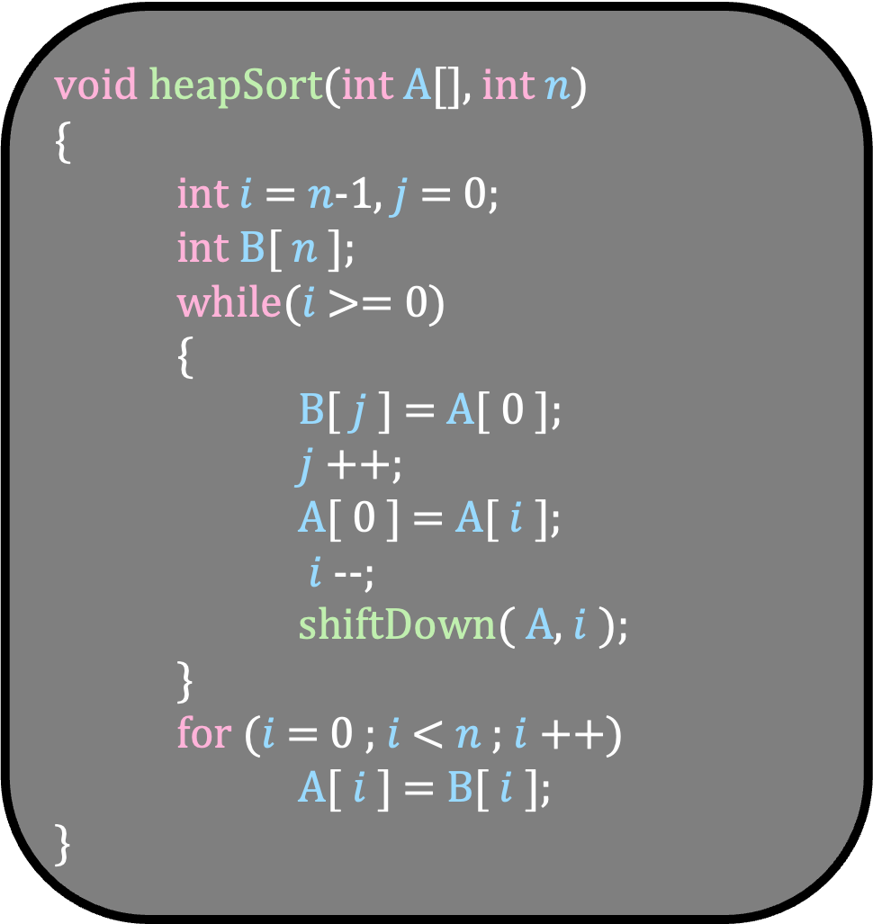
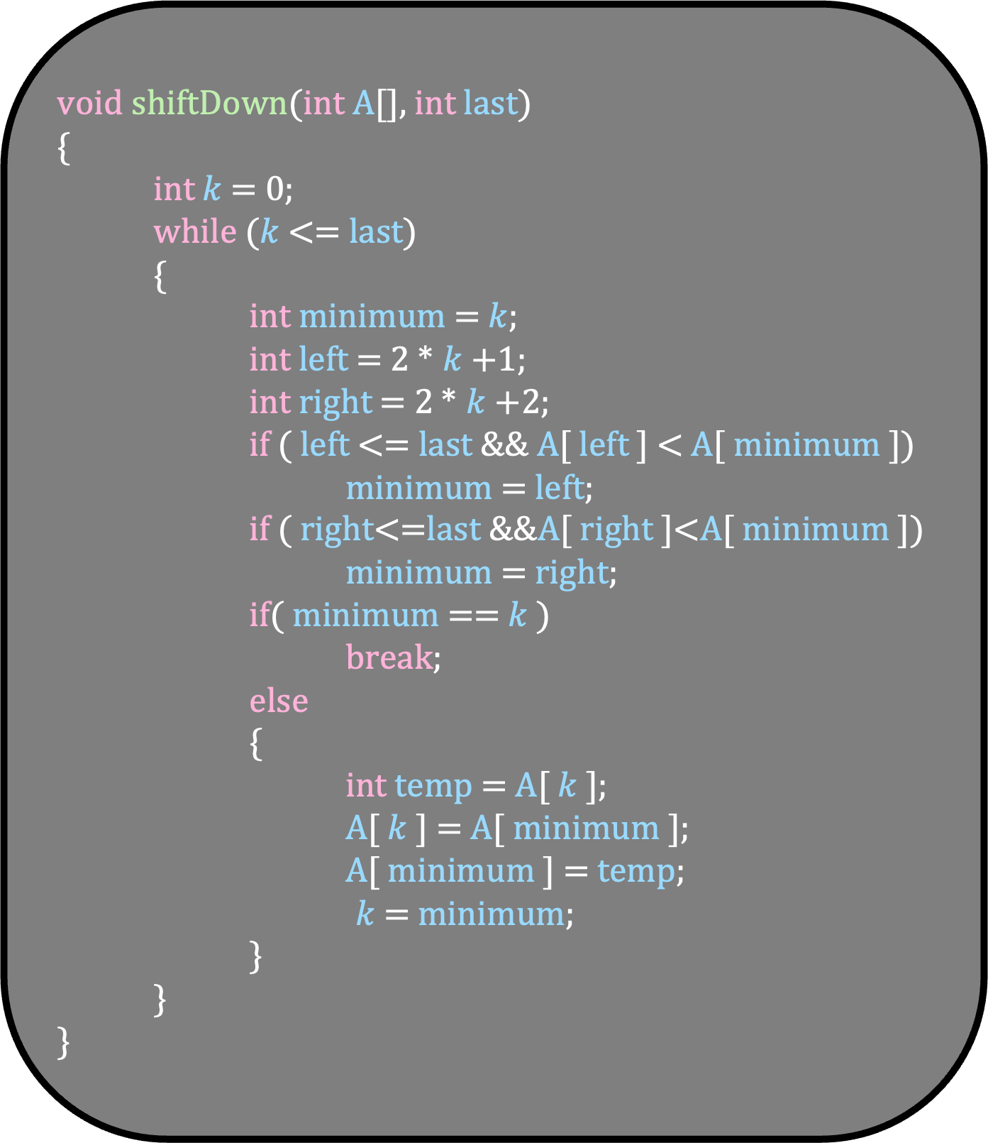
$$i$$
void shiftDown(int A[], int last)
{
int $k$ = 0;
while ($k$ <= last)
{
int minimum = $k$;
int left = 2 * $k$+1;
int right = 2 * $k$+2;
if ( left <= last && A[ left ] < A[ minimum ])
minimum = left;
if ( right<=last &&A[ right ]<A[ minimum ])
minimum = right;
if( minimum == $k$ )
break;
else
{
int temp = A[ $k$ ];
A[ $k$ ] = A[ minimum ];
A[ minimum ] = temp;
$k$ = minimum;
}
}
}
4
5
9
7
10
9
A
0
1
2
3
4
5
void heapSort(int A[], int $n$)
{
int $i$ = $n$-1, $j$ = 0;
int B[ $n$ ];
while($i$ >= 0)
{
B[ $j$ ] = A[ 0 ];
$j$++;
A[ 0 ] = A[ $i$ ];
$i$--;
shiftDown( A, $i$ );
}
for ($i$ = 0 ; $i$ < $n$ ; $i$++)
A[ $i$ ] = B[ $i$ ];
}
4
0
5
9
1
2
7
10
3
4
$$j$$
B
2

Slide 66
$$i$$
void shiftDown(int A[], int last)
{
int $k$ = 0;
while ($k$ <= last)
{
int minimum = $k$;
int left = 2 * $k$+1;
int right = 2 * $k$+2;
if ( left <= last && A[ left ] < A[ minimum ])
minimum = left;
if ( right<=last &&A[ right ]<A[ minimum ])
minimum = right;
if( minimum == $k$ )
break;
else
{
int temp = A[ $k$ ];
A[ $k$ ] = A[ minimum ];
A[ minimum ] = temp;
$k$ = minimum;
}
}
}
4
5
9
7
10
9
A
0
1
2
3
4
5
void heapSort(int A[], int $n$)
{
int $i$ = $n$-1, $j$ = 0;
int B[ $n$ ];
while($i$ >= 0)
{
B[ $j$ ] = A[ 0 ];
$j$++;
A[ 0 ] = A[ $i$ ];
$i$--;
shiftDown( A, $i$ );
}
for ($i$ = 0 ; $i$ < $n$ ; $i$++)
A[ $i$ ] = B[ $i$ ];
}
4
0
5
9
1
2
7
10
3
4
$$j$$
B
2

Slide 67
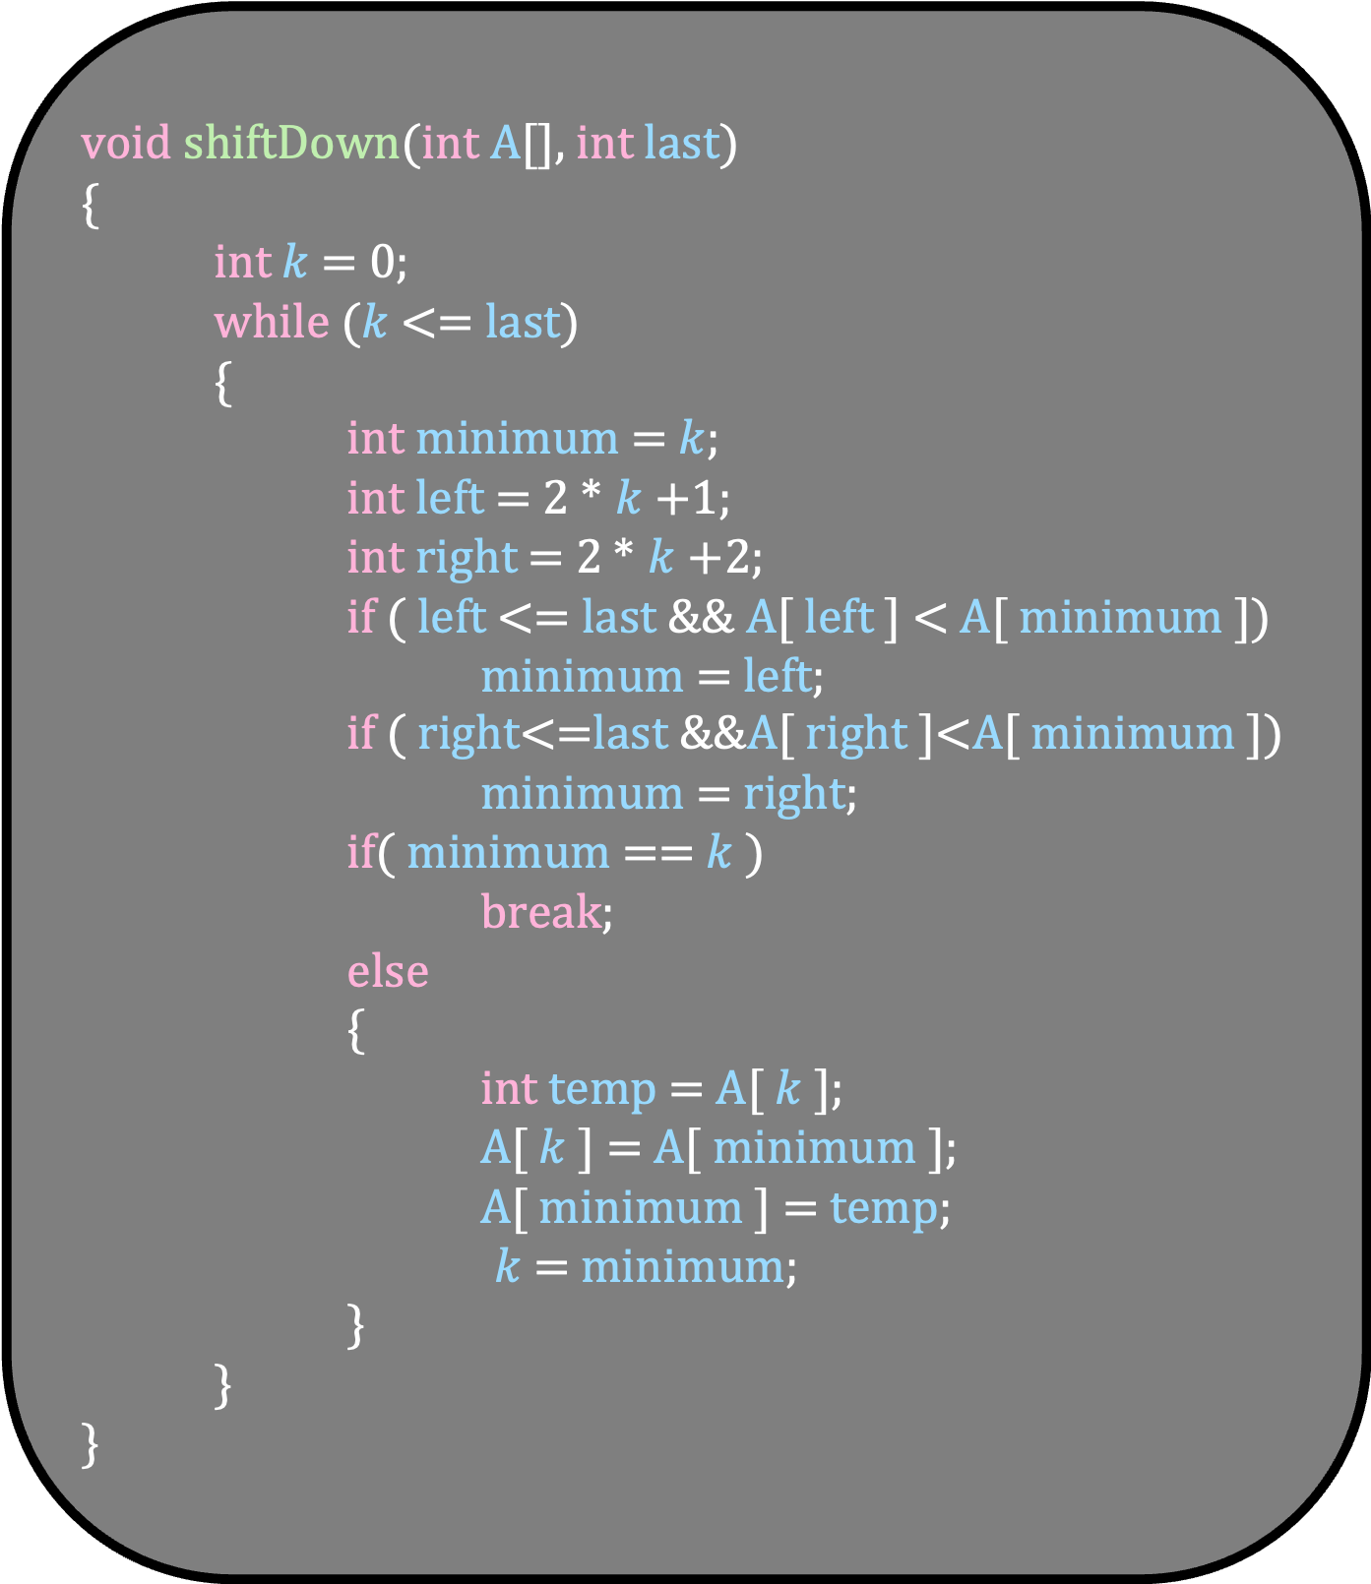
void shiftDown(int A[], int last)
{
int $k$ = 0;
while ($k$ <= last)
{
int minimum = $k$;
int left = 2 * $k$+1;
int right = 2 * $k$+2;
if ( left <= last && A[ left ] < A[ minimum ])
minimum = left;
if ( right<=last &&A[ right ]<A[ minimum ])
minimum = right;
if( minimum == $k$ )
break;
else
{
int temp = A[ $k$ ];
A[ $k$ ] = A[ minimum ];
A[ minimum ] = temp;
$k$ = minimum;
}
}
}
What is the running time of shiftDown ?
There is a constant number of statements in each iteration of while loop
But how many times does the while loop run?
Remember that we are placing the number into its correct place in the heap
After each iteration, the number moves down the heap by one level
But the number of levels in the heap is O( log n)
Thus, the total number of times the while loop runs is O(log n)
Thus, the running time of shiftDown is O( log n)

Slide 68
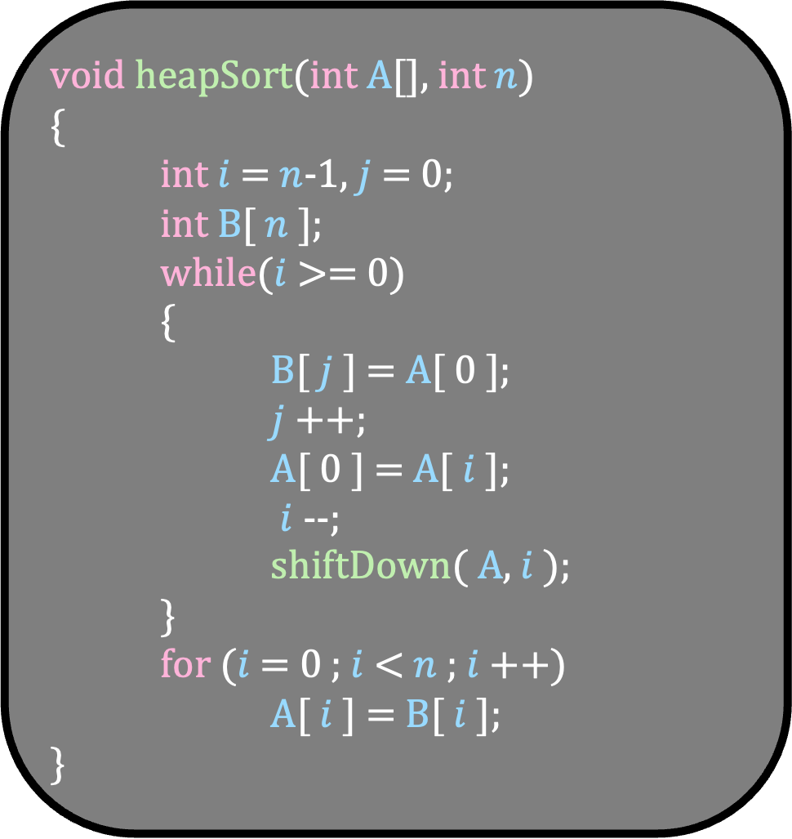
void heapSort(int A[], int $n$)
{
int $i$ = $n$-1, $j$ = 0;
int B[ $n$ ];
while($i$ >= 0)
{
B[ $j$ ] = A[ 0 ];
$j$++;
A[ 0 ] = A[ $i$ ];
$i$--;
shiftDown( A, $i$ );
}
for ($i$ = 0 ; $i$ < $n$ ; $i$++)
A[ $i$ ] = B[ $i$ ];
}
What is the running time of heapSort ?
O(n log n)
But we assumed that the array A is a min-heap to start with
But how to get a heap from an initially arbitrary array?

Slide 69
Given an arbitrary array A, design an algorithm that converts this array into an implicit min heap
Do not use any other sorting algorithm !!!!!!
Your algorithm should take O(n log n) time
In fact, we will see an algorithm that takes O(n) time!!!!

Slide 70
9
5
7
2
1
10
A
0
1
2
3
4
5
Consider the two subtrees of the root of the heap
Let us assume that somehow, we are able to build a heap in these two subtrees
9
0
5
7
1
2
2
1
10
3
4
5

Slide 71
9
1
7
2
5
10
A
0
1
2
3
4
5
Consider the two subtrees of the root of the heap
Let us assume that somehow, we are able to build a heap in these two subtrees
9
0
1
7
1
2
Can you build the entire heap?
2
5
10
3
4
5
Just call shiftDown

Slide 72
void shiftDown(int A[], int last)
{
int $k$ = 0;
while ($k$ <= last)
{
int minimum = $k$;
int left = 2 * $k$+1;
int right = 2 * $k$+2;
if ( left <= last && A[ left ] < A[ minimum ])
minimum = left;
if ( right<=last &&A[ right ]<A[ minimum ])
minimum = right;
if( minimum == $k$ )
break;
else
{
int temp = A[ $k$ ];
A[ $k$ ] = A[ minimum ];
A[ minimum ] = temp;
$k$ = minimum;
}
}
}

Slide 73
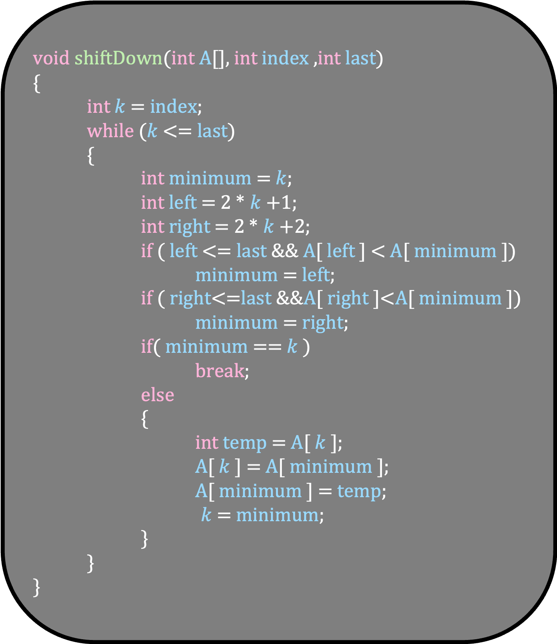
void shiftDown(int A[], int index ,int last)
{
int $k$ = index;
while ($k$ <= last)
{
int minimum = $k$;
int left = 2 * $k$+1;
int right = 2 * $k$+2;
if ( left <= last && A[ left ] < A[ minimum ])
minimum = left;
if ( right<=last &&A[ right ]<A[ minimum ])
minimum = right;
if( minimum == $k$ )
break;
else
{
int temp = A[ $k$ ];
A[ $k$ ] = A[ minimum ];
A[ minimum ] = temp;
$k$ = minimum;
}
}
}
Write a recursive C program that will build the heap:
buildHeap(int A[], int index, int n)
Initially index=0

Slide 74
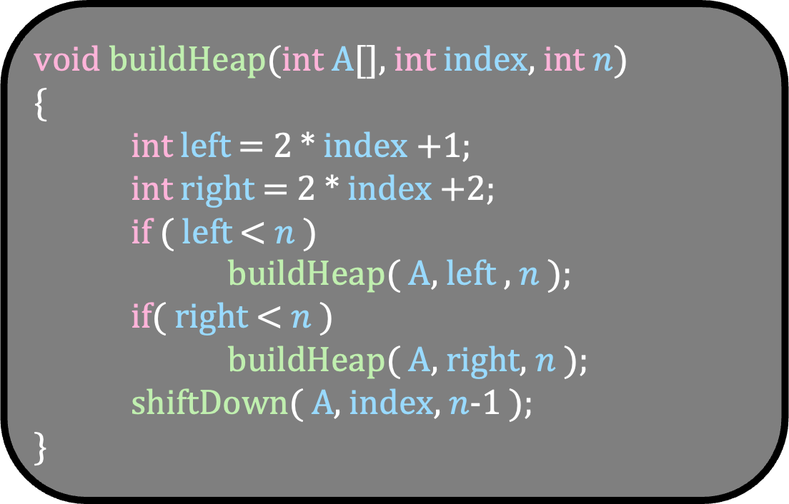
void buildHeap(int A[], int index, int $n$)
{
int left = 2 * index +1;
int right = 2 * index +2;
if ( left < $n$ )
buildHeap( A, left , $n$ );
if( right < $n$ )
buildHeap( A, right, $n$ );
shiftDown( A, index, $n$-1 );
}

Slide 75
9
5
7
2
1
10
A
0
1
2
3
4
5
void buildHeap(int A[], int index, int $n$)
{
int left = 2 * index +1;
int right = 2 * index +2;
if ( left < $n$ )
buildHeap( A, left , $n$ );
if( right < $n$ )
buildHeap( A, right, $n$ );
shiftDown( A, index, $n$-1 );
}
9
0
5
7
1
2
2
1
10
3
4
5
index = 0
n = 6
left =
right =

Slide 76
9
5
7
2
1
10
A
0
1
2
3
4
5
void buildHeap(int A[], int index, int $n$)
{
int left = 2 * index +1;
int right = 2 * index +2;
if ( left < $n$ )
buildHeap( A, left , $n$ );
if( right < $n$ )
buildHeap( A, right, $n$ );
shiftDown( A, index, $n$-1 );
}
9
0
5
7
1
2
2
1
10
3
4
5
index = 0
n = 6
left = 1
right = 2

Slide 77
9
5
7
2
1
10
A
0
1
2
3
4
5
void buildHeap(int A[], int index, int $n$)
{
int left = 2 * index +1;
int right = 2 * index +2;
if ( left < $n$ )
buildHeap( A, left , $n$ );
if( right < $n$ )
buildHeap( A, right, $n$ );
shiftDown( A, index, $n$-1 );
}
9
0
5
7
1
2
2
1
10
3
4
5
index = 0
n = 6
left = 1
right = 2

Slide 78
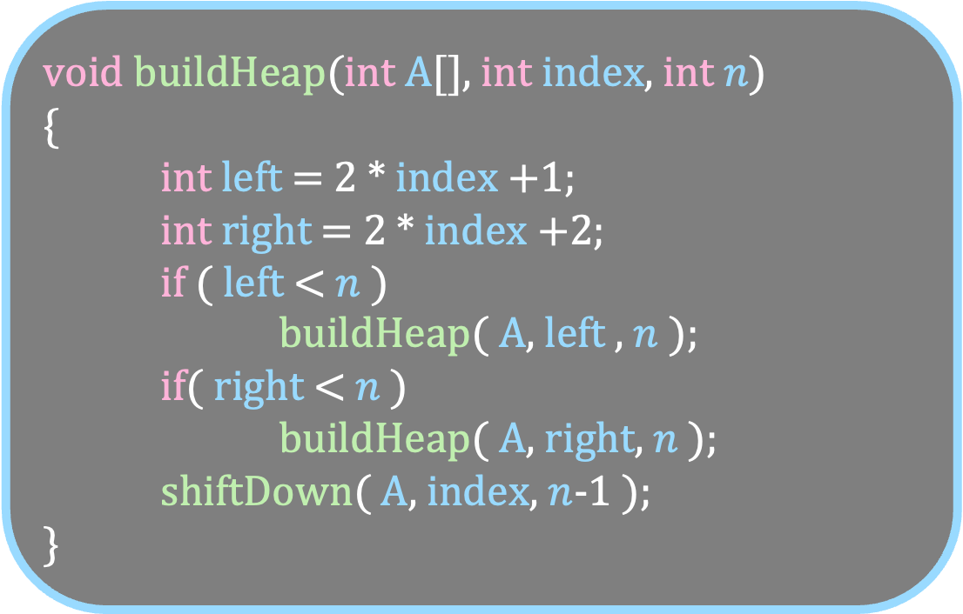
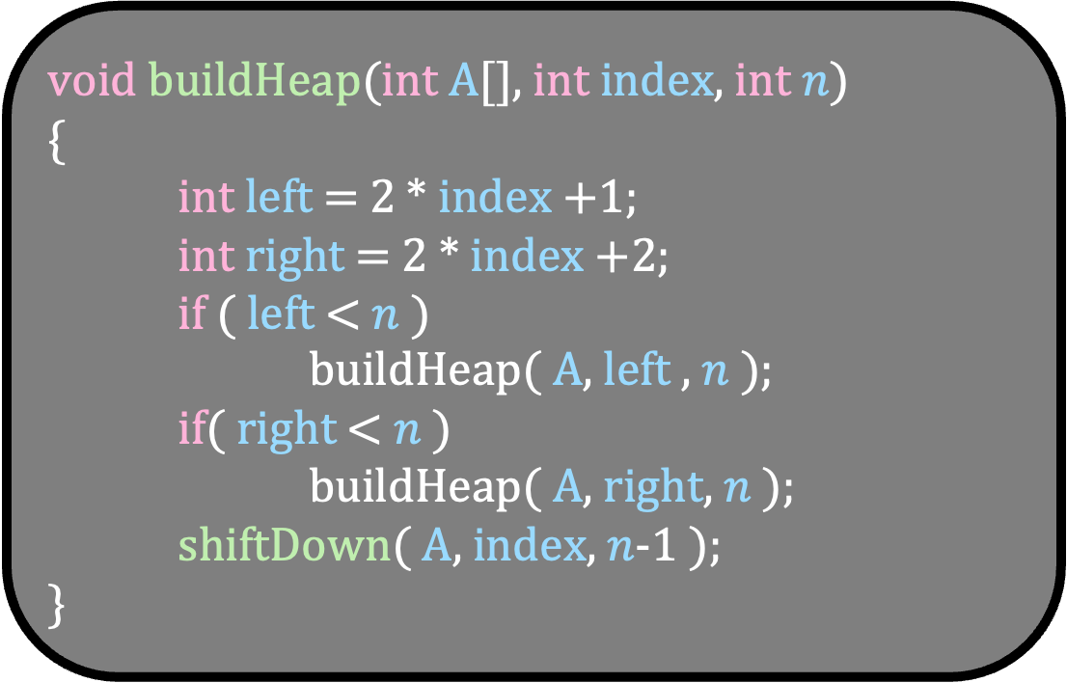
9
5
7
2
1
10
A
0
1
2
3
4
5
void buildHeap(int A[], int index, int $n$)
{
int left = 2 * index +1;
int right = 2 * index +2;
if ( left < $n$ )
buildHeap( A, left , $n$ );
if( right < $n$ )
buildHeap( A, right, $n$ );
shiftDown( A, index, $n$-1 );
}
void buildHeap(int A[], int index, int $n$)
{
int left = 2 * index +1;
int right = 2 * index +2;
if ( left < $n$ )
buildHeap( A, left , $n$ );
if( right < $n$ )
buildHeap( A, right, $n$ );
shiftDown( A, index, $n$-1 );
}
9
0
5
7
1
2
2
1
10
index = 0
n = 6
left = 1
right = 2
index = 1
n = 6
left =
right =
3
4
5

Slide 79
9
5
7
2
1
10
A
0
1
2
3
4
5
void buildHeap(int A[], int index, int $n$)
{
int left = 2 * index +1;
int right = 2 * index +2;
if ( left < $n$ )
buildHeap( A, left , $n$ );
if( right < $n$ )
buildHeap( A, right, $n$ );
shiftDown( A, index, $n$-1 );
}
void buildHeap(int A[], int index, int $n$)
{
int left = 2 * index +1;
int right = 2 * index +2;
if ( left < $n$ )
buildHeap( A, left , $n$ );
if( right < $n$ )
buildHeap( A, right, $n$ );
shiftDown( A, index, $n$-1 );
}
9
0
5
7
1
2
2
1
10
index = 0
n = 6
left = 1
right = 2
index = 1
n = 6
left = 3
right =4
3
4
5

Slide 80
9
5
7
2
1
10
A
0
1
2
3
4
5
void buildHeap(int A[], int index, int $n$)
{
int left = 2 * index +1;
int right = 2 * index +2;
if ( left < $n$ )
buildHeap( A, left , $n$ );
if( right < $n$ )
buildHeap( A, right, $n$ );
shiftDown( A, index, $n$-1 );
}
void buildHeap(int A[], int index, int $n$)
{
int left = 2 * index +1;
int right = 2 * index +2;
if ( left < $n$ )
buildHeap( A, left , $n$ );
if( right < $n$ )
buildHeap( A, right, $n$ );
shiftDown( A, index, $n$-1 );
}
9
0
5
7
1
2
2
1
10
index = 0
n = 6
left = 1
right = 2
index = 1
n = 6
left = 3
right =4
3
4
5

Slide 81
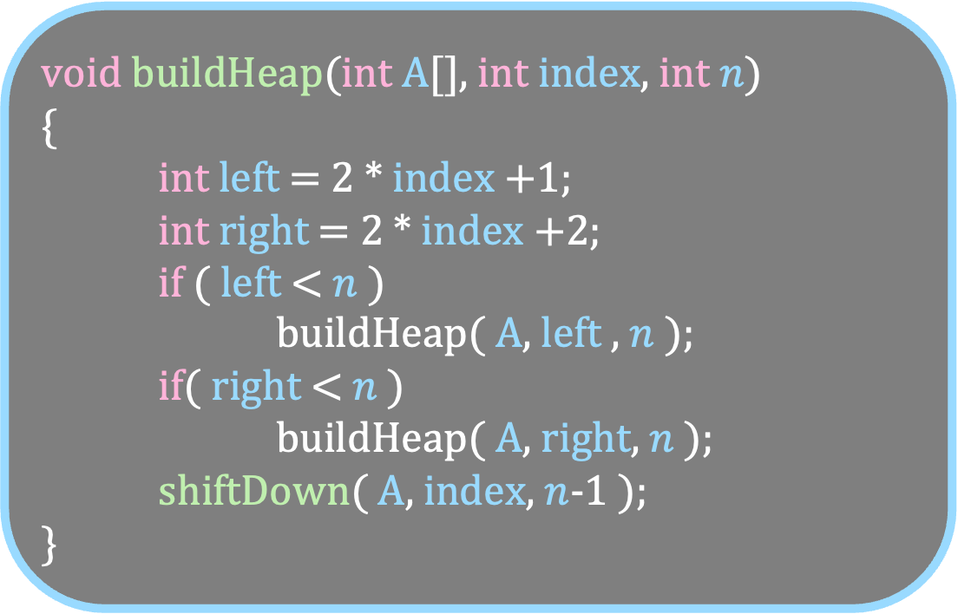
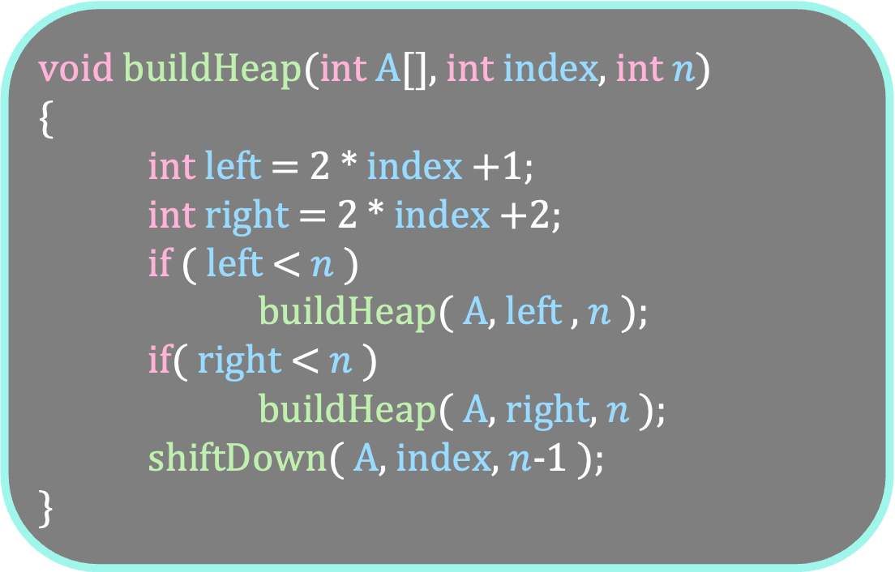
void buildHeap(int A[], int index, int $n$)
{
int left = 2 * index +1;
int right = 2 * index +2;
if ( left < $n$ )
buildHeap( A, left , $n$ );
if( right < $n$ )
buildHeap( A, right, $n$ );
shiftDown( A, index, $n$-1 );
}
index = 1
n = 6
left = 3
right =4
9
5
7
2
1
10
A
0
1
2
3
4
5
void buildHeap(int A[], int index, int $n$)
{
int left = 2 * index +1;
int right = 2 * index +2;
if ( left < $n$ )
buildHeap( A, left , $n$ );
if( right < $n$ )
buildHeap( A, right, $n$ );
shiftDown( A, index, $n$-1 );
}
void buildHeap(int A[], int index, int $n$)
{
int left = 2 * index +1;
int right = 2 * index +2;
if ( left < $n$ )
buildHeap( A, left , $n$ );
if( right < $n$ )
buildHeap( A, right, $n$ );
shiftDown( A, index, $n$-1 );
}
9
0
5
7
1
2
2
1
10
index = 0
n = 6
left = 1
right = 2
index = 3
n = 6
left =
right =
3
4
5

Slide 82
void buildHeap(int A[], int index, int $n$)
{
int left = 2 * index +1;
int right = 2 * index +2;
if ( left < $n$ )
buildHeap( A, left , $n$ );
if( right < $n$ )
buildHeap( A, right, $n$ );
shiftDown( A, index, $n$-1 );
}
index = 1
n = 6
left = 3
right =4
9
5
7
2
1
10
A
0
1
2
3
4
5
void buildHeap(int A[], int index, int $n$)
{
int left = 2 * index +1;
int right = 2 * index +2;
if ( left < $n$ )
buildHeap( A, left , $n$ );
if( right < $n$ )
buildHeap( A, right, $n$ );
shiftDown( A, index, $n$-1 );
}
void buildHeap(int A[], int index, int $n$)
{
int left = 2 * index +1;
int right = 2 * index +2;
if ( left < $n$ )
buildHeap( A, left , $n$ );
if( right < $n$ )
buildHeap( A, right, $n$ );
shiftDown( A, index, $n$-1 );
}
9
0
5
7
1
2
2
1
10
index = 0
n = 6
left = 1
right = 2
index = 3
n = 6
left = 7
right =8
3
4
5

Slide 83
void buildHeap(int A[], int index, int $n$)
{
int left = 2 * index +1;
int right = 2 * index +2;
if ( left < $n$ )
buildHeap( A, left , $n$ );
if( right < $n$ )
buildHeap( A, right, $n$ );
shiftDown( A, index, $n$-1 );
}
index = 1
n = 6
left = 3
right =4
9
5
7
2
1
10
A
0
1
2
3
4
5
void buildHeap(int A[], int index, int $n$)
{
int left = 2 * index +1;
int right = 2 * index +2;
if ( left < $n$ )
buildHeap( A, left , $n$ );
if( right < $n$ )
buildHeap( A, right, $n$ );
shiftDown( A, index, $n$-1 );
}
void buildHeap(int A[], int index, int $n$)
{
int left = 2 * index +1;
int right = 2 * index +2;
if ( left < $n$ )
buildHeap( A, left , $n$ );
if( right < $n$ )
buildHeap( A, right, $n$ );
shiftDown( A, index, $n$-1 );
}
9
0
5
7
1
2
2
1
10
index = 0
n = 6
left = 1
right = 2
index = 3
n = 6
left = 7
right =8
3
4
5

Slide 84
void buildHeap(int A[], int index, int $n$)
{
int left = 2 * index +1;
int right = 2 * index +2;
if ( left < $n$ )
buildHeap( A, left , $n$ );
if( right < $n$ )
buildHeap( A, right, $n$ );
shiftDown( A, index, $n$-1 );
}
index = 1
n = 6
left = 3
right =4
9
5
7
2
1
10
A
0
1
2
3
4
5
void buildHeap(int A[], int index, int $n$)
{
int left = 2 * index +1;
int right = 2 * index +2;
if ( left < $n$ )
buildHeap( A, left , $n$ );
if( right < $n$ )
buildHeap( A, right, $n$ );
shiftDown( A, index, $n$-1 );
}
void buildHeap(int A[], int index, int $n$)
{
int left = 2 * index +1;
int right = 2 * index +2;
if ( left < $n$ )
buildHeap( A, left , $n$ );
if( right < $n$ )
buildHeap( A, right, $n$ );
shiftDown( A, index, $n$-1 );
}
9
0
5
7
1
2
2
1
10
index = 0
n = 6
left = 1
right = 2
index = 3
n = 6
left = 7
right =8
3
4
5

Slide 85
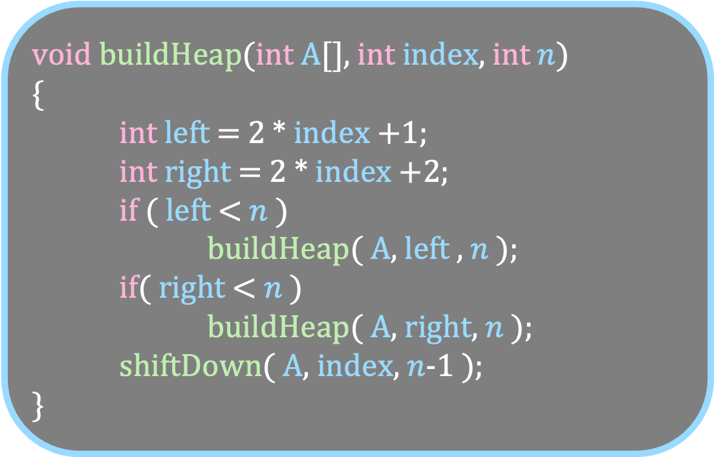
9
5
7
2
1
10
A
0
1
2
3
4
5
void buildHeap(int A[], int index, int $n$)
{
int left = 2 * index +1;
int right = 2 * index +2;
if ( left < $n$ )
buildHeap( A, left , $n$ );
if( right < $n$ )
buildHeap( A, right, $n$ );
shiftDown( A, index, $n$-1 );
}
void buildHeap(int A[], int index, int $n$)
{
int left = 2 * index +1;
int right = 2 * index +2;
if ( left < $n$ )
buildHeap( A, left , $n$ );
if( right < $n$ )
buildHeap( A, right, $n$ );
shiftDown( A, index, $n$-1 );
}
9
0
5
7
1
2
2
1
10
index = 0
n = 6
left = 1
right = 2
index = 1
n = 6
left = 3
right =4
3
4
5

Slide 86
9
5
7
2
1
10
A
0
1
2
3
4
5
void buildHeap(int A[], int index, int $n$)
{
int left = 2 * index +1;
int right = 2 * index +2;
if ( left < $n$ )
buildHeap( A, left , $n$ );
if( right < $n$ )
buildHeap( A, right, $n$ );
shiftDown( A, index, $n$-1 );
}
void buildHeap(int A[], int index, int $n$)
{
int left = 2 * index +1;
int right = 2 * index +2;
if ( left < $n$ )
buildHeap( A, left , $n$ );
if( right < $n$ )
buildHeap( A, right, $n$ );
shiftDown( A, index, $n$-1 );
}
9
0
5
7
1
2
2
1
10
index = 0
n = 6
left = 1
right = 2
index = 1
n = 6
left = 3
right =4
3
4
5

Slide 87
9
5
7
2
1
10
A
0
1
2
3
4
5
void buildHeap(int A[], int index, int $n$)
{
int left = 2 * index +1;
int right = 2 * index +2;
if ( left < $n$ )
buildHeap( A, left , $n$ );
if( right < $n$ )
buildHeap( A, right, $n$ );
shiftDown( A, index, $n$-1 );
}
void buildHeap(int A[], int index, int $n$)
{
int left = 2 * index +1;
int right = 2 * index +2;
if ( left < $n$ )
buildHeap( A, left , $n$ );
if( right < $n$ )
buildHeap( A, right, $n$ );
shiftDown( A, index, $n$-1 );
}
9
0
5
7
1
2
2
1
10
index = 0
n = 6
left = 1
right = 2
index = 1
n = 6
left = 3
right =4
3
4
5

Slide 88
9
5
7
2
1
10
A
0
1
2
3
4
5
void buildHeap(int A[], int index, int $n$)
{
int left = 2 * index +1;
int right = 2 * index +2;
if ( left < $n$ )
buildHeap( A, left , $n$ );
if( right < $n$ )
buildHeap( A, right, $n$ );
shiftDown( A, index, $n$-1 );
}
void buildHeap(int A[], int index, int $n$)
{
int left = 2 * index +1;
int right = 2 * index +2;
if ( left < $n$ )
buildHeap( A, left , $n$ );
if( right < $n$ )
buildHeap( A, right, $n$ );
shiftDown( A, index, $n$-1 );
}
9
0
5
7
1
2
2
1
10
index = 0
n = 6
left = 1
right = 2
index = 1
n = 6
left = 3
right =4
3
4
5

Slide 89
9
5
7
2
1
10
A
0
1
2
3
4
5
void buildHeap(int A[], int index, int $n$)
{
int left = 2 * index +1;
int right = 2 * index +2;
if ( left < $n$ )
buildHeap( A, left , $n$ );
if( right < $n$ )
buildHeap( A, right, $n$ );
shiftDown( A, index, $n$-1 );
}
void buildHeap(int A[], int index, int $n$)
{
int left = 2 * index +1;
int right = 2 * index +2;
if ( left < $n$ )
buildHeap( A, left , $n$ );
if( right < $n$ )
buildHeap( A, right, $n$ );
shiftDown( A, index, $n$-1 );
}
9
0
1
7
1
2
2
5
10
index = 0
n = 6
left = 1
right = 2
index = 1
n = 6
left = 3
right =4
3
4
5

Slide 90
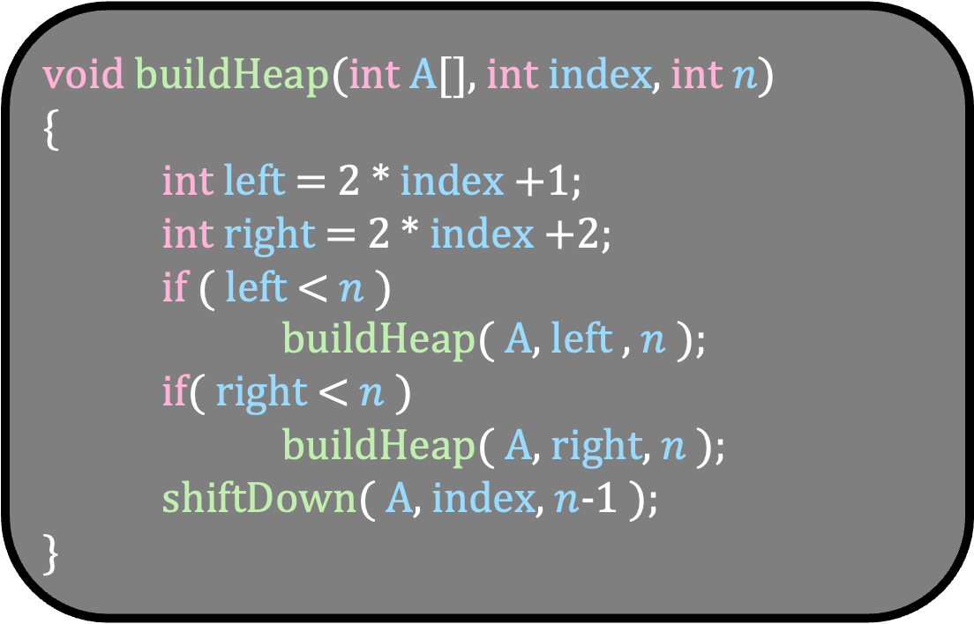
9
5
7
2
1
10
A
0
1
2
3
4
5
void buildHeap(int A[], int index, int $n$)
{
int left = 2 * index +1;
int right = 2 * index +2;
if ( left < $n$ )
buildHeap( A, left , $n$ );
if( right < $n$ )
buildHeap( A, right, $n$ );
shiftDown( A, index, $n$-1 );
}
9
0
1
7
1
2
index = 0
n = 6
left = 1
right = 2
2
5
10
3
4
5

Slide 91
9
5
7
2
1
10
A
0
1
2
3
4
5
void buildHeap(int A[], int index, int $n$)
{
int left = 2 * index +1;
int right = 2 * index +2;
if ( left < $n$ )
buildHeap( A, left , $n$ );
if( right < $n$ )
buildHeap( A, right, $n$ );
shiftDown( A, index, $n$-1 );
}
9
0
1
7
1
2
index = 0
n = 6
left = 1
right = 2
2
5
10
3
4
5

Slide 92
9
5
7
2
1
10
A
0
1
2
3
4
5
void buildHeap(int A[], int index, int $n$)
{
int left = 2 * index +1;
int right = 2 * index +2;
if ( left < $n$ )
buildHeap( A, left , $n$ );
if( right < $n$ )
buildHeap( A, right, $n$ );
shiftDown( A, index, $n$-1 );
}
9
0
1
7
1
2
index = 0
n = 6
left = 1
right = 2
2
5
10
3
4
5

Slide 93
9
5
7
2
1
10
A
0
1
2
3
4
5
void buildHeap(int A[], int index, int $n$)
{
int left = 2 * index +1;
int right = 2 * index +2;
if ( left < $n$ )
buildHeap( A, left , $n$ );
if( right < $n$ )
buildHeap( A, right, $n$ );
shiftDown( A, index, $n$-1 );
}
9
0
1
7
1
2
index = 0
n = 6
left = 1
right = 2
2
5
10
3
4
5

Slide 94
9
5
7
2
1
10
A
0
1
2
3
4
5
void buildHeap(int A[], int index, int $n$)
{
int left = 2 * index +1;
int right = 2 * index +2;
if ( left < $n$ )
buildHeap( A, left , $n$ );
if( right < $n$ )
buildHeap( A, right, $n$ );
shiftDown( A, index, $n$-1 );
}
1
0
9
7
1
2
index = 0
n = 6
left = 1
right = 2
2
5
10
3
4
5

Slide 95
9
5
7
2
1
10
A
0
1
2
3
4
5
void buildHeap(int A[], int index, int $n$)
{
int left = 2 * index +1;
int right = 2 * index +2;
if ( left < $n$ )
buildHeap( A, left , $n$ );
if( right < $n$ )
buildHeap( A, right, $n$ );
shiftDown( A, index, $n$-1 );
}
1
0
2
7
1
2
index = 0
n = 6
left = 1
right = 2
9
5
10
3
4
5

Slide 96
9
5
7
2
1
10
A
0
1
2
3
4
5
void buildHeap(int A[], int index, int $n$)
{
int left = 2 * index +1;
int right = 2 * index +2;
if ( left < $n$ )
buildHeap( A, left , $n$ );
if( right < $n$ )
buildHeap( A, right, $n$ );
shiftDown( A, index, $n$-1 );
}
1
0
2
7
1
2
9
5
10
3
4
5

Slide 97
void buildHeap(int A[], int index, int $n$)
{
int left = 2 * index +1;
int right = 2 * index +2;
if ( left < $n$ )
buildHeap( A, left , $n$ );
if( right < $n$ )
buildHeap( A, right, $n$ );
shiftDown( A, index, $n$-1 );
}
What is the running time of buildHeap?

Slide 98

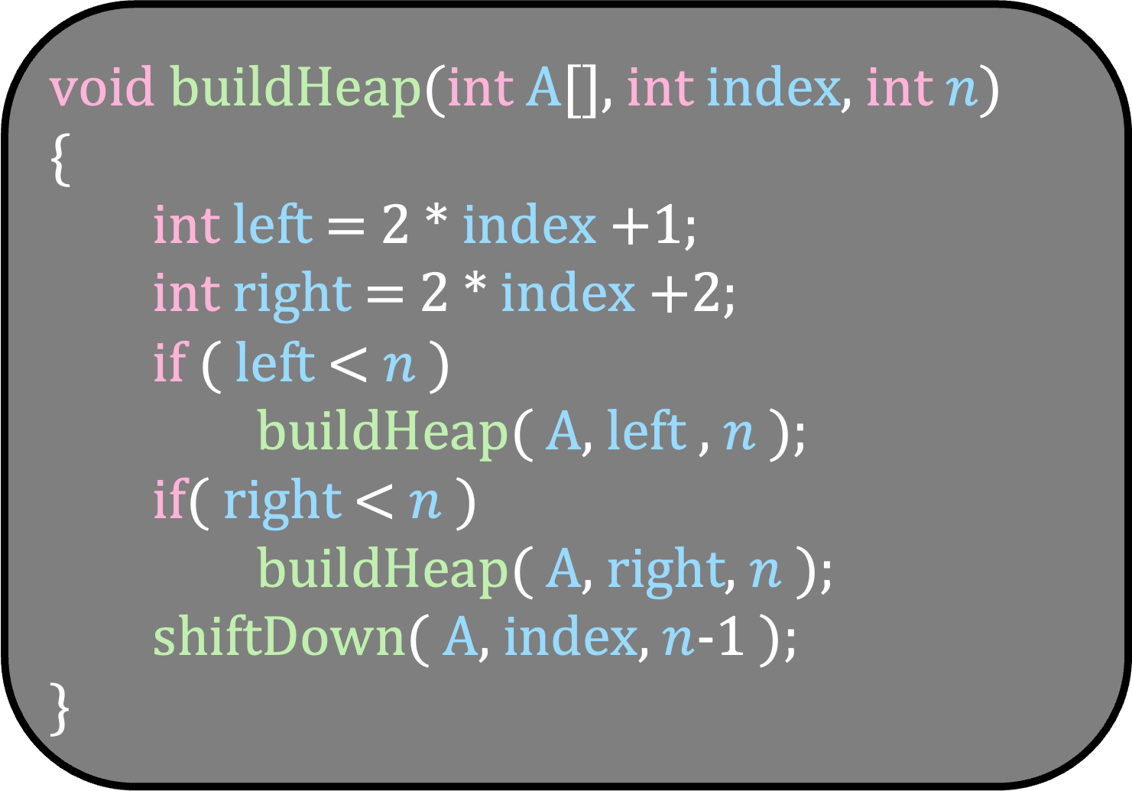
void buildHeap(int A[], int index, int $n$)
{
int left = 2 * index +1;
int right = 2 * index +2;
if ( left < $n$ )
buildHeap( A, left , $n$ );
if( right < $n$ )
buildHeap( A, right, $n$ );
shiftDown( A, index, $n$-1 );
}
1
T(n)
0
9
7
1
2
T(n/2)
T(n/2)
2
5
10
3
4
5
$$\log{n}$$

Slide 99

void buildHeap(int A[], int index, int $n$)
{
int left = 2 * index +1;
int right = 2 * index +2;
if ( left < $n$ )
buildHeap( A, left , $n$ );
if( right < $n$ )
buildHeap( A, right, $n$ );
shiftDown( A, index, $n$-1 );
}
1
0
9
7
1
2
2
5
10
3
4
5
T(n)
T(n/2)
T(n/2)
$$\log{n}$$
T(1)
c

Slide 100
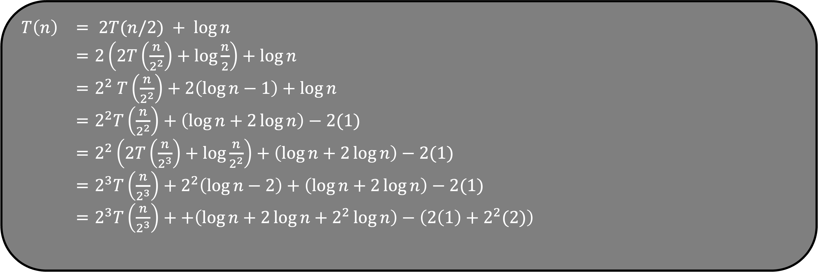
$T\left(n\right)$ = $2T(n/2) + log⁡n$
= $2\left(2T\left(\frac{n}{2^{2}}\right)+\log{\frac{n}{2}}\right)+\log{n}$
= $2^{2} T\left(\frac{n}{2^{2}}\right)+2\left(\log{n}−1\right)+\log{n}$
= $2^{2}T\left(\frac{n}{2^{2}}\right)+\left(\log{n}+2\log{n}\right)−2(1)$
= $2^{2}\left(2T\left(\frac{n}{2^{3}}\right)+\log{\frac{n}{2^{2}}}\right)+\left(\log{n}+2\log{n}\right)−2(1)$
= $2^{3}T\left(\frac{n}{2^{3}}\right)+2^{2}\left(\log{n}−2\right)+\left(\log{n}+2\log{n}\right)−2(1)$
= $2^{3}T\left(\frac{n}{2^{3}}\right)++\left(\log{n}+2\log{n}+2^{2}\log{n}\right)−\left(2\left(1\right)+2^{2}(2)\right)$
Do you see the pattern?

Slide 101
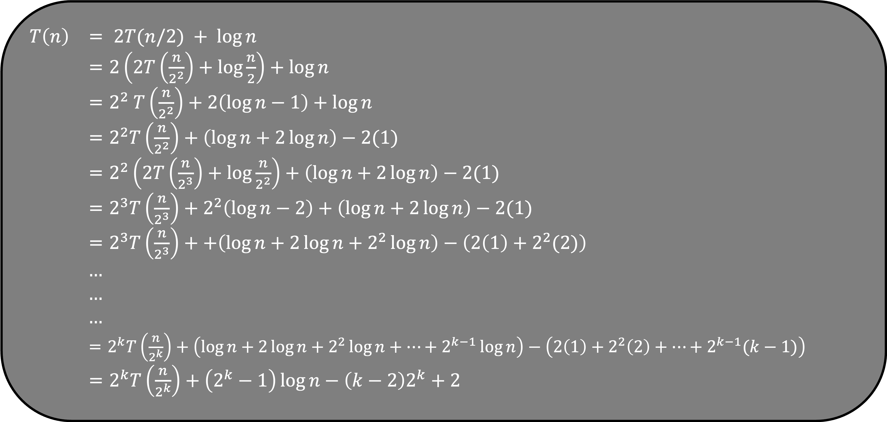
$T\left(n\right)$ = $2T(n/2) + log⁡n$
= $2\left(2T\left(\frac{n}{2^{2}}\right)+\log{\frac{n}{2}}\right)+\log{n}$
= $2^{2} T\left(\frac{n}{2^{2}}\right)+2\left(\log{n}−1\right)+\log{n}$
= $2^{2}T\left(\frac{n}{2^{2}}\right)+\left(\log{n}+2\log{n}\right)−2(1)$
= $2^{2}\left(2T\left(\frac{n}{2^{3}}\right)+\log{\frac{n}{2^{2}}}\right)+\left(\log{n}+2\log{n}\right)−2(1)$
= $2^{3}T\left(\frac{n}{2^{3}}\right)+2^{2}\left(\log{n}−2\right)+\left(\log{n}+2\log{n}\right)−2(1)$
= $2^{3}T\left(\frac{n}{2^{3}}\right)++\left(\log{n}+2\log{n}+2^{2}\log{n}\right)−\left(2\left(1\right)+2^{2}(2)\right)$
$…$
$…$
$…$
= $2^{k}T\left(\frac{n}{2^{k}}\right)+\left(\log{n}+2\log{n}+2^{2}\log{n}+…+2^{k−1}\log{n}\right)−\left(2\left(1\right)+2^{2}\left(2\right)+…+2^{k−1}(k−1)\right)$
= $2^{k}T\left(\frac{n}{2^{k}}\right)+\left(2^{k}−1\right)\log{n}−\left(k−2\right)2^{k}+2$
But the height of the tree is $≈\log{n}$
Set $k=\log{n}$

Slide 102
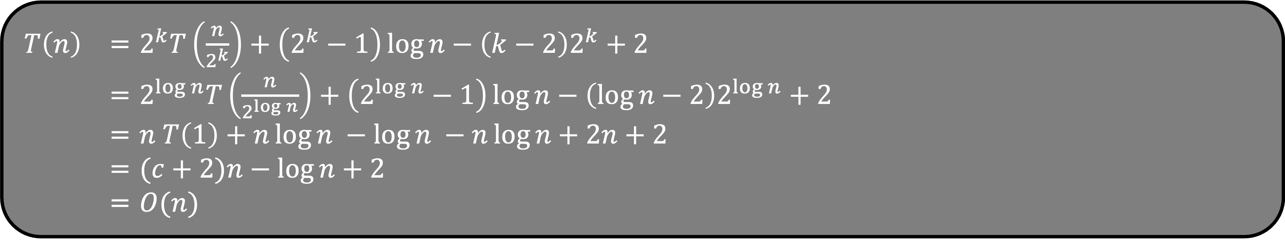
$T\left(n\right)$ = $2^{k}T\left(\frac{n}{2^{k}}\right)+\left(2^{k}−1\right)\log{n}−\left(k−2\right)2^{k}+2$
= $2^{\log{n}}T\left(\frac{n}{2^{\log{n}}}\right)+\left(2^{\log{n}}−1\right)\log{n}−\left(\log{n}−2\right)2^{\log{n}}+2$
= $n T\left(1\right)+n\log{n −\log{n −n\log{n+2n+2}}}$
= $(c+2)n−\log{n+2}$
= $O(n)$

Slide 103
void buildHeap(int A[], int index, int $n$)
{
int left = 2 * index +1;
int right = 2 * index +2;
if ( left < $n$ )
buildHeap( A, left , $n$ );
if( right < $n$ )
buildHeap( A, right, $n$ );
shiftDown( A, index, $n$-1 );
}
What is the running time of buildHeap?
O(n)

Slide 104
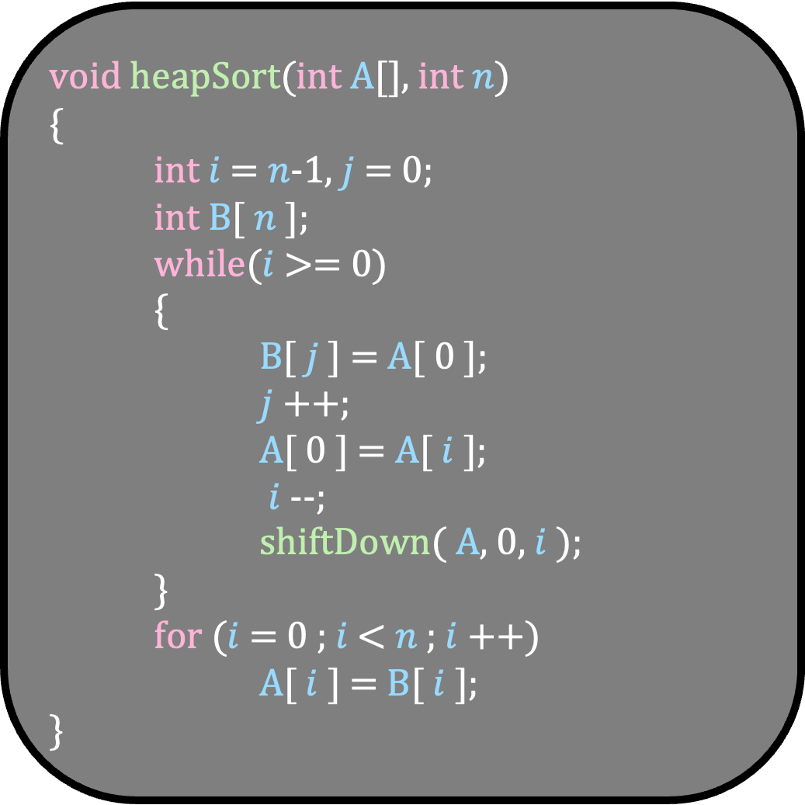
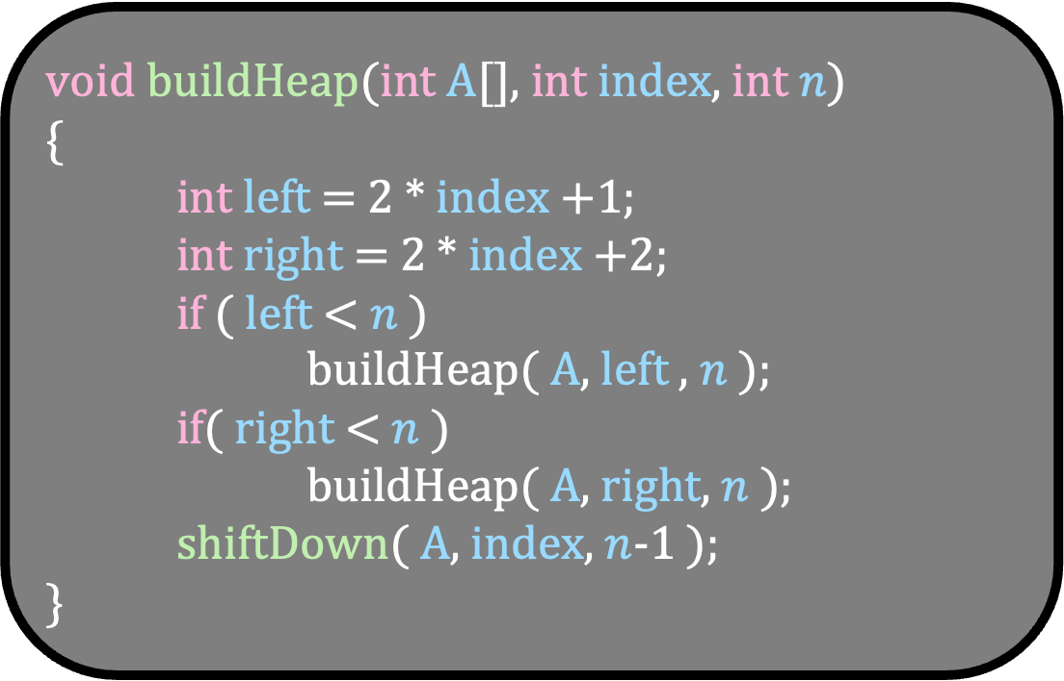
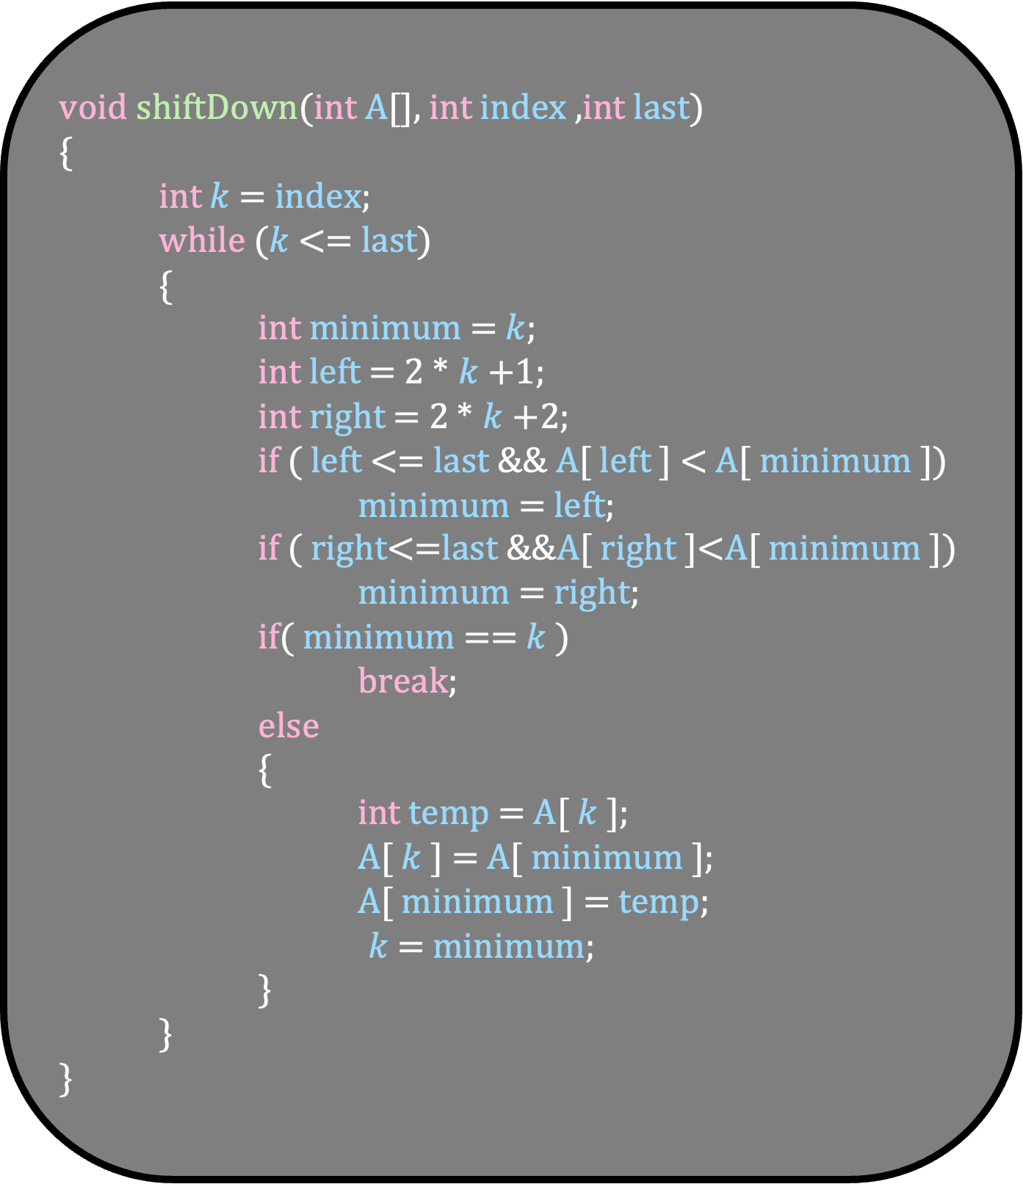
void buildHeap(int A[], int index, int $n$)
{
int left = 2 * index +1;
int right = 2 * index +2;
if ( left < $n$ )
buildHeap( A, left , $n$ );
if( right < $n$ )
buildHeap( A, right, $n$ );
shiftDown( A, index, $n$-1 );
}
void heapSort(int A[], int $n$)
{
int $i$ = $n$-1, $j$ = 0;
int B[ $n$ ];
while($i$ >= 0)
{
B[ $j$ ] = A[ 0 ];
$j$++;
A[ 0 ] = A[ $i$ ];
$i$--;
shiftDown( A, 0, $i$ );
}
for ($i$ = 0 ; $i$ < $n$ ; $i$++)
A[ $i$ ] = B[ $i$ ];
}
void shiftDown(int A[], int index ,int last)
{
int $k$ = index;
while ($k$ <= last)
{
int minimum = $k$;
int left = 2 * $k$+1;
int right = 2 * $k$+2;
if ( left <= last && A[ left ] < A[ minimum ])
minimum = left;
if ( right<=last &&A[ right ]<A[ minimum ])
minimum = right;
if( minimum == $k$ )
break;
else
{
int temp = A[ $k$ ];
A[ $k$ ] = A[ minimum ];
A[ minimum ] = temp;
$k$ = minimum;
}
}
}
O(n)
O(n log n)
Total Running Time of HeapSort is O(n log n)

