Slide 1
Arrays and Sorting

Slide 2
#include <stdio.h> int main() {
int num[5] = {1,2,3,4,5};
num[2] = 6;
printf(“%d”, num[0]); return 0; }

Slide 3

Taking input from the user
#include <stdio.h> int main() {
int $n$,$i$;
scanf(“%d”, &$n$);
int num[$n$];
for($i$=0 ; $i$ < $n$; $i$++)
{
scanf(“%d”, &num[$i$]);
} return 0; }
Write a program to add the number 6 at the end of num
Unfortunately, we cannot write: num += [6]
What to do then?

Slide 4
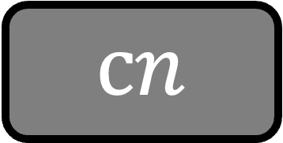

#include <stdio.h> int main() {
int $n$,$i$;
scanf(“%d”, &$n$);
int num[$n$];
for($i$=0 ; $i$ < $n$; $i$++)
{
scanf(“%d”, &num[$i$]);
}
//Simulate num += [6]
int arr[$n$+1];
for($i$=0; $i$ < $n$; $i$++)
{
arr[$i$] = num[$i$];
}
arr[$n$] = 6; return 0; }
Write a program to add the number 6 at the end of num
Unfortunately, we cannot write: num += [6]
What to do then?
$$cn$$
Adding an element to the array takes O(n) time

Slide 5
Adding an element to the array takes O(n) time
Write a program to delete the element at index j from num
Unfortunately, there is no slicing in C
What to do then?

Slide 6
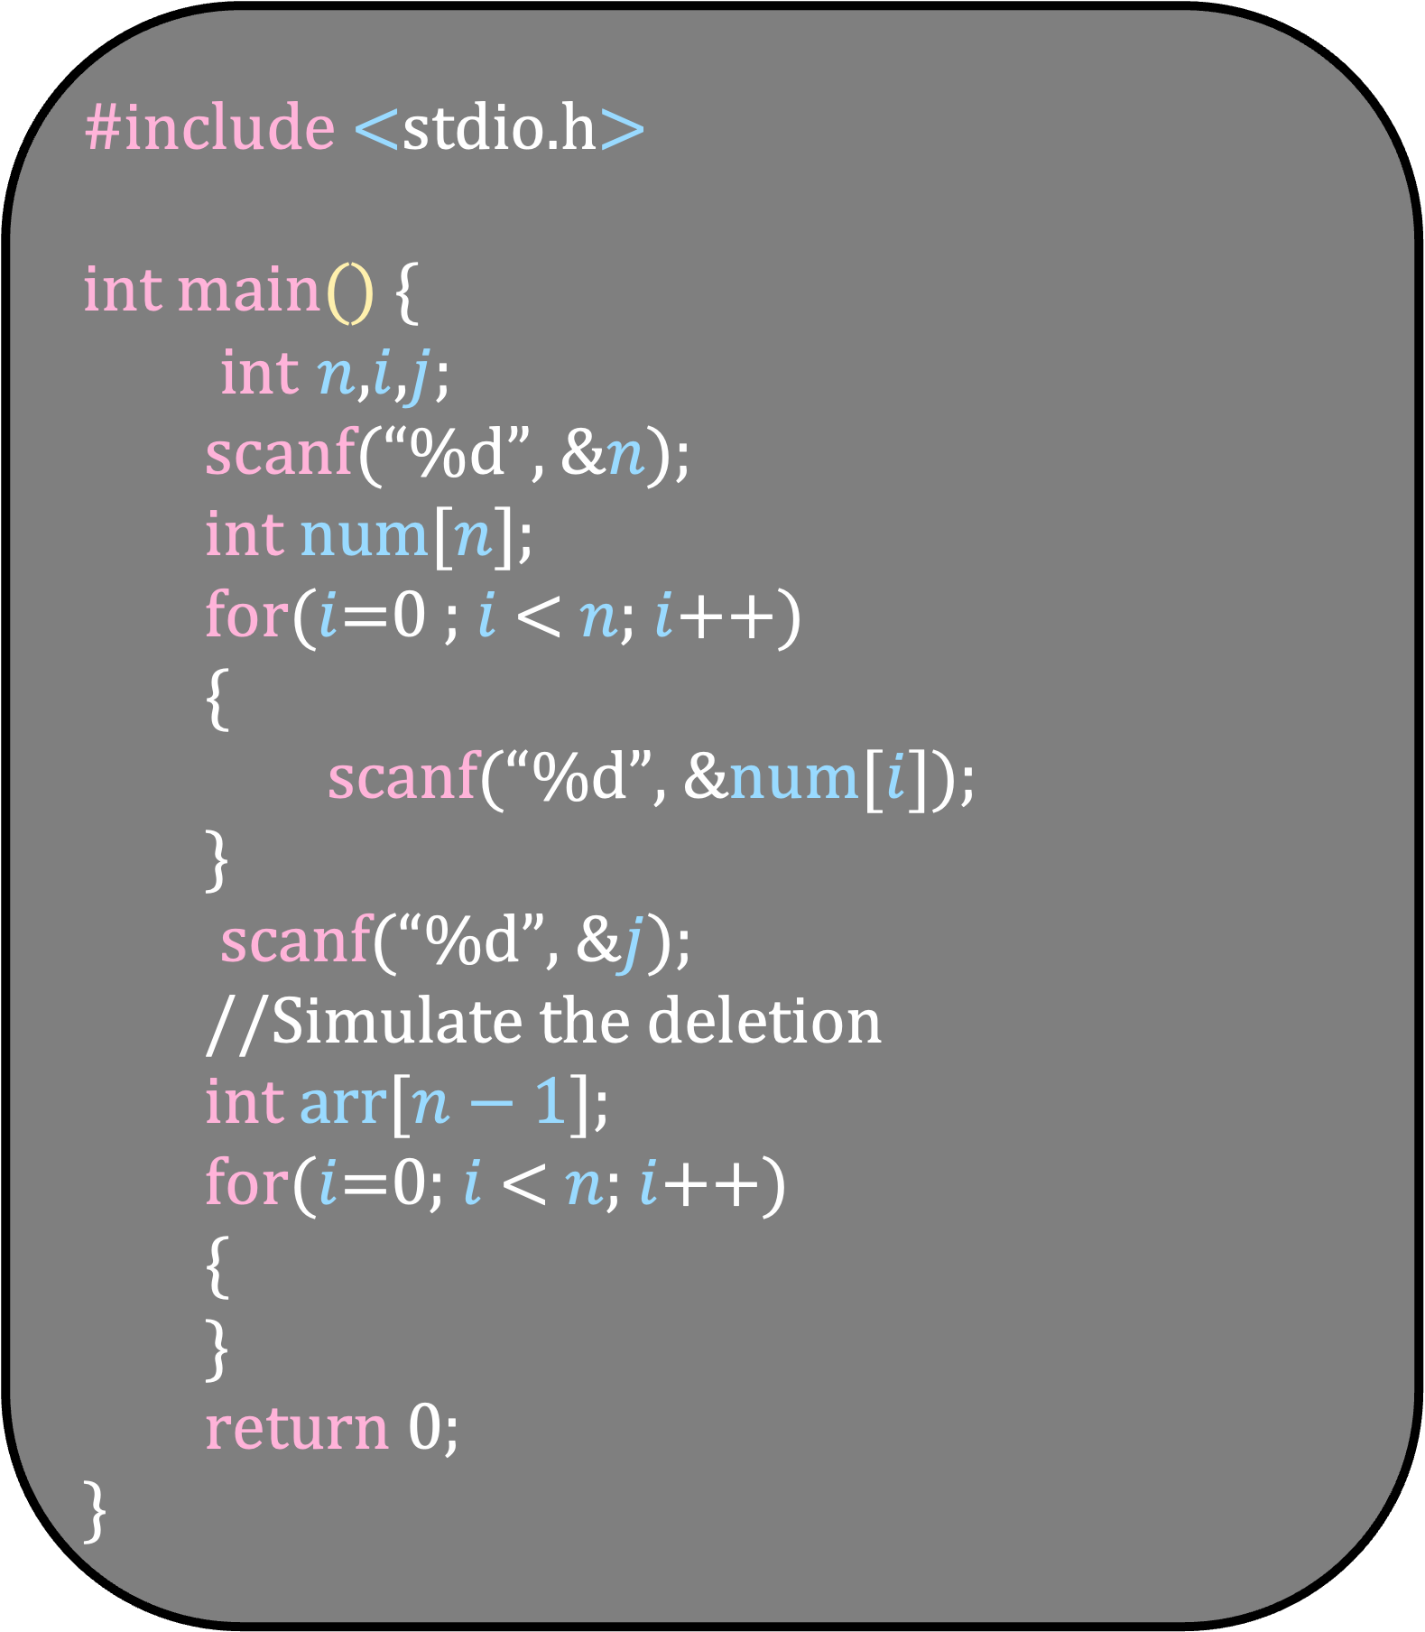
#include <stdio.h> int main() {
int $n$,$i$,$j$;
scanf(“%d”, &$n$);
int num[$n$];
for($i$=0 ; $i$ < $n$; $i$++)
{
scanf(“%d”, &num[$i$]);
}
scanf(“%d”, &$j$);
//Simulate the deletion
int arr[$n−1$];
for($i$=0; $i$ < $n$; $i$++)
{
} return 0; }

Slide 7
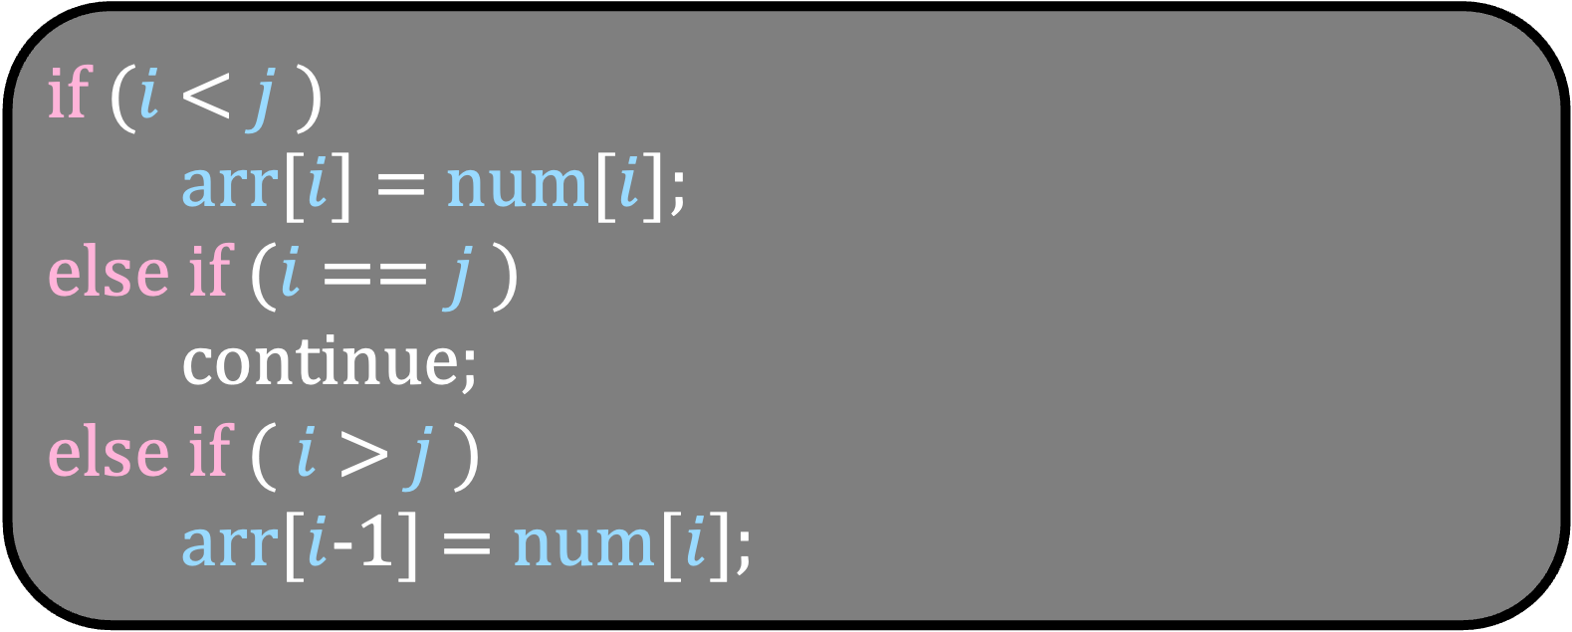
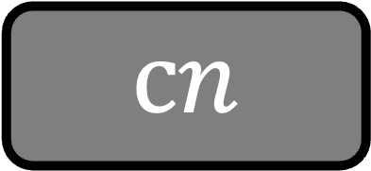
#include <stdio.h> int main() {
int $n$,$i$,$j$;
scanf(“%d”, &$n$);
int num[$n$];
for($i$=0 ; $i$ < $n$; $i$++)
{
scanf(“%d”, &num[$i$]);
}
scanf(“%d”, &$j$);
//Simulate the deletion
int arr[$n−1$];
for($i$=0; $i$ < $n$; $i$++)
{
} return 0; }
if ($i$ < $j$ )
arr[$i$] = num[$i$];
else if ($i$ == $j$ )
continue; else if ( $i$ > $j$ )
arr[$i$-1] = num[$i$];
$$cn$$
Removing an element from the array takes O(n) time

Slide 8
Adding an element to the array takes O(n) time
Removing an element from the array takes O(n) time
Searching an element in the array takes

Slide 9
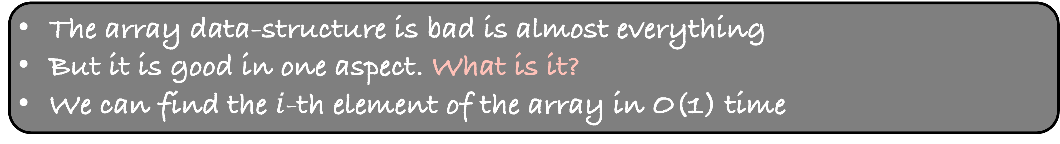
Adding an element to the array takes O(n) time
Removing an element from the array takes O(n) time
Searching an element in the array takes O(n) time
The array data-structure is bad is almost everything
But it is good in one aspect. What is it?
We can find the $i$-th element of the array in O(1) time

Slide 10

Insert
O(n)
Delete
O(n)
search
O(n)
Get the $i$-th element
O(1)
Is there any other data-structure that can perform all these operations in O(1) time?
We will revisit this question later in the course

Slide 11
Insertion Sort

Slide 12
15
7
35
8
80
55
23

Slide 13
15
7
35
8
80
55
23
Imagine that there is one element in the array
So, the first element of the array is already sorted
Imagine adding the next element in the array

Slide 14
15
7
35
8
80
55
23
Put this new element in its correct place in this array
Compare it with the previous element and swap if required
Can you see that in this process, you will insert the new element to its correct place?

Slide 15
7
15
35
8
80
55
23

Slide 16
7
15
35
8
80
55
23
Now, the first two elements of the array are already sorted
Let us now add the next element

Slide 17
7
15
35
8
80
55
23
Put this new element in its correct place in this array
But 15 itself is less than 35. So, 35 is already at its correct place
Let us add the next element

Slide 18
7
15
35
8
80
55
23
Put this new element in its correct place in this array
Compare it with the previous element and swap if required

Slide 19
7
15
8
35
80
55
23

Slide 20
7
8
15
35
80
55
23
7 is less than 8
So, 8 is at its correct place in this sub-array of size 4
Completely visualize the algorithm

Slide 21
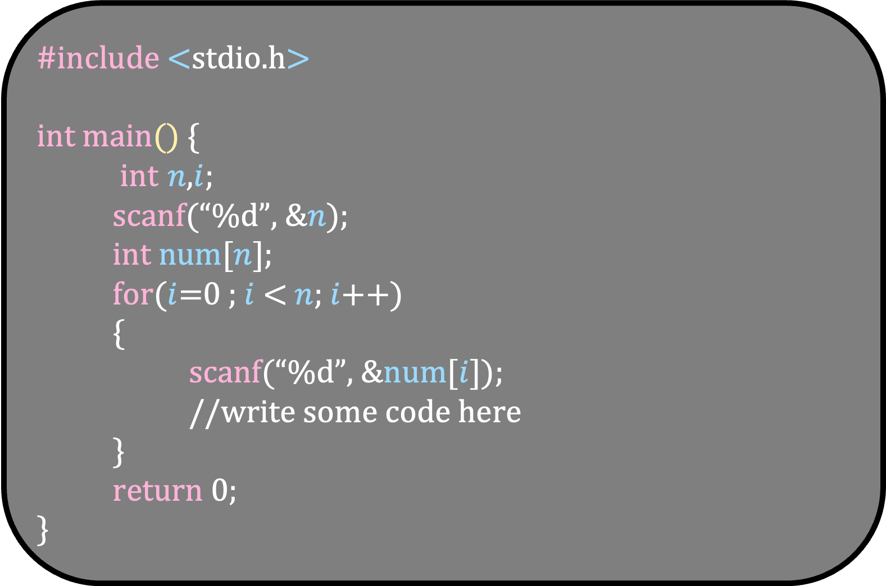
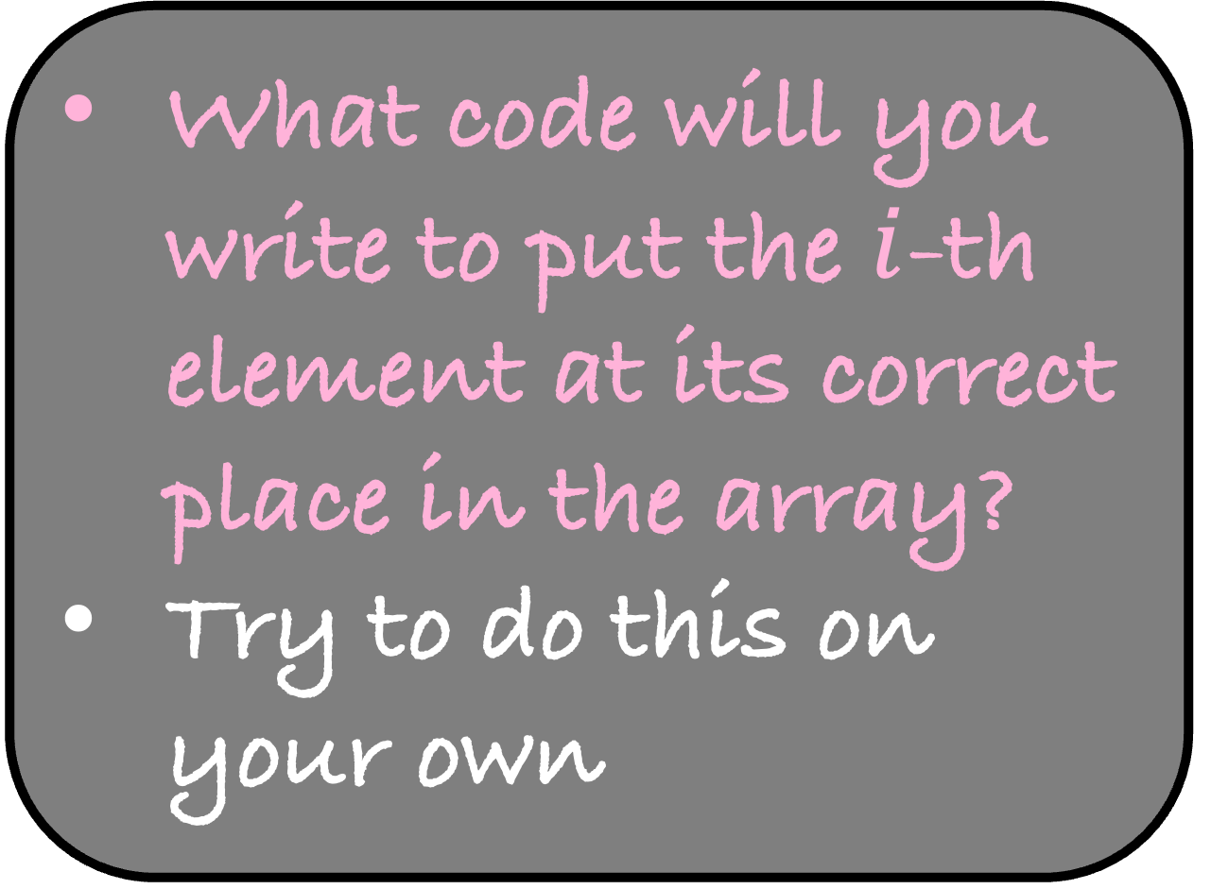
#include <stdio.h> int main() {
int $n$,$i$;
scanf(“%d”, &$n$);
int num[$n$];
for($i$=0 ; $i$ < $n$; $i$++)
{
scanf(“%d”, &num[$i$]);
//write some code here
} return 0; }
What code will you write to put the $i$-th element at its correct place in the array?
Try to do this on your own

Slide 22
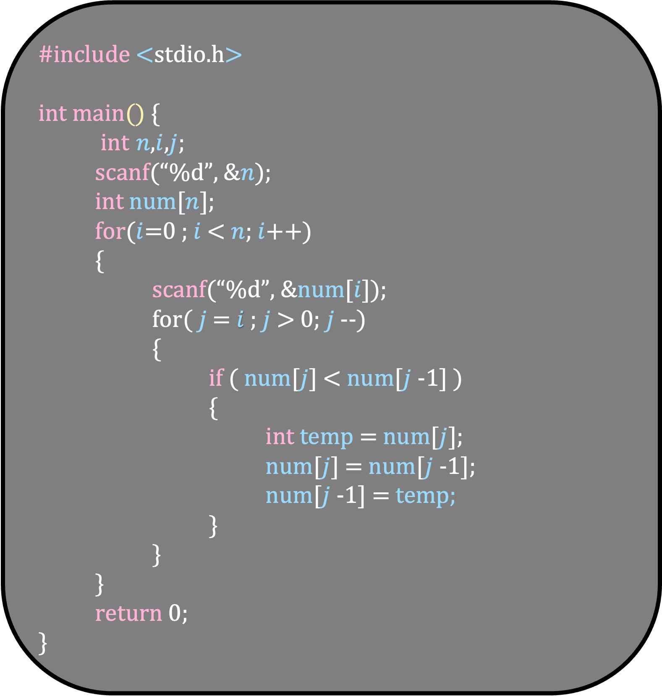
#include <stdio.h> int main() {
int $n$,$i$,$j$;
scanf(“%d”, &$n$);
int num[$n$];
for($i$=0 ; $i$ < $n$; $i$++)
{
scanf(“%d”, &num[$i$]);
for( $j$ = $i$ ; $j$ > 0; $j$--)
{
if ( num[$j$] < num[$j$-1] )
{
int temp = num[$j$];
num[$j$] = num[$j$-1];
num[$j$-1] = temp;
}
}
} return 0; }
What code will you write to put the $i$-th element at its correct place in the array?
Try to do this on your own

Slide 23
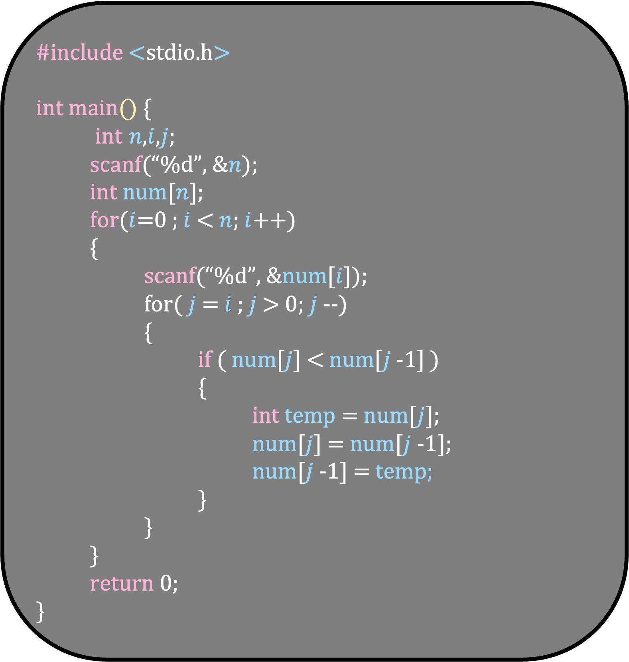
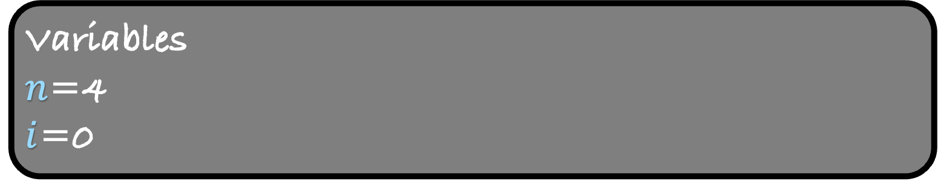
#include <stdio.h> int main() {
int $n$,$i$,$j$;
scanf(“%d”, &$n$);
int num[$n$];
for($i$=0 ; $i$ < $n$; $i$++)
{
scanf(“%d”, &num[$i$]);
for( $j$ = $i$ ; $j$ > 0; $j$--)
{
if ( num[$j$] < num[$j$-1] )
{
int temp = num[$j$];
num[$j$] = num[$j$-1];
num[$j$-1] = temp;
}
}
} return 0; }
Input/Output
4
15 2 47 8
Variables
$n$=4
$i$=0

Slide 24
#include <stdio.h> int main() {
int $n$,$i$,$j$;
scanf(“%d”, &$n$);
int num[$n$];
for($i$=0 ; $i$ < $n$; $i$++)
{
scanf(“%d”, &num[$i$]);
for( $j$ = $i$ ; $j$ > 0; $j$--)
{
if ( num[$j$] < num[$j$-1] )
{
int temp = num[$j$];
num[$j$] = num[$j$-1];
num[$j$-1] = temp;
}
}
} return 0; }
Input/Output
4
15 2 47 8
Variables
$n$=4
$i$=0
15

Slide 25
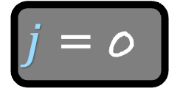
#include <stdio.h> int main() {
int $n$,$i$,$j$;
scanf(“%d”, &$n$);
int num[$n$];
for($i$=0 ; $i$ < $n$; $i$++)
{
scanf(“%d”, &num[$i$]);
for( $j$ = $i$ ; $j$ > 0; $j$--)
{
if ( num[$j$] < num[$j$-1] )
{
int temp = num[$j$];
num[$j$] = num[$j$-1];
num[$j$-1] = temp;
}
}
} return 0; }
Input/Output
4
15 2 47 8
Variables
$n$=4
$i$=0
15
$j$ = 0

Slide 26

#include <stdio.h> int main() {
int $n$,$i$,$j$;
scanf(“%d”, &$n$);
int num[$n$];
for($i$=0 ; $i$ < $n$; $i$++)
{
scanf(“%d”, &num[$i$]);
for( $j$ = $i$ ; $j$ > 0; $j$--)
{
if ( num[$j$] < num[$j$-1] )
{
int temp = num[$j$];
num[$j$] = num[$j$-1];
num[$j$-1] = temp;
}
}
} return 0; }
Input/Output
4
15 2 47 8
Variables
$n$=4
$i$=0
15

Slide 27

#include <stdio.h> int main() {
int $n$,$i$,$j$;
scanf(“%d”, &$n$);
int num[$n$];
for($i$=0 ; $i$ < $n$; $i$++)
{
scanf(“%d”, &num[$i$]);
for( $j$ = $i$ ; $j$ > 0; $j$--)
{
if ( num[$j$] < num[$j$-1] )
{
int temp = num[$j$];
num[$j$] = num[$j$-1];
num[$j$-1] = temp;
}
}
} return 0; }
Input/Output
4
15 2 47 8
Variables
$n$=4
$i$=1
15

Slide 28
#include <stdio.h> int main() {
int $n$,$i$,$j$;
scanf(“%d”, &$n$);
int num[$n$];
for($i$=0 ; $i$ < $n$; $i$++)
{
scanf(“%d”, &num[$i$]);
for( $j$ = $i$ ; $j$ > 0; $j$--)
{
if ( num[$j$] < num[$j$-1] )
{
int temp = num[$j$];
num[$j$] = num[$j$-1];
num[$j$-1] = temp;
}
}
} return 0; }
Input/Output
4
15 2 47 8
Variables
$n$=4
$i$=1
15

Slide 29
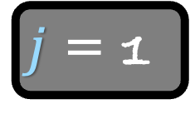
#include <stdio.h> int main() {
int $n$,$i$,$j$;
scanf(“%d”, &$n$);
int num[$n$];
for($i$=0 ; $i$ < $n$; $i$++)
{
scanf(“%d”, &num[$i$]);
for( $j$ = $i$ ; $j$ > 0; $j$--)
{
if ( num[$j$] < num[$j$-1] )
{
int temp = num[$j$];
num[$j$] = num[$j$-1];
num[$j$-1] = temp;
}
}
} return 0; }
Input/Output
4
15 2 47 8
Variables
$n$=4
$i$=1
15
2
$j$ = 1

Slide 30
#include <stdio.h> int main() {
int $n$,$i$,$j$;
scanf(“%d”, &$n$);
int num[$n$];
for($i$=0 ; $i$ < $n$; $i$++)
{
scanf(“%d”, &num[$i$]);
for( $j$ = $i$ ; $j$ > 0; $j$--)
{
if ( num[$j$] < num[$j$-1] )
{
int temp = num[$j$];
num[$j$] = num[$j$-1];
num[$j$-1] = temp;
}
}
} return 0; }
Input/Output
4
15 2 47 8
Variables
$n$=4
$i$=1
15
2
$j$ = 1

Slide 31
#include <stdio.h> int main() {
int $n$,$i$,$j$;
scanf(“%d”, &$n$);
int num[$n$];
for($i$=0 ; $i$ < $n$; $i$++)
{
scanf(“%d”, &num[$i$]);
for( $j$ = $i$ ; $j$ > 0; $j$--)
{
if ( num[$j$] < num[$j$-1] )
{
int temp = num[$j$];
num[$j$] = num[$j$-1];
num[$j$-1] = temp;
}
}
} return 0; }
Input/Output
4
15 2 47 8
Variables
$n$=4
$i$=1
15
2
$j$ = 1

Slide 32
#include <stdio.h> int main() {
int $n$,$i$,$j$;
scanf(“%d”, &$n$);
int num[$n$];
for($i$=0 ; $i$ < $n$; $i$++)
{
scanf(“%d”, &num[$i$]);
for( $j$ = $i$ ; $j$ > 0; $j$--)
{
if ( num[$j$] < num[$j$-1] )
{
int temp = num[$j$];
num[$j$] = num[$j$-1];
num[$j$-1] = temp;
}
}
} return 0; }
Input/Output
4
15 2 47 8
Variables
$n$=4
$i$=1
2
15
$j$ = 1

Slide 33
#include <stdio.h> int main() {
int $n$,$i$,$j$;
scanf(“%d”, &$n$);
int num[$n$];
for($i$=0 ; $i$ < $n$; $i$++)
{
scanf(“%d”, &num[$i$]);
for( $j$ = $i$ ; $j$ > 0; $j$--)
{
if ( num[$j$] < num[$j$-1] )
{
int temp = num[$j$];
num[$j$] = num[$j$-1];
num[$j$-1] = temp;
}
}
} return 0; }
Input/Output
4
15 2 47 8
Variables
$n$=4
$i$=1
2
15
$j$ = 0

Slide 34
#include <stdio.h> int main() {
int $n$,$i$,$j$;
scanf(“%d”, &$n$);
int num[$n$];
for($i$=0 ; $i$ < $n$; $i$++)
{
scanf(“%d”, &num[$i$]);
for( $j$ = $i$ ; $j$ > 0; $j$--)
{
if ( num[$j$] < num[$j$-1] )
{
int temp = num[$j$];
num[$j$] = num[$j$-1];
num[$j$-1] = temp;
}
}
} return 0; }
Input/Output
4
15 2 47 8
Variables
$n$=4
$i$=1
2
15
$j$ = 0

Slide 35
Visualize the code of Insertion Sort
Let us now try to find the running time of Insertion Sort

Slide 36
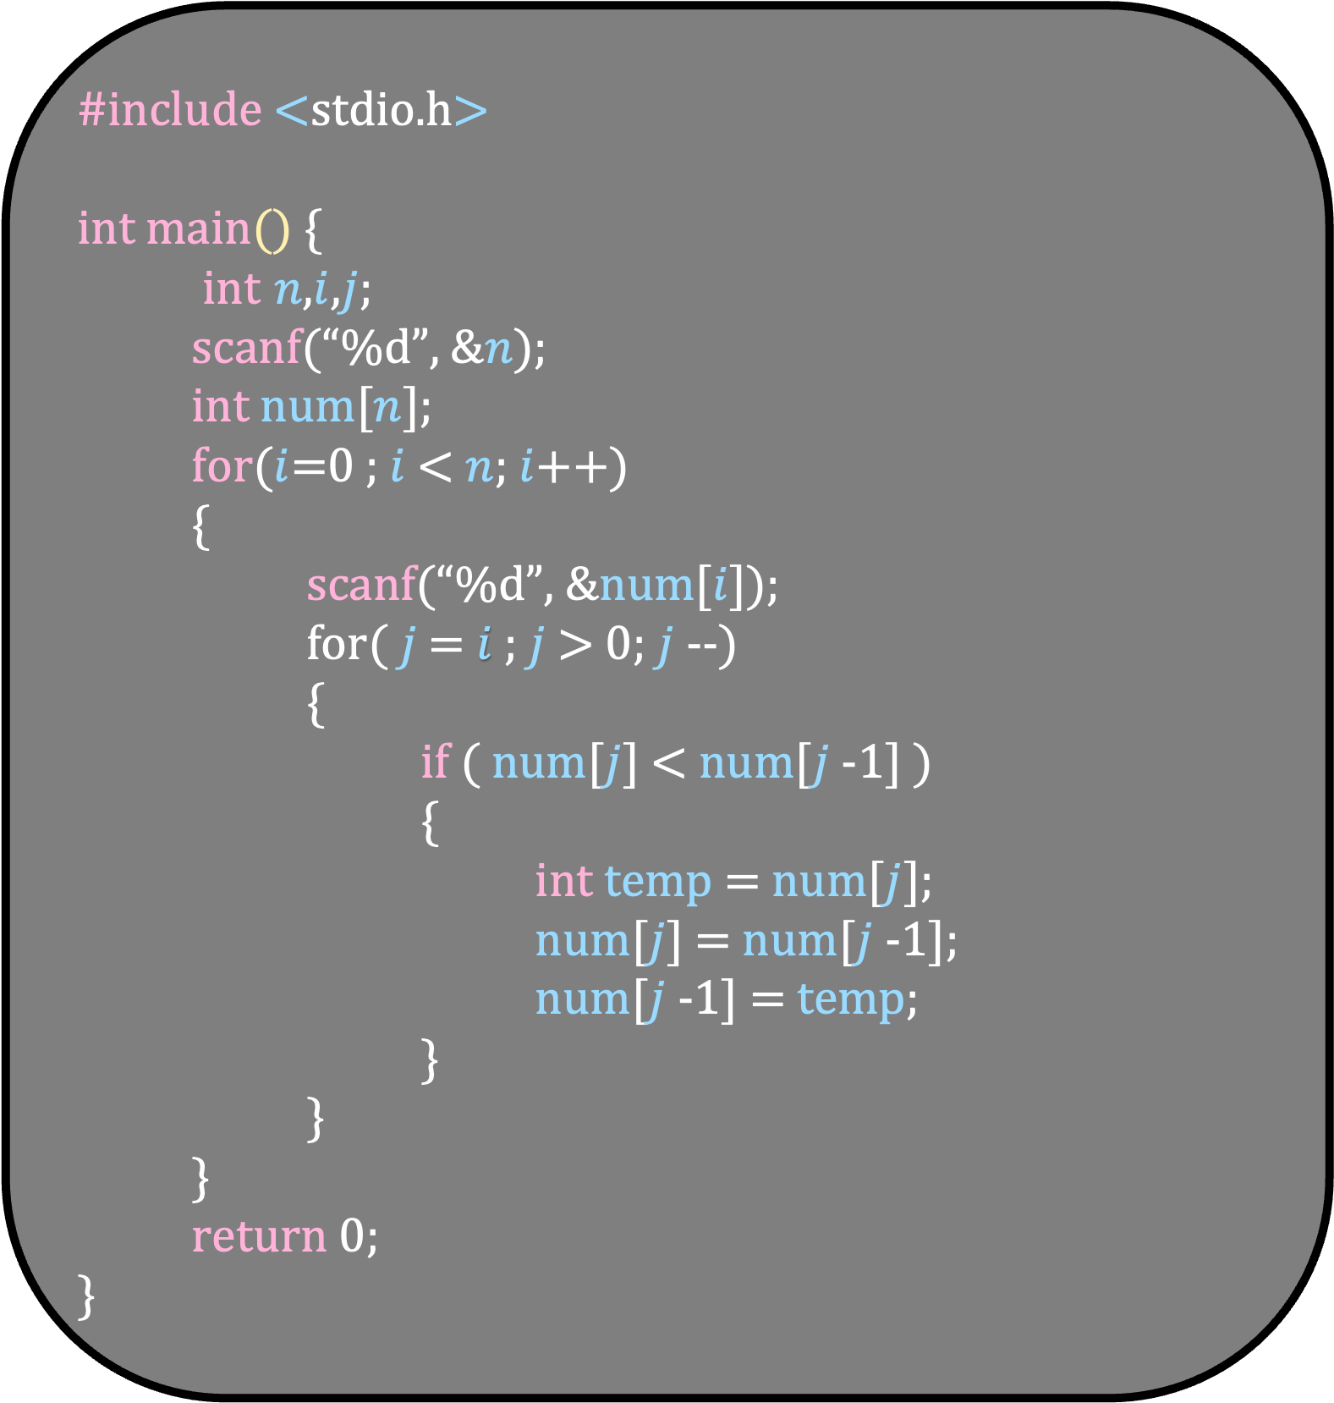
#include <stdio.h> int main() {
int $n$,$i$,$j$;
scanf(“%d”, &$n$);
int num[$n$];
for($i$=0 ; $i$ < $n$; $i$++)
{
scanf(“%d”, &num[$i$]);
for( $j$ = $i$ ; $j$ > 0; $j$--)
{
if ( num[$j$] < num[$j$-1] )
{
int temp = num[$j$];
num[$j$] = num[$j$-1];
num[$j$-1] = temp;
}
}
} return 0; }
Before that, let us do a slight optimization in the code

Slide 37
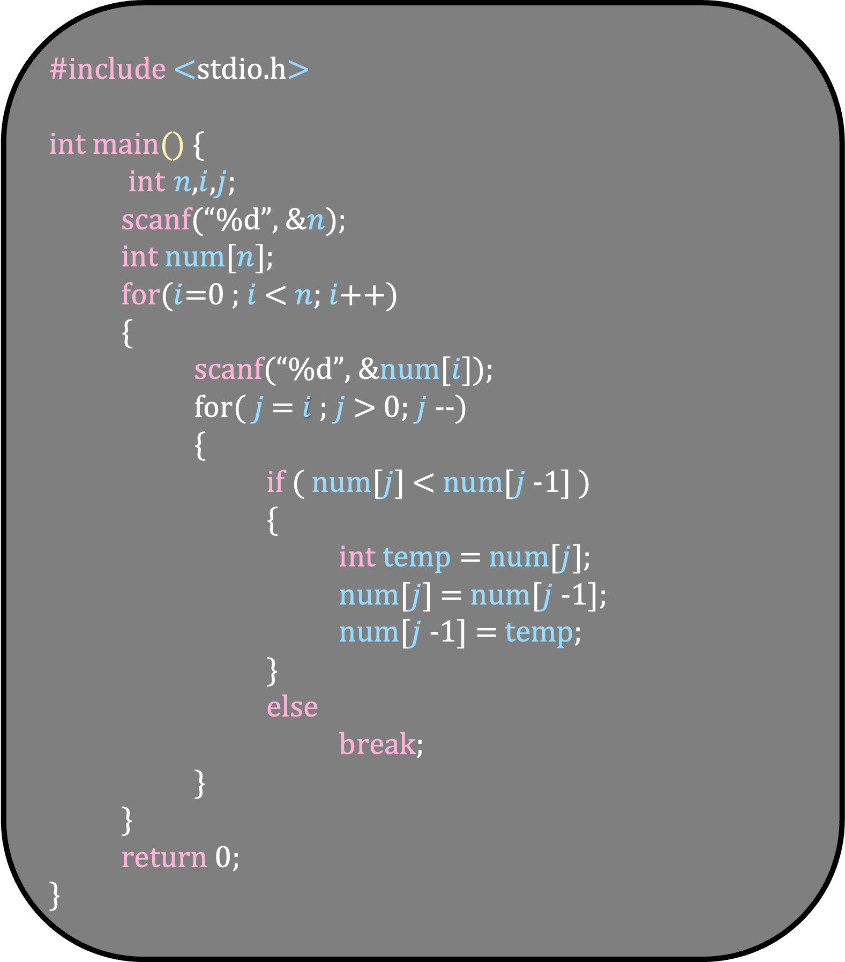
#include <stdio.h> int main() {
int $n$,$i$,$j$;
scanf(“%d”, &$n$);
int num[$n$];
for($i$=0 ; $i$ < $n$; $i$++)
{
scanf(“%d”, &num[$i$]);
for( $j$ = $i$ ; $j$ > 0; $j$--)
{
if ( num[$j$] < num[$j$-1] )
{
int temp = num[$j$];
num[$j$] = num[$j$-1];
num[$j$-1] = temp;
}
else
break;
}
} return 0; }
Before that, let us do a slight optimization in the code
If there is no swap, then break out of the inner for loop

Slide 38
#include <stdio.h> int main() {
int $n$,$i$,$j$;
scanf(“%d”, &$n$);
int num[$n$];
for($i$=0 ; $i$ < $n$; $i$++)
{
scanf(“%d”, &num[$i$]);
for( $j$ = $i$ ; $j$ > 0; $j$--)
{
if ( num[$j$] < num[$j$-1] )
{
int temp = num[$j$];
num[$j$] = num[$j$-1];
num[$j$-1] = temp;
}
else
break;
}
} return 0; }
2
15
47
27

Slide 39
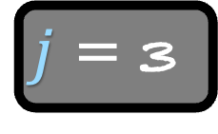
#include <stdio.h> int main() {
int $n$,$i$,$j$;
scanf(“%d”, &$n$);
int num[$n$];
for($i$=0 ; $i$ < $n$; $i$++)
{
scanf(“%d”, &num[$i$]);
for( $j$ = $i$ ; $j$ > 0; $j$--)
{
if ( num[$j$] < num[$j$-1] )
{
int temp = num[$j$];
num[$j$] = num[$j$-1];
num[$j$-1] = temp;
}
else
break;
}
} return 0; }
2
15
47
27
$j$ = 3

Slide 40
#include <stdio.h> int main() {
int $n$,$i$,$j$;
scanf(“%d”, &$n$);
int num[$n$];
for($i$=0 ; $i$ < $n$; $i$++)
{
scanf(“%d”, &num[$i$]);
for( $j$ = $i$ ; $j$ > 0; $j$--)
{
if ( num[$j$] < num[$j$-1] )
{
int temp = num[$j$];
num[$j$] = num[$j$-1];
num[$j$-1] = temp;
}
else
break;
}
} return 0; }
2
15
47
27
$j$ = 3

Slide 41
#include <stdio.h> int main() {
int $n$,$i$,$j$;
scanf(“%d”, &$n$);
int num[$n$];
for($i$=0 ; $i$ < $n$; $i$++)
{
scanf(“%d”, &num[$i$]);
for( $j$ = $i$ ; $j$ > 0; $j$--)
{
if ( num[$j$] < num[$j$-1] )
{
int temp = num[$j$];
num[$j$] = num[$j$-1];
num[$j$-1] = temp;
}
else
break;
}
} return 0; }
2
15
27
47
$j$ = 3

Slide 42

#include <stdio.h> int main() {
int $n$,$i$,$j$;
scanf(“%d”, &$n$);
int num[$n$];
for($i$=0 ; $i$ < $n$; $i$++)
{
scanf(“%d”, &num[$i$]);
for( $j$ = $i$ ; $j$ > 0; $j$--)
{
if ( num[$j$] < num[$j$-1] )
{
int temp = num[$j$];
num[$j$] = num[$j$-1];
num[$j$-1] = temp;
}
else
break;
}
} return 0; }
2
15
27
47
$j$ = 2

Slide 43
#include <stdio.h> int main() {
int $n$,$i$,$j$;
scanf(“%d”, &$n$);
int num[$n$];
for($i$=0 ; $i$ < $n$; $i$++)
{
scanf(“%d”, &num[$i$]);
for( $j$ = $i$ ; $j$ > 0; $j$--)
{
if ( num[$j$] < num[$j$-1] )
{
int temp = num[$j$];
num[$j$] = num[$j$-1];
num[$j$-1] = temp;
}
else
break;
}
} return 0; }
2
15
27
47
$j$ = 2

Slide 44
#include <stdio.h> int main() {
int $n$,$i$,$j$;
scanf(“%d”, &$n$);
int num[$n$];
for($i$=0 ; $i$ < $n$; $i$++)
{
scanf(“%d”, &num[$i$]);
for( $j$ = $i$ ; $j$ > 0; $j$--)
{
if ( num[$j$] < num[$j$-1] )
{
int temp = num[$j$];
num[$j$] = num[$j$-1];
num[$j$-1] = temp;
}
else
break;
}
} return 0; }
2
15
27
47
$j$ = 2

Slide 45
#include <stdio.h> int main() {
int $n$,$i$,$j$;
scanf(“%d”, &$n$);
int num[$n$];
for($i$=0 ; $i$ < $n$; $i$++)
{
scanf(“%d”, &num[$i$]);
for( $j$ = $i$ ; $j$ > 0; $j$--)
{
if ( num[$j$] < num[$j$-1] )
{
int temp = num[$j$];
num[$j$] = num[$j$-1];
num[$j$-1] = temp;
}
else
break;
}
} return 0; }
2
15
27
47

Slide 46

#include <stdio.h> int main() {
int $n$,$i$,$j$;
scanf(“%d”, &$n$);
int num[$n$];
for($i$=0 ; $i$ < $n$; $i$++)
{
scanf(“%d”, &num[$i$]);
for( $j$ = $i$ ; $j$ > 0; $j$--)
{
if ( num[$j$] < num[$j$-1] )
{
int temp = num[$j$];
num[$j$] = num[$j$-1];
num[$j$-1] = temp;
}
else
break;
}
} return 0; }
What is the best input for Insertion Sort?
Already Sorted Array
2
15
27
47
$$c$$
Each iteration of inner for loop runs at most once
Running Time = O(n)

Slide 47
#include <stdio.h> int main() {
int $n$,$i$,$j$;
scanf(“%d”, &$n$);
int num[$n$];
for($i$=0 ; $i$ < $n$; $i$++)
{
scanf(“%d”, &num[$i$]);
for( $j$ = $i$ ; $j$ > 0; $j$--)
{
if ( num[$j$] < num[$j$-1] )
{
int temp = num[$j$];
num[$j$] = num[$j$-1];
num[$j$-1] = temp;
}
else
break;
}
} return 0; }
Insertion Sort is extremely quick on already sorted input
We will see later that this property is not true for other sorting algorithms
It stands to reason that insertion sort is quick for nearly sorted arrays
$$c$$

Slide 48

#include <stdio.h> int main() {
int $n$,$i$,$j$;
scanf(“%d”, &$n$);
int num[$n$];
for($i$=0 ; $i$ < $n$; $i$++)
{
scanf(“%d”, &num[$i$]);
for( $j$ = $i$ ; $j$ > 0; $j$--)
{
if ( num[$j$] < num[$j$-1] )
{
int temp = num[$j$];
num[$j$] = num[$j$-1];
num[$j$-1] = temp;
}
else
break;
}
} return 0; }
What is the worst input for Insertion Sort?
Reverse Sorted Array
47
27
15
5
$$ci$$
Running Time of insertion sort on this input?

Slide 49

#include <stdio.h> int main() {
int $n$,$i$,$j$;
scanf(“%d”, &$n$);
int num[$n$];
for($i$=0 ; $i$ < $n$; $i$++)
{
scanf(“%d”, &num[$i$]);
for( $j$ = $i$ ; $j$ > 0; $j$--)
{
if ( num[$j$] < num[$j$-1] )
{
int temp = num[$j$];
num[$j$] = num[$j$-1];
num[$j$-1] = temp;
}
else
break;
}
} return 0; }
What is the worst input for Insertion Sort?
Reverse Sorted Array
47
27
15
5
$$i$$
Running Time of insertion sort on this input?

Slide 50

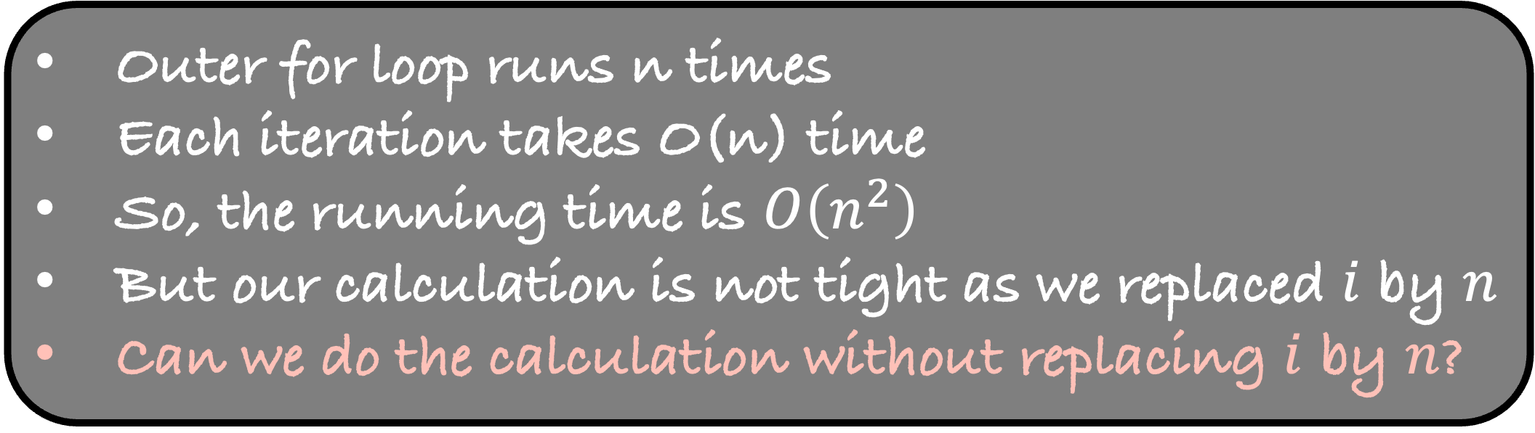
#include <stdio.h> int main() {
int $n$,$i$,$j$;
scanf(“%d”, &$n$);
int num[$n$];
for($i$=0 ; $i$ < $n$; $i$++)
{
scanf(“%d”, &num[$i$]);
for( $j$ = $i$ ; $j$ > 0; $j$--)
{
if ( num[$j$] < num[$j$-1] )
{
int temp = num[$j$];
num[$j$] = num[$j$-1];
num[$j$-1] = temp;
}
else
break;
}
} return 0; }
What is the worst input for Insertion Sort?
Reverse Sorted Array
47
27
15
5
$$n$$
Running Time of insertion sort on this input?
Outer for loop runs n times
Each iteration takes O(n) time
So, the running time is $O\left(n^{2}\right)$
But our calculation is not tight as we replaced $i$ by $n$
Can we do the calculation without replacing $i$ by $n$?

Slide 51
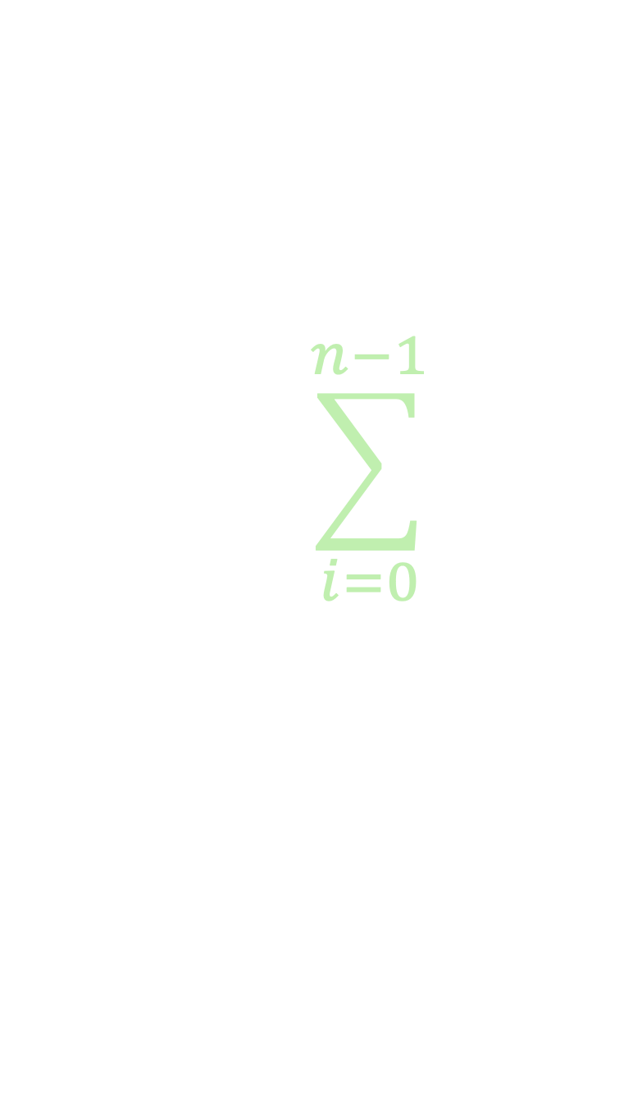
#include <stdio.h> int main() {
int $n$,$i$,$j$;
scanf(“%d”, &$n$);
int num[$n$];
for($i$=0 ; $i$ < $n$; $i$++)
{
scanf(“%d”, &num[$i$]);
for( $j$ = $i$ ; $j$ > 0; $j$--)
{
if ( num[$j$] < num[$j$-1] )
{
int temp = num[$j$];
num[$j$] = num[$j$-1];
num[$j$-1] = temp;
}
else
break;
}
} return 0; }
What is the worst input for Insertion Sort?
Reverse Sorted Array
47
27
15
5
$$i$$
Running Time of insertion sort on this input?
$$\sum_{i=0}^{n−1}{}$$
Running Time

Slide 52

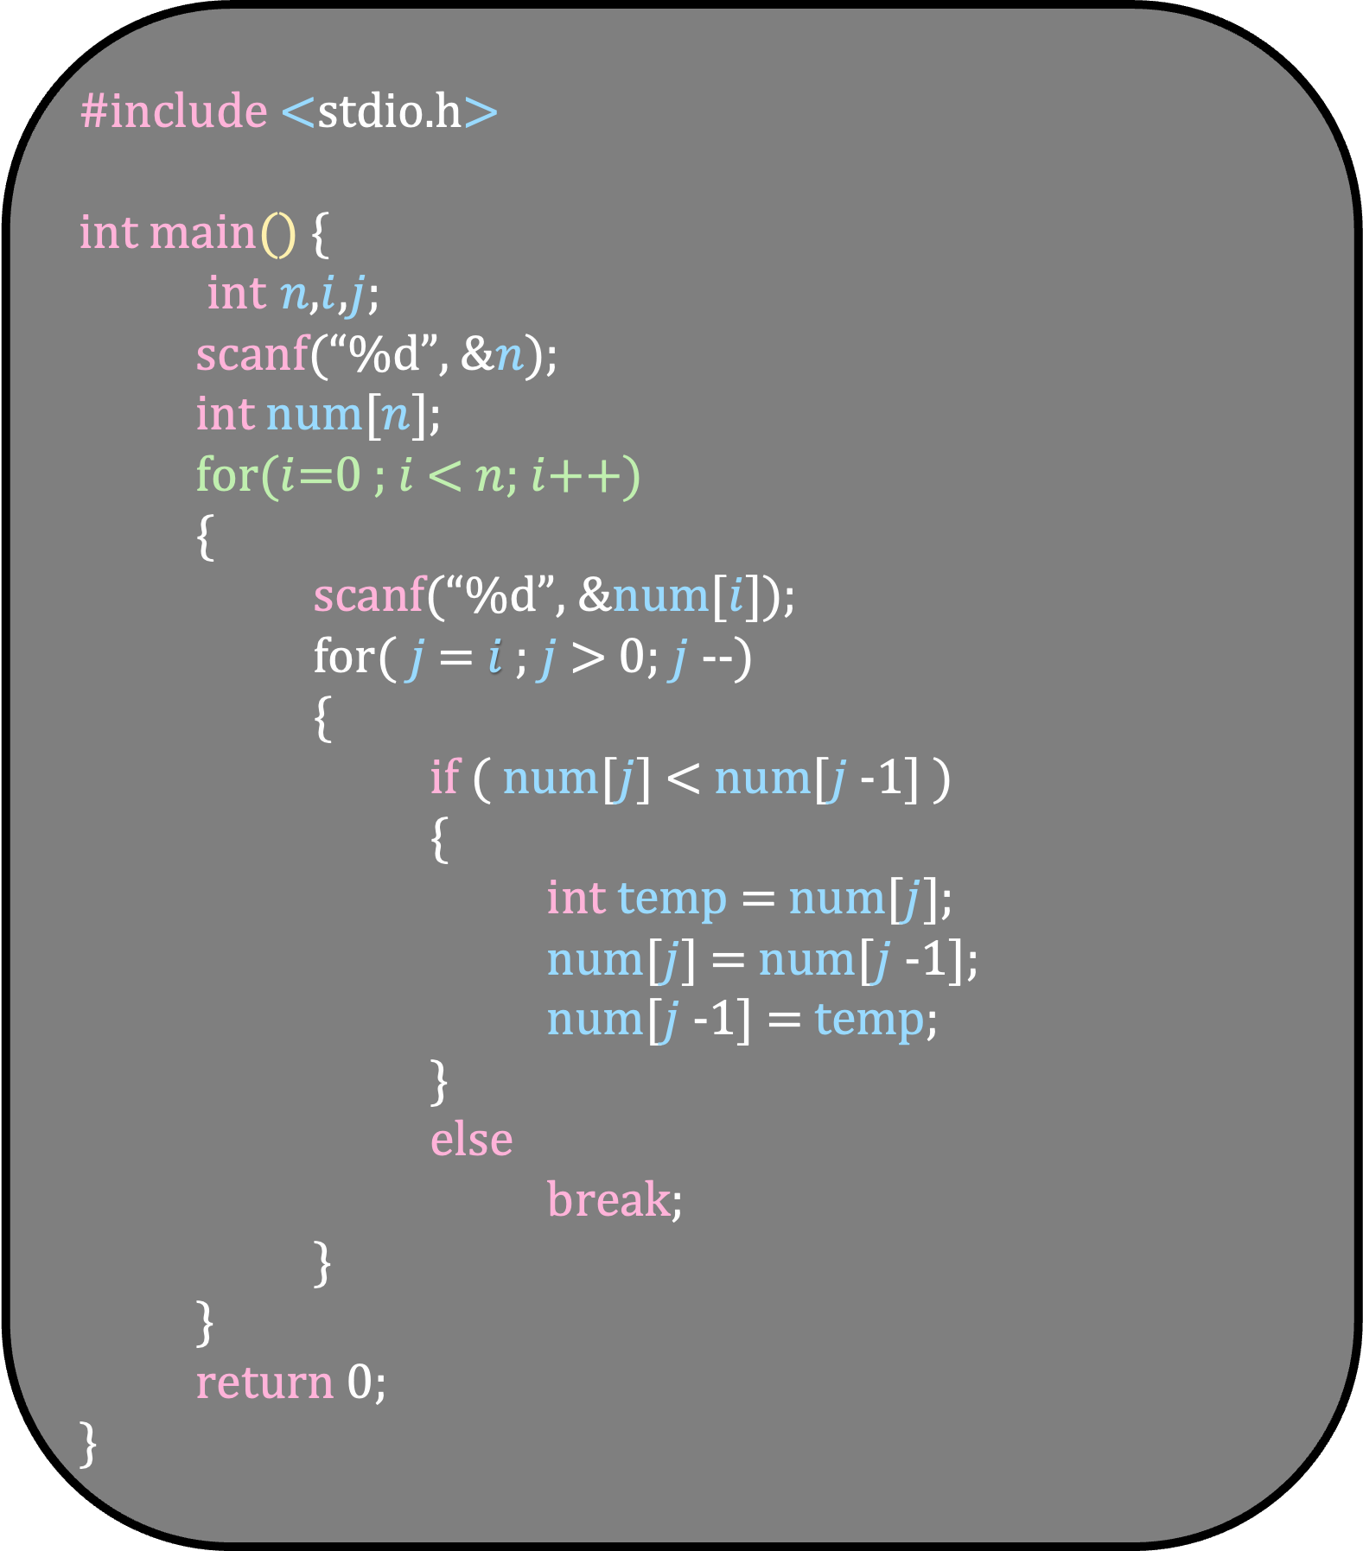


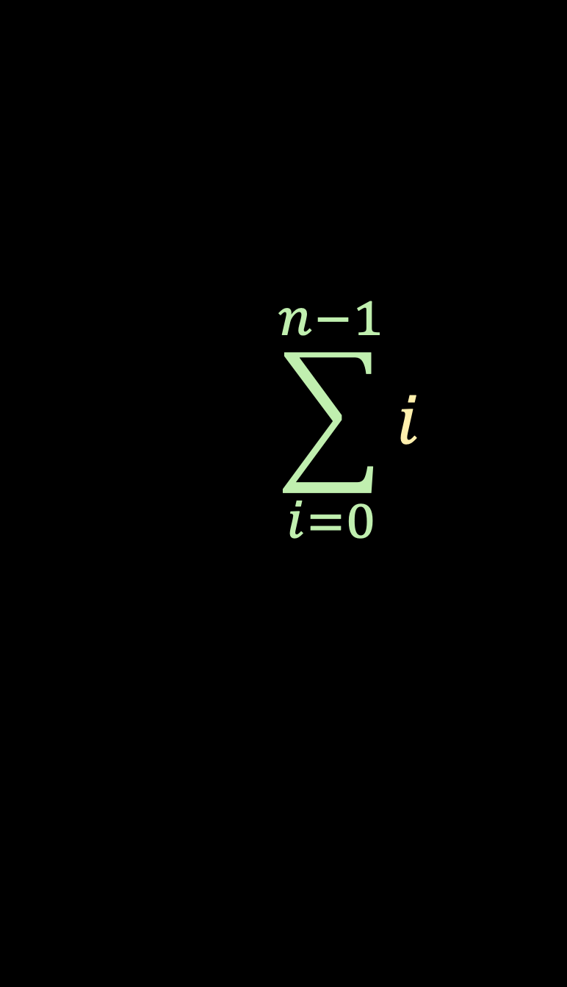
#include <stdio.h> int main() {
int $n$,$i$,$j$;
scanf(“%d”, &$n$);
int num[$n$];
for($i$=0 ; $i$ < $n$; $i$++)
{
scanf(“%d”, &num[$i$]);
for( $j$ = $i$ ; $j$ > 0; $j$--)
{
if ( num[$j$] < num[$j$-1] )
{
int temp = num[$j$];
num[$j$] = num[$j$-1];
num[$j$-1] = temp;
}
else
break;
}
} return 0; }
What is the worst input for Insertion Sort?
Reverse Sorted Array
47
27
15
5
$$i$$
Running Time of insertion sort on this input?
$$\sum_{i=0}^{n−1}{i}$$
$$\frac{n(n−1)}{2}$$
Running Time
$$O(n^{2})$$

Slide 53


Worst Case Running Time
$$O(n^{2})$$
Best Case Running Time
$$O(n)$$
If I give Insertion Sort a random input, is its running time O(n) or O($n^{2}$)?
On average, how does Insertion sort behave -- closer to best case or worst case?
Intuitively, it feels like Insertion Sort should be closer to its worst case on average
But how can we state this formally?

Slide 54
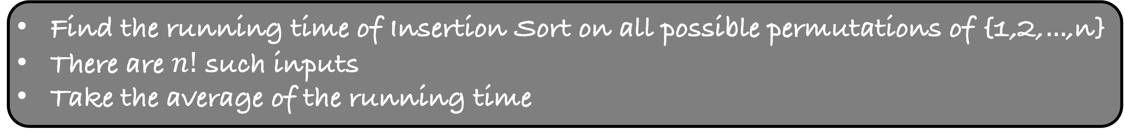
Average Case Running Time of an Algorithm
Find the running time of Insertion Sort on all possible permutations of {1,2,$…$,n}
There are $n!$ such inputs
Take the average of the running time
n=3
123
132
213
231
312
321

Slide 55
Number of swaps in each iteration of Insertion Sort
1
2
3
Total
n=3
123
0
0
0
0
132
0
0
1
1
213
0
1
0
1
Average = 9/6=1.5
231
0
0
2
2
312
0
1
1
2
321
0
1
2
3
But in general, how do we calculate the average number of swaps?

Slide 56
Look at all permutations of size n
Look at the second iteration of insertion sort
1
2
3
Total
n=3
123
0
0
0
0
132
0
0
1
1
213
0
1
0
1
231
0
0
2
2
312
0
1
1
2
321
0
1
2
3

Slide 57
Look at all permutations of size n
Look at the second iteration of insertion sort
How many permutations require no swaps?
1
2
3
Total
n=3
123
0
0
0
0
132
0
0
1
1
213
0
1
0
1
231
0
0
2
2
312
0
1
1
2
321
0
1
2
3

Slide 58
Look at all permutations of size n
Look at the second iteration of insertion sort
How many permutations require no swaps?
Pick any two numbers out of n
a
b

Slide 59


Look at all permutations of size n
Look at the second iteration of insertion sort
How many permutations require no swaps?
Pick any two numbers out of n
Let us assume a is less than b
Put $a$ as the first and $b$ as the second number in the sequence
a
$$<$$
b
What about the remaining n-2 numbers?
Don’t care. Put rest n-2 numbers in any order

Slide 60
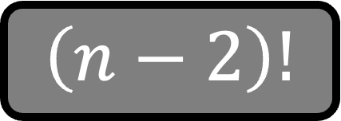

Look at all permutations of size n
Look at the second iteration of insertion sort
How many permutations require no swaps?
Pick any two numbers out of n
Let us assume a is less than b
Put $a$ as the first and $b$ as the second number in the sequence
a
$$<$$
b
$n−2$ numbers
In how many ways can we select these two numbers?
In how many ways can we arrange the rest numbers?
$\left({n \atop 2}\right)$
$\left(n−2\right)!$

Slide 61
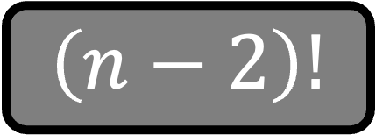

Look at all permutations of size n
Look at the second iteration of insertion sort
How many permutations require no swaps?
$\left({n \atop 2}\right)$
$\left(n−2\right)!$

Slide 62

Look at all permutations of size n
Look at the second iteration of insertion sort
How many permutations require one swap?
Pick any two numbers out of n
Let us assume a is less than b
Put $b$ as the first and $a$ as the second number in the sequence
a
$$<$$
b

Slide 63
Look at all permutations of size n
Look at the second iteration of insertion sort
How many permutations require one swap?
Pick any two numbers out of n
Let us assume a is less than b
Put $b$ as the first and $a$ as the second number in the sequence
b
a

Slide 64
Look at all permutations of size n
Look at the second iteration of insertion sort
How many permutations require one swap?
Pick any two numbers out of n
Let us assume a is less than b
Put $b$ as the first and $a$ as the second number in the sequence
b
a
$n−2$ numbers
In how many ways can we select these two numbers?
In how many ways can we arrange the rest numbers?
$\left({n \atop 2}\right)$
$\left(n−2\right)!$

Slide 65
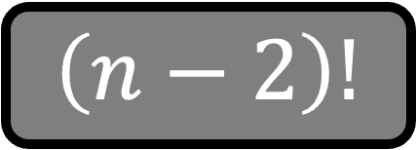

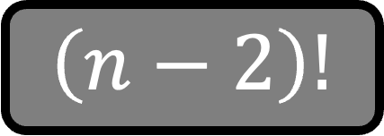

Look at all permutations of size n
Look at the second iteration of insertion sort
How many permutations require one swap?
$\left({n \atop 2}\right)$
$\left(n−2\right)!$
Look at all permutations of size n
Look at the second iteration of insertion sort
How many permutations require no swaps?
$\left({n \atop 2}\right)$
$\left(n−2\right)!$

Slide 66
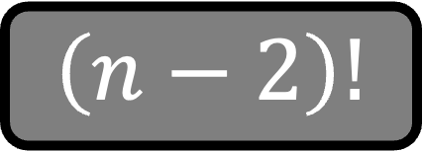

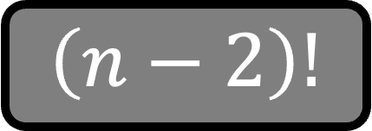

Look at all permutations of size n
Look at the second iteration of insertion sort
How many permutations require one swap?
Look at all permutations of size n
Look at the second iteration of insertion sort
How many permutations require no swaps?
Total number of swaps in second iteration
$\left({n \atop 2}\right)$
$\left(n−2\right)!$
0
$\left({n \atop 2}\right)$
$\left(n−2\right)!$
1

Slide 67

Look at all permutations of size n
Look at the second iteration of insertion sort
How many permutations require one swap?
Look at all permutations of size n
Look at the second iteration of insertion sort
How many permutations require no swaps?
Total number of swaps in second iteration
$\left({n \atop 2}\right)\left(n−2\right)!$

Slide 68




Look at all permutations of size n
Look at the second iteration of insertion sort
How many permutations require one swap?
Look at all permutations of size n
Look at the second iteration of insertion sort
How many permutations require no swaps?
Average number of swaps in second iteration
$\left({n \atop 2}\right)\left(n−2\right)!$
$\frac{n!}{2}$
$$n!$$
$$n!$$

Slide 69









Average number of swaps in second iteration
$\frac{n!}{2}$
$$n!$$
Average number of swaps in third iteration
$\frac{n!}{3}$
$2\frac{n!}{3}$
$$n!$$
Average number of swaps in fourth iteration
$\frac{n!}{4}$
$2\frac{n!}{4}$
$3\frac{n!}{4}$
$$n!$$

Slide 70

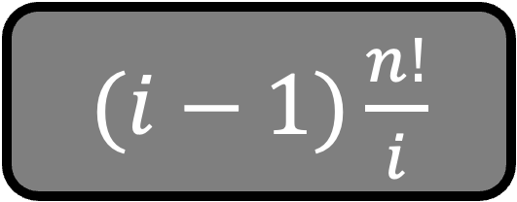






Average number of swaps in $i$-th iteration
$\frac{n!}{i}$
$$…$$
$2\frac{n!}{i}$
$(i−1)\frac{n!}{i}$
$$n!$$
$\frac{1}{i}+\frac{2}{i}+…+\frac{i−1}{i}$
$$\frac{\left(i−1\right)i}{2i}$$
$$\frac{\left(i−1\right)}{2}$$

Slide 71





Average number of swaps across all iteration
$$\sum_{i=2}^{n}{}$$
Average number of swaps in $i$-th iteration
$$\sum_{i=2}^{n}{\frac{i−1}{2}}$$
$$\frac{n\left(n−1\right)}{4}$$
$$O\left(n^{2}\right)$$

Slide 72
Visualize the code of Insertion Sort
Let us now try to write a recursive algorithm for insertion sort

Slide 73
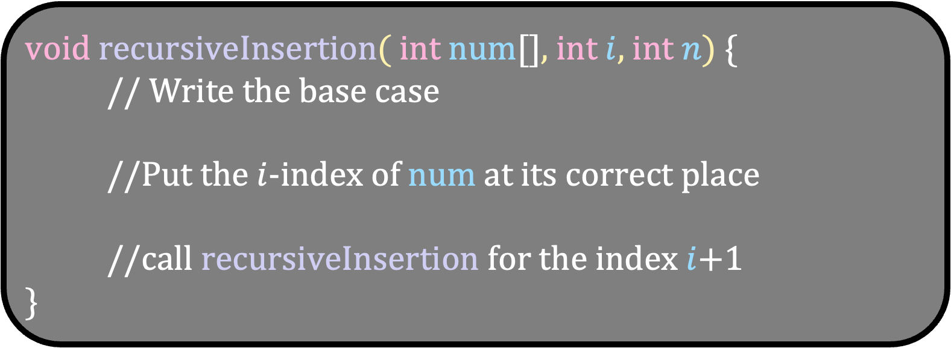
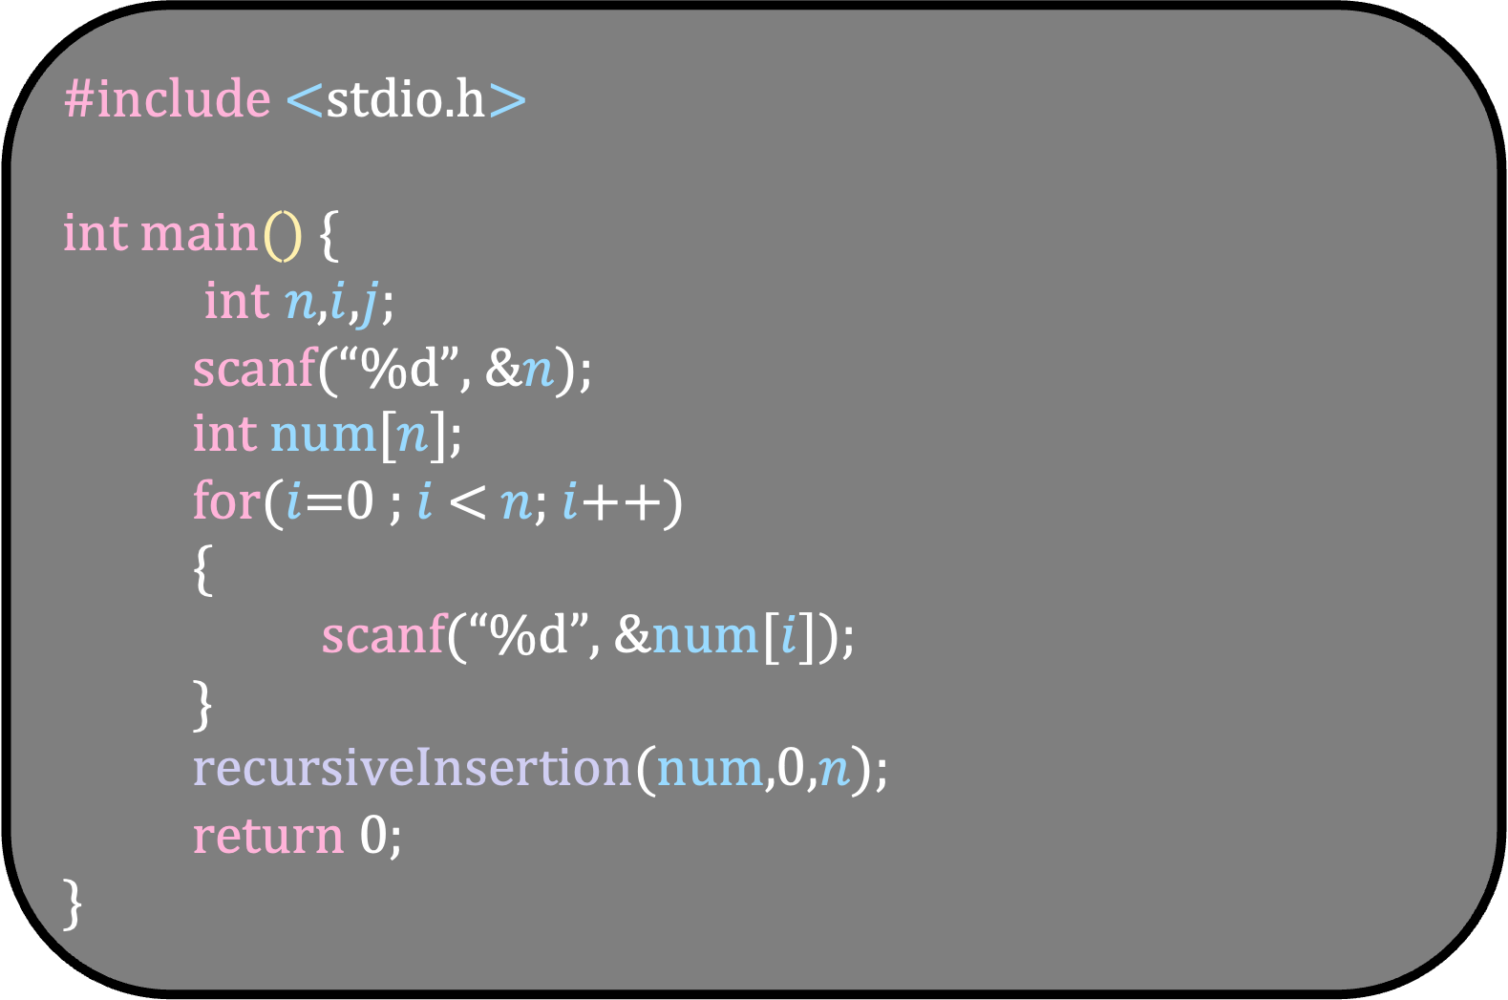
#include <stdio.h> int main() {
int $n$,$i$,$j$;
scanf(“%d”, &$n$);
int num[$n$];
for($i$=0 ; $i$ < $n$; $i$++)
{
scanf(“%d”, &num[$i$]);
}
recursiveInsertion(num,0,$n$); return 0; }
void recursiveInsertion( int num[], int $i$, int $n$) {
// Write the base case
//Put the $i$-index of num at its correct place
//call recursiveInsertion for the index $i$+1 }

Slide 74
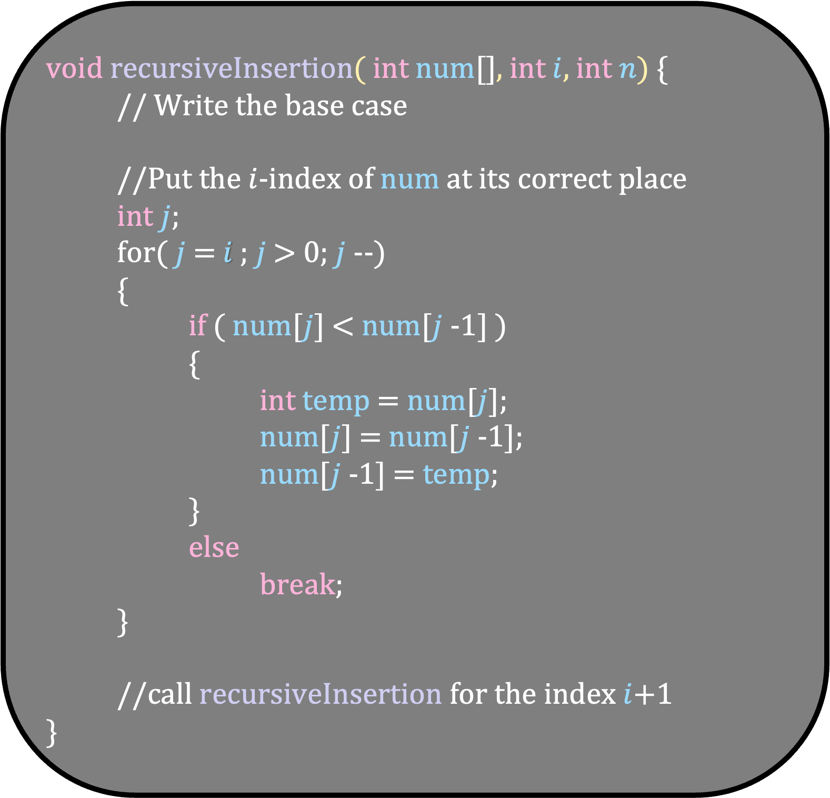
void recursiveInsertion( int num[], int $i$, int $n$) {
// Write the base case
//Put the $i$-index of num at its correct place
int $j$;
for( $j$ = $i$ ; $j$ > 0; $j$--)
{
if ( num[$j$] < num[$j$-1] )
{
int temp = num[$j$];
num[$j$] = num[$j$-1];
num[$j$-1] = temp;
}
else
break;
}
//call recursiveInsertion for the index $i$+1 }
#include <stdio.h> int main() {
int $n$,$i$,$j$;
scanf(“%d”, &$n$);
int num[$n$];
for($i$=0 ; $i$ < $n$; $i$++)
{
scanf(“%d”, &num[$i$]);
}
recursiveInsertion(num,0,$n$); return 0; }

Slide 75
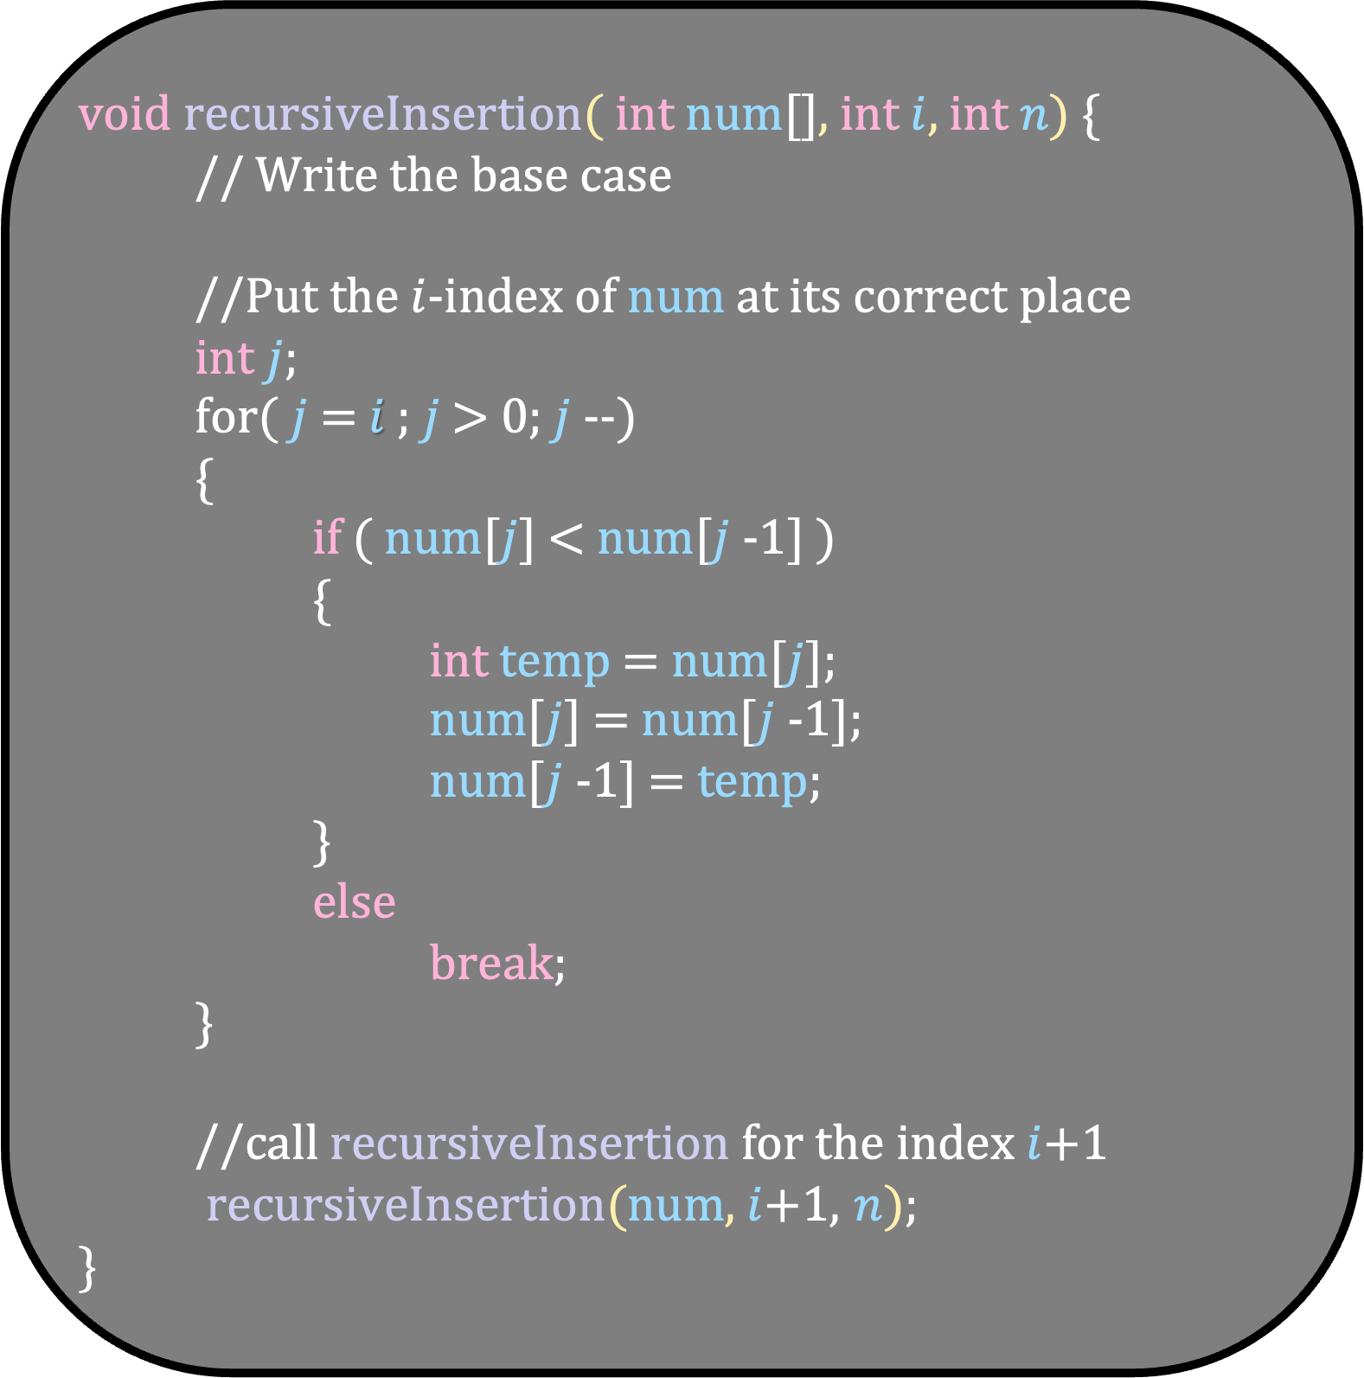
void recursiveInsertion( int num[], int $i$, int $n$) {
// Write the base case
//Put the $i$-index of num at its correct place
int $j$;
for( $j$ = $i$ ; $j$ > 0; $j$--)
{
if ( num[$j$] < num[$j$-1] )
{
int temp = num[$j$];
num[$j$] = num[$j$-1];
num[$j$-1] = temp;
}
else
break;
}
//call recursiveInsertion for the index $i$+1
recursiveInsertion(num, $i$+1, $n$); }
#include <stdio.h> int main() {
int $n$,$i$,$j$;
scanf(“%d”, &$n$);
int num[$n$];
for($i$=0 ; $i$ < $n$; $i$++)
{
scanf(“%d”, &num[$i$]);
}
recursiveInsertion(num,0,$n$); return 0; }

Slide 76
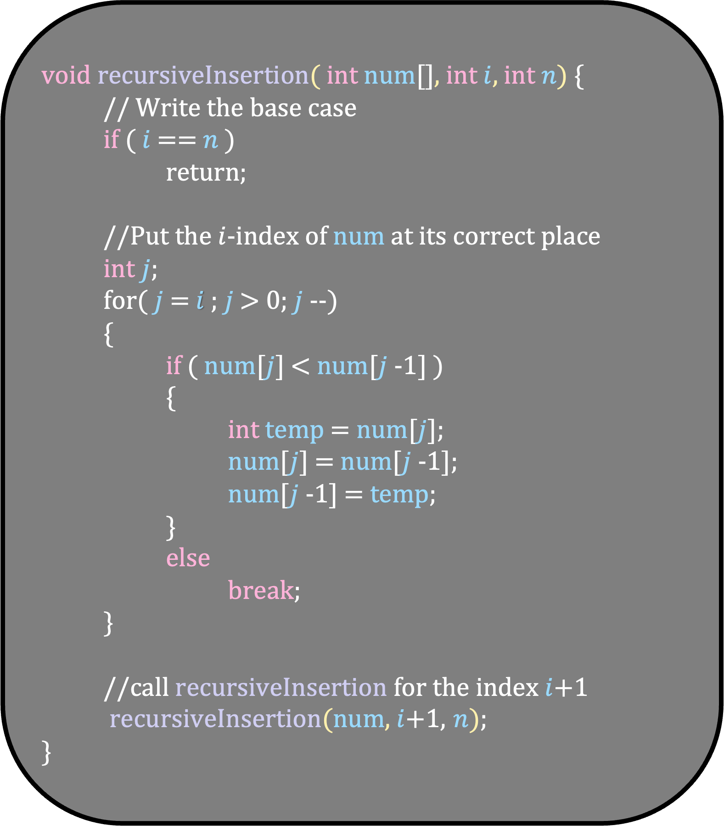
void recursiveInsertion( int num[], int $i$, int $n$) {
// Write the base case
if ( $i$ == $n$ )
return;
//Put the $i$-index of num at its correct place
int $j$;
for( $j$ = $i$ ; $j$ > 0; $j$--)
{
if ( num[$j$] < num[$j$-1] )
{
int temp = num[$j$];
num[$j$] = num[$j$-1];
num[$j$-1] = temp;
}
else
break;
}
//call recursiveInsertion for the index $i$+1
recursiveInsertion(num, $i$+1, $n$); }
#include <stdio.h> int main() {
int $n$,$i$,$j$;
scanf(“%d”, &$n$);
int num[$n$];
for($i$=0 ; $i$ < $n$; $i$++)
{
scanf(“%d”, &num[$i$]);
}
recursiveInsertion(num,0,$n$); return 0; }

